Slide 1
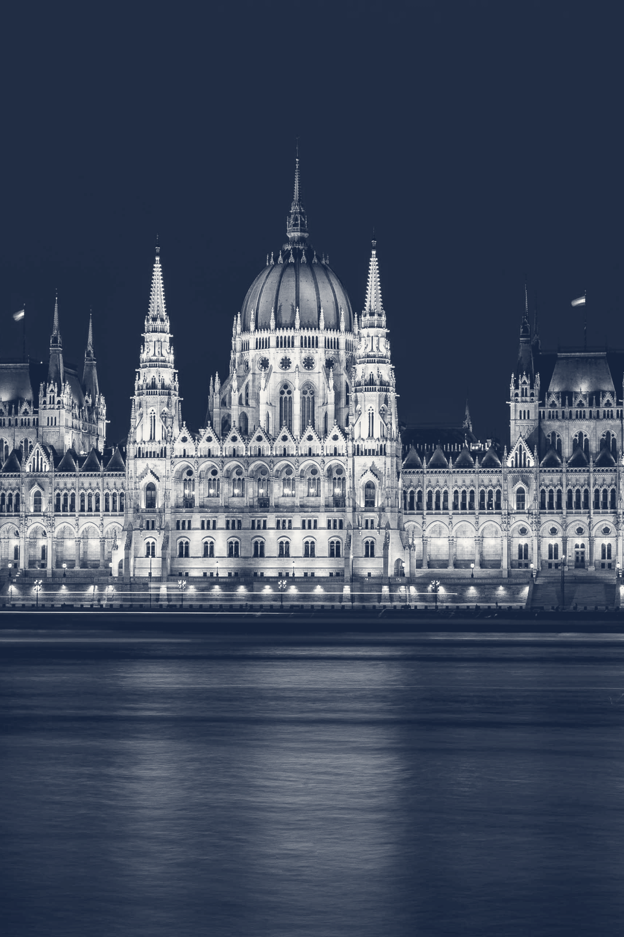
DEMOCRATIC BACKSLIDING
AND INSTITUTIONAL CAPTURE
“The new autocrats come to power
not with bullets
but with laws.”
Kim Lane Scheppele, “Autocratic Legalism” (2018)
How elected governments take control of
parliaments, courts and election authorities,
one legal step at a time
Seminar presentation · November 2026
Readings: Haggard & Kaufman 2021 · Waldner & Lust 2018 · Wolin 2001
Photo: Aleksander Kracht-Winter / Wikimedia Commons / CC BY-SA 4.0 (cropped, toned)
Notes:
My topic is democratic backsliding: a democracy slowly becomes less democratic. The legal expert Kim Lane Scheppele says it in one sentence: “the new autocrats come to power not with bullets but with laws.” An autocrat is a leader who rules without real limits. First I explain what backsliding is, and how it differs from a coup and from a fascist takeover. Then I show how elected governments take control of parliaments, courts and election authorities. I use our three readings. Let me start with the idea.

Slide 2
WHAT IT IS
Democracies today are rarely ended by force.
They are taken apart slowly, from the inside.
Backsliding is the step-by-step¹ weakening of a democracy’s institutions
and rules² by its own elected government³. — based on Haggard & Kaufman 2021, p. 27
1
Step by step
4 of 5
Many small actions with pauses in between,
not one final blow. (Waldner & Lust 2018)
democracies that broke down
since the 2000s were ended
by their own elected leaders
2
Aimed at the limits on power
Courts, election rules and rights are made weaker,
not removed.
1973 to 2018, out of 197 cases of democratic decline
3
Done by an elected government
Takeovers by elected leaders
The government that weakens democracy first won
power in an election.
88
Military coups
46
Sources: Haggard & Kaufman 2021, p. 27 · Waldner & Lust 2018, p. 95 · Svolik 2019, Journal of Democracy 30(3)
02
Notes:
Democracies today are rarely ended by force. They are taken apart slowly, from the inside. Haggard and Kaufman define backsliding, in simple words, as the step-by-step weakening of a democracy’s institutions and rules by its own elected government. First, it happens step by step: Waldner and Lust describe many small actions with pauses in between, not one final blow. Second, it is aimed at the limits on power: courts, election rules and rights get weaker, but they are not removed. Third, it is done by a government that first won an election. How common is it? Milan Svolik’s numbers show it: since the 2000s, four out of five democracies that broke down were ended by their own elected leaders. How is this different from the older ways a democracy could end?

Slide 3
WHAT IT IS NOT
Backsliding is not a coup or a fascist takeover:
it is slower, quieter and still looks democratic.
Coup
Fascist takeover
Backsliding
by the army or by the leader
Italy 1922 · Germany 1933
Hungary · Turkey · Venezuela
Who acts?
the army, or a group
inside the state
a mass party with its own fighters,
invited in by those already in power
a government that won
an election
Is it legal?
no: it openly breaks
the constitution
yes, on paper: first appointed,
then given full power by a new law
yes, at every step: new
laws, new rules, new judges
How fast?
hours or days
weeks: 24 days from the Reichstag
fire to that law, the Enabling Act
years, over several
elections
Violent?
yes: force is the tool
yes: terror clears the way; 107 MPs
were kept out of the vote in 1933
rarely: the law is used
against opponents instead
The result?
no elections; the
constitution is set aside
an open dictatorship;
parliament no longer matters
it still looks democratic, but
the institutions are captured
Sources: Britannica · US Holocaust Memorial Museum · Paxton 2004 (NYT review) · Bermeo 2016 · Svolik 2019 · Levitsky & Ziblatt 2018 · Scheppele 2018
03
Notes:
Backsliding is not a coup and not a fascist takeover. It is slower and quieter, and it still looks democratic. A coup takes power by force. It openly breaks the constitution and is over in days. The fascist takeover, in Italy in 1922 and Germany in 1933, was legal on paper. People already in power invited a mass party with its own fighters into the government. Then a law, the Enabling Act, let Hitler’s government make laws without parliament. But this took only 24 days after the Reichstag fire. And terror cleared the way: 107 members of parliament were kept out of the vote, as the US Holocaust Memorial Museum records. Backsliding is done by a government that won an election. Every step is legal, and it takes years. Violence is rare, because the law is used against opponents instead. The institutions stay, but they are captured: the government controls them. So being legal is not the difference. Speed, terror and the result are. How does this slow path work?

Slide 4
HOW IT WORKS
The path: a divided society, a big election win,
then capture in small, legal steps.
1
2
3
A divided society
A big election win
Capture in small steps
Society splits into two
hostile camps. This is
called polarization.
The leader’s party also wins
parliament. Now parliament
no longer says no.
Each step is small and legal,
like thin slices of a salami.
People notice it too late.
12 of 16
34% → 66%
12 of 16
cases: polarization went up
votes into seats, Turkey 2002
cases: the courts were attacked
With a majority, a government can make
revolutionary changes in a legal way.
It needs no revolution. — based on Wolin 2001, p. 245
The targets: the three referees
Parliament
Courts
Election authorities
Sources: Haggard & Kaufman 2021, pp. 27–38 (sixteen backsliding cases) · Wolin 2001, ch. XII
04
Notes:
The path has three steps: a divided society, a big election win, and then capture in small, legal steps. Step one: society splits into two hostile camps. This is called polarization, and it went up in 12 of Haggard and Kaufman’s 16 cases. Step two is a big election win. In Turkey in 2002, 34 percent of the votes gave Erdoğan’s party 66 percent of the seats. Now the leader’s party also controls parliament, and parliament no longer says no. Wolin explains why this matters: with a majority, a government can make revolutionary changes in a legal way. It needs no revolution. Step three is capture. Each step is small and legal, like thin slices of a salami, so people notice it too late. In 12 of the 16 cases, the courts were attacked. The targets are three referees, the institutions that make a government follow the rules: parliament, the courts and the election authorities. Let me take them one by one.

Slide 5
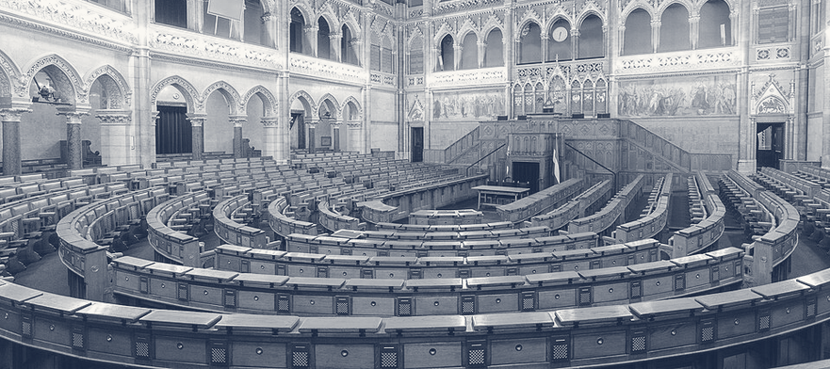
REFEREE 1 OF 3 · PARLIAMENT
A loyal parliament makes every later step legal,
and even gives away its own power.
1
It fires the other referees
El Salvador, 1 May 2021: the new parliament fired
five top judges and the chief prosecutor.
2
It removes the limits on the leader
El Salvador, 2025: parliament removed the limit
on how many terms a president can serve.
Debating chamber, Hungarian Parliament Building
Wei-Te Wong / Wikimedia Commons / CC BY-SA 2.0 (cropped, toned)
3
It gives its own power to the leader
137 of 199 MPs
Hungary, 30 March 2020: parliament let the prime
minister rule alone, by decree, with no end date.
voted for rule by decree
with no end date.
Hungary, 30 March 2020
Parliaments often helped to weaken
their own power. — based on Haggard & Kaufman 2021
Sources: CRS R47083 (El Salvador) · V-Dem Democracy Report 2026 · Business Insider, 30 March 2020 · Haggard & Kaufman 2021, pp. 34–35
05
Notes:
The first referee is parliament. A loyal parliament makes every later step legal, and in the end it even gives away its own power. First, it fires the other referees. On 1 May 2021, El Salvador’s new parliament fired five top judges and the chief prosecutor, as the US Congressional Research Service reports. Second, it removes the limits on the leader. In 2025, El Salvador’s parliament also removed the limit on how many terms a president can serve, as the V-Dem report records. Third, it gives its own power to the leader. On 30 March 2020, Hungary’s parliament let the prime minister rule by decree: he could make rules alone, with no end date. Business Insider reported 137 yes votes out of 199. Haggard and Kaufman see the same pattern: parliaments often helped to weaken their own power. With parliament on its side, a government can turn to the courts.

Slide 6
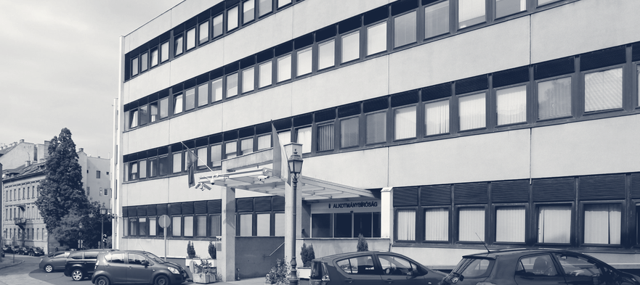
REFEREE 2 OF 3 · THE COURTS
Captured courts stop being neutral: they protect
the government and punish its opponents.
1
Add seats and fill them with loyal judges
Hungary 2011: top court grew from 11 to 15 judges.
Venezuela 2004: top court grew from 20 to 32.
2
Push the current judges out
Turkey after July 2016: more than 4,000 judges
and prosecutors were fired.
Constitutional Court of Hungary, Budapest
Thaler Tamas / Wikimedia Commons / CC BY-SA 4.0 (cropped, toned)
3
Control who becomes a judge
10 of 13 decisions
Poland since 2018: about 2,700 judges appointed or
promoted through a council that parliament chose.
went the government’s way
once the judges it chose were
the majority. Before: 0 of 10.
Captured referees: “more than a shield. It also
offers a powerful weapon”. — Levitsky & Ziblatt 2018
Sources: Human Rights Watch 2013 and 2004 · Freedom House · Wójcik 2025 (GMF) · Hungarian Helsinki Committee · Levitsky & Ziblatt 2018
06
Notes:
The second referee is the courts. A captured court stops being neutral: it protects the government and punishes its opponents. One way to capture a court is to add seats and fill them with loyal judges. Hungary’s top court grew from 11 to 15 judges in 2011, and Venezuela’s from 20 to 32 in 2004, as Human Rights Watch documents. Another way is to push the current judges out. After the failed coup of July 2016, Turkey fired more than 4,000 judges and prosecutors, says Freedom House. The third way is to control who becomes a judge. In Poland, since 2018, about 2,700 judges were appointed or promoted through a council that parliament chose, Anna Wójcik reports. Does it work? The Hungarian Helsinki Committee compared decisions of Hungary’s Constitutional Court. Before the government’s judges were the majority, none of ten went the government’s way. Afterwards, ten of thirteen did. Levitsky and Ziblatt write that capturing the referees gives the government “more than a shield. It also offers a powerful weapon”. That leaves the referee that runs the elections.

Slide 7
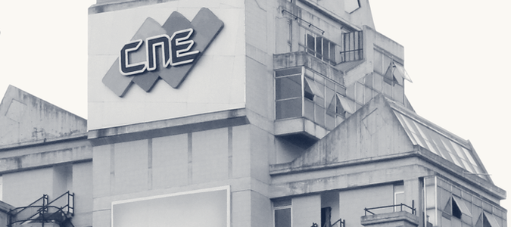
REFEREE 3 OF 3 · ELECTION AUTHORITIES
Captured election authorities can decide
the result before election day, or after it.
1
Change the map and the rules
before election day
Hungary 2014: about 45% of the votes, but two-thirds
of the seats: it won 96 of 106 districts.
2
Decide who is allowed to run
before election day
Nicaragua 2021: the election authorities banned
three opposition parties before the vote.
National Electoral Council (CNE), Caracas
Omerta-ve / Wikimedia Commons / CC BY-SA 3.0 (cropped, toned)
3
Control the count
51.2%
after election day
Istanbul 2019: the election authorities cancelled a
vote for mayor that the opposition had won.
declared for Maduro by the
election authorities, 29 July 2024,
with no detailed results.
Venezuela 2024: the election “cannot be
considered democratic”. — The Carter Center, 30 July 2024
Sources: US State Department (Hungary 2014, Nicaragua 2021) · OSW 2019 · WOLA 2024 · The Carter Center, 30 July 2024
07
Notes:
The third referee is the election authorities: the offices that organize elections and count the votes. When they are captured, the result can be decided before election day, or after it. One move is to change the map and the rules. In Hungary in 2014, the governing parties got about 45 percent of the votes, but two thirds of the seats: they won 96 of 106 districts. Another is to decide who is allowed to run. In Nicaragua in 2021, the election authorities banned three opposition parties. Both cases are in US State Department reports. The third move comes after election day: control the count. In Istanbul in 2019, the election authorities cancelled a vote for mayor that the opposition had won. Venezuela shows where this ends. On 29 July 2024, the election authorities declared Nicolás Maduro the winner with 51.2 percent, but published no detailed results. Nobody could check the count. The Carter Center said that the election “cannot be considered democratic”. How far has all this spread?

Slide 8
HOW FAR IT HAS SPREAD
A worldwide trend: far more countries are
becoming less democratic than more democratic.
Becoming less democratic
Becoming more democratic
41%
44
of the world’s people live in
countries that are becoming
less democratic: 3.4 billion.
In 2005 it was 9%.
27
18
15 of 28
12
democracies that started to
slide back have already
broken down.
2005
2025
Source: V-Dem Institute, Democracy Report 2026. V-Dem’s own words for the two groups: “autocratizing” and “democratizing” countries.
08
Notes:
This is now a worldwide trend. The V-Dem Institute gives every country a democracy score. When a country loses many points over several years, it is becoming less democratic. V-Dem’s own word for this is autocratizing. In 2005, 12 countries were becoming less democratic and 27 more democratic. By 2025 it was the other way round: 44 against 18. Counted in people, the change is even bigger. 41 percent of the world’s people, 3.4 billion, now live in countries that are becoming less democratic. In 2005 it was 9 percent. And this is not harmless. 28 of the 44 countries were democracies when the slide began. In 15 of them, democracy has already broken down. So can backsliding be undone?

Slide 9

CAN IT BE UNDONE? · HUNGARY 2010 TO 2026
It can be voted out, but repair then needs
the same tools that did the damage.
2010
Fidesz turns 53% of votes into 68% of seats
2011–2013
new constitution; top court gets loyal judges
2014
two-thirds again, with about 45% of the votes
2018
V-Dem: Hungary is no longer a democracy
April 2026
Tisza wins 141 of 199 seats, Fidesz 52
July 2026
the new majority changes the constitution
10 April 2026: concert crowd two days before the vote
Envagyokabela / Wikimedia Commons / CC BY-SA 4.0 (cropped, toned)
141 of 199 seats
With two-thirds
Without two-thirds
Hungary: the new majority
repairs fast. Human Rights
Watch warns: good goals do
not excuse bad methods.
Poland: the EU closed its
rule-of-law case in 2024. A
president close to the old
ruling party blocks repair.
for the opposition Tisza party
on 12 April 2026. Fidesz fell
to 52 after 16 years in power.
Sources: Haggard & Kaufman 2021 · Human Rights Watch 2013, 2026 · US State Department · V-Dem 2026 · POLITICO Europe · OSW 2026 · Wójcik 2025
09
Notes:
Yes, backsliding can be voted out. But repair then needs the same tools that did the damage. In Hungary in 2010, Viktor Orbán’s party, Fidesz, turned 53 percent of the votes into 68 percent of the seats, as Haggard and Kaufman note. With more than two thirds, it wrote a new constitution and put loyal judges on the top court. From 2018, V-Dem no longer counted Hungary as a democracy: there were elections, but they were not free and fair. Then, on 12 April 2026, the opposition party Tisza won 141 of 199 seats, and Fidesz fell to 52 after 16 years in power, POLITICO Europe reported. In July, the new majority used its own two thirds to change the constitution. Here is the problem: it can repair things fast, but Human Rights Watch warned that a good goal does not excuse bad methods. Poland has the opposite problem. The EU closed its rule-of-law case against Poland in 2024. But the government has no two-thirds majority, and a president close to the old ruling party blocks the repair of the courts. So what should we remember?

Slide 10
KEY POINTS AND DISCUSSION
Taken apart, not ended by force:
what to remember, and what to discuss.
REMEMBER
DISCUSS
1
It is done by elected governments
If every step is legal,
when does a democracy stop
being one, and who decides?
Slow and legal on paper, with no single breaking point.
2
It is not a coup or a fascist takeover
Wolin and Tocqueville: is this
a misuse of majority rule,
or just majority rule?
It is slower, needs no terror and still looks democratic.
3
The referees are not removed
Hungary: is it right to repair
the damage with the same
fast, two-thirds methods?
Parliaments, courts and election authorities are
captured, then used.
Course readings: Haggard & Kaufman 2021 · Waldner & Lust 2018 · Wolin 2001, ch. XII · all sources with links on the next slide
10
Notes:
Democracies today are not ended by force. They are taken apart. Three points to remember. One: backsliding is done by elected governments. It is slow and legal on paper, with no single breaking point. Two: it is not a coup and not a fascist takeover. It is slower, needs no terror and still looks democratic. Three: the referees are not removed. Parliaments, courts and election authorities are captured and then used. Each point leaves a question for our discussion. If every step is legal, when does a democracy stop being one, and who decides? Tocqueville warned of a tyranny of the majority, but Wolin notes that he gave no proof of one in America as a whole. So is backsliding a misuse of majority rule, or just majority rule? And Hungary: is it right to repair the damage with the same fast, two-thirds methods? The sources are on the last slide. I look forward to the discussion.

Slide 11
SOURCES
References
Every fact on the slides comes from a reading or a public source. Underlined titles are links.
COURSE READINGS
MORE BOOKS AND ARTICLES
SOURCES FOR THE CASES
Haggard, S. & Kaufman, R. (2021).
“The Anatomy of Democratic Backsliding”.
Journal of Democracy 32(4), 27–41.
Bermeo, N. (2016).
“On Democratic Backsliding”.
Journal of Democracy 27(1), 5–19.
Britannica: “March on Rome”; “Enabling Act”
US Holocaust Memorial Museum:
“The Enabling Act of 1933”
Waldner, D. & Lust, E. (2018).
“Unwelcome Change: Coming to Terms
with Democratic Backsliding”. Annual
Review of Political Science 21, 93–113.
Scheppele, K. L. (2018).
“Autocratic Legalism”. University of Chicago
Law Review 85(2), 545–583.
Congressional Research Service: report R47083
Business Insider, 30 March 2020
Human Rights Watch: Hungary 2013;
Venezuela 2004; Hungary 2026
Svolik, M. W. (2019).
“Polarization versus Democracy”.
Journal of Democracy 30(3), 20–32.
Freedom House (N. Schenkkan): Turkey’s courts
Wolin, S. S. (2001).
Tocqueville between Two Worlds, ch. XII,
241–259. Princeton University Press.
Wójcik 2025: “Poland’s Rule-of-Law Repair”,
German Marshall Fund
Levitsky, S. & Ziblatt, D. (2018).
How Democracies Die. New York: Crown.
Hungarian Helsinki Committee: Constitutional Court
DATA
US State Department, human rights reports:
Hungary 2014; Nicaragua 2021
Paxton, R. O. (2004).
The Anatomy of Fascism, as summarised by
S. Power, “The Original Axis of Evil”,
The New York Times, 2 May 2004.
OSW, Warsaw: Istanbul 2019; Hungary 2026
V-Dem Institute (2026).
Democracy Report 2026: Unraveling the
Democratic Era? University of Gothenburg.
WOLA: “Explainer: Venezuela’s Unfair Election”
The Carter Center: statement of 30 July 2024
POLITICO Europe, 19 April 2026
Photographs are credited on the slides where they appear.
11
Notes:
This is a reference slide and it is not presented. It lists the readings and the public sources behind slides one to ten; the underlined titles are links.

