Slide 1


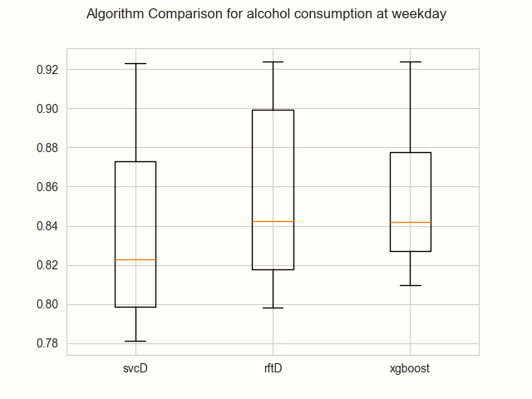
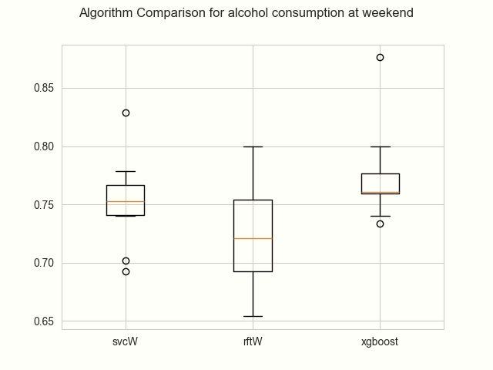
Analysis of Factors Influencing Student Alcohol Consumption
Group 8: AA
Meichen Yu, Yingxin Zeng, Kanghui Chen, Monica Zhangwang
Abstract
Methodology
Conclusion
aaa
aaa
Start
Split training set and test set
Finding dataset
Encoding
Categorical Data
Defining research question
Process relevant data
Numerical
Data
Define causal effect graph
Training models
Bootstrapping
Classification report of each model
Analyse performance obtained
Estimate the distributions
Save models for evaluation
End
Present visualization of models comparison
Introduction
Results
In daily life, many people have drinking habits, either for leisure or due to stress. Moderate drinking may not pose significant health risks, but it has been observed that the drinking population is becoming younger, with some younger individuals consuming alcohol in quantities exceeding recommended levels. Considering the health of the drinking population, the research question proposed by the team is: How and at what level do personal and family conditions affect students’ alcohol consumption? The team hopes to analyze and identify which factors/reasons are more likely to cause students to drink alcohol or even alcoholism. To provide more fundamentally important suggestions for students to quit drinking in future.
Experimental results are obtained by applying a dataset corresponding to the alcohol consumption of secondary school students from Portugal. A variety of methods have been implemented but only three of them stand out, in concrete, Xgboost, Random Forest and SVM. Then, we evaluate the performance between these algorithms in terms of accuracy.
Acknowledge
aaa

