Slide 1


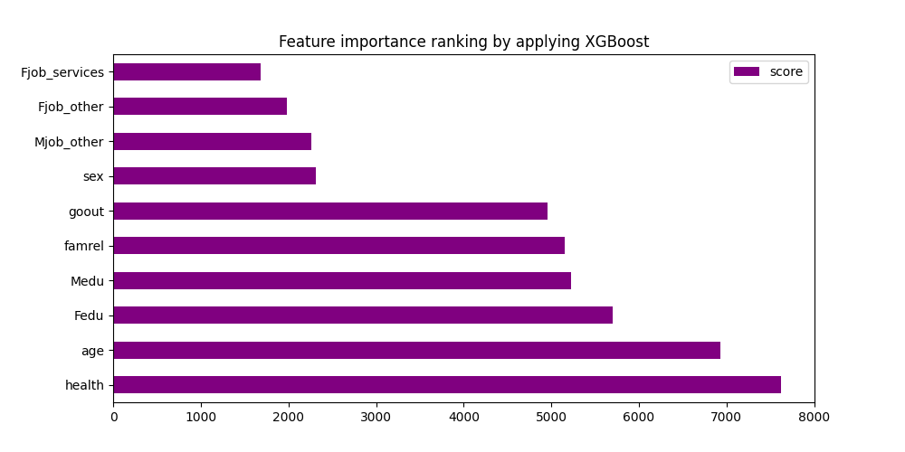
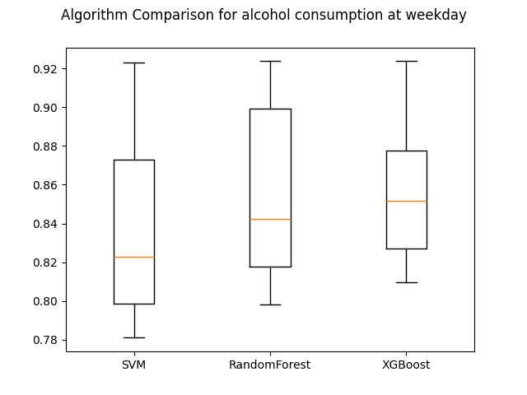
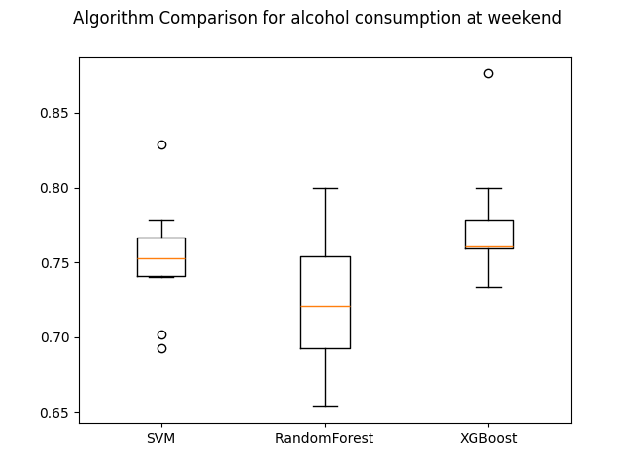
Analysis of Factors Influencing Student Alcohol Consumption
Group 8: AA
Meichen Yu, Yingxin Zeng, Kanghui Chen, Monica Zhangwang
Abstract
Methodology
In daily life, many people have drinking habits, either for leisure or due to stress. Moderate drinking may not pose significant health risks, but it has been observed that the drinking population is becoming younger, with some younger individuals consuming alcohol in quantities exceeding recommended levels. The project aims to explore the impact of family background and personal circumstances, such as age, gender and health on alcohol consumption among secondary school students in Portugal. Given the categorical nature of most variables, we employed different methods, specifically, XGBoost, Random Forest, and Support Vector Machines (SVM) for training and testing. In parallel, we conducted Causal Analysis by using the Causal Bootstrapping (CB) technique to investigate relationships between the elements and the alcohol consumption at weekday and weekend. The analysis yielded promising results, underscoring the complex interplay between personal circum-stances, family features, and alcohol consumption among secondary school students in Portugal.
Start
End
Finding dataset
Present visualization of models comparison
Defining research question
Analyse performance obtained
Save models for evaluation
Process relevant data
Numerical
Data
Estimate the distributions
Classification report of each model
Categorical
Data
Bootstrapping
Famrel
Encoding
Sex
Define causal effect graph
Training models
Pstatus
Age
Split training set and test set
Medu
Dalc/Walc
Fedu
Results
Mjob
Fjob
Experimental results are obtained by applying a dataset corresponding to the alcohol consumption of secondary school students from Portugal. A variety of methods have been implemented but only three of them stand out, concrete, XGBoost, Random Forest, and SVM. Then, we evaluate the performance between these algorithms in terms of how accurate is the prediction. In addition, we show a ranking of the importance of the different features in our dataset.
Conclusion
Introduction
The project utilizes causal analysis and causal boots-trapping techniques to estimate the probability of various factors impacting alcohol consumption. Compared with all previous models, the XGBoost model has the best performance. Overall, this project fills a gap in the research on factors influencing alcohol consumption by employing causal analysis and helping insiders to provide suggestions for secondary school student’s alcohol consumption in the future.
According to the 2022 National Survey on Drug Use and Health (NSDUH), of full-time college students ages 18 to 22, 49.0% drank alcohol, and 28.9% engaged in binge drinking, which exacts an enormous toll on the lives of students on campuses [1]. Considering the health of the drinking population, the research question proposed by the team is: How and at what level do personal and family conditions affect students’ alcohol consumption? The team hopes to analyze and identify which factors/reasons are more likely to cause students to drink alcohol or even alcoholism. To provide more fundamentally important suggestions for students to quit drinking in the future.
Acknowledgment
We would like to thank Jianqiao Mao and Huiping Chen for their guidance through the project.
[1] National Institute on Alcohol Abuse and Alcoholism. “College Drinking.” NIAAA, 2024, www.niaaa.nih.gov/publications/brochures-and-fact-sheets/college-drinking.

Slide 2
Famrel
Pstatus
Sex
Medu
Dalc/Walc
Age
Mjob
Fedu
Fjob
Start
Split training set and test set
Finding dataset
Encoding
Categorical Data
Defining research question
Process relevant data
Numerical
Data
Define causal effect graph
Training models
Bootstrapping
Classification report of each model
Analyse performance obtained
Estimate the distributions
Save models for evaluation
End
Present visualization of models comparison

