Slide 1
Student Alcohol Consumption
Group 8: AA

Slide 2


Agenda
A
Proposed Problem
Motivation
Solution
Current Results Display
Next Plan

Slide 3
Proposed Problem
How and in what level does personal and family condition affect students’ alcohol consumption?

Slide 4
Family Factors:
Personal Factors:
Gender
Age
Health condition
Frequency of going out with friends
Family relationship
Parents job
Parents education level
Whether parents are separated

Slide 5
Motivation

Slide 6
We hope to analyze and identify which factors/reasons are more likely to cause students to drink alcohol or even alcoholism
In order to provide more fundamentally important suggestions for students to quit drinking in future

Slide 7
Approach
Using machine learning models to identify the interrelationships between factors, establishing classification models, and simulating portraits of people who tend to drink excessively (such as decision trees/branches in the forest that lead to "very high")
By conducting causal analysis (common sense, literature, models, etc.) to obtain one-way links, concretize the vague "impact" into causality.

Slide 8
Reasons for model selection
 | XGBoost | SVM | Random Forest | Causal Analysis
Suitability | Applicable to handling categorical variables Efficient for handling large datasets Efficient for handling nonlinear relationships | Applicable to handling categorical variables Effective for high-dimensional data Efficient for handling complex classification problems capable of handling nonlinear relationships through kernel functions. | Applicable to handling categorical variables Suitable for high-dimensional datasets and feature selection. | Useful for understanding causal relationships.
Advantage | Effective for datasets with numerous features and complex relationships. | Capable of finding optimal hyperplanes to separate different levels of alcohol consumption. | Can handle large feature sets effectively and has good generalization ability. | Helps in determining causal effects among personal and family factors influencing alcohol consumption.
Summary | These models offer complementary strengths for understanding and predicting the impact of personal and family factors on drinking behavior among college students.

Slide 9
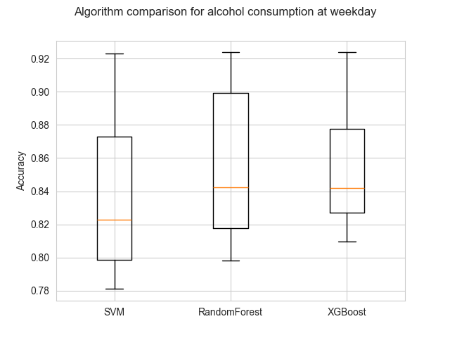
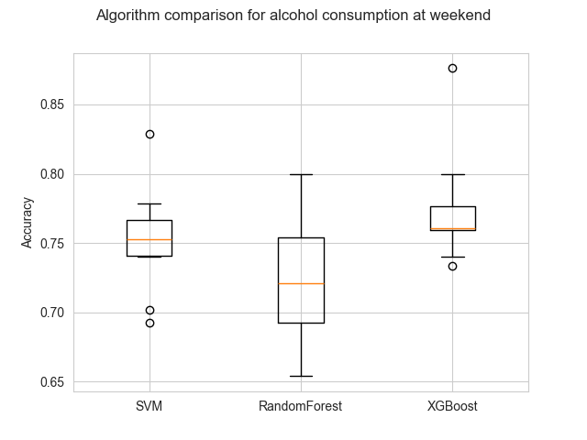
Experimental results
Algorithm comparison
Fig 1. Evaluation of the models by using cross-validation and comparing them by accuracy

Slide 10
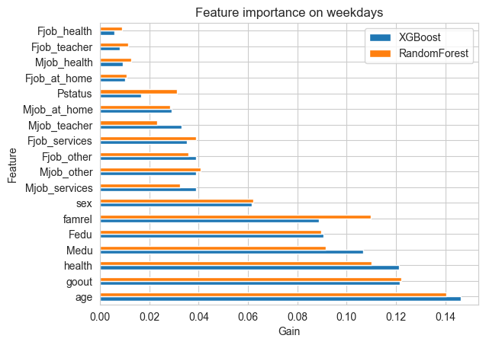
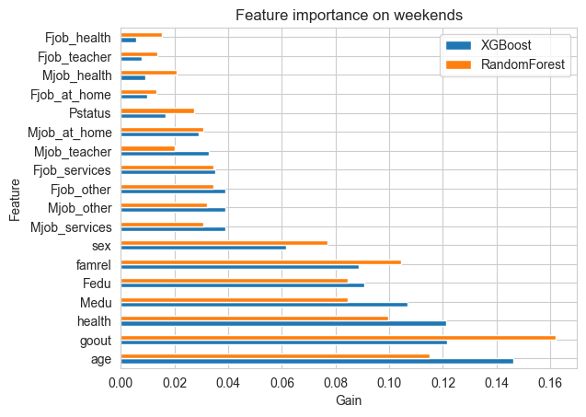
Experimental results
Feature Importance
Fig 2. Analysis of the feature importance obtained by classifiers based on trees

Slide 11
Experimental results
Causal graph
Famrel
Sex
Pstatus
Age
Medu
Dalc/Walc
Fedu
Mjob
Fjob
Fig 3. Causal effect graph created to apply the causal bootstrapping algorithm

Slide 12
Experimental results
Causal Bootstrapping Analysis Results
Target | Model | Accuracy | Recall | f1-score
Weekday | Confounded | 0.61 | 0.61 | 0.459
 | De-confounded | 0.67 | 0.67 | 0.657
Weekend | Confounded | 0.61 | 0.61 | 0.459
 | De-confounded | 0.64 | 0.64 | 0.638
Fig 4. Comparison of the causal bootstrapping results by training XGBoost classifiers using confounded and de-confounded datasets

Slide 13
Future Works
Permutation feature importance for SVM
Update the causal effect graph
Report writing and submission
Group 8

Slide 14
Thanks for Listening
“
”
Group 8: AA

