Slide 1
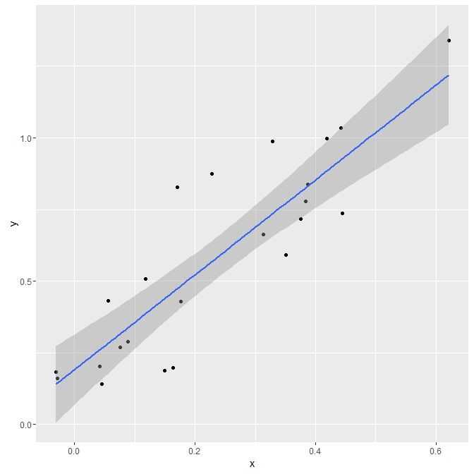
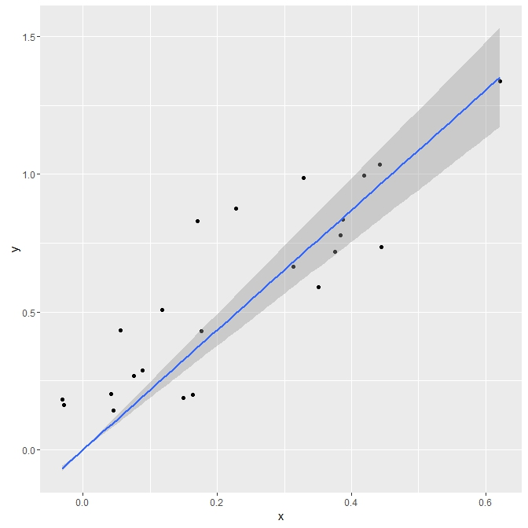
With intercept
Call: lm(formula = y ~ x)
Residuals: Min 1Q Median 3Q Max
-0.26384 -0.10206 -0.04672 0.11409 0.35548
Coefficients: Estimate Std.Error t value Pr(>|t|)
(Intercept) 0.19137 0.05919 3.233 0.00382 **
x 1.65346 0.19927 8.297 3.2e-08 ***
---
Signif. codes: 0 ‘***’ 0.001 ‘**’ 0.01 ‘*’ 0.05 ‘.’ 0.1 ‘ ’ 1
Residual standard error: 0.1706 on 22 degrees of freedom
Multiple R-squared: 0.7578, Adjusted R-squared: 0.7468
F-statistic: 68.85 on 1 and 22 DF, p-value: 3.203e-08
Without intercept
Call: lm(formula = y ~ 0 + x)
Residuals: Min 1Q Median 3Q Max
-0.22967 -0.06648 0.05945 0.23039 0.45808
Coefficients: Estimate Std. Error t value Pr(>|t|)
x 2.1744 0.1393 15.61 9.9e-14 ***
---
Signif. codes: 0 ‘***’ 0.001 ‘**’ 0.01 ‘*’ 0.05 ‘.’ 0.1 ‘ ’ 1
Residual standard error: 0.2027 on 23 degrees of freedom
Multiple R-squared: 0.9137, Adjusted R-squared: 0.91
F-statistic: 243.7 on 1 and 23 DF, p-value: 9.899e-14

Slide 2
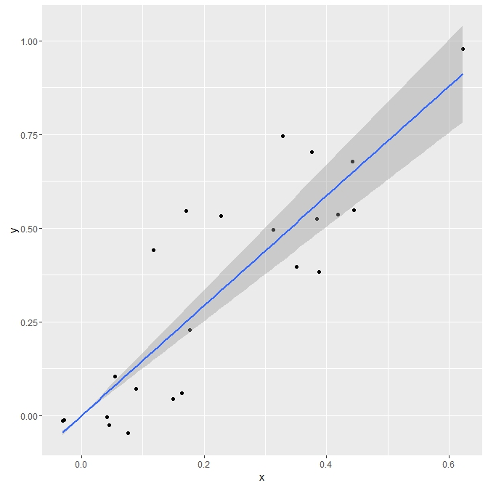
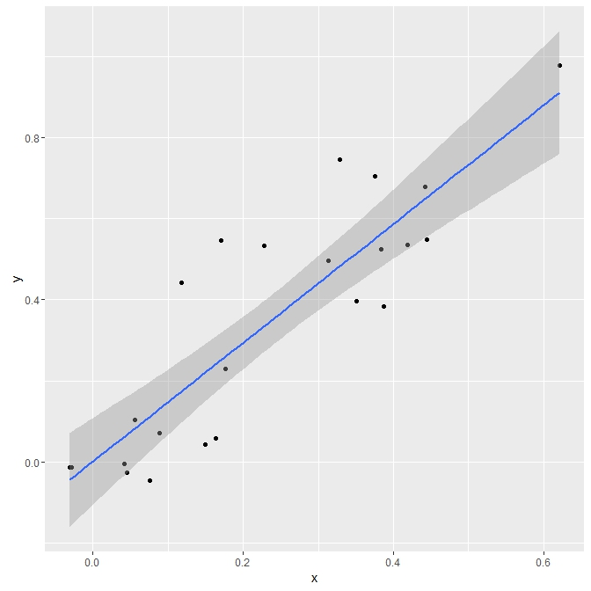
With intercept
Call: lm(formula = y ~ x)
Residuals: Min 1Q Median 3Q Max
-0.18459 -0.10272 -0.03413 0.04355 0.29547
Coefficients: Estimate Std. Error t value Pr(>|t|)
(Intercept) 0.001865 0.051519 0.036 0.971
x 1.461620 0.173453 8.427 2.47e-08 ***
---
Signif. codes: 0 ‘***’ 0.001 ‘**’ 0.01 ‘*’ 0.05 ‘.’ 0.1 ‘ ’ 1
Residual standard error: 0.1485 on 22 degrees of freedom
Multiple R-squared: 0.7635, Adjusted R-squared: 0.7527
F-statistic: 71.01 on 1 and 22 DF, p-value: 2.466e-08
Without intercept
Call: lm(formula = y ~ 0 + x)
Residuals: Min 1Q Median 3Q Max
-0.18469 -0.10311 -0.03369 0.04343 0.29647
Coefficients: Estimate Std. Error t value Pr(>|t|)
x 1.46670 0.09983 14.69 3.53e-13 ***
---
Signif. codes: 0 ‘***’ 0.001 ‘**’ 0.01 ‘*’ 0.05 ‘.’ 0.1 ‘ ’ 1
Residual standard error: 0.1453 on 23 degrees of freedom
Multiple R-squared: 0.9037, Adjusted R-squared: 0.8995
F-statistic: 215.8 on 1 and 23 DF, p-value: 3.531e-13

