Slide 1

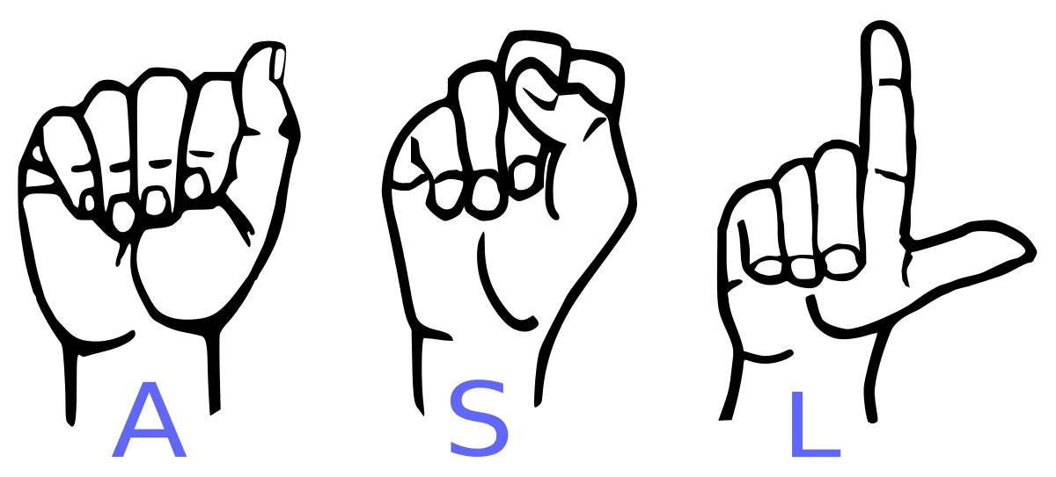
Conversion of Sign Language to Text
For Dumb and Deaf
*not for Blind

Slide 2

Efforts by
Project Under Supervision of
Mr. Sumit Bagchi
Sourav Dhali
&
Shubhadeep Chakraborty

Slide 3

Introduction.
Motivation
A person with speaking disorders face major problems of expressing their emotions as freely in this world.
“Not able to utilize” some of the new technologies.

Slide 4
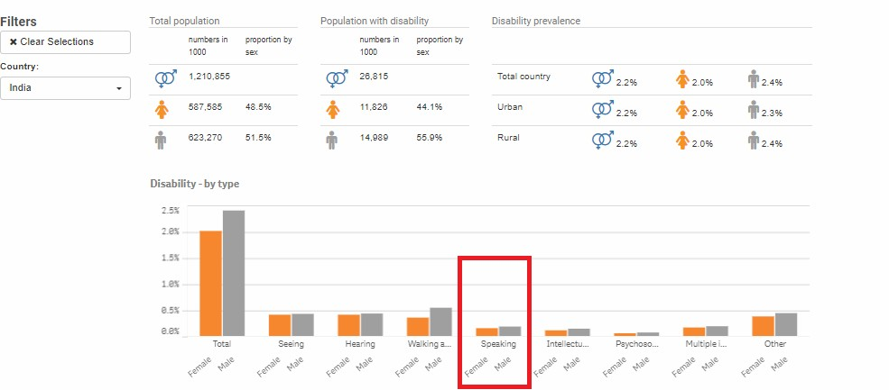
Statistics retrieved from
United Nation Statistics Division

Slide 5
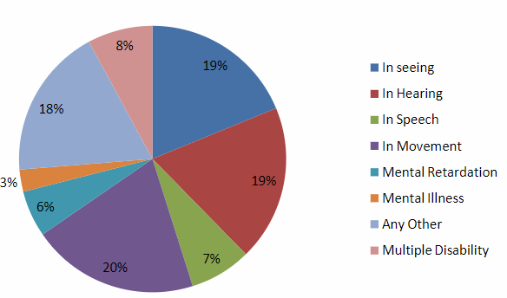
Disabled population by type of disability in India census 2011

Slide 6
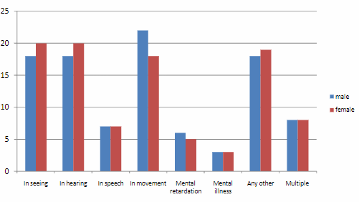
Distribution disabled person by sex and by type of disability (%) in India Census 2011

Slide 7
Abstract
Our project aims to create a computer application and train a model which when shown a real time video of hand gestures of American Sign Language shows the output for that particular sign in text format on the screen.

Slide 8
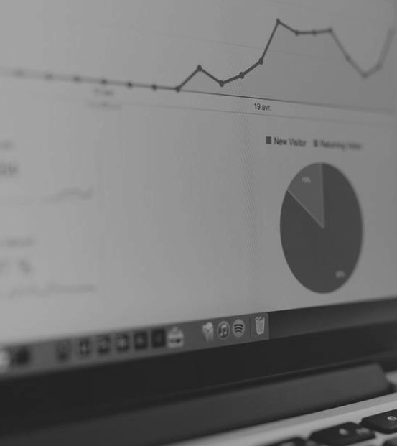
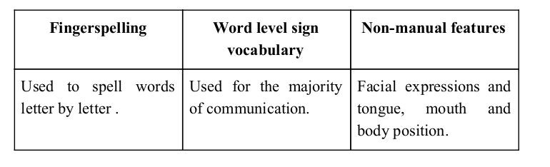
Sign language is a visual language and consists of 3 major components:

Slide 9
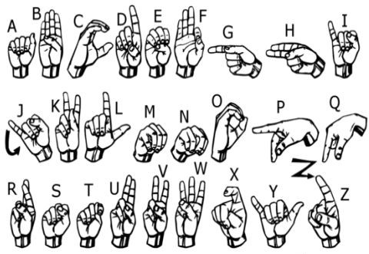
We implemented 20 symbol(A,B,C,D,E,F,G,I,K,L, O,P,Q,W,X,Y,Like,Dislike,
Rocking,Thank you) of ASL
in our project.

Slide 10




Technologies Used
Python 3.11.
TensorFlow framework, Keras API
Real-time computer vision using OpenCV

Slide 11
➔ For the project we tried to find already made datasets but we couldn’t find dataset in the form of raw images that matched our requirements.
➔ Hence we decided to create our own data set.

Slide 12
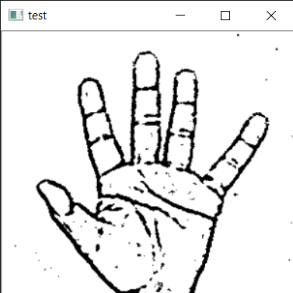
Layer 1
Gesture Classification
Layer 2
Classify between Similar Symbols
Classify between
20
Symbols

Slide 13
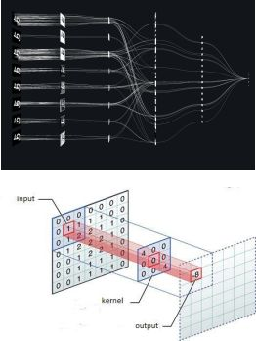
Convolutional Neural Networks
CNNs consist of multiple convolutional layers each layer containing numerous “filters” which perform feature extraction.
Initially these “filters” are random and by training, the feature extraction gets better by better.
It’s primarily used for image classification.

Slide 14
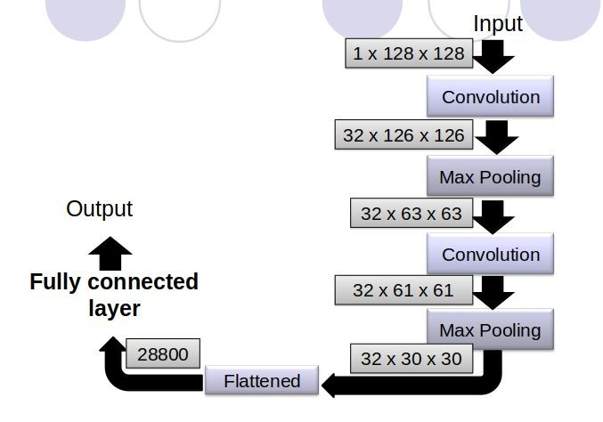
Our CNN Classifier Model

Slide 15
Implementation
After collecting hand data we trained our data in google teachable machine and take our keras model.
Then we create the all alphabet array and classify the model with program.
The model take the image input and predict the accuracy and which alphabet accuracy in high show the output of this alphabet.

Slide 16
Challenges Faced
We couldn’t find a dataset with raw images of all the asl characters so we made our own dataset.
Issues were faced relating to the accuracy of the model we trained in earlier phases which we eventually improved by increasing the input image size and also by improving the dataset.

Slide 17
Core Modules
Data Pre-Processing
Scan Single Gesture
Create gesture
Formation of sentence
Exporting

Slide 18
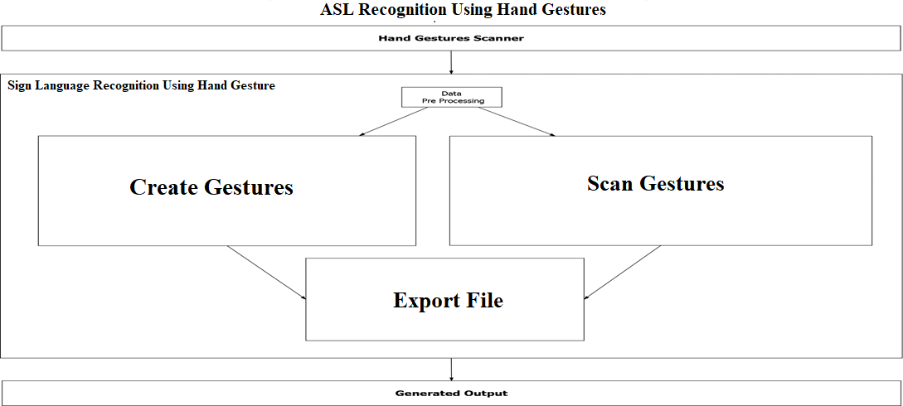

Slide 19
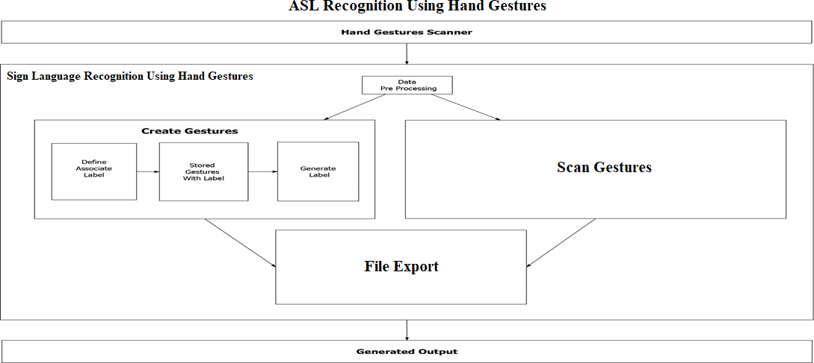

Slide 20
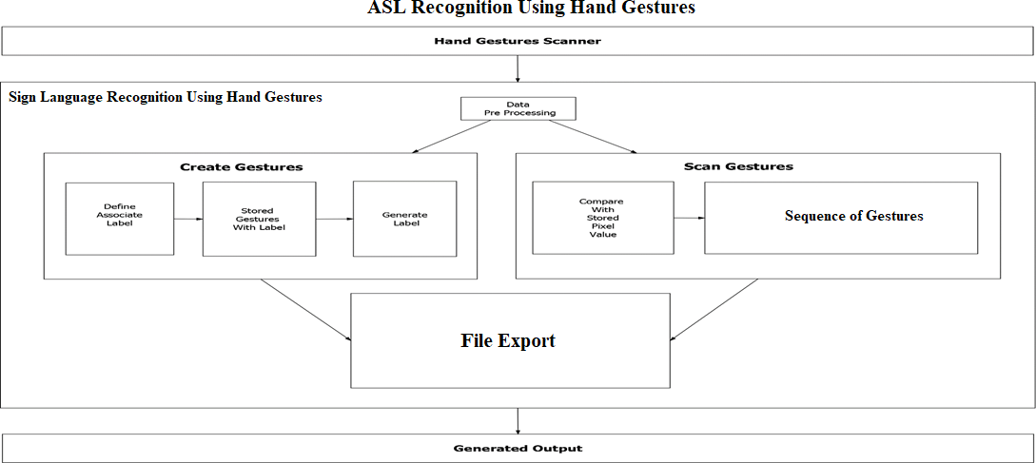


Slide 21
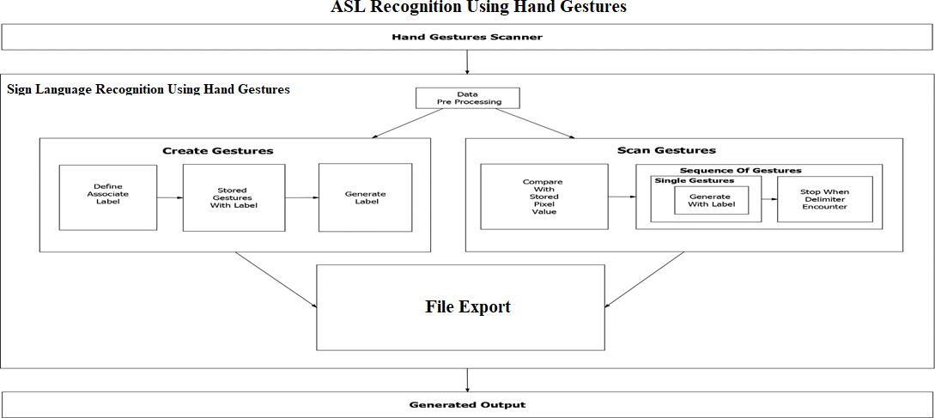

Slide 22
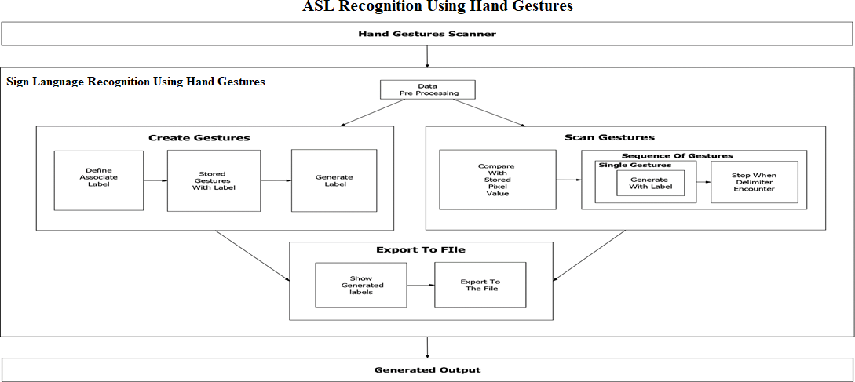


Slide 23
Conclusion
In this report, a functional real time vision based american sign language recognition for D&M people have been developed for asl alphabets.
We achieved an accuracy of 70-80% on our dataset.
Prediction has been improved after implementing two layers of algorithms in which we verify and predict symbols which are more similar to each other.

Slide 24
Limitations of our model
The model works well only in good lighting conditions.
Plain background is needed for the model to detect with accuracy.

Slide 25
Future Scope
We are planning to achieve higher accuracy even in case of complex backgrounds by trying out various background subtraction algorithms.
We are also thinking of improving the preprocessing to predict gestures in low light conditions with a higher accuracy.

Slide 26
References
http://mospi.nic.in/sites/default/files/publication_reports/Disabled_ persons_in_India_2016.pdf
https://www.quora.com/What-are-some-problems-faced-by-deaf- and-dumb-people-whileusing-todays-common-tech-like-phones-and- PCs

Slide 27
Thank You :)

