Slide 1


GIAIC STUDENT
Home
Service
About Us
Contact
prompt
Engineering
WWW.GITHUB.COM
01

Slide 2


GIAIC STUDENT
Home
Service
About Us
Contact
About prompt
engineering
Prompt engineering is the process of crafting instructions, or "prompts," to guide large language models (LLMs) in order to get the desired output. It involves using clear and structured language, context, and examples to optimize the AI's performance for tasks like writing, summarizing, or coding.
02

Slide 3
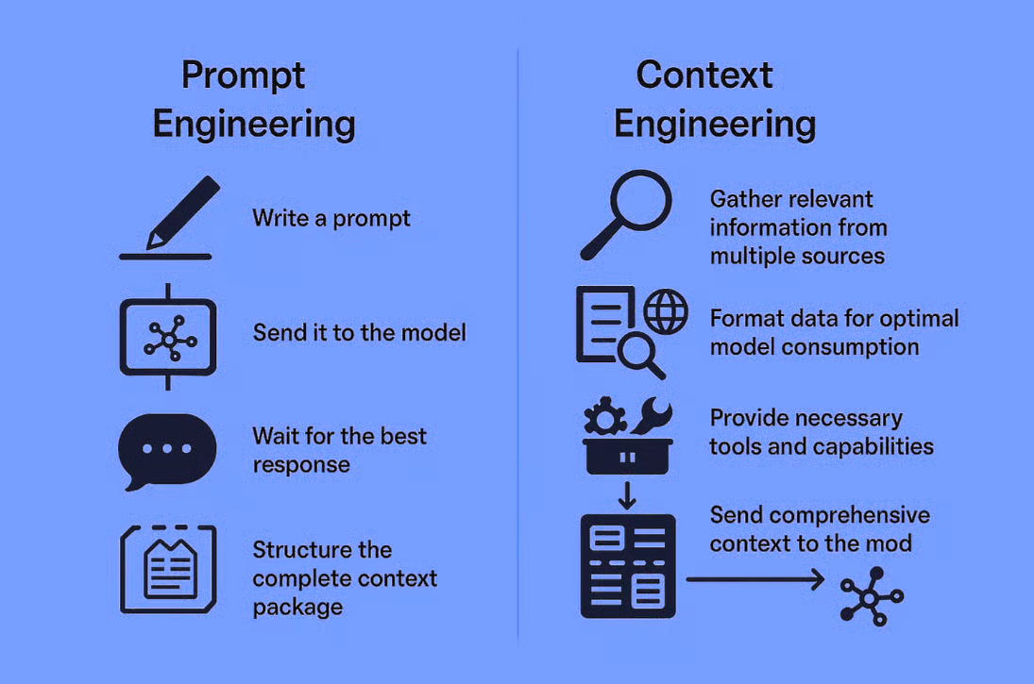
GIAIC STUDENT
Home
Service
About Us
Contact
03

Slide 4

GIAIC STUDENT
Home
Service
About Us
Contact
large language model
Large Language Models (LLMs) are deep learning AIs trained on vast amounts of text data to understand and generate human-like language. They use the Transformer neural network architecture to process text in parallel, allowing them to learn patterns, grammar, and context from the data they are fed.
05

Slide 5

GIAIC STUDENT
Home
Service
About Us
Contact
Fundamental Prompting Techniques
1. Zero-Shot Prompting :- The simplest approach—just ask directly without examples.
2. One-Shot Prompting:- Provide a single example to guide the response format.
3. Few-Shot Prompting :- Provide multiple examples to establish a clear pattern.
4. System Prompting :- Set overall context and behavior guidelines.
5. Role Prompting :- Assign a specific character or expertise to the AI.
6. Contextual Prompting :- Provide specific background information relevant to the task.
06

