Slide 1
Record Linkage-1 Matching and Merge STATA-1
Byunggeor Moon

Slide 2

Cleaning

Slide 3
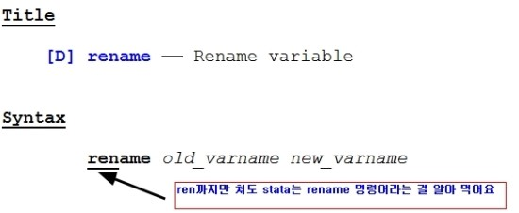
Cleaning

Slide 4
Cleaning
subinstr("바꾸고싶은 문자"나 또는 해당문자변수,"바꾸고자하는 문자", "바꾸게되는문자",바꾸는 횟수)
subinstr("this is the day","is","X",1) = "thX is the day"
subinstr("this is the hour","is","X",2) = "thX X the hour"
subinstr("this is this","is","X",.) = "thX X thX"

Slide 5
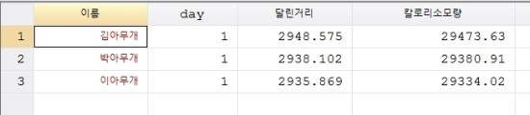
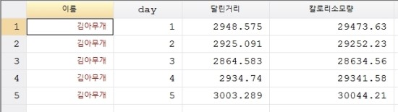
Cleaning
횡단면
시계열

Slide 6
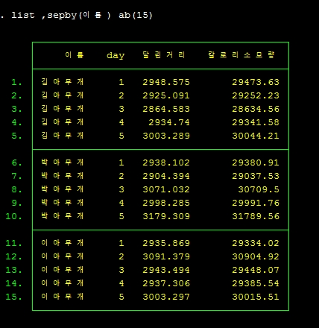
Cleaning
패널 long

Slide 7

Cleaning
패널 Wide

Slide 8
Cleaning
reshape long 달린거리 칼로리소모량, i(이름) j(day)

Slide 9
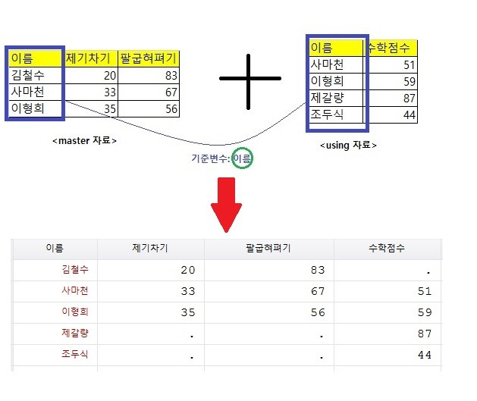
Merge

Slide 10
Merge
****************************
* merge (1:1)
****************************
import excel merge.xlsx, sheet(using) firstrow clear //import using sheet
save using.dta,replace
* merge
u master.dta,clear
merge m:m 이름 using using.dta // 이름을 기준으로 merge하기 , 1:1대신 m:m 써도 됨

Slide 11
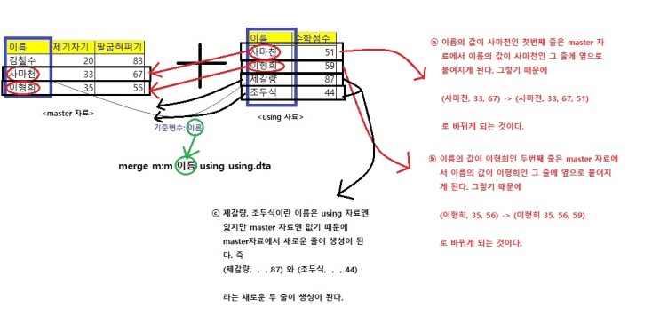
Merge

Slide 12
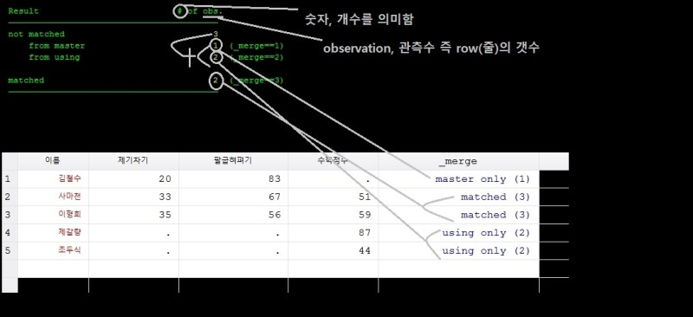
Merge

Slide 13
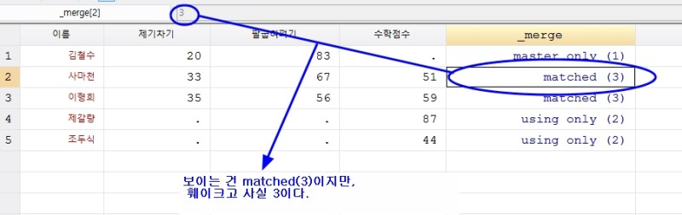
Merge

Slide 14
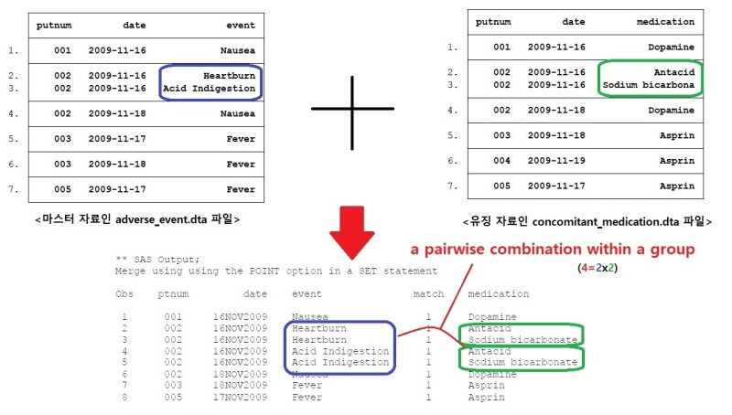
Merge-2

Slide 15
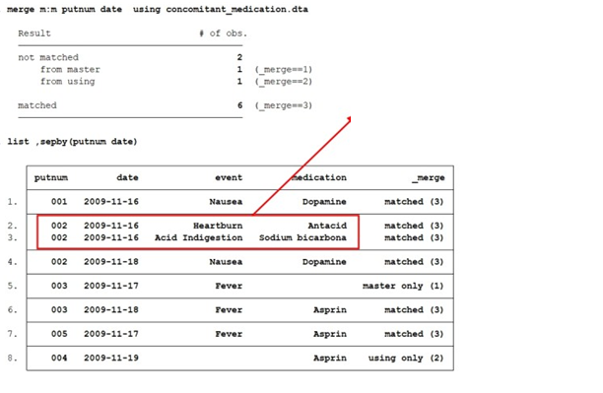
Merge-2

Slide 16
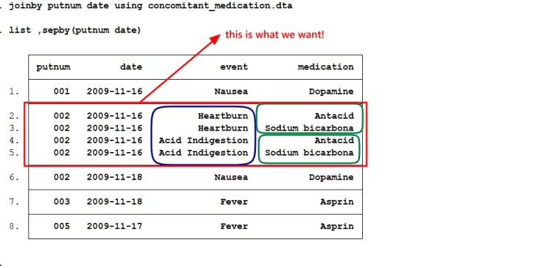
Merge-2
joinby [변수리스트] using 파일명 [, 옵션들]

Slide 17
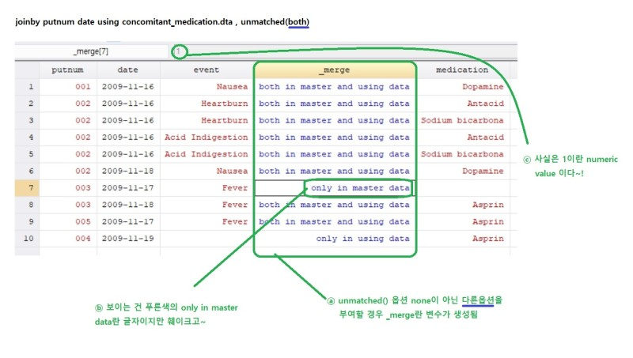
Merge-2

