Slide 1
Language Models
Formal grammars (e.g. regular, context free) give a hard “binary” model of the legal sentences in a language.
For NLP, a probabilistic model of a language that gives a probability that a string is a member of a language is more useful.
To specify a correct probability distribution, the probability of all sentences in a language must sum to 1.

Slide 2
Uses of Language Models
Speech recognition
  “I ate a cherry” is a more likely sentence than “Eye eight uh Jerry”
OCR & Handwriting recognition
  More probable sentences are more likely correct readings.
Machine translation
  More likely sentences are probably better translations.
Generation
  More likely sentences are probably better NL generations.
Context sensitive spelling correction
  “Their are problems wit this sentence.”

Slide 3
Completion Prediction
A language model also supports predicting the completion of a sentence.
  Please turn off your cell _____
  Your program does not ______
Predictive text input systems can guess what you are typing and give choices on how to complete it.

Slide 4
N-Gram Models
Estimate probability of each word given prior context.
  P(phone | Please turn off your cell)
Number of parameters required grows exponentially with the number of words of prior context.
An N-gram model uses only N−1 words of prior context.
  Unigram: P(phone)
  Bigram: P(phone | cell)
  Trigram: P(phone | your cell)
The Markov assumption is the presumption that the future behavior of a dynamical system only depends on its recent history. In particular, in a kth-order Markov model, the next state only depends on the k most recent states, therefore an N-gram model is a (N−1)-order Markov model.

Slide 5
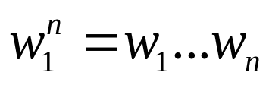
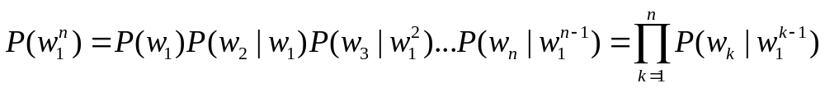
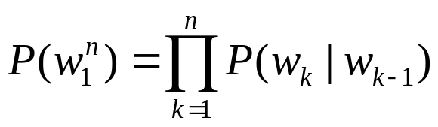
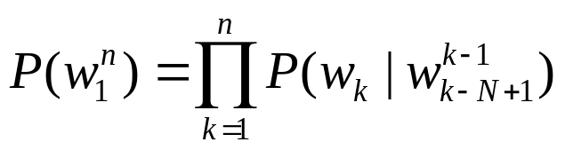
N-Gram Model Formulas
Word sequences
Chain rule of probability
Bigram approximation
N-gram approximation

Slide 6
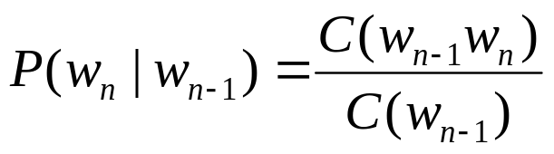
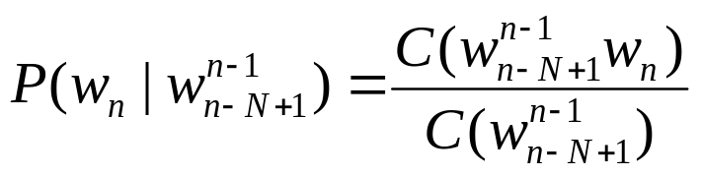
Estimating Probabilities
N-gram conditional probabilities can be estimated from raw text based on the relative frequency of word sequences.
To have a consistent probabilistic model, append a unique start (<s>) and end (</s>) symbol to every sentence and treat these as additional words.
Bigram:
N-gram:

Slide 7
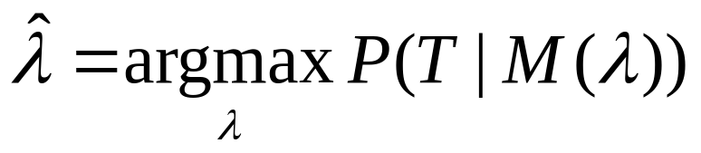
Generative Model & MLE
An N-gram model can be seen as a probabilistic automata for generating sentences.
Relative frequency estimates can be proven to be maximum likelihood estimates (MLE) since they maximize the probability that the model M will generate the training corpus T.
Initialize sentence with N−1 <s> symbols
Until </s> is generated do:
Stochastically pick the next word based on the conditional
probability of each word given the previous N −1 words.

Slide 8
Example from Textbook
P(<s> i want english food </s>)
= P(i | <s>) P(want | i) P(english | want)
P(food | english) P(</s> | food)
= .25 x .33 x .0011 x .5 x .68 = .000031
P(<s> i want chinese food </s>)
= P(i | <s>) P(want | i) P(chinese | want)
P(food | chinese) P(</s> | food)
= .25 x .33 x .0065 x .52 x .68 = .00019

Slide 9
Train and Test Corpora
A language model must be trained on a large corpus of text to estimate good parameter values.
Model can be evaluated based on its ability to predict a high probability for a disjoint (held-out) test corpus (testing on the training corpus would give an optimistically biased estimate).
Ideally, the training (and test) corpus should be representative of the actual application data.
May need to adapt a general model to a small amount of new (in-domain) data by adding highly weighted small corpus to original training data.

Slide 10
Unknown Words
How to handle words in the test corpus that did not occur in the training data, i.e. out of vocabulary (OOV) words?
Train a model that includes an explicit symbol for an unknown word (<UNK>).
  Choose a vocabulary in advance and replace other words in the training corpus with <UNK>.
  Replace the first occurrence of each word in the training data with <UNK>.

Slide 11
Evaluation of Language Models
Ideally, evaluate use of model in end application (extrinsic, in vivo)
  Realistic
  Expensive
Evaluate on ability to model test corpus (intrinsic).
  Less realistic
  Cheaper
Verify at least once that intrinsic evaluation correlates with an extrinsic one.

Slide 12
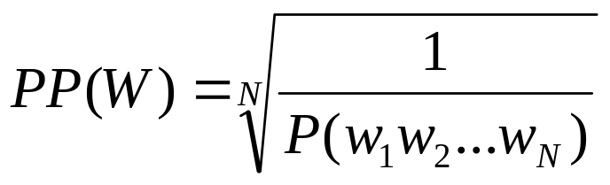
Perplexity
Measure of how well a model “fits” the test data.
Uses the probability that the model assigns to the test corpus.
Normalizes for the number of words in the test corpus and takes the inverse.
Measures the weighted average branching factor in predicting the next word (lower is better).

Slide 13
Sample Perplexity Evaluation
Models trained on 38 million words from the Wall Street Journal (WSJ) using a 19,979 word vocabulary.
Evaluate on a disjoint set of 1.5 million WSJ words.
 | Unigram | Bigram | Trigram
Perplexity | 962 | 170 | 109

Slide 14
Smoothing
Since there are a combinatorial number of possible word sequences, many rare (but not impossible) combinations never occur in training, so MLE incorrectly assigns zero to many parameters (a.k.a. sparse data).
If a new combination occurs during testing, it is given a probability of zero and the entire sequence gets a probability of zero (i.e. infinite perplexity).
In practice, parameters are smoothed (a.k.a. regularized) to reassign some probability mass to unseen events.
  Adding probability mass to unseen events requires removing it from seen ones (discounting) in order to maintain a joint distribution that sums to 1.

Slide 15
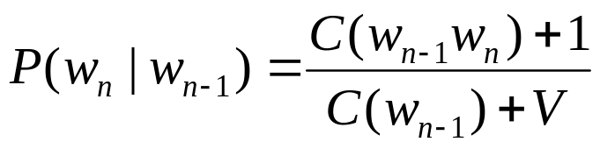
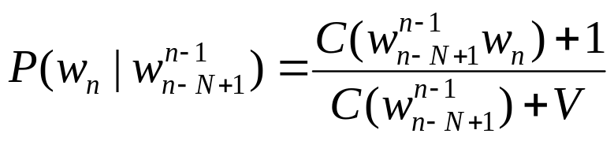
Laplace (Add-One) Smoothing
“Hallucinate” additional training data in which each possible N-gram occurs exactly once and adjust estimates accordingly.
where V is the total number of possible (N−1)-grams (i.e. the vocabulary size for a bigram model).
Bigram:
N-gram:
Tends to reassign too much mass to unseen events, so can be adjusted to add 0<δ<1 (normalized by δV instead of V).

Slide 16
Advanced Smoothing
Many advanced techniques have been developed to improve smoothing for language models.
  Good-Turing
  Interpolation
  Backoff
  Kneser-Ney
  Class-based (cluster) N-grams

Slide 17
Model Combination
As N increases, the power (expressiveness) of an N-gram model increases, but the ability to estimate accurate parameters from sparse data decreases (i.e. the smoothing problem gets worse).
A general approach is to combine the results of multiple N-gram models of increasing complexity (i.e. increasing N).

Slide 18
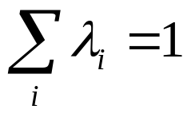
Interpolation
Linearly combine estimates of N-gram models of increasing order.
Interpolated Trigram Model:
Where:
Learn proper values for λ_{i} by training to (approximately) maximize the likelihood of an independent development (a.k.a. tuning) corpus.

Slide 19
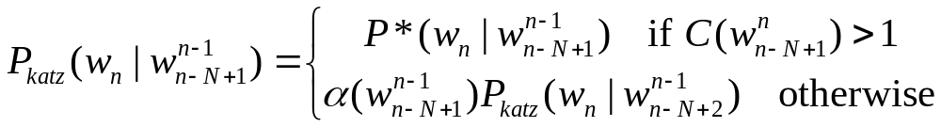
Backoff
Only use lower-order model when data for higher-order model is unavailable (i.e. count is zero).
Recursively back-off to weaker models until data is available.
Where P* is a discounted probability estimate to reserve mass for unseen events and α’s are back-off weights (see text for details).

Slide 20
A Problem for N-Grams:
Long Distance Dependencies
Many times local context does not provide the most useful predictive clues, which instead are provided by long-distance dependencies.
  Syntactic dependencies
    “The man next to the large oak tree near the grocery store on the corner is tall.”
    “The men next to the large oak tree near the grocery store on the corner are tall.”
  Semantic dependencies
    “The bird next to the large oak tree near the grocery store on the corner flies rapidly.”
    “The man next to the large oak tree near the grocery store on the corner talks rapidly.”
More complex models of language are needed to handle such dependencies.

Slide 21
Summary
Language models assign a probability that a sentence is a legal string in a language.
They are useful as a component of many NLP systems, such as ASR, OCR, and MT.
Simple N-gram models are easy to train on unsupervised corpora and can provide useful estimates of sentence likelihood.
MLE gives inaccurate parameters for models trained on sparse data.
Smoothing techniques adjust parameter estimates to account for unseen (but not impossible) events.

