Slide 1
Data Searching
Byunggeor Moon

Slide 2
Sea of Information
Internet data are extremely prevalent
They can be useful in many applications:
Predicting outcomes of political elections
Market trend research
Sentiment/reputation analysis
Stock market prediction
Sports science
Diffusion of information
Natural disasters
Diseases, epidemiology, public health
… the list goes on and on

Slide 3
Data is the new oil
We have to “mine” it…
Publicly available datasets
Raw files made available for download
e.g. UCI ML repository, Kaggle competitions, data.gov, NIH Chest X-ray Dataset, …
Web crawling/scraping
Automated bots/macros to collect data from the web
Navigate through websites by tracking down the links
e.g. Search engines!
API - Application Programming Interface
A programing interface to send query & retrieve data
e.g. Twitter API
Proprietary datasets

Slide 4
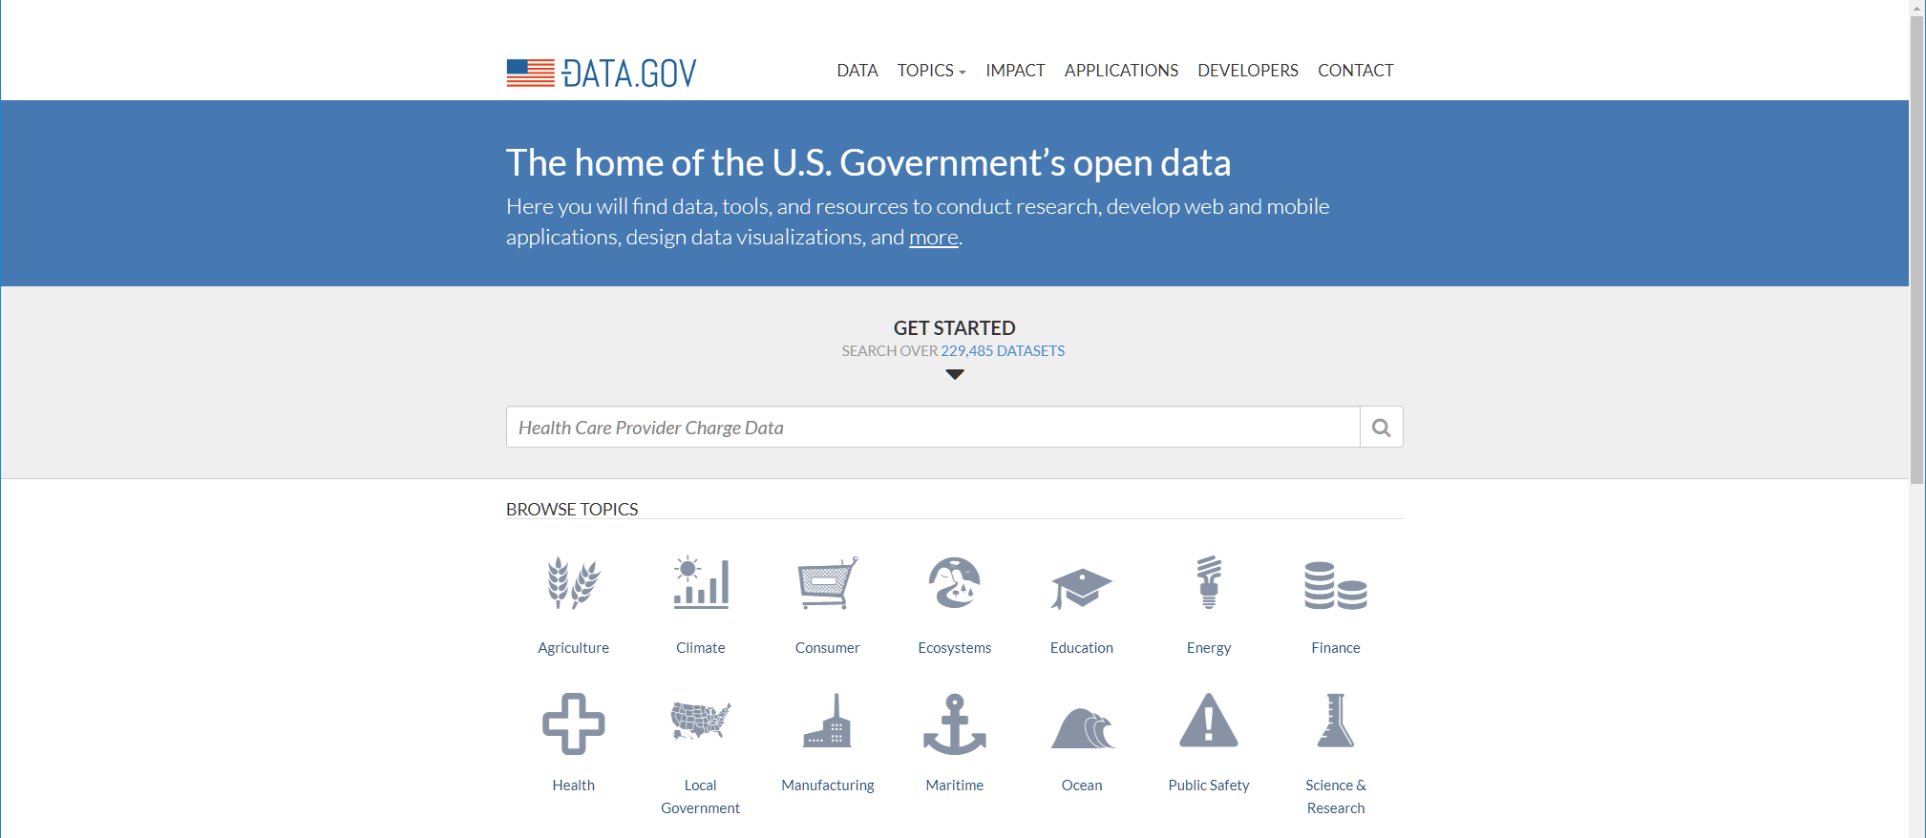
Public Datasets
https://www.data.gov/

Slide 5
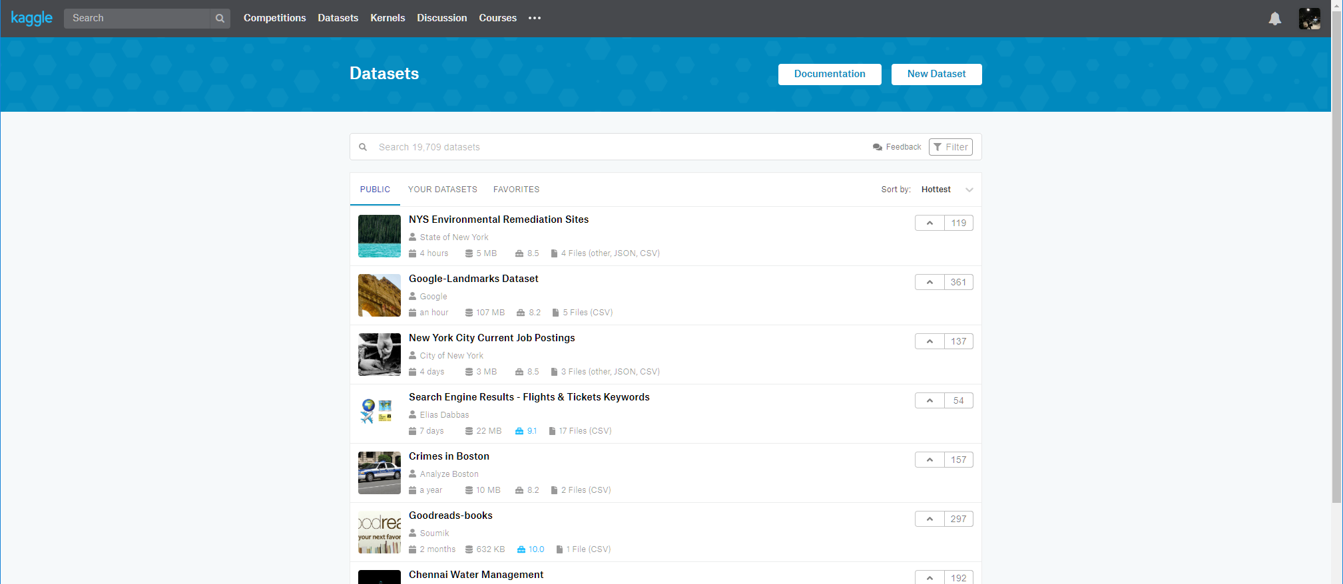
Public Datasets
https://www.kaggle.com

Slide 6
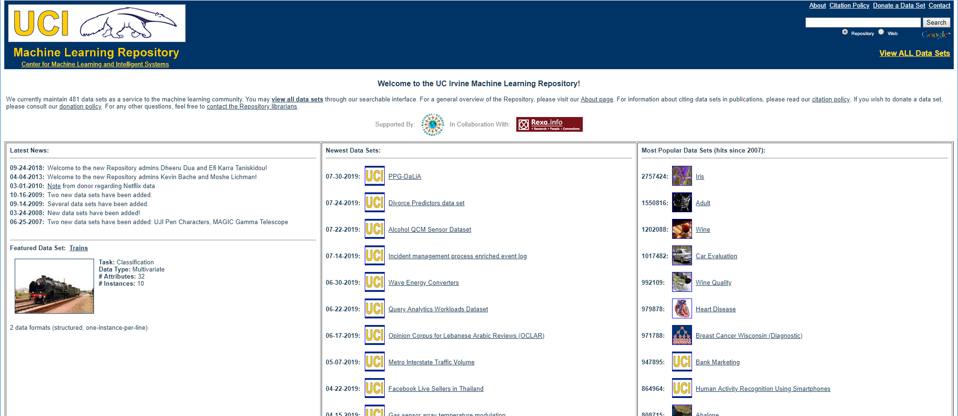
Public Datasets
https://archive.ics.uci.edu/ml/index.php

Slide 7
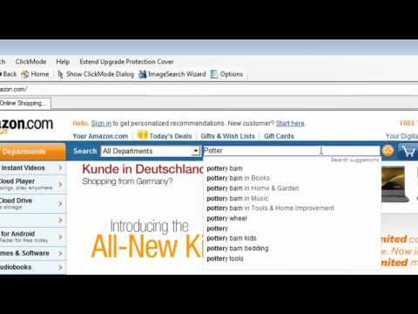
Web Crawling & Scraping
Data mining from websites can be incredibly tedious and repetitious
Web browser macros can automate repetitive web clicks, filling in forms, etc.
https://youtu.be/hytfjJGqlio

Slide 8
Web Crawling & Scraping
Crawler: aka web robot, or web spider
A software program that automatically traverses hyperlinks
Systematically browses the world wide web
Examples:
Googlebot: collects documents from the web to build a searchable index.
Xenon: is a web crawler used by government tax authorities to detect fraud
There are many open source crawlers:
For example: https://github.com/scrapinghub
BeautifulSoup, LXML

Slide 9
Web Crawler Policies
The behavior of a web crawler is the outcome of a combination of policies
a selection policy which states the pages to download,
a re-visit policy which states when to check for changes to the pages,
a politeness policy that states how to avoid overloading Web sites.
a parallelization policy that states how to coordinate distributed web crawlers.

Slide 10
Web Crawler Policies
The behavior of a web crawler is the outcome of a combination of policies
a selection policy which states the pages to download,
a re-visit policy which states when to check for changes to the pages,
a politeness policy that states how to avoid overloading Web sites.
a parallelization policy that states how to coordinate distributed web crawlers.
Web crawlers are not always welcome
A not so well-behaved crawler can be blacklisted
robot.txt: a special file located on a web server that enforces restrictions
‘Allow’ tag: list of pages that can be accessed
‘Disallow’ tag: list of pages that should not be indexed
HTML META tags: does the similar thing with robot.txt
<META name=”ROBOT” content=”NOFOLLOW”>
<META name=”GOOGLEBOT” content=”NOINDEX”>

Slide 11
Application Programming Interface (API)
Set of functions, routines, protocols, and tools for building software applications
APIs define the standard way of accessing data
Examples:
Twitter API: https://dev.twitter.com
Facebook API: https://developers.facebook.com
Yahoo! Finance API
Google Map API
…

Slide 12
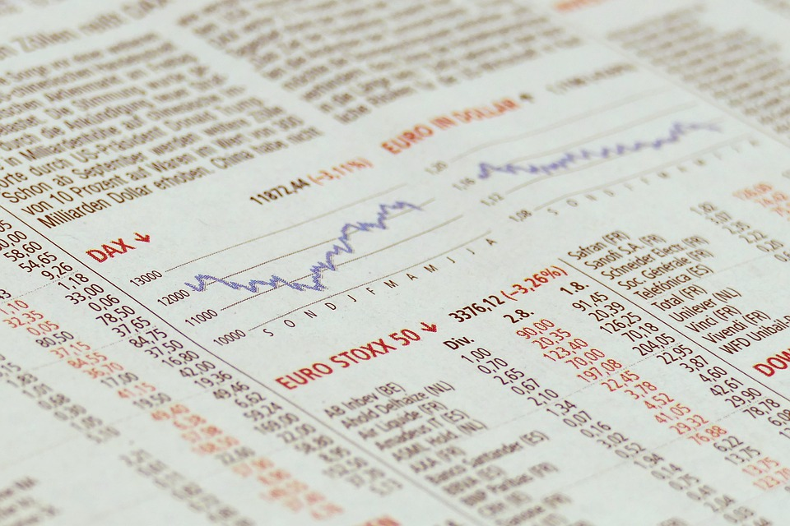
Let’s Play
Image Source: https://pixabay.com

Slide 13
Thanksgiving!

