Slide 1
Record Linkage-1 Preprocessing Concept/Indexing Blocking/Matching-1
Byunggeor Moon

Slide 2
Motivation
Big data diﬀers from survey data in that it is typically necessary to combine data from multiple sources to get a complete picture
Computer scientists tend to simply “mash” data sets together
Social scientists are rightfully concerned about issues of missing links, duplicative links, and erroneous links

Slide 3
Motivation
Big data oﬀers social scientists great opportunities to bring together many diﬀerent types of data, from many diﬀerent sources
Merging diﬀerent data sets provides new ways of creating population frames that are generated from the digital traces of human activity
Combining information from diﬀerent sources about an individual, business, or geographic entity means that the social scientist must determine whether or not two entities on two diﬀerent ﬁles are the same

Slide 4
Motivation
Determination is not easy
David A. Miller from Stanford, CA vs David Andrew Miller from Fairhaven, NJ
서울 김민수 vs 서울 김민수 in Credit Data
삼성 vs 삼성전자
Poor record linkage decisions can be substantial
12% of business revenues are lost due to bad linkages
Failure to match travelers to a “known terrorist
innocent citizens being detained

Slide 5
Motivation
Type of Record Linkage(Data Matching)
Exact Matching
Judgemental Matching
Probability Matching
Statistical Matching

Slide 6
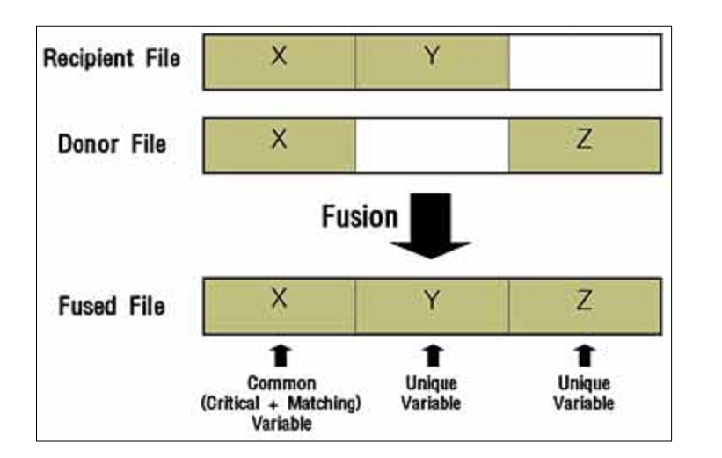
Motivation
Record Linkage(Data Matching) Scheme

Slide 7
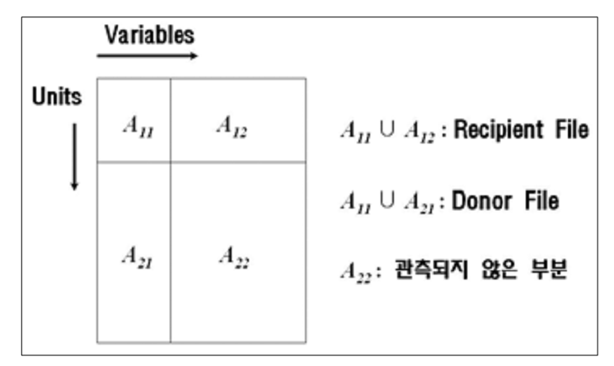
Motivation
Imputation

Slide 8
Motivation
Imputation Method
Procedure Based on Completely Recorded Units (결측치 포함 데이터 제거)
Sufficiently Small- O.K
Bias and Efficiency
Imputation-Based Procedure
Model-Based Procedure

Slide 9
Motivation
Evaluation Method
Predictability
Distance between Expected outcome and Matched sample
Representation

Slide 10
Introduction
Linking to existing data sources to solve a measurement need instead of implementing a new survey results in cost savings
a new survey may not be possible
Record linkage can be used to compensate for data quality issue
If a large number of observations for a particular ﬁeld are missing, it may be possible to link to another data source to ﬁll in the missing values
Ex) Survey without Income-administrative list with income data

Slide 11
Introduction
Record linkage is often used to create new longitudinal data sets by linking the same entities over time
create a combined data set that is richer in coverage and measurement than any of the individual data sources

Slide 12
Linking Data
Linking is straightforward if each entity has a corresponding unique identiﬁer that appears in the data sets to be linked
Social Security Number
주민등록번호
사업자등록번호/납세자 번호

Slide 13
Linking Data
If there is no unique identiﬁer available, then the task of identifying unique entities is challenging.
names, addresses, or dates of birth
시군구/행정동/단지

Slide 14
Linking Data
The problem is further complicated by poor data quality and duplicate records / more important in the context of big data
input errors (typos, misspellings, truncation, extraneous letters, abbreviations, and missing values)
diﬀerences in the way variables are coded between the two data sets (age versus date of birth, for example)

Slide 15
Linking Data
To ﬁnd all possible links between two data sets
compare each record of the ﬁrst data set with each record of the second data set- complexity increase quadratically with the size of the data
Indexing or blocking, which creates subsets of similar records and reduces the total number of comparisons
The outcome of the matching step is a set of predicted links—record pairs that are likely to correspond to the same entity

Slide 16
Linking Data
The ﬁnal stage of the record linkage process is to evaluate the result and estimate the resulting error rates
Unlike other areas of application for predictive algorithms, ground truth or gold standard data sets are rarely available.
The only way to create a reliable truth data set sometimes is through an expensive clerical review process
error rates must be estimated- To be discussed later

Slide 17
Linking Data
Develop a well-speciﬁed reason for linking the data sets
specify a loss function to proxy the cost of false negative matches versus false positive matches that can be used to guide match decisions.
Understand the coverage of the diﬀerent data sets being linked because diﬀerences in coverage may result in bias in the linked data

Slide 18
Linking Data
Example) Linking Twitter Data and Sample Base Survey Data
What can happen? Youth Bias
Example) Measures in different data sets
occupational classiﬁcation vs job title vs current position

Slide 19
Linking Data
Example) Employment and earnings outcomes of doctoral recipients(Science)
Match UMETRICS data on doctoral recipients to Census data on earnings and employment outcomes
20% of the doctoral recipients not matched
Does not have a job in the US/ Starts up a business / Uniquely match him/her to a Census Bureau record
What to do?- Accept bias and explain

Slide 20
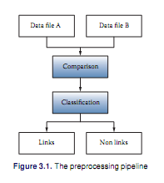
Preprocessing Data

Slide 21
Preprocessing Data
One approach is to compare all data units from ﬁle A with all units in ﬁle B and classify all of the comparison outcomes
Perfect world-Link or Nonlink decided
There is likely to be noise in the variables that are common to both data sets
The identiﬁers must be preprocessed before they can be compared

Slide 22
Preprocessing Data
Preprocessing-Complex and Time Consuming-“hands-on”
requires judgment and cannot be eﬀectively automated
The ﬁrst step in record linkage is to develop link keys
ﬁrst and last name, address, birth date, and sex-Administrative Data
The identiﬁers must be preprocessed before they can be compared
PLUTO DATA
Firm ID

Slide 23
Preprocessing Data
Some Rules for Identifying Fields
exhibit a wider range of values are more powerful
Names> Sex or Year of Birth
Complex link keys like addresses can be broken down into components so that the components can be compared independently of one another
1600 or Penn Ave< 1600 Penn Ave
혜화동/ 산 52길<혜화동 산 52길-Generate Unique ID using two variables

Slide 24
Preprocessing Data
Example) Legal Name or Nickname vs First Name
If legal and Nick name are identical-Then double counted
If legal and Nick name are different-Unfairly Penalize
Preprocessing Purpose
correct for issues in data quality
account for the diﬀerent ways that the input ﬁles were generate

Slide 25
Indexing and Blocking
Challenge to consider when comparing the records in two files
100 records in the ﬁrst and 100 records in the second ﬁle
10,000 possible comparisons
Spend the bulk of time comparing records that are not matches

Slide 26
Indexing and Blocking
Indexing
techniques that determine which of the possible comparisons will be made
Blocking is popular method
Blocking
construct a “blocking key” for each record by concatenating ﬁelds or parts of ﬁelds
Two records with identical blocking keys are said to be in the same block, and only records in the same block are compared
Fuzzy String comparator

Slide 27
Indexing and Blocking
Indexing
techniques that determine which of the possible comparisons will be made
Blocking is popular method
Blocking
construct a “blocking key” for each record by concatenating ﬁelds or parts of ﬁelds
Two records with identical blocking keys are said to be in the same block, and only records in the same block are compared
Fuzzy String comparator

Slide 28
Indexing and Blocking
Example)
First Character of Last Name and Zipcode
reduces the total number of comparisons by only comparing those individuals in the two ﬁles who live in the same locality and whose last names begin with the same letter
Considerations
the choice of blocking key creates a potential bias -individuals whose last name changed or who moved
implicit assumption that the included ﬁelds will not have typos or other data entry errors

Slide 29
Indexing and Blocking
Possible Solutions
One simple strategy for dealing with imperfect blocking keys is to implement multiple rounds of blocking and matching
Error Tolerant Approach
one may use clustering algorithms to identify sets of similar records. In this approach an index key, which is analogous to the blocking key above, is generated for both data
A distance function must be chosen and pairwise distances computed for all keys

Slide 30
Matching
Exact Matching
Edited, unique identifiers available on all files
Examples: Social Security Numbers (after validation), Employer Identification Numbers (after validation)

Slide 31
Matching
Exact Matching
Pluto Data-NYC
Location, GIS, Census Data
Exact, Blocking and Merging

Slide 32
Matching
Exact Matching
Using BBL- Unique ID with Borough Block Lot Variable
Can generate with those variable-Blocking
Generate Unique ID with egen, group
Generate Numeric ID with keeping the variable

Slide 33
Matching
Novel Dataset
Merge with Census Data
Merge with GIS data
Generate Location (Distance Data, Driving Time data)

Slide 34
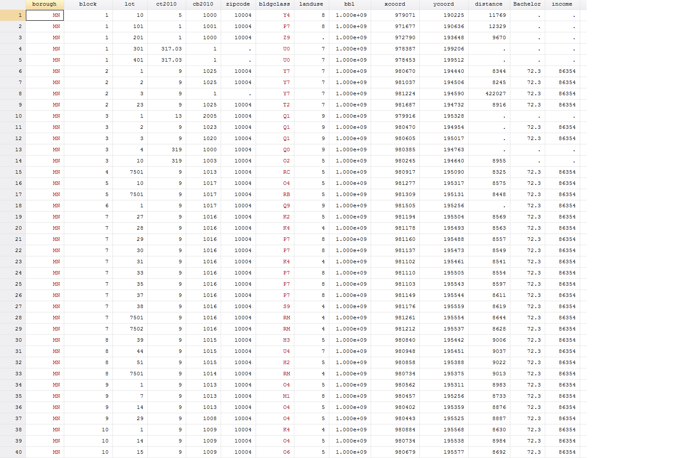
Matching
Pluto Data-NYC

Slide 35
Matching
Rolling Sales Data
BOROUGH | NEIGHBORHOOD | BUILDING CLASS CATEGORY | TAX CLASS AT PRESENT | BLOCK | LOT | EASEMENT | BUILDING CLASS AT PRESENT | ADDRESS | APARTMENT NUMBER | ZIP CODE | RESIDENTIAL UNITS | COMMERCIAL UNITS | TOTAL UNITS | LAND SQUARE FEET | GROSS SQUARE FEET | YEAR BUILT | TAX CLASS AT TIME OF SALE | BUILDING CLASS AT TIME OF SALE | SALE PRICE | SALE DATE
1 | ALPHABET CITY | 01 ONE FAMILY DWELLINGS | 1 | 374 | 46 |  | A4 | 347 EAST 4TH STREET |  | 10009 | 1 | 0 | 1 | 2,116 | 4,400 | 1900 | 1 | A4 | 2,385,000 | 2021-02-09
1 | ALPHABET CITY | 02 TWO FAMILY DWELLINGS | 1 | 377 | 72 |  | B9 | 231 EAST 7TH |  | 10009 | 2 | 0 | 2 | 1,718 | 5,154 | 1901 | 1 | B9 | 0 | 2020-10-02
1 | ALPHABET CITY | 03 THREE FAMILY DWELLINGS | 1 | 377 | 66 |  | C0 | 243 EAST 7TH STREET |  | 10009 | 3 | 0 | 3 | 2,381 | 3,084 | 1899 | 1 | C0 | 0 | 2020-10-31
1 | ALPHABET CITY | 07 RENTALS - WALKUP APARTMENTS | 2B | 372 | 10 |  | C7 | 274 EAST 3RD |  | 10009 | 9 | 1 | 10 | 2,021 | 6,445 | 1900 | 2 | C7 | 0 | 2020-12-27
1 | ALPHABET CITY | 07 RENTALS - WALKUP APARTMENTS | 2B | 374 | 1 |  | C7 | 301-303 EAST 4TH STREET |  | 10009 | 8 | 2 | 10 | 1,501 | 6,929 | 1900 | 2 | C7 | 3,672,530 | 2020-11-24
1 | ALPHABET CITY | 07 RENTALS - WALKUP APARTMENTS | 2 | 376 | 54 |  | C4 | 719 EAST SIXTH STREET, 5C |  | 10009 | 20 | 0 | 20 | 2,302 | 9,750 | 1900 | 2 | C4 | 154,196 | 2021-06-11
1 | ALPHABET CITY | 07 RENTALS - WALKUP APARTMENTS | 2 | 386 | 53 |  | C1 | 233 EAST 3 STREET |  | 10009 | 29 | 0 | 29 | 3,927 | 17,754 | 1910 | 2 | C1 | 7,500,000 | 2021-06-14
1 | ALPHABET CITY | 07 RENTALS - WALKUP APARTMENTS | 2 | 390 | 57 |  | C7 | 197 EAST 7TH STREET |  | 10009 | 10 | 1 | 11 | 1,600 | 5,320 | 1910 | 2 | C7 | 3,425,000 | 2021-02-11
1 | ALPHABET CITY | 07 RENTALS - WALKUP APARTMENTS | 2A | 392 | 5 |  | C2 | 151 AVENUE B |  | 10009 | 5 | 0 | 5 | 2,139 | 4,416 | 1900 | 2 | C2 | 0 | 2021-03-31
1 | ALPHABET CITY | 07 RENTALS - WALKUP APARTMENTS | 2B | 393 | 37 |  | C7 | 167 AVENUE C, 2A |  | 10009 | 8 | 2 | 10 | 1,920 | 7,485 | 1920 | 2 | C7 | 37,189 | 2020-09-01
1 | ALPHABET CITY | 07 RENTALS - WALKUP APARTMENTS | 2B | 393 | 37 |  | C7 | 167 AVENUE C, 3B |  | 10009 | 8 | 2 | 10 | 1,920 | 7,485 | 1920 | 2 | C7 | 20,661 | 2020-09-01
1 | ALPHABET CITY | 07 RENTALS - WALKUP APARTMENTS | 2B | 394 | 37 |  | C4 | 656 EAST 12 STREET |  | 10009 | 9 | 1 | 10 | 1,273 | 6,365 | 1910 | 2 | C4 | 3 | 2021-06-30
1 | ALPHABET CITY | 07 RENTALS - WALKUP APARTMENTS | 2 | 395 | 6 |  | C7 | 205 AVENUE B |  | 10009 | 11 | 1 | 12 | 2,232 | 6,432 | 1910 | 2 | C7 | 0 | 2020-10-21

Slide 36
Matching
Building Permit Data
Job # | Doc # | Borough | House # | Street Name | Block | Lot | Bin # | Job Type | Job Status | Job Status Descrp | Building Type | Community - Board | Other Description | Applicant's First Name | Applicant's Last Name | Applicant Professional Title | Applicant License #
2.1E+08 | 2 | BRONX | 97 | WEST 169 STREET | 2519 | 27 | 2130622 | NB | D | APPLICATION PROCESSED - ENTIRE | OTHERS | 204 | FOUNDATION | JOSEPH | DE NARDIS | PE | 60272
2.1E+08 | 3 | BRONX | 97 | WEST 169 STREET | 2519 | 27 | 2130622 | NB | D | APPLICATION PROCESSED - ENTIRE | OTHERS | 204 | SOE | THOMAS | THOMANN | PE | 78732
4.21E+08 | 2 | QUEENS | 88-36 | 139TH STREET | 9620 | 33 | 4623670 | NB | P | PLAN EXAM - APPROVED | OTHERS | 412 | SOE | PATRICK | MAHON | PE | 83395
4.21E+08 | 3 | QUEENS | 88-36 | 139TH STREET | 9620 | 33 | 4623670 | NB | P | PLAN EXAM - APPROVED | OTHERS | 412 | FOUNDATION | STEVEN | NAJARIAN | PE | 63868
1.21E+08 | 2 | MANHATTAN | 96 | SOUTH STREET | 73 | 11 | 1090738 | NB | R | PERMIT ISSUED - ENTIRE JOB/WORK | OTHERS | 1 |  | JOHN | BREDEHORST | PE | 87490
3.22E+08 | 1 | BROOKLYN | 12 | ROCKWELL PLACE | 2094 | 1 | 3418383 | NB | J | PLAN EXAM - DISAPPROVED | OTHERS | 302 | GEN. CONSTR. | HAMISH | WHITEFIELD | RA | 43228
4.02E+08 | 1 | QUEENS | 41-58 | CASE STREET | 1565 | 138 | 4538692 | NB | R | PERMIT ISSUED - ENTIRE JOB/WORK | 1-2-3 FAMILY | 404 | GEN CONST | HSIN | CHAO | PE | 70181
1.2E+08 | 1 | MANHATTAN | 45 | WADSWORTH AVENUE | 2144 | 3 | 1089928 | NB | R | PERMIT ISSUED - ENTIRE JOB/WORK | OTHERS | 112 | GEN. CONSTR | THEODORE | RIEPER | RA | 13294
4.2E+08 | 1 | QUEENS | 6508 | BEACH FRONT ROAD | 15905 | 297 | 4596381 | NB | X | SIGNED OFF | 1-2-3 FAMILY | 414 | GEN. CONSTR | ANGELO | COSTA | RA | 16907
4.21E+08 | 1 | QUEENS | 211-42 | 94 AVENUE | 10546 | 26 | 4588796 | NB | J | PLAN EXAM - DISAPPROVED | 1-2-3 FAMILY | 413 | GEN. CONSTR. | MICHIO | SANGA | RA | 20628

Slide 37
Matching
Novel Dataset
Pluto Data- Rolling Sales Data- Census Data-Building Permit Data
Locational Characteristics
Land Value
Effects of FAR(용적률)

Slide 38
Matching
Novel Dataset- Extension
Energy Usage Data- Crime Data-Mobility Data
Locational Characteristics
Energy Use/ Co2
Mobility/ Crime/ Quarantine

Slide 39
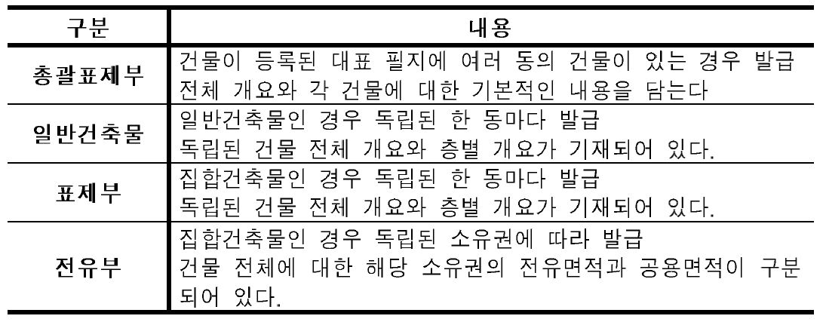
Matching
건축물 대장 데이터
http://open.eais.go.kr

Slide 40
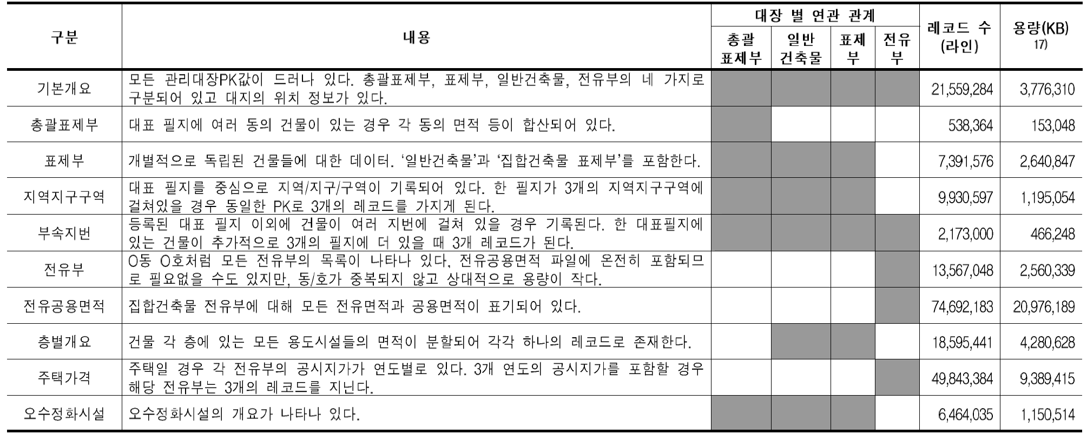
Matching
건축물 대장 데이터

Slide 41
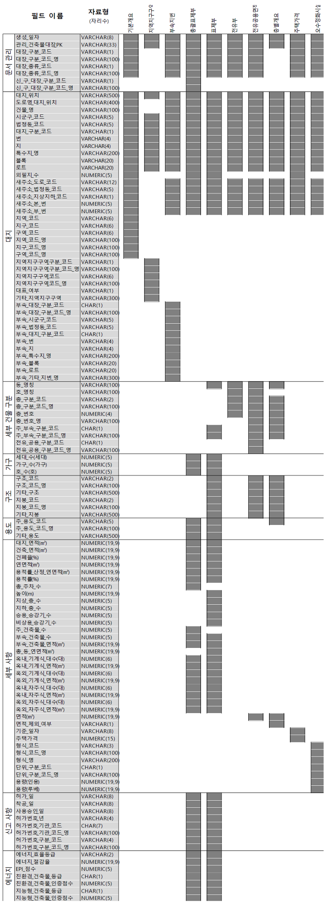

Slide 42
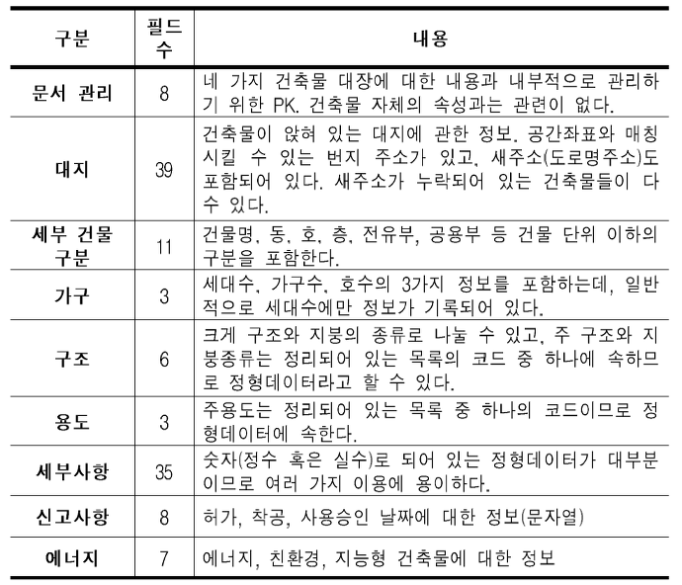

Slide 43
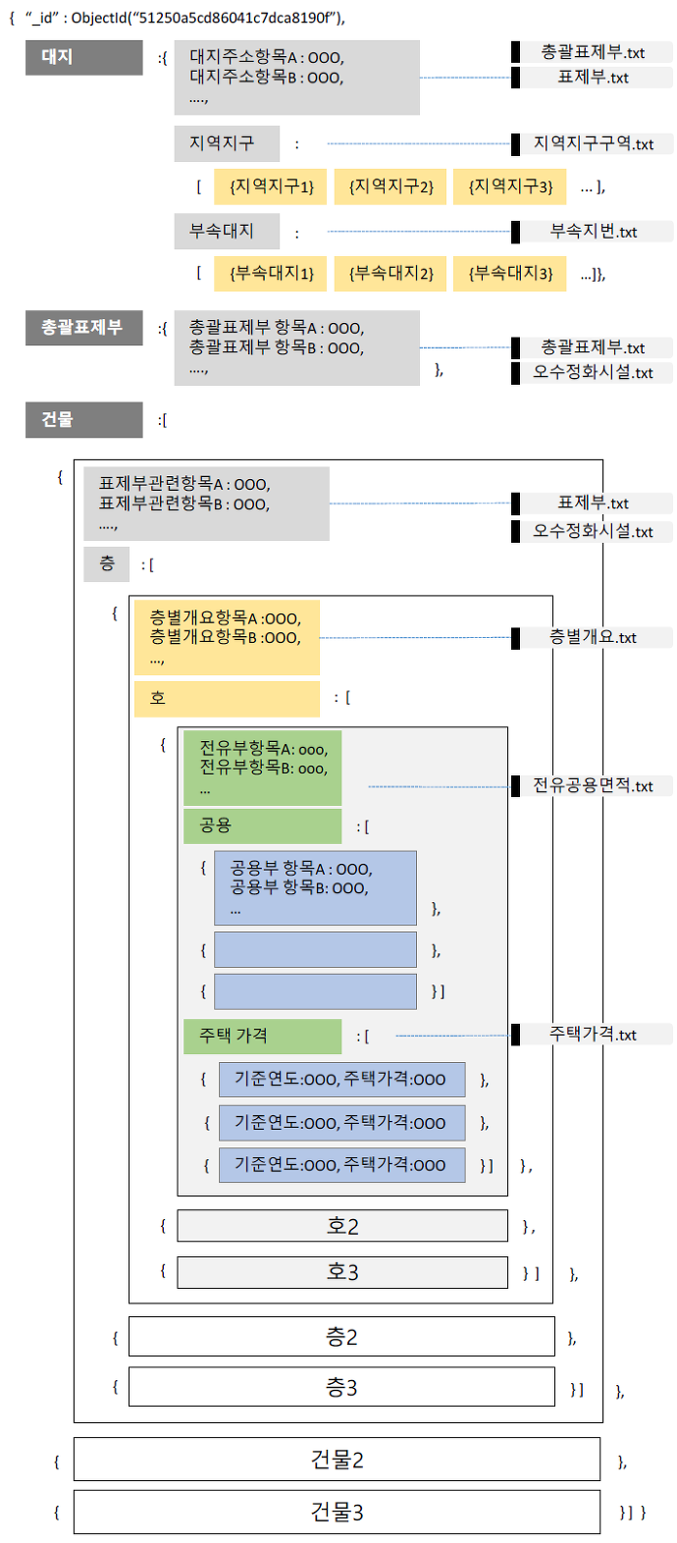

Slide 44
