Slide 1
Record Linkage-2 Matching
Byunggeor Moon

Slide 2
Matching
examine pairs of records and make a prediction as to whether they correspond to the same underlying entity.
Core of every record linkage algorithm is a function that compares two records and outputs a “score”
quantiﬁes the similarity between those records
Mathematically, the match score is a function of the output from individual ﬁeld comparisons: agreement in the ﬁrst name ﬁeld, agreement in the last name ﬁeld, etc
Nearest-neighbor matching, regression-based matching, and propensity score matching

Slide 3
Matching
Deterministic (also called exact)
Edited, unique identifiers available on all files
Examples: Social Security Numbers (after validation), Employer Identification Numbers (after validation)
Model-based
Comparison variables available on all files (list may be incomplete)
Examples: Fellegi-Sunter probabilistic record linkage, distance-based record linkage, posterior predictive models

Slide 4
Matching
Comparing continuous ﬁelds – straightforward!
10 vs 10: 10-10=0
Comparing character ﬁelds (String)-Edit distnace
Levenshtein distance
Jaro Winkler Distance

Slide 5
Levenshtein distance
The Levenshtein distance is a number that tells you how different two strings are
the Levenshtein distance between “kitten” and “sitting” is 3 since, at a minimum, 3 edits are required to change one into the other.
kitten → sitten (substitution of “s” for “k”)
sitten → sittin (substitution of “i” for “e”)
sittin → sitting (insertion of “g” at the end)

Slide 6
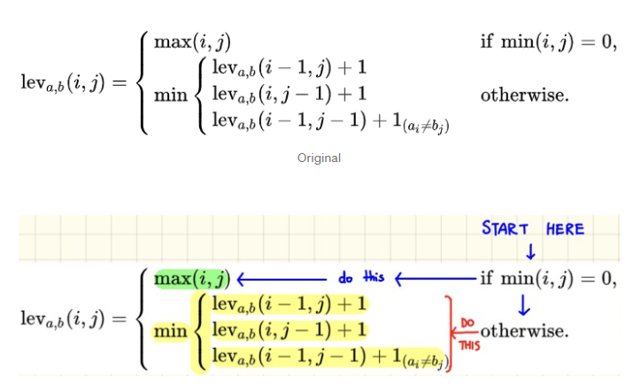
Levenshtein distance

Slide 7
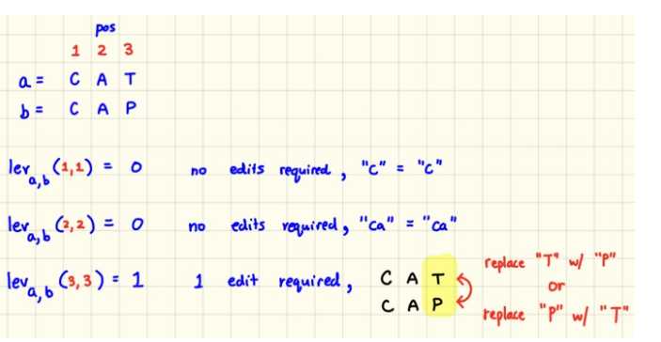
Levenshtein distance

Slide 8
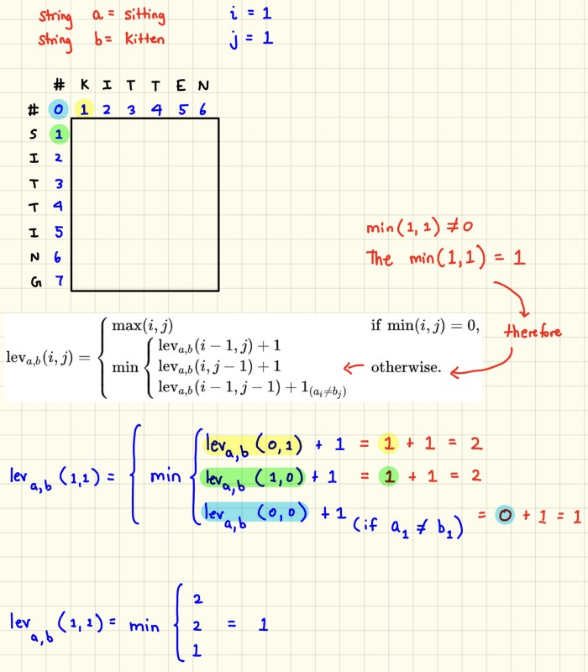
Levenshtein distance

Slide 9
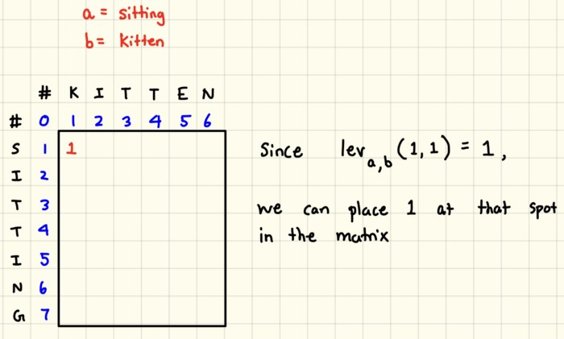
Levenshtein distance

Slide 10
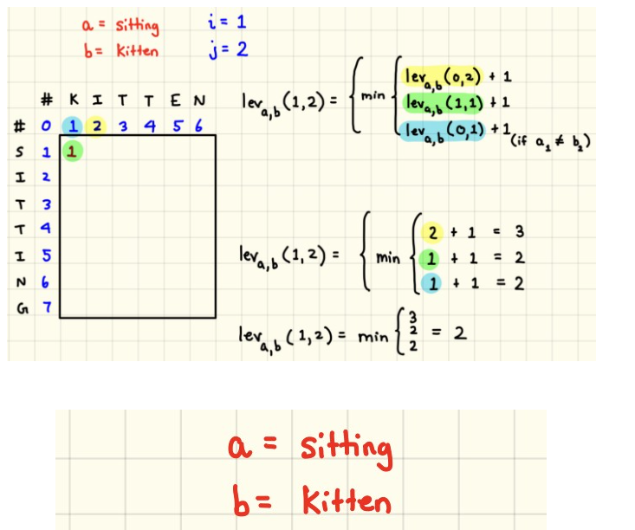
Levenshtein distance

Slide 11
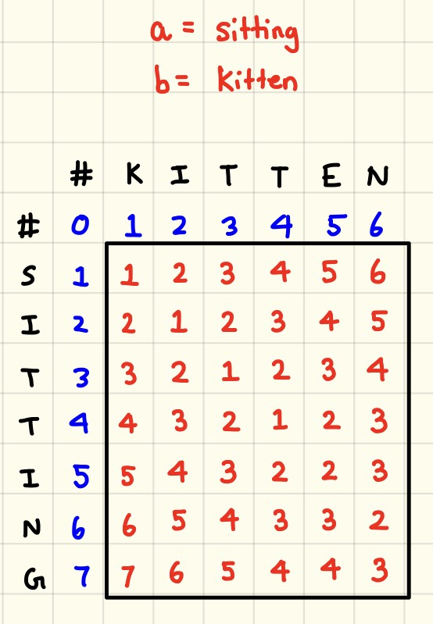
Levenshtein distance

Slide 12
Levenshtein distance
delete: ‘점심을먹자 →→ 점심먹자’ 로 바꾸기 위해서는 을 을 삭제
insert: ‘점심먹자 →→ 점심을먹자’ 로 바꾸기 위해서는 반대로 을 을 삽입
substitution: ‘점심먹자 →→ 점심먹장’ 로 바꾸기 위해서는 자를 장 으로 치환

Slide 13
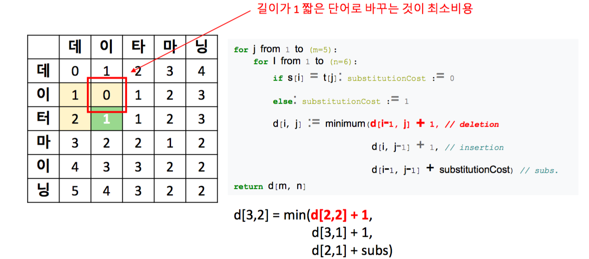
Levenshtein distance

Slide 14
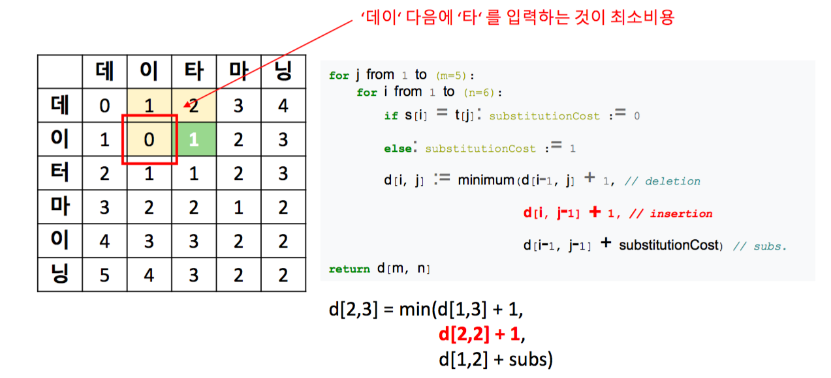
Levenshtein distance

Slide 15
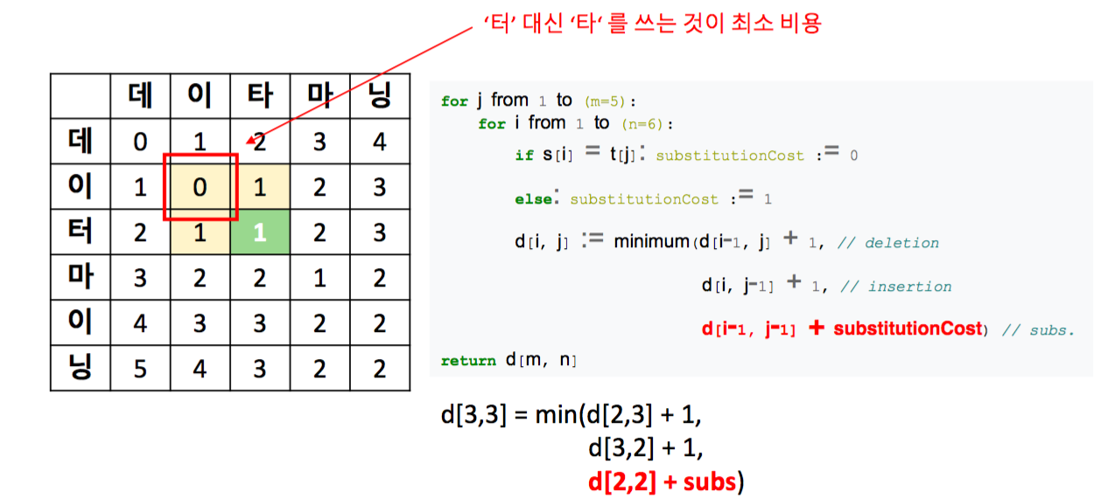
Levenshtein distance

Slide 16
Levenshtein distance
꿈을꾸는아이/ 아이오아이
d[0,0] = 1-첫글자가 각각 ‘꿈’과 ‘아’로 다르기 때문에 substitution 비용이 발생
0 번째 row 의 다른 값은 s1s1 = ‘꿈’ 이 ‘아’로 바뀐 뒤, 한글자씩 insertion 이 되기 때문에 [1, 2, 3, 4, 5] 로 비용이 증가

Slide 17
Levenshtein distance
꿈을 꾸는 아이/ 아이는 꿈을 꿔요
띄어쓰기가 있는 string 에 대하여 Levenshtein 을 계산
‘꿈을’ 이라는 어절이 같지만, character 기준으로 Levenshtein 을 적용하기 때문에 두 string 의 거리는 7

Slide 18
Levenshtein distance
꿈을 꾸는 아이/ 아이는 꿈을 꿔요
s1,s2s1,s2 에 대하여 str.split() 을 함으로써 list of str 이 되도록 입력하면 어절 단위로 거리가 계산
그 결과 어절 단위에서 세 번의 수정으로 두 string 이 변환

Slide 19
Levenshtein distance
아이쿠/아이쿵
‘쿠’와 ‘쿵’이 초/중/종성 중 종성만 다르니 그 거리를 1/3 으로 정의
Encoding-각 글자 고유아이디
Python 에서 글자를 아이디로 변형하기 위해서는 ord 함수를 이용

Slide 20
Levenshtein distance
FuzzyWuzzy
The concept of fuzzy matching is to calculate similarity between any two given strings
fuzzywuzzy is an inbuilt package you find inside python which has certain functions in it which does all this calculation

Slide 21
Levenshtein distance
FuzzyWuzzy
fuzz.ratio()
fuzz.partial_ratio()
fuzz.token_sort_ratio()
fuzz.token_set_ration()

Slide 22
Levenshtein distance
FuzzyWuzzy
from fuzzywuzzy import fuzz fuzz.ratio('My name is Sreemanta','My name is Sreemanta Kesh')
Output : 89

Slide 23
Levenshtein distance
FuzzyWuzzy
print(fuzz.ratio('My name is Sreemanta','My name is Sreemanta ')) print(fuzz.ratio('My name is Sreemanta','My name is Sreemanta'))
Output : 98/100

Slide 24
Levenshtein distance
FuzzyWuzzy
print(fuzz.partial_ratio('My name is Sreemanta','My name is Sreemanta Kesh')) print(fuzz.partial_ratio('My name is Sreemanta','My name is Sreemanta '))
Output : 100/100
partial_ratio() is just checking if either of the string is a sub string of the other
fuzz.partial_ratio('New York City','New York')

Slide 25
Levenshtein distance
FuzzyWuzzy
fuzz.token_sort_ratio('My name is Sreemanta','Sreemanta name is My ')
Output : 100
fuzz.token_sort_ratio('My name is Sreemanta','sreemanta name is My ** ')
Output : 100
Order of the words does not matter.
It also ignores punctuation.

Slide 26
Levenshtein distance
FuzzyWuzzy
print(fuzz.token_sort_ratio('My name is Sreemanta','Sreemanta name is My Kesh '))
Output : 89 print(fuzz.token_set_ratio('My name is Sreemanta','Sreemanta name is My Kesh '))
Output : 100
token_set_ratio() takes a more flexible approach than token_sort_ratio()
sorting and then pasting the tokens back together, token_set_ratio performs a set operation that takes out the common tokens (the intersection)

Slide 27
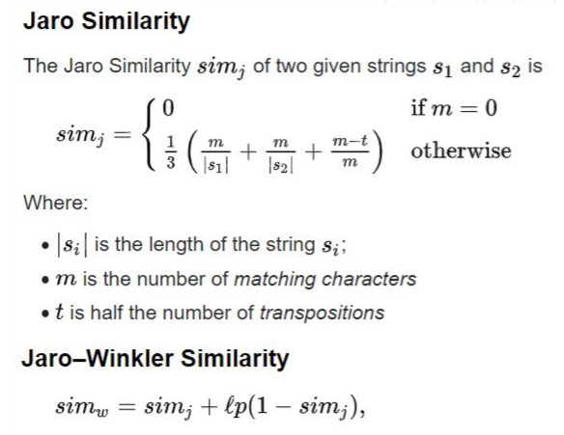
Jaro–Winkler distance
Words with more characters in common will have a higher Jaro–Winkler value than those with fewer characters in common

Slide 28
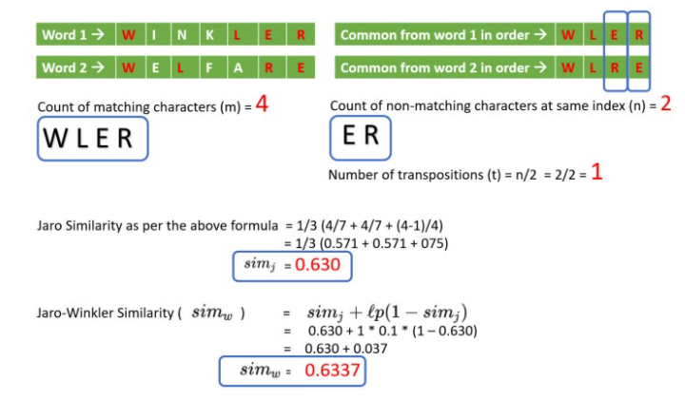
Jaro–Winkler distance

Slide 29
Record Linkage Algorithm
After getting some inference data, what to do?
rule-based
Probabilistic
machine learning

Slide 30
Rule-based approaches
Create a set of ad hoc rules that determine which pairs of records should be linked
the Jaro–Winkler comparison of ﬁrst names is greater than 0.9
the Jaro–Winkler comparison of ﬁrst names is greater than 0.9
the ﬁrst three digits of the year of birth are the same
Auxiliary ﬁeld
Education in the first file and Occupation in the second file
History Major vs Aero Space Engineer

Slide 31
Rule-based approaches
attractive if it produces a reasonable-looking set of links from intuitive rules
number of rules grows it becomes harder to understand
no notion of a threshold that can be increased or decreased depending on the tolerance for false positive and false negative errors

Slide 32
Probabilistic record linkage
Fellegi–Sunter algorithm
From Now on, see problinkage slides
Labor Static Data Reading

Slide 33
Longitudinal Business Database
BR 1976
X_{1,1}
X_{1,2}
…
X_{1,j}
…
X_{1,N1}
BR 1977
X_{2,1}
X_{2,2}
…
X_{2,j}
…
X_{2,N2}
BR 1978
X_{3,1}
X_{3,2}
…
X_{3,j}
…
X_{3,N3}
BR 2014
X_{39,1}
X_{39,2}
…
X_{39,j}
…
X_{39,N39}
Adapted from: Jarmin and Miranda (2002)
Notes:
These data form the basis of the Business Dynamics Statistics
X_{1,1} is present from 1976 through 2014, but changes identifiers.
X_{2,2} is a birth, continuing.
X_{2,N2} is a birth and death.
Jarmin and Miranda (2002) contains discussion of the sensitivity of the construction to linkage assumptions.

Slide 34
Longitudinal ES 202 from the Bureau of Labor Statistics
ES 202 1990:1
X_{1,1}
X_{1,2}
…
X_{1,j}
…
X_{1,N1}
ES 202 1990:2
X_{2,1}
X_{2,2}
…
X_{2,j}
…
X_{2,N2}
ES 202 1990:3
X_{3,1}
X_{3,2}
…
X_{3,j}
…
X_{3,N3}
ES 202 2016:4
X_{108,1}
X_{108,2}
…
X_{108,j}
…
X_{108,N108}
Adapted from: Robertson et al. 1997
Notes:
These data are the basis for the BLS’s Business Employment Dynamics.
Same birth and death issues as in LBD
Primarily used Fellegi-Sunter record linkage
Published a detailed study of the effects of implementation decisions on BED (Robertson et al. 1997), which I will discuss later

Slide 35
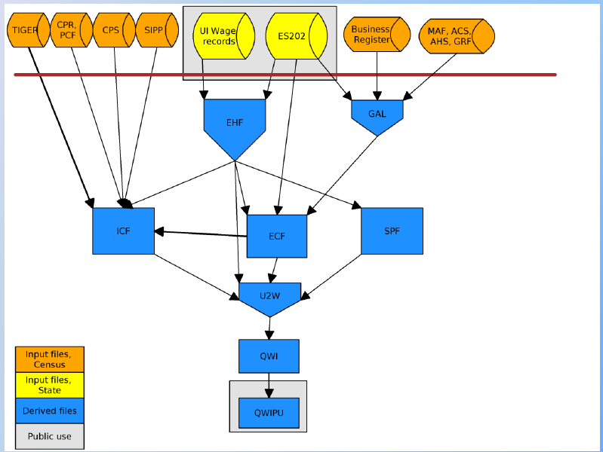
The Longitudinal Employer-Household Dynamics Infrastructure File System
Source: Abowd and Vilhuber (2016)
Notes:
Longitudinal Employer-Household Dynamics Infrastructure File System
Some record linkage is by exact identifiers, some by Bayesian posterior predictive distributions
Abowd et al. (2009), Abowd and Vilhuber (2005), Benedetto et al. (2007), McKinney et al. (2017) discuss many aspects of the effects of the linkage assumption on these data. McKinney et al. (2017) is the first full-scale study of the effects of all sources of variation, including linkage uncertainty on the Quarterly Workforce Indicators

Slide 36
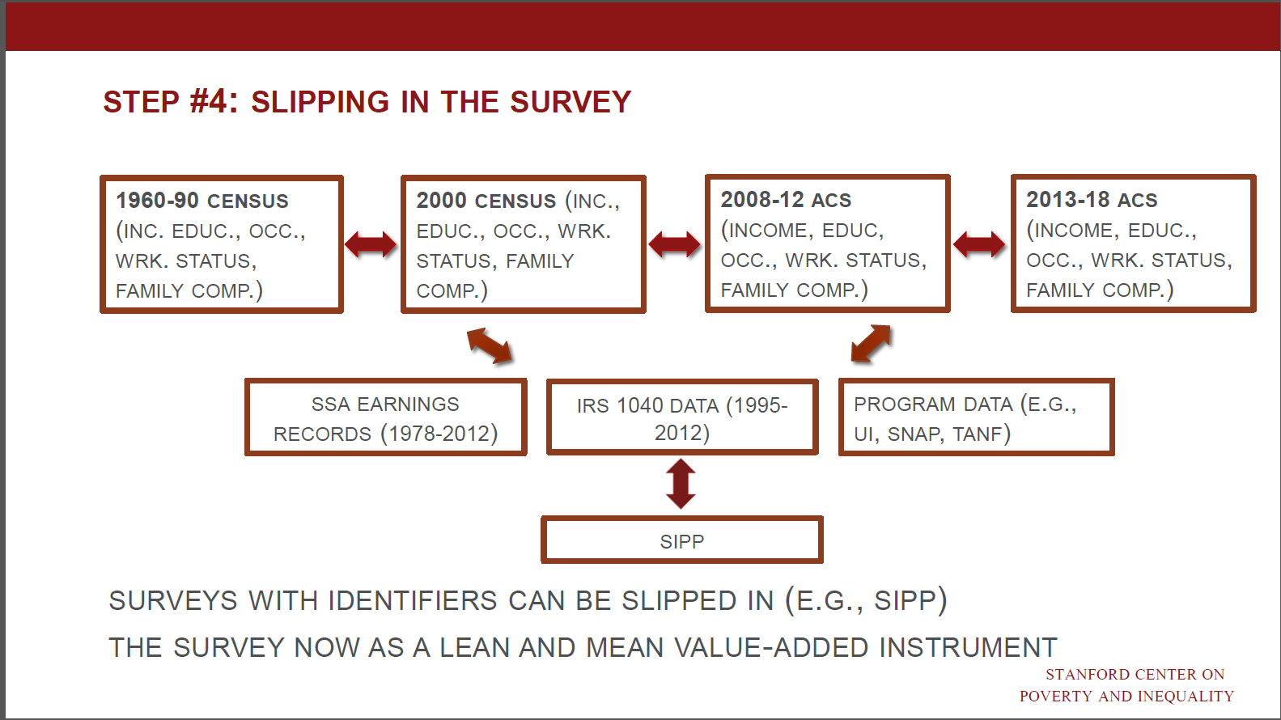
Census Longitudinal Infrastructure Project
Source: Alexander et al. (2016)
Notes:
Census Longitudinal Infrastructure Project (in support of the American Opportunity Study)
Censuses, ACS and SIPP linked via Fellegi-Sunter on the person and household address.
Administrative data (IRS, SSA, UI, SNAP, TANF) linked via exact person identifiers.
Mulrow et al. (2011) is a comprehensive quality assessment of the underlying linkage system.
Wagner and Layne (2014), Layne et al. (2014), Bond et al. (2014) and Brummet (2015) discuss many aspects of the quality of this linkage system.

Slide 37
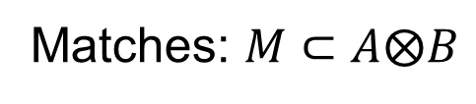

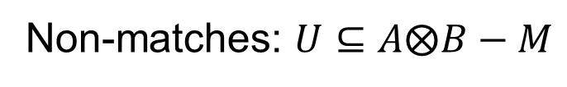
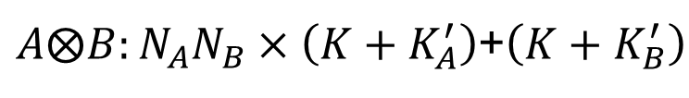


Fellegi-Sunter Record Linkage
$$A: N_{A}×\left(K+K_{A}^{′}\right)$$
$$B: N_{B}×\left(K+K_{B}^{′}\right)$$
$A⨂B:N_{A}N_{B}×\left(K+K_{A}^{′}\right)$+$\left(K+K_{B}^{′}\right)$
$$a_{i}∈A, b_{j}∈B, {ab}_{r}∈A⨂B$$
Matches: $M⊂A⨂B$
Non-matches: $U⊆A⨂B−M$

Slide 38
Fellegi-Sunter Record Linkage
γ(a, b) = (1, 1, 0)
records a and b agree on ﬁrst name and last name,but disagree on city of residence.

Slide 39
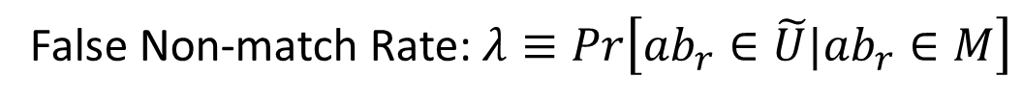
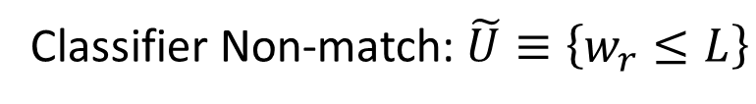
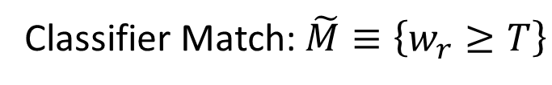
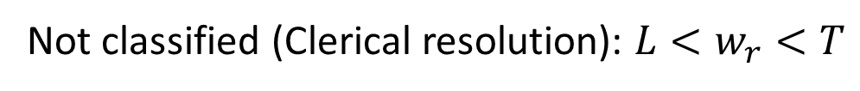
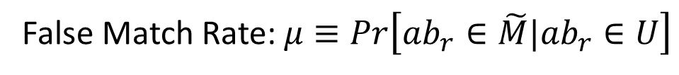
Fellegi-Sunter Record Linkage III
Classifier Match: $\tilde{M}≡\left\{w_{r}≥T\right\}$
Classifier Non-match: $\tilde{U}≡\left\{w_{r}≤L\right\}$
Not classified (Clerical resolution): ${L<w}_{r}<T$
False Match Rate: $μ≡Pr\left[{ab}_{r}∈\tilde{M}|{ab}_{r}∈U\right]$
False Non-match Rate: $λ≡Pr\left[{ab}_{r}∈\tilde{U}|{ab}_{r}∈M\right]$
Adapted from: Christen and Goiser (2007) and Herzog, Scheuren and Winkler (2007)
Notes:
The classifier put records into classified matches $\tilde{M}$ and classified non-matches $\tilde{U}$.
The not-classified set is handled by clerical resolution.
For what follows, I assume T=L when discussing error rates. Clerical resolutions have been used, where available, to train the classifier so that it can run unsupervised without clerical resolution.
In the ideal application T and L are set optimally for a given value of the false match rate (FPR) and false non-match rate (FNR).
Under conditional independence, both can be estimated, along with the weights needed to from the agreement index via maximum likelihood (EM algorithm).

Slide 40
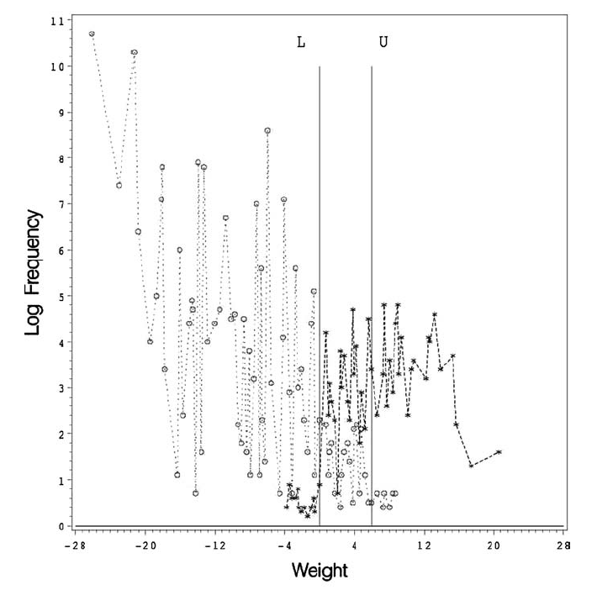
L
T
+ True matches o = True Non-matches
+ = False Non-matches
o = False Matches
Source: Herzog, Scheuren and Winkler (2007)
Notes:
Example from the 1988 dress rehearsal for the 1990 Census.
X-axis plots the natural logarithm of the Fellegi-Sunter weight.
Y-axis plots the natural logarithm of 1 + frequency of the weight in the classification space.
Pairs with weight above T were classified as matches; o in the region above U is a false match.
Pairs with weight below L were classified as Non-matches; + in the region below L is a false Non-match.
Pairs between L and T were unclassified; the clerical resolution is assumed to be correct, so there are no classification errors in this region by assumption.
All pairs were clerically reviewed, including returning to the field.
(+,o) represent true matches.
The data are well separated, meaning that most of the true matches lie above U and most of the true Non-matches lie below L.

Slide 41
Fellegi-Sunter Record Linkage III
Fuzzymatcher Package
A Python package that allows the user to fuzzy match two pandas dataframes based on one or more common fields.
Uses probabilistic record linkage to score matches.
Adapted from: Christen and Goiser (2007) and Herzog, Scheuren and Winkler (2007)
Notes:
The classifier put records into classified matches $\tilde{M}$ and classified non-matches $\tilde{U}$.
The not-classified set is handled by clerical resolution.
For what follows, I assume T=L when discussing error rates. Clerical resolutions have been used, where available, to train the classifier so that it can run unsupervised without clerical resolution.
In the ideal application T and L are set optimally for a given value of the false match rate (FPR) and false non-match rate (FNR).
Under conditional independence, both can be estimated, along with the weights needed to from the agreement index via maximum likelihood (EM algorithm).

Slide 42
Thresholds
Based on you data
optimalThreshold: Optimal Threshold for Record Linkage
https://rdrr.io/cran/RecordLinkage/man/optimalThreshold.html
Calculates the optimal threshold for weight-based Record Linkage

Slide 43
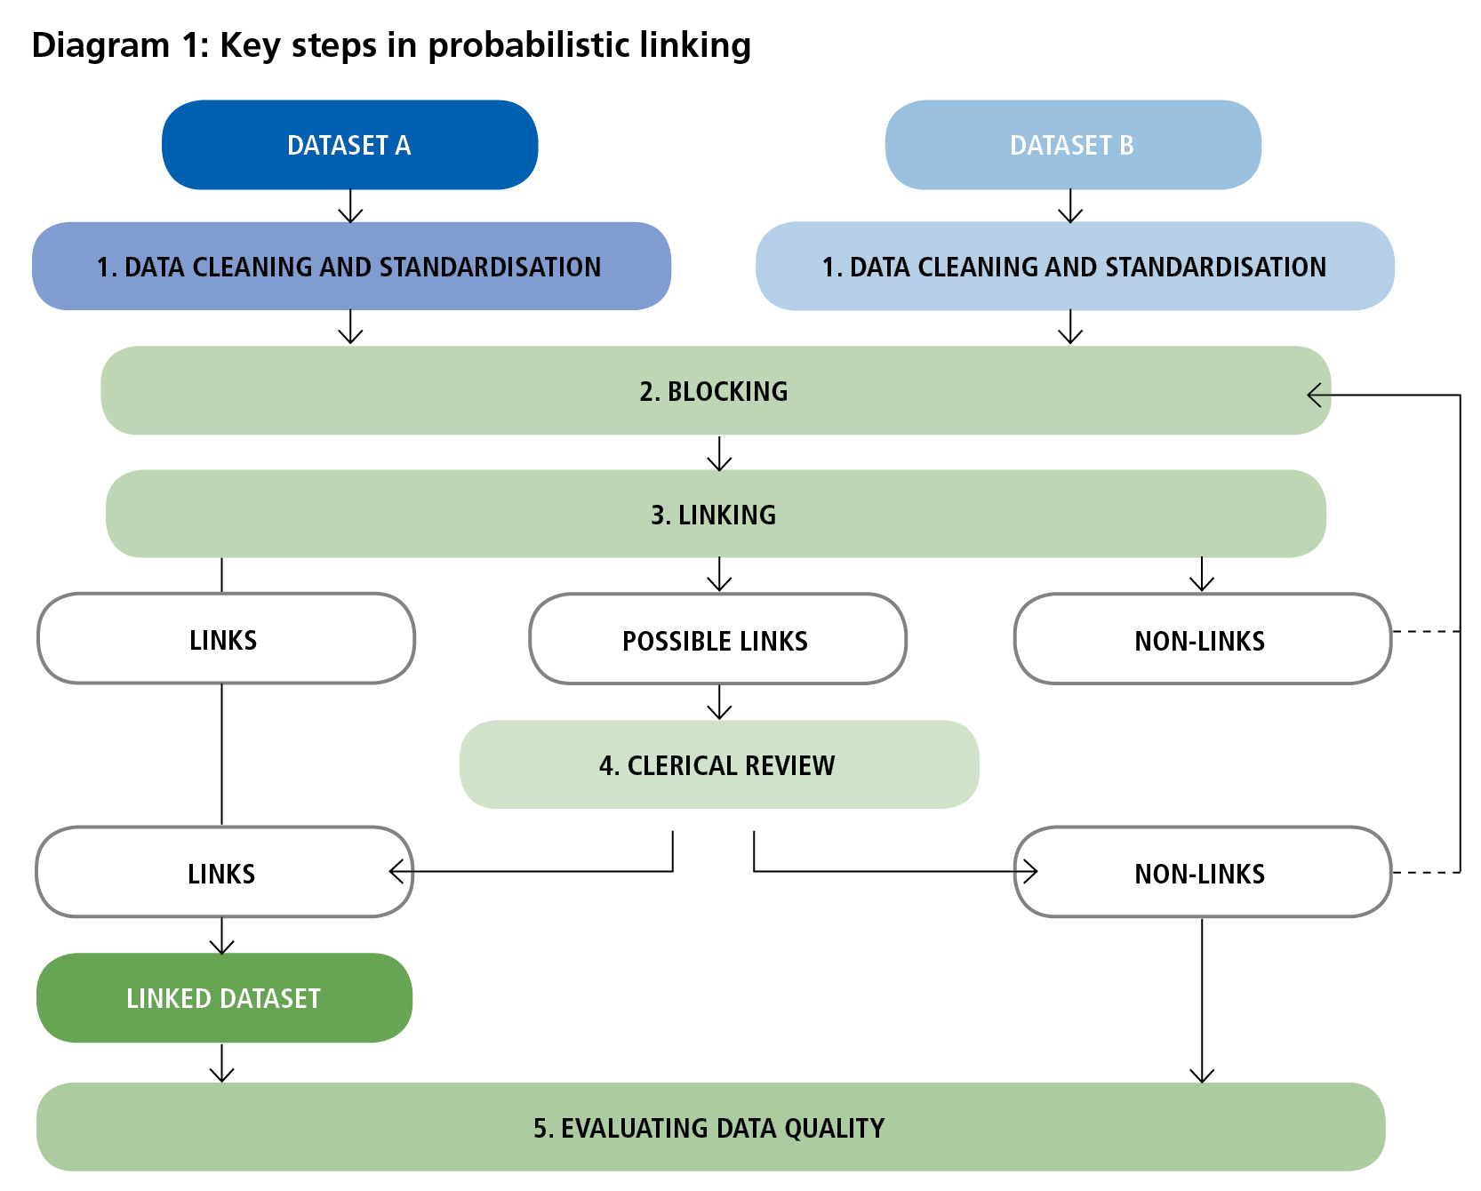
Summarize

Slide 44
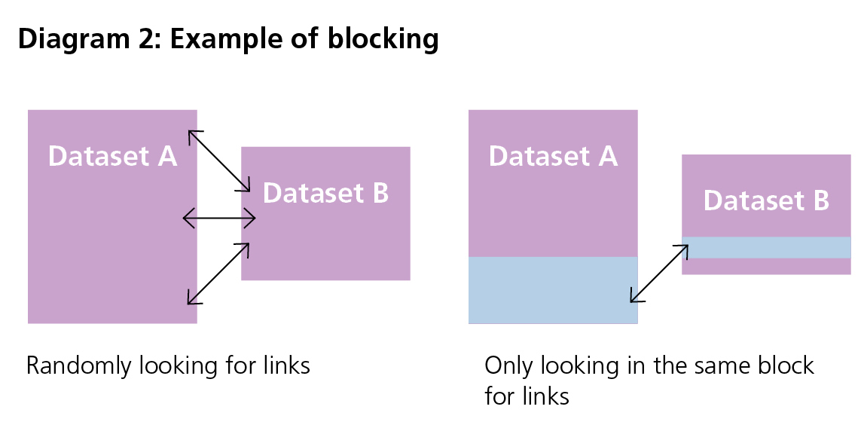
Summarize

Slide 45
Summarize
Evaluating data quality
Field | Record A | Record B
Name | Jon Block | John Black
Date of birth | 23-11-65 | 23-11-63
Sex | M | M
Address | 89 Molesworth Street | 112 Hiropi Street

Slide 46
Summarize
Evaluating data quality
Field | m probability | u probability | Agreement field weight | Disagreement field weight
Name | 0.95 | 0.01 | 6.57 | −4.31
Date of birth | 0.9 | 0.01 | 6.49 | −3.31
Sex | 0.95 | 0.5 | 0.93 | −3.32
Address | 0.7 | 0.01 | 6.13 | −1.72

Slide 47
Summarize
Evaluating data quality
Field | File A | File B | Agreement? | Field weight
Name | Jon Block | John Black | No | −4.31
Date of birth | 23-11-65 | 23-11-63 | No | −3.31
Sex | M | M | Yes | 0.93
Address | 89 Molesworth Street | 112 Hiropi Street | No | −1.72
 |  |  | Composite weight (sum of field weights) | −8.41
the linking process would determine that these records are a non-link.

Slide 48
Machine learning approaches to linking
In recent years machine learning approaches have been applied to record linkage following their success in other areas of prediction and classiﬁcation

Slide 49
What is Machine learning?
Humans improve their skills with experience, they are said to learn
How about computer?
Arthur Samuel, who coined the term machine learning in 1959
programming a computer to play checkers.
The computer played against itself and human opponents, improving its performance with every game.
Eventually, after suﬃcient training (and experience), the computer became a better player than the human programmer

Slide 50
What is Machine learning?
Drive (and park) autonomous cars
Recommend books, products, and movies
Speech recognition
Personalized ads
Face recognition

Slide 51
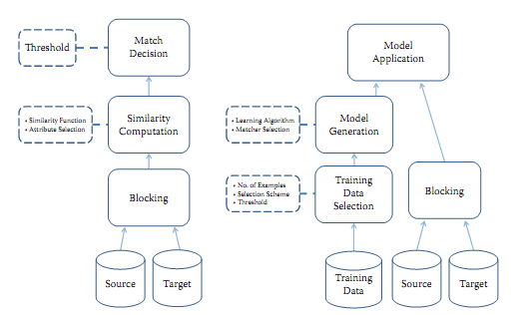
Machine learning approaches to linking

Slide 52
Machine learning approaches to linking
Python Record Linkage Toolkit

