Slide 1
Big Data for Public Policy Analysis
Instructor: Byunggeor Moon
1. Course Overview and Introduction

Slide 2
(Big) Data can diagnose policy problems.

Slide 3
(Big) Data can diagnose (and hopefully help solve) policy problems.

Slide 4
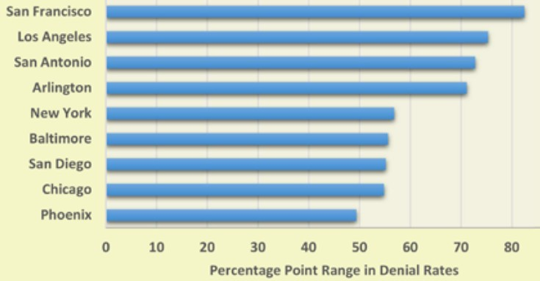
U.S. Asylum Courts: Disparities in Grant Rates
In San Francisco, one judge grants 90.6% of asylum requests, while another judge grants just 2.9%!

Slide 5
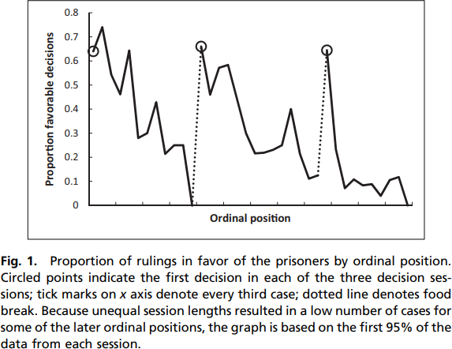
Jailing Decisions Before/After Lunch Breaks
Source: Danziger et al, PNAS 2011, Israel judges deciding on parole.

Slide 6
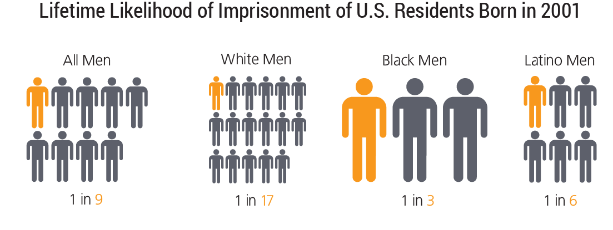
Source: The Sentencing Project.

Slide 7
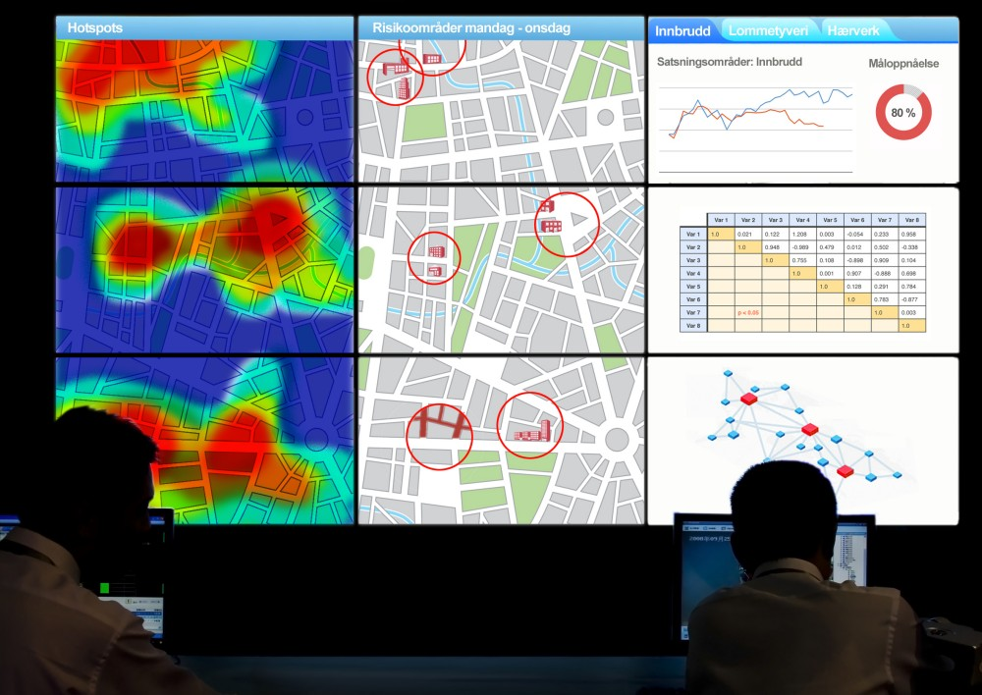
Predictive Policing

Slide 9
(Big) Data can cause (or magnify) problems.

Slide 10

"때론 잘못 분류해도 이의를 제기 당할 수 없습니다. 그런 실수는 제 잘못이 아닙니다. 저는 효율에 최적화됐습니다."

Slide 11
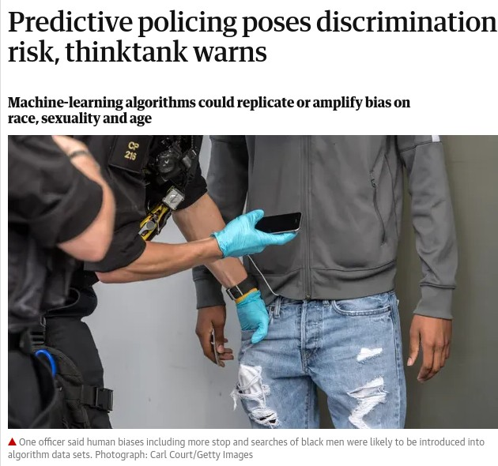

Slide 12
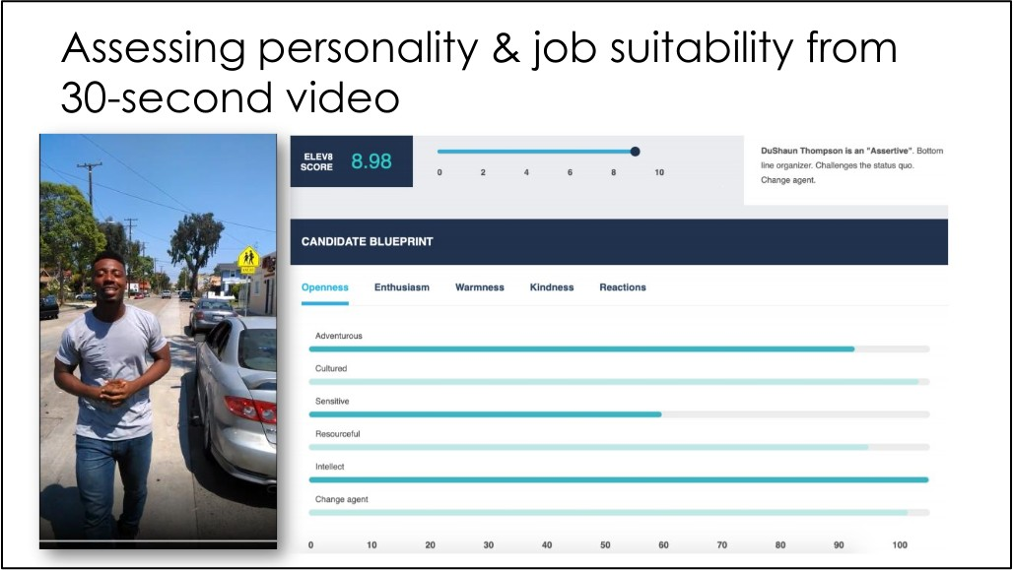
Source: Narayanan slides.

Slide 13
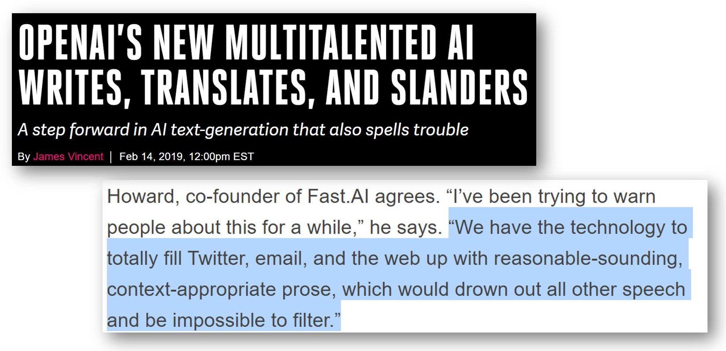
https://transformer.huggingface.co/doc/distil-gpt2

Slide 14
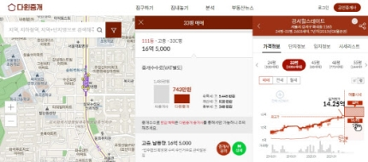
네이버, 다윈중개 크롤링 차단…소송도 검토

Slide 15
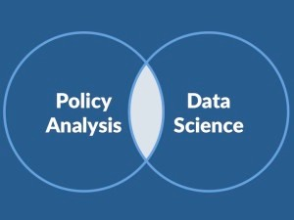
Welcome
This course focuses on applications of big data tools to
public policy analysis
Goals:
Understanding Big Data
Exercise some skills
Link Big Data and Public Policy
Put it to work on a real-world policy project.
.
12/48

Slide 16
Objectives
What is “Big Data”?
What are new and nontraditional sources of data?
API’s, web scraping, etc.
What are the advantages and disadvantages of using large or new sources of data?
new problems
new solutions
What are the technical, ethical and legal constraints of using large data sources?
13/48

Slide 17
Outline
Class Organization and Logistics
Motivations
Project Management

Slide 18
Lecture Times
Wednesdays, 1:00pm-4pm
Location: Online first
Office hours:
Mondays, or by appointment (moonbg@skku.edu)

Slide 19
Course outline
Course Syllabus

Slide 20
Lecture Slides
Additional Materials on Python(Anaconda), STATA, and R
Some Examples and Assignments
Middle Final Paper

Slide 21
Spirit of the class
Learning
by searching and doing
Understanding Unique Features of Big data and Public Policy

Slide 22
Outline
Class Organization and Logistics
Motivations
Project Management

Slide 23
Motivations
We are seeing a revolution in policy analysis...
new datasets: administrative microdata, digitization of text archives, social media
new methods: causal inference, natural language processing, data mining, merging
26/48

Slide 24
Motivations
We are seeing a revolution in policy analysis...
new datasets: administrative microdata, digitization of text archives, social media
new methods: causal inference, natural language processing, machine learning
.
.. which contribute to tackle forecasting and public policy
evaluation with a new angle
26/48

Slide 25
Motivations
We are seeing a revolution in policy analysis...
new datasets: administrative microdata, digitization of text archives, social media
new methods: causal inference, natural language processing, machine learning
.
.. which contribute to tackle forecasting and public policy
evaluation with a new angle
New possibilities: exciting!
26/48

Slide 26
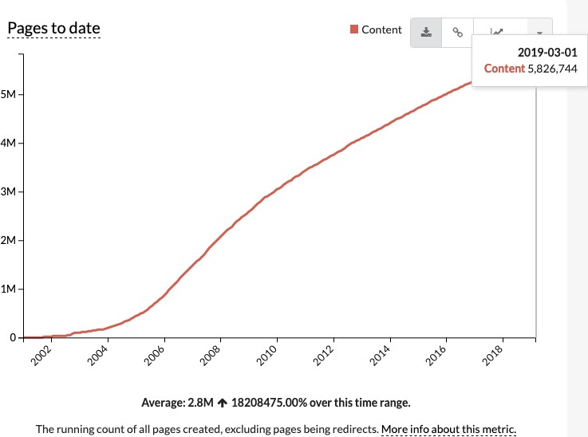
# of Wikipedia Pages, 2001-2019

Slide 27
Big Data Definition
“Big Data” is data whose scale, diversity, and complexity require new architecture, techniques, algorithms, and analytics to manage it and extract value and hidden knowledge from it…
Big data analytics examines large and different types of data to, uncover hidden patterns , correlations and other insights.

Slide 28
“Big data is high-volume, high-velocity and high-variety information assets that demand cost-effective, innovative forms of information processing for enhanced insight and decision making.” -- Gartner
While enterprises struggle to consolidate systems and collapse redundant databases to enable greater operational, analytical, and collaborative consistencies, changing economic conditions have made this job more difficult. E-commerce, in particular, has exploded data management challenges along three dimensions: volumes, velocity and variety. In 2001/02, IT organizations much compile a variety of approaches to have at their disposal for dealing each.” – Doug Laney

Slide 29
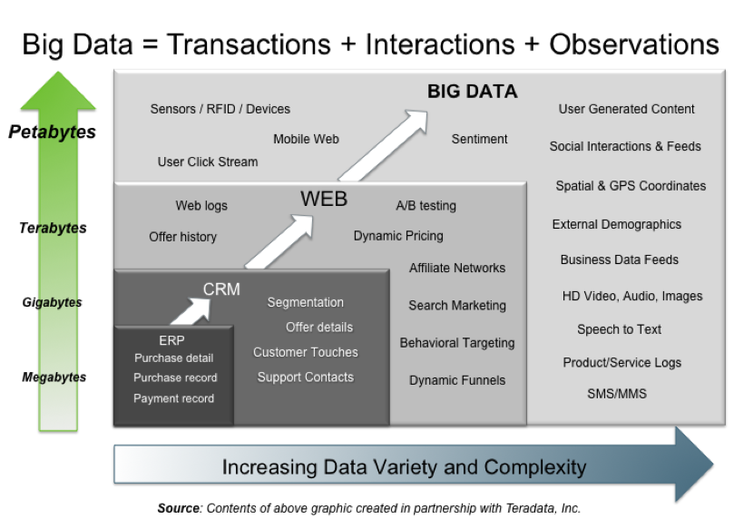
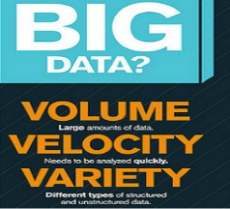
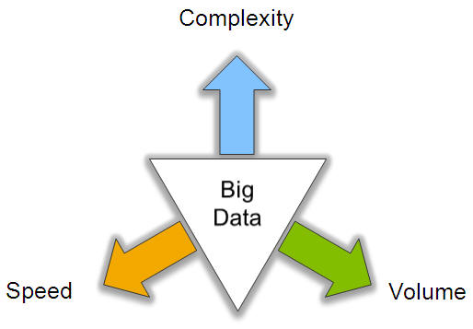
Big Data: 3V’s

Slide 30
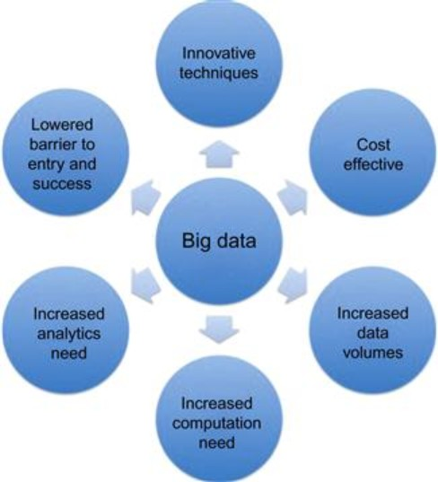

Slide 31






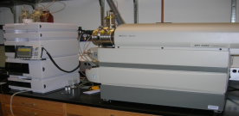
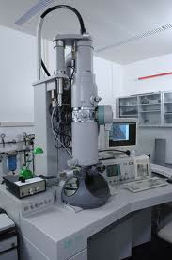
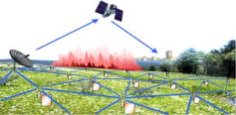

Who’s Generating Big Data
Mobile devices
(tracking all objects all the time)
Social media and networks
(all of us are generating data)
Scientific instruments
(collecting all sorts of data)
Sensor technology and networks
(measuring all kinds of data)
The progress and innovation is no longer hindered by the ability to collect data
But, by the ability to manage, analyze, summarize, visualize, and discover knowledge from the collected data in a timely manner and in a scalable fashion

Slide 32
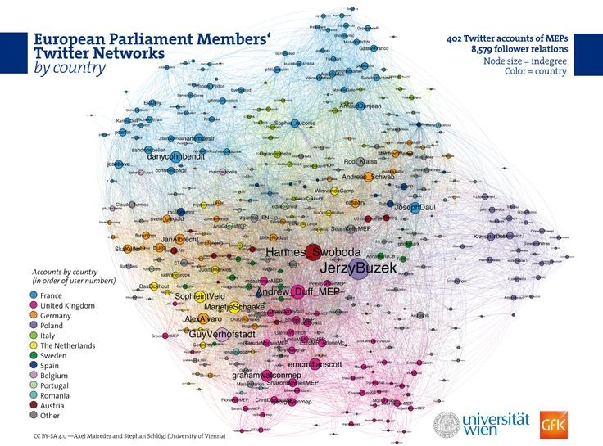
New Data, New Possibilities

Slide 33
What is Big Data?
Volume of data
Format:
Structured
Unstructured
Ready made vs. custommades
⇒ data will be even more important for policy making analyses

Slide 34
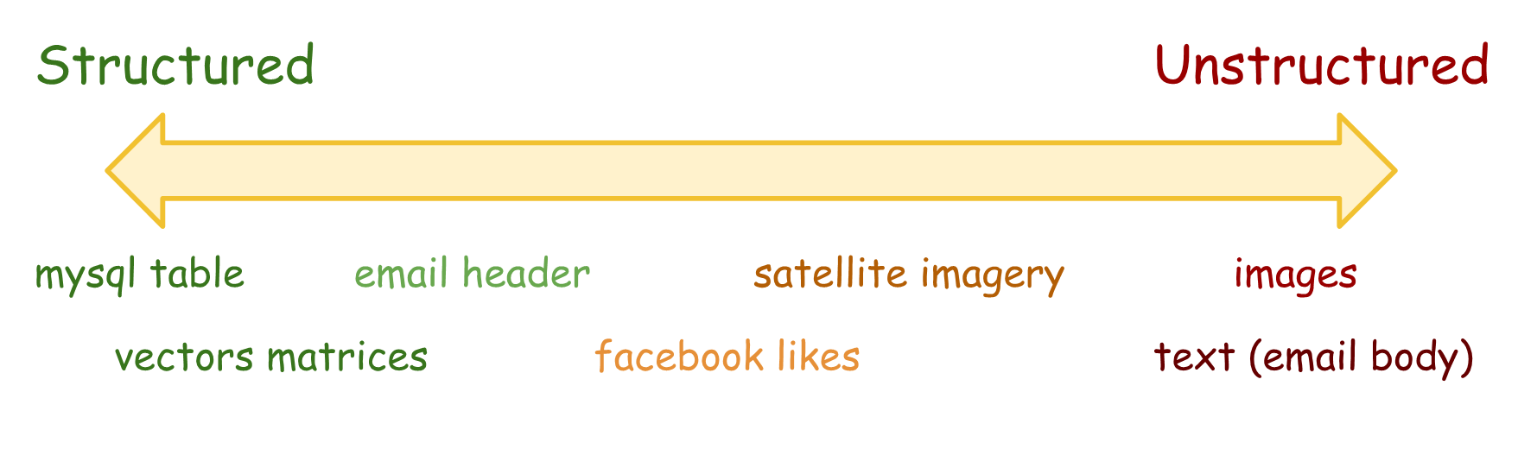

Slide 35
New Tools and Methods
Data collection (eg. APIs, webscraping)
Analysis (e.g. text analysis, machine learning)
Visualization (e.g, maps, GIS)

Slide 36
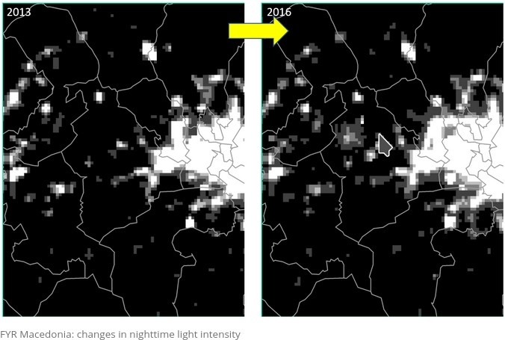
New Measurements
Source: World Bank.

Slide 37
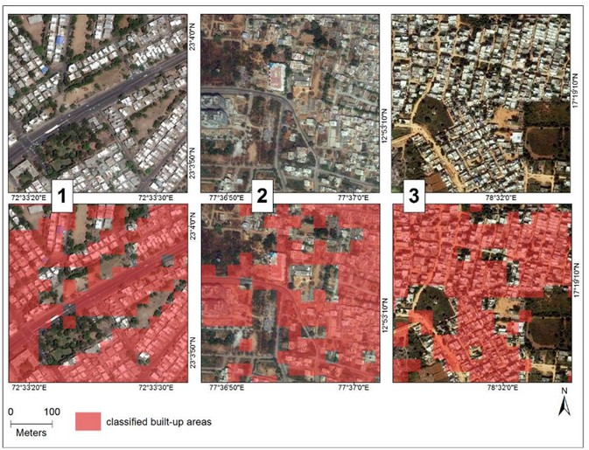
New Measurements
Source: World Bank.

Slide 38
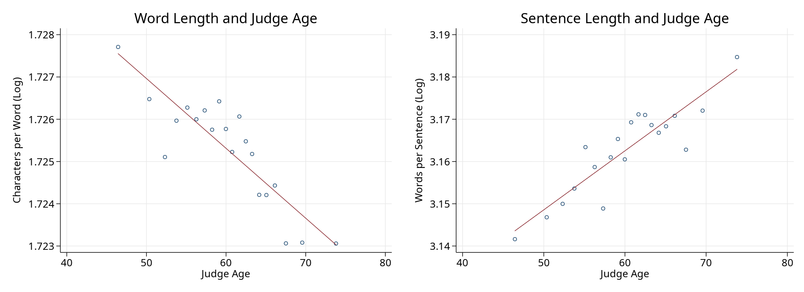
Judge Age and Writing Style
Ash and MacLeod (2020)

Slide 39
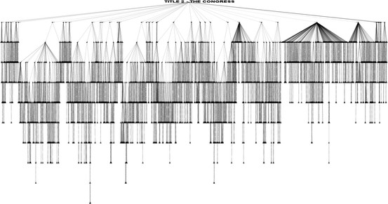
Complexity Analysis of Legislation
The U.S. Code consists of 49 titles, which can be further
subdivided into subtitle, chapter, subchapter, part, subpart, section, subsection, paragraph, subparagraph, clause, and subclause (Katz and Bommarito 2014)
35/48

Slide 40
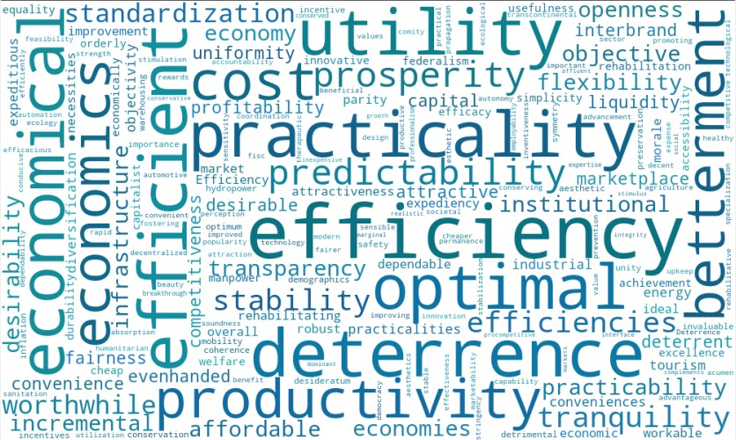
Impact of Economics Training on Economics Language
Effect: Case Similarity to Ellickson Law-Econ Word Vector
-.04 -.02 0 .02 .04 .06
-6 -5 -4 -3 -2 0 1 2 3 4 5
Years Before and After Manne Attendance
6
After attendance, Economics Trained Judges increase use of a selection of terms related to law and economics (Ash, Chen, and Naidu 2019)

Slide 41
Measuring uncertainty in macroeconomy
Baker, Bloom, and Davis (2016)
Baker, Bloom, and Davis measure economic policy uncertainty using Boolean search of newspaper articles.
37/48

Slide 42
Measuring uncertainty in macroeconomy
Baker, Bloom, and Davis (2016)
Baker, Bloom, and Davis measure economic policy uncertainty using Boolean search of newspaper articles.
For each newspaper on each day since 1985, submit the following query:
1. Article contains “uncertain” OR “uncertainty”, AND
2. Article contains “economic” OR “economy”, AND
3. Article contains “congress” OR “deficit” OR “federal reserve” OR “legislation” OR “regulation” OR “white house”
37/48

Slide 43
Measuring uncertainty in macroeconomy
Baker, Bloom, and Davis (2016)
Baker, Bloom, and Davis measure economic policy uncertainty using Boolean search of newspaper articles.
For each newspaper on each day since 1985, submit the following query:
1. Article contains “uncertain” OR “uncertainty”, AND
2. Article contains “economic” OR “economy”, AND
3. Article contains “congress” OR “deficit” OR “federal reserve” OR “legislation” OR “regulation” OR “white house”
Normalize resulting article counts by total newspaper articles that month.
37/48

Slide 44
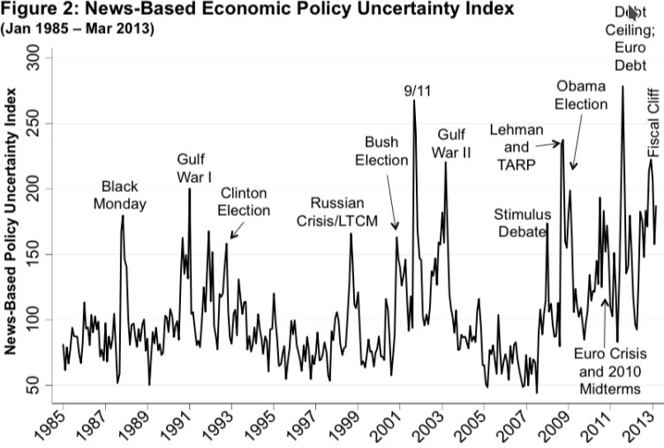
Measuring uncertainty in macroeconomy

Slide 45
Predicting U.S. Asylum Court Decisions
 |  | Predicted
 |  | Denied | Granted
True | Denied | 195,223 | 65,798
 | Granted | 73,269 | 104,406
Accuracy = 68.3%, F1 = 0.60
Prediction App (Beta):
https://floating-lake-11821.herokuapp.com/

Slide 46
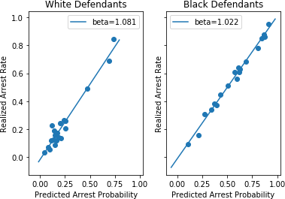
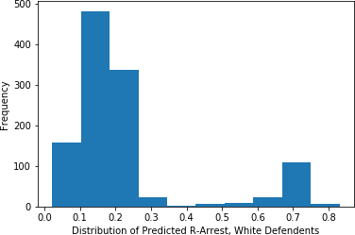
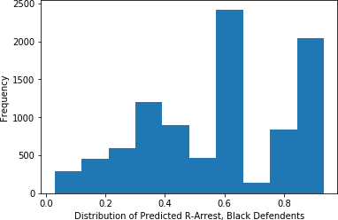
Predicting Re-Arrest, New Orleans Prosecutor Office
Amaranto, Ash, Chen, Ren, and Roper (2018)

Slide 47
Algorithms can correct for biases in human decision-making:
for judges: all defendants get the same decision for the same evidence.
41/48

Slide 48
Algorithms can correct for biases in human decision-making:
for judges: all defendants get the same decision for the same evidence.
What about systematic biases?
e.g., those leading to racial disparities.
41/48

Slide 49
Algorithms can correct for biases in human decision-making:
for judges: all defendants get the same decision for the same evidence.
What about systematic biases?
e.g., those leading to racial disparities.
There is a risk these could be reproduced or even amplified by the algorithm.
41/48

Slide 50
Algorithms can correct for biases in human decision-making:
for judges: all defendants get the same decision for the same evidence.
What about systematic biases?
e.g., those leading to racial disparities.
There is a risk these could be reproduced or even amplified by the algorithm.
But algorithms can also be used to detect systematic bias, to
understand it – and therefore to help reduce it.
41/48

Slide 51
Interpretable Machine Learning
Key point:
Standard machine learning techniques cannot be interpreted easily.
42/48

Slide 52
Interpretable Machine Learning
Key point:
Standard machine learning techniques cannot be interpreted easily.
Users and decision subjects want to understand the model
42/48

Slide 53
Interpretable Machine Learning
Key point:
Standard machine learning techniques cannot be interpreted easily.
Users and decision subjects want to understand the model
Other models/approaches improve interpretability:
Random Forests provide feature importance ranking.
LIME and related tools can help interpret any model (Ribeiro et al 2016).
42/48

Slide 54
Econometrics (applied statistical causal inference):
y is one-dimensional, x is low-dimensional.
estimate a low-dimensional
causal parameter ρ using
yi = αi + xi · ρ + gi
where i indexes over documents, αi includes control variables (and fixed effects), · is dot product, and gi is the error residual.
ρ gives a prediction how outcome y would change if treatment variable x were exogenously shifted.
useful for policy evaluation.
43/48

Slide 55
Machine learning:
y can be multi-dimensional,
x can be high-dimensional.
learn a high-dimensional
vector of parameters θ to approximate a (potentially non-linear) function
yi = h(x ; θ)
that predicts y given covariates x .
x , we could predict the associated yˆ.
43/48

Slide 56
Machine learning:
but h(·) does not provide a
counterfactual prediction – that is, how the outcome would change if x ’s were exogenously shifted.
43/48

Slide 57
Objectives
1. What is the policy problem or research question?
44/48

Slide 58
Objectives
What is the policy problem or research question?
Corpus and Data:
obtain, clean, preprocess, and link.
Produce descriptive visuals and statistics on the text and metadata
44/48

Slide 59
Objectives
What is the policy problem or research question?
Corpus and Data:
obtain, clean, preprocess, and link.
Produce descriptive visuals and statistics on the text and metadata
Machine learning:
Select a model and train it.
Fine-tune hyperparameters for out-of-sample fit.
Interpret predictions using model explanation methods.
44/48

Slide 60
Objectives
What is the policy problem or research question?
Corpus and Data:
obtain, clean, preprocess, and link.
Produce descriptive visuals and statistics on the text and metadata
Machine learning:
Select a model and train it.
Fine-tune hyperparameters for out-of-sample fit.
Interpret predictions using model explanation methods.
Empirical analysis
Produce statistics or predictions with the trained model.
Solve the problem / Answer the research question.
44/48

Slide 61
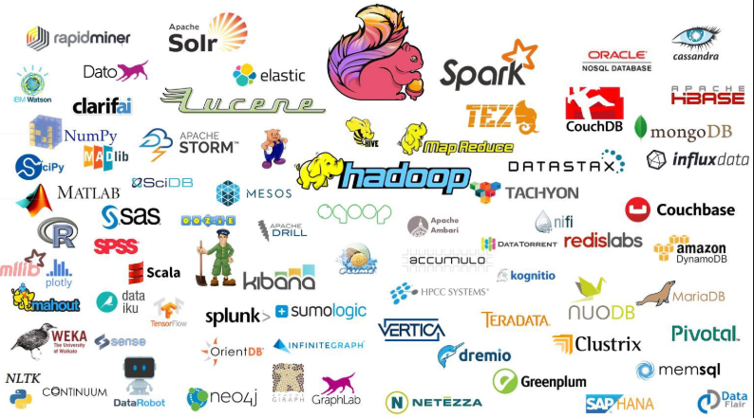
Big Data Landscape

Slide 62
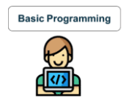
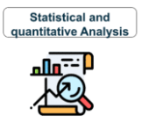
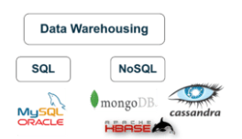
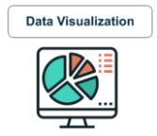


Skills

Slide 63
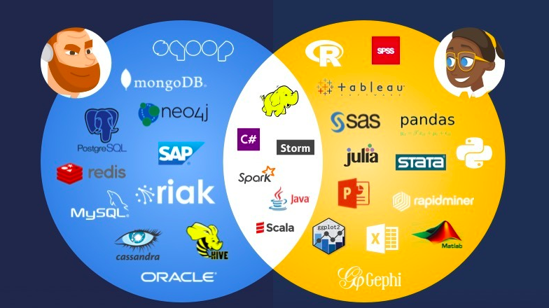
Notes:
https://www.datacamp.com/community/blog/data-scientist-vs-data-engineer

Slide 64
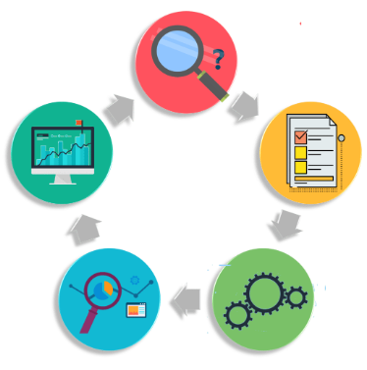





Stages in Big Data Analytics
Notes:
https://www.edureka.co/blog/big-data-analytics/

Slide 65
Data Sets
https://www.kaggle.com/datasets
https://archive.ics.uci.edu/ml/datasets.html
https://opendata.com.pk/
http://www.kdnuggets.com/2011/02/free-public-datasets.html
http://aws.amazon.com/publicdatasets/
http://www.quora.com/Where-can-I-find-large-datasets-open-to-the-public
http://stackoverflow.com/questions/2674421/free-large-datasets-to-experiment-with-hadoop
http://www.ll.mit.edu/mission/communications/cyber/CSTcorpora/ideval/data/
http://www.gapminder.org/data/
https://data.worldbank.org/

