Slide 1
Solid Recover: A Unified Framework for Multi-Omics Data Analysis

Slide 2
Fig 1. Method Overview

Slide 3
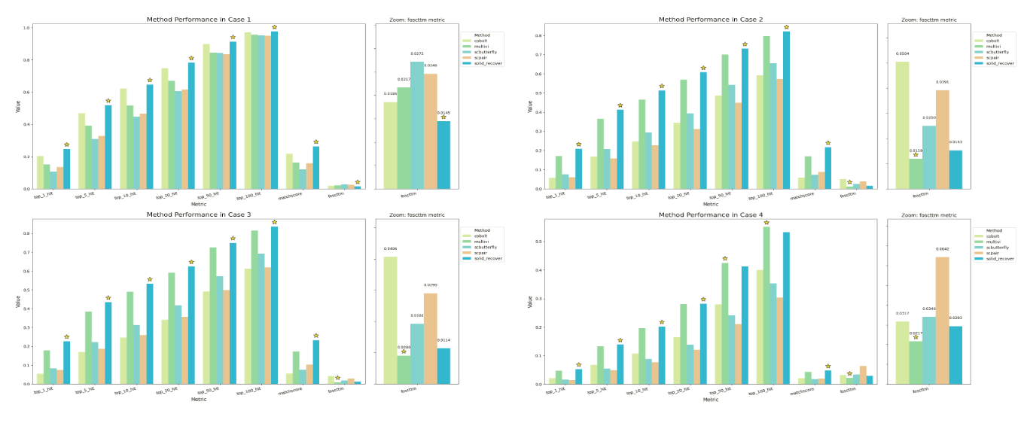
Fig 2. Cross modality retrieval
Case 1: 10X 海马
Case2: 八个脑区
Case3: 八个脑区+10X海马
Case4: 八个脑区→ 10X海马
a

Slide 4
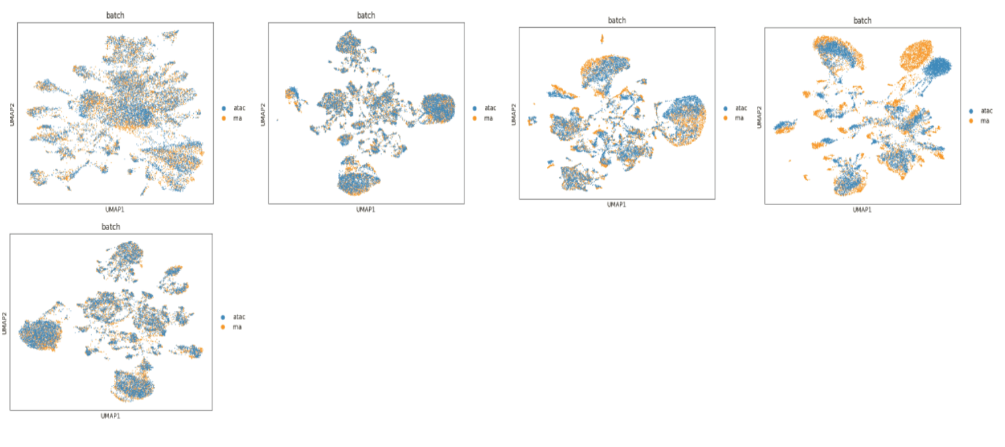
Case 2: 单细胞多脑区多组学数据，cobolt, multivi, scbutterfly, scpair, sr 结果展示
b
RNA UMAP with cell type annotation,
and ARI evaluation
ATAC UMAP with cell type annotation,
and ARI evaluation
SR UMAP with cell type annotation,
and ARI evaluation

Slide 5
c
BMMC数据集上，SR生成的多组学embedding 在ARI, ASW等指标上相较原始RNA,ATAC的embedding 的提升，柱状图展示

Slide 6
Fig 2: cross modality prediction
a
ATAC2RNA evaluation
RNA2ATAC evaluation
b
DEG heatmap of ori data
DEG heatmap of imputed data

Slide 7
Fig 3: GRN inference of sr
a
Sr GRN inference overview
b
Sr GRN inference evaluation
c
d
GRN visualization
GRN result analysis, biological insights

Slide 8
Fig 4: Single omic pretrain

Slide 9
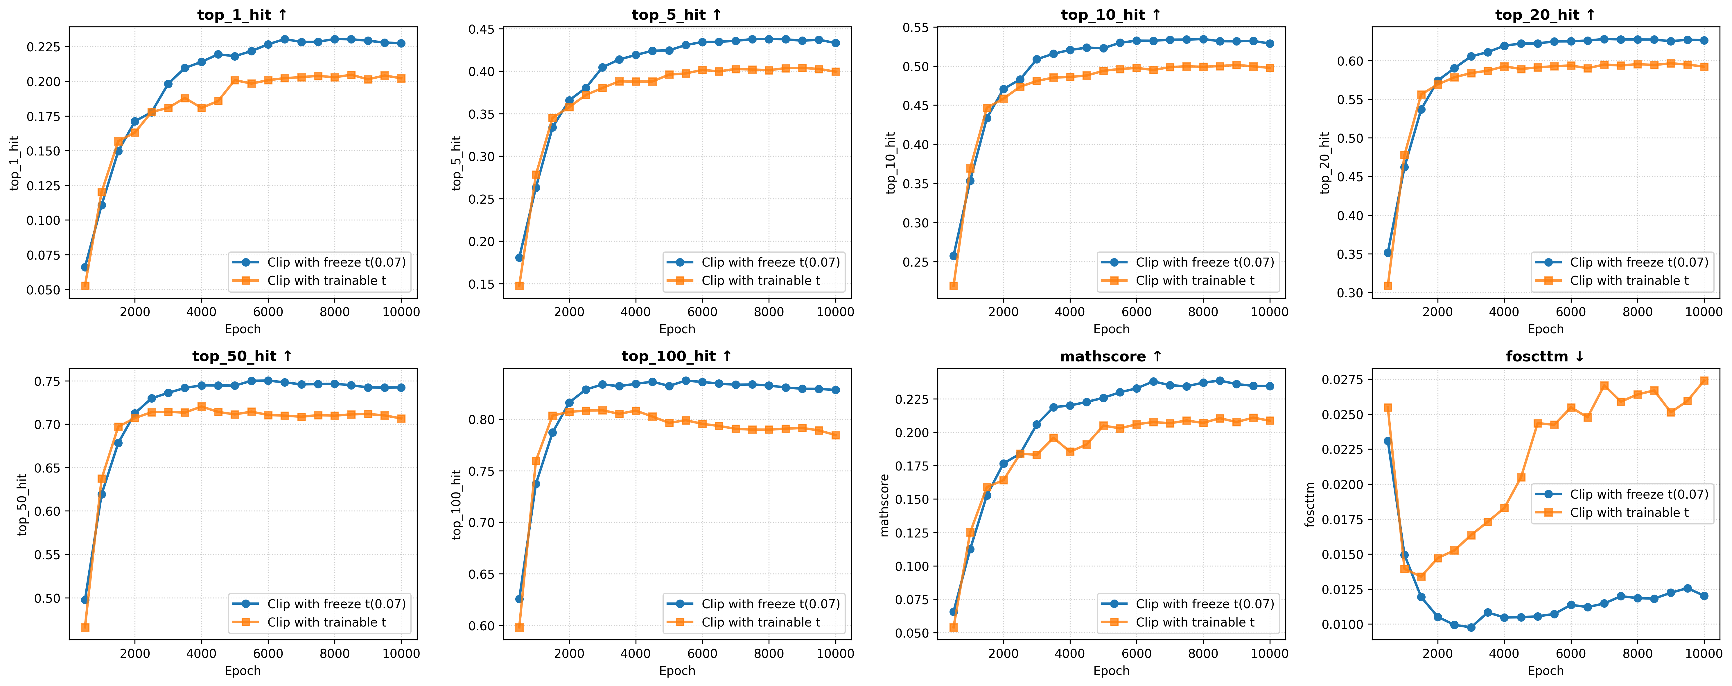
附属材料
模型消融，可变温度t, freeze t 表现更好，可变温度训练中逐渐提升，容易过拟合

Slide 10
嵌入维度：说明SR 即使在较小的唯独下也具有更好的性能

