Slide 1

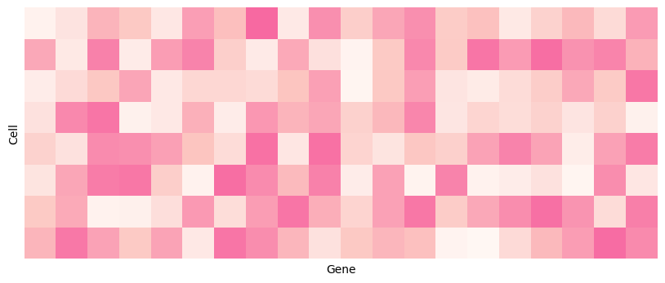

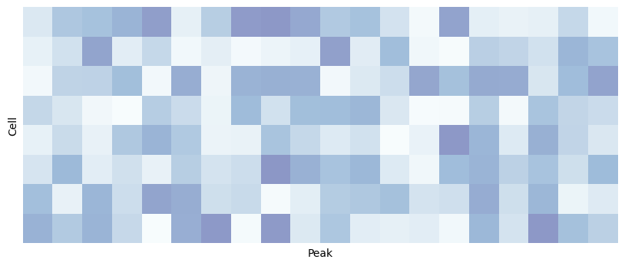
Data Input
Solid Recover Framework
scRNA-seq
scATAC-seq
Contrastive Learning
Downstream Analysis

Slide 2
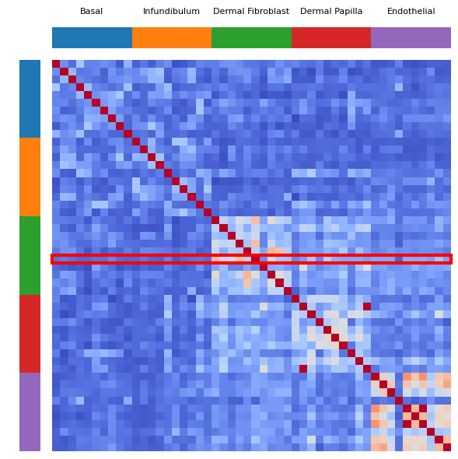
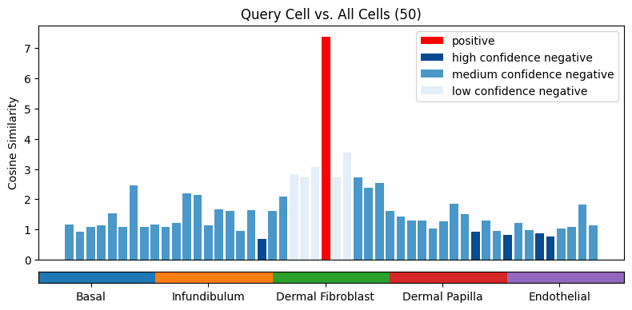
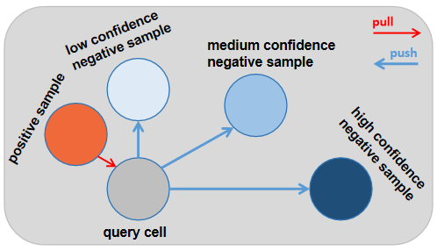


Weighted Clip Loss

Slide 3
low confidence negative sample
pull
medium confidence negative sample
push
positive sample
high confidence negative sample
query cell

Slide 4
