Slide 1
ECE2071 Project
Team F08

Slide 2
Introduction

Slide 3
Introduction and project task overview
This project develops a two-STM32 audio recording system that captures sound through an ADC,
processes the sampled data, and then sends it to a computer for storage and playback.
Tasks:
Task 1: Create a 2-stm32 MVP that records in a sampling STM, sends to a processing STM, and finally to a python script as a .wav file
Task 2: Create an interface in Python (CLI), add features based on proximity (USS), bonus features for analysis
Task 3: Improve the audio quality to 10 bits, at a sampling of 44.1ksps, down-sampling and outlier rejection
Task 4: Improve the audio quality to 12 bits at a sampling of 44.1ksps+

Slide 4
Task 1 (MVP)

Slide 5
Task 1 (MVP)
Sampling STM:
• Captures biased audio input using the ADC and transmits the sampled data to the Processing STM through SPI. (aiming for task 4 done)
Processing STM:
• Receives the samples, applies a length-2 moving average filter, and forwards the processed data to the PC through USART2.
Python Script:
• Reads the incoming serial data, converts it into audio samples, and saves the result as a .wav file.

Slide 6
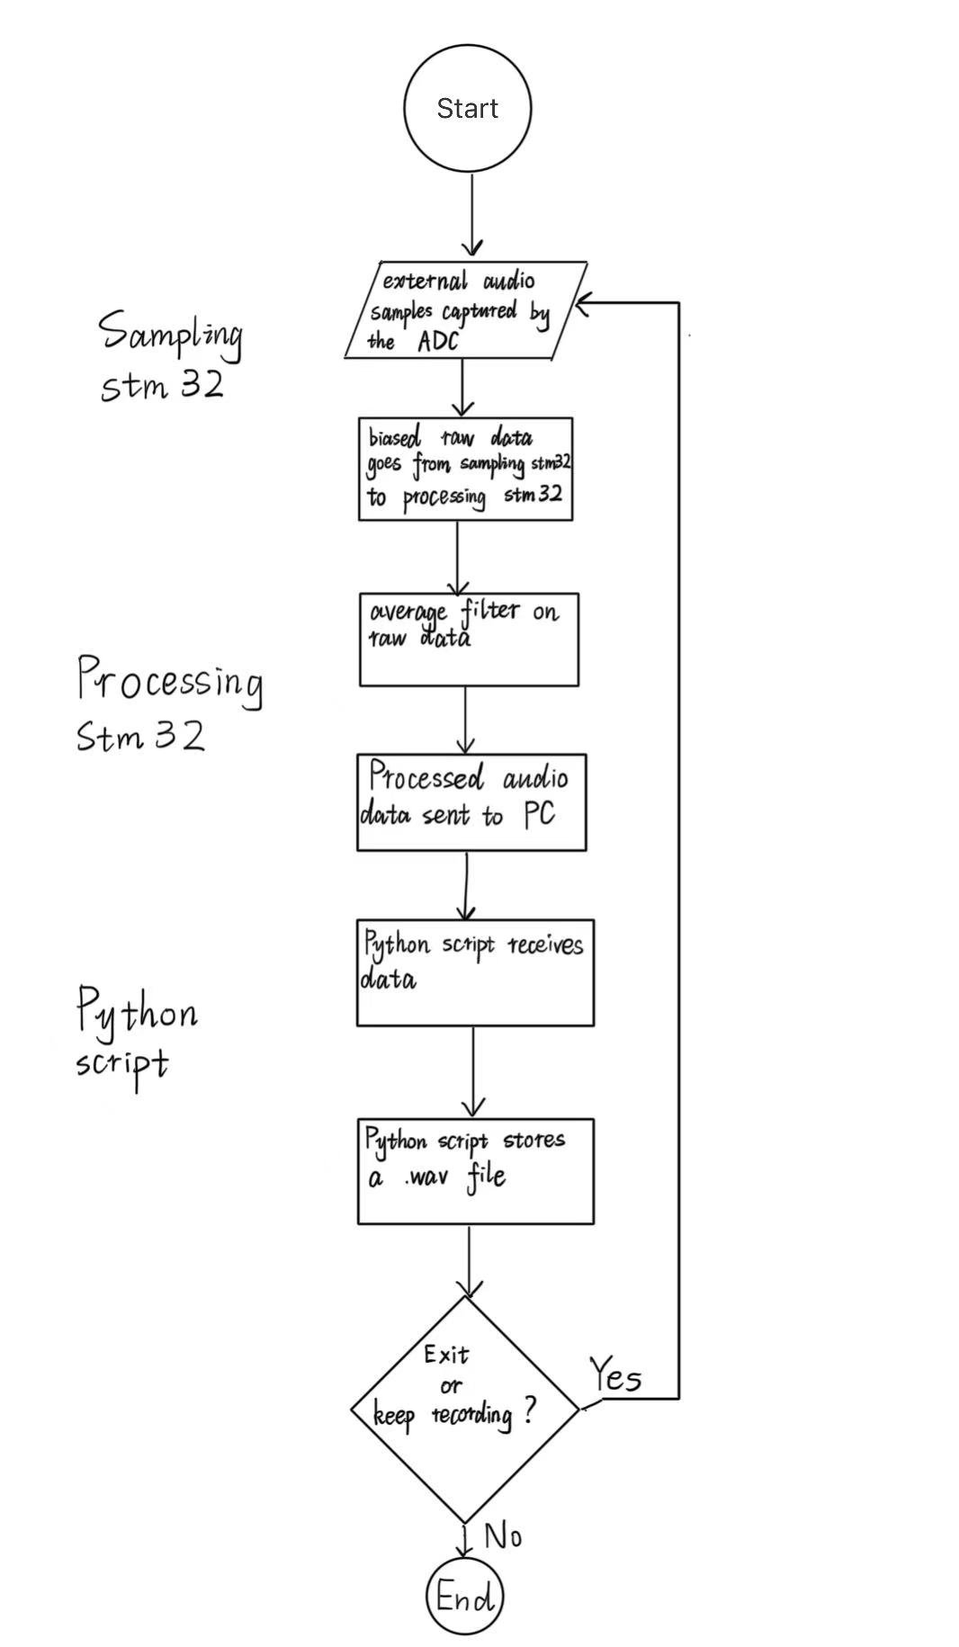
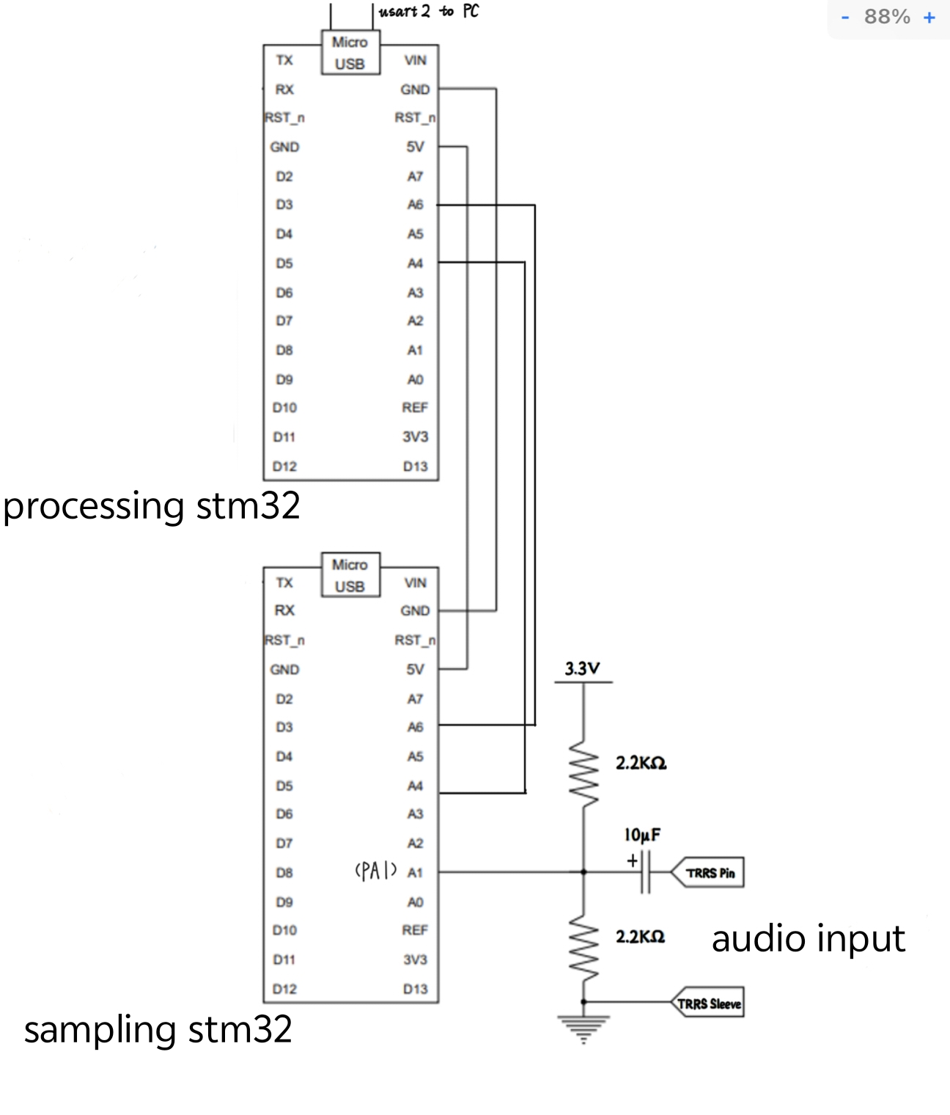
Stm32 diagram

Slide 7
Task 2
Python interface CLI
(User interface and modes)

Slide 8
Task 2 (user interface and modes)
CLI Interface
• Extends the Python script into a user-controlled interface.
• Supports audio export types as .wav, .png, and .csv waveform files.
• Adds two operating modes: “Manual Recording Mode” and “Distance Trigger Mode”.
• Manual Mode records for a user-specified duration.
• Distance Trigger Mode uses an ultrasonic sensor to automatically record when an object is within the selected range, and when the object leaves the range, the recording stops after a short delay, while the system remains ready to trigger again.

Slide 9
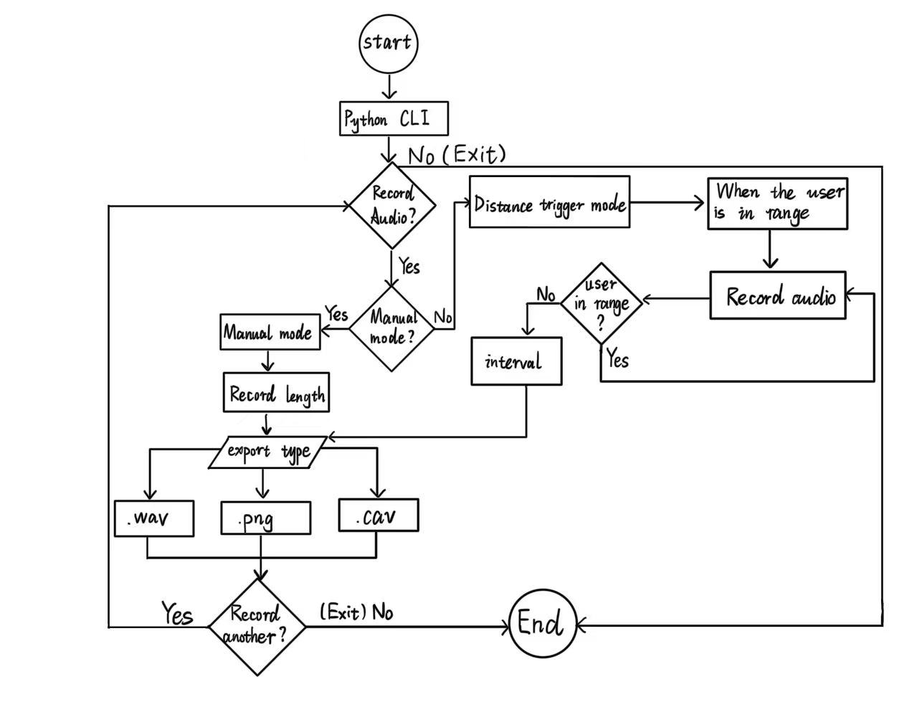
Task 2 block diagram (CLI)

Slide 10
Task 3
Audio improvements

Slide 11
Task
Adding content

Slide 12
Task 4
Further audio improvements

Slide 13
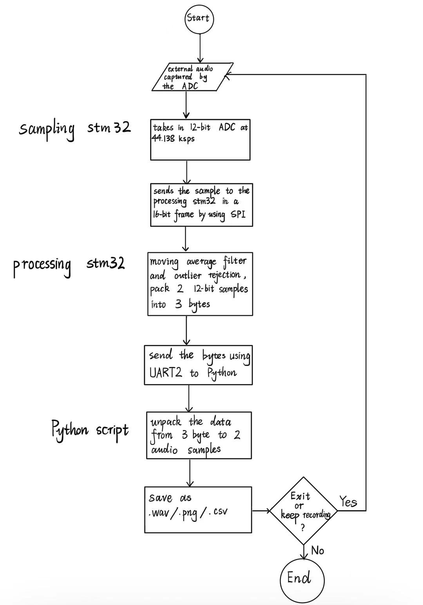
Task 4 block diagram
Sampling STM:
takes in 12-bit ADC at 44.138 ksps, using SPI to send sample to process in a 16-bit frame
Processing STM:
filters the sample using moving average and outlier rejection then pack two 12bit sample into 3 byte and sends bytes using UART2 to python

Slide 14
Thx

