Slide 1
模型特点
系统依赖图
控制逻辑元模型
元模型 1
…
元模型 n
系统行为（事件触发条件、状态）
通信模式、同步方式
通信协议
群体模型生成
事件触发、
通信任务协同
资源约束模块
形式化通信方式
约束 1
…
约束 n

Slide 2
复杂工控系统
结构体系
系统特性
元模型
系统层
异构式并发性
多并发模型
场景层
实时控制
事件驱动
层次精化
功能层
触发事件、通信
系统逻辑描述
配置层
异构模块特性
资源约束
系统环境
异构式计算模块
系统物理资源
资源约束

Slide 3
Complex System
Architectural
Characteristic
Model
System Layer
Concurrency
Multi model
Refine
Scene Layer
Real-control
Event-driven
Function Layer
Communication
System logic
Confuguration Layer
Event-Triggered
Resource
System Environment
Controller
System Resources
resource constraint

Slide 4
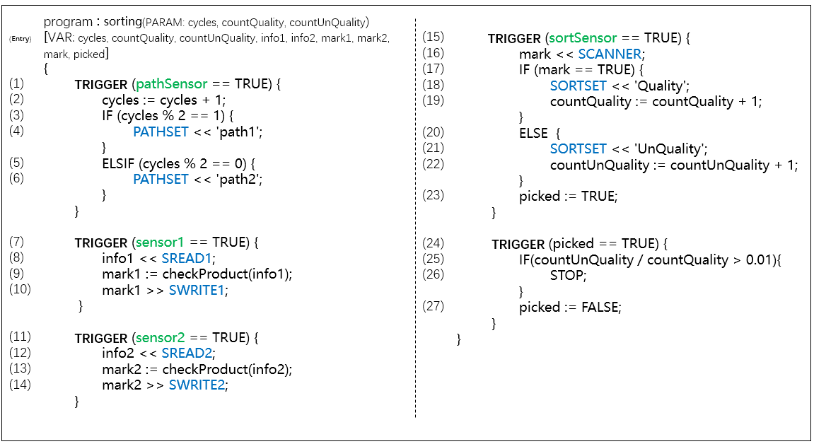
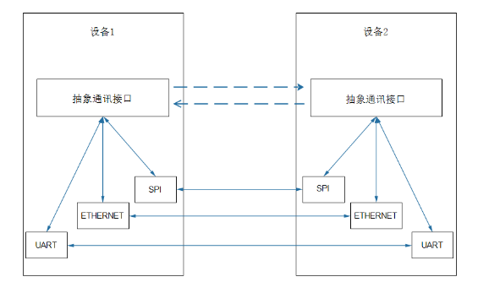

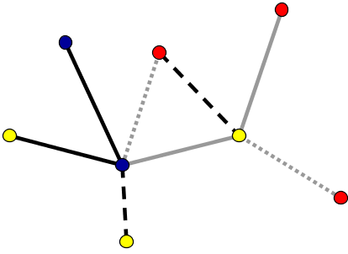
关键技术 -多平台环境协作式异构计算操作系统实现技术
协作式异构程序
C
TRIGGER(CHANNEL.CD.?3){
PATHSET<<'path2';
CHANNEL.CD.!4
}
TRIGGER(CHANNEL.CD.?1){
PATHSET<<'path1';
CHANNEL.CD.!2
}
TRIGGER(sensor1==TRUE){
CHANNEL.CD.!5;
}
TRIGGER(sensor2==TRUE){
CHANNEL.CD.!7;
CHANNEL.CD.!6;
}
对等式异构计算
抽象接口简单
无平台限制
轻量化
通讯链路多样化
TrusLinkOS
TrusLinkOS
程序拆分
抽象通讯接口
资源约束
程序拆分
模型映射
B
TRIGGER(pathSensor==TRUE){
cycles:=cycles+1;
IF(cycles%2==1){
CHANNEL.CD.!1;
CHANNEL.CD.?2;
}
ELSIF(cycles%2==0){
CHANNEL.CD.!3;
CHANNEL.CD.?4;
}
}
TRIGGER(picked==TRUE){
SYNC.DATA.2:countQuality;
SYNC.DATA.2:countUnQuality;
IF(countUnQuality/countQuality>0.01){
STOP;
}
picked:=FALSE;
}
程序拆分
协作通讯链路
模型映射
ARM Cortex-M4
ARM Cortex-M4
ZYNQ 7000
FPGA
A
TRIGGER(CHANNEL.CD.?6){
CHANNEL.DD.?1:info2;
mark2:=checkProduct(info2);
mark2>>SWRITE2;
}
TRIGGER(sortSensor==TRUE){
mark<<SCANNER;
IF(mark==TRUE){
countQuality:=countQuality+1;
CHANNEL.CD.!8;
CHANNEL.CD.?9;
}
ELSE{
countUnQuality:=countUnQuality+1;
CHANNEL.CD.!10;
CHANNEL.CD.?11;
}
picked:=TRUE;
}
转译部署
PPC 460
ZYNQ 7000
FPGA
STM32-429
ARM Cortex-M4
PPC 460

Slide 5
Resources
Devices .etc
Controller A
Controller B
Model generation
IMCL-PC
Model
Network Protocol
Communication
mode
communication
mode
System Scenes
IMCL Model
SPI
SPI
Event
Communication
Platform mapping
Systemg mechanism
Model
generation
ETHERENT
ETHERENT
Platform
Multiplex controller
UART
UART
Model
generation
IMCL-PLC
Model
Communication mapping
IMCL-FPGA
Model
ZYNQ 7000
FPGA
ARM Cortex-M4
ARM Cortex-M4
Platform mapping
STM32-429
Platform mapping
PPC 460
Configuration
for platforms
ZYNQ 7000
FPGA
. . .
. . .

Slide 6
Resources
资源管理
Resources
Devices .etc
System Scenes
复杂系统场景
IMCL Model
Event
driving
Communication synergy
IMCL Model
事件驱动机制
通信协同机制
Systemg mechanism
Platform
Multiplex controller
系统功能业务
平台
多异构处理模块

Slide 7
Library
Resource Definition
Entity
System
Architecture
IMCL Model
VHDL
Event
IMCL
Structure
Communication
Dataflow
Resource scheduling
Behavior
Configuration
Resource Constraint
IMCL对VHDL描述电路建模原理

Slide 8
VHDL
IMCL
LIBRARY IEEE;
USE IEEE_STD_LOGIC_1164.ALL;
ENTITY mux21 IS
PORT(a, b, s:IN STD_LOGIC;
Y: OUT STD_LOGIC)
END mux21;
ARCHITECTURE behavior OF mux21 IS
BEGIN
PROCESS(a, b, s)
IF (s = ‘0’) THEN y <= a;
ELSE y <= b;
END PROCESS;
END;
PORT: IN_a, IN_b, IN_s, OUT_y;
program : mux21()
[VAR: LOGIC_a, LOGIC_b, LOGIC_s, LOGIC_y]{
TRIGGER (TRUE){
LOGIC_a << IN_a;
LOGIC_b << IN_b;
LOGIC_s << IN_s;
IF (LOGIC_s == '0’){
LOGIC_a >> LOGIC_y;
}
ELSE{
LOGIC_b >> LOGIC_y;
}
}
}
constraint: FPGA{IN_a, IN_b, IN_s, OUT_y};
资源
https://wenku.baidu.com/view/a5a83bbd7fd5360cba1adbd3.html
库
实体
事件
a
架构
b
mux21
y
s
约束

Slide 9
资源统一描述
CPU
Resource Definition
Internal processing stage
Communication service phase
Input processing stage
Program processing stage
Output stage
System
IMCL Model
Input interface module
Output interface module
Event
IMCL
PLC
Communication
Resource scheduling
（LR/IL/FBD/SFC/ST）
Resource Constraint
external device
Notes:
Internal processing stage
Communication service phase
Input processing stage
Program processing stage
Output stage

Slide 10
z_Start
X0
Y0
电机
z_Stop
PLC
S7-300
X1
Com
Com1
220V
PLC的梯形图LD程序
IMCL模型
DEVICE: IS1, IS2, z_Montor;
program: T1(PARAM:status)[]{
TRIGGER (IS1 == TRUE){
IF (status == FALSE){
status := TRUE;
status >> z_Montor;
}
}
TRIGGER (IS2 == TRUE){
IF (status == TRUE){
status := FALSE;
status >> z_Montor;
}
}
}
constraint: PLC{IS1, IS2, z_Montor};
T1
IS1开启按钮
“z_Start”
Montor电机
“z_Montor”
S_ODBS
S
Q
S5T#5S
TY
IS2关闭按钮
“z_Close”
BI
…
R
BCD
…

Slide 11
Event task 1
Event task 2
Event task 3
Resource Definition
Thread
#1
Thread
#2
……
Thread
#n
System
IMCL Model
PC
communication
Data Area
communication
Event
IMCL
CPU
Instruction Area
Communication
Resource scheduling
Devices
Resources
Resource Constraint

Slide 12
triggerDefine : 'TRIGGER' '('conditionExpr')' '{'codeBlock+ '}'; codeBlock : assignDefine | whileDefine | ......; whileDefine : 'WHILE' '('conditionExpr')' '{'codeBlock+ '}'; assignDefine : varAtom ':=' conditionExpr ';' | ......; conditionExpr : varAtom op (varAtom| valueAtom) )* | ......;
TRIGGER
条件语句
循环语句
赋值语句
==
WHILE
:=
条件语句
赋值语句
mess
TRUE
==
:=
ret
FALSE
计算表达
TRUE
var1
*
var2
2
TRIGGER(mess == TRUE) { WHILE(ret == TRUE) { var1 := var2 * 2; } ret := FALSE; }
TRIGGER(mess == TRUE)
{
WHILE(ret == TRUE)
{
var1 := var2 * 2;
}
ret := FALSE;
}

Slide 13
triggerDefine
TRIGGER
( conditionExpr:1 )
{ codeBlock:3 codeBlock:1 }
varAtom == varAtom
WhileDefine
assignDefine : assignVariable
mess
TRUE WHILE ( conditionExpr:1 ) { codeBlock:1 } varAtom := conditionExpr:1 ;
varAtom == varAtom assignDefine:assignVariable ret varAtom
ret TRUE varAtom := conditionExpr:1 ; FALSE
var1 varAtom * valueAtom
var2 2

Slide 14
Controller A
Controller B
communication
mode
Communication
mode
SPI
SPI
ETHERENT
ETHERENT
UART
UART

Slide 15
FPGA
{ varA, result }
UART
<channel.DD.2, res>
SPI
<channel.DD.3, res>
<channel.DD.1, res>
{ varC, res }
{ varB, res }
PC
PLC

Slide 16
FPGA Model
PLC Model
PC Model
program:FPGA(VAR: res, varA){
TRIGGER(TRUE){
res:=4;
CHANNEL.DD.!2:res;
CHANNEL.DD.?1:varA;
WHILE(varA > 0){
res:=res+1;
varA:=varA-1;
}
CHANNEL.DD.!3:res;
}
}
program:PLC(VAR: res, varB){
TRIGGER(TRUE){
varB:=10;
CHANNEL.DD.?2:res;
IF(res % 2 == 1){
varB :=res+varB;
}
CHANNEL.DD.!1: varB;
}
}
program:PC(VAR:res, varC){
TRIGGER(TRUE){
CHANNEL.DD.?3:res;
varC :=res+varC;
varC>>Screen;
}
TRIGGER(TRUE){
if (varC > 100){
“Waring” >> Screen;
}
}
}

Slide 17
VHDL
61131-3
C
library IEEE;
use IEEE.STD_LOGIC_1164.ALL;
use IEEE.STD_LOGIC_ARITH.ALL;
use IEEE.STD_LOGIC_UNSIGNED.ALL;
entity UART is
Port (varA : out_uart : out INTEGER;
clock : in STD_LOGIC);
end UART;
entity SPI is
Port (varA : in_spi : out INTEGER;
out_spi : out INTEGER;
clock : in STD_LOGIC);
end SPI;
architecture Behavioral of FPGA_MAIN is
Variable varA, res: INTEGER;
begin
FPGA: process(clock)
begin
res:=4;
out_uart <= res; --// sent res
varA <= in_uart; --// receive varA
While varA > 0 Loop
res:=res+1;
varA:=varA-1;
End Loop;
out_spi <= res;
end process FPGA;
end Behavioral;
(* Function receive_SPI *)
FUNCTION receive_SPI : REAL
VAR_INPUT
fromId: REAL;
END_VAR
(* detail of the SPI that receive message*)
(* Function send_SPI *)
FUNCTION send_SPI : REAL
VAR_INPUT
to: REAL;
END_VAR
(* detail of the SPI that sent message*)
(* Main body of program*)
VAR
res, varB: REAL;
END_VAR
varB:=10;
res:= receive_SPI(2);
IF(res % 2 = 1) THEN
varB := res+vaarB;
END_IF
send_SPI(varB)
#include <pthread.h>
...
extern void receive_Uart(string &fromId);
extern void driver_Screen(Data &data);
void trigger1() {
res = receive_Uart(2);
varC = res + varc;
driver_Screen(varC);
}
void trigger2() {
if (varC > 100) {
driver_Screen("Warning");
}
}
int main(){
pthread_t t1, t2;
pthread_create(&t1, NULL, trigger1, NULL);
pthread_create(&t2, NULL, trigger2, NULL);
pthread_join(t1,NULL);
pthread_join(t2,NULL);
// ...
return 0;
}

