Slide 1
3D in the Browser with WebGL
Chad Moon
@moondev

Slide 2
Disclaimer: This is a birds eye view of the technology from the perspective of a web developer.
So what is WebGL?

Slide 3

WebGL: This Ain’t Your Grandma’s JavaScript!

Slide 4
What is it?
WebGL Extends JavaScript to allow generation of 3d graphics via the canvas element
Uses the power of your gpu for rendering
No plug-in needed!
Bleeding edge: 1.0 of spec released March 3, 2011

Slide 5
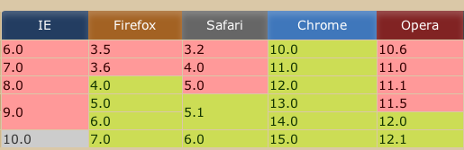
Browser Compatibility
* Safari support must be enabled via the command line

Slide 6
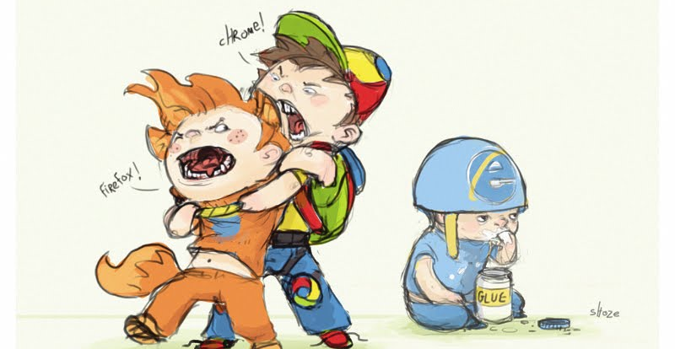
No IE support without a plugin

Slide 7
Very Low Level
Get canvas element with webgl context
Set viewport
Configure depth buffer
Create perspective matrix
Create modelview matrix
Create and compile shader and shader program
Create vertex array
Create and bind vertex buffer…
Notes:
----- Meeting Notes (8/5/11 11:56) -----
wrapper for opengl on the video card

Slide 8
Demo 1: A cube with raw webgl
http://moondev.net/webgl/demo1/
Looks 2d but is actually a 3d element unlit

Slide 9
WebGL Frameworks and Libs
C3DL – older, ported from canvas3d (precursor of webgl)
GLGE – “webgl for the lazy” uses node.js to build
Processing.js – js port of processing language
SceneJS – focuses on creation of scenes in js. Scene objects are json.
Copperlicht – primarily focused on loading pre-made models/scenes from 3d software
Three.js…

Slide 10

The Best!
Create a scene object
Create a camera object
Add models/items to scene
Add light(s) objects to scene
Render the scene (can also render to 2d canvas and svg)
Notes:
----- Meeting Notes (8/5/11 11:56) -----
uses more logical approach to 3d generation and abstracts the complex things for you.

Slide 11
Demo 2: Cube with three.js
http://moondev.net/webgl/demo2/
Much easier!

Slide 12
Demo 3: A lit sphere
http://moondev.net/webgl/demo3/

Slide 13
Demo 4: Dynamically adding spheres
http://moondev.net/webgl/demo4/

Slide 14
Demo 5: Animating
Avoid setInterval and use RequestAnimationFrame instead
Better performance and battery friendly animations!
Plays nice with other libraries like jQuery and sugar.js
http://moondev.net/webgl/demo5/

Slide 15
The Grand Finale
Recreate the “rutt-etra” video synthesizer effect on an image
Originally developed by Steve Rutt and Bill Etra in the 70’s
3d lines are drawn horizontally across image
The z value of the lines relates to how dark or light the pixel is
Creates a 3d effect from a 2d source

Slide 16
Demo 5
http://moondev.net/webgl/finale/
Modified from demo found at http://airtight.cc

Slide 17
More three.js Demos
http://mrdoob.github.com/three.js/examples/webgl_panorama_equirectangular.html
http://mrdoob.github.com/three.js/examples/webgl_materials_normalmap.html
http://mrdoob.github.com/three.js/examples/webgl_materials_shaders_fresnel.html
http://mrdoob.github.com/three.js/examples/webgl_materials_cubemap.html
http://mrdoob.github.com/three.js/examples/webgl_geometry_minecraft_ao.html

