Slide 1

GaitGuard: Real-Time Gait, Posture & Fatigue Monitor
Dongkun Moon (2020-13236) · SNU Mobile Computing and Its Applications (Spring 2026) · Prof. Youngki Lee

Slide 2

01 | MOTIVATION
Goal & Usage Scenario
The Problem
Target Users
Physical fatigue and poor posture accumulate silently in daily life — often undetected until injury occurs. Existing monitoring solutions require expensive dedicated wearables or constant internet connectivity.
🏃 Athletes
Monitor fatigue and asymmetry during training sessions
The Solution
🧓 Elderly Users
GaitGuard leverages the phone's built-in IMU sensors and camera to monitor gait patterns and posture in real time — fully on-device, no internet, no wearable required.
Fall risk detection and continuous gait health monitoring
💼 Office Workers
Real-time posture alerts for chronic spinal issue prevention

Slide 3

02 | CONCEPT
Key Idea: Two Simultaneous Sensing Modes
GaitGuard runs two independent pipelines in parallel on a Samsung Galaxy S22 — no cloud, no wearable, fully offline.
Mode A — IMU Gait Tracking
Mode B — Camera Posture Analysis
Accelerometer + gyroscope at 50 Hz
Outputs: composite fatigue score, fall risk level, stride symmetry
Phone in pocket, belt clip, or shirt pocket
ML Kit Pose Detection at 15 fps, 33 BlazePose landmarks
Outputs: shoulder level, kyphosis angle, pelvic tilt, asymmetry index, axial alignment
AR skeleton overlay on live camera feed
Both modes run fully on-device — no internet connection required at any point.

Slide 4
03 | GAIT MONITORING
App Functionality: Gait Monitoring
Sensor Pipeline
A 400-slot ring buffer stores [AccX, AccY, AccZ, GyroX, GyroY, GyroZ] at 50 Hz. Twelve hand-crafted features are extracted: cadence, ISI CV%, harmonic ratio, trunk tilt, arm swing, dominant frequency, band energy, symmetry score, and stance/swing ratio.
Composite Fatigue Score (0–100, every 2s)
55%
20%
15%
10%
TCN Output
ISI CV
Harmonic Ratio
Trunk Tilt
Safety Features
Terrain Classifier
Fall Detection FSM
Emergency SMS
Flat ground, stairs (up/down), incline, uneven terrain
Freefall (<0.5g for 200ms) + impact (>3g within 500ms) detection
Auto-sends caregiver GPS coordinates on confirmed fall

Slide 5
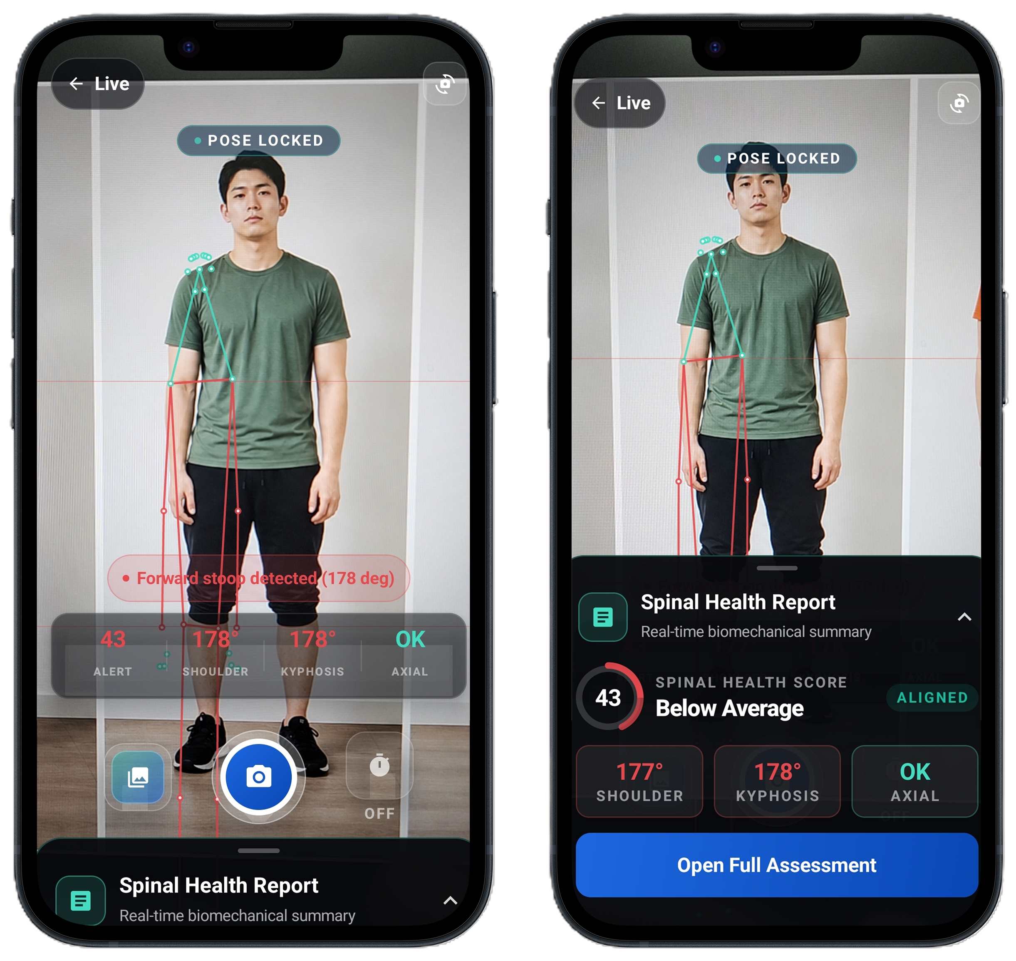
04 | POSTURE ANALYSIS
App Functionality: Posture Analysis
Camera Pipeline
5 Live Metrics Per Frame
01
Shoulder Level
Left/right shoulder height difference in degrees
02
Kyphosis Angle
Spinal curvature proxy via hip-shoulder-knee angle
03
Pelvic Tilt
Hip asymmetry in degrees
04
Asymmetry Index
Combined shoulder + pelvic deviation score (%)
05
Axial Alignment
Nose / shoulder / hip / ankle vertical deviation check

Slide 6
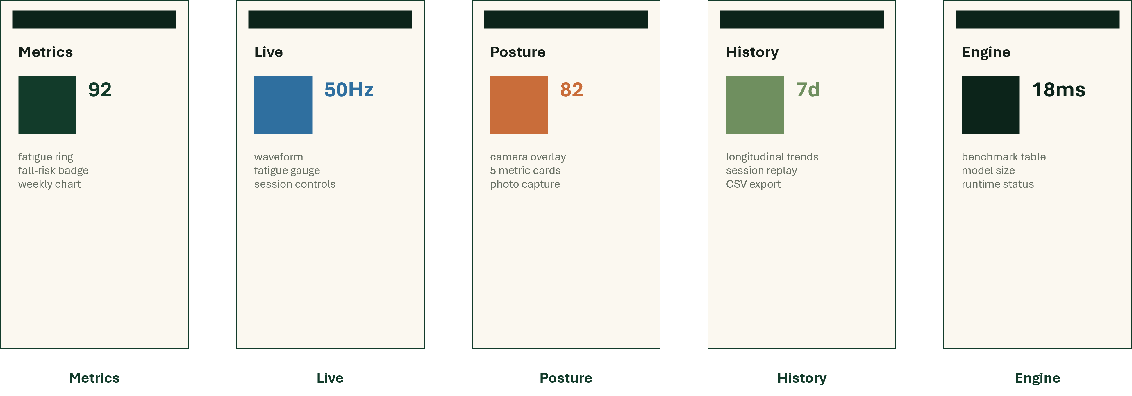

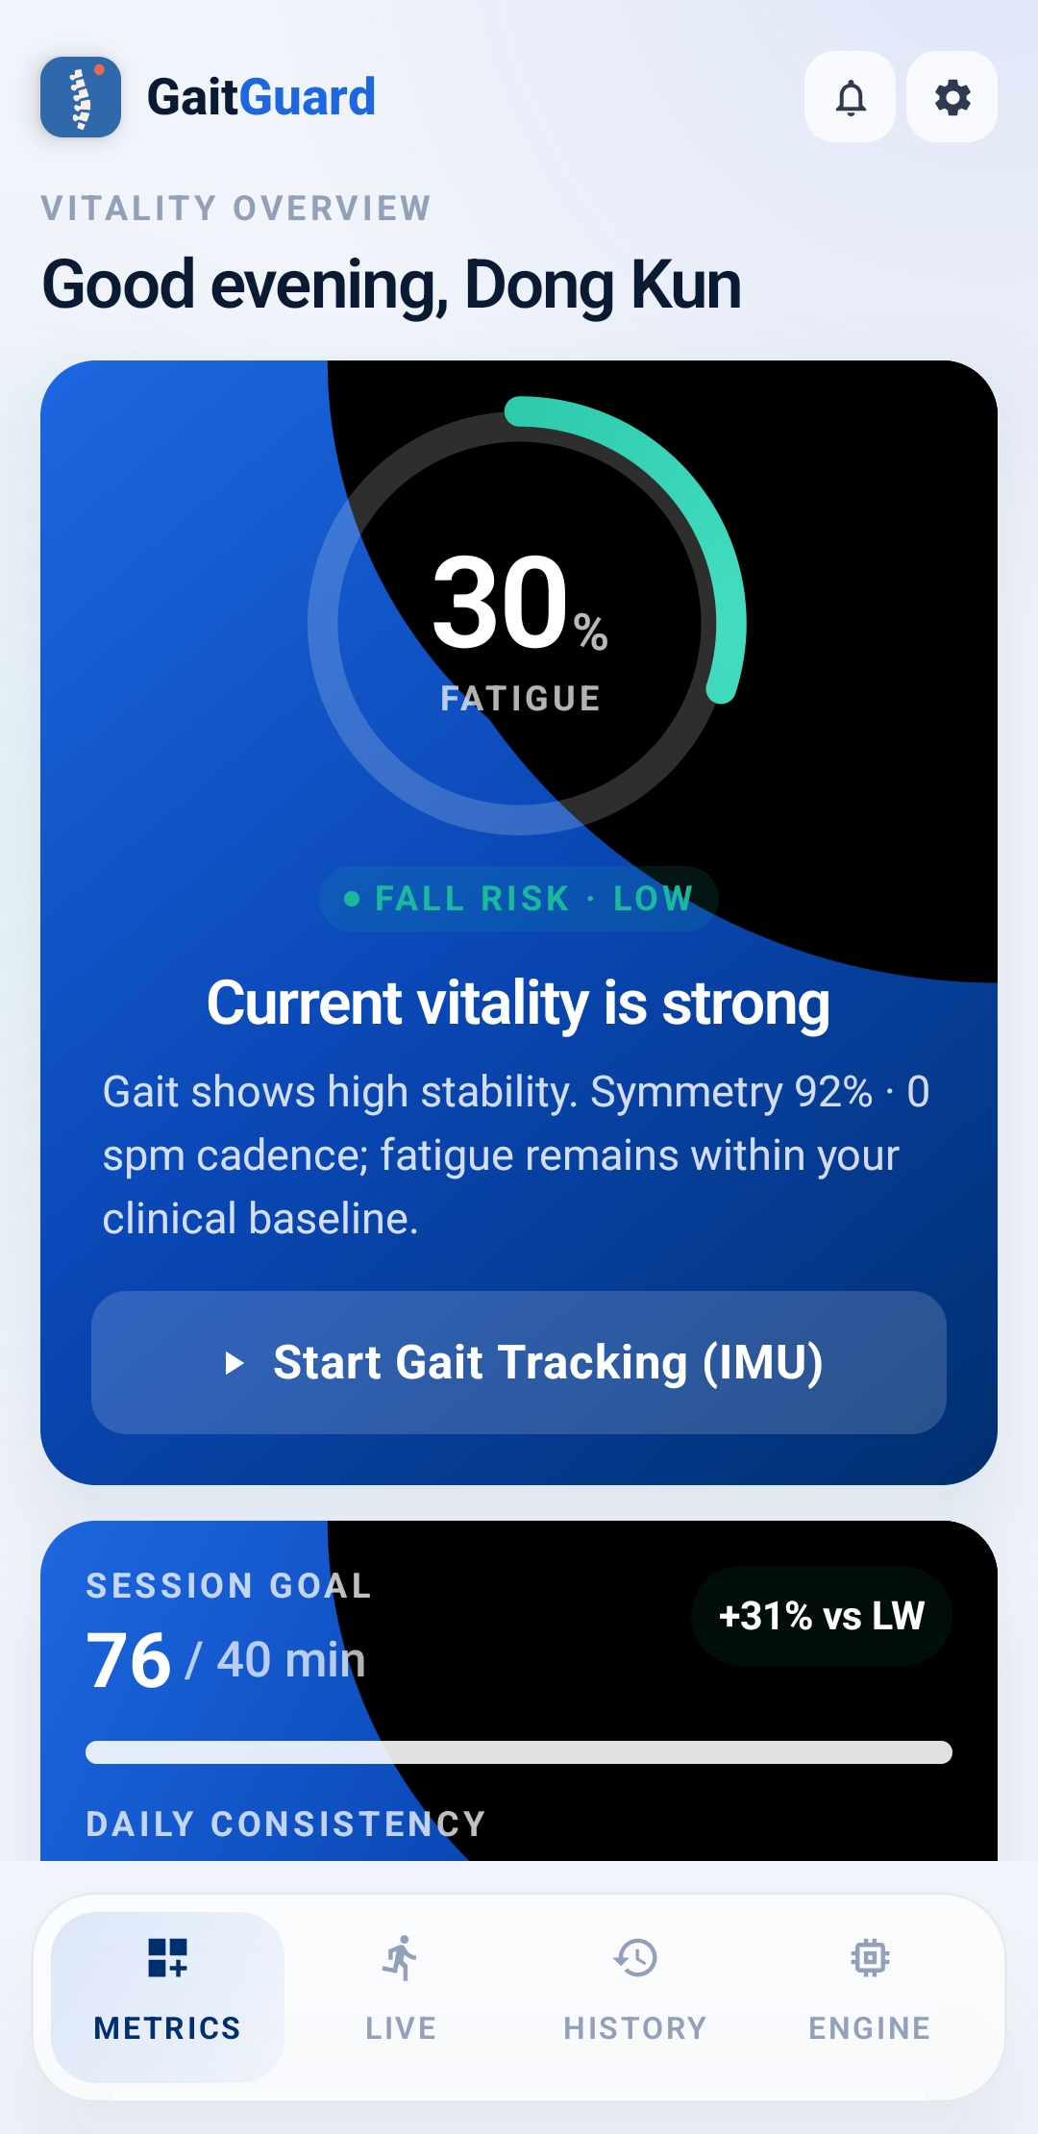
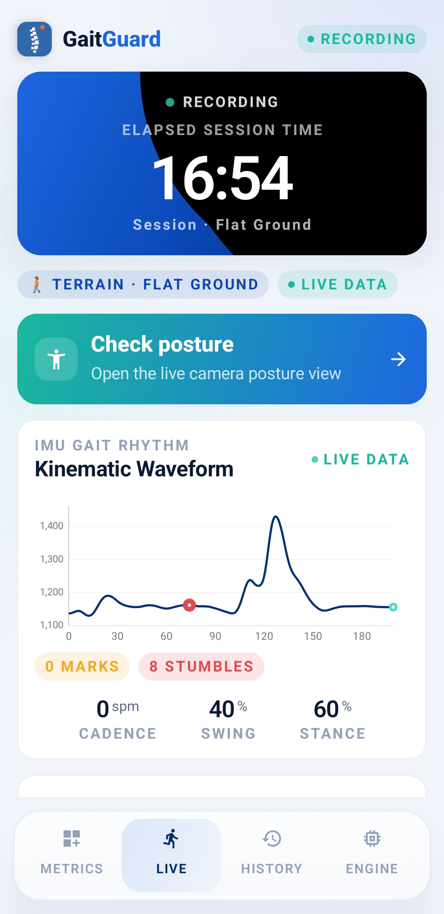
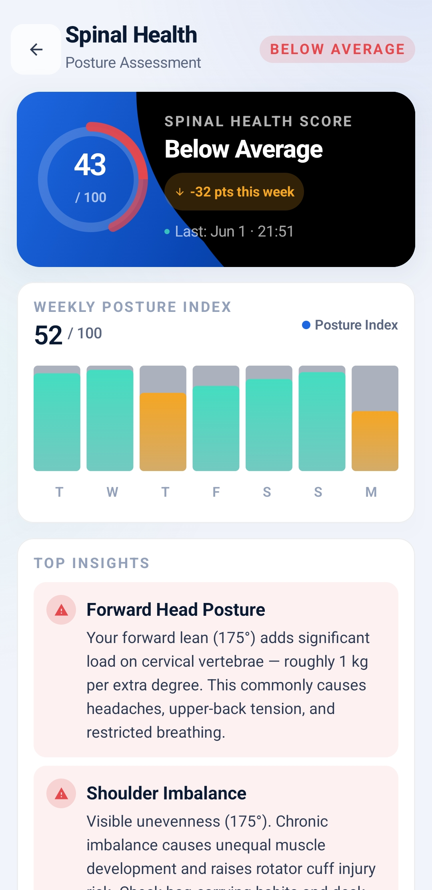
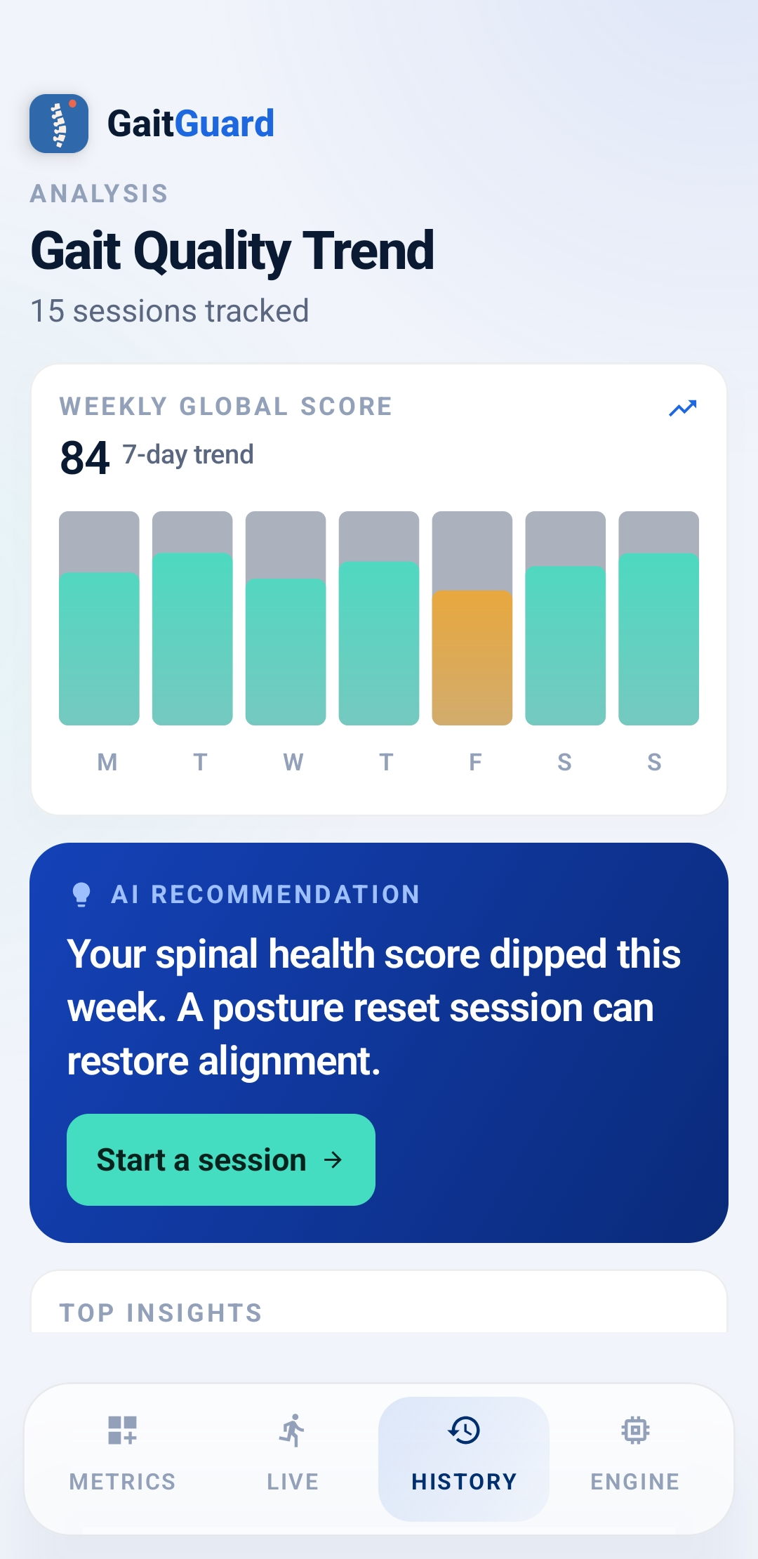
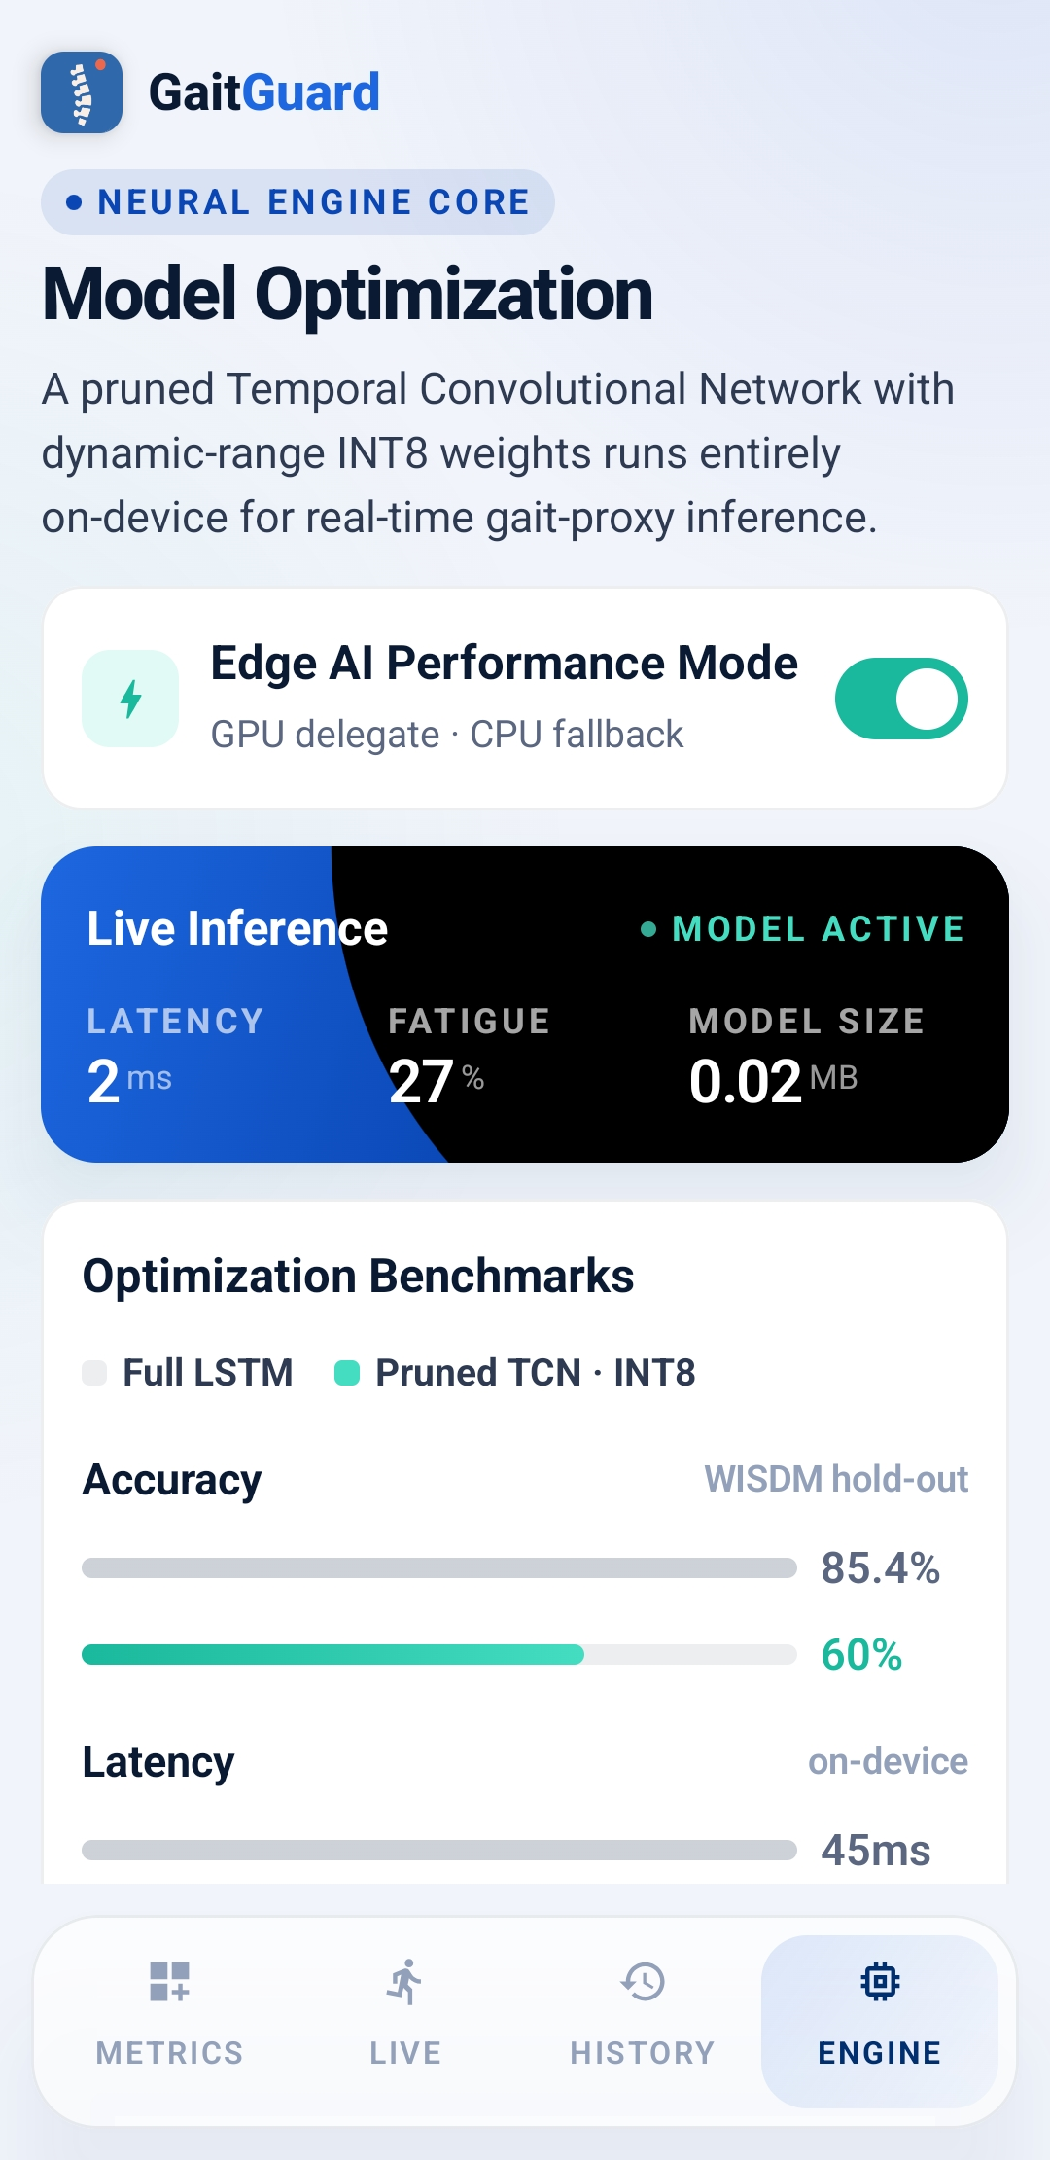
05 | PRODUCT
App Screens — five-tab experience
home dashboard · fatigue ring
waveform · fatigue gauge
Assessment
camera · AR overlay
longitudinal charts
model optimization

Slide 7
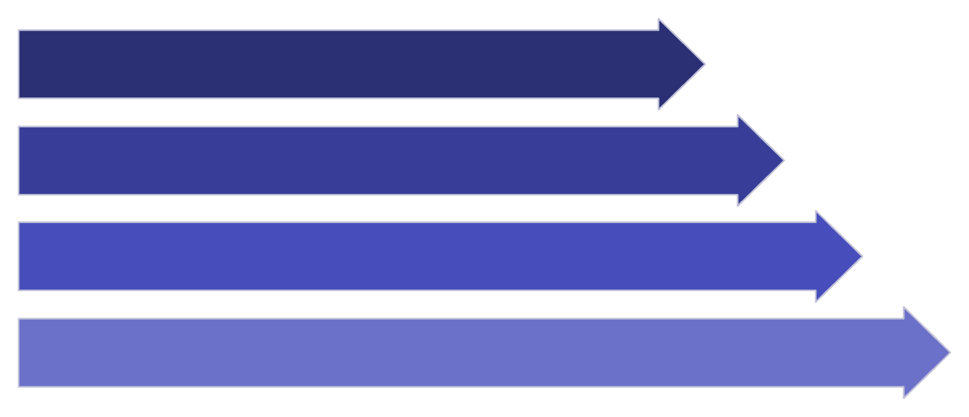

06 | MACHINE LEARNING
Model Architecture: Temporal Convolutional Network
Architecture Details
Input A: Raw IMU window [200 × 6] at 50 Hz (4 seconds)
Input B: 12 Z-score normalized hand-crafted features
3 TCN blocks with dilation rates 1, 2, 4
Global avg pooling → concat with Input B → Dense(8)
Input
3 TCN Blocks
Pool & Concat
Output Heads
3 Output Heads
Training: WISDM v1.1 + UCI-HAR · Proxy labeling · 80/20 split · 50 epochs
Fatigue Score
Fall Risk
Symmetry
[0, 1] continuous
Low / Medium / High (softmax)
[0, 1] continuous

Slide 8

KEY RESULT | OPTIMIZATION
Model Optimization Results
Optimization Pipeline
Metric
LSTM
TCN
Pruned
INT8
01
Accuracy
85.4%
60.0%
60.0%
60.0%
Structured Pruning
85% sparsity via polynomial schedule (50%→85%), 25 fine-tuning epochs, then strip wrappers
Model Size
0.14 MB
0.04 MB
0.04 MB
0.02 MB
02
Latency
45 ms
30 ms
18 ms
18 ms
INT8 Quantization
Size vs LSTM
—
−71%
−71%
−83%
Dynamic-range INT8 weights, float32 activations for TFLite 2.16.1 on Android
Key Outcome: 83% smaller than LSTM baseline · 2.5× faster inference · Full GPU delegate on-device

Slide 9
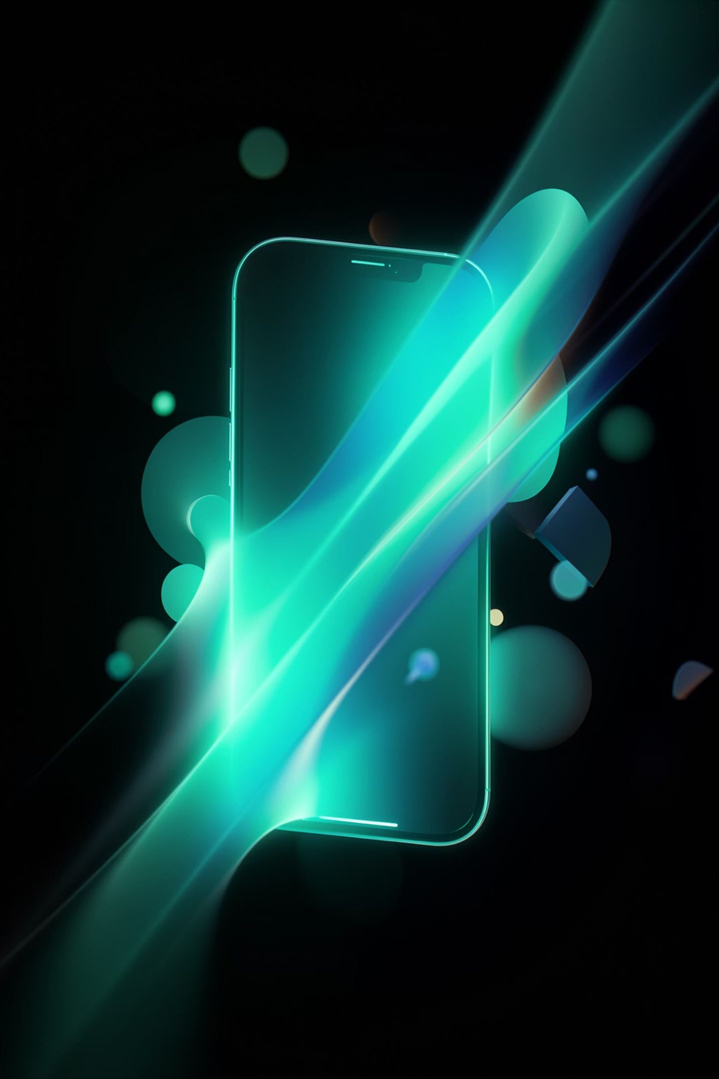
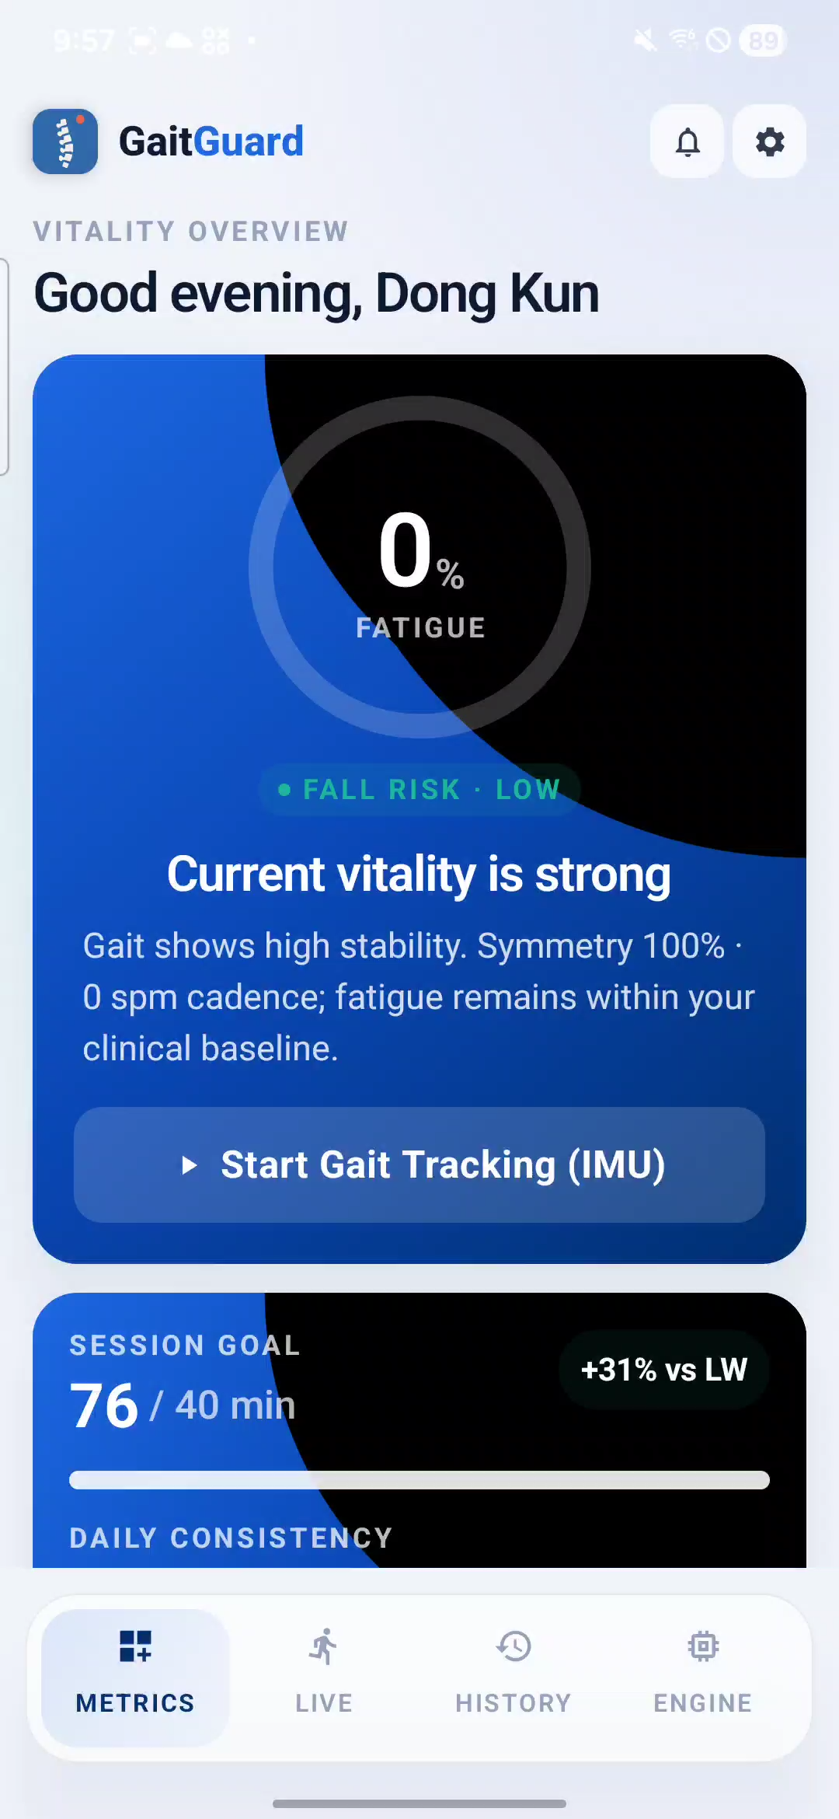

08 | DEMO
Live Demo
Running live on Samsung Galaxy S22 — fully offline, no internet at any point.
⚡ <20ms Inference
Real-time gait scoring on-device with GPU delegate
🦴 AR Skeleton
Live posture overlay with color-coded joint confidence
🔄 2s Updates
Fatigue arc gauge and fall risk badge refresh continuously
📊 Engine Screen
Live latency readout and INT8 optimization status
GitHub: github.com/moondongkun/gaitguard-mobile

Slide 10

09 | PROJECT
Project Timeline & Deliverables
Solo project — Dongkun Moon (2020-13236)
Solo project
Week 1–2 · May 6–11
Deliverables
Dongkun Moon 2020-13236
Architecture design, IMU sensor pipeline, ring buffer, Room DB, MVVM setup
Android App
Week 3 · May 18–23
Kotlin + Jetpack Compose + Material 3
Full UI (7 screens), ML Kit posture integration, TCN model training
Week 4 · May 23–31
model/train.py
Design refinement, static photo analysis, posture AI insights, icon redesign
TCN training + pruning + INT8 quantization pipeline
Week 5 · June 1
GitHub Repository
Model optimization pipeline, benchmark table, GitHub submission
github.com/moondongkun/gaitguard-mobile

