Slide 1
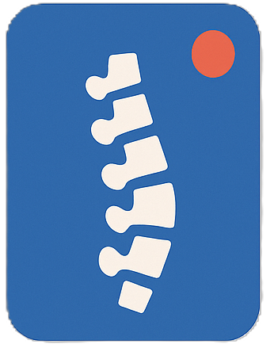
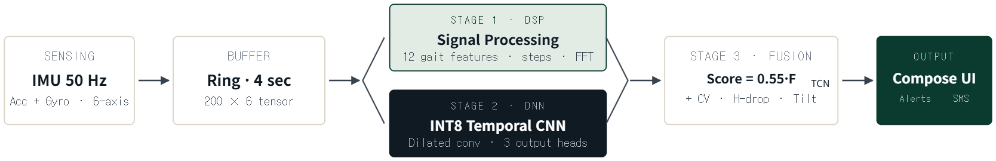

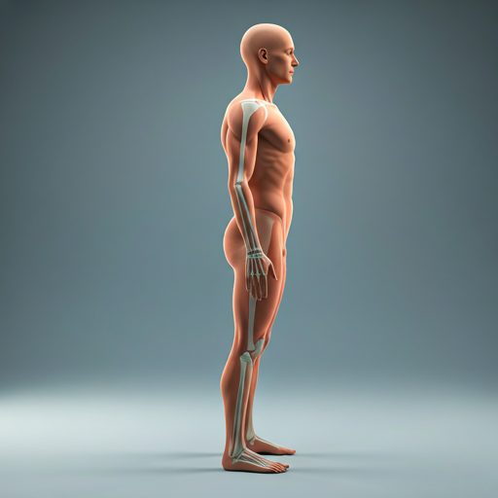


Dong Kun Moon
2020-13236
|
College of Liberal Studies · Business / CS
MINI PROJECT PROPOSAL
G
SOLO PROJECT · ON-DEVICE SENSING · ANDROID
GaitGuard — Real-Time Gait & Posture-Based Fatigue Monitor
A fully offline Android app that estimates physical fatigue, stride symmetry, and fall-risk from a phone's built-in IMU — using a pruned, INT8-quantized Temporal CNN running entirely on-device.
GALAXY S22
TFLITE · INT8
100% OFFLINE
I.
Project Overview
PROBLEM · SOLUTION · TARGET
II.
Technical Pipeline
SENSING → DSP + DNN → UI
Problem
Physical fatigue degrades gait before people consciously notice it — cadence drifts, stride symmetry drops, trunk sway grows. Existing systems require force plates, lab treadmills, wearables, or cameras — all impractical for daily mobile use, especially for elderly living independently , athletes risking overtraining, and rehab patients.
Solution
A fully offline Android app using only the phone's built-in accelerometer + gyroscope , carried in a pocket or belt clip. Continuous 4-second IMU windows at 50 Hz feed an on-device Temporal CNN — no camera, microphone, cloud,
or internet required.
Target Device
TFLite INT8 TCN with GPU delegate, solo project. Calibrates gravity over 5 s before walking begins.
DSP · Stage 1
5 Hz low-pass → adaptive step detection → 12 features: cadence · ISI-CV · symmetry · harmonic ratio · trunk tilt · FFT energy .
Normal
Early Fatigue
Stop / Fall Risk
TCN · Stage 2
Dilated causal (1, 2, 4) + depthwise-separable + residual → 3 heads: fatigue, fall-risk, symmetry.
SCORE 0 – 39
SCORE 40 – 69
SCORE 70 – 100
Fusion · Stage 3
Weighted composite → live gauge, vibration alert (amber), offline SmsManager on sustained risk.
Steady cadence, balanced gait
Vibration alert → rest advised
SMS to caregiver via SmsManager
III.
Key Requirements & Main Features
TARGETS · LIVE UI
IV.
Optimization Strategy
FP32 LSTM → PRUNED INT8 TCN
9:41
< 15
ms
< 1
MB
BASELINE
STEP 1 · ARCHITECT
STEP 2 · PRUNE
STEP 3 · QUANTIZE
GaitGuard
LIVE
FP32 LSTM
Dilated TCN
85% sparsity
INT8 TFLite
Posture · Live scan
INFERENCE / WINDOW
INT8 MODEL SIZE
multi-output · ~4 MB
SepConv1D · residual
tfmot · 25-epoch FT
500 calib · <1 MB
NECK TILT
SHOULDER LEVEL
7.2°
0.0°
> 75
%
< 2
%
Datasets
WISDM + UCI-HAR public datasets · self-collected walking samples for terrain & fall-risk behavior.
SIZE REDUCTION
ACCURACY DROP
Baseline Model
Multi-output FP32 LSTM trained on combined dataset — head: fatigue · fall-risk · symmetry. Establishes
upper-bound accuracy reference.
PELVIC TILT
ASYMMETRY
Reliability
100% offline — no internet, no camera, no cloud. Works on aircraft mode with full
privacy preservation.
+4.2°
12%
Production Model
3-block dilated TCN (dilations 1, 2, 4) → 85% magnitude pruning with PolynomialDecay → post-training
INT8 quantization with 500 calibration windows.
Stand straight
Core Features
Real-time fatigue gauge · stride-symmetry bar · fall-risk badge · live waveform with step
peaks · session timeline · caregiver SMS · CSV export via Room.
Evaluation
Model size · latency · fall-risk F1 drop · false-alert rate · end-to-end update latency on
Galaxy S22.
Target Outcome
size −75% · latency <15 ms · F1 drop <2% — measured directly on-device against the FP32 baseline.
METRICS
LIVE
POSTURE
HISTORY
MOBILE COMPUTING & ITS APPLICATIONS · 4190.406B
dongkun1115@snu.ac.kr

