Slide 1
Deep Reinforcement Learning for multi-agent cooperative games and control
Mounir Hinedi, Glenn Vinnicombe
F-gv103-3

Slide 2
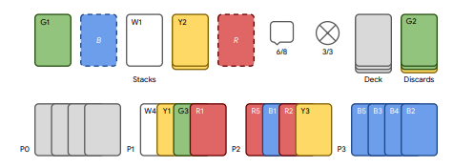
Challenge – Hanabi
Deck of cards
(unseen)
Fireworks (R)
Hints (H, max 8)
Lives (L, max 3)
Actions:
- Play Card from hand (+1 R or -1 L)
Discard and draw ( +1 H)
Hint Color/Rank to specific player(-1 H)
Discards
(seen)
Your Cards (facing away)
Teammates cards
(facing you)

Slide 3
Self play vs Ad-hoc
Self play is when all the agents are using the same algorithm or method to make moves
  Parameters or q-table is stored and updated centrally
  Conventions can be assumed by a method and applied globally
Ad-hoc is when each agent playing is different and non-optimal
  Real world setting

Slide 4
Contextual Inference
Hints are a form of explicit information.
Hints can reveal additional information when used in the correct context.
How to infer Information from context?
Finesse moves

Slide 5
Previous approaches - Hardcoded
- Smartbot: Tracks publicly known information and predicts other players movement using built in convention
- HatBot, WTFWThat: Uses a predefined protocol to determine a recommended action for all players. When other players receive a hint, they can decode further information by observing hints given to other players.
- FireFlower: Keeps track of all private and public information. Performs a search over all actions and models the pdf of what partners are likely to do in response to maximize the expected reward.

Slide 6
Previous approaches – RL methods
Actor-Critic-Hanabi-Agent: Uses a deep neural network to represent the policy, which also learns a value function to act as a baseline for variance reduction. It is trained using experience accrued in parallel by several copies of the agent running in parallel.
Rainbow-Agent: Deep Q-Network that combines recent innovations to achieve high sample efficiency and high rewards at convergence
Bayesian Action Decoder: Achieves state of the art in 2-player setting. It uses a Bayesian update belief update that conditions on the current policy of the agent.

Slide 7
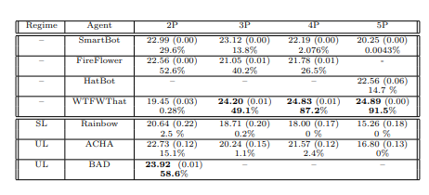
Previous performance

Slide 8
Progress
Simplified the game into 1 colour, 5 ranks and 2 players so that we can try tabular q-learning.
Achieves an average score of 4.3.
Not as good as human performance but learning slows down as you traverse deeper into the graph.

Slide 9
Plan
- Investigate using DQN using rainbow
- Try build a DQN using machine TOM.

