Slide 1
Round - 01
Presentation Skill Competition 2023
MERN Batch - 04
MD. Mahedi Hasan Moon
Roll :- 464298
Reg :- 1502028290
Session:- 19-20
from
NIET
National Institute of Engineering & Technology

Slide 2

MongoDB, Express, React, Node
MERN Stack

Slide 3

<!DOCTYPE html>
<html>
<head>
<title>MERN-04</title>
</head>
<body>
<h1>Round 01</h1>
<p>Presentation Skill competition.</p>
</body>
</html>
HTML
HTML stands for Hyper Text Markup Language. HTML is the standard markup language for creating Web pages.

Slide 4
<!DOCTYPE html>
<html>
<head>
<title>MERN-04</title
>
<link rel="stylesheet" href="style.css">
</head>
<body>
<h1>Round 01</h1>
<p>Presentation Skill competition.</p>
</body>
</html>
CSS
The full form of CSS is Cascading Style Sheets. It is enabled by browsers and is specifically designed the document's content from the report's appearance. It explains how to show HTML elements on display.

Slide 5
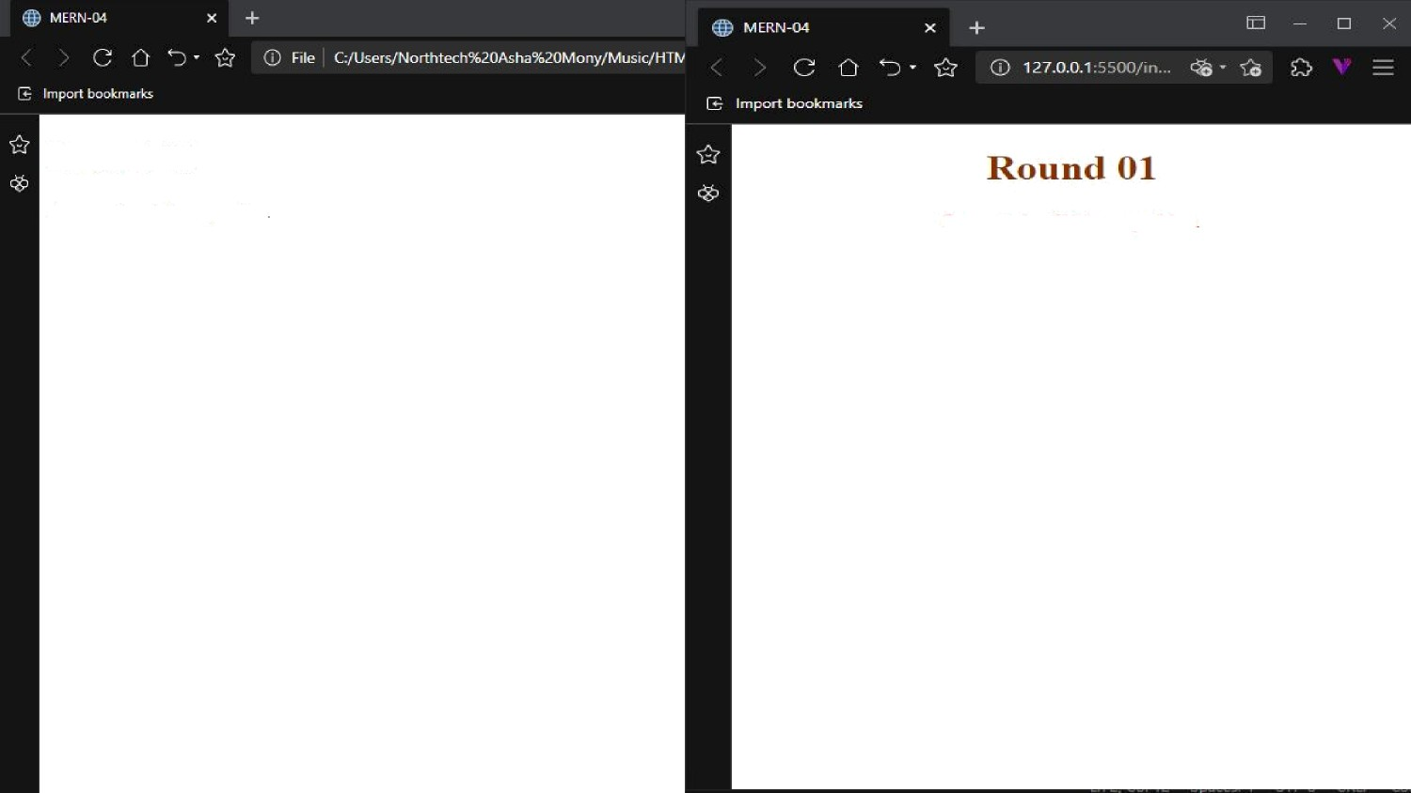
Rouod 01
Presentation Skill competition
Pre s w1 atinn Ski11 cninpetition

Slide 6
Bootstrap is a free
front-end framework for faster and easier web development. Bootstrap includes HTML and CSS based design templates for typography, forms, buttons, tables, navigation, modals, image carousels and many other, as well as optional JavaScript plugins.
Bootstrap

Slide 7
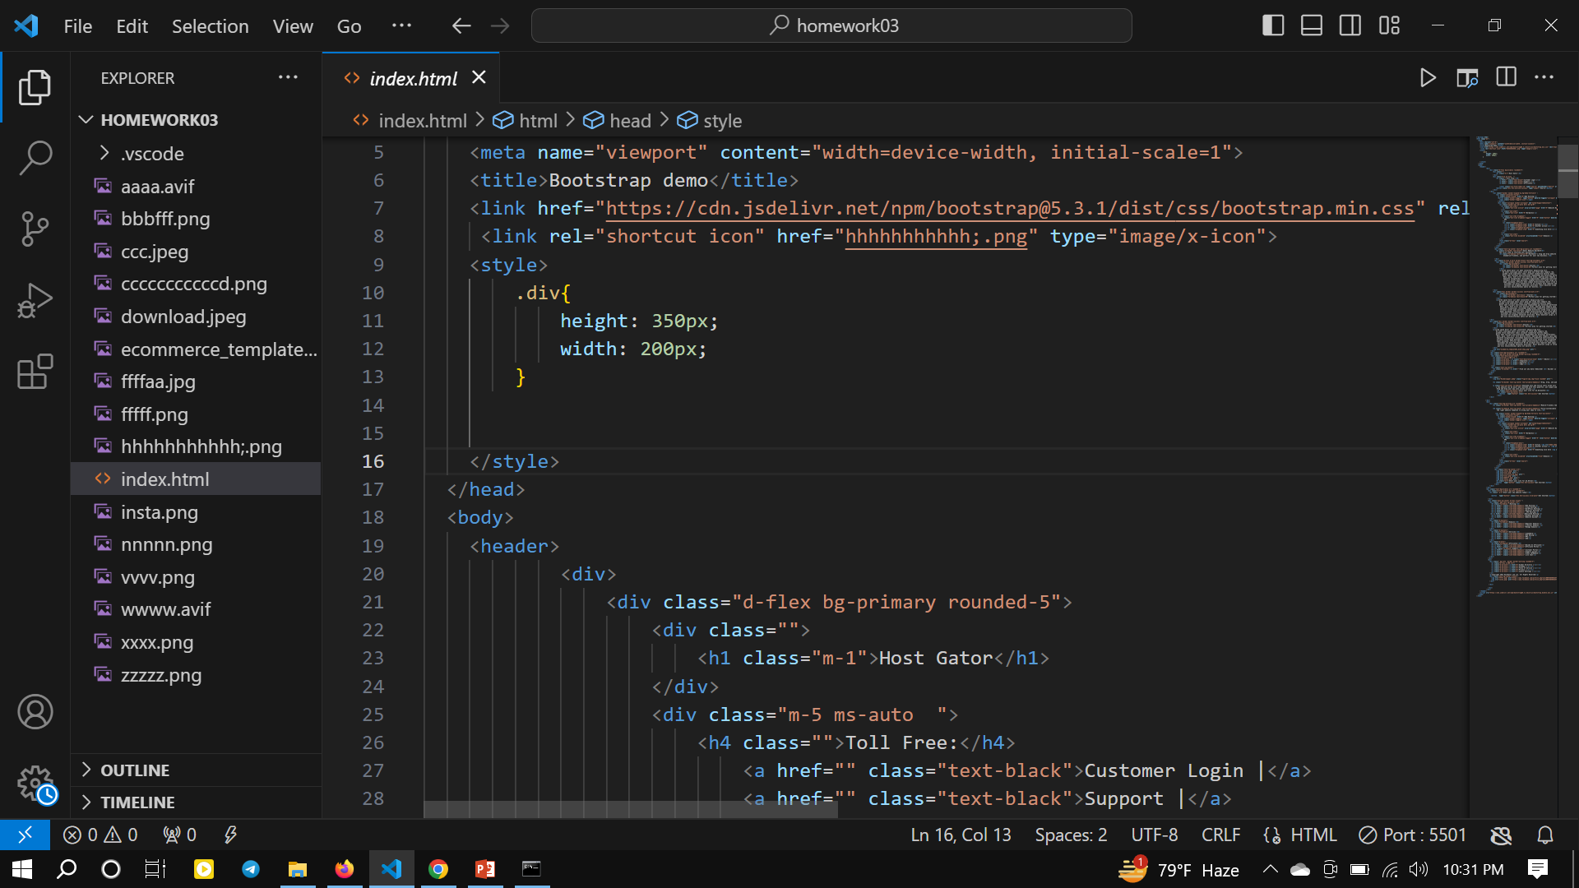

Slide 8
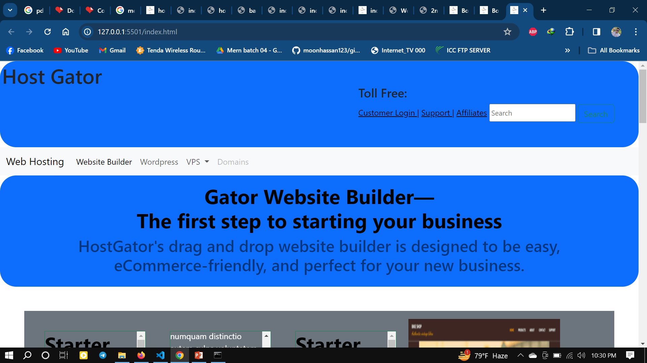

Slide 9
Tailwind is a modern CSS framework that offers several advantages over traditional CSS. Its
utility-first approach and pre-defined classes make styling HTML components faster, more efficient, and more consistent
Tailwind

Slide 10
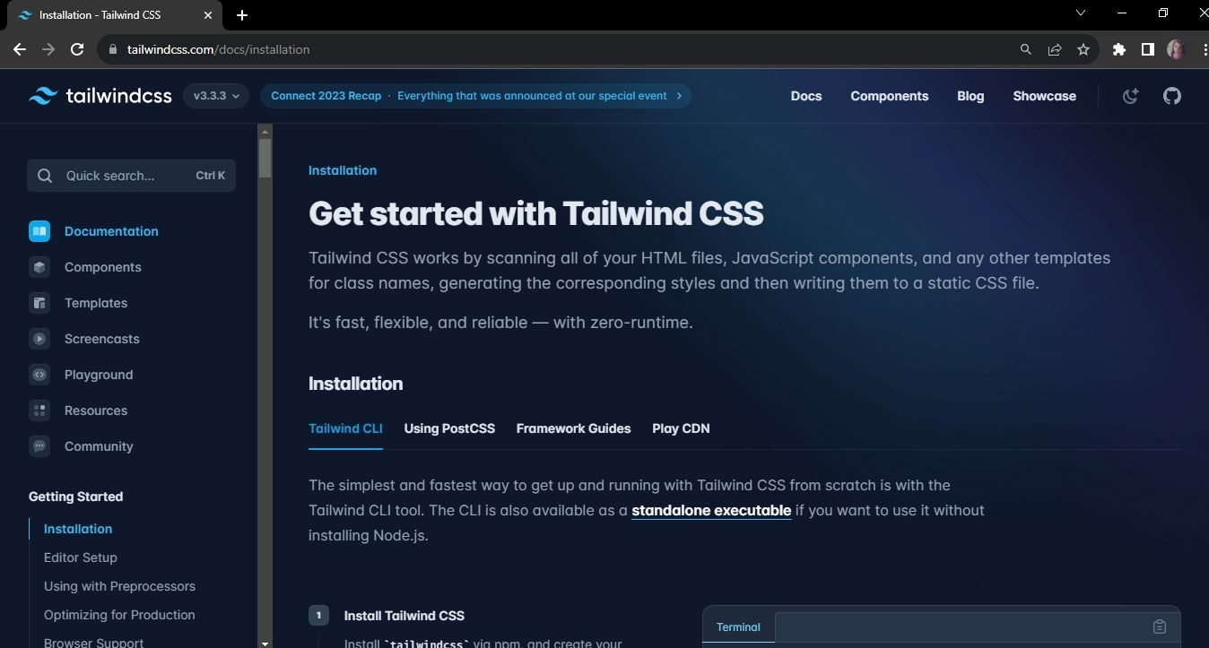

Slide 11
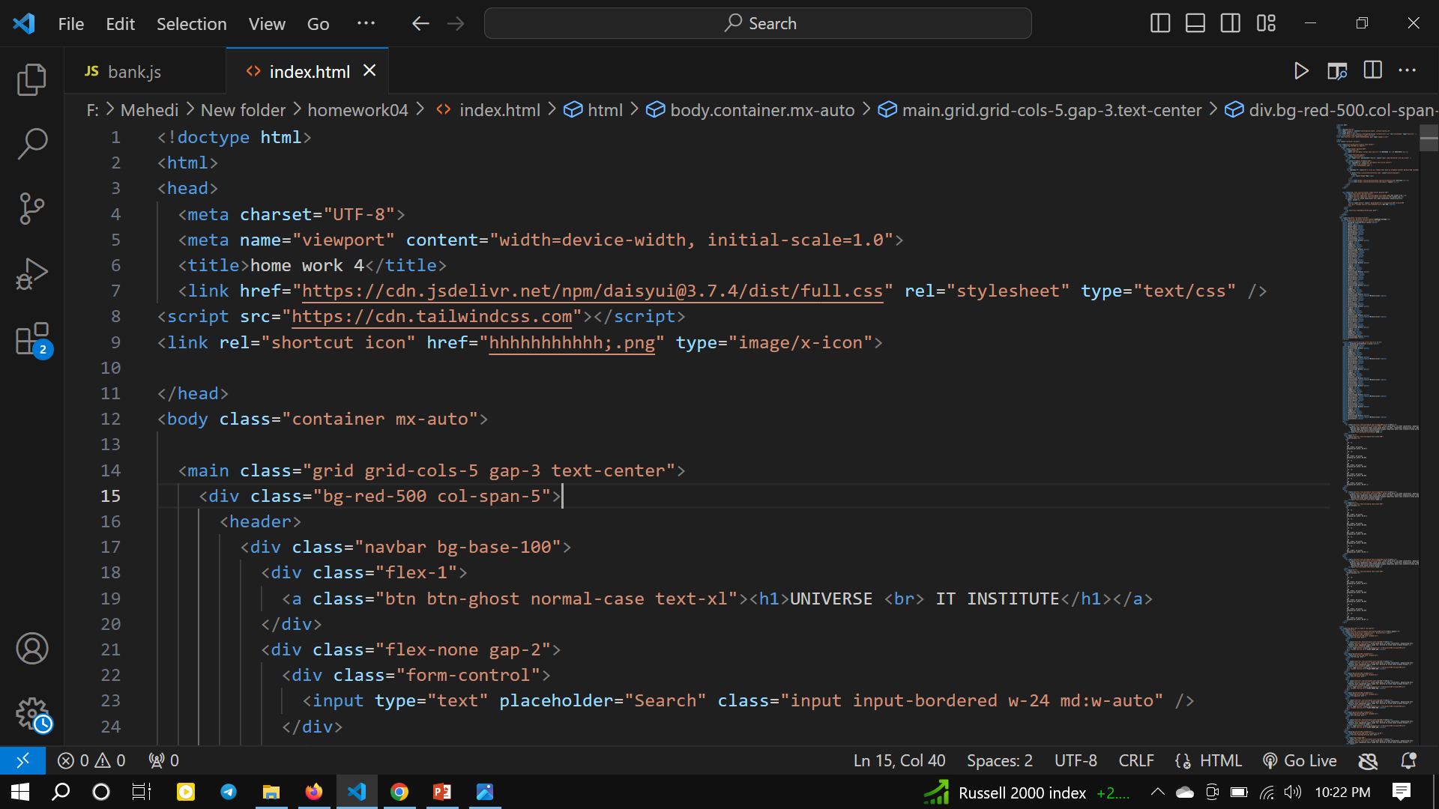

Slide 12
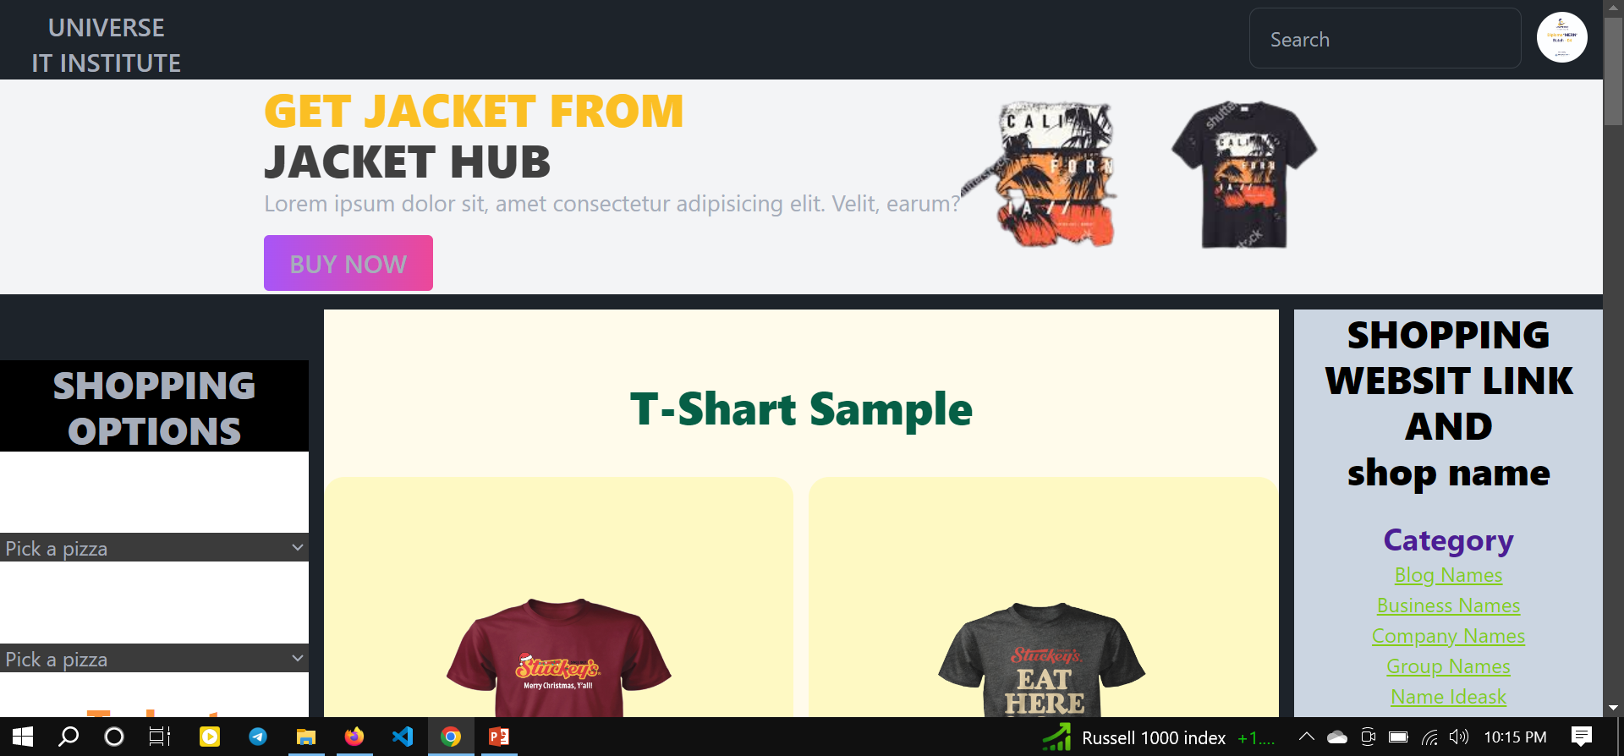

Slide 13
JavaScript
Javascript (JS) is a scripting languages, primarily used on the Web. It is used to enhance HTML pages and is commonly found embedded in HTML code. JavaScript is an interpreted language.

Slide 14
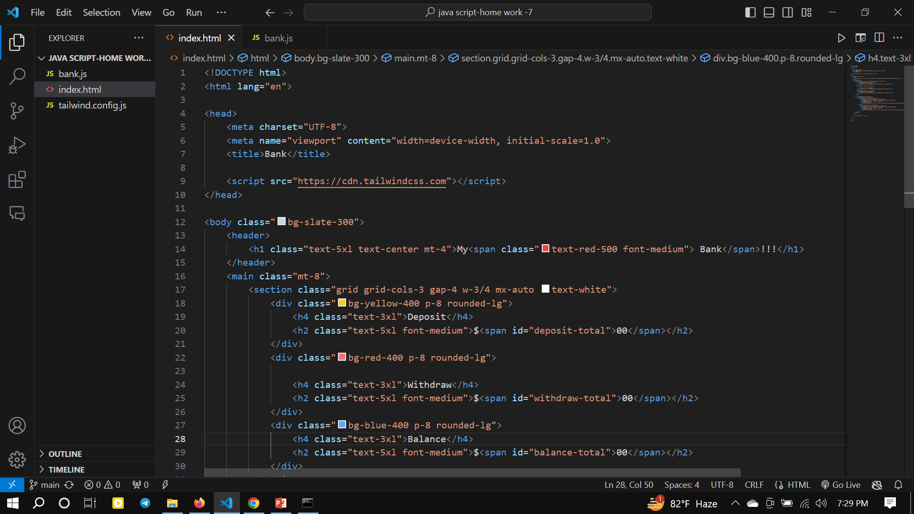

Slide 15
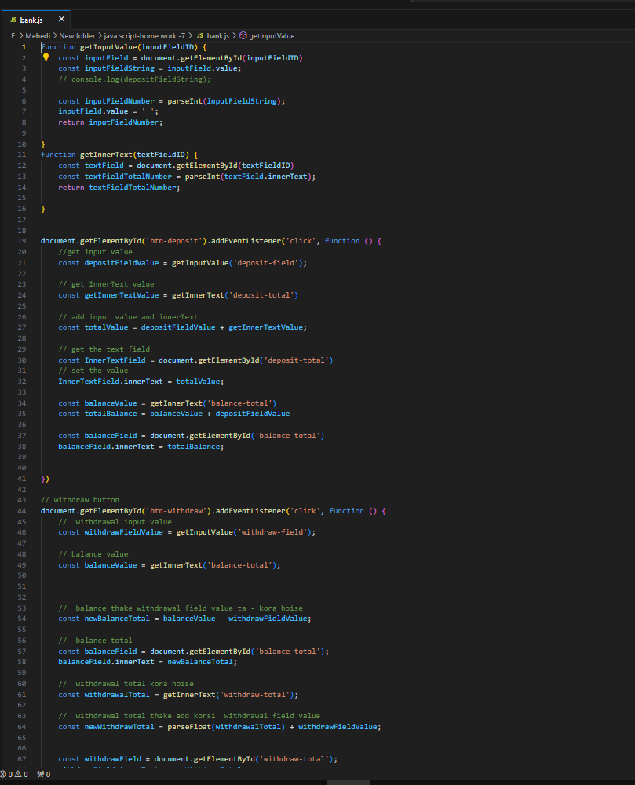

Slide 16
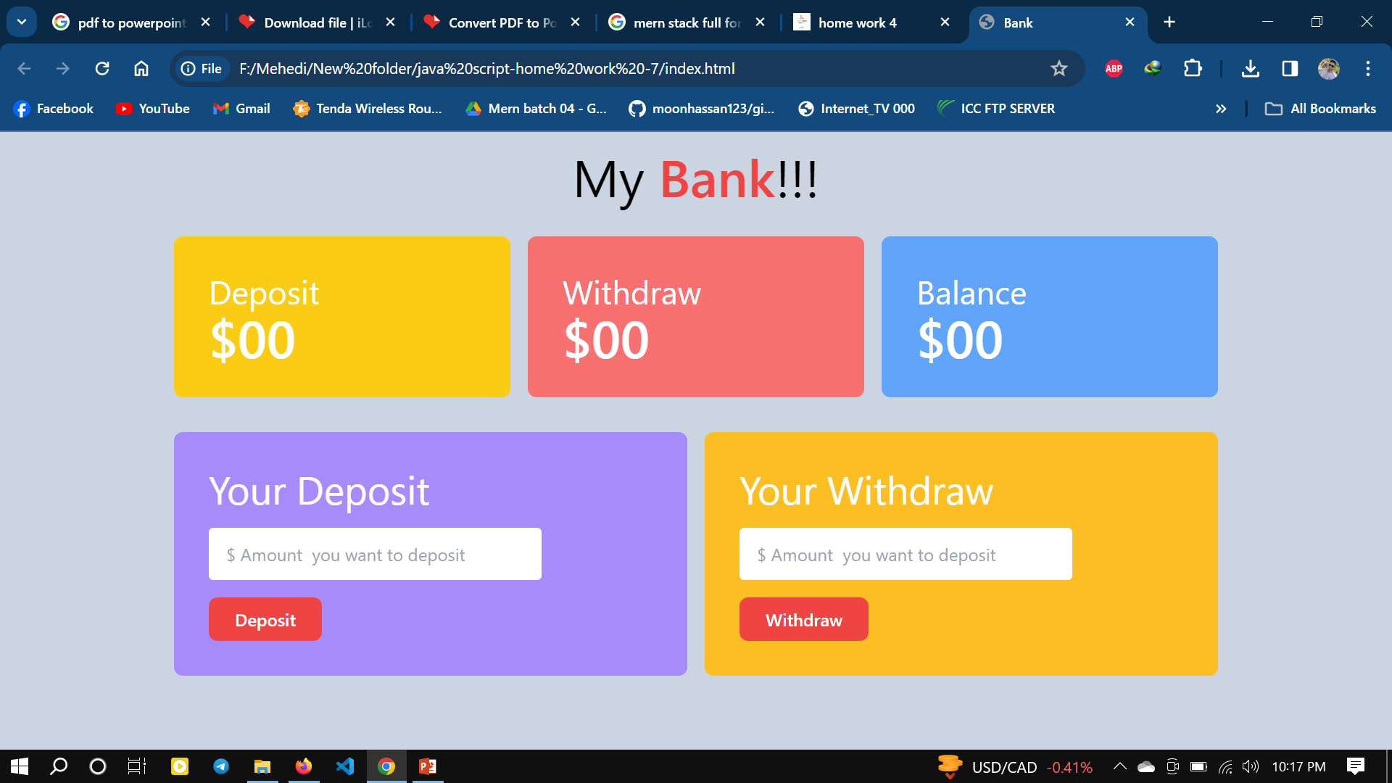

Slide 17
