Slide 1

PREDICTIVE ANALYTICS FOR CUSTOMER
TARGETING:
Application in Bank Telemarketing Scenario
Mannan (R.no 22)
Ali Hussain (R.no 29)
Iqra Baba (R.no 33)
Moonis Ali (R.no 50)

Slide 2
Contents
Problem Description
Tools and Technologies used
Flow of the project
About the Dataset
Data Exploration results
Establishing Feature Importance
Project result and findings I
Project result and findings II
Recommendations
T

Slide 3
Problem description
Problem Statement: Deals with the marketing campaign of a Portuguese bank by analyzing the client’s data to provide recommendation about which customer to target for future sale of long-term deposits.
Problem Motivation: By using classification (machine learning algorithms) the bank can better target its customers and better channelize its marketing efforts, thus optimising costs and improve conversion rates.
Context

Slide 4


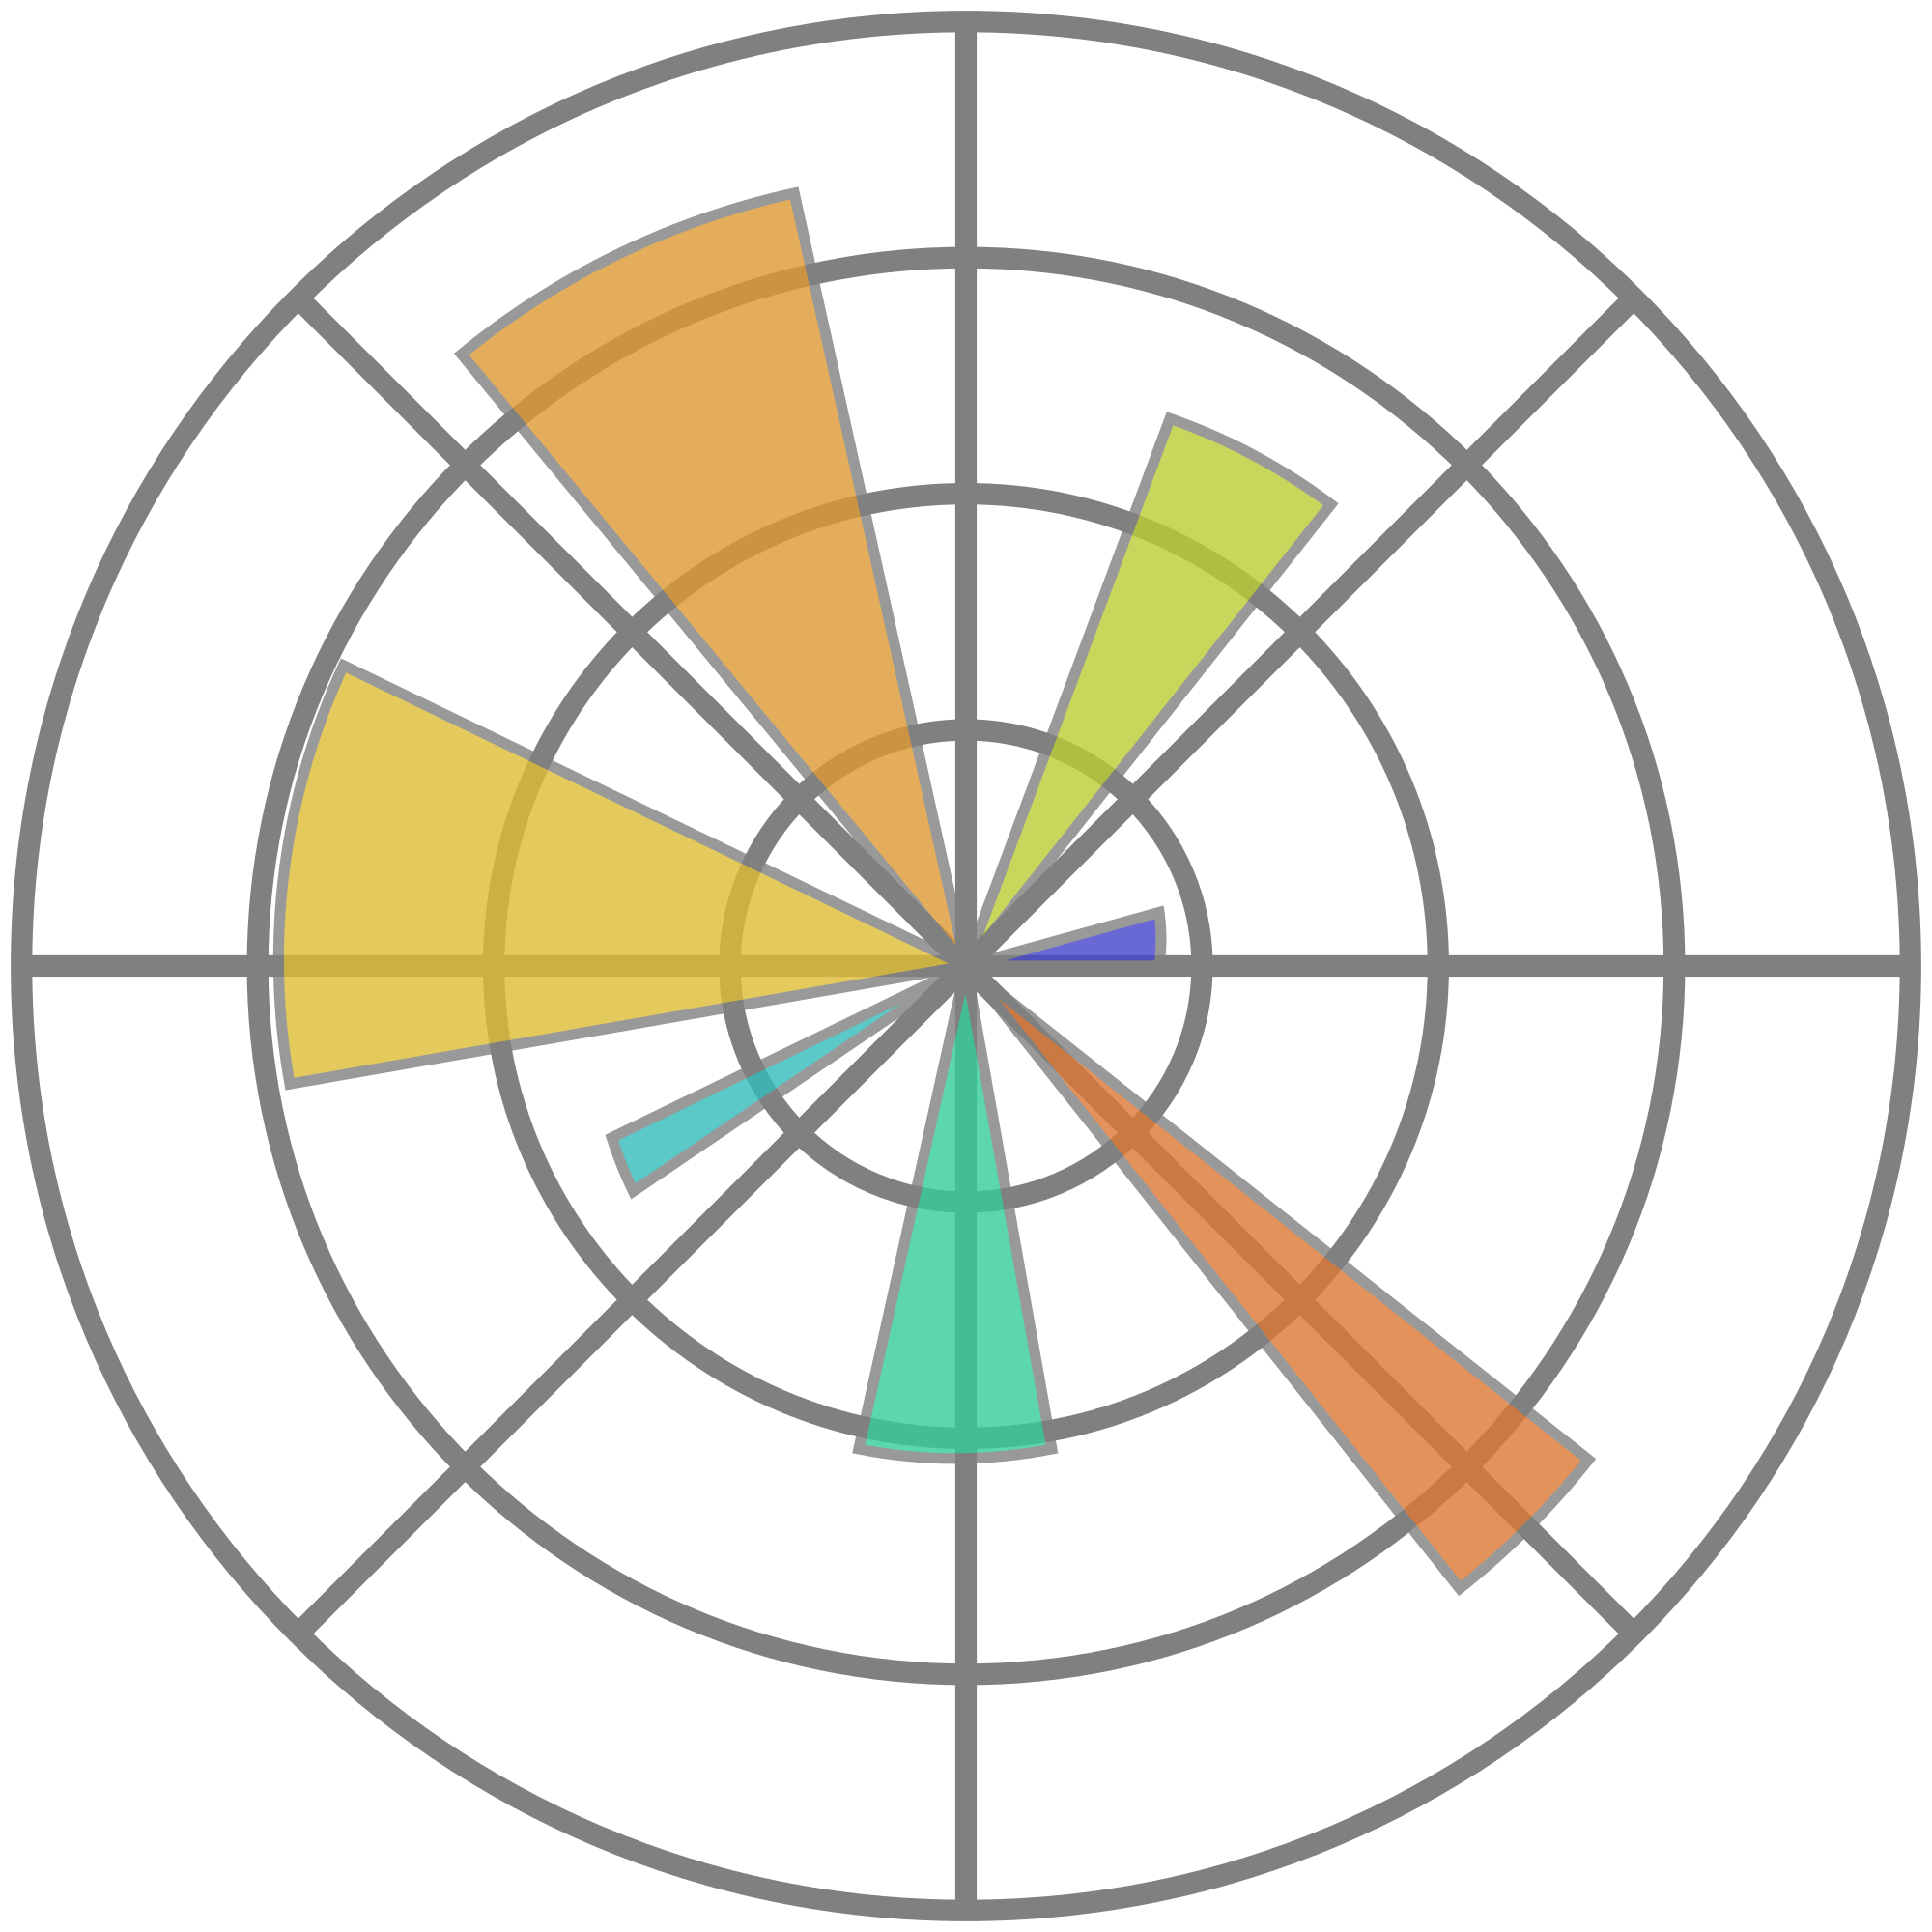


Tools & Technologies Used
The project was implemented entirely in Jupyter notebook using Python version 3.5 aided by the use of the following libraries:
Pandas- Pandas is a software library written for the Python programming language for data manipulation and analysis
Numpy - NumPy is a library for the Python programming language, adding support for large, Multi-dimensional arrays and matrices, along with a large collection of high-level mathematical functions to operate on these arrays.
Matplotlib - Matplotlib is a Python 2D plotting library which produces publication quality figures in a variety of hardcopy formats and interactive environments
Seaborn - Seaborn is a Python data visualization library based on matplotlib. It provides a high-level interface for drawing attractive and informative statistical graphics
Scikit-learn - Scikit-learn (formerly scikits.learn) is a free software machine learning library for the Python programming language
Context
Source: Wikipedia

Slide 5
Flow of the project
DATA
DATA SET
DATA
RESULTS
ML
EXPLORATION
PREPROCESSING
COMPARISON
EXPLORATORY DATA ANALYSIS
FEATURE SELECTION
RESULTS
ML

Slide 6
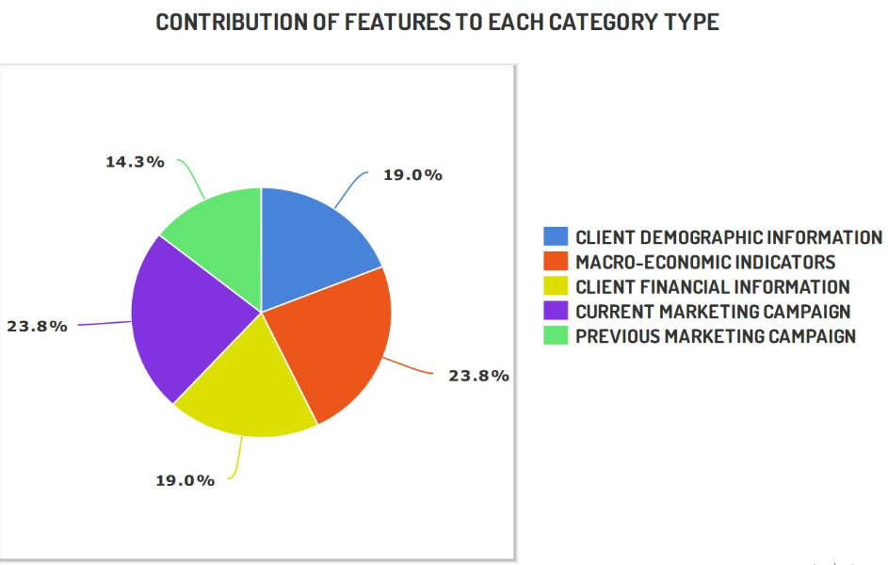
About the Dataset
Dataset courtesy: Banco de Portugal
Highlights: 41,188 instances, 21 features.
The client’s demographic information (like age, marital status)
The client’s financial information (like housing loan, default)
Features related to the current marketing campaign (like contact month, day, type of contact)
Features related to previous campaigns (like outcome of previous campaign )
Macroeconomic indicators (like consumer confidence rate, euribor).

Slide 7

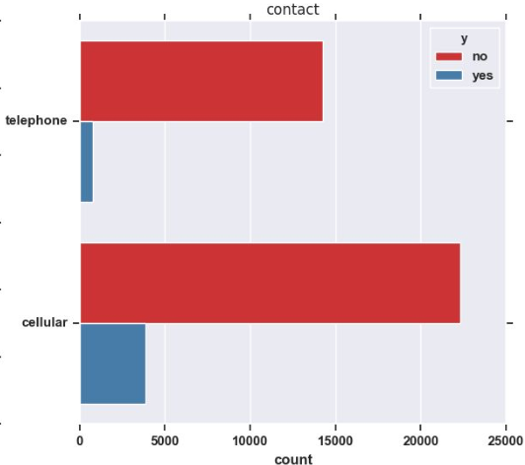
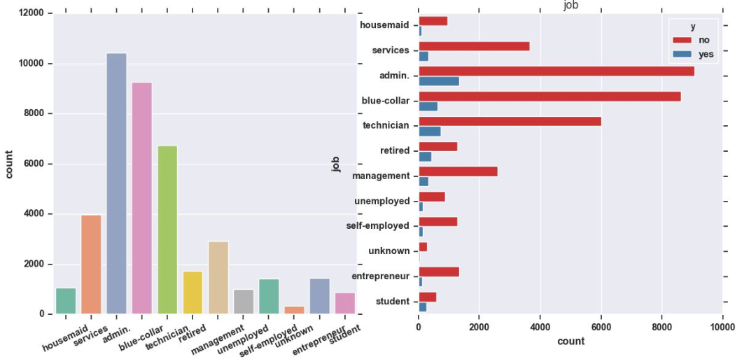
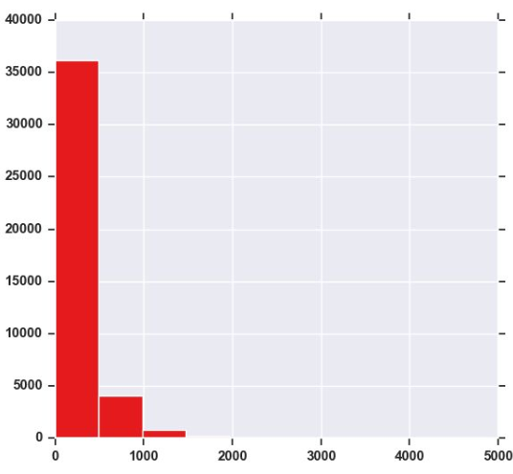
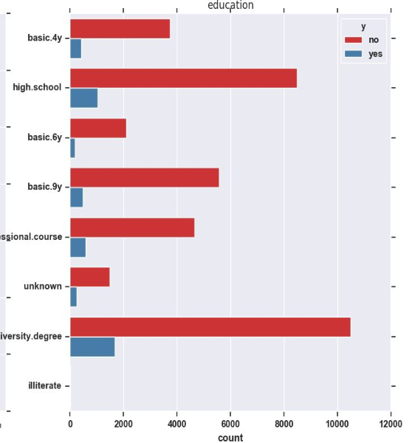
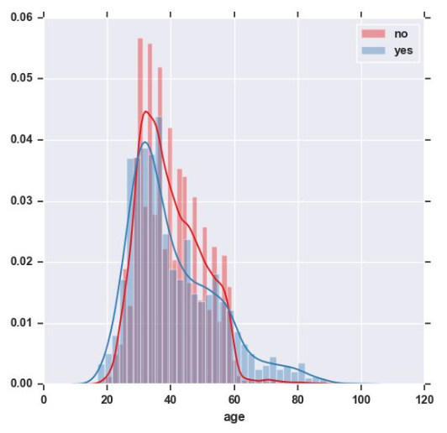
Data Exploration Results
INTERESTING INSIGHTS
Among all the job classes, blue collar workers were the least subscribers- 6.89%.
64% of the clients that had subscribed did not have housing loans.
People mostly below age 60 tend to subscribe to long term products with a median age of 40.
Education wise, the biggest demographic that contains subscribers is people with a university education.
Count vs duration
Notes:
A whopping 99% of the clients who had subscribed to the product did not have any credit default.
About half of the clients (52%) who subscribed to the long-term deposit were married.
64% of the clients that had subscribed did not have housing loans.
A major proportion of the clients who had subscribed (64%) were not contacted during the previous marketing campaign.
Education wise, the biggest demographic that contains subscribers is people with a university education.
People mostly below age 60 tend to subscribe to long term products with a median age of 40.
Understandably, students and unemployed were the least contacted groups for the purchase of long term deposits.
Among all the job classes, blue collar workers were the least subscribers- 6.89%.

Slide 8
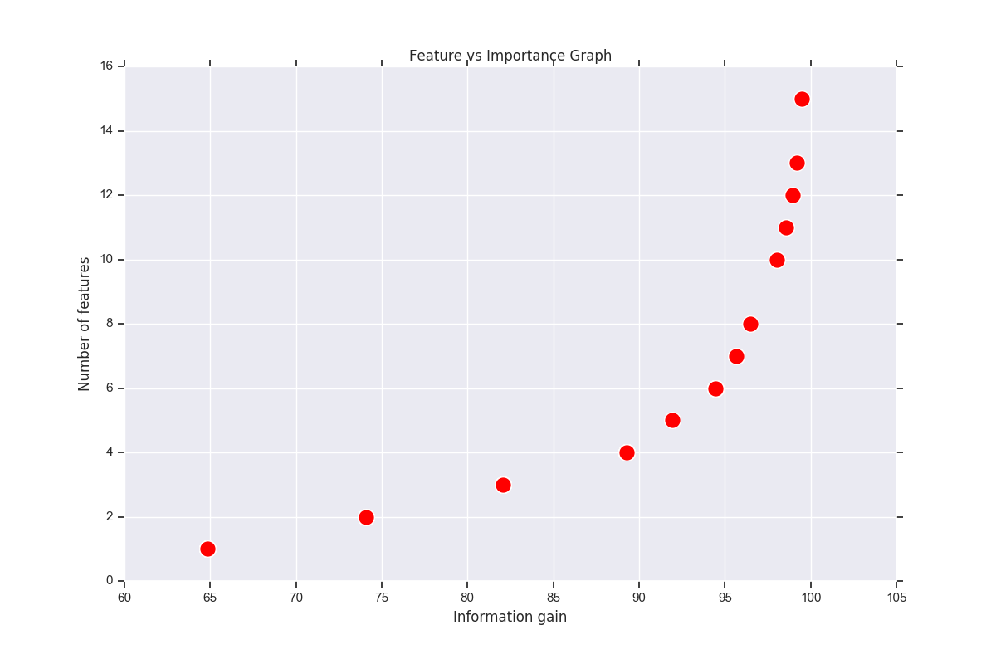
Data preprocessing and Establishing feature Importance
CLUBBED FEATURES IN EDUCATION AND JOB FEATURE, e.g housemaid, blue-collar to super class feature Unskilled.
DATA AGGREGATION
INACCURACIES IN FEATURES LIKE pdays IS ADDRESSED BY DISCRETIZING IT TO 4 NEW FEATURES,
DATA PREPROCESSING
DATA DISCRETIZATION
IMPUTATION ANALYSIS
TO INFER THE MISSING VALUES IN FEATURES LIKE job AND education WE MAKE USE OF THE CROSS-TABULATION BETWEEN job AND education

Slide 9
PROJECT RESULTS AND FINDINGS- COMPARATIVE ANALYSIS OF VARIOUS ALGORITHMS
 | Without Feature Selection |  |  |  | With Feature Selection
Algorithm | F1 score | Accuracy | Cross validation accuracy | Execution time | F1 score | Accuracy | Cross validation accuracy | Execution time
Decision tree | 0.88 | 90.48% | 72.83% | 2.7898 s | 0.88 | 90.13% | 72.83% | 2.5228 s
Logistic regression | 0.88 | 90.42% | 84.40% | 12.651 s | 0.88 | 90.43% | 84.40% | 11.346 s
Random forest | 0.88 | 90.43% | 83.06% | 3.6097 s | 0.88 | 90.42% | 83.35% | 3.3314 s
Ada boost | 0.88 | 90.48% | 80.60% | 18.008 s | 0.88 | 90.39% | 80.79% | 16.596 s
Linear SVM | 0.88 | 90.43% | 80.87% | 220.99 s | 0.88 | 90.43% | 78.55% | 212.52 s
K-Nearest Neighbour | 0.88 | 90.48% | 82.93% | 20.472 s | 0.88 | 90.43% | 82.93% | 17.127 s
Extra Tree | 0.88 | 90.48% | 72.34% | 10.459 s | 0.88 | 90.43% | 71.88% | 10.063 s
Voting Classifier | 0.89 | 90.53% | 74.10% | 33.621 s | 0.88 | 90.31% | 74.86% | 31.644 s

Slide 10
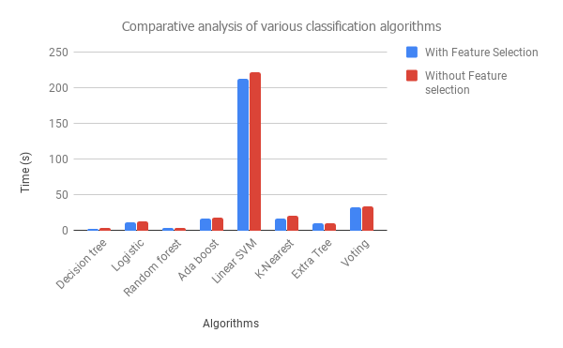
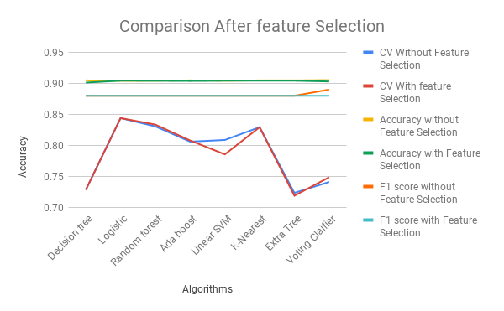
PROJECT RESULTS AND FINDINGS-II
RESULTS
HIGHLIGHTS
A) Cross validation score of Linear SVM has decreased after Feature selection, but comparatively for voting classifier it has increased.
B) The CV accuracy and Accuracy has stayed the same after Feature selection
FINDINGS
A) Decision tree, Logistic Regression and and SVM’s execution time is reduced after Feature Selection
B)Decision Tree and Random Forest have the least execution time

Slide 11
PROJECT RESULTS AND FINDINGS-II
RESULTS
HIGHLIGHTS
A) Cross validation score of Linear SVM has decreased after Feature selection, but comparatively for voting classifier it has increased.
B) The CV accuracy and Accuracy has stayed the same after Feature selection

Slide 12
Recommendations
Features like euribor rate, type of contact (cellular), p_outcome (success) are considerably more important than others.
There is a heavy impact of macroeconomic indicators like employee variance rate, euribor ( Euro Interbank Offered Rate) on the outcome.
There is considerable reduction in time of Decision tree, Logistic Regression and and SVM’s execution after Feature Selection
Decision Tree and Random Forest have the least execution time and SVM has the worst time complexity.
The decision to choose the best algorithm has to be based on execution time and cross validation.
For the said problem Random Forest algorithm comes out to be better than other algorithms. (in terms of time and cross validation parameters)

Slide 13
THANK YOU

