Slide 1
Metal Detector
Weekly Inspection
User Manual v2.0
Q-TRAIN System
HWK Vietnam - QIP Department
March 2026
1 / 23

Slide 2
What Changed? Before vs After
BEFORE (Manual Process)
AFTER (Q-TRAIN System)
✗ Record on paper forms
✓ Enter on phone or PC
✗ Compile Excel manually
✓ Auto dashboard & KPI
→
✗ Email weekly report
✓ PDF report in 1 click
✗ Track CA in separate files
✓ CA tracked in system
✗ No real-time visibility
✓ Real-time factory comparison
From 2+ hours manual work → 5 minutes data entry per day!
2 / 23

Slide 3
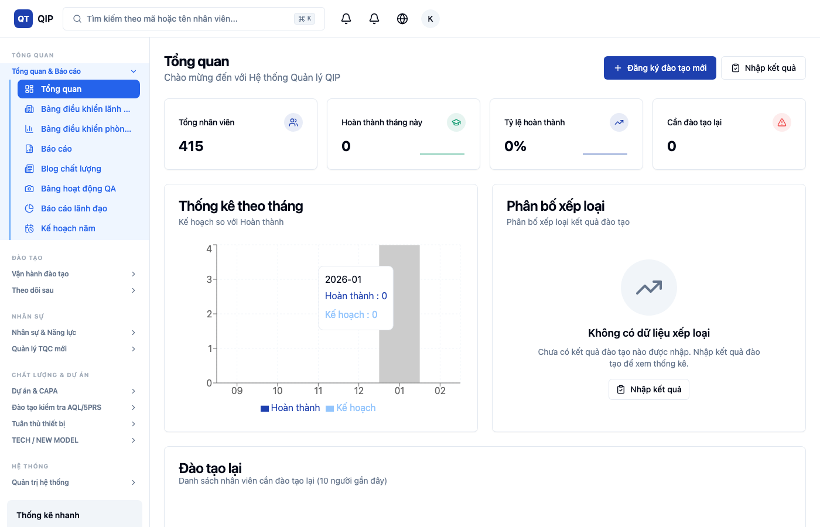
System Overview - 4 Pages
📊
📝
📋
📄
Dashboard
Input Form
History
Report
KPI summary, factory comparison, trends
Quick Entry + Detailed Entry modes
All inspection records, CA tracking
PDF report generation by week
3 / 23

Slide 4
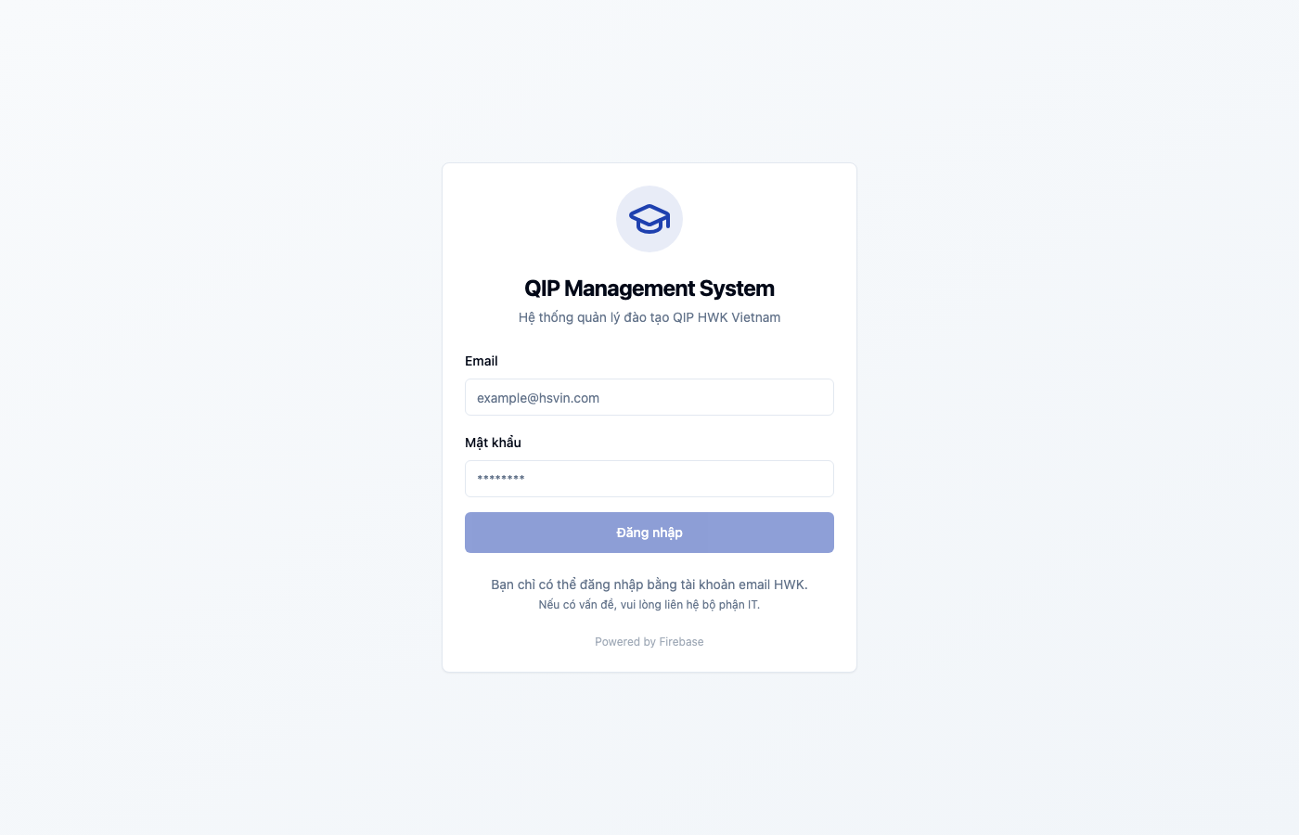
Step 1: Open Q-TRAIN
https://q-train-web.web.app/
Open Chrome browser and enter the URL above
1
Email field
2
Password field
3
Login button
4 / 23

Slide 5
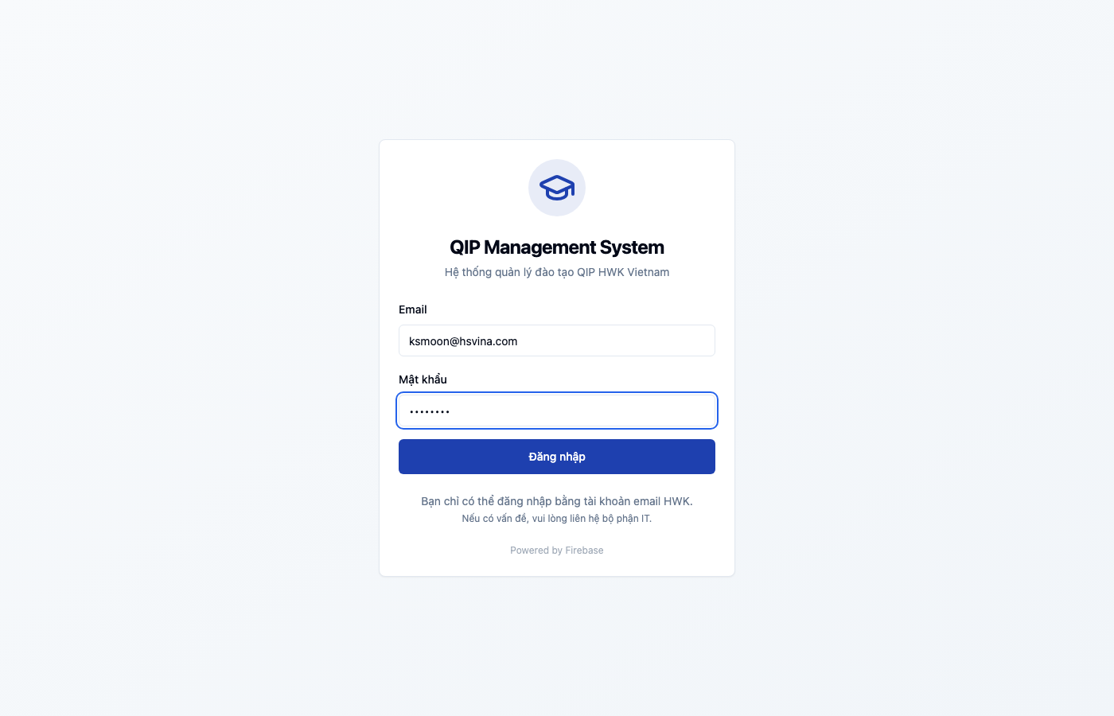
Step 2: Enter Credentials & Login
1
Enter your company email (@hsvina.com)
2
Enter your password
3
Click "Login" button
Only @hsvina.com, @hwaseung.com, @hwaseungvina.com emails allowed
5 / 23

Slide 6
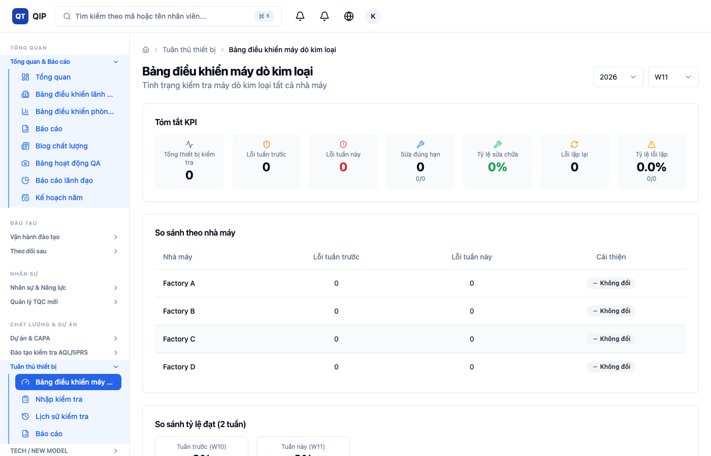
Step 3: Navigate to Metal Detector
Sidebar > Equipment Compliance > Metal Detector
The sidebar menu shows all Q-TRAIN modules. Metal Detector is under "Equipment Compliance".
1
Dashboard
2
Input Form
3
History
4
Report
6 / 23

Slide 7
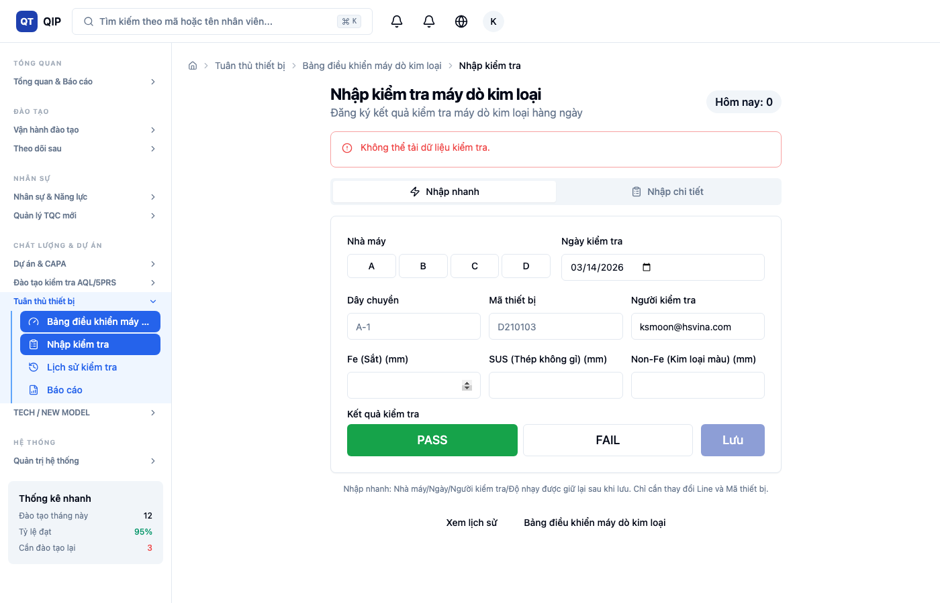
Quick Entry: Overview
All input fields on ONE screen - the fastest way to record inspections
"Quick Entry" tab selected at top
Sensitivity: Fe / SUS / Non-Fe
Factory A/B/C/D buttons
PASS/FAIL result + Save button
Line + Machine ID + Inspector
1
"Today: 0" counter at top right
4
2
5
3
6
7 / 23

Slide 8
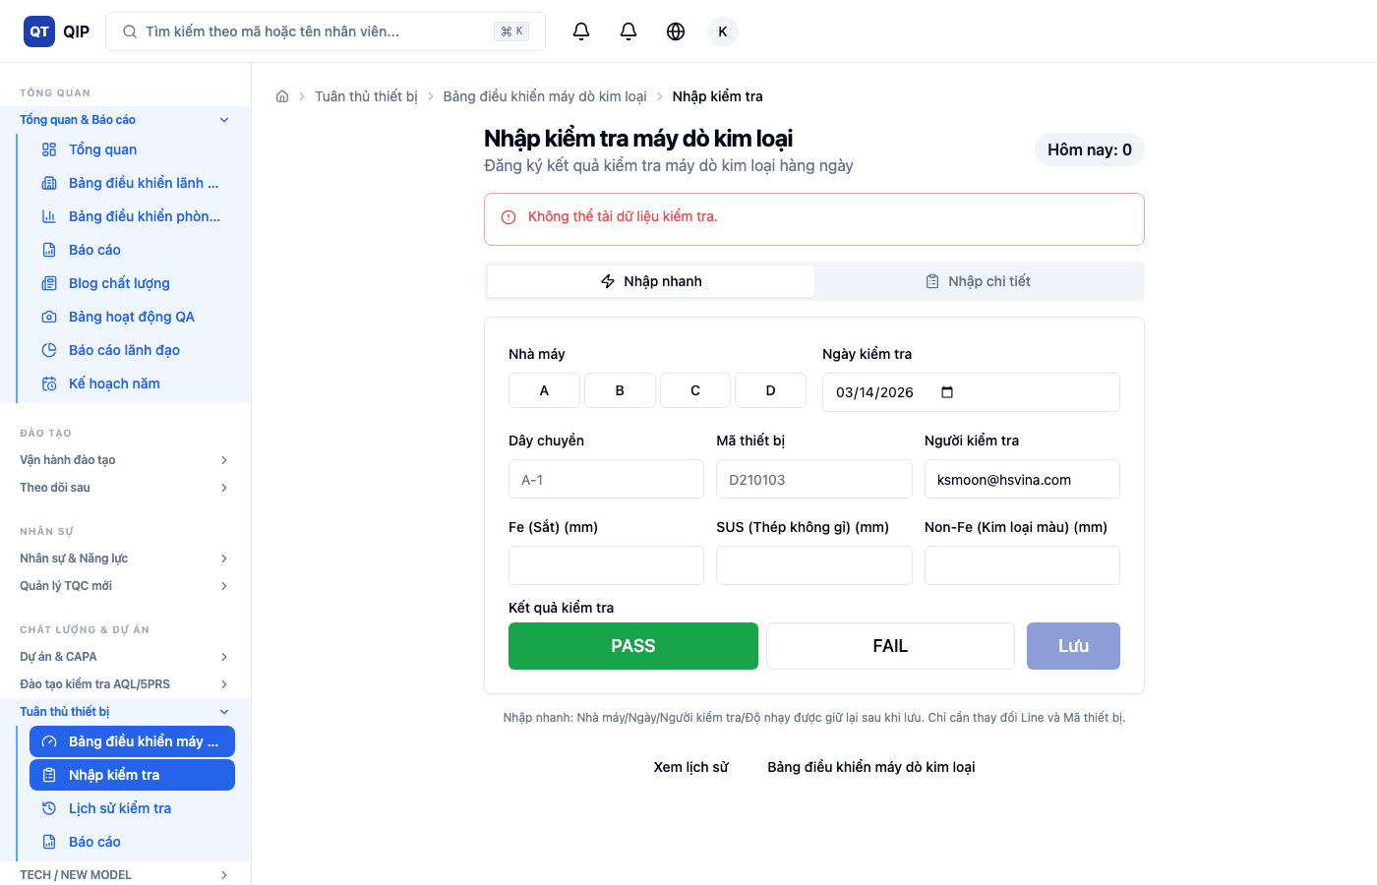
Step 4: Select Factory
Click one of A / B / C / D buttons. The selected button turns blue.
!
Factory A selected (blue)
Factory selection is retained after saving for continuous input.
8 / 23

Slide 9
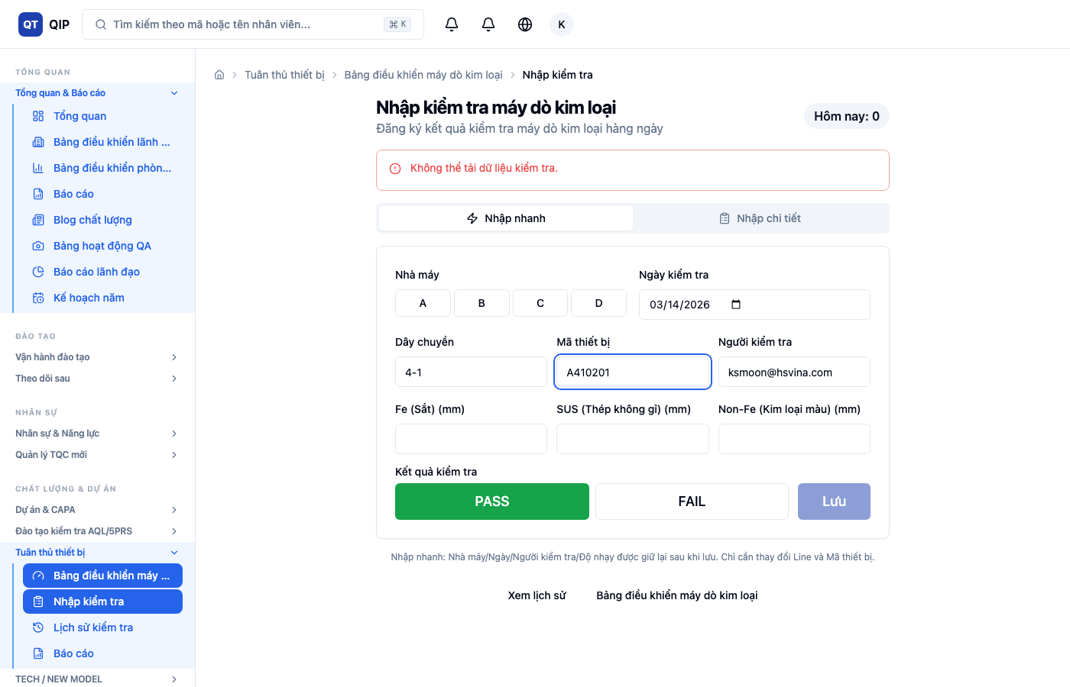
Step 5: Enter Line & Machine ID
1
Line field (e.g., 4-1)
2
Machine ID field (e.g., A410201)
💡 Machine ID is printed on the machine label. Auto-complete suggests previously used IDs.
9 / 23

Slide 10

Step 6: Enter Sensitivity Values
1
Fe = 1.5 mm
2
SUS = 2.0 mm
3
Non-Fe = 2.5 mm
✓ These values are retained after save for the next entry.
10 / 23

Slide 11
Step 7: Select Result & Save
1
PASS button (green) - default
2
Save button
Default is PASS. Only click FAIL if the machine failed the test.
11 / 23

Slide 12
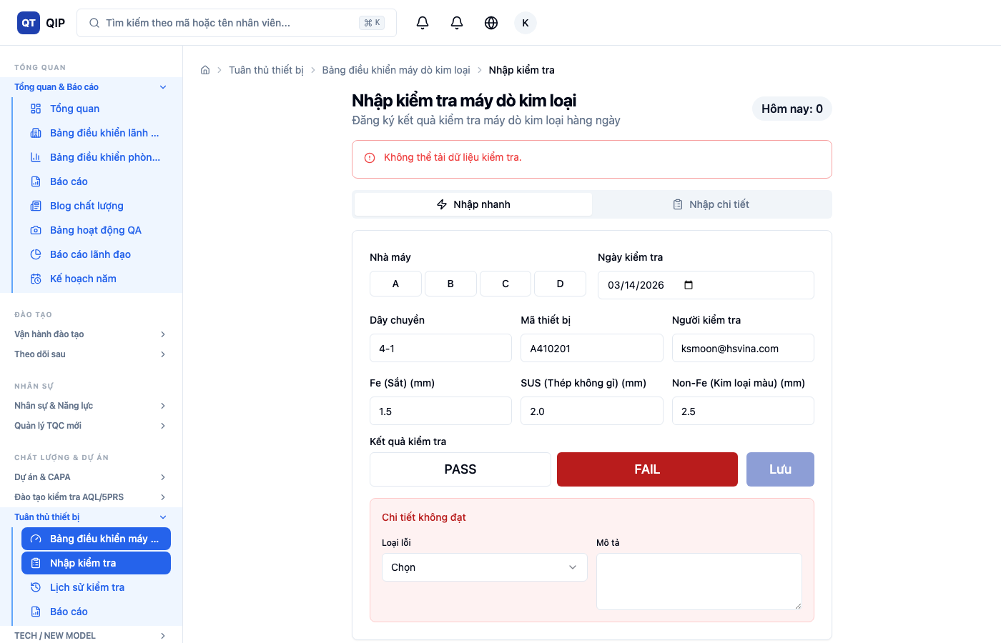
If FAIL: Enter Failure Details
When FAIL is selected, a red section appears:
1
Failure Type (dropdown): Sensitivity Drift, Equipment Malfunction, Calibration Error, etc.
2
Description (text): Describe what happened
AUTOMATIC: A Corrective Action (CA) is automatically created with status "Pending"
12 / 23

Slide 13
Quick Entry: Continuous Input Tips
✅ Retained after save
🔄 Reset after save
• Factory
• Line
• Date
• Machine ID
• Inspector
• Result (→ PASS)
• Sensitivity values
• Failure details
💡 Tips
1
Just change Line + Machine ID for each machine
2
"Today: N" counter tracks your progress
3
Green success message auto-hides after 3 seconds
4
Only change Factory button when moving to different building
13 / 23

Slide 14
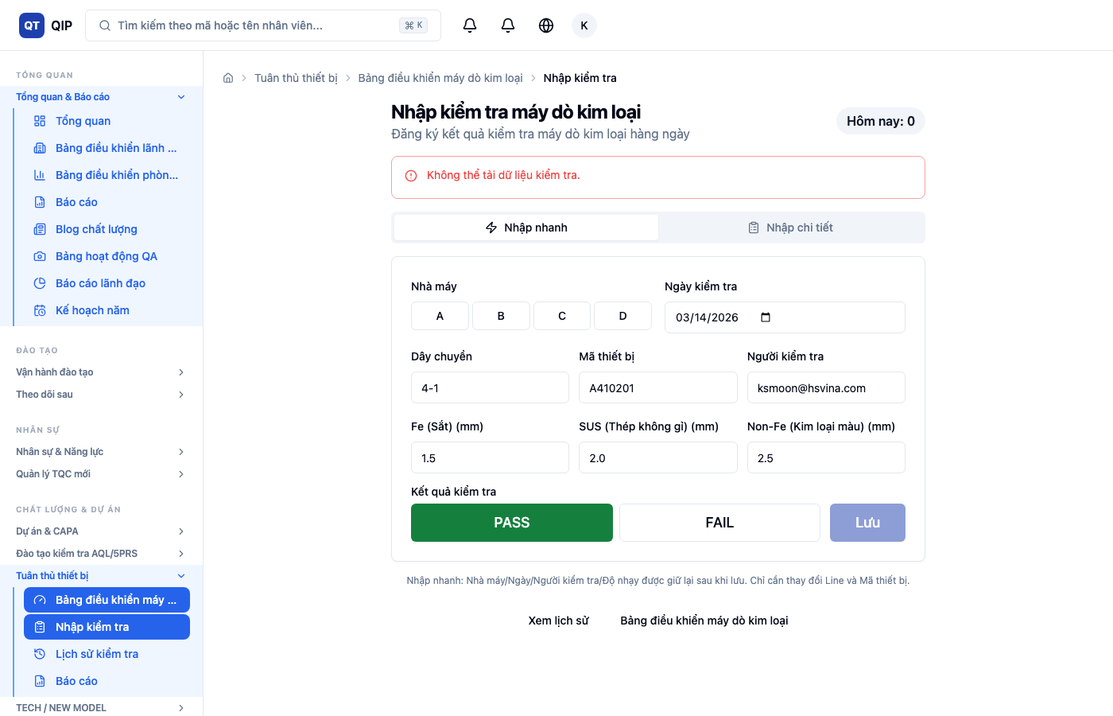
Detailed Entry Mode (4 Steps)
Use when you need Product Name or detailed Remarks
Step 1: Factory & Line
Step 2: Inspector Info
Step 3: Sensitivity
Step 4: Result & Save
Use Back/Next buttons to navigate. Green checkmarks show completed steps.
14 / 23

Slide 15
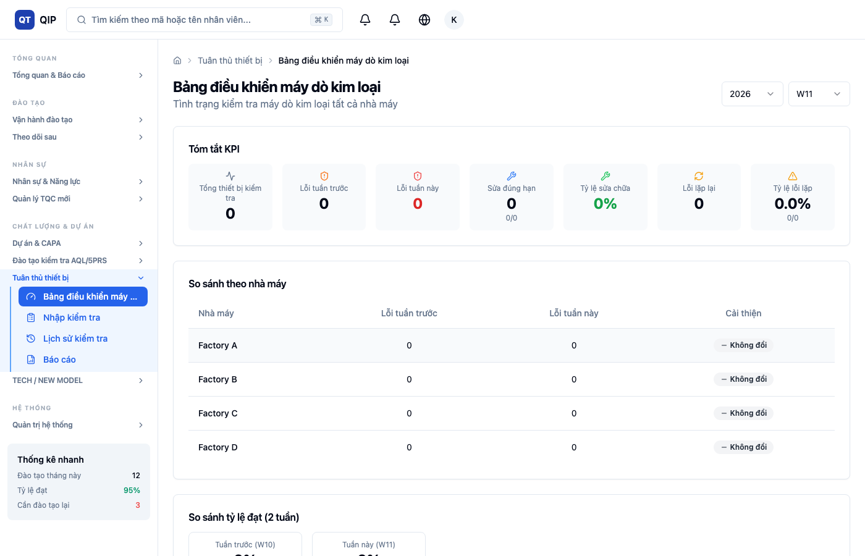
Dashboard: KPI Summary
Select Year and Week (W1-W52) at top right
1
2
3
4
5
6
7
Total Checked
Failed Last Week
Failed This Week
Fixed On Time
Maintenance Fix Rate
Repeated Issues
Repeated Issue Rate
15 / 23

Slide 16
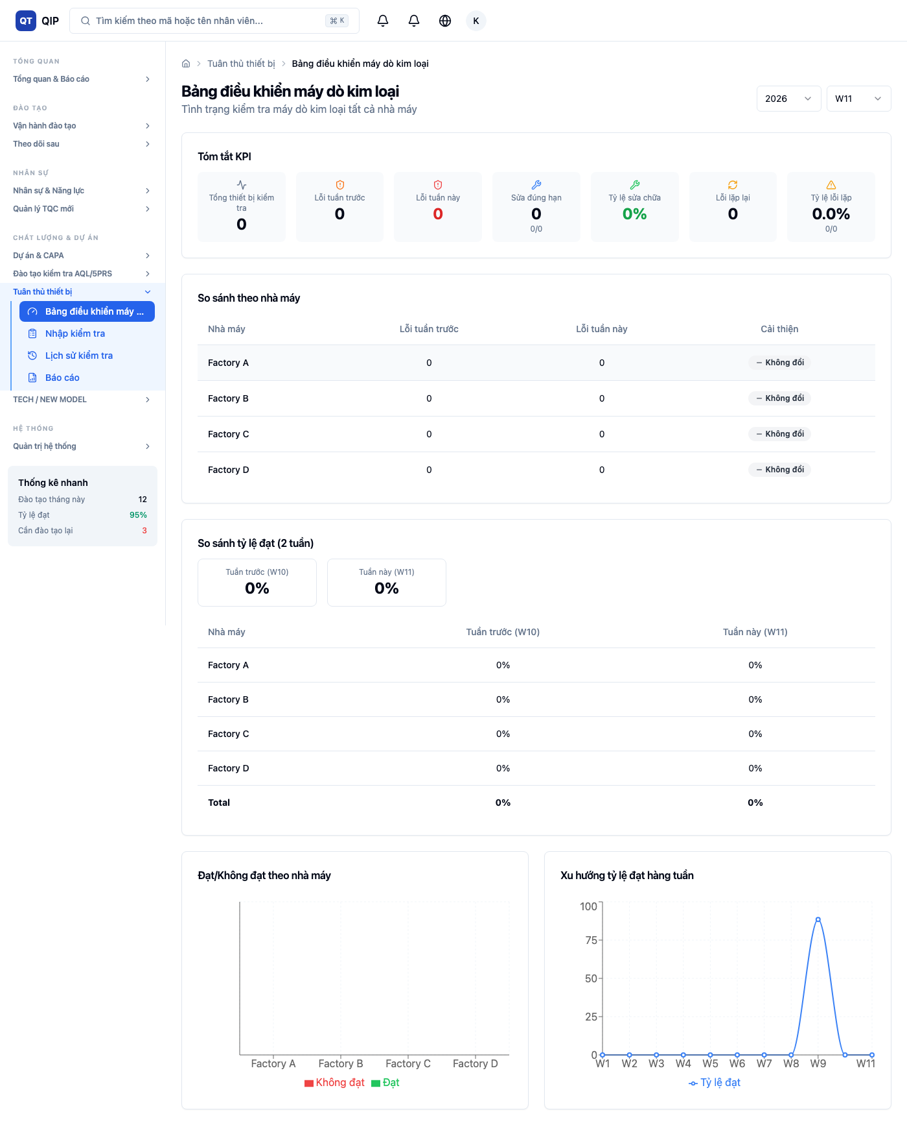
Dashboard: Factory Comparison
Compare this week vs last week by factory
Improved
No Change
Increased
This replaces the email report sent to management.
16 / 23

Slide 17
Dashboard: Pass Rate Comparison
2-week comparison table by factory
Green = improved vs last week
Red = decreased vs last week
Charts below: Bar chart (Pass/Fail by factory) + Line chart (12-week trend)
17 / 23

Slide 18
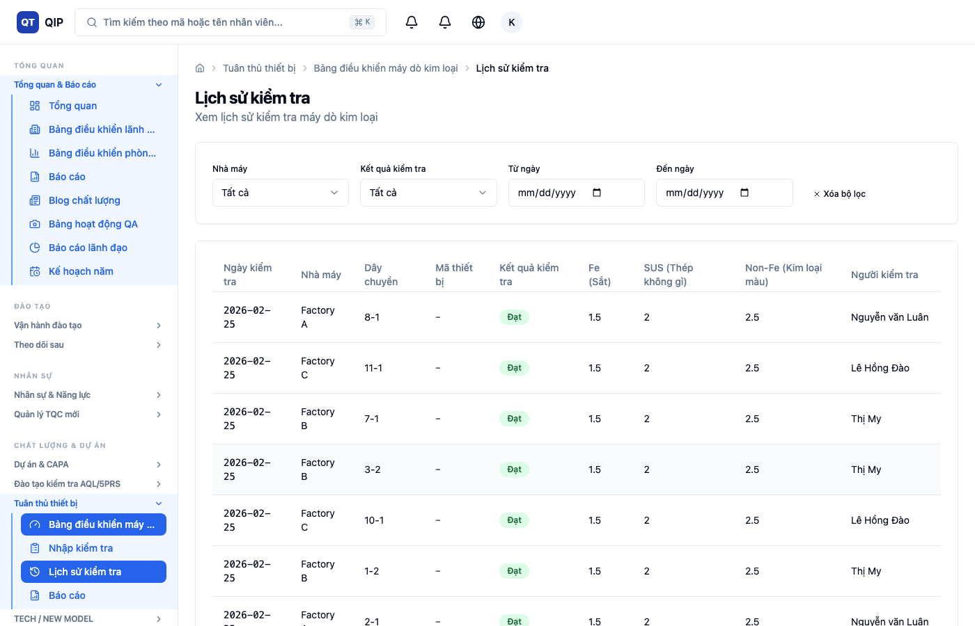
Inspection History: Search & Filter
1
Factory: All / A / B / C / D
2
Result: All / PASS / FAIL
3
Date From / Date To
4
Clear: Reset all filters
💡 Click any row to see full details and update CA status.
18 / 23

Slide 19
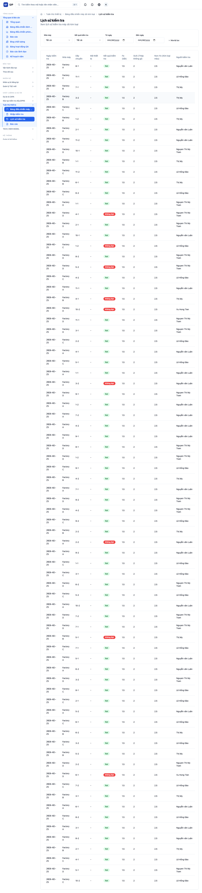
History: Update Corrective Action
Pending → Waiting for maintenance
→
In Progress → Being fixed
→
Completed → Fixed and verified
1. Go to History page
4. Update CA status in modal
2. Filter: Result = FAIL
5. Add fix description
3. Click the FAIL row
6. Click Update
✓ CA completion feeds the "Maintenance Fix Rate" KPI on Dashboard.
19 / 23

Slide 20
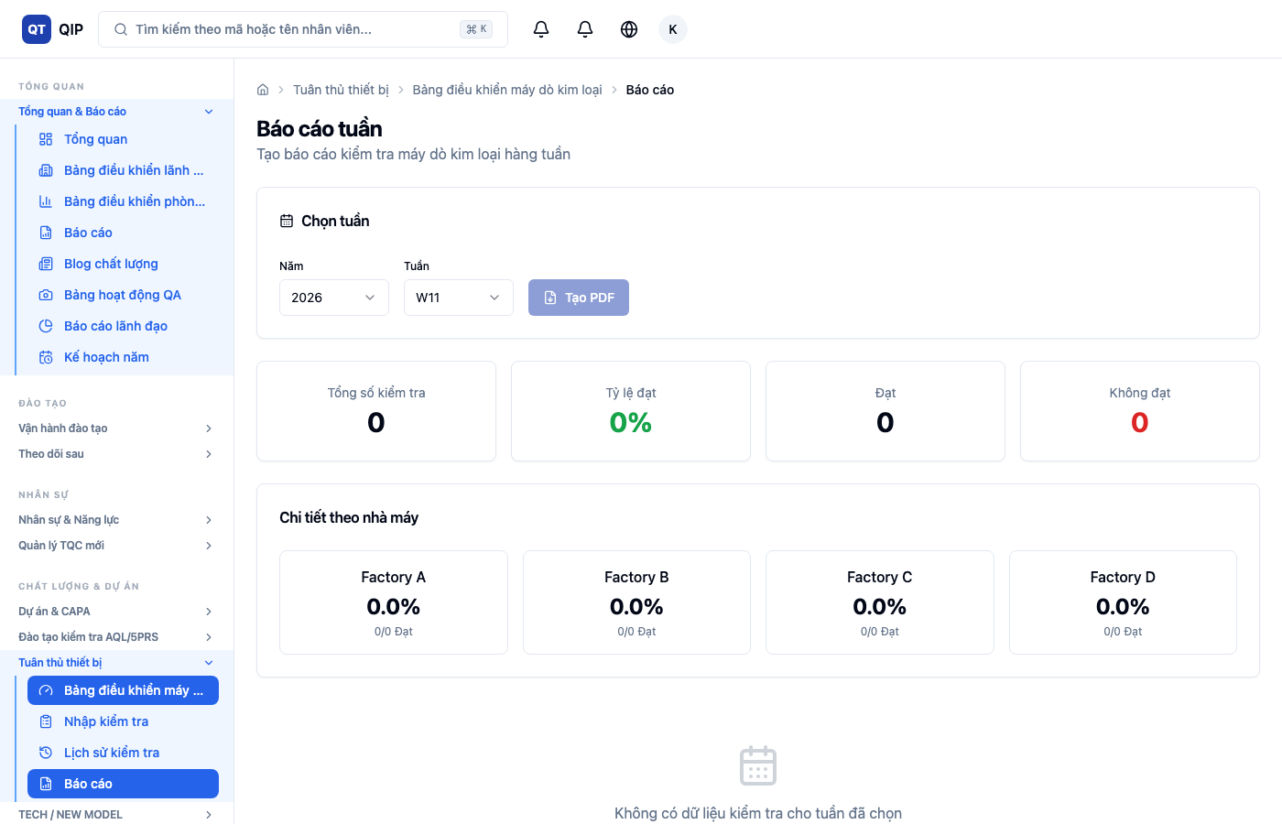
Weekly Report: PDF Generation
1
Select Year
2
Select Week (W1-W52)
3
Click "Generate PDF"
File: MD_Report_2026_W11.pdf
If no data for selected week, PDF button is disabled.
20 / 23

Slide 21
Daily Workflow Summary
MORNING
IF FAIL
WEEKLY
AFTER FIX
📋
⚠️
📊
🔧
Record Inspections
Handle Failure
Review Dashboard
Update CA
1. Open Q-TRAIN
1. Select FAIL result
1. Check KPI summary
1. Go to History
2. Quick Entry mode
2. Choose Failure Type
2. Review factory comparison
2. Find FAIL item
3. Enter each machine
3. Enter description
3. Check repeated issues
3. Update CA status
4. Check "Today: N" counter
4. Save → CA auto-created
4. Generate PDF if needed
4. Add fix description
21 / 23

Slide 22
Frequently Asked Questions
Q1: Do I need Machine ID?
A: Optional, but needed for repeated issue tracking.
Q2: What if I make a mistake?
A: Find in History, contact admin to correct.
Q3: How is repeated issue detected?
A: Same machine/line FAIL 2 weeks in a row.
Q4: Who updates CA status?
A: QIP or maintenance team.
Q5: Can I use my phone?
A: Yes! Works on Chrome mobile. Add to home screen.
22 / 23

Slide 23
Contact & Support
System URL
https://q-train-web.web.app/
Support
QIP Department
Email
ksmoon@hsvina.com
Thank you for using Q-TRAIN!
Accurate inspection data leads to better quality.
23 / 23

