Slide 1
HWK Metal Found in Shoes Report System
Q-TRAIN Metal Shoe Case — User Manual
March 20, 2026
HWK Vietnam QIP Department

Slide 2
Workflow: Before vs After
❌ Previous (Manual)
✅ New System (Q-TRAIN)
• Manual Excel recording (144 cases/year)
• Web-based case registration + Excel bulk import
• Single QA staff managing alone
• Real-time dashboard (KPI, charts, by factory/supplier)
• Action plans requested/tracked via email
• Auto workflow by supplier type (Bottom→Return Dashboard / Upper→PPTX)
• Reports manually created (weekly/monthly)
• PDF/Excel/PPTX reports with 1-click
• No data sharing, no real-time visibility
• 3-project integration (Q-TRAIN ↔ Return Dashboard ↔ Quality OS)

Slide 3
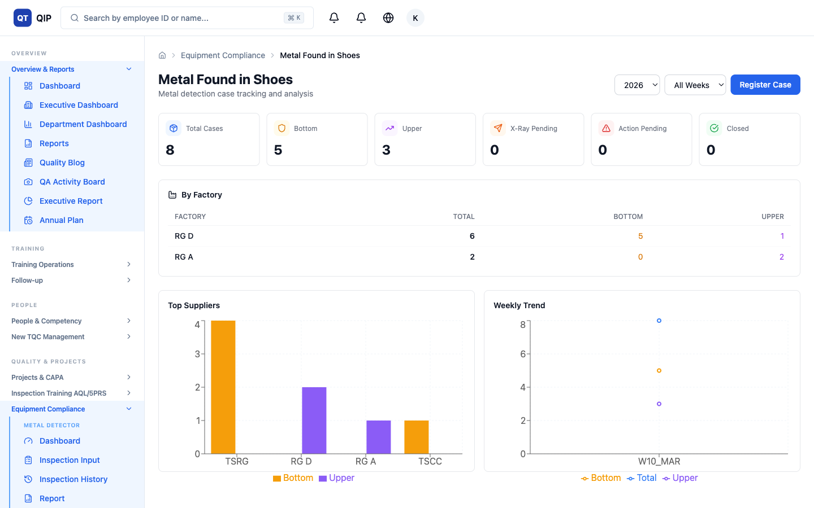
1. Dashboard
6 KPI cards, factory table, supplier chart, weekly trend

Slide 4
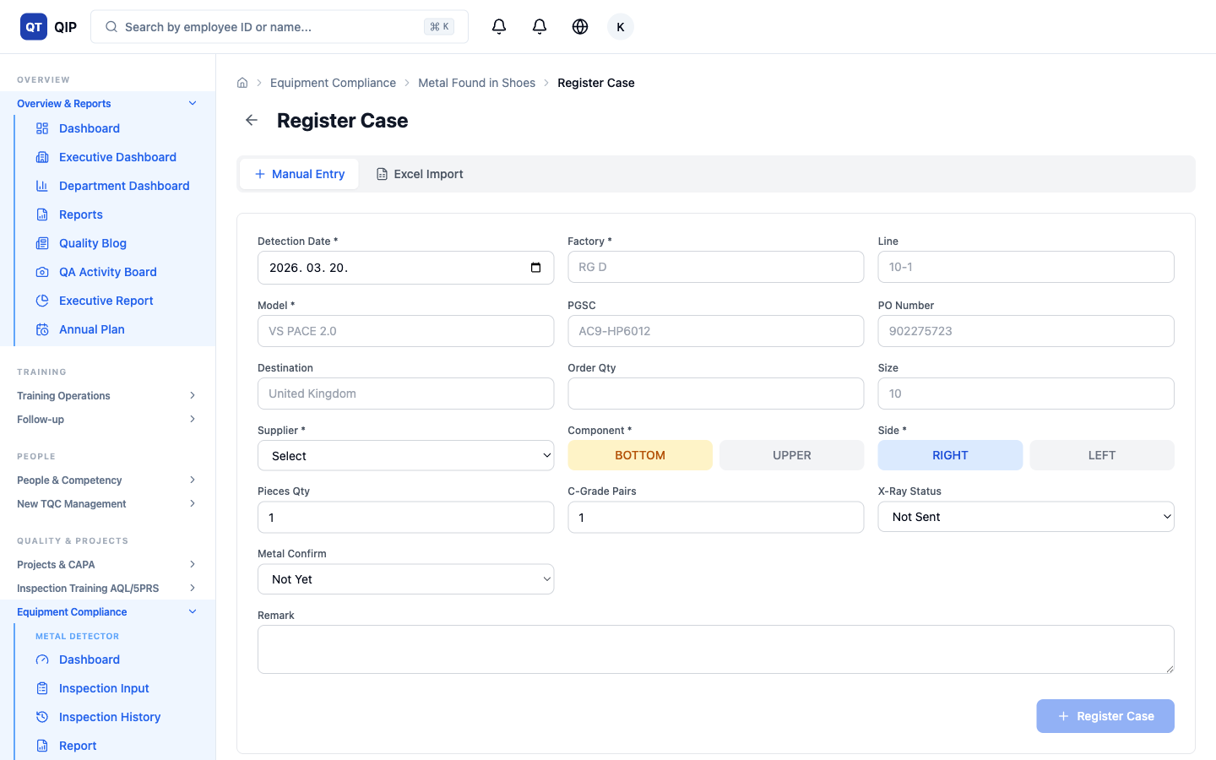
2. Case Register (Manual)
Manual entry form — 15 fields (date, factory, line, model, supplier, component, X-Ray etc.)

Slide 5
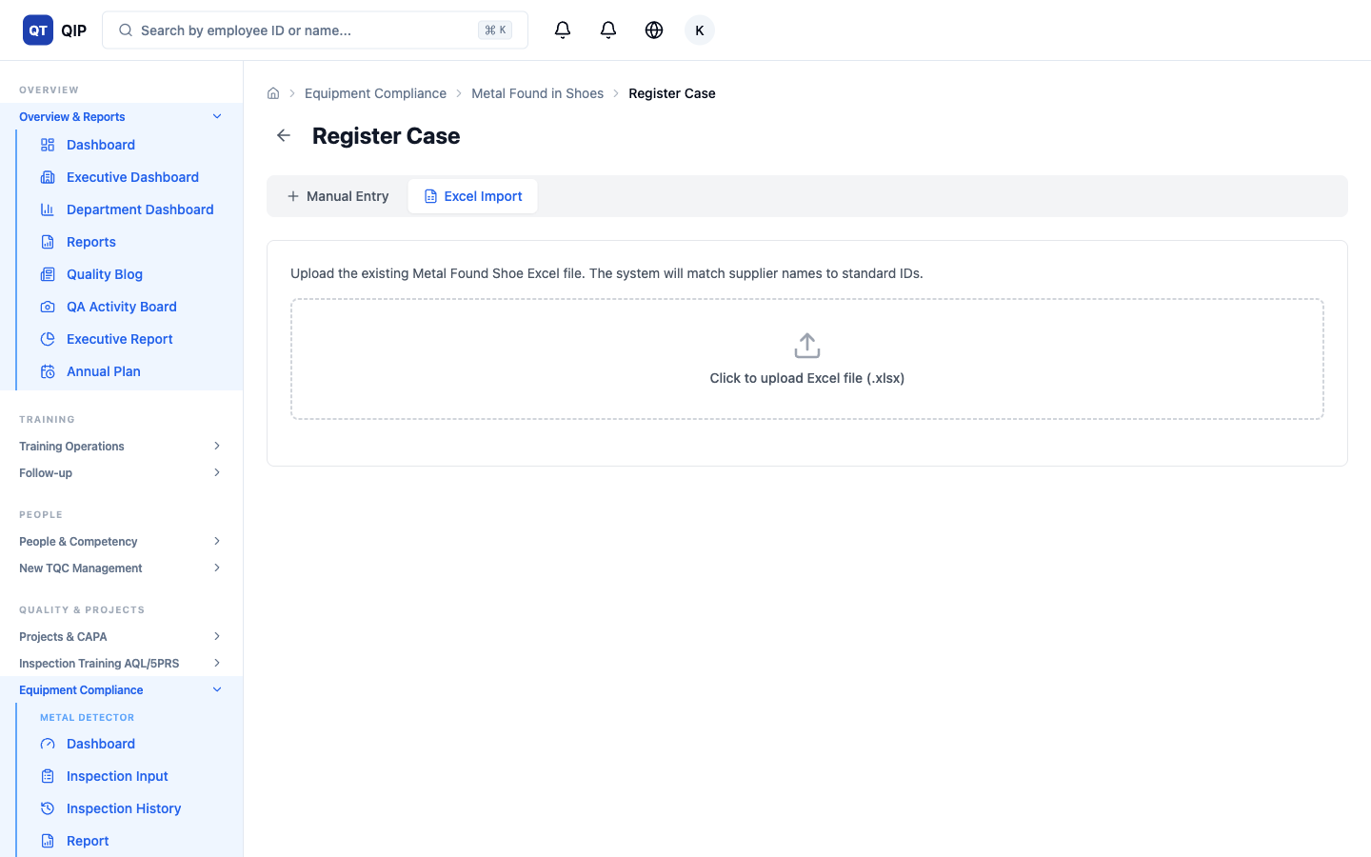
3. Case Register (Excel)
Upload existing Excel file → Auto-match supplier names → Bulk import

Slide 6
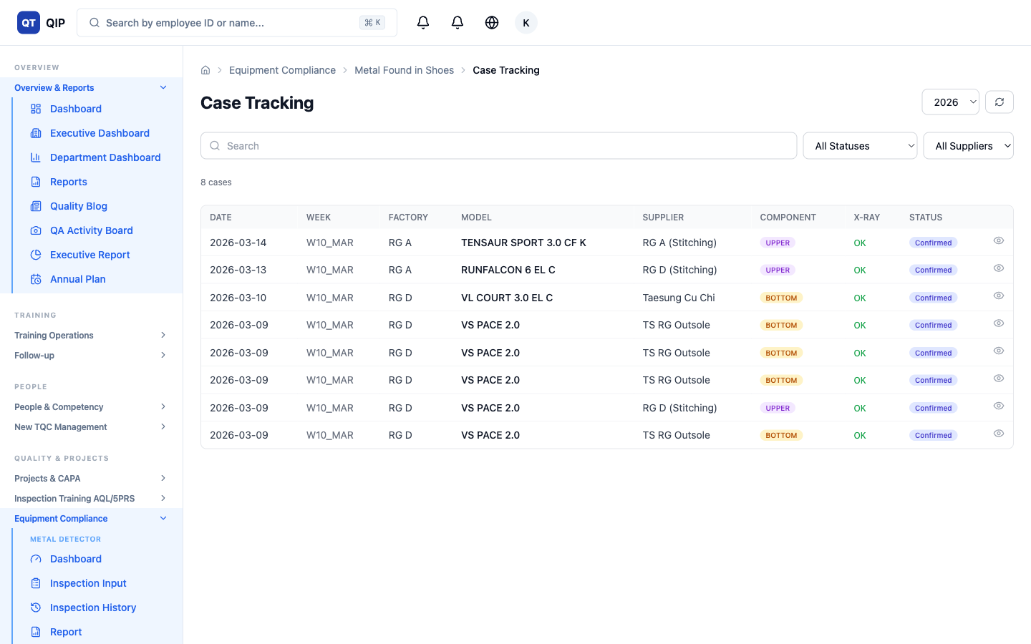
4. Case Tracking
Table with search/status/supplier filters + detail modal

Slide 7
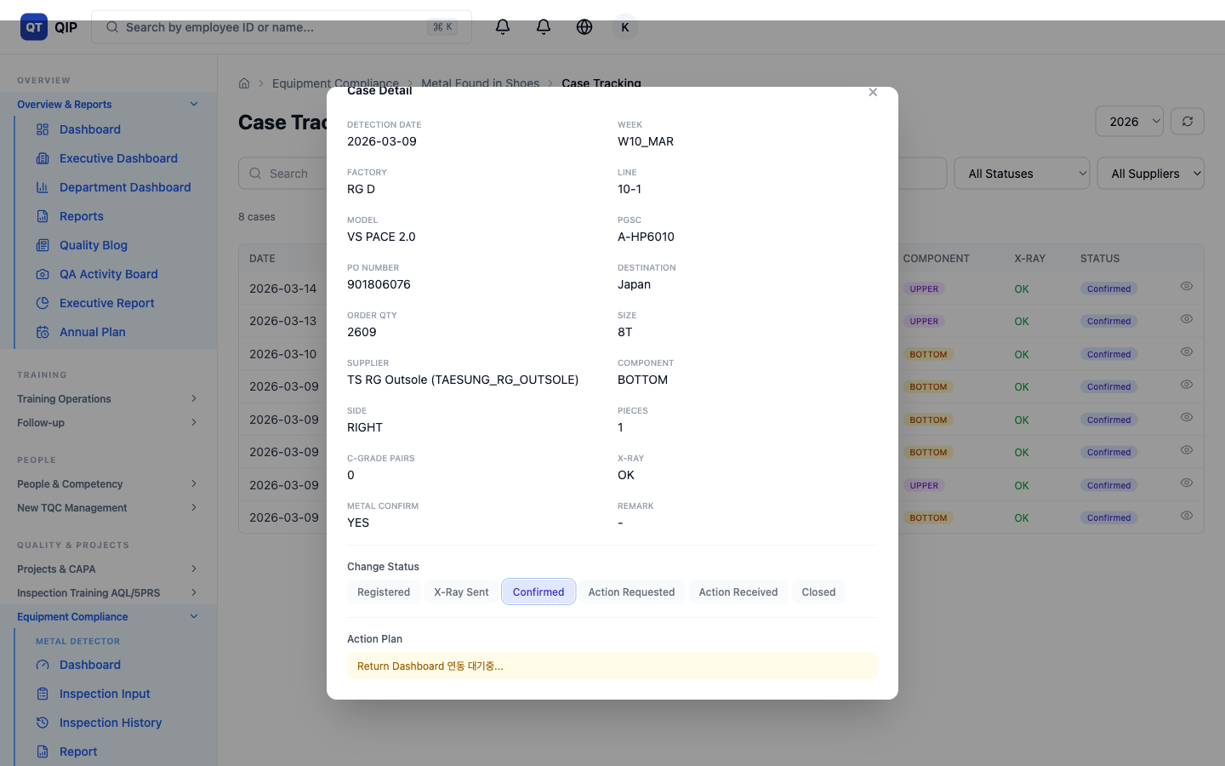
5. Bottom Supplier Workflow
Auto sync to Return Dashboard → Supplier submits action plan → Reverse sync

Slide 8
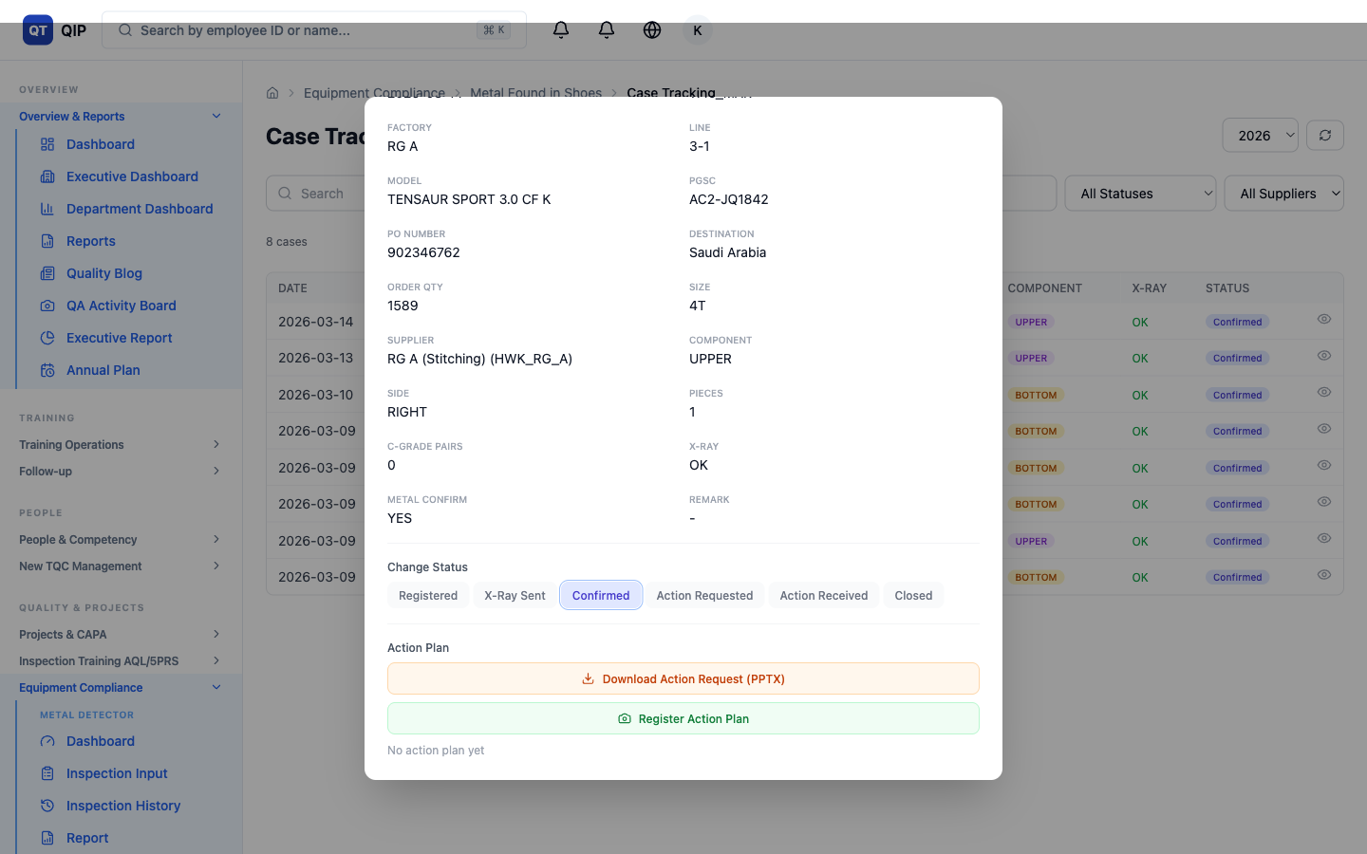
6. Upper/Internal Supplier Workflow
Download PPTX action request → Send to team → Upload photos + description

Slide 9
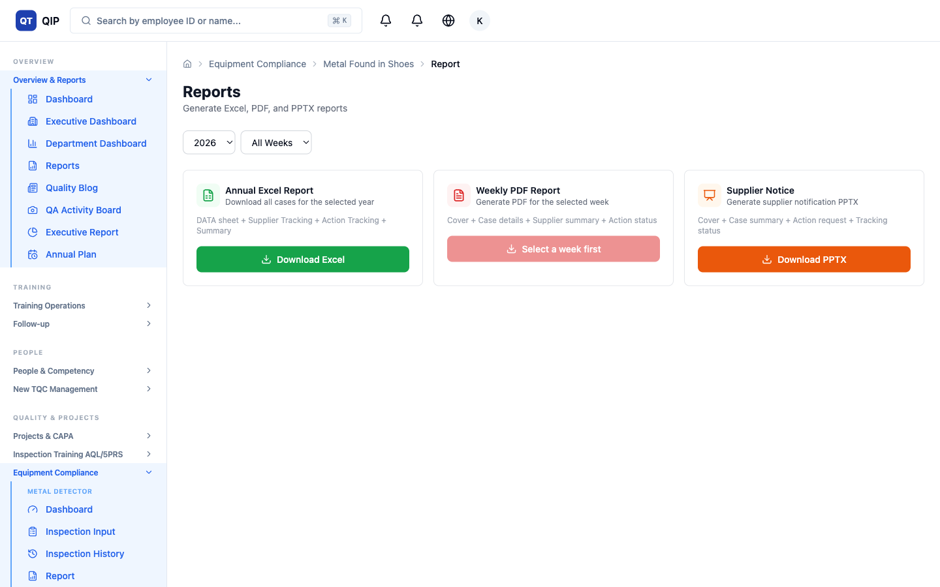
7. Report Generation
Annual Excel (4 sheets), Weekly PDF (jsPDF), Supplier Notice PPTX (16:9)

Slide 10
Example Scenarios
Scenario 1: Bottom — TS RG Outsole Metal Found
1. QA registers case (VS PACE 2.0, RG D 10-1, BOTTOM)
2. System auto-creates issue in Return Dashboard
3. TS RG Outsole submits action plan in Return Dashboard
4. QA clicks "Sync Actions" → Confirmed
5. Status: Confirmed → Action Received → Closed

Slide 11
Example Scenarios
Scenario 2: Upper — RG A Stitching Metal Found
1. QA registers case (TENSAUR SPORT, RG A 3-1, UPPER)
2. Click "Download Action Request (PPTX)" in Tracking
3. Email PPTX to RG A stitching team
4. Team replies with root cause + corrective action
5. QA clicks "Register Action Plan" → upload photos
6. Status: Confirmed → Action Received → Closed

Slide 12
Example Scenarios
Scenario 3: Excel Bulk Import
1. Prepare existing Excel file (DATA sheet)
2. Case Register → Excel Import → Upload file
3. Auto-match supplier names (TSRG → TAESUNG_RG_OUTSOLE)
4. Review unmatched → Click Import
5. Dashboard shows all data immediately

Slide 13
Thank You
Contact: hwk_qa@hsvina.com | System: https://q-train-web.web.app/equipment/metal-shoes
Generated by Q-TRAIN System

