Slide 1
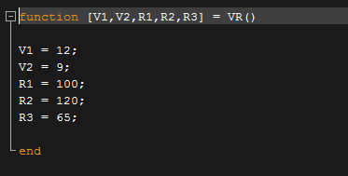
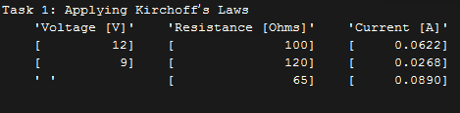

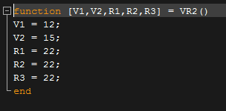
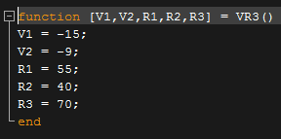
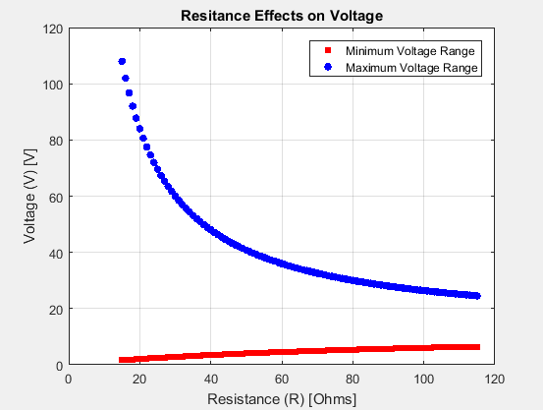
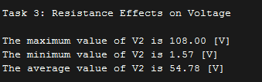
Circuit Analysis: Applying Kirchhoff’s Laws
Mubashar Khan, Andrew Nguyen, Nelson Nguyen
ENGI 1331 – Project 2 – The best group
This project is designed to give students insight into the types of work that they will be doing in their future circuit analysis I and II classes. Designed with electrical and computer engineers in mind, the project requires using Ohm's Law and Kirchhoff's Loop rules and solving the given circuit for currents (I1, I2, I3). In addition to using Kirchhoff's laws to analyzing the circuit in order to calculate the currents in their respective resistors, the program also finds the allowable limits for the voltage using a system of linear equations.
Method/Algorithm
Test Cases:
Results:
The first portion of the output displays an array listing the current voltage and resistance
The second portion of output is the minimum and maximum Voltages with the given test case
The final portion of the output is the largest voltage the largest smallest and average voltages of the circuit based on the resistance as well as a graph displaying the relationship.
Start: Call the VR function to the those values in the script
Create a new function called CircuitSolver that will be used for all calculations.
In this function using equations based on Kirchhoff’s loop rules and the junction rule, calculate the current passing through the 3 respective resistors.
Display there values in an array with formatted output.
Test Cases were chosen at random aside from the given case, but all test cases were worked out by hand before being finalized
Test Case 1:
2. In CircuitSolver, redefine all variables so that you don’t overwrite any previous calculations and find the max and min voltages that will work for the circuit if the circuit is limited to 1 Amp.
3. Similar to step 2, you need to write the code in CircuitSolver that will find the range of voltage values that work for a resistance from 15 ohms to 115 ohms.
This is done by creating a for loop ranging from
R = 15 to R = 115 and redefining all variables used
steps 1 and 2.
The loop will need to store the min and max values in 2 vectors which will be used as the Y values of the graph. The index value for the vector should be (R-14) because the first R value is 15.
Test Case 2:
Test Case 3:
Test Case 3 has negative voltages so that you can test the code to see if it will accept negative values. (The code converts all negative values into positive values and continues as normal)
Conclusions and Limitations:
When negative values are input in the VR function, the program passes them on to continue after they are converted to positive values. Rather than giving an error, the program outputs a warning notifying the user that it detected an issue with the provided data and adjusted accordingly.
Although writing the code was a little repetitive and at times very difficult to fix issues (Because the errors were in the math and more often than not it’s not easy to spot errors in your own calculations), the final product is quite a helpful tool. This program allows a user to define any values for V1,V2,R1,R2,R3 and use the program to solve the circuit for not only the currents but also analyze the circuit to optimize it for the best voltage value. The limitations of this code are that it can only work for this one specific type of circuit. In addition to that, the code was not intended to be able to deal with negative currents or voltages meaning that it won’t work for either of those scenarios.

