Slide 1

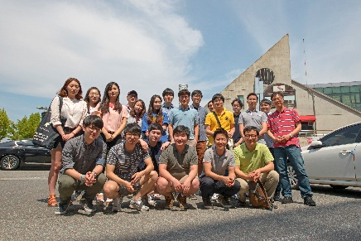
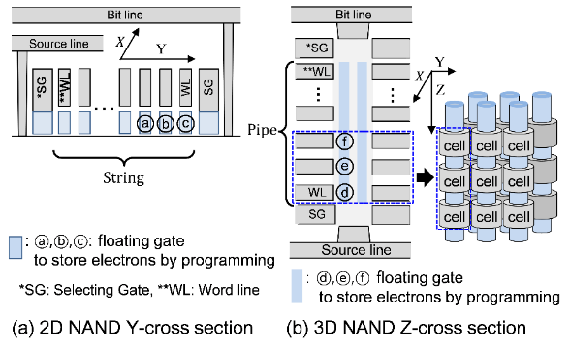
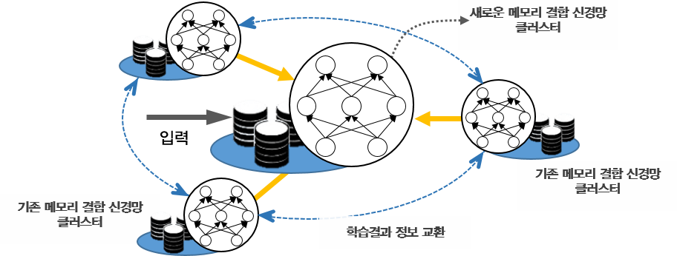
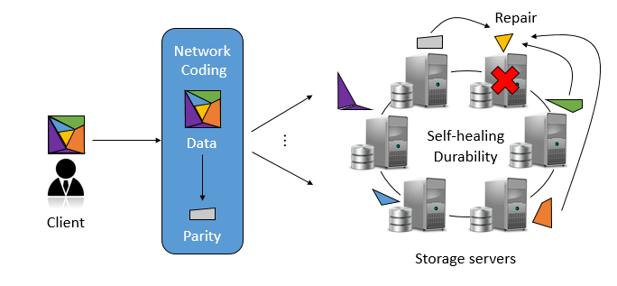
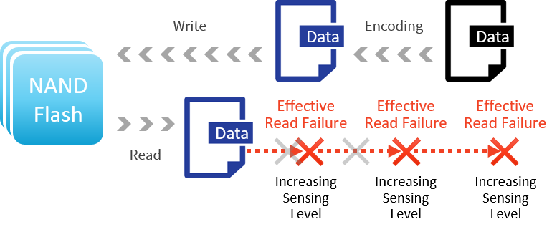
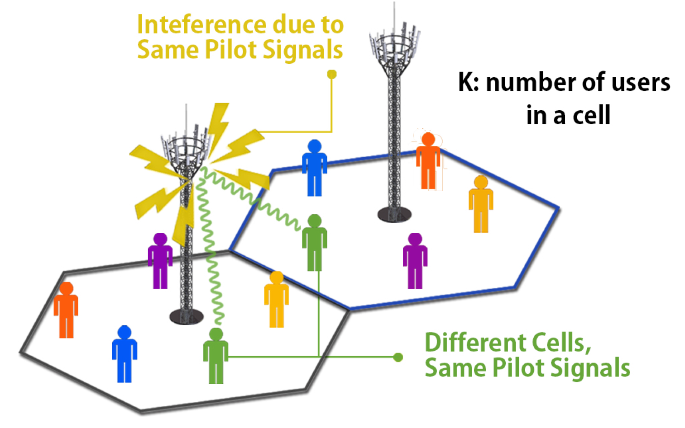
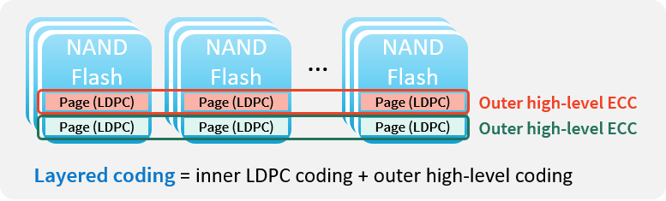
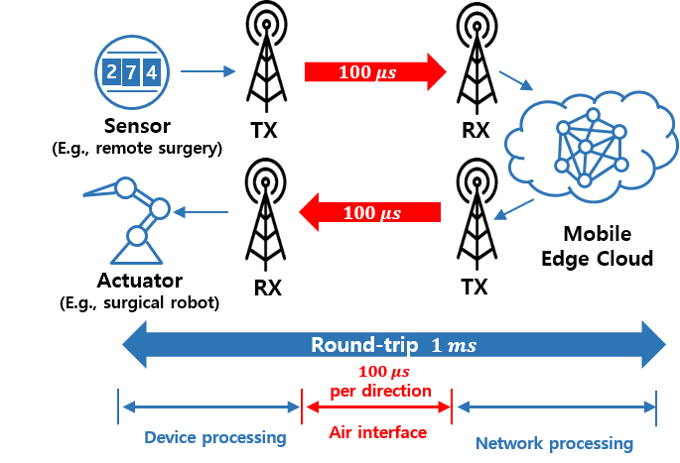


Communications and Storage Laboratory*
* Selecting KEPSI students only for 2018 Spring
Prof. Jaekyun Moon
School of Electrical Engineering
“
The Communications and Storage Lab (the "ComSto" Lab) is Prof. Jaekyun Moon's research group in the School of Electrical Engineering at KAIST. Our research deals with signal processing and coding for various communication and storage channels. Our research topics cover a broad range of issues - from highly theoretical capacity studies to more practically-oriented low-complexity algorithms - on equalization, detection, interference cancelation, error correction coding, channel-matched coding, timing recovery and parameter estimation.
’’
3D NAND Flash
Artificial Intelligence
Recently, 3D NAND flash has been introduced to replace 2D NAND flash. We investigate equalization techniques and error-correction coding algorithms to reduce the error rate of 3D NAND flash.
We focus on developing clustered neural network with an external memory for high speed/adaptive meta learning. Both theoretical and experimental analyses are ongoing.
Distributed Storage System^{[4-7]}
Distributed storage system is a network of storage nodes to store data reliably over a long period of time. We focus on network coding for distributed storage, considering bandwidth efficiency, latency and security issues.
System Error-Correction Codes (ECCs) ^{[3, 8-10, 12]}
Error-correction codes (ECCs) for storage applications are under study with a particular focus on the tradeoffs and efficient allocation of resources throughout the system.
5G Communications^{[1,2,11]}
Pilot Reuse Strategies in Massive MIMO Systems. We proposed pilot reuse methods which effectively mitigate pilot contamination and increase the net throughput.
New Waveform Design for 5G low-latency Communications. We investigate ways of improving OFDM by combining windowing and filtering.
Recent Research Achievements
[1] J. Sohn, S. W. Yoon and J. Moon, "Pilot Reuse Strategy Maximizing the Weighted-Sum-Rate in Massive MIMO Systems," IEEE Journal on Selected Areas in Communications, vol. 35, no. 8, pp. 1728-1740, Aug. 2017.
[2] D.-J. Han, J. Moon, D. Kim, S.-Y. Chung and Y. Lee, "Combined Subband-Subcarrier Spectral Shaping in Multi-Carrier Modulation under the Excess Frame Length Constraint," IEEE Journal on Selected Areas in Communications, vol. 35, no. 6, pp. 1339-1352, June 2017.
[3] S. W. Yoon and J. Moon, "Low-Complexity Concatenated Polar Codes with Excellent Scaling Behavior," 2017 IEEE International Conference on Communications (ICC) Workshop on Channel Coding for 5G and Future Networks, May. 2017
[4] H. Park and J. Moon, "Improving Read Access Time of High-Performance Solid-State Drives via Layered Coding Schemes," 2017 IEEE International Conference on Communications (ICC), May. 2017
[5] J. Sohn, B. Choi, S. W. Yoon and J. Moon, "Capacity of Clustered Distributed Storage," 2017 IEEE International Conference on Communications (ICC), May. 2017 (won the Best Paper Award of the conference)
[6] B. Choi, J. Sohn, S. W. Yoon and J. Moon, "Secure Clustered Distributed Storage Against Eavesdroppers," 2017 IEEE International Conference on Communications (ICC), May. 2017
[7] D. Lee, H. Park and J. Moon, "Reducing repair-bandwidth using codes based on factor graphs," 2016 IEEE International Conference on Communications (ICC), Kuala Lumpur, May. 2016.
[8] S. Kang, J. Moon, J. Ha and J. Shin, "Breaking the Trapping Sets in LDPC Codes: Check Node Removal and Collaborative Decoding," in IEEE Transactions on Communications, Jan. 2016.
[9] J. Oh, J. Ha, H. Park and J. Moon, "RS-LDPC Concatenated Coding for the Modern Tape Storage Channel," in IEEE Transactions on Communications, Jan. 2016.
[10] S. W. Yoon and J. Moon, "Two-Dimensional Error-Pattern-Correcting Codes," in IEEE Transactions on Communications, Aug. 2015.
[11] J. Y. Sohn, S. W. Yoon and J. Moon, "When pilots should not be reused across interfering cells in massive MIMO," 2015 IEEE International Conference on Communication Workshop (ICCW), London, 2015 (won the Qualcomm Innovation Award in 2015).
[12] G. Yu and J. Moon, "Concatenated Raptor Codes in NAND Flash Memory," in IEEE Journal on Selected Areas in Comm., May 2014.

