Slide 1
Chapter 1: Introduction
Yanhui Guo
yhguo@bupt.edu.cn

Slide 2
Outline
Course Information
Why Study Compilers?
The Evolution of Programming Languages
Compiler Structure and Phases
How to Learn Compilers?
Notes:
课程信息
为什么要学习编译器？
程序设计语言的演变
编译器结构和阶段
如何学习这门课程？

Slide 3
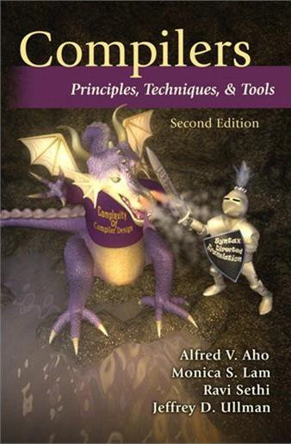
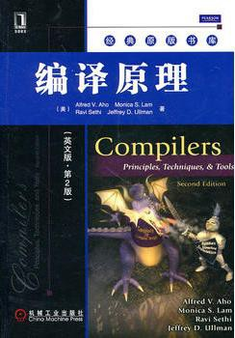
Textbook: The “Dragon Book” (Second Edition)

Slide 4
Reference Book for Labs
《程序设计语言编译原理》，陈火旺等编著、国防工业出版社，2012.7
《编译原理》（第3版）， 王生原等编著， 清华大学出版社，2015.12
《编译原理》，蒋宗礼著，高等教育出版社，2010.2
《编译原理与技术》，李文生编著，清华大学出版社，2018.6

Slide 5
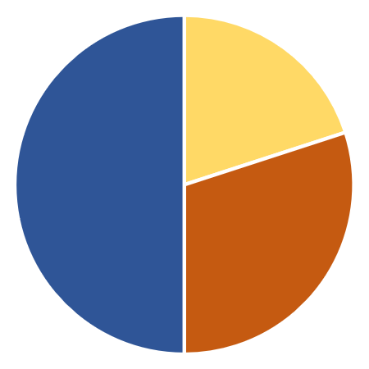
Marking Scheme
Projects
20%
Final exam
50%
Written assignments & Labs
30%
Notes:
评分标准

Slide 6

Course Content
Introduction to Compilers (引论)
Lexical Analysis (词法分析)
Syntax Analysis (语法分析)
Syntax-Directed Translation (语法制导的翻译)
Intermediate-Code Generation (中间代码生成)
Run-Time Environments (运行时刻环境)
Code Generation (代码生成)
Machine-Independent Optimizations (机器无关优化)
indicates difficulty level, the more the harder

Slide 7
Outline
Course Information
Why Study Compilers?
The Evolution of Programming Languages
Compiler Structure and Phases
How to Learn Compilers?
Notes:
课程信息
为什么要学习编译器？
程序设计语言的演变
编译器结构和阶段
如何学习这门课程？

Slide 8
Why Study This “Difficult” Course?
A fundamental computer science course
Learn compilation and program analysis techniques
Learn how to build programming languages
Course covers both theoretical and practical aspects
Theory: Lectures and written assignments
Practice: Labs and programming assignments
If you want to become a hardcore programmer
Notes:
为什么要学习这门“难”的课程？
计算机科学基础课程
学习编译和程序分析技术
学习如何构建程序设计语言
课程涵盖理论和实践两个方面
▪ 理论：讲座和书面作业
▪ 实践：实验室和编程任务
如果你想成为一名硬核程序员

Slide 9
Outline
Course Information
Why Study Compilers?
The Evolution of Programming Languages
Compiler Structure and Phases
How to Learn Compilers?
Notes:
课程信息
为什么要学习编译器？
程序设计语言的演变
编译器结构和阶段
如何学习这门课程？

Slide 10
Programming Languages
Notations for describing computations
All software is written in some programming language
Nowadays, there are over 700 programming languages (~250 popular ones)¹
Low-level (低级语言): directly understandable by a computer
High-level (高级语言): understandable by human beings, need a translator to be understood by a computer
¹ https://en.wikipedia.org/wiki/List_of_programming_languages
Notes:
编程语言
描述计算的符号
所有软件都是用某种编程语言编写的
如今，有700多种编程语言（约250种流行语言）
▪ 低级语言: 计算机可直接理解
▪ 高级语言: 人类可以理解，需要翻译才能被计算机理解

Slide 11

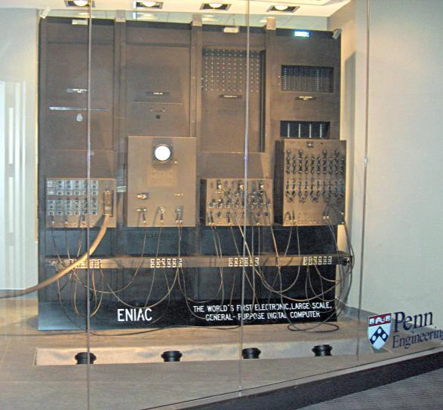
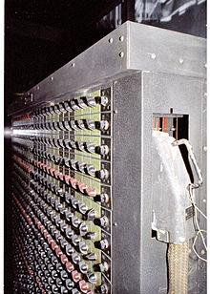
When It All Started …
The first electronic computer ENIAC appeared in 1946. It was programmed in machine language (sequences of 0’s and 1’s) by setting switches and cables.
https://en.wikipedia.org/wiki/ENIAC
Notes:
第一台电子计算机ENIAC出现在1946年。它是用机器语言（0和1的序列）通过设置开关和电缆进行编程的。

Slide 12
Can You Understand This?
0000100100101110011001100110100101101100011001010000100
1001000100110110001100101011000110111010001110101011100
1001100101001100010010111001100011001000100000101001100
1110110001101100011001100100101111101100011011011110110
1101011100000110100101101100011001010110010000101110001
1101000001010001011100111001101100101011000110111010001
1010010110111101101110000010010010001000101110011101000
1100101011110000111010000100010000010100000100100101110
0110000101101100011010010110011101101110001000000011010
0000010100000100100101110011001110110110001101111011000
1001100001011011000010000001101101011000010110100101101
1100000101000001001001011100111010001111001011100000110
0101000010010010000001101101011000010110100101101110...

Slide 13
Assembly Language (Early 1950s)
save %sp,-128,%sp
mov 1,%o0
st %o0,[%fp-20] mov 2,%o0
st %o0,[%fp-24] ld [%fp-20],%o0 ld [%fp-24],%o1 add %o0,%o1,%o0 st %o0,[%fp-28] mov 0,%i0
nop
1st step towards human-friendly languages
Mnemonic names (助记符) for machine instructions
Macro instructions for frequently used
sequences of machine instructions
Explicit manipulation of memory addresses and content
Still low-level and machine dependent
Notes:
汇编语言
迈向人类友好语言的第一步
助记符用于机器指令
宏指令用于频繁使用的机器指令序列
对内存地址和内容的显式操作
仍然是低级的且依赖于机器

Slide 14
The Move to High-Level Languages
Disadvantages of assembly language
Programming is tedious and slow
Programs are not understandable by human beings
Programs are error-prone and hard to debug
High-level programming languages appeared in the second half of the 1950s
Fortran: for scientific computation
Cobol: for business data processing
Lisp: for symbolic computation
Notes:
迈向高级语言
汇编语言的缺点
▪ 编程既乏味又缓慢
▪ 人类无法理解程序
▪ 程序容易出错且难以调试
高级编程语言出现在20世纪50年代后半叶
▪ Fortran：用于科学计算
▪ Cobol：用于业务数据处理
▪ Lisp：用于符号计算

Slide 15

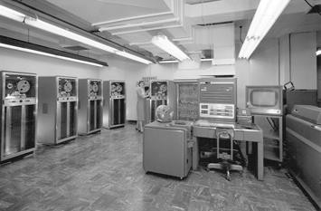
Fortran: The 1st High-Level Language
In 1953, John Backus proposed to develop a more practical alternative to assembly language for programming on IBM 704 mainframe computer
John Backus (1924 – 2007)
American Computer Scientist ACM Turing Award (1997)
IBM 704 mainframe
Notes:
1953年，John Backus提出开发一种更实用的替代汇编语言的方法，用于在IBM 704大型计算机上编程

Slide 16
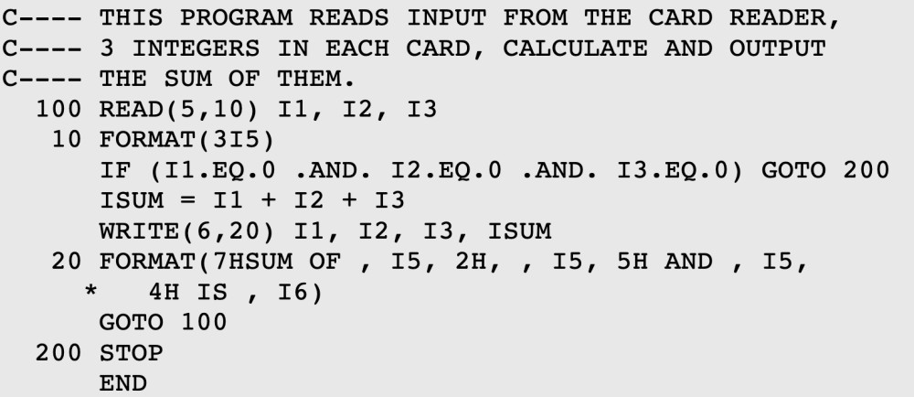
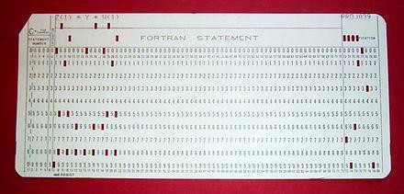
Fortran: The 1st High-Level Language
The 1st Fortran (Formula Translation) compiler was delivered in 1957
Coding became much faster, 50%+ software was in Fortran in 1958
Huge impact, modern compilers preserve the outline of Fortran I
Fortran is still widely used today (No. 31, TIOBE Index 2020)
Fortran code example Fortran code on a punch card
http://www.herongyang.com/Computer-History/FORTRAN-Program-Store-on-Punch-Card.html
Notes:
Fortran：第一代高级语言
第一个Fortran（Formula Translation）编译器于1957年推出
编码变得更快，1958年有50%以上的软件使用Fortran
影响巨大，现代编译器保留了Fortran I的大纲
Fortran至今仍在广泛使用）

Slide 17
Outline
Course Information
Why Study Compilers?
The Evolution of Programming Languages
Compiler Structure and Phases
How to Learn Compilers?
Notes:
课程信息
为什么要学习编译器？
程序设计语言的演变
编译器结构和阶段
如何学习这门课程？

Slide 18
The Structure of a Compiler
Lexical Analyzer
Syntax Analyzer
Semantic Analyzer
Intermediate Code Generator
Machine-Independent Code Optimizer
Code Generator
Machine-Dependent Code Optimizer
Source Code
Frontend (the analysis part)
Backend
(the synthesis part)
Machine Code
Notes:
编译器的结构
输入：源代码
前端：（分析部分）
词法分析器
语法分析器
语义分析器
中间代码生成器
后端：（合成部分）
机器无关代码优化器
代码生成器
机器相关代码优化器
输出：机器码

Slide 19
The Frontend (前端) of a Compiler
Lexical Analyzer
Syntax Analyzer
Semantic Analyzer
Intermediate Code Generator
Source
Code
IR
Breaks up the source program into constituent pieces and imposes a
grammatical structure on them
Uses the grammatical structure to create an intermediate representation
(IR) of the source program
Collect the information about the source program and stores it in a data structure called symbol table (will be passed to backend with IR)
Notes:
编译器的前端
词法分析器
语法分析器
语义分析器
中间代码生成器
将源程序分解为多个组成部分，并在其上强加语法结构
使用语法结构创建源程序的中间表示（IR）
收集有关源程序的信息，并将其存储在称为符号表的数据结构中（将与IR一起传给后端）

Slide 20
The Backend (后端) of a Compiler
Machine-Independent Code Optimizer
Code Generator
Machine-Dependent Code Optimizer
Machine Code
IR
Constructs the target program (typically, in machine language) from the IR and the information in the symbol table
Performs code optimizations during the process
Notes:
编译器的后端
机器无关代码优化器
代码生成器
机器相关代码优化器
根据IR和符号表中的信息构建目标程序（通常使用机器语言）
在此过程中执行代码优化

Slide 21
Lexical Analysis (Scanning, 词法分析)
Lexical Analyzer
Character stream Token stream
The lexical analyzer (lexer/tokenizer/scanner) breaks down the source code into a sequence of “lexemes” (词素) or “words”
For each lexeme, produce a “token” (词法单元) in the form:
<token-name, attribute-value>
An abstract symbol that is used during syntax analysis
Points to an entry in the symbol table. Info in the table entry is for semantic analysis and code generation.
Notes:
字符流 → 词法分析 → token流
词法分析器将源代码分解为一系列 词素 或“words”
对于每个词素 ，生成一个形式上为<token名， 属性值>的词法单元
词法单元中单元名称：语法分析过程中使用的抽象符号
属性值：指向符号表中的一个条目。表条目中的信息用于语义分析和代码生成。

Slide 22
Lexemes vs. Tokens
A lexeme is a string of characters that is a lowest-level syntactic unit in the programming language
"words" and punctuation of the programming language (instance)
A token is a syntactic category representing a class of lexemes
In English: Noun, Verb, Adjective…
In programming language: Identifier, Keyword, Whitespace… (pattern)
https://courses.cs.vt.edu/~cs1104/Compilers/Compilers.070.html
Notes:
词素 vs token
词素是一个字符串，是程序设计语言中最低级别的句法单元
▪ “单词”和程序设计语言的标点符号记号
token是一种语法类别，代表一类词汇
▪ 英语：名词，动词，形容词…
▪ 在编程语言中：标识符，关键字，空白…（模式）

Slide 23
Lexical Analysis (Example)
position = initial + rate * 60
SYMBOL TABLE
Lexical Analyzer
<id, 1>
<=>
<id, 2>
<+>
1 2 3 | position | ...
 | initial | ...
 | rate | ...
Note: <=>, <+>, <*>, <60> are not in the defined form. This is for notational convenience. <=> could have been
<assign, -> and <60> could have been <number, 4>.
<id, 3>
<*>
<60>
Notes:
注意: <=>, <+>, <*>, <60>不是定义的形式。这是为了便于注释。: <=>可能是<assign, -> and <60>可能是<number, 4>.

Slide 24
Lexical Analysis (Analogy)
position = initial + rate * 60
BUPT is a good university
Lexical Analyzer
Human brain
<id, 1>
<=>
<id, 2>
<+>
<id, 3>
<*>
<60>
<noun, “BUPT”>
<verb, “is”>
<article, “a”>
<adjective, “good”>
<noun, “university”>

Slide 25
Syntax Analysis (Parsing, 语法分析)
Syntax Analyzer
Token stream Syntax Analyzer Syntax tree
The syntax analyzer (parser) uses the token names produced by the lexer to create an intermediate representation that depicts the grammar structure of the token stream, typically a syntax tree
Each interior node represents an operation and the children of the node represent the arguments of the operation
Notes:
语法分析器（解析器）使用lexer生成的token的名称来创建一个中间表示，
该中间表示描述token流的语法结构，通常用语法树来表示
每个内部节点表示一个操作，内部节点的子节点表示该操作的参数

Slide 26
Syntax Analysis (Example)
<id, 1> <=> <id, 2> <+> <id, 3> <*> <60>
Syntax Analyzer
=
Interior node (operation)
<id, 1>
+
<id, 2>
*
children node (argument)
<id, 3>
60

Slide 27
Syntax Analysis in English
<noun, “BUPT”> <verb, “is”> <article, “a”>
<adjective, “good”> <noun, “university”>
Human brain
sentence
subject
noun verb BUPT is
object
article
adjective
noun
a
good
University
Notes:
BUPT为名词，is为动词，a为冠词，good为形容词，university为名词

Slide 28
Semantic Analysis (语义分析)
Syntax tree
Semantic Analyzer
Syntax tree
The semantic analyzer uses the syntax tree and the information in the symbol table to check the source program for semantic consistency with the language definition
Also gathers type information for type checking, type conversion,
and intermediate code generation
Notes:
语义分析器使用语法树和符号表中的信息来检查源程序与语言定义的语义一致性
还收集用于类型检查、类型转换和中间代码生成的类型信息

Slide 29
What is Semantics?
The syntax of a programming language describes the
proper form of its programs
The semantics of a programming language describes the meaning of its programs, i.e., what each program does when it executes
Notes:
什么是语义？
编程语言的语法描述程序的正确形式
编程语言的语义描述程序的含义，即每个程序在执行时做什么

Slide 30
Semantic Analysis in English
Jack said Jerry left his assignment at home.
What does “his” refer to? Jack’s or Jerry’s?
Jack said Jack left his assignment at home.
How many Jacks? Which one left the assignment?
Examples are from Aiken’s notes (Stanford CS143)
Notes:
英语中的语义分析
杰克说杰瑞把他的作业落在家里了。“他的”指的是什么？杰克的还是杰瑞的？
杰克说杰克把他的作业落在家里了。有多少个杰克？哪一个把作业落在家里了？

Slide 31
Semantic Analysis in Programming
Understanding the meaning of a program is very hard ☹
Compilers perform only very limited analysis to catch
semantic inconsistencies.
1. {
2. int Jack = 3;
3. {
int Jack = 4;
print Jack; 6. }
7. }
Which value will be printed?
Programming languages define strict rules to avoid ambiguities. Compiler will bind Jack at line 5 to its inner definition at line 4.
Notes:
程序中的语义分析
理解程序的含义是非常困难的。
编译器只执行非常有限的分析来捕捉语义不一致。
编程语言定义了严格的规则来避免歧义。
编译器将把第5行的Jack绑定到第4行的内部定义。

Slide 32
Type Checking (类型检查)
An important part of semantic analysis is type checking
Compilers check that each operator has matching operands (of correct types)
Example: Many language definitions require an array index to be an integer.
Compilers should report an error if the argument of an array element access operation is a floating-point number.
Notes:
类型检查是语义分析的一个重要部分
编译器检查每个运算符是否具有匹配的操作数（正确类型
示例：许多语言定义要求数组索引为整数。如果数组元素访问操作的参数是浮点数，则编译器应报告错误。

Slide 33
Semantic Analysis (Example)
=
<id, 1> +
<id, 2> *
<id, 3>
60
Semantic Analyzer
=
Coercion
<id, 1>
+
(强制转换)
<id, 2>
*
<id, 3>
inttofloat
Suppose position, rate, and initial are all floating-point numbers.
60

Slide 34
Intermediate Code Generation (中间代码生成)
Intermediate Code Generator
IR
(in three-address code)
Syntax tree
After semantic analysis, compilers generate an intermediate representation, typically three-address code (三地址码)
Assembly-like instructions with three operands per instruction
Each operand acts like a register
Each assignment instruction has at most one operator on the RHS
Easy to translate into machine instructions of the target machine
Notes:
语义分析后，编译器生成一个中间表示，通常为三地址码
▪ 每个指令有三个操作数的类汇编指令
▪ 每个操作数的作用就像一个寄存器
▪ 每个赋值指令在RHS上最多有一个运算符
▪ 易于翻译成目标机器的机器指令

Slide 35
Three-Address Code Example
=
<id, 1>
+
<id, 2>
*
<id, 3>
inttofloat
60
Intermediate Code Generator
t1 | = | inttofloat(60)
t2 | = | id3 * t1
t3 | = | id2 + t2
id1 = t3

Slide 36
Machine-Independent Code Optimization (机器无关的代码优化)
IR
IR
Machine-Independent Code Optimizer
Akin to article editing/revising in English
Improve the intermediate code for better target code
Run faster
Use less memory
Shorter code
Consume less power …
Notes:
使用英语编辑/修改文章改进中间代码
以获得更好的目标代码
▪ 跑得更快
▪ 使用更少的内存
▪ 较短代码
▪ 耗电更少…

Slide 37
Code Optimization (Example)
t1 = inttofloat(60) t2 = id3 * t1
t3 = id2 + t2 id1 = t3
1. 60 is a constant integer value. Its conversion to floating-point can be done once and for all at compile time
2. t3 is only used for value transmitting
Optimization
t1 = id3 * 60.0 id1 = id2 + t1
Notes:
60是一个恒定的整数值。它到浮点的转换可以在编译时一次性完成。
t3仅用于值传输

Slide 38
Code Generation (代码生成)
IR
Code Generator
Target-machine code
Map IR to target language, analogous to human translation
It is crucial to allocate register and memory to hold values
LDF R2, id3
MULF R2, R2, #60.0 LDF R1, id2
ADDF R1, R1, R2 STF id1, R1
t1 = id3 * 60.0 id1 = id2 + t1
Code
Generation
Notes:
将IR映射到目标语言，类似于人工翻译
分配寄存器和内存以保存值至关重要

Slide 39
Symbol Table Management
Performed by the frontend, symbol table is passed along with the intermediate code to the backend
Record the variable names and various attributes
storage allocated, type, scope
Record the procedure names and various attributes
the number and type of arguments
the way of passing arguments (by value or by reference)
the return type
Notes:
符号表管理
由前端执行，符号表与中间代码一起传递到后端
记录变量名称和各种属性
▪ 分配的存储、类型、范围
记录过程名称和各种属性
▪ 参数的数量和类型
▪ 传递参数的方式（通过值或引用）
▪ 返回类型

Slide 40
Intermediate Language (IL)
Intermediate code is in IL (e.g., three-address code)
A good IL eases compiler implementation
Code | in | lang | 1 | Target | machine | 1
Code | in … | lang | 2 | Target | machine … | 2
Code | in | lang | M | Target | machine | N
Code | in | lang | 1 | Target | machine | 1
M * N compilers without a good IL
Abstract Machine
M + N compilers with a good IL
Code in lang 2
Target machine 2
 | … |  |  |  | …
Code | in | lang | M | Target | machine | N
Notes:
中间语言（IL）
中间代码在IL中（例如，三个地址代码）
一个好的IL简化了编译器的实现

Slide 41
Compilers vs. Interpreters
A complier translates source programs written in high-level languages into
machine codes that can run directly on the target computer.
An interpreter directly executes each statement in the source code, without requiring the program to have been compiled into machine codes.
1
Source program
Input
Source program Input
Compiler
Target program
Interpreter
Target program
Output
Output
Notes:
编译器将用高级语言编写的源程序翻译成可以直接在目标计算机上运行的机器代码。
解释器直接执行源代码中的每个语句，而不需要将程序编译成机器代码。

Slide 42
Compilers vs. Interpreters
Interpreters often take less time to analyze the source code: they simply parse each statement and execute it (e.g., Python code).
2
In comparison, compilers typically analyze the relationships among statements (e.g., control and data flows) to enable optimizations.
Interpreters continue executing a program until the first error is met, in which case they stop.
3
For compiled languages, programs are executable only after they are successfully compiled.
Notes:
解释器通常花更少的时间来分析源代码：他们只需解析每个语句并执行它（例如Python代码）。
相比之下，编译器通常会分析语句（例如，控制流和数据流）之间的关系，以实现优化。
解释器持续执行程序，直到遇到第一个错误才停止。
对于编译语言，程序只有在成功编译后才能执行。

Slide 43
Outline
Course Information
Why Study Compilers?
The Evolution of Programming Languages
Compiler Structure and Phases
How to Learn Compilers?
Notes:
课程信息
为什么要学习编译器？
程序设计语言的演变
编译器结构和阶段
如何学习这门课程？

Slide 44

Group Chat for Course
For
Handling queries
Sharing courseware
Sending some notifications
Notes:
课程QQ群
作用：答疑、课件分享、发送相关通知

Slide 45
About Assignments
Assignments types:
Written assignments
Labs
Projects
How to view assignments ?
QQ --- 群文件
How to submit assignments ?
Teaching cloud platform(教学云平台)
（信息门户 --- 系统直通车 --- 教学云平台 --- 云邮教学空间）
Notes:
关于作业：书面作业、实验、课程项目三种
如何查看：QQ群文件
提交：教学云平台

Slide 46
About Labs & Projects
Labs:
Standalone exercises involving the implementation of different concepts
Providing support for projects
Projects:
More comprehensive tasks
Applying the knowledge gained from labs to a practical compiler development
Programming practices
Complement each other
For building a compiler
Notes:
关于实验和项目
实验和项目是编程实践，它们是相辅相成的，最终目标是构建一个编译器。
实验通常是独立的练习，涉及不同的概念实现，为项目的基础。
项目是更综合性的任务，要求将实验中的知识应用到一个实际的编译器开发任务中。

Slide 47
Projects Overview
Goal
Design & implement a compiler for BUPT Programming Language(BPL).
BPL is a C-like Programming language, but it removes most advanced features, while it keeps general-purpose programming language functionalities.
Notes:
项目概览
设计并实现BUPT程序设计语言（BPL）的编译器。
BPL是一种类似C的编程语言，但它删除了大多数高级功能，同时保留了通用编程语言的功能。

Slide 48
Projects Overview
Target
The compiler reads a BPL source code, translates it into a particular intermediate representation (IR).
During this semester, you will learn how to build your own compiler from scratch. You are expected to realize it through lexical and syntax analysis, semantics checking, intermediate code generation and target code generation(optional).
Notes:
编译器读取BPL源代码，将其转换为特定的中间表示（IR）。
在这学期里，你将学习如何从头开始构建自己的编译器。您需要通过词法和语法分析、语义检查、中间代码生成和目标代码生成（可选）来实现它。

Slide 49
Projects Overview
Stages (approximately 3 weeks each):
Lexical analysis & syntax analysis
Semantic analysis
Intermediate code generation
Target code generation (optional)
Notes:
项目阶段（每个阶段约3周）：
词汇分析与句法分析
语义分析
中间代码生成
目标代码生成（可选）

Slide 50
BPL Specification
token.txt
Lexical specification, defines valid tokens in BPL.
syntax.txt
Grammar rules, specifies the syntactical structure.
Notes:
BPL规范
token.txt
词汇规范，定义了BPL中的有效标记。
syntax.txt
语法规则，规定语法结构。

Slide 51
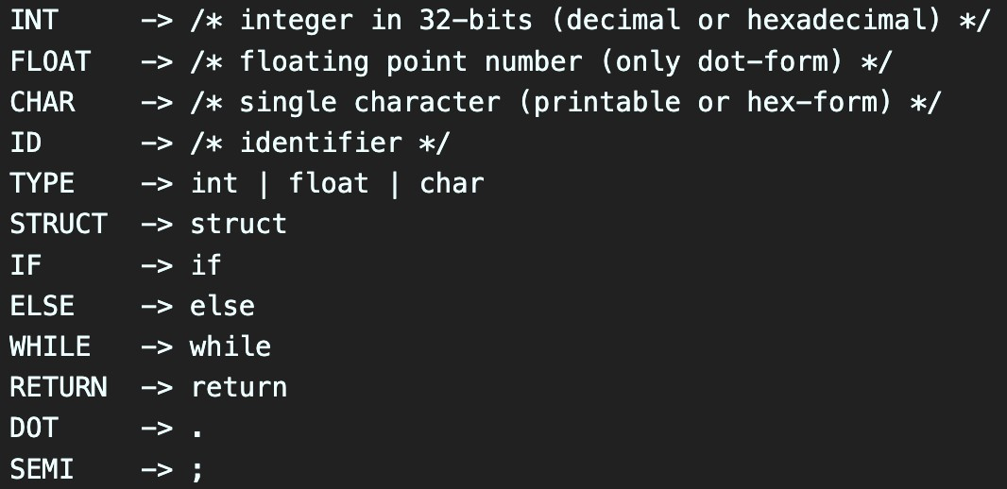
BPL Specification
Lexical specification(a snippet)
Notes:
词汇规范（摘录）

Slide 52
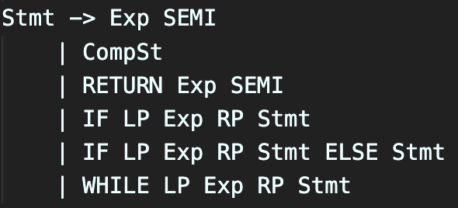
BPL Specification
Grammar rule (a single production)
Notes:
语法规则（单个产生式）

Slide 53
Development Environment
The necessary dependencies as follow：
GCC version 7.5.0
• GNU Make version 4.1
• GNU Flex version 2.6.4
• GNU Bison version 3.0.4
• Python3 version 3.6.9
To reduce the burden, we choose docker for environmental configuration.
Scan the QR code to enter the course group chat
Obtain the environment configuration tutorial on the group file.（群文件）
Notes:
开发环境
列出了一些必要依赖
为了减轻负担，我们选择Docker进行环境配置。首先扫描二维码进入课程群聊，获取共享空间Docker环境配置教程。

Slide 54
Assignment
Lab 1
Note:
The lab 1 has been published on the teaching cloud platform.
Before conducting lab 1, it is necessary to deploy the docker experimental environment.
Submit through teaching cloud platform.
Dealine:
September 15, 2024, 24:00
Notes:
Lab 1
注：
Lab 1已经发布在教学云平台上。
在进行lab 1之前，需部署docker实验环境。
通过教学云平台提交。
Dealine：
2024年9月15日24:00

