Slide 1
Chapter 4:
Syntax-Directed Translation
Yanhui Guo
yhguo@bupt.edu.cn

Slide 2
Outline
Syntax-Directed Definitions
Evaluation Orders for SDD’s
Applications of Syntax-Directed Translation
Syntax-Directed Translation Schemes
Implementing L-Attributed SDD’s

Slide 3
A Brief Introduction
Syntax-directed translation (语法制导的翻译) is the process of language translation guided by context-free grammars
Here, “language translation” is in a broad sense
Transforming infix expressions (中缀表达式) to postfix expressions (后缀表达式)
A language construct is typically made of smaller constructs
The semantics of a construct can be synthesized from its constituent constructs’ semantics
The type of the expression x + y is determined by the type of x and y, and the operator +
Or inherited from other constructs (e.g., siblings in the parse tree)
In “ int x”, the type of x is determined by the type specifier to the left of x
Notes:
• 读取源程序的输入字符，将其归类为词素，并生成词素序列
• 必要时将词目添加到符号表中
• 删除注释和空白（空格、换行符、制表符等）
• 将错误信息与行号关联起来（跟踪换行符）

Slide 4
Syntax-Directed Definitions
A syntax-directed definition (语法制导定义,SDD) is a context-free grammar together with attributes and rules
A set of attributes (属性) is associated with each grammar symbol*
Can be anything, e.g., data type of expressions, # instructions in the generated code
A semantic rule (语义规则) is associated with a production and describes how attributes are computed
E → E₁ + T
E.code = E₁.code || T.code || ‘+’
The attribute code represents the postfix notation of the construct
|| is the operator for string concatenation
*Grammar symbols represent language constructs. Nonterminal nodes and subtrees rooted at these nodes
correspond to productions.
Notes:
语法制导定义（SDD）是一种无上下文语法，同时包含属性和规则。
一组属性（attributes）与每个语法符号相关联*。
可以是任何属性，例如表达式的数据类型，# 生成代码中的指令
语义规则（semantic rule）与语法生成相关联，描述如何计算属性
属性code表示结构体的后缀符号
|| 是字符串连接操作符

Slide 5
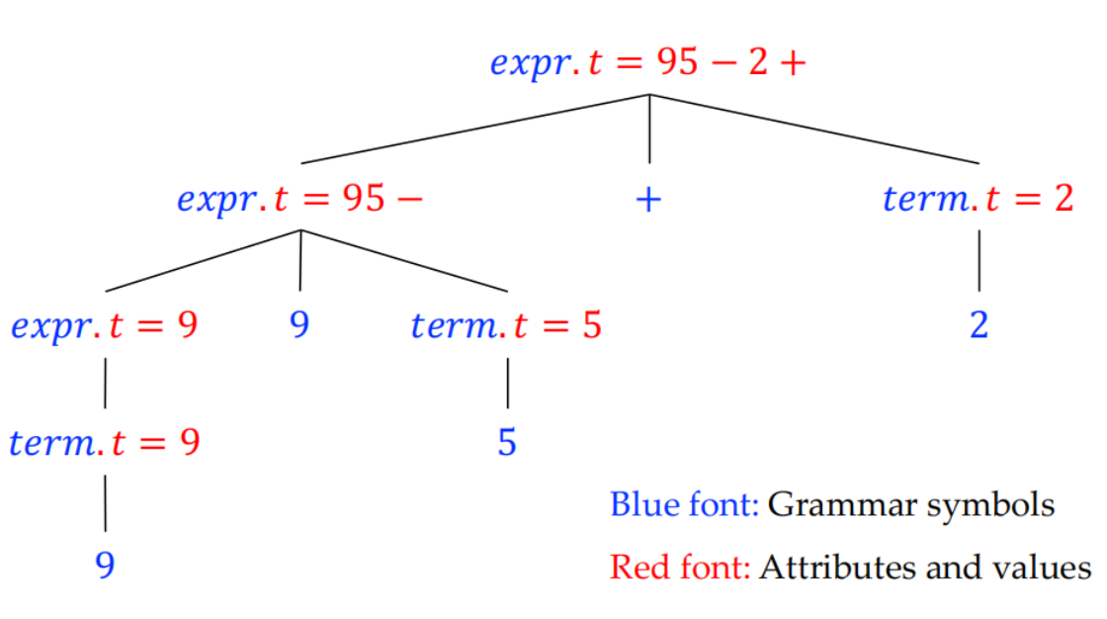
Annotated Parse Tree
An annotated parse tree for infix expression 9-5+2
The attribute t represents postfix notation
expr → expr + term
expr → expr - term
expr → term
term → 0
…
term → 9
-
Notes:
注释解析树
下位表达式 9-5+2 的注释解析树
属性 t 代表后缀符号

Slide 6
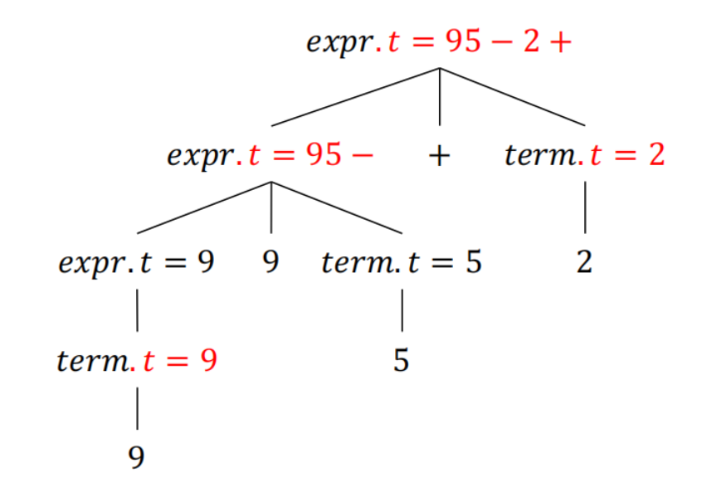
Synthesized Attributes (综合属性)
An attribute is said to be synthesized if its value at a parse-tree node N is only determined from attribute values at the children of N and at N itself (defined by a semantic rule associated with the production at N)
ProProduction | Expr → expr₁ + term
Rule | Expr.t = expr₁.t || term.t || ‘+’
ProProduction | Term → 9
Rule | Term.t = ‘9’
-
Terminals can also have synthesized attributes (lexical values), but there are not rules for computing the value of an attribute for a terminal.
Notes:
如果一个属性在解析树节点 N 上的值仅由 N 的子节点和 N 本身的属性值决定，则称该属性为合成属性；

Slide 7
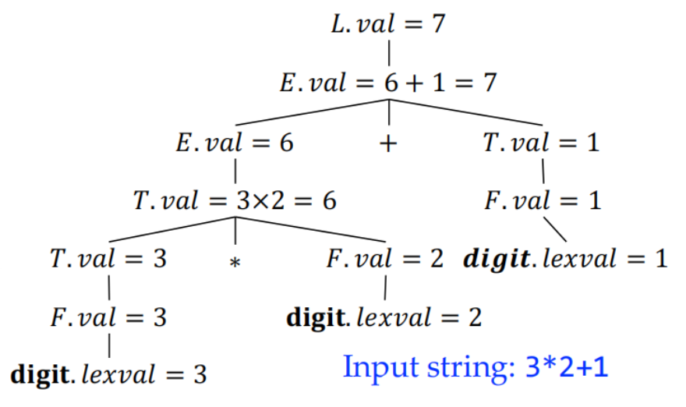
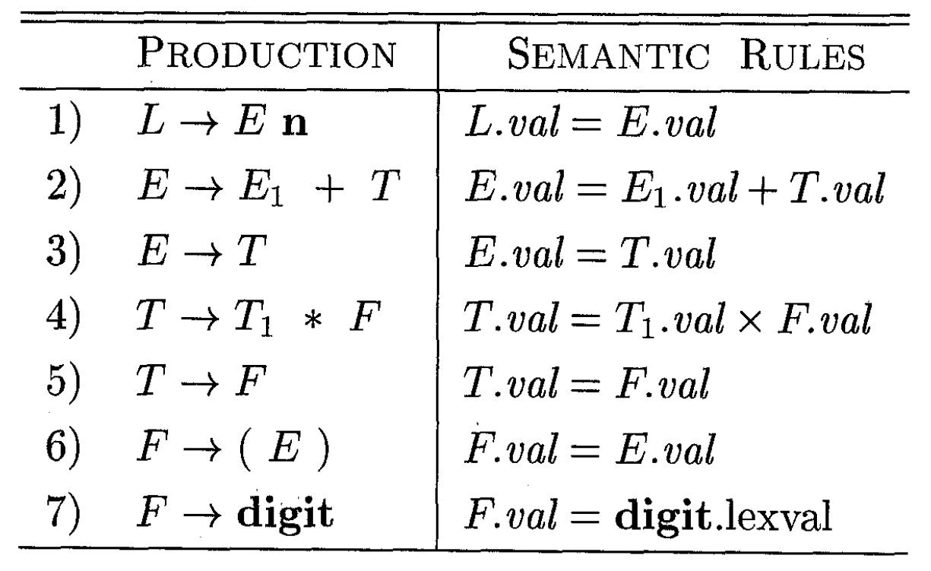
A Complete Example of SDD
The SDD below helps compute the value of an expression
SDD’s do not specify the evaluation order of attributes on a parse tree
Any order that computes an attribute after all other attributes that depends on is fine
Synthesized attributes have a nice property that they can be evaluated during a single bottom-up traversal of a parse tree (it is often unnecessary to explicitly create the tree)
Notes:
下面的 SDD 可以帮助计算表达式的值
SDD 不指定解析树上属性的计算顺序
任何顺序，只要能在依赖的所有其他属性之后计算一个属性就可以了
合成属性有一个很好的特性，即它们可以在解析树的一次自下而上的遍历中进行评估（通常不需要显式创建解析树）。

Slide 8
productions
L→En
E→E₁+T
E→T
T→T₁*F
T→F
F→ (E)
F→digit
semantic rules
L.val=E.val
E.val := E₁.val+T.val
E.val :=T.val
T.val :=T₁.val* F.val
T.val :=F.val
F.val :=E.val
F.val :=digit.lexval
L.val=7
E.val=7
n
E.val=6
+
T.val=1
T.val=6
F.val=1
T.val=3
*
F.val=2
digit.lexval=1
F.val=3
digit.lexval=2
digit.lexval=3
Fall 2023

Slide 9

Inherited Attributes (继承属性)
Inherited attributes have their value at a parse-tree node determined from attribute values at the node itself, its parent, and its siblings in the parse tree
Notes:
继承属性在解析树节点上的值由该节点本身、其父节点和解析树中同级节点的属性值决定
回答：继承属性在处理与上下文相关的问题时仍然是非常有用的。它为我们提供了一种在语法树中考虑外部信息的方法，从而使得我们可以更为精确和灵活地描述语法制导定义的属性

Slide 10
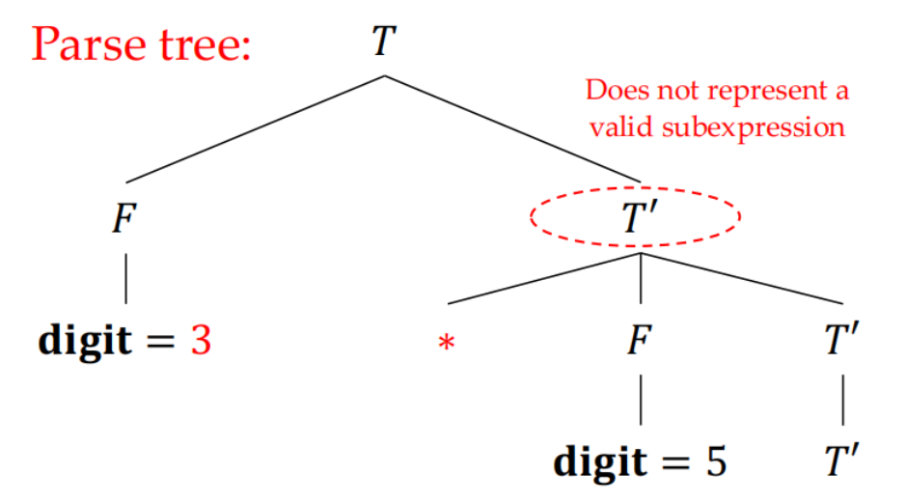
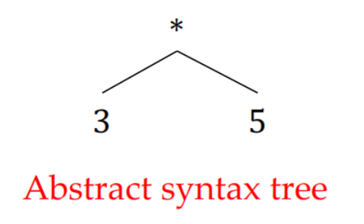
Top-Down Parse of 3*5
T → FT’
T’ → *FT’
T’ → ε
F → digit
For some grammars, the structure of the parse tree does not match the abstract syntax of the code (3 and * are in different subtrees)
Not all non-terminals in a parse tree correspond to language constructs, e.g., T’ above.
Notes:
对于某些语法，解析树的结构与代码的抽象语法不一致（3 和 * 位于不同的子树中）

Slide 11
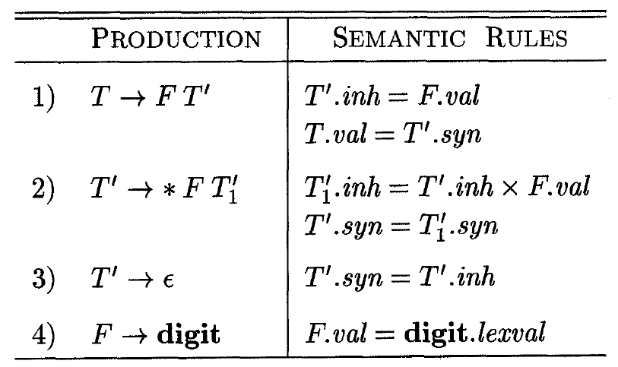
SDD with Inherited Attributes
*
value flow
The left operand of the operator ∗ is inherited by T’ and kept for later computation when T’ further gets replaced
The inherited attribute of T‘ is not defined by a rule associated with the production (2) or (3), whose head is T’
Notes:
运算符 ∗ 的左操作数由 T' 继承，并在 T' 进一步被替换时保留用于以后的计算。

Slide 12
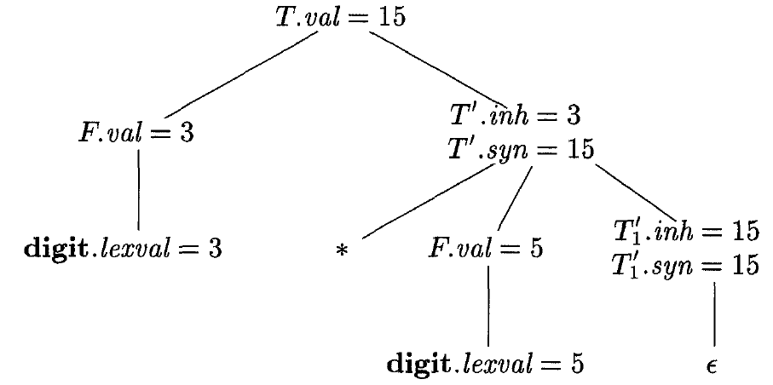
Annotated Parse Tree for 3*5
P stands for parent
S stands for sibling
S
P
S
Notes:
先从具体的输入开始（这是语义计算的起点）结合分析树的结构来分析
根据4）产生式及其语义规则，得到F.val，
根据2）产生式及其语义规则，要想计算T1 ‘.inh=T ‘.inh（未知）X F.val（5）。要计算T ‘.syn=T1 ‘syn（未知）
根据1）产生式及其语义规则，T ‘.inh=F.val（已知）=3，T.val=T ‘.syn（未知）
返回2）产生式及其语义规则，计算T1 ‘.inh=T ‘.inh（3）X F.val（5）=15。
根据3）产生式及其语义规则，计算T1 ‘.syn=T1‘.inh=15。
返回2）产生式及其语义规则，计算T ‘.syn=T1 ‘syn（15）
返回1）产生式及其语义规则，计算T.val=T ‘.syn（15）

Slide 13
PRODUCTIONS SEMANTIC RULES
D→TL L.in := T.type
T→int T.type := integer
T→real T.type := real
L→L₁, id L₁.in :=L.in
addtype(id.entry, L.in)
L→id addtype(id.entry,L.in)
Annotated Parse Tree for real id₁，id₂，id₃
D
T.type=real
L.in=real
T
L
name | type
… | …
real
,
L.in=real
L
id₃
id₃
real
id₂
real
L.in=real
,
L
id₂
id₁
real
id₁
Symbol table

Slide 14
Outline
Syntax-Directed Definitions
Evaluation Orders for SDD’s
Applications of Syntax-Directed Translation
Syntax-Directed Translation Schemes
Implementing L-Attributed SDD’s

Slide 15
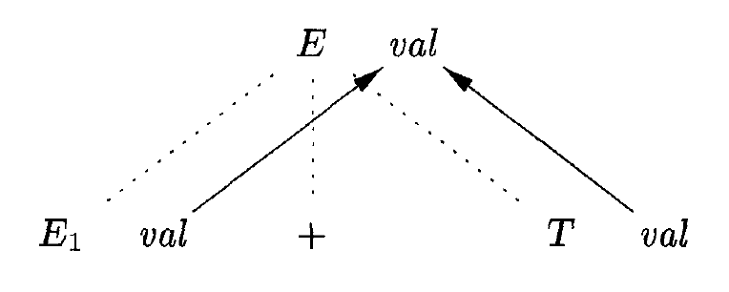
Evaluation Orders for SDD’s
Given parse tree nodes N,M₁,M₂,M₃,…,M_{k}, if the attribute a of N is defined as N.a = f(M₁,a₁,M₂,a₂,…,M_{k},a_{k})then in order to compute N.a, we must first compute M₁. a₁ (1 ≤ i ≤ k)
Dependency graphs (依赖图) are a useful tool for determining evaluation orders
Depict the information flow among the attribute instances in a particular parse tree
Model the partial order among attribute instances
Notes:
给定解析树节点 N,M1,M2,M3,...,Mk，如果 N 的属性 a 定义为 N.a = f(M1,a1,M2,a2,...,Mk,ak)，那么为了计算 N.a，我们必须先计算 M1。
依赖图 (依赖图) 是确定评估顺序的有用工具
描述特定解析树中属性实例之间的信息流
为属性实例之间的部分顺序建模

Slide 16
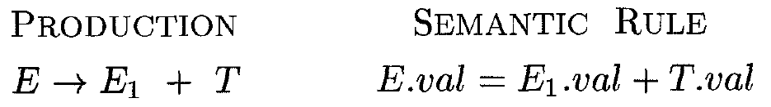
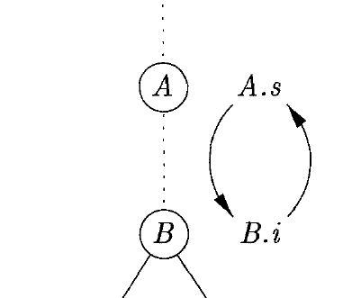
Dependency Graph
An edge from one attribute instance (a₁) to another (a₂) means that the value of a₁is needed to compute the value of a₂
If there is any cycle in a dependency graph, we cannot find an order to compute the value of all attribute instances
Dotted lines: parse tree edges
Solid lines: depedency graph edges
Notes:
从一个属性实例（a1）到另一个属性实例（a2）的边表示计算 a2 的值需要 a1 的值。
如果依赖关系图中存在循环，我们就无法找到计算所有属性实例值的顺序ε

Slide 17
Example1: Parsing real id₁，id₂，id₃
Attribute values can be computed according to any topological sort (拓扑 排序) of the graph, e.g., 1, 2, 3, …, 10 in the example below
D
④
type
PRODUCTIONS SEMANTIC RULES
D→TL L.in := T.type
T→int T.type := integer
T→real T.type := real
L→L₁, id L₁.in :=L.in
addtype(id.entry, L.in)
L→id addtype(id.entry, L.in)
T
⑤
in
L
⑦ addtype
real
L
⑨ addtype
,
id₃
③
entry
⑥
in
⑧
in
L
⑩ addtype
,
id₂
②
entry
id₁
①
entry
1⎼10: Evaluation order

Slide 18
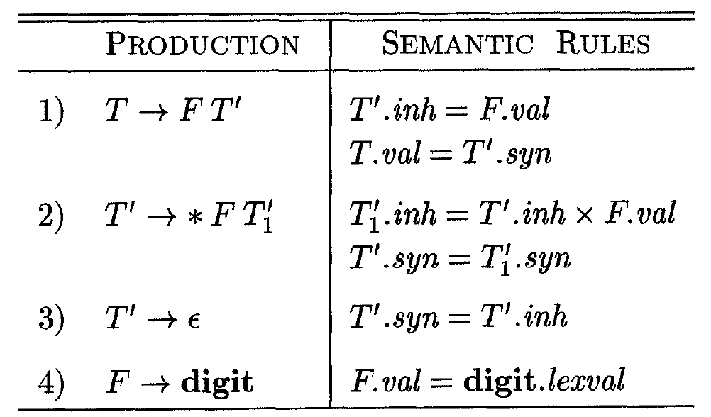
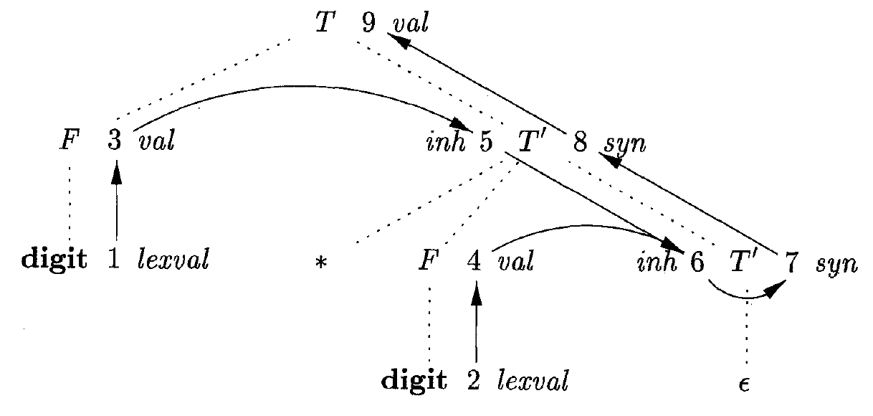
Example2: Parsing 3*2
1⎼9: Evaluation order
Notes:
属性值可根据图的任意拓扑排序 (拓扑排序) 计算，例如下例中的 1、2、3、......、9

Slide 19
Ordering the Evaluation of Attributes
Given an SDD, it is very hard to tell whether there exist any parse trees whose dependency graphs have cycles
In practice, translations can be implemented using classes of SDD’s that guarantee an evaluation order*
S-attributed SDD’s
L-attributed SDD’s
* The dependency graphs for such SDDs are directed acyclic graphs
Notes:
如果一属性文法不存在属性之间的循环依赖关系，则称该文法为良定义的
一个依赖图的任何拓扑排序都给出一个语法树中结点的语义规则计算的有效顺序
在给定 SDD 的情况下，很难判断是否存在依赖图具有循环的解析树。
在实践中，可以使用保证求值顺序的 SDD 类来实现翻译*。(这种 SDD 的依赖图是有向无环图)
S 属性 SDD
L 属性 SDD
有向无环图 directed acyclic graphs

Slide 20
S-Attributed Definitions
An SDD is S-attributed if every attribute is synthesized
Intuitively, there cannot be cycles in the dependency graph of any parse tree, since edges always go from children nodes to parent nodes, never the other way around.
Notes:
S 属性定义
如果每个属性都是合成的，那么语法制导定义就是 S 属性的
直观地说，任何解析树的依赖关系图中都不可能存在循环，因为边总是从子节点到父节点，而不是相反。

Slide 21
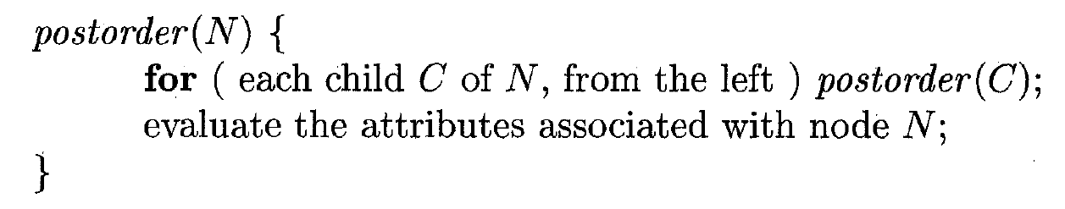
S-Attributed Definitions Cont.
When an SDD is S-attributed, we can evaluate its attributes in any bottom up order of the parse-tree nodes
e.g., postorder traversal (后序遍历) of the parse tree
S-attributed definitions can be easily implemented during bottom-up parsing (corresponds to a postorder traversal)
Notes:
当 SDD 具有 S 属性时，我们可以按照解析树节点的任何自下而上的顺序评估其属性。
例如，解析树的后序遍历（postorder traversal
S 属性定义可以在自下而上的解析过程中轻松实现（相当于后序遍历）

Slide 22
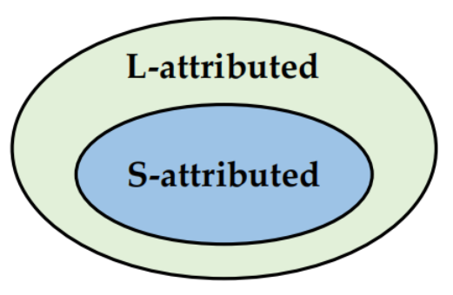
L-Attributed Definitions
An SDD is L-attributed if for each production A → X₁X₂…X_{n}, for each J = 1 … n, each inherited attribute of x_{j} depends on only:
the attributes of x₁,…,x_{j-1}(either synthesized or inherited), or
the inherited attributes of A
Dependency-graph edges can go from left to right (for a parse tree), but not right to left (hence “L-attributed”)
Notes:
L 属性定义
如果对于每个产品 A → X1X2...Xn，对于每个 J = 1 ... n，xj 的每个继承属性仅取决于以下属性，则 SDD 是 L 属性 SDD：
x1,...xj-1 的属性（合成的或继承的），
或 A 的继承属性
依赖关系图的边可以从左到右（对于解析树而言），但不能从右到左（因此称为 "L-属性"）。

Slide 23
L-Attributed Definition Example
Left sibling’s attribute
• Parent’s inherited attribute
• Left sibling’s attribute
Synthesized attributes: val, syn, lexval. Inherited attributes: inh
Notes:
- 左同胞的属性
- 父辈的继承属性 - 左同胞的属性

Slide 24
Attribute Evaluation for L-Attributed Definitions
Input: A node n in a parse tree T
Output: An evaluation order for the attributes of the subtree rooted at n
Procedure depth_first(n)*
Begin
end
When evaluating the inherited attributes of a node, the attributes of nodes to its left have been evaluated
Guarantee
for every child m of n from left to right do begin
evaluate the inherited attributes of m;
depth_first(m); // here m’s synthesized attributes will be evaluated
end
evaluate the synthesized attributes of n;
* The inherited attributes of n are computed before calling depth_first(n), as indicated by the for body
Notes:
在计算节点的继承属性时，已计算了其左侧节点的属性
前序遍历计算继承属性
输入: 解析树 T 中的节点 n
输出: 以 n 为根的子树属性的评估顺序
程序 depth_first(n)*
开始
对于 n 的每个子节点 m，从左到右依次执行 开始
评估 m 的继承属性；
depth_first(m); // 这里将评估 m 的合成属性
结束
评估 n 的合成属性；
保证：在评估节点的继承属性时，已评估了其左侧节点的属性
end

Slide 25
Attribute Evaluation for L-Attributed Definitions
Input: A node n in a parse tree T
Output: An evaluation order for the attributes of the subtree rooted at n
Procedure depth_first(n)*
Begin
end
When evaluating the inherited attributes of a node, the inherited attributes of its parent node have been evaluated
Guarantee
for every child m of n from left to right do begin
evaluate the inherited attributes of m;
depth_first(m); // here m’s synthesized attributes will be evaluated
end
evaluate the synthesized attributes of n;
* The inherited attributes of n are computed before calling depth_first(n), as indicated by the for body
Notes:
保证：在计算节点的继承属性时，已计算出其父节点的继承属性

Slide 26
T
F
{ T′.inh = F.val }
T’
{ T.val = T′.syn }
val=3
3 * 5
digit * digit
digit
(3)
{ F.val = digit.lexval }
F
T’
{T΄.syn = T₁′.syn }
*
{ T₁′.inh = T′.inh×F.val }
digit
(5)
ε
{ T΄.syn = T′.inh }
{ F.val = digit.lexval }
Notes:
通用方法
首先建立一棵语法分析树，然后按照从左到右的深度优先顺序来执行这些动作，也就是说在一个前序遍历过程中执行

Slide 27
T
F
{ T′.inh = F.val }
inh=3
T’
{ T.val = T′.syn }
val=3
3 * 5
digit * digit
digit
(3)
{ F.val = digit.lexval }
F
T’
{T΄.syn = T₁′.syn }
*
{ T₁′.inh = T′.inh×F.val }
digit
(5)
ε
{ T΄.syn = T′.inh }
{ F.val = digit.lexval }

Slide 28
T
F
{ T′.inh = F.val }
inh=3
T’
{ T.val = T′.syn }
val=3
3 * 5
digit * digit
digit
(3)
{ F.val = digit.lexval }
F
T’
{T΄.syn = T₁′.syn }
*
{ T₁′.inh = T′.inh×F.val }
val=5
digit
(5)
ε
{ T΄.syn = T′.inh }
{ F.val = digit.lexval }

Slide 29
T
F
{ T′.inh = F.val }
inh=3
T’
{ T.val = T′.syn }
val=3
3 * 5
digit * digit
digit
(3)
{ F.val = digit.lexval }
F
T’
{T΄.syn = T₁′.syn }
*
{ T₁′.inh = T′.inh×F.val }
val=5
inh=15
digit
(5)
ε
{ T΄.syn = T′.inh }
{ F.val = digit.lexval }

Slide 30
T
F
{ T′.inh = F.val }
inh=3
T’
{ T.val = T′.syn }
val=3
3 * 5
digit * digit
digit
(3)
{ F.val = digit.lexval }
F
T’
{T΄.syn = T₁′.syn }
*
{ T₁′.inh = T′.inh×F.val }
val=5
inh=15
syn=15
digit
(5)
ε
{ T΄.syn = T′.inh }
{ F.val = digit.lexval }

Slide 31
T
F
{ T′.inh = F.val }
inh=3
T’
syn=15
{ T.val = T′.syn }
val=3
输入：
3 * 5
digit * digit
digit
(3)
{ F.val = digit.lexval }
F
T’
{T΄.syn = T₁′.syn }
*
{ T₁′.inh = T′.inh×F.val }
val=5
inh=15
syn=15
digit
(5)
ε
{ T΄.syn = T′.inh }
{ F.val = digit.lexval }

Slide 32
T
val=15
F
{ T′.inh = F.val }
inh=3
T’
syn=15
{ T.val = T′.syn }
val=3
3 * 5
digit * digit
digit
(3)
{ F.val = digit.lexval }
F
T’
{T΄.syn = T₁′.syn }
*
{ T₁′.inh = T′.inh×F.val }
val=5
inh=15
syn=15
digit
(5)
ε
{ T΄.syn = T′.inh }
{ F.val = digit.lexval }

Slide 33
Attribute Evaluation for L-Attributed Definitions
Input: A node n in a parse tree T
Output: An evaluation order for the attributes of the subtree rooted at n
Procedure depth_first(n)*
Begin
end
for every child m of n from left to right do begin
evaluate the inherited attributes of m;
depth_first(m); // here m’s synthesized attributes will be evaluated
end
evaluate the synthesized attributes of n;
Can be implemented in
top-down parsing
* The inherited attributes of n are computed before calling depth_first(n), as indicated by the for body
Notes:
可自顶向下解析

Slide 34
Can be implemented in
top-down parsing
T
val=15
F
T’
val=3
inh=3
syn=15
input：
3 * 5
digit * digit
digit
*
F
T’
syn=15
lexval=3
val=5
inh=15
digit
ε
lexval=5
Notes:
通用方法（两趟）
首先建立一棵语法分析树，然后按照从左到右的深度优先顺序来执行这些动作，也就是说在一个前序遍历过程中执行(继承属性的计算），然后再执行一个后序遍历完成综合属性的计算。

Slide 35
Outline
Syntax-Directed Definitions
Evaluation Orders for SDD’s
Applications of Syntax-Directed Translation
Syntax-Directed Translation Schemes
Implementing L-Attributed SDD’s
• Constructing Syntax tree
• The Structure of a Type
Notes:
构建语法树

Slide 36
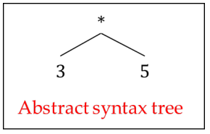
Construction of Syntax Tree (1)
Abstract syntax tree (revisited)
Each interior node N represents a construct (corresponding to an operator)
The children of N represent the meaningful components of the construct represented by N (corresponding to operands)
Notes:
抽象语法树（重温）
每个内部节点 N 代表一个结构体（对应一个运算符）
N 的子节点代表 N 所代表结构的有意义成分（相当于操作数）

Slide 37
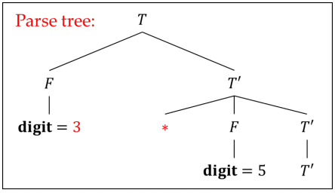
Construction of Syntax Tree (2)
Syntax tree vs. parse tree
In a syntax tree, interior nodes represent programming constructs, while in a parse tree, interior nodes represent nonterminals*
A parse tree is also called a concrete syntax tree, and the underlying grammar is called a concrete syntax for the language
* Not all nonterminals represent programming constructs, e.g., those introduced to eliminate left recursions (T’ in the earlier L-attributed definition example)
Notes:
语法树与解析树
在语法树中，内部节点代表编程结构，而在解析树中，内部节点代表非终结符*。
解析树也称为具体语法树，其底层语法称为语言的具体语法

Slide 38
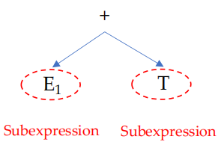
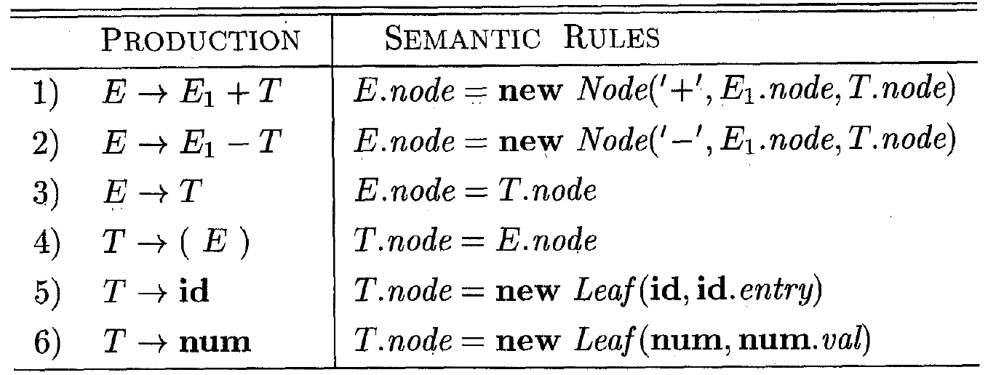
Construction of Syntax Tree (3)
An S-attributed SDD for building syntax trees for simple expressions
Each node of the syntax tree is implemented as an object with a field op, representing the label of the node, and some additional fields
Leaf node: one additional field holding the lexical value
Interior node: # additional fields = # of children
Notes:
为简单表达式构建语法树的 S 属性 SDD
语法树的每个节点都是一个对象，其中有一个字段 op（代表节点的标签）和一些附加字段
叶节点：一个包含词法值的附加字段
内部节点：额外的字段数量等于子节点的数量

Slide 39
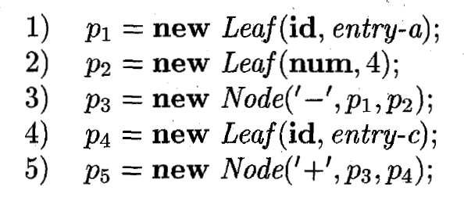
Construction of Syntax Tree (4)
Input expression: a – 4 + c
Steps (bottom-up evaluation):
E
.node
E
.node
+
T
.node
E
T
.node
+
.node
-
id
T
.node
-
id
num
id
To entry for c
id
num
4
To entry for a

Slide 40
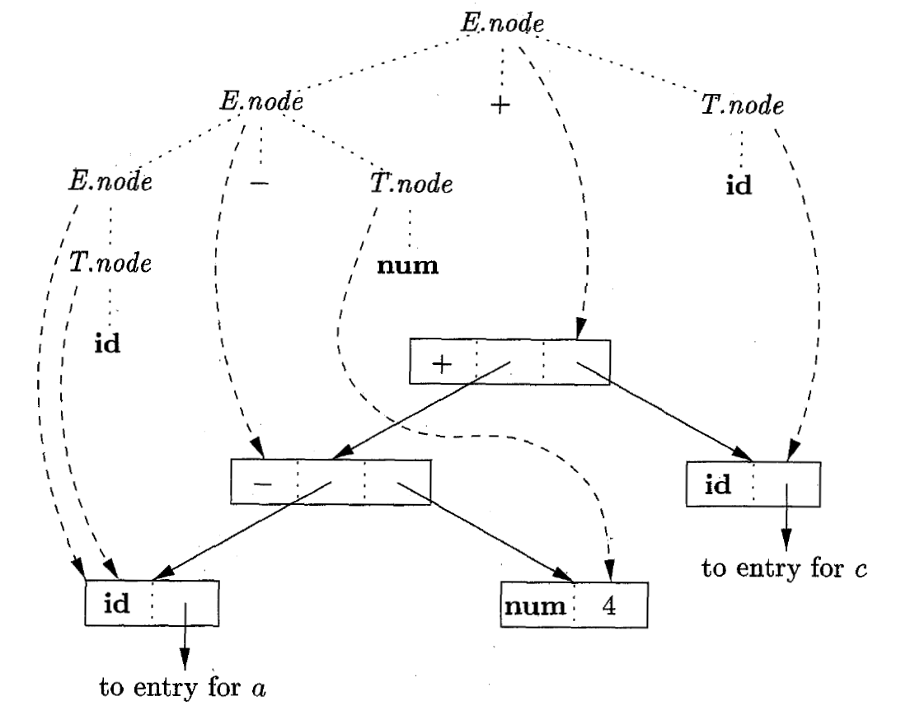


Slide 41
Outline
Syntax-Directed Definitions
Evaluation Orders for SDD’s
Applications of Syntax-Directed Translation
Syntax-Directed Translation Schemes
Implementing L-Attributed SDD’s
• Constructing Syntax tree
• The Structure of a Type

Slide 42

Computing the Structure of a Type
int[2][3] a = ...;
What is the type of a?
Leave it to the next chapter...
Notes:
计算类型的结构

Slide 43
Outline
Syntax-Directed Definitions
Evaluation Orders for SDD’s
Applications of Syntax-Directed Translation
Syntax-Directed Translation Schemes
Implementing L-Attributed SDD’s

Slide 44
Syntax-Directed Translation Schemes
SDD’s tell us what to do (high-level specifications) in the translation, but not how to do
Syntax-directed translation schemes (SDT’s, 语法制导的翻译方案) specify more details on how to do the translation
An SDT is a context-free grammar with semantic actions (program fragments) embedded within production bodies
Differ from the semantic rules in SDD’s
Semantic actions can appear anywhere within a production body
Notes:
SDD 告诉我们在翻译中要做什么（高级规范），但不告诉我们如何做
语法制导的翻译方案（SDT's，Syntax-directed translation schemes）规定了如何进行翻译的更多细节。
SDT 是一种无上下文语法，其语义动作（程序片段）嵌入在生产体中 ：
与 SDD 的语义规则不同
语义动作可以出现在制作体的任何地方

Slide 45
Implementation of SDT’s
Any SDT can be implemented by:
First building a parse tree
Treating semantic actions as “virtual” parse-tree nodes
Performing a left-to-right depth-first (i.e., preorder) tree traversal and triggering the actions when visiting the corresponding nodes
Notes:
任何 SDT 都可以通过以下方式实现：
首先构建一棵解析树
将语义操作视为 "虚拟 "解析树节点
执行从左到右的深度优先（即预排序）树遍历，并在访问相应节点时触发操作

Slide 46
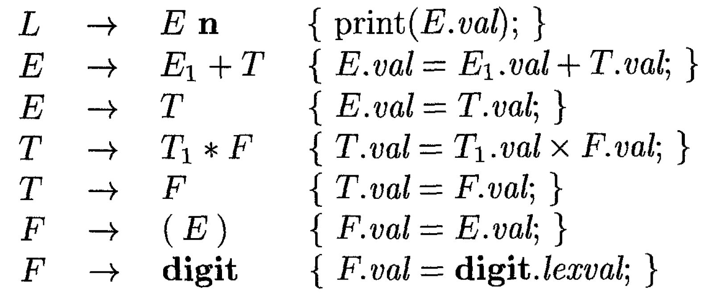
An Example SDT (1)
The SDT below implements a simple calculator
Semantic actions:
Real code in {}
SDT
SDD
Semantic rules:
Definitions (not code)
Notes:
SDD（Syntax Directed Definition）：
SDD定义了与语法产生式关联的属性和规则。它为每个语法产生式指定一个或多个属性计算或语义动作。
SDD关注于如何为语法树中的节点计算属性值，但不一定涉及产生中间代码或目标代码的具体操作。
它可以有合成属性和继承属性，因此可以描述为S属性的（只有合成属性）或L属性的（允许继承属性但有限制）。
SDT（Syntax Directed Translation）：
SDT是SDD的一个特例，它专门用于生成中间代码或目标代码。换句话说，SDT的目的是翻译，它定义了与语法产生式关联的动作，这些动作通常在解析时执行。
当解析器在处理产生式时，与该产生式关联的SDT动作被执行，从而生成代码或进行其他翻译工作。
动作可以嵌入到产生式中，例如，在YACC或Bison这样的工具中，可以直接在语法规则中插入C代码作为动作。
总结差异：
SDD更为通用，关注于为语法树的节点计算属性。这些属性可以用于多种目的，如类型检查、变量绑定等。
SDT特化于翻译任务，即将源代码转换为中间代码或目标代码。它通常涉及在解析过程中执行特定的动作。
尽管有这些区别，但在实际应用中，SDD和SDT的界限可能会模糊，因为编译器的语义分析和翻译阶段通常是交织在一起的

Slide 47
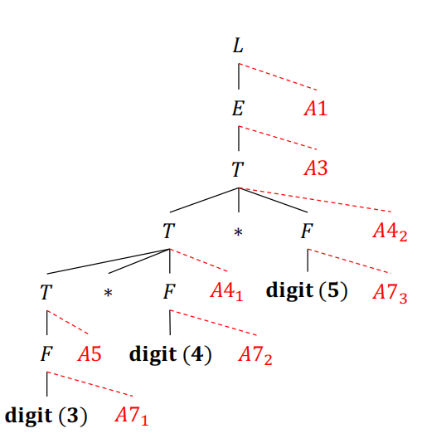
An Example SDT (2)
Parse and calculate 3*4*5
A1
A2
A3
A4
A5
A6
A7
Order of actions:
A7₁,A5,A7₂,A4₁,A7₃,A4₂,A3,A1

Slide 48
SDT’s With Actions Inside Productions
B → X{a}Y
The action a should be done after we have recognized X (if X is a terminal) or all the terminals derived from X (if X is a nonterminal)
If the parse is bottom-up, we perform the action a as soon as X appears on the top of the parsing stack
If the parse is top-down, we perform the action a before attempting to expand Y (if Y is a nonterminal) or check for Y on the input (if Y is a terminal)
结合语法分析树理解
Notes:
动作 a 应在我们识别完 X（如果 X 是终结符）或由 X 派生的所有终结符（如果 X 是非终结符）后执行
如果解析是自下而上的，那么一旦 X 出现在解析栈顶端，我们就执行操作 a （此时，有关X的所有信息都已在栈中）
如果解析是自上而下的，我们在尝试扩展 Y（如果 Y 是非终结符）或检查输入中的 Y（如果 Y 是终结符）之前执行操作 a（此时有关X的所有信息已分析完毕）

Slide 49
SDT’s Implementable During Parsing
In practice, SDT’s are often implemented during parsing, without building a parse tree
Not all SDT’s can be implemented during parsing*
Even if the underlying grammar is parsable by a method (e.g., LL, LR), after introducing semantic actions, the method may become inapplicable
Determine if an SDT can be implemented during parsing
Introduce distinct marker nonterminals to replace each embedded action; each marker 𝑀 has only one production 𝑀 → 𝜖
If the grammar with marker nonterminals can be parsed by a given method, then the SDT can be implemented during parsing
*Note that all SDT’s can be implemented after building the parse tree, as earlier mentioned
Notes:
注意，如前所述，所有 SDT 都可以在构建分析树后实施。
将语义动作用标记非终结M来代替，对应的的产生式为𝑀 → 𝜖，得到文法可以被LL或LR分析器所分析，这样的SDT才能在语法分析时一并进行。

Slide 50
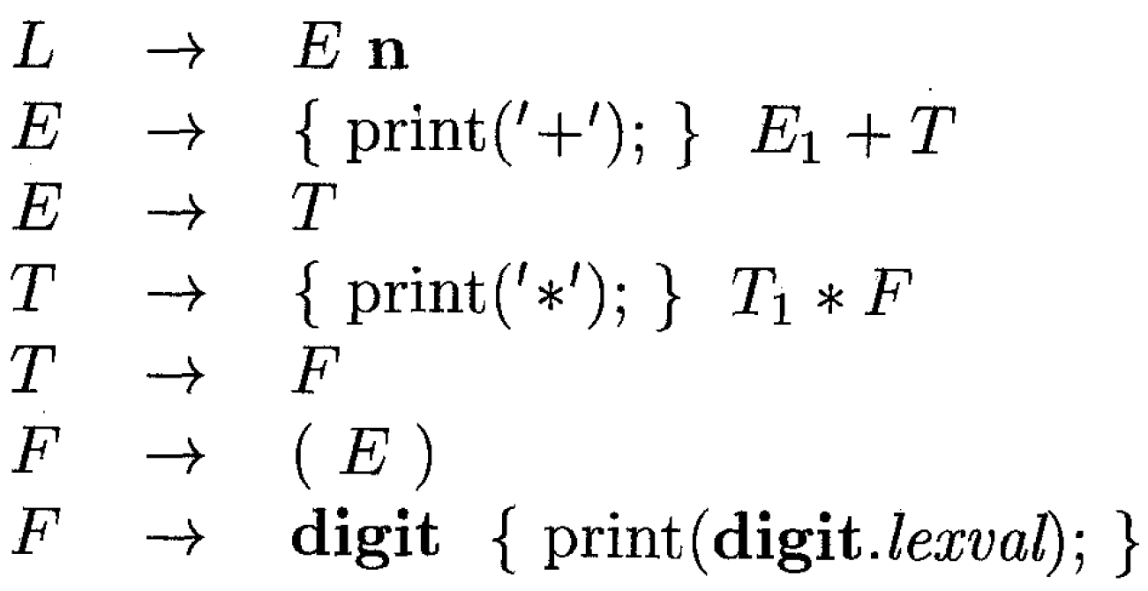
A Problematic SDT
This SDT translates infix expression to prefix expressions
L → E
E → M₁E + T M₁ → ε
E → T
T → M₂T * F M₂ → ε
T → F
F → (E)
F → digit M₃ M₃ → ε
It is impossible to build parsing tables without conflicts using top-down or
bottom-up parsing methods. This SDT cannot be implemented during parsing.
Notes:
使用自上而下或自下而上的解析方法不可能建立没有冲突的解析表。
自下而上的解析方法来建立没有冲突的解析表。这种 SDT 无法在解析过程中执行。

Slide 51
Uses of SDT’s
We can use SDT’s to implement two important classes of SDD’s:
The underlying grammar is LR, and the SDD is S-attributed
The underlying grammar is LL, and the SDD is L-attributed
Notes:
我们可以使用 SDT 来实现两类重要的 SDD：
基础语法是 LR，SDD 是 S 属性的
基础语法是 LL，SDD 是 L 属性的
底层语法是LR，而SDD是S属性的：
LR语法：这是一种可以用自底向上的方式进行解析的语法。LR解析器从左到右读取输入，但决策是基于右侧的上下文进行的。它使用一个堆栈来存储已经读取的符号，并在适当的时候进行规约。
S属性的SDD：这意味着所有属性都是合成属性，它们只从子节点传递给父节点，没有从父节点传递给子节点的继承属性。这对于自底向上的LR解析是非常合适的，因为我们从叶子节点开始构建并向上移动，因此只需要合成属性即可。
底层语法是LL，而SDD是L属性的：
LL语法：这是一种可以用自顶向下的方式进行解析的语法。LL解析器从左到右读取输入，并基于左侧的上下文来进行决策。它通常使用递归下降的方法，直接从起始符号开始，并尝试应用各种产生式。
L属性的SDD：这种SDD除了合成属性外，还包括继承属性，但这些继承属性只能依赖于它左边的兄弟节点或其父节点的属性。由于LL解析是自顶向下的，所以可以在解析过程中计算这些继承属性。

Slide 52
Postfix Translation Schemes
If the grammar of an SDD is LR, and the SDD is S-attributed, then we can construct a postfix SDT (后缀SDT) to implement the SDD in bottom-up parsing
Semantic actions always appear at the end of productions (hence “postfix”)
SDT
SDD
This is possible because in bottom-up parsing, before reducing to a production head, the grammar symbols in the production body have been visited and their synthesized attributes have been computed.
Notes:
如果 SDD 的语法是 LR，而且 SDD 是 S 属性的，那么我们就可以构造一个后缀 SDT（后缀 SDT），在自下而上的解析中实现 SDD 语义动作总是出现在制作的末尾（因此称为 "后缀"）。
之所以能做到这一点，是因为在自下而上的解析过程中，在还原到生产头之前，已经访问过生产体中的语法符号，并计算了它们的合成属性。

Slide 53
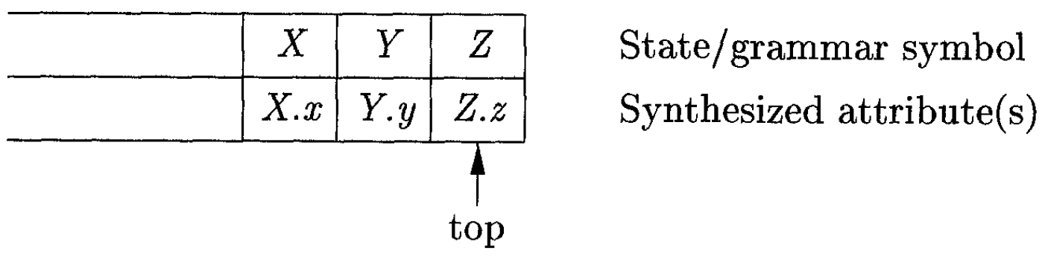
Parser-Stack Implementation of Postfix SDT’s
Postfix SDT’s can be implemented during LR parsing by executing the actions when reductions occur
The synthesized attributes can be placed along with the grammar symbols on the stack
If we do reduction using A → XYZ, then the attributes of A can be calculated
based on the attributes of X, Y, and Z, which are already on the stack.
Notes:
在 LR 解析过程中，可以通过在还原发生时执行以下操作来实现后缀 SDT
合成的属性可与语法符号一起放在堆栈中
如果我们使用 A → XYZ 进行还原，那么 A 的属性就可以根据堆栈中已经存在的 X、Y 和 Z 计算出来。就可以根据堆栈中已经存在的 X、Y 和 Z 的属性计算出 A 的属性。

Slide 54
 |  | 
S₀ | — | #
TOP
S_{m} Z Z.z
S_{m-1} Y Y.y
TOP
S_{m-2} X X.x
S’ A A.a
state symbol attribute

Slide 55
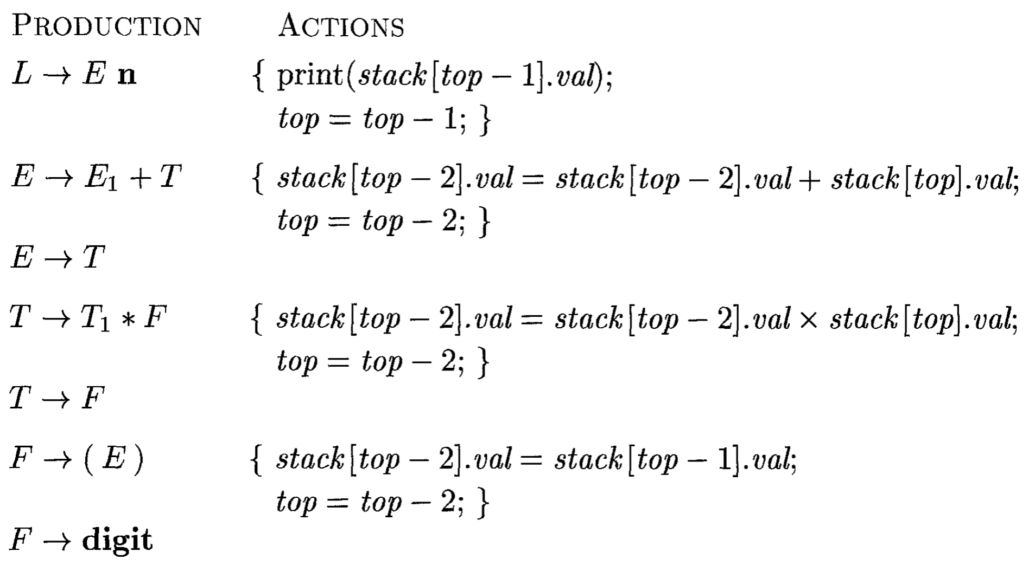
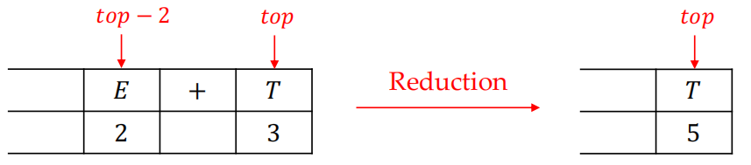
The Calculator Example
Notes:
• 在许多语言中，保留字或关键词（如 then）也符合标识符模式
• 问题：搜索标识符的过渡图也能识别保留字

Slide 56
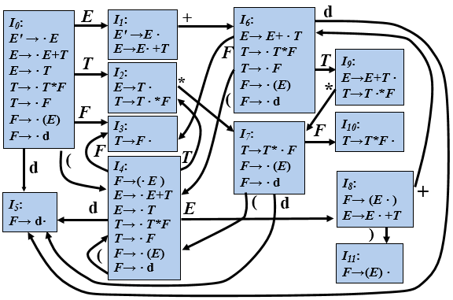
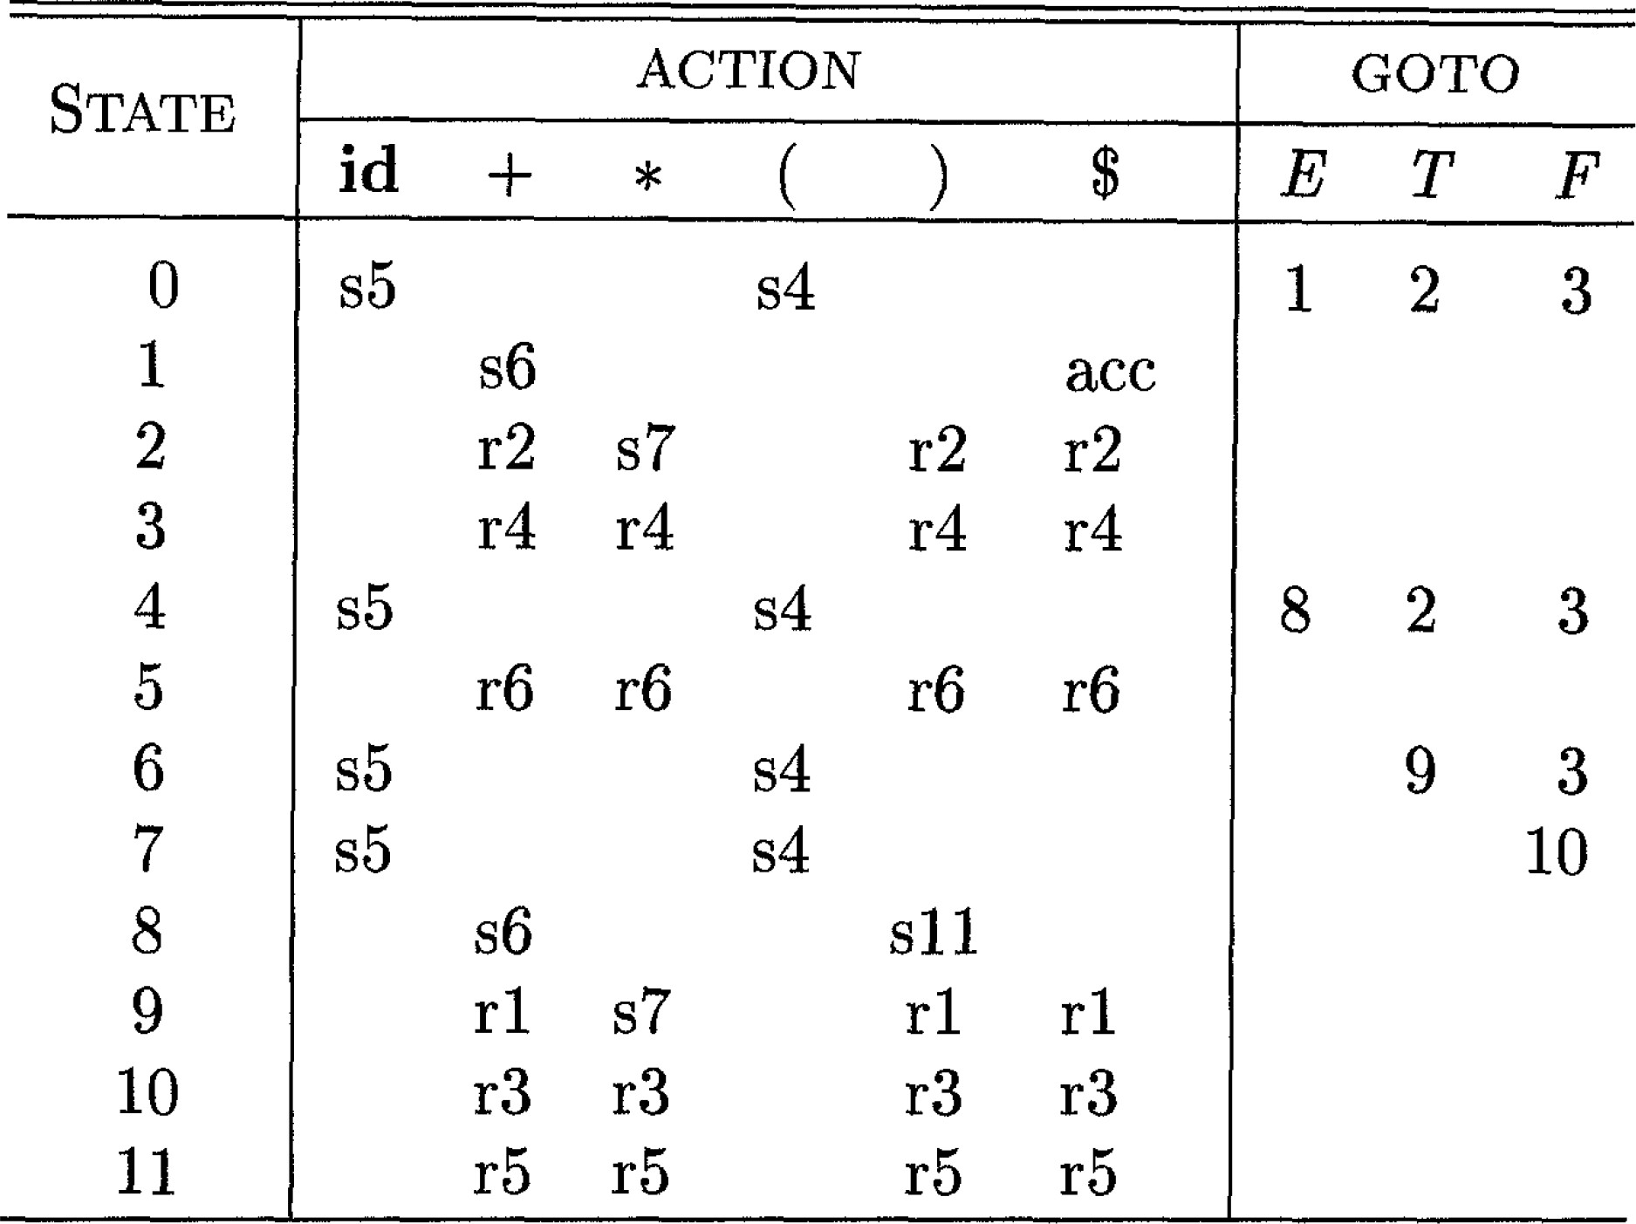
PRODUCTONS ACTONS
(1)E′ → E { print (stack[top].val );}
(2)E → E₁ + T {stack[top-2].val = stack[top-2].val + stack[top].val ;
top=top-2; }
(3)E → T
(4)T → T₁ * F {stack[top-2].val = stack[top-2].val × stack[top].val ;
top=top-2; }
(5)T → F
(6)F → ( E ) {stack[top-2].val = stack[top-1].val;
top=top-2; }
(7)F → digit
3*5+4n
step | state | symbol | (val) | Input
0 | 0 |  | - | 3*5+4n
1 | 5 | #3 | -3 | *5+4n
2 | 3 | #F | -3 | *5+4n
3 | 2 | #T | -3 | *5+4n
4 | 27 | #T* | -3- | 5+4n
5 | 275 | #T*5 | -3-5 | +4n
6 | 2710 | #T*F | -3-5 | +4n
7 | 2 | #T | -15 | +4n
8 | 1 | #E | -15 | +4n
9 | 16 | #E+ | -15- | 4n
10 | 165 | #E+4 | -15-4 | n
11 | 163 | #E+F | -15-4 | n
11 | 169 | #E+T | -15-4 | n
12 | 1 | #E | -19 | n
13 |  | #En | -19-
14 |  | #L | -19

Slide 57
Uses of SDT’s
We can use SDT’s to implement two important classes of SDD’s:
The underlying grammar is LR, and the SDD is S-attributed
The underlying grammar is LL, and the SDD is L-attributed

Slide 58
SDT’s for L-Attributed SDD’s
L-attributed SDD’s can be implemented during top-down parsing, if the underlying grammar is LL
The way of turning an L-attributed SDD into an SDT is to place semantic actions at appropriate positions in the concerned production A → X₁X₂…X_{n}
Embed the action that computes the inherited attributes for a nonterminal X_{i} immediately before X_{i} in the production body
Place the actions that compute a synthesized attribute for the production head at the end of the production body
Notes:
如果基础语法是 LL，那么 L 归因 SDD 可以在自上而下的解析过程中实现。
将 L 属性 SDD 转化为 SDT 的方法是将语义动作放在相关语篇 A → X1X2...Xn 的适当位置上。
将计算非终端 Xi 的继承属性的动作紧接在生产体中 Xi 的前面
将为语篇头部计算合成属性的操作放在语篇主体的末尾

Slide 59
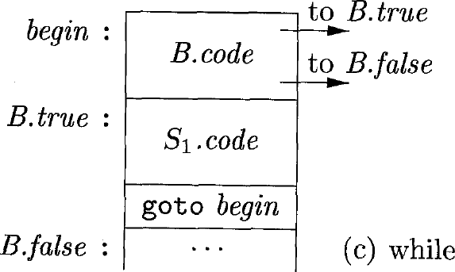
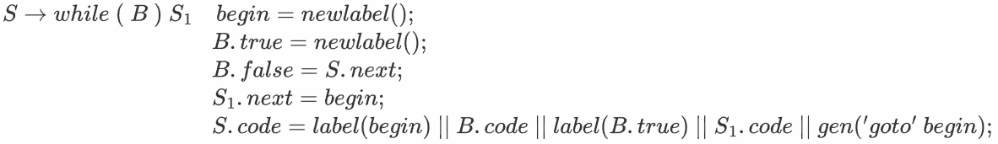
An L-Attributed SDD
The SDD generates labels for the while loop
Inherited attributes: S.next, B.true, B.false
Synthesized attribute: S.code, S1.code
Notes:
S.Begin while 语句开头
C.True S1的第一条语句

Slide 60
Turning into an SDT
• Semantic actions:
a) begin = newlabel(); B.true = newlabel();
b) B.false = S.next;
c) S₁.next = begin;
d) S.code = ⋯ ;
According to the rules of action placement:
b) should be placed before C, c) should be placed before S₁, and d) should be placed at the end of the production body
a) can be placed at the very beginning; there is no constraint
Notes:
- 语义操作：
L1 = new()；L2 = new()；
b) C.false = S.next; C.true = L2；
c) S1.next = L1；
d) S.code = ⋯ ；
根据动作位置规则，
b) 应放在判断语句C 之前，c) 应放在S1语句之前（计算S1的继承属性），d) 应放在产生式末尾（产生式左部S的综合属性计算应该在产生式右部所有文法符号的属性都计算完才能计算）
a) 可以放在开头；没有限制条件

Slide 61
Outline
Syntax-Directed Definitions
Evaluation Orders for SDD’s
Applications of Syntax-Directed Translation
Syntax-Directed Translation Schemes
Implementing L-Attributed SDD’s

Slide 62
Translation During Recursive-Descent Parsing
Many translation applications can be addressed using L-attributed SDD’s. It is possible to extend a recursive-descent parser to implement L-attributed SDD’s as follows:
A recursive-decent parser has a function A for each nonterminal A
Use the arguments of function A to pass A’s inherited attributes
Return the synthesized attributes of A when the function A completes
With the above extension, in the body of the function A, we need to both parse and handle attributes
Notes:
许多翻译应用都可以使用 L 归因 SDD 来解决。如下所示，我们可以扩展递归-下降解析器来实现 L 属性 SDD：
递归-迭代解析器为每个非终端 A 都有一个函数 A
使用函数 A 的参数传递 A 的继承属性
当函数 A 完成时，返回 A 的合成属性
通过上述扩展，在函数 A 的主体中，我们需要同时解析和处理属性

Slide 63
T′syn T′ (token, T′inh)
{ D: Fval, T₁′inh, T₁′syn；
if token=“*” then
{ Getnext(token)；
Fval=F(token)；
T₁′inh= T′inh×Fval；
Getnext(token)；
T₁′syn=T₁′(token, T₁′inh)；
T΄syn=T₁′syn；
return T′syn；
}
else if token= “ $” then
{ T′syn= T′inh；
return T′syn；
}
else Error；
}
算术表达式计算的例子
为每个非终结符A构造一个函数，A的每个继承属性对应该函数的一个形参，函数的返回值是A的综合属性值
例
SDT
1) T → F { T′.inh = F.val } T′
{ T.val = T′.syn }
2) T′ → *F { T₁′.inh = T′.inh×F.val } T₁′
{ T′.syn = T₁′.syn }
3) T′ → ε { T′.syn = T′.inh }
4) F → digit { F.val = digit.lexval }
对出现在A产生式右部中的每个文法符号的每个属性都设置一个局部变量
对于每个动作，将其代码复制到语法分析器，并把对属性的引用改为对相应变量的引用

Slide 64
Tval T(token)
{
D：Fval, T′inh, T′syn；
Fval = F(token);
T′inh = Fval；
Getnext(token);
T′syn = T₁′ (token, T′inh);
Tval = T′syn;
return Tval;
}
例
SDT
1) T → F { T′.inh = F.val } T′
{ T.val = T′.syn }
2) T′ → *F { T₁′.inh = T′.inh×F.val } T₁′
{ T′.syn = T₁′.syn }
3) T′ → ε { T′.syn = T′.inh }
4) F → digit { F.val = digit.lexval }

Slide 65
例
SDT
1) T → F { T′.inh = F.val } T′
{ T.val = T′.syn }
2) T′ → *F { T₁′.inh = T′.inh×F.val } T₁′
{ T′.syn = T₁′.syn }
3) T′ → ε { T′.syn = T′.inh }
4) F → digit { F.val = digit.lexval }
Fval F(token)
{
if token ≠ digit then Error；
Fval=token.lexval；
return Fval；
}

Slide 66
Desent()
{
D：Tval；
Getnext(token)；
Tval = T(token)；
if token ≠ “$” then Error；
return ；
}
例
SDT
1) T → F { T′.inh = F.val } T′
{ T.val = T′.syn }
2) T′ → *F { T₁′.inh = T′.inh×F.val } T₁′
{ T′.syn = T₁′.syn }
3) T′ → ε { T′.syn = T′.inh }
4) F → digit { F.val = digit.lexval }

