Slide 1
Train a Deep Q Learning network to play 2048

Slide 2
Layout
2048?
TEPFA
Network architecture
Q-learning detail
Result
Summary

Slide 3
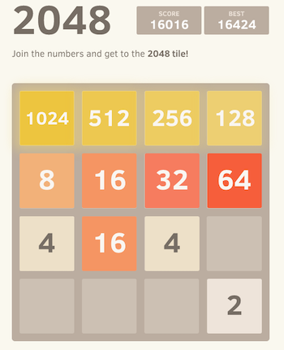
i. 2048
https://2048game.com/

Slide 4
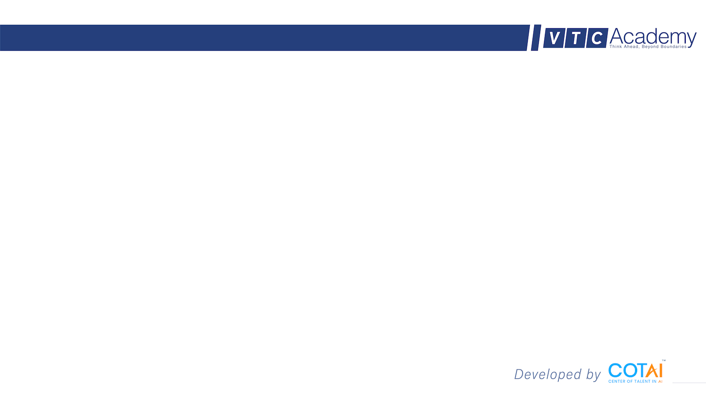
ii. TEPFA
Task: From game state, choose action that leads to optimal rewards
Experience: On the job experience
Performance: Mean Square Error between current Q and maximized Q for network, rewards function for maximizing Q.
Function space: CNN layers, Fully connected layer.
Algorithm: Batch gradient descent for network, Q-learning algorithm for Q values.
Notes:
giải thích hình đã dc normalize kích cỡ, recenter

Slide 5
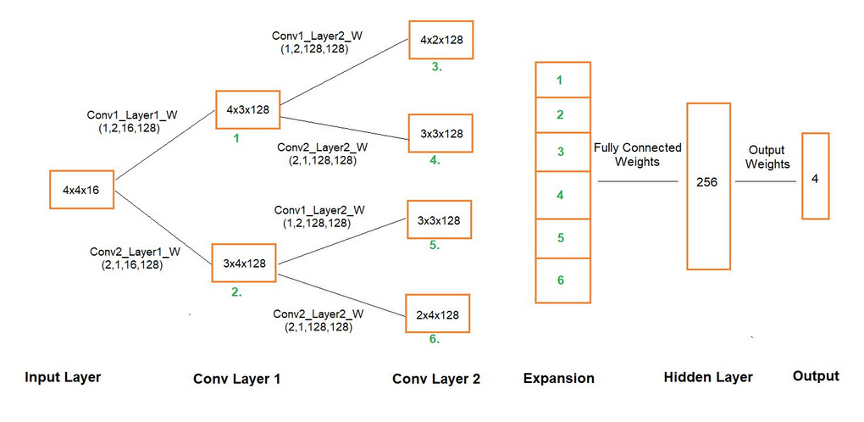
iii. Network architecture

Slide 6
iv. Q-learning detail
Gamma = 0.9
Rewards:
-
-
Epsilon-greedy = 0.9
Epsilon is exponentially decay by 1.005 after episode 10000th
Notes:
Van de kho khan cua vision co ban la gi ? → Cac buoc tien hanh

Slide 7
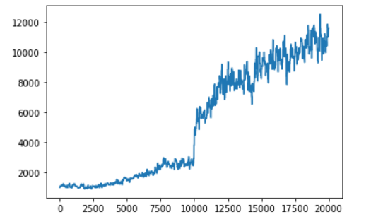
v. Result
Scores upon trainings:

Slide 8
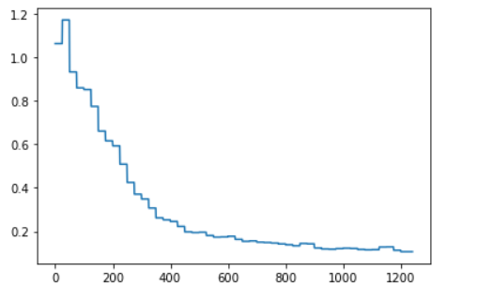
v. Result
Loss upon training:

Slide 9
vi. Summary
The model can learn and play 2048 with score increasing gradually.
The model can play 2048 equally compared to a moderate player.
The model can learn and implement strategies that relates to human’s strategies, due to reward policy.
TODO:
Current network is not yet stable, cannot guarantee a WIN game
-> Tuning kernels
-> Tuning reward policies

Slide 10
Thank you!
Any questions?

