Slide 1
Train a Deep Q Learning network to play 2048

Slide 2
Layout
2048?
TEPFA
Network architecture
Q-learning detail
Result
Summary

Slide 3
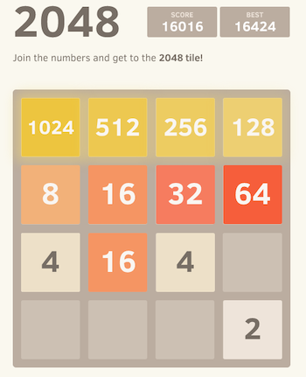
i. 2048
https://2048game.com/

Slide 4

ii. TEPFA
Task
Experience
Performance
Function
Algorithm
Notes:
giải thích hình đã dc normalize kích cỡ, recenter

Slide 5
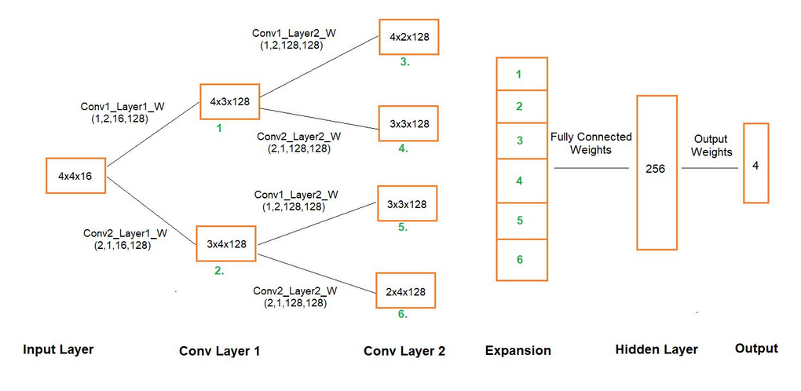
iii. Network architecture

Slide 6
iv. Q-learning detail
Gamma = 0.9
Rewards:
-
-
Epsilon-greedy = 0.9
Epsilon is exponentially decay by 1.005 after episode 10000th
Notes:
Van de kho khan cua vision co ban la gi ? → Cac buoc tien hanh

Slide 7
v. Result

Slide 8
vi. Summary

Slide 9
Thank you!
Any questions?

