Slide 1
Linear Regression Algorithm
Ramkumar Subramanian

Slide 2
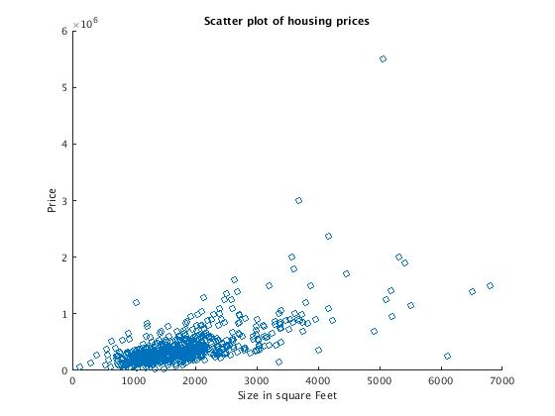
Housing Prices

Slide 3
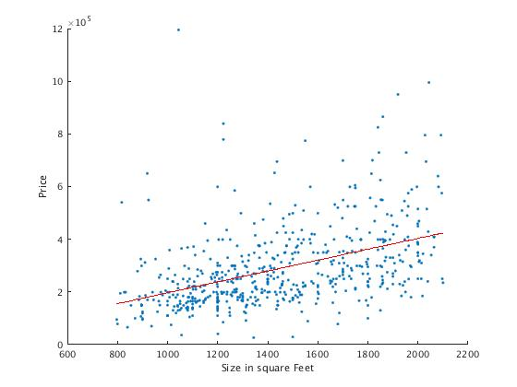
Goal of Machine Learning algorithm
Y = M * X + C
Where,
Y = Price of House
X = Size of House
M = Slope of Line
C = Constant
We need to find M and C using Linear regression algorithm

Slide 4
Algorithm
Inputs
Weights
Final ML Model
Const Size of House
Cost of House
1 1000
800K
C
M
Y = M * X + C
1 1100
1M
…….
…….
1 2000
1.5M
576x2
576x1
2x1
X
Y

Slide 5
Algorithm contd..
Step 1:
Random Values
*
=
2x1
576x1
576x2
F
X
W
Step 2:
Sum all Rows of JW1
=
=
*
576
576x1
576x2
576x1
F
X
JW1

Slide 6
Step 3:
Sum all Rows of JW2
=
=
*
576
576x1
576x2
576x1
F
X
JW2
Step 4:
C = C - Learning_Rate * JW1
M = M - Learning_Rate * JW2
Step 5:
Repeat Step 1 to Step 4 again till convergence (Approx 10,000 iterations)
Step 6:
Take C and M and store it as Machine Learning Model

Slide 7
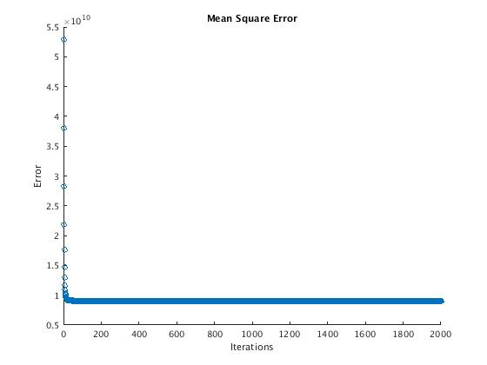
Mean Square Error and Final Model
-0.0992 * 1.0e+05
2.6912 * 1.0e+05
ML Model = Y = (2.6912 * 1.0e+05) * X + (-0.0992 * 1.0e+05)

