Slide 1
TAnoGAN: Time Series Anomaly Detection with Generative Adversarial Networks
Md Abul Bashar, Richi Nayak 2020 IEEE

Slide 2
The main contributions of this paper are:
propose a GAN-based method called TAnoGan to detect anomalies in time series datasets when a small number of data points are available.
evaluate TAnoGan on an extensive and diverse range of 46 time series datasets from the NAB collection that cover a variety of domains.
show that TAnoGan performs better than traditional and neural network models.

Slide 3
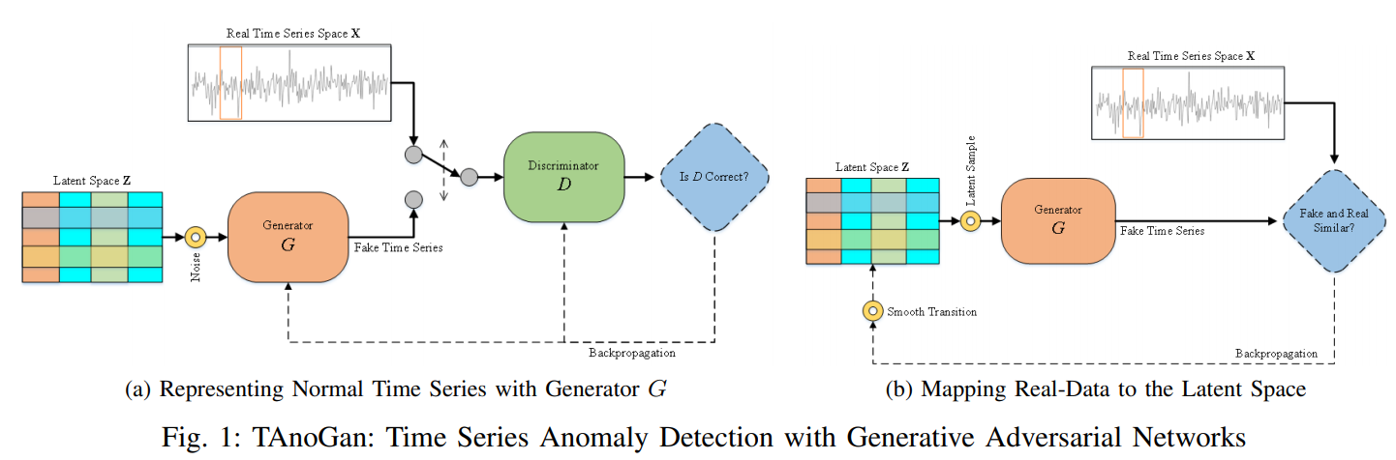
TAnoGAN

Slide 4
Anomaly detection
1. Latent space → real data로의 mapping을 위한 Generator 학습
2. Real data → latent space로의 inverse mapping

Slide 5
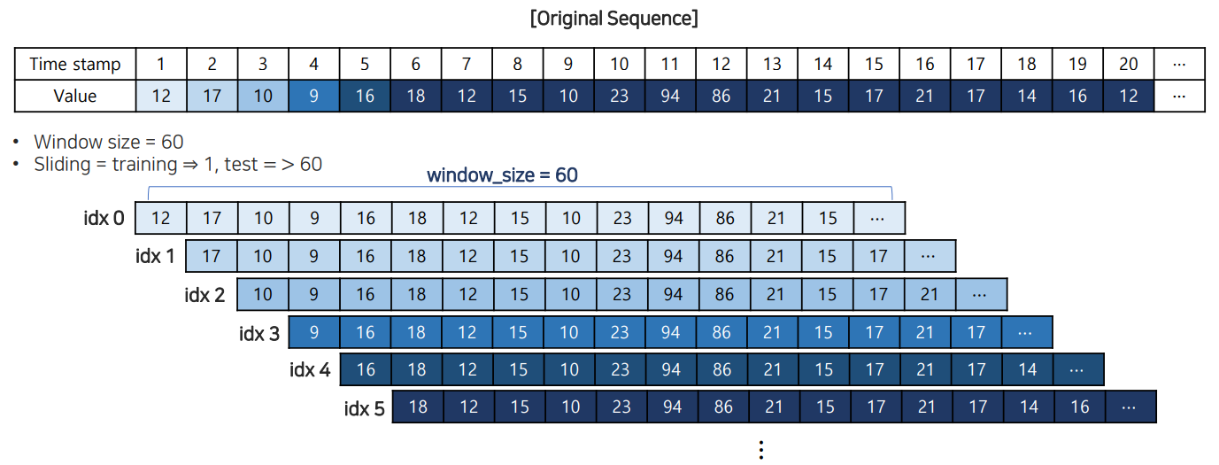

Slide 6
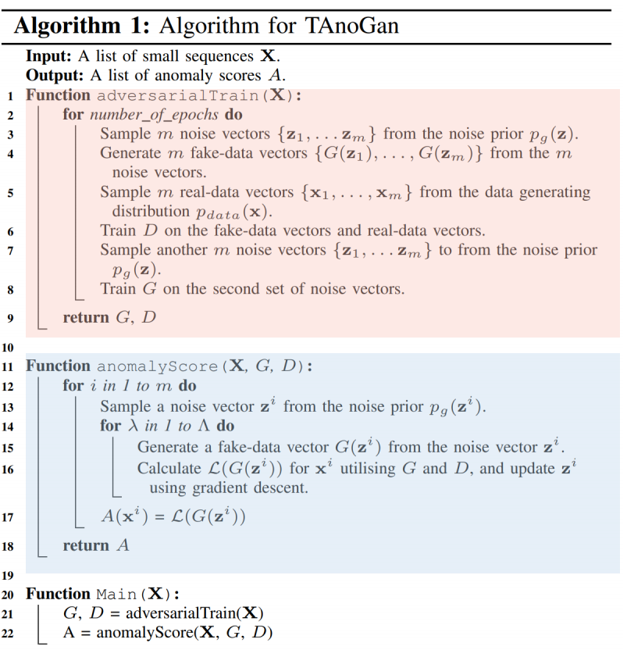


Learning General Data Distribution
Mapping Real-Data to the Latent Space

Slide 7
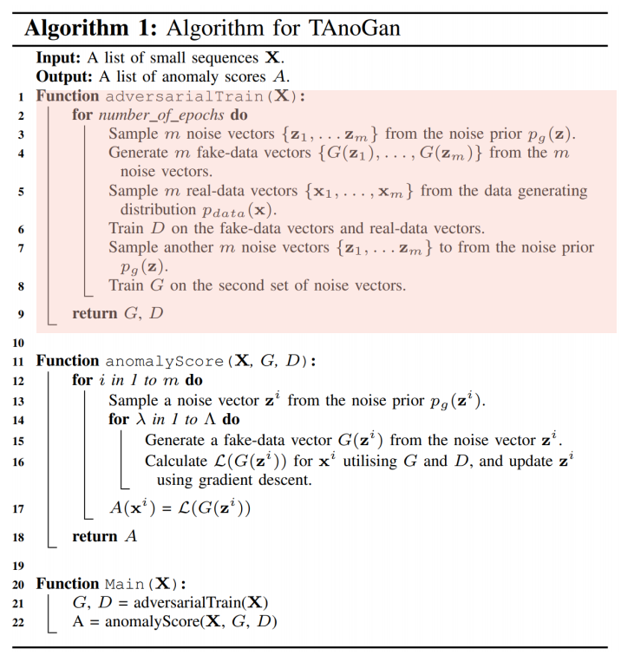

Slide 8
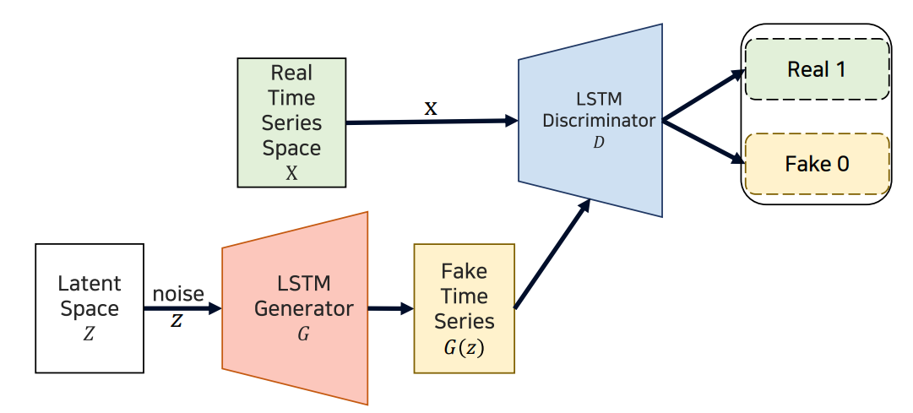
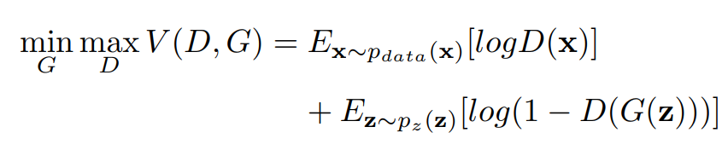

Slide 9
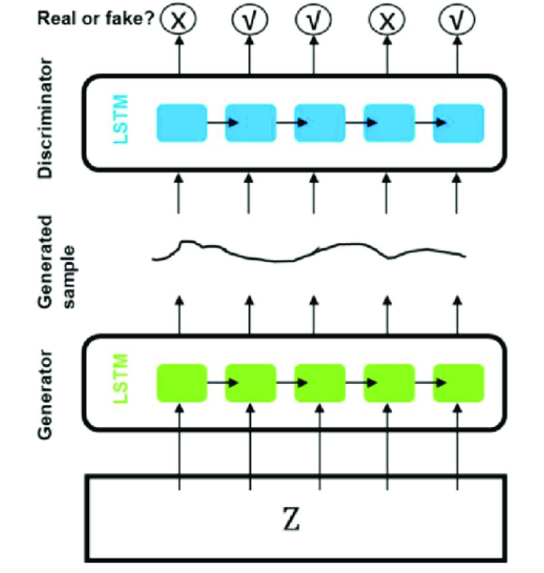
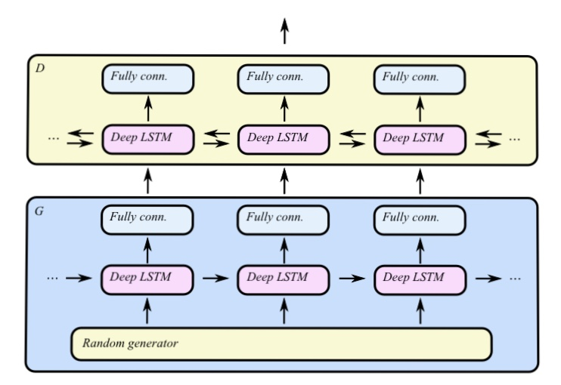

Slide 10
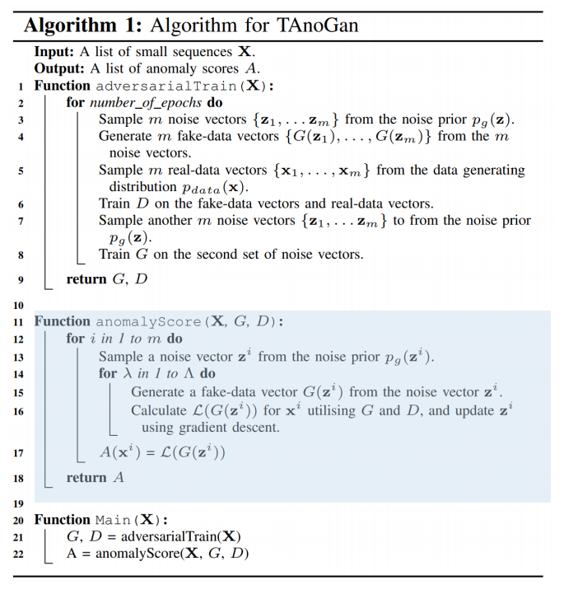

Slide 11
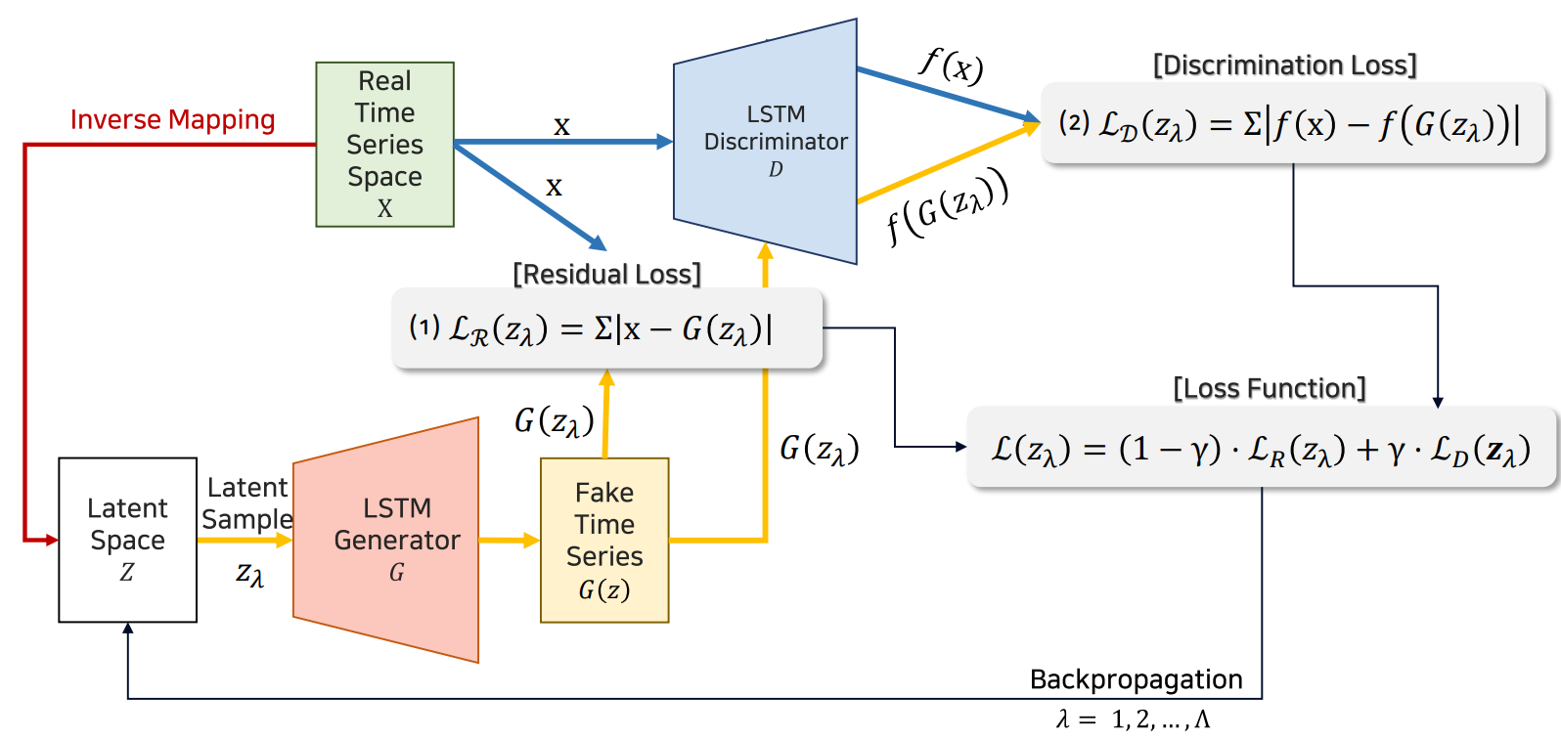

Slide 12


Slide 13
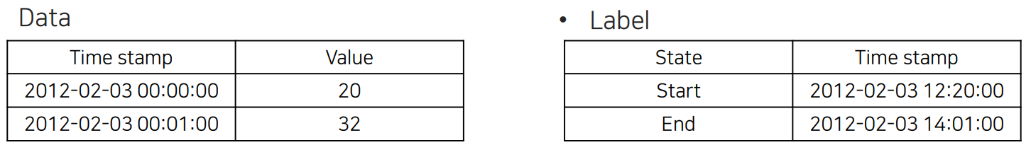
Numenta Anomaly Benchmark
58개의 dataset
각 dataset은 1,000~22,000개의 instance

Slide 14
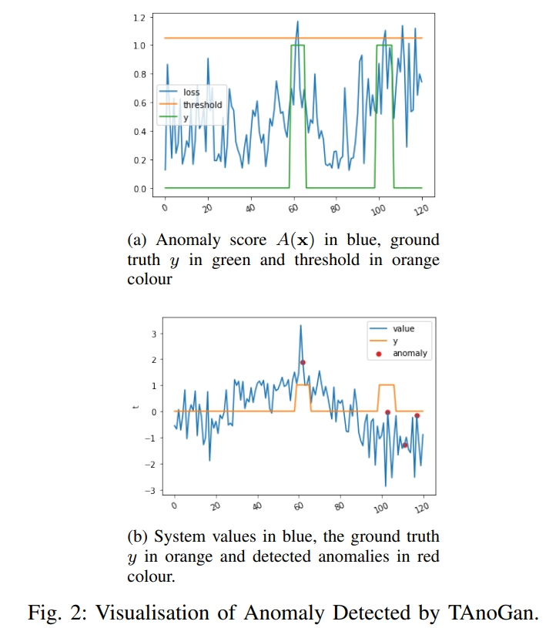

Slide 15
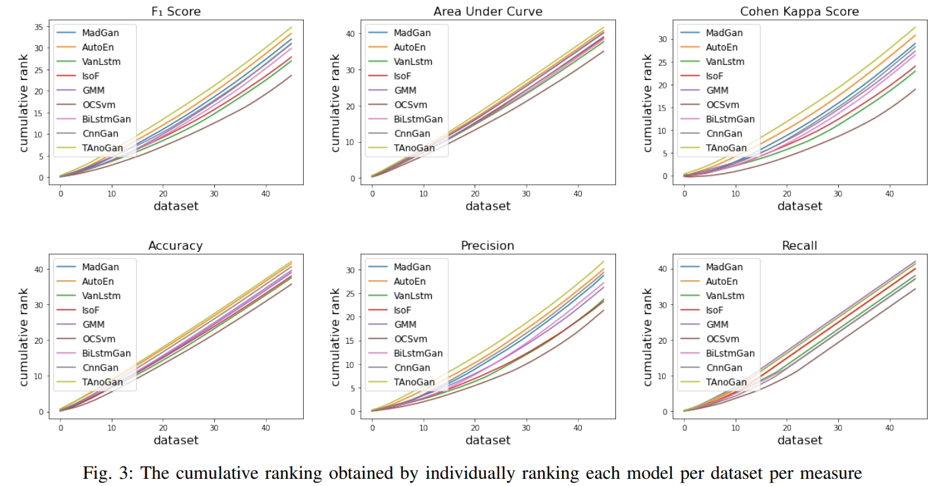

Slide 16
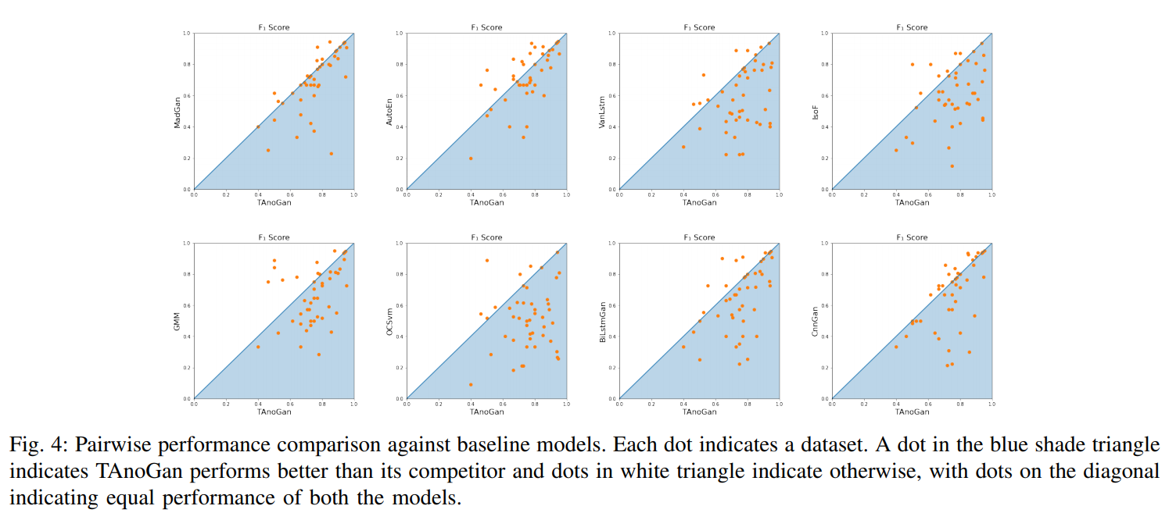

Slide 17
감사합니다.

