Slide 1
MAD-GAN: Multivariate Anomaly Detection for Time Series Data with Generative Adversarial Networks
Dan Li, Dacheng Chen, Lei Shi, Baihong Jin, Jonathan Goh, and See-Kiong Ng

Slide 2
Introduction
Cyber-Physical Systems (CPSs) : 사이버물리시스템
(물리적 현실세계에서 수집한 데이터를 컴퓨팅 세계에서 분석하여 다시 현실세계를 제어하는 것)
Long-Short-Term-Memory Recurrent Neural Networks as the base models in the GAN framework to capture the temporal correlation of time series distributions.
We use a novel Discrimination and Reconstruction Anomaly Score (DR-Score) to combine the two losses to detect potential anomalies in the data

Slide 3
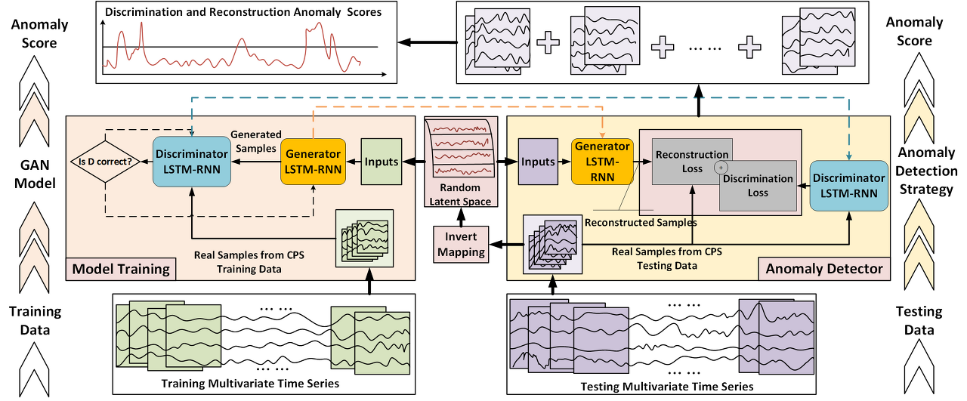
Anomaly Detection 구조

Slide 4
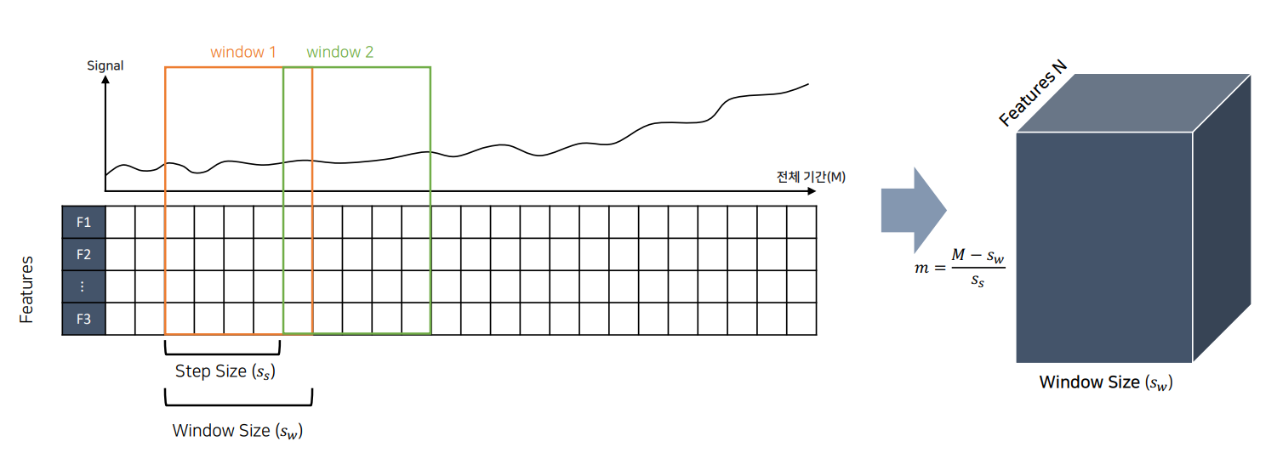
입력데이터 구성

Slide 5
Anomaly Detection 구조

Slide 6
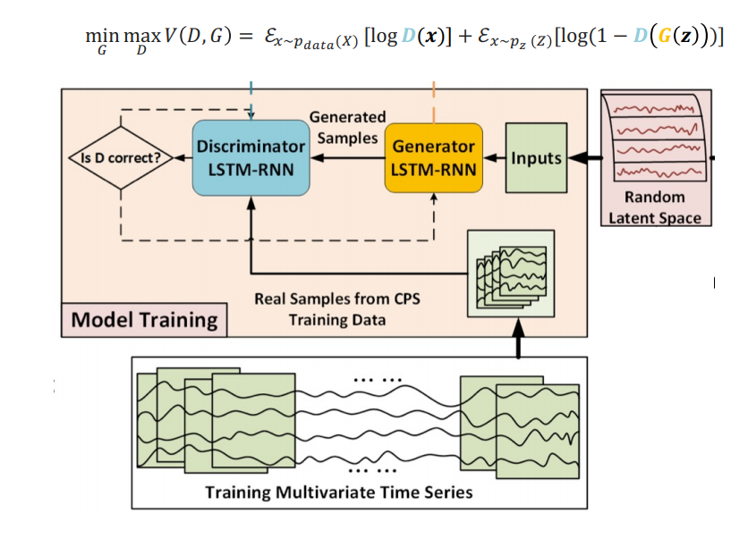
GAN모델 학습

Slide 7
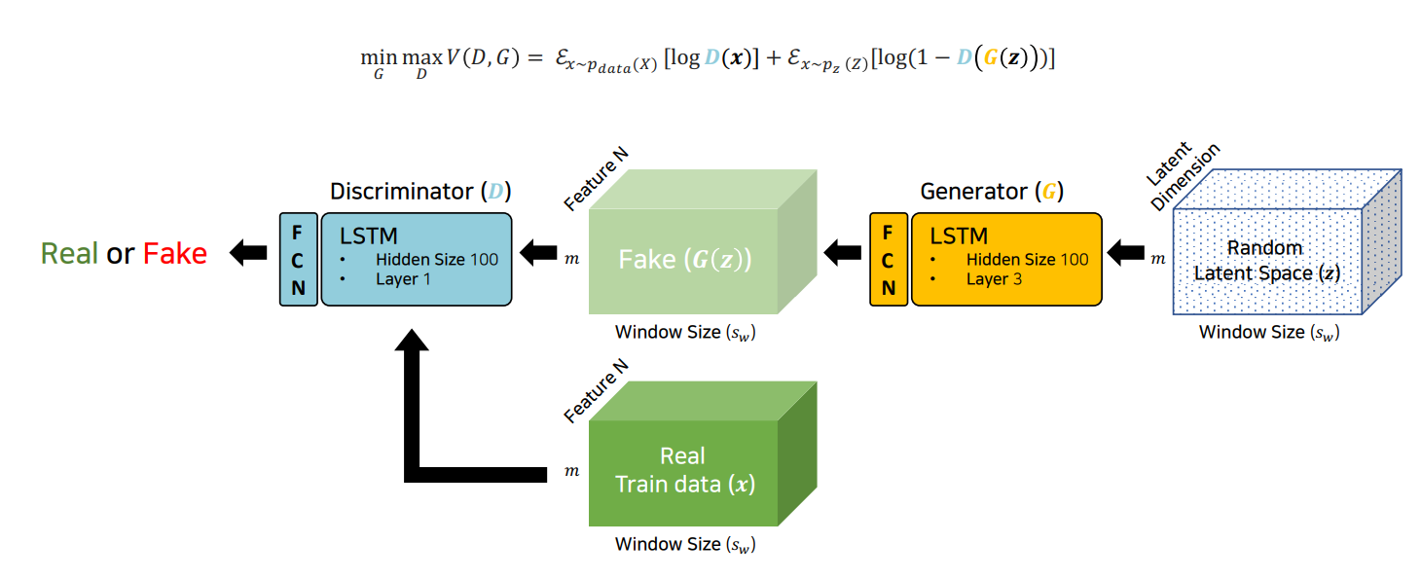
GAN모델 학습

Slide 8
Anomaly Detection 구조

Slide 9
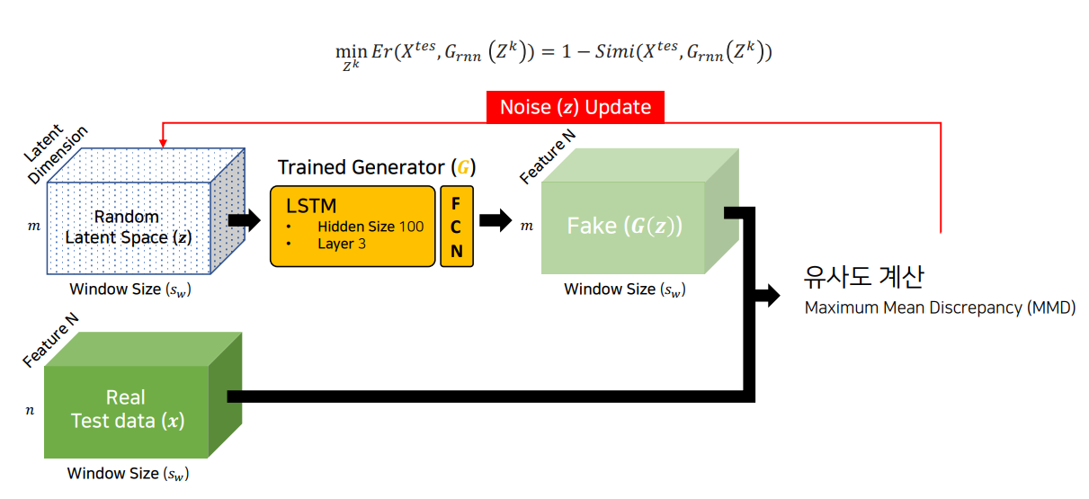
AnomalyDetector
where the similarity between sequences could be defined as covariance for simplicity.

Slide 10
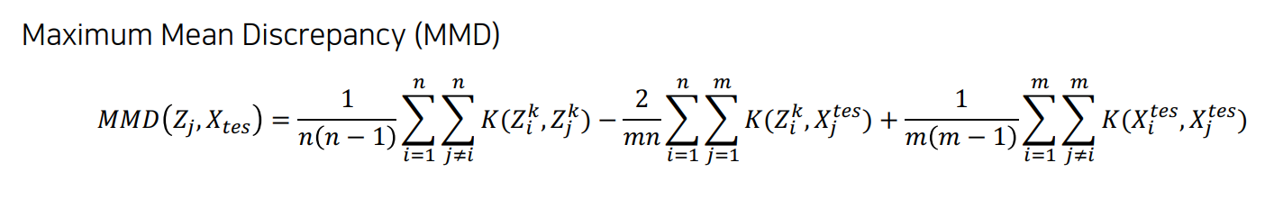

Slide 11
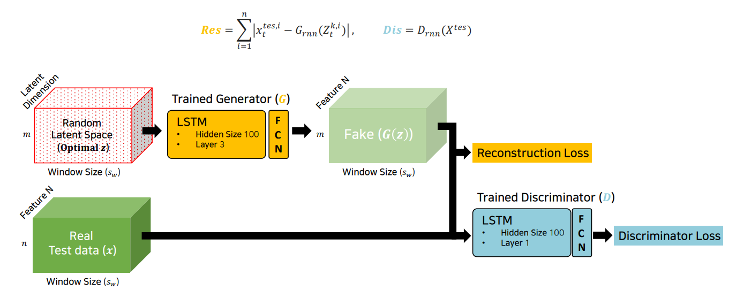
AnomalyDetector

Slide 12
Anomaly Detection 구조

Slide 13
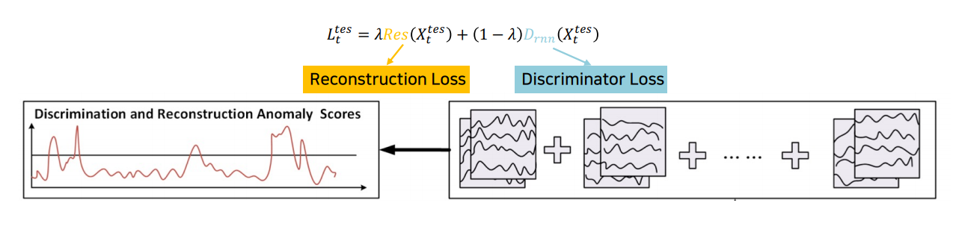
AnomalyScore

Slide 14
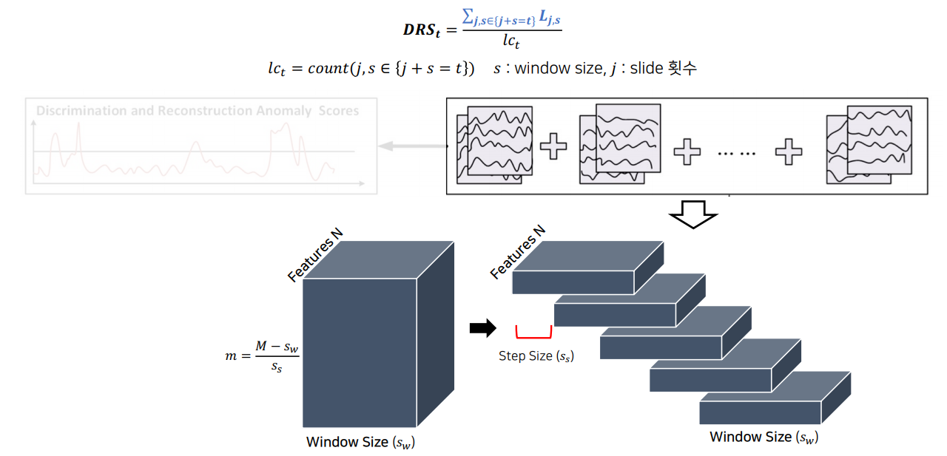
DR-Score

Slide 15
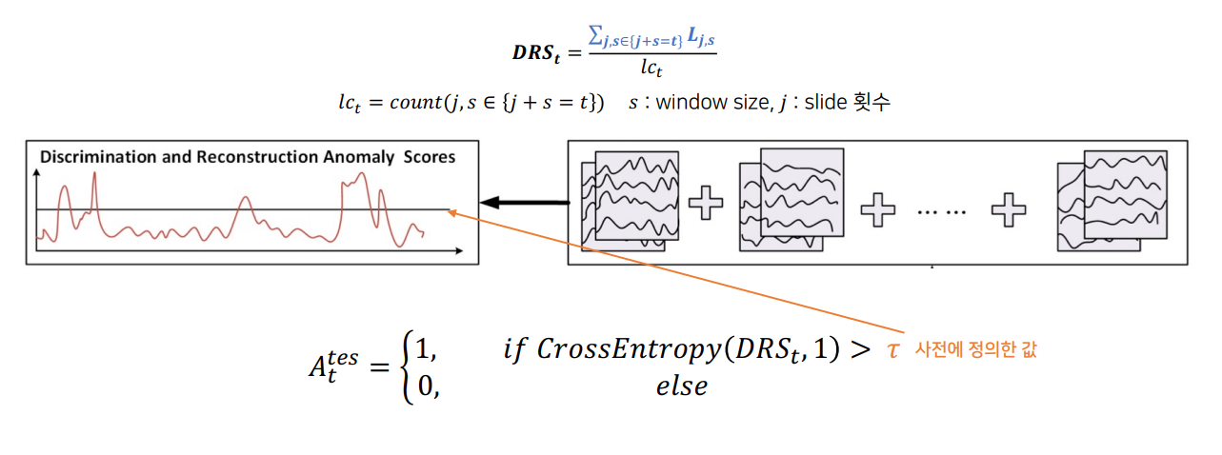
DR-Score

Slide 16
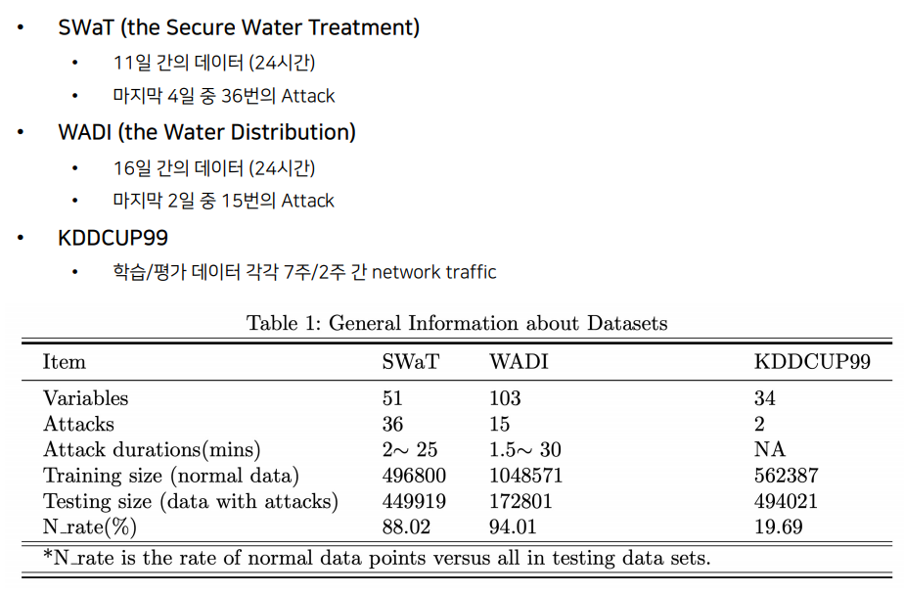
Dataset

Slide 17
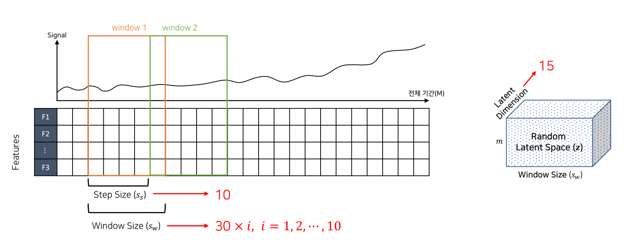
Dataset

Slide 18
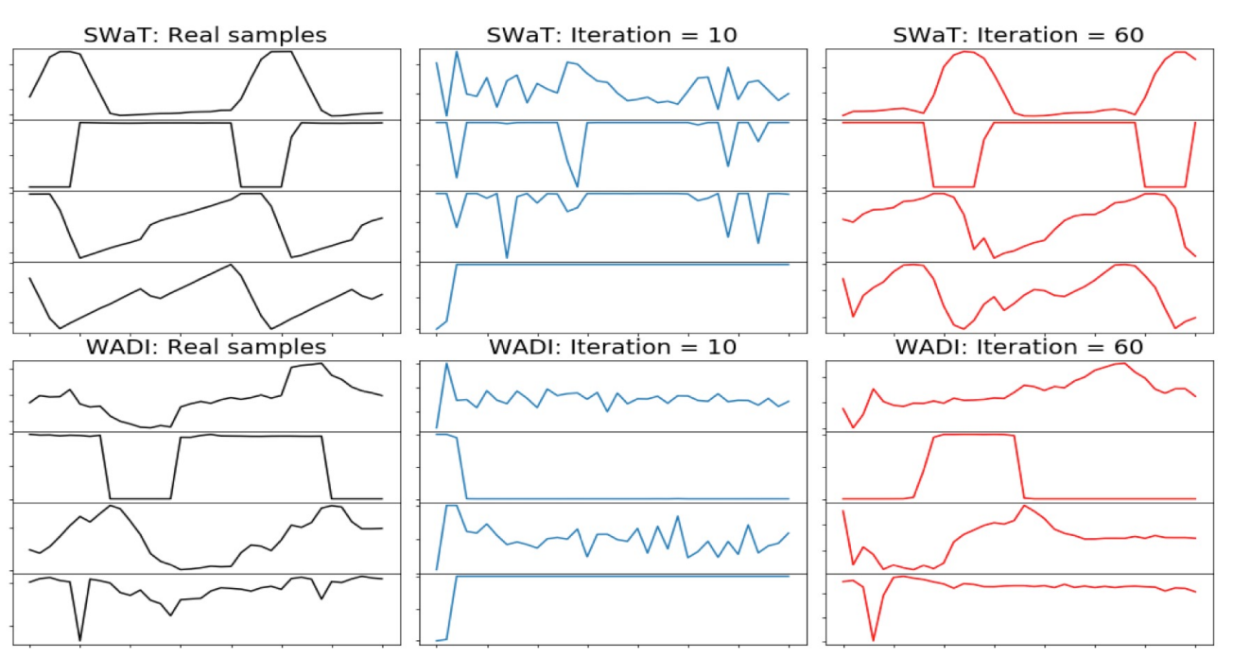
Results

Slide 19
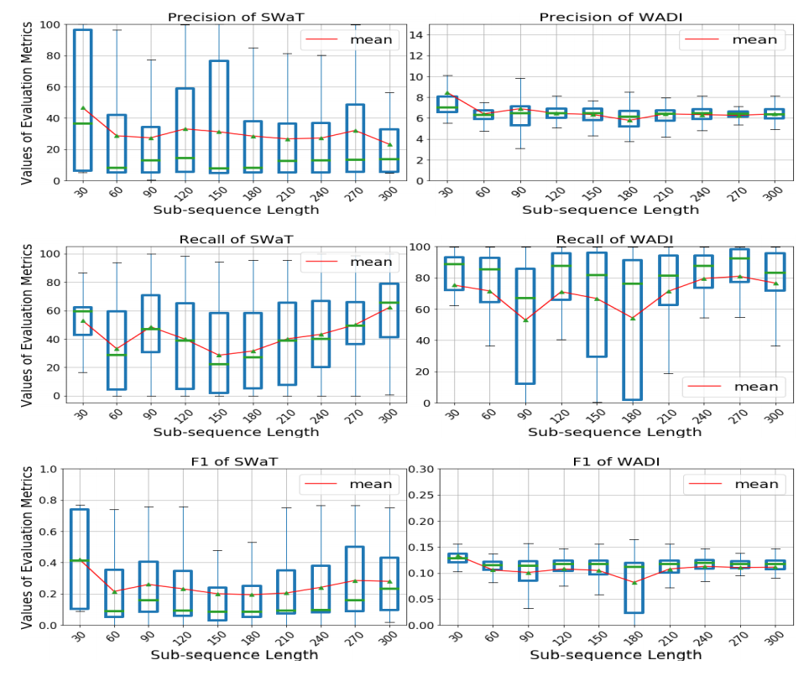
Results

Slide 20
감사합니다.

