Slide 1
LIPNET :
END-TO-END SENTENCE-LEVEL LIPREADING
Yannis M. Assael , Brendan Shillingford, Shimon Whiteson& Nando de Freitas

Slide 2
What is LipReading?
https://www.youtube.com/watch?v=fa5QGremQf8

Slide 3
립리딩의 필요성
1. 청각장애인들에게 도움을 줄 수 있다.
2. 주변 소음이 많은 환경에서 사용될 수 있다.

Slide 4
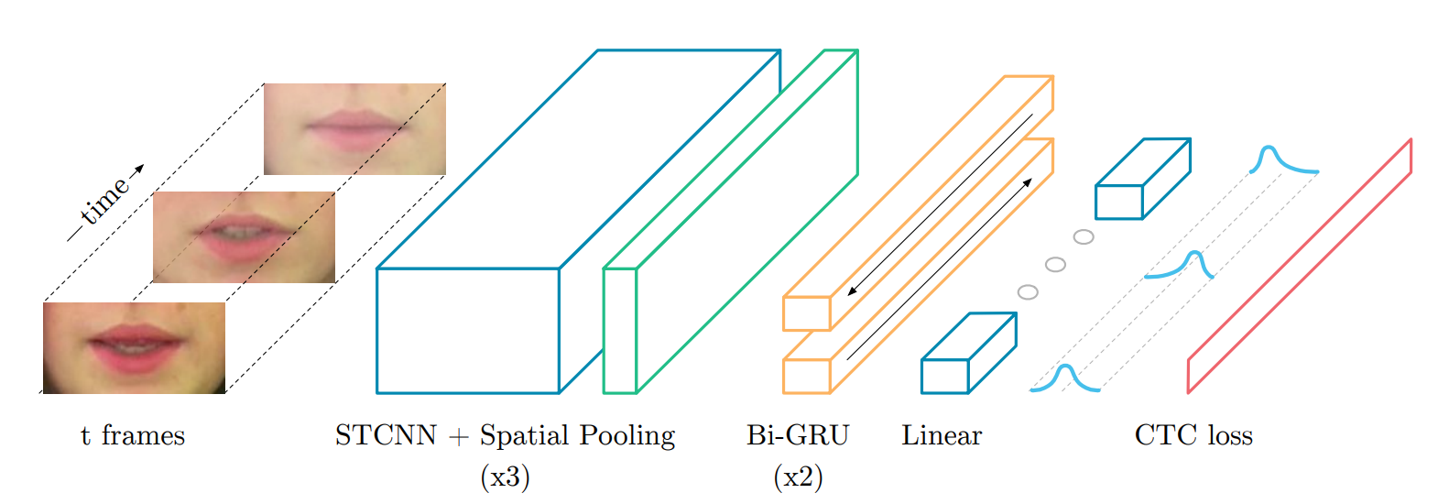
LipNet architecture

Slide 5
LipNet architecture

Slide 6
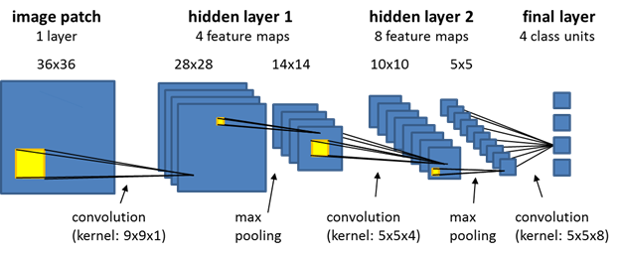

Spatial CNN

Slide 7
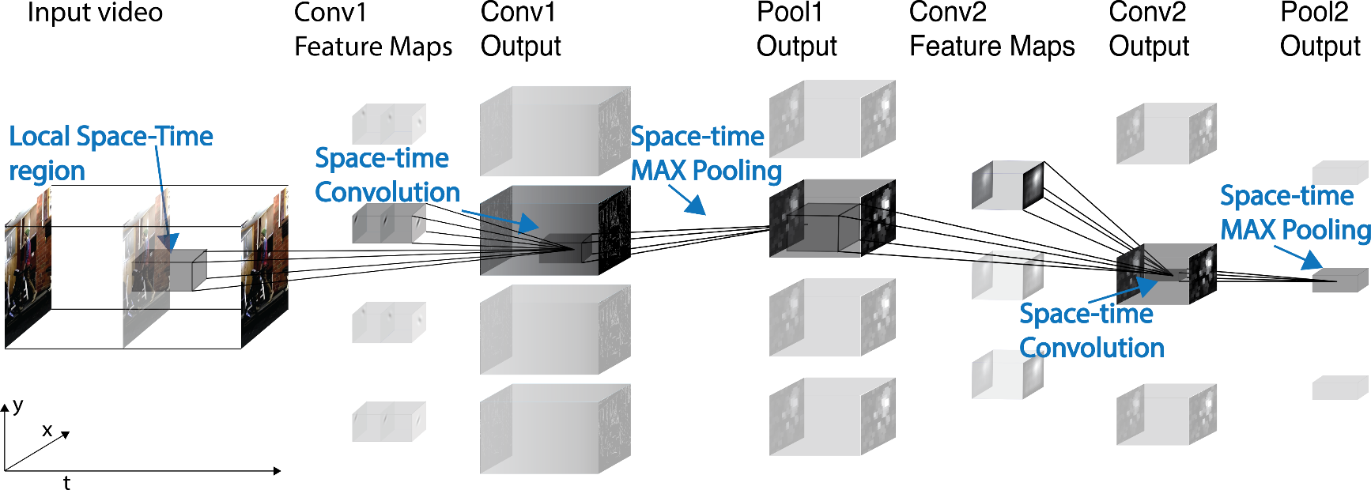

Spatio-Temporal CNN

Slide 8
LipNet architecture

Slide 9
GRU

Slide 10
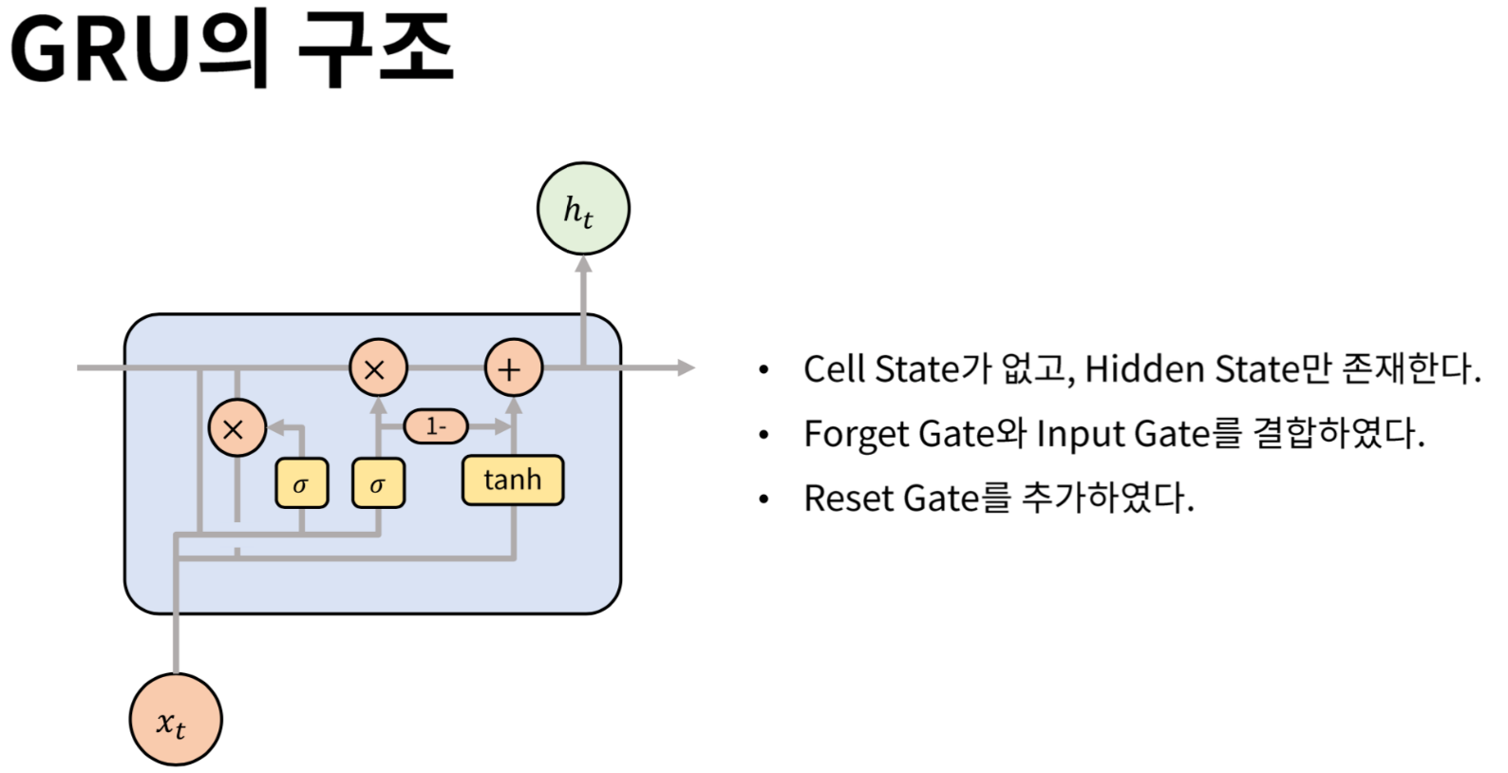
GRU

Slide 11
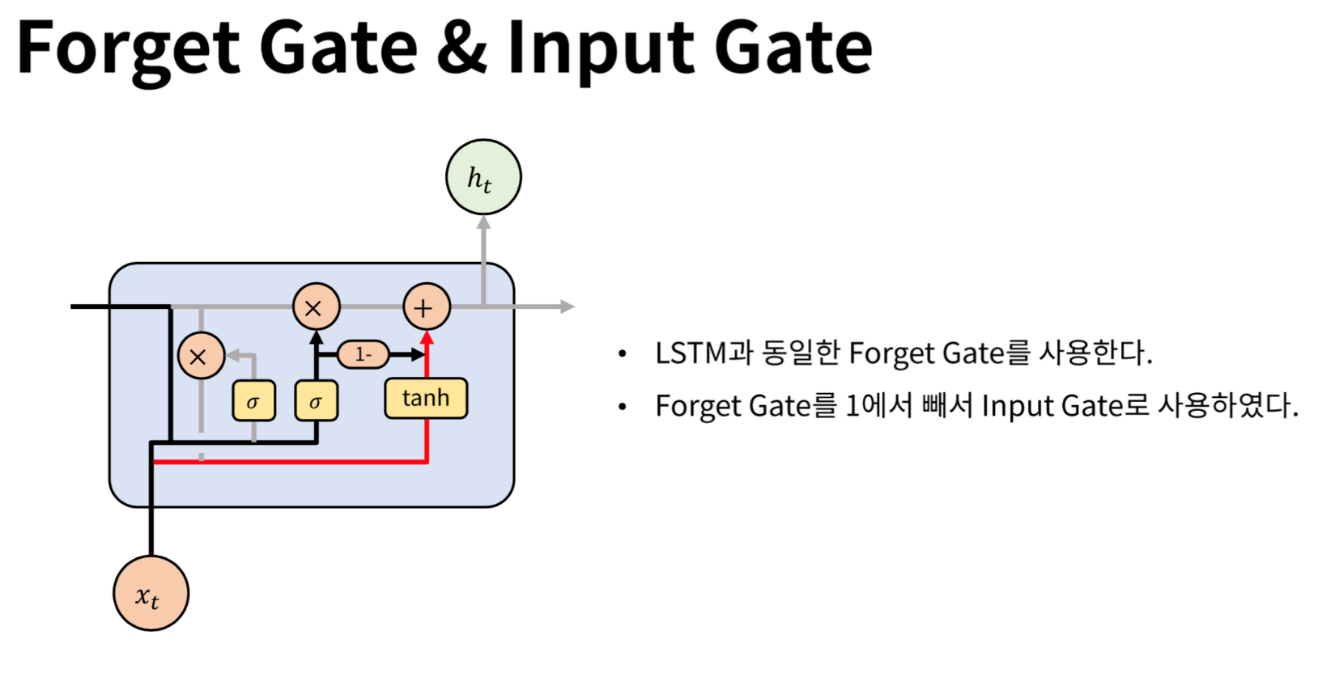
GRU

Slide 12
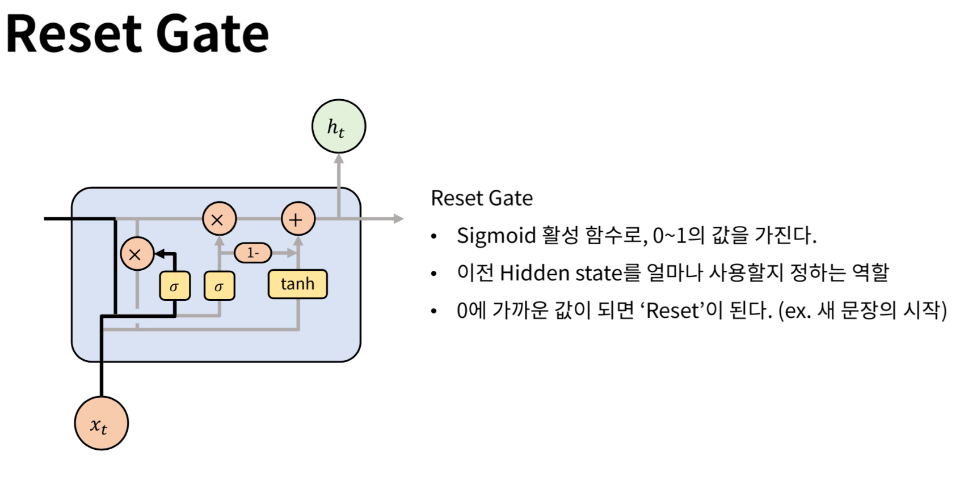
GRU

Slide 13
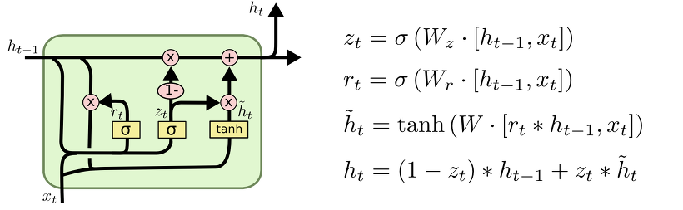
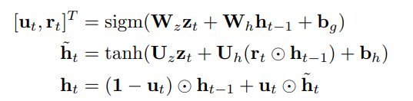
GRU

Slide 14
LipNet architecture

Slide 15
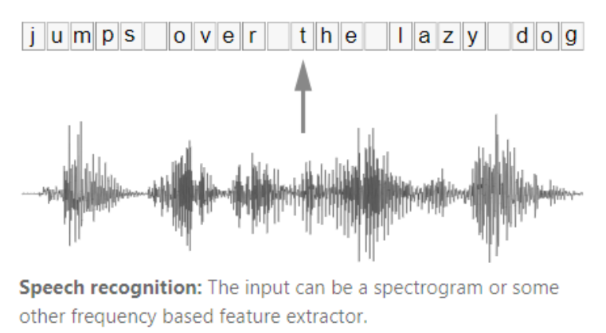
Connectionist temporal classification
우리는 어떤 단어의 Character가 Audio와 Alignment가 맞는지 알 수 없다.

Slide 16
Connectionist temporal classification
As an example, think of an image containing the text "Hello".
You must now specify where the "H" starts and ends (e.g. "H" starts at the 10th pixel and goes until the 25th pixel).
The same for "e", "l, ... That sounds boring and is a hard work for large datasets.

Slide 17
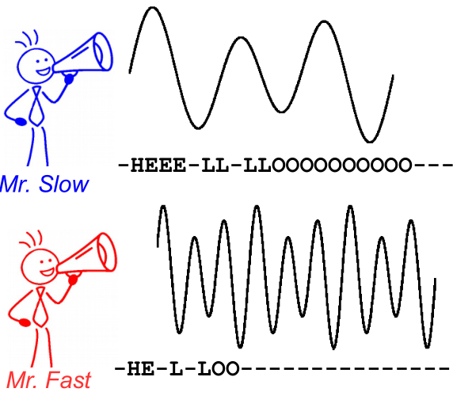
Connectionist temporal classification

Slide 18
Connectionist temporal classification
CTC solves both problems:
you can train the network from pairs (I, T) without having to specify at which position a character occurs using the CTC loss
you don't have to postprocess the output, as a CTC decoder transforms the NN output into the final text

Slide 19
Connectionist temporal classification
How is this achieved?
introduce a special character (CTC-blank, denoted as "-" in this text) to indicate that no character is seen at a given time-step
modify the ground truth text T to T' by inserting CTC-blanks and by repeating characters in in all possible ways
we know the image, we know the text, but we don't know where the text is positioned. So, let's just try all possible positions of the text "Hi----", "-Hi---", "--Hi--", ...

Slide 20
Connectionist temporal classification
How is this achieved?
we also don't know how much space each character occupies in the image. So let's also try all possible alignments by allowing characters to repeat like "HHi----", "HHHi---", "HHHHi--", ...
if we allow a character to repeat multiple times, how do we handle real duplicate characters like the "l" in "Hello"? Well, just always insert a blank in between in these situations, that is e.g. "Hel-lo" or "Heeellll-------llo

Slide 21
Connectionist temporal classification
How is this achieved?
calculate score for each possible T' (that is for each transformation and each combination of these), sum over all scores which yields the loss for the pair (I, T)
decoding is easy: pick character with highest score for each time step, e.g. "HHHHHH-eeeellll-lll--oo---", throw away duplicate characters "H-el-l-o", throw away blanks "Hello", and we are done.

Slide 22
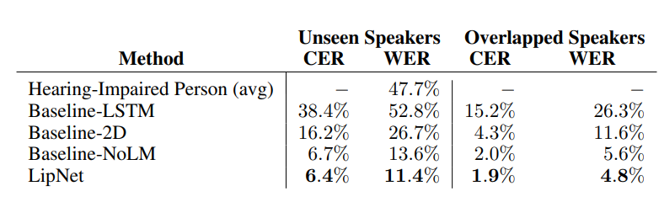
Performance Evaluation

Slide 23
감사합니다.

