Slide 1
Optimization
Multi-Dimensional Unconstrained Optimization
Part II: Gradient Methods

Slide 2
Optimization Methods
One-Dimensional Unconstrained Optimization
Golden-Section Search
Quadratic Interpolation
Newton's Method
Multi-Dimensional Unconstrained Optimization
Non-gradient or direct methods
Gradient methods
Linear Programming (Constrained)
Graphical Solution
Simplex Method

Slide 3
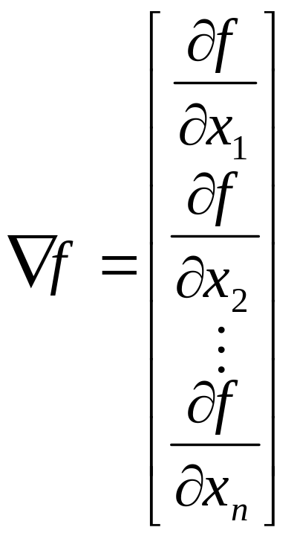
Gradient
The gradient vector of a function f, denoted as f, tells us that from an arbitrary point
  Which direction is the steepest ascend/descend?
    i.e. Direction that will yield the greatest change in f
  How much we will gain by taking that step?
    Indicate by the magnitude of f = || f ||₂

Slide 4
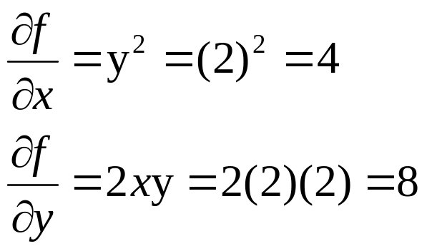
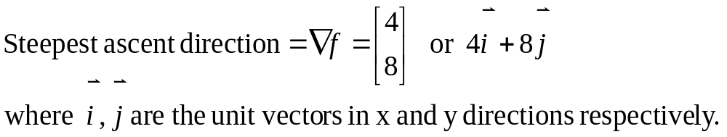
Gradient – Example
Problem: Employ gradient to evaluate the steepest ascent direction for the function f(x, y) = xy² at point (2, 2).
Solution:
8 unit
4 unit

Slide 5
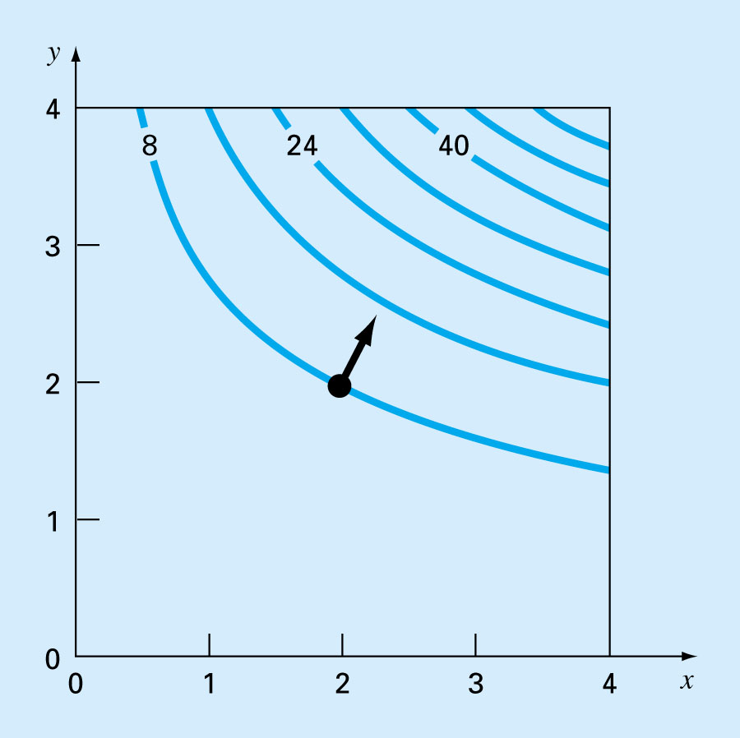
The direction of steepest ascent (gradient) is generally perpendicular, or orthogonal, to the elevation contour.

Slide 6
Testing Optimum Point
For 1-D problems
  If f'(x') = 0
  and
  If f"(x') < 0, then x' is a maximum point
  If f"(x') > 0, then x' is a minimum point
  If f"(x') = 0, then x' is a saddle point
What about for multi-dimensional problems?

Slide 7
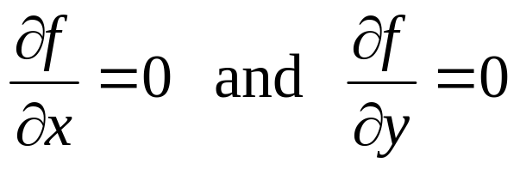
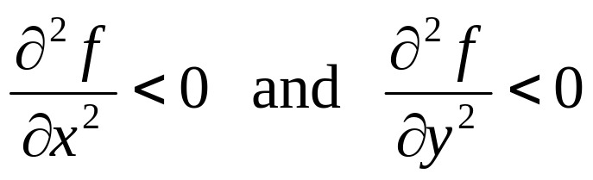
Testing Optimum Point
For 2-D problems, if a point is an optimum point, then
In addition, if the point is a maximum point, then
Question: If both of these conditions are satisfied for a point, can we conclude that the point is a maximum point?

Slide 8
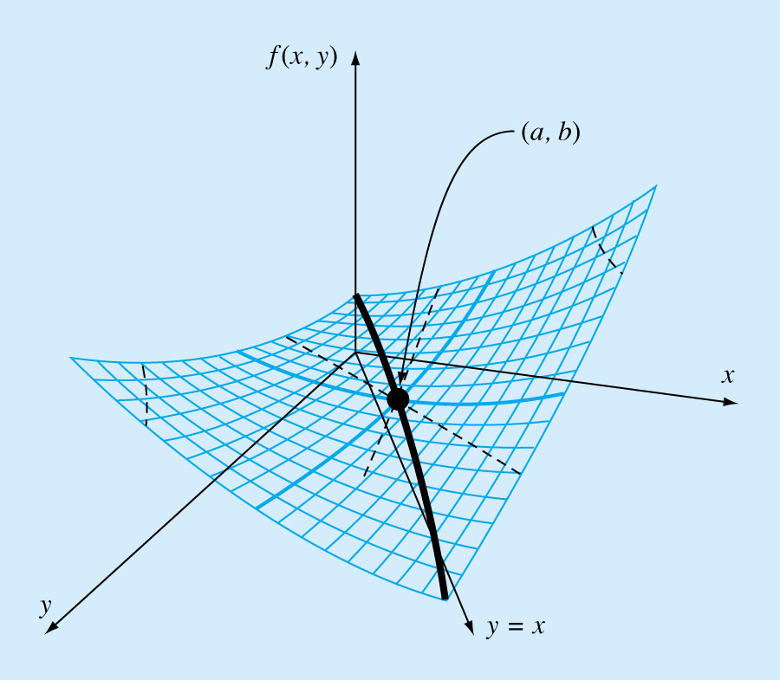
Testing Optimum Point
When viewed along the x and y directions.
When viewed along the y = x direction.
(a, b) is a saddle point

Slide 9
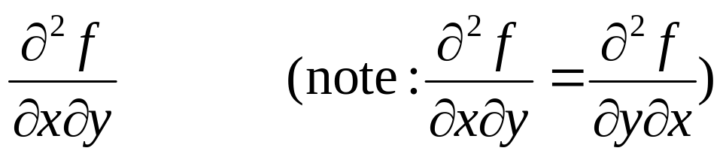
Testing Optimum Point
For 2-D functions, we also have to take into consideration of
That is, whether a maximum or a minimum occurs involves both partial derivatives w.r.t. x and y and the second partials w.r.t. x and y.

Slide 10
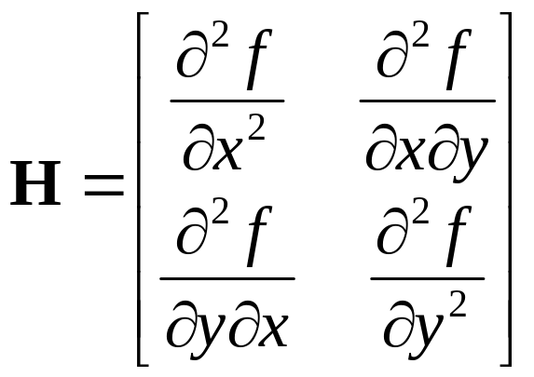
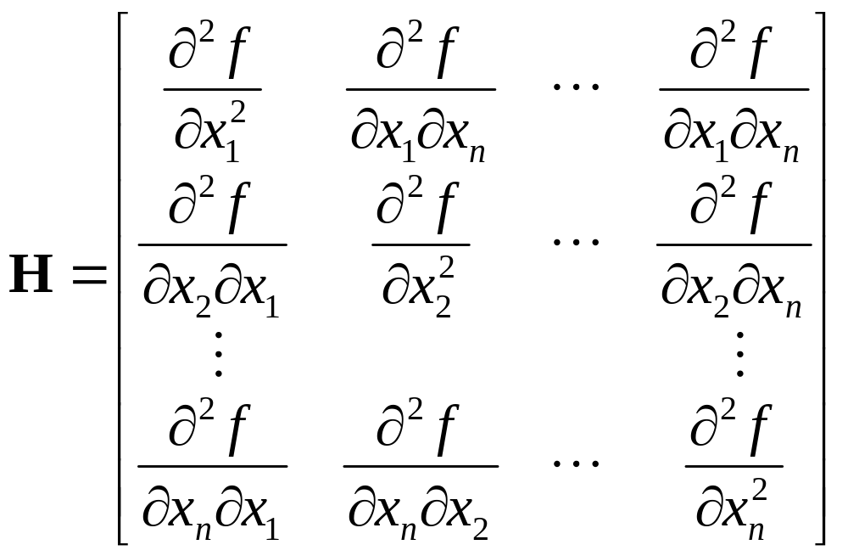
Hessian Matrix (or Hessian of f )
n=2
Also known as the matrix of second partial derivatives.
It provides a way to discern if a function has reached an optimum or not.

Slide 11
Testing Optimum Point (General Case)
Supposef and H is evaluated at x* = (x*₁, x*₂, …, x*_{n}).
If f = 0,
  If H is positive definite, then x* is a minimum point.
  If -H is positive definite (or H is negative definite) , then x* is a maximum point.
  If H is indefinite (neither positive nor negative definite), then x* is a saddle point.
  If H is singular, no conclusion (need further investigation)
Note:
A matrix A is positive definite iff x^{T}Ax > 0 for all non-zero x.
A matrix A is positive definite iff the determinants of all its upper left corner sub-matrices are positive.
A matrix A is negative definite iff -A is positive definite.

Slide 12
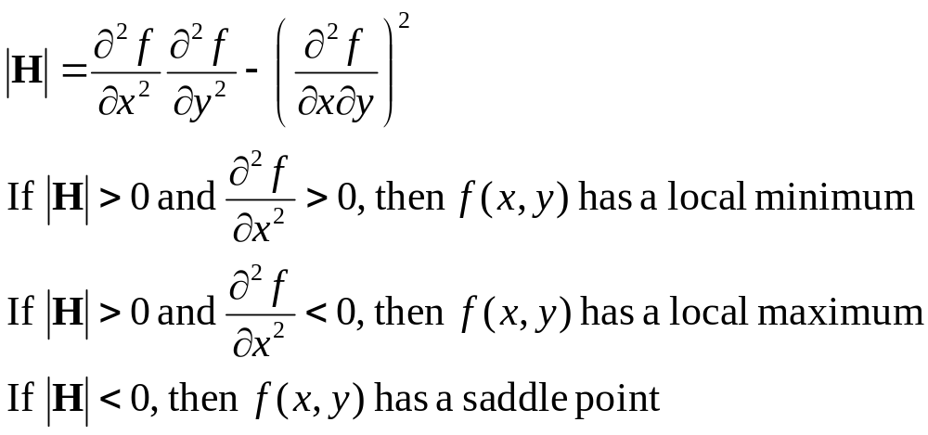
Testing Optimum Point (Special case – function with two variables)
Assuming that the partial derivatives are continuous at and near the point being evaluated.
For function with two variables (i.e. n = 2),
The quantity |H| is equal to the determinant of the Hessian matrix of f.

Slide 13
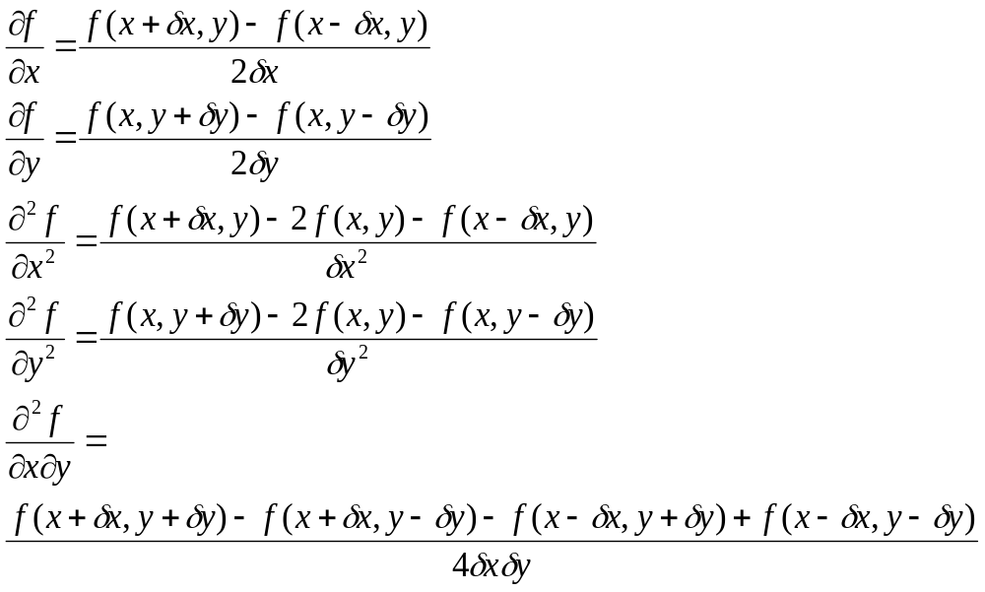
Finite Difference Approximation using
Centered-difference approach
Used when evaluating partial derivatives is inconvenient.

Slide 14
Steepest Ascent Method
Steepest Ascent Algorithm
  Select an initial point, x₀ = ( x₁, x₂ , …, x_{n} )
  for i = 0 to Max_Iteration
  S_{i} = f at x_{i}
  Find h such that f (x_{i} + hS_{i}) is maximized
  x_{i+1} = x_{i} + hS_{i}
  Stop loop if x converges or if the error is small enough
Steepest ascent method converges linearly.

Slide 15
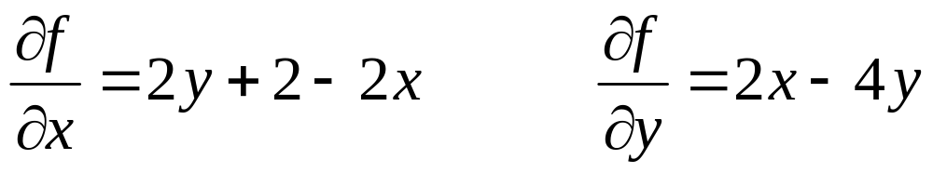
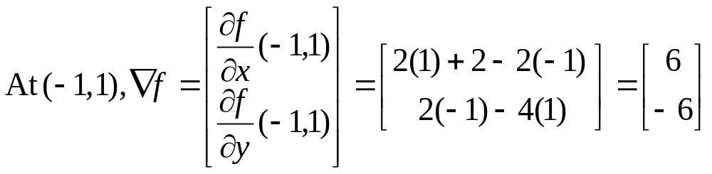
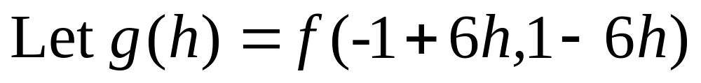
Example: Suppose f(x, y) = 2xy + 2x – x² – 2y²
Using the steepest ascent method to find the next point if we are moving from point (-1, 1).
Next step is to find h that maximize g(h)

Slide 16
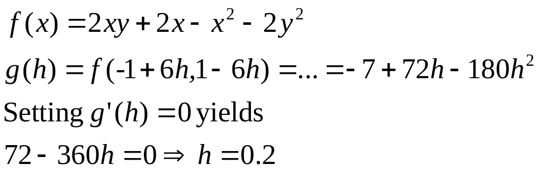
If h = 0.2 maximizes g(h), then x = -1+6(0.2) = 0.2 and y = 1-6(0.2) = -0.2 would maximize f(x, y).
So moving along the direction of gradient from point (-1, 1), we would reach the optimum point (which is our next point) at (0.2, -0.2).

Slide 17
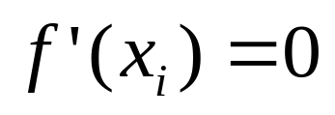
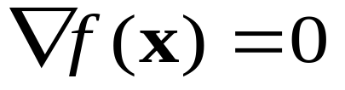
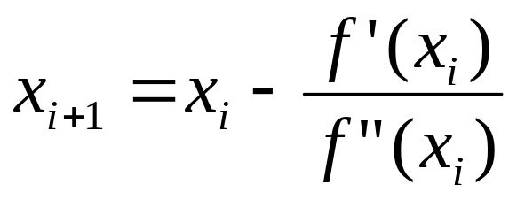
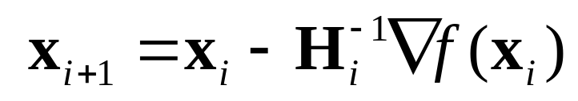
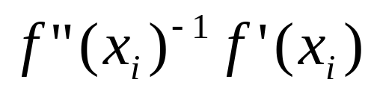
Newton's Method
 | One-dimensional Optimization | Multi-dimensional Optimization
At the optimal
Newton's Method
H_{i} is the Hessian matrix (or matrix of 2nd partial derivatives) of f evaluated at x_{i}.

Slide 18
Newton's Method
Converge quadratically
May diverge if the starting point is not close enough to the optimum point.
Costly to evaluate H⁻¹

Slide 19
Conjugate Direction Methods
Conjugate direction methods can be regarded as somewhat in between steepest descent and Newton's method, having the positive features of both of them.
Motivation: Desire to accelerate slow convergence of steepest descent, but avoid expensive evaluation, storage, and inversion of Hessian.

Slide 20
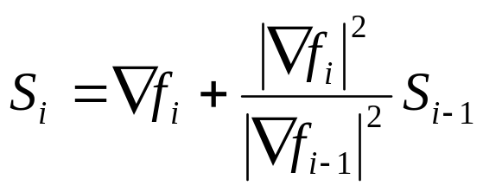
Conjugate Gradient Approaches
(Fletcher-Reeves) **
Methods moving in conjugate directions converge quadratically.
Idea: Calculate conjugate direction at each points based on the gradient as
Converge faster than Powell's method.
Ref: Engineering Optimization (Theory & Practice), 3rd ed, by Singiresu S. Rao.

Slide 21
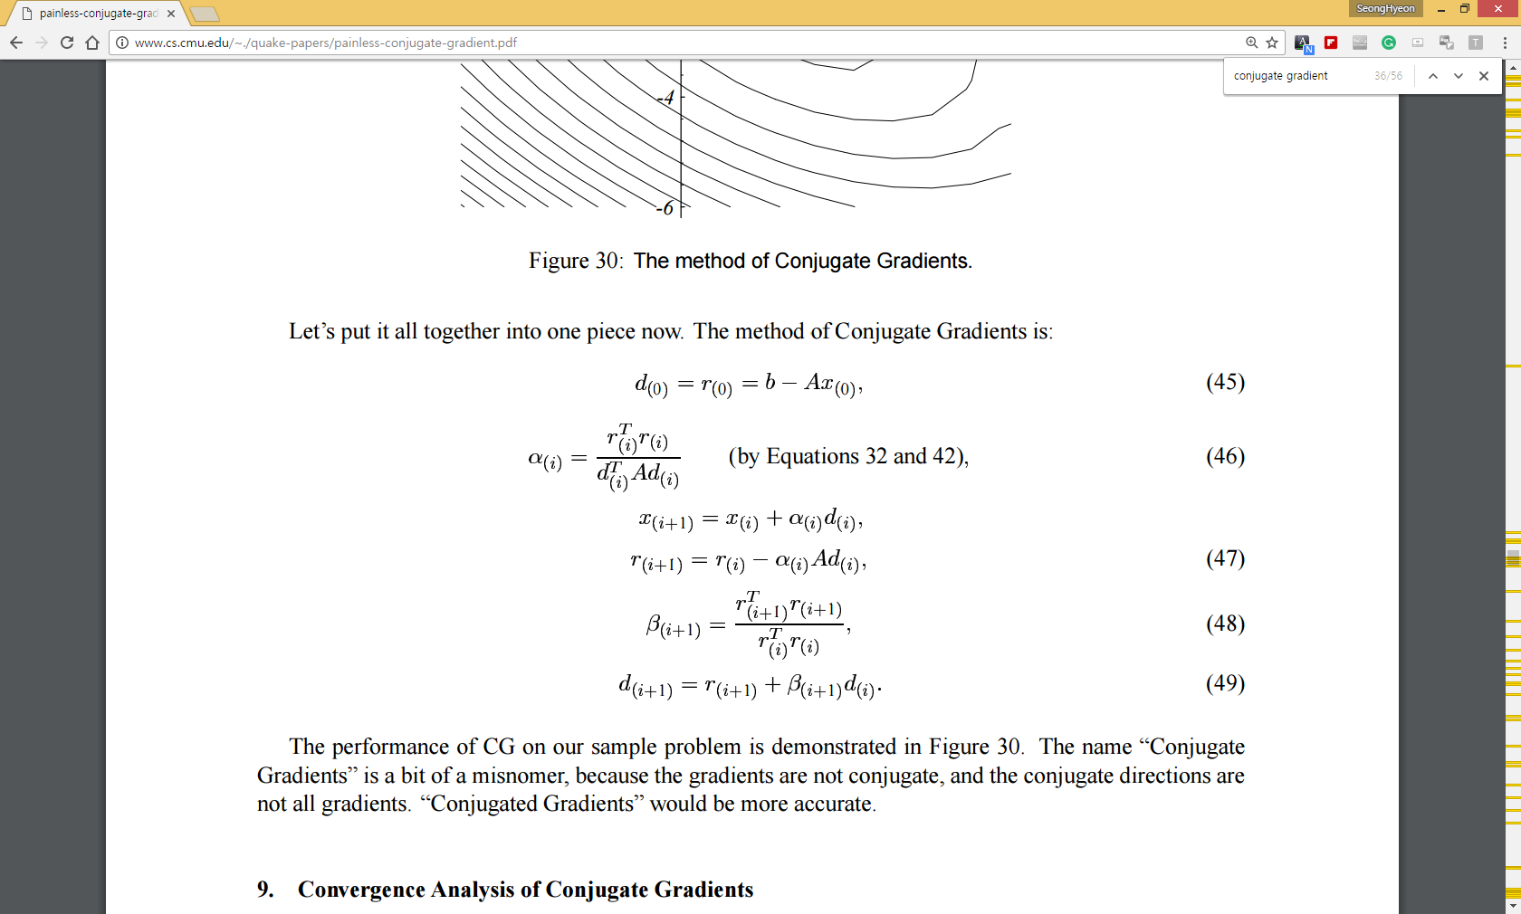
Linear conjugate gradient method
Schmidt, 1908
http://www.cs.cmu.edu/~./quake-papers/painless-conjugate-gradient.pdf

Slide 22
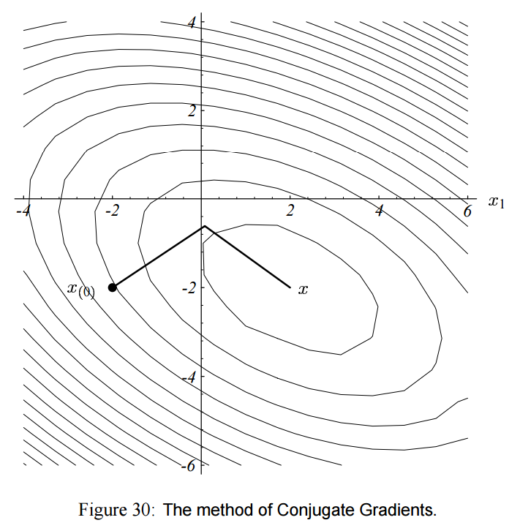
http://www.cs.cmu.edu/~./quake-papers/painless-conjugate-gradient.pdf

Slide 23
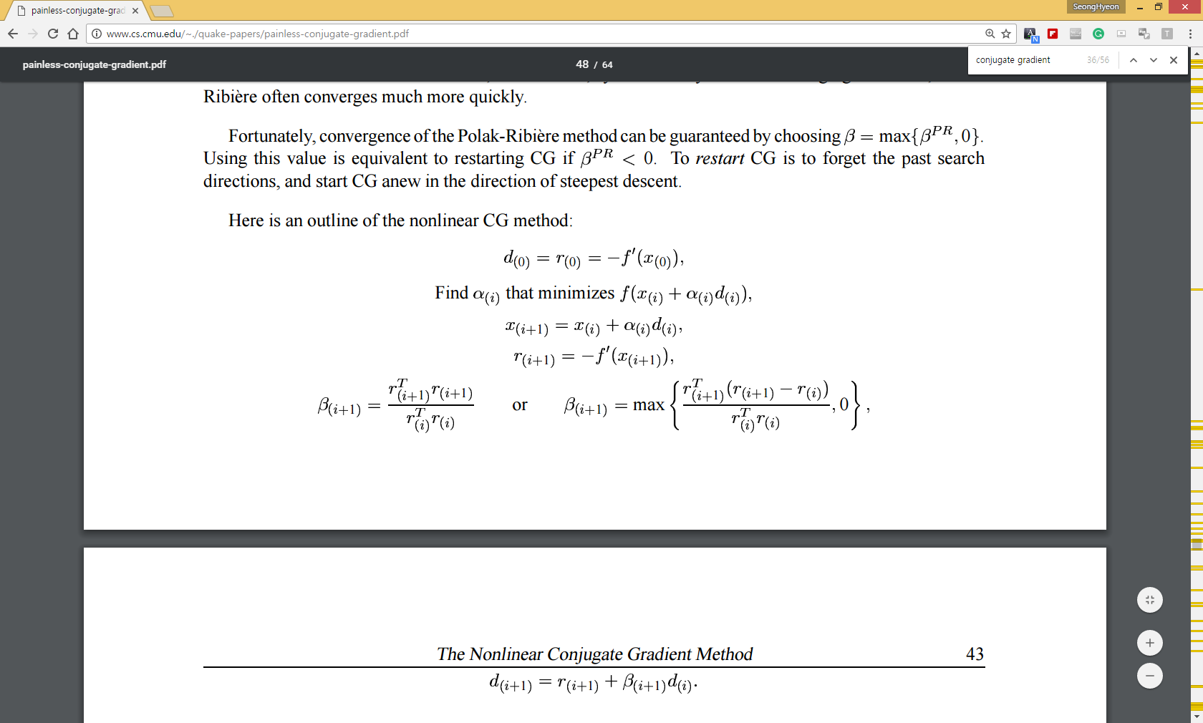
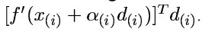
Nonlinear conjugate gradient method
= 0
Fletcher-Reeves version, 1964
Polak and Ribere version, 1971
http://www.cs.cmu.edu/~./quake-papers/painless-conjugate-gradient.pdf

Slide 24
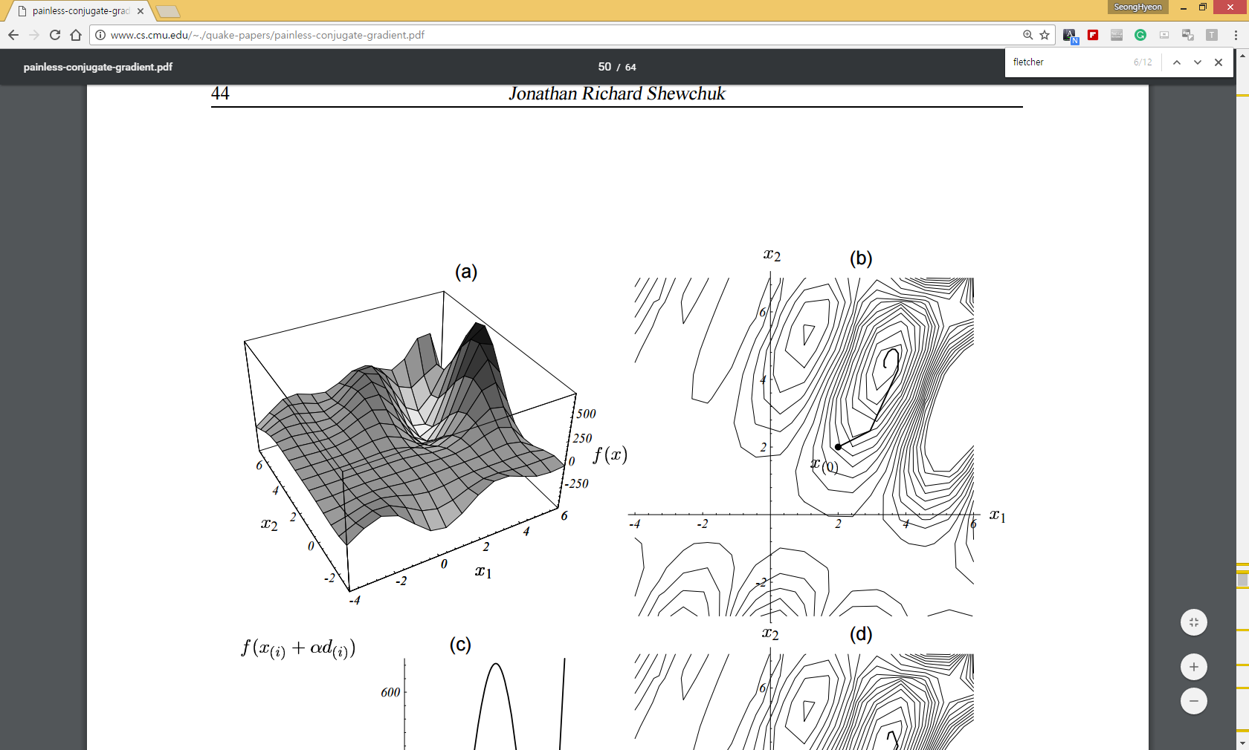
(b) Convergence path of Fletcher-Reeves CG. Unlike linear CG, convergence does not occur in two steps
http://www.cs.cmu.edu/~./quake-papers/painless-conjugate-gradient.pdf

Slide 25
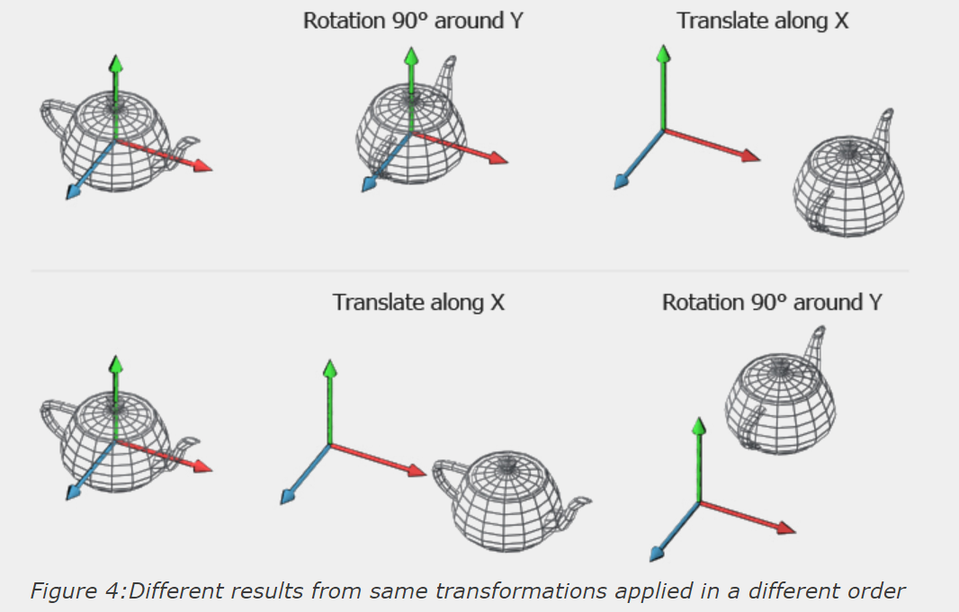
Rigid body transformation
http://www.codinglabs.net/article_world_view_projection_matrix.aspx

Slide 26
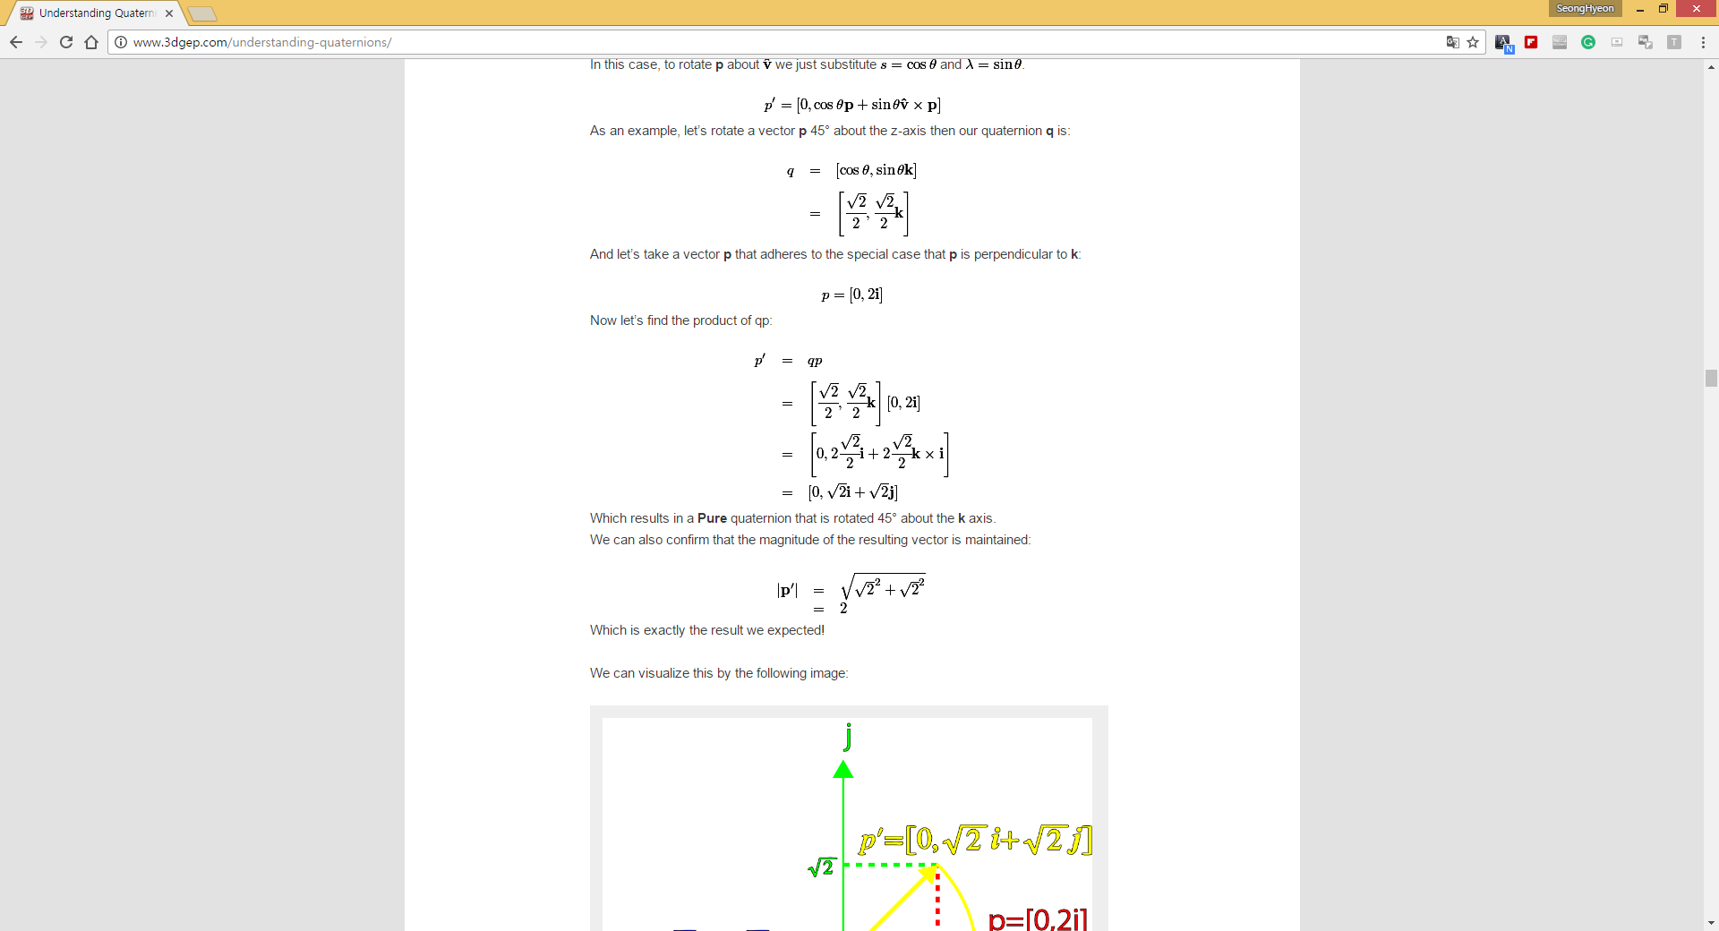
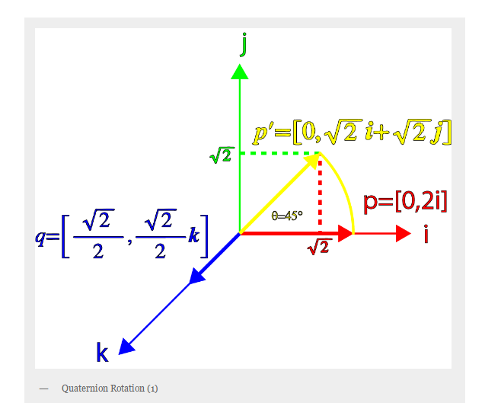
Quaternion based rotation
http://www.3dgep.com/understanding-quaternions/

Slide 27
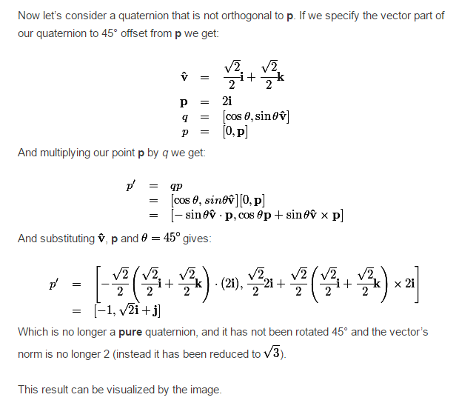
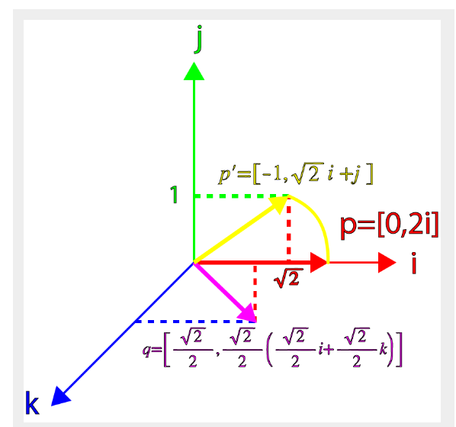
Quaternion based rotation
http://www.3dgep.com/understanding-quaternions/

Slide 28
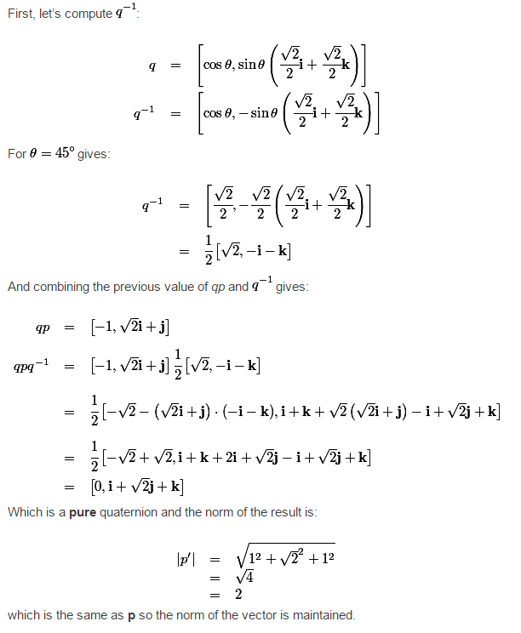
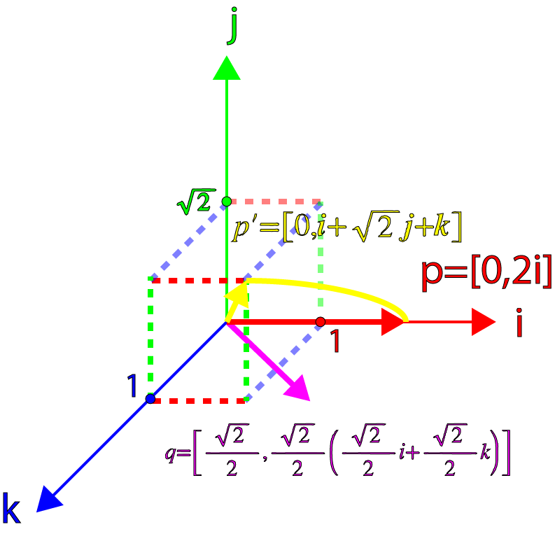
Quaternion based rotation
http://www.3dgep.com/understanding-quaternions/

Slide 29
Bezier, B-spline, Nurbs curves
http://nurbscalculator.in/
http://geometrie.foretnik.net/files/NURBS-en.swf

Slide 30
Bezier, B-spline, Nurbs surfaces
http://nurbscalculator.in/
http://geometrie.foretnik.net/files/NURBS-en.swf

