Slide 1
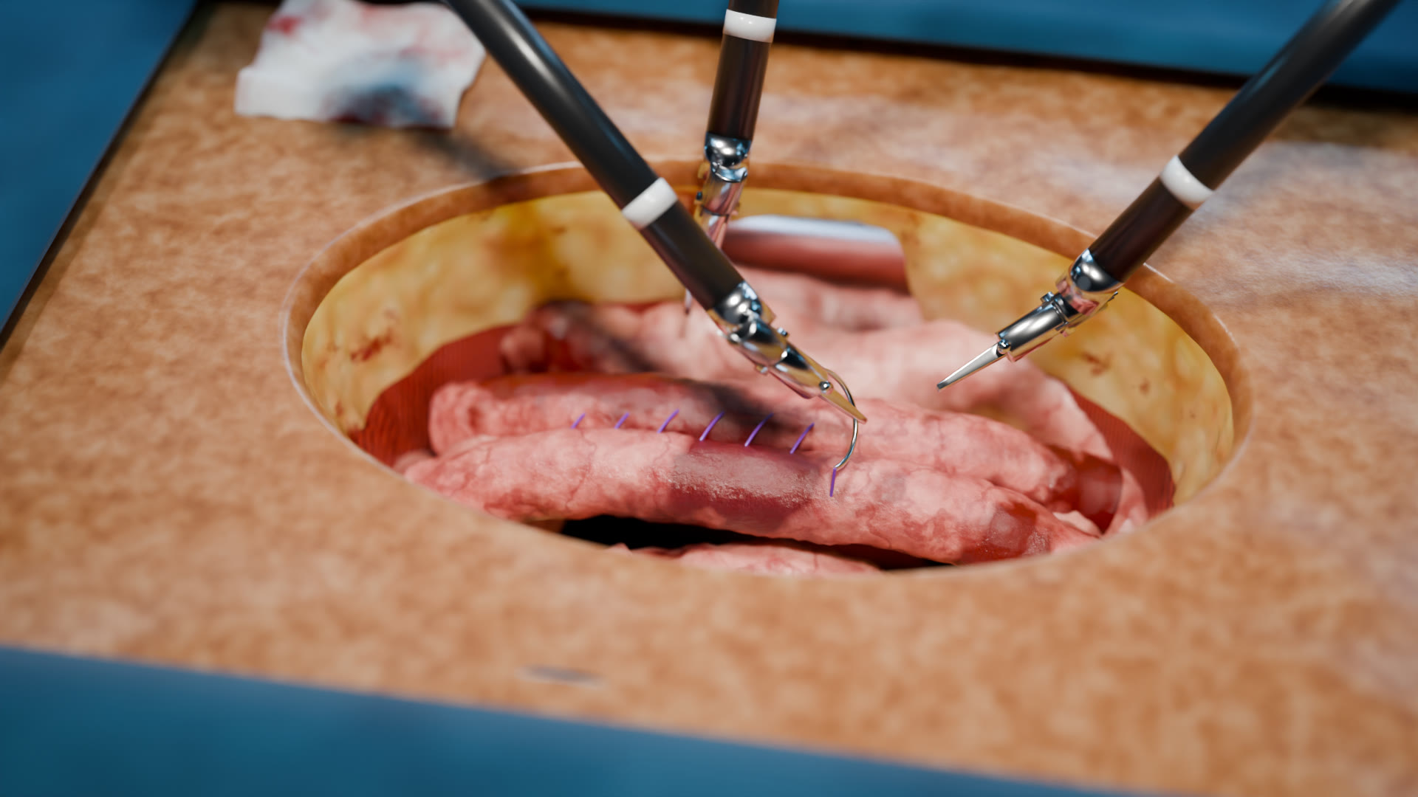
Precision beyond the human hand
LUMENARA SURGICAL · COMPANY PROFILE 2026
Lumenara Arc robotic surgical system · Boston · Munich · Seoul
Notes:
Opening: Lumenara builds one robotic platform for open, laparoscopic and micro-surgery. Hero image: robot-assisted open laparotomy rendered in Blender. Concept document; figures illustrative.

Slide 2
What this profile covers
CONTENTS
01
Executive summary
09
Specialties & procedures
02
Message from the CEO
10
Clinical value & outcomes
03
Company overview
11
Competitive advantage
04
Milestones
12
Adoption & training
05
Market opportunity
13
Business model
06
Lumenara Arc platform
14
Roadmap
07
MicroWrist instruments
15
Partnership & contact
08
Core technology
A
Appendix

Slide 3
One robotic platform for tremor-free, sub-millimetre control in open, laparoscopic and micro-surgery
01 · EXECUTIVE SUMMARY
Physiological tremor, fatigue and the limited range of the human wrist set a ceiling on surgical precision. Lumenara Arc removes it: a real-time motion engine filters tremor and scales motion down by up to 10:1, while cable-driven MicroWrist instruments articulate beyond any human wrist.
0.1 mm
7 DOF
10:1
4K 3D
Instrument tip motion resolution
Degrees of freedom at the MicroWrist
Adjustable motion scaling
Stereoscopic, fluorescence-ready vision

Slide 4




What we do, who we serve, why we are different and how we grow
01 · AT A GLANCE
What we do
Who we serve
Design, manufacture and support the Lumenara Arc robotic surgical system and its MicroWrist instruments.
Hospitals and surgical teams in general, colorectal, urologic, gynecologic, thoracic and reconstructive surgery.
Why we are different
How we grow
One platform for open, laparoscopic and micro-surgery; up to 10:1 motion scaling; haptic feedback; on-device AI.
System placements with recurring instrument, service and training revenue, backed by clinical partnerships.

Slide 5

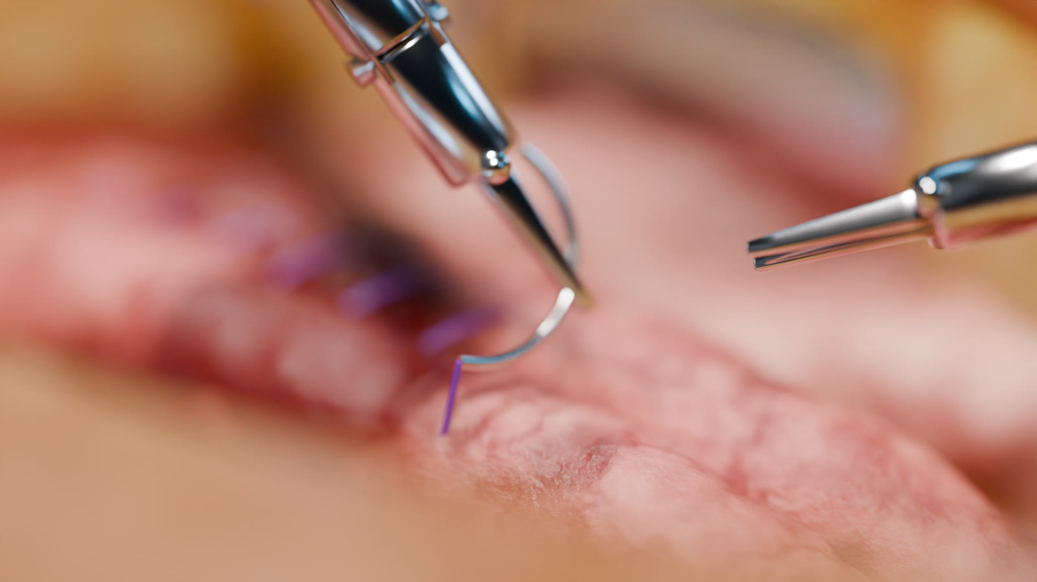
Technology should extend a surgeon's skill, never replace their judgement
02 · MESSAGE FROM THE CEO
When we founded Lumenara, we asked surgeons one question: what would you do if your hands were perfectly steady? Their answers shaped everything we build: sutures placed exactly where intended, vessels repaired below a millimetre, and long reconstructions finished with the precision of the first stitch.
We measure success by what happens after surgery: shorter recoveries, fewer complications and surgeons who can operate at their best for their whole careers.
[Name of CEO]
Co-founder and Chief Executive Officer

Slide 6



Our mission is to give every surgeon the steadiest hands in medicine
03 · COMPANY OVERVIEW
Mission
Vision
Values
Give every surgeon the steadiest hands in medicine.
A world where the precision of surgery is limited by judgement, not by anatomy or fatigue.
Patients first · Built with surgeons · Evidence over claims · Safety by design · One team across three continents

Slide 7

Founded in 2016, more than 900 people across three R&D centres
03 · COMPANY OVERVIEW
2016
Founded in Boston
Boston, USA
Headquarters. Console, robotics and MicroWrist engineering; motion engine and haptics.
900+
Engineers, clinicians and specialists
Munich, Germany
3
Precision mechanics, sterilization and manufacturing engineering; European clinical affairs.
R&D and training centres
Seoul, Korea
40+
Wristed MicroWrist instruments
Imaging, AI scene understanding and software platform; Asia-Pacific training center.
Regulatory status: [To be provided]

Slide 8
From a surgeon-led research project to a platform for open, laparoscopic and micro-surgery
04 · MILESTONES
2016
2018
2019
2021
2023
2025
2026
Founded in Boston by surgeons, roboticists and imaging scientists
First cable-driven MicroWrist prototype and tremor-filtering motion engine
Munich precision-engineering center opens
Seoul imaging and AI center; first 4K stereoscopic vision tower
Lumenara Arc introduced with open and MIS docking
40+ wristed instruments; AI tissue and vessel tracking
Arc 2 with 10:1 scaling and 5 mm instruments; Seoul Training Center
Dates before 2026 are illustrative for this concept document.

Slide 9




Surgery now asks for more precision than the unaided hand can reliably deliver
05 · MARKET OPPORTUNITY
CHALLENGE
WHAT HAPPENS TODAY
LUMENARA ARC
Physiological tremor
8–12 Hz tremor limits fine suturing
Real-time tremor filtering
Scale of anatomy
Vessels below 0.8 mm at the edge of manual technique
10:1 scaling, 0.1 mm tip resolution
Restricted access
Rigid tools cannot turn corners deep in the body
7-DOF wrist, ±90° articulation
Surgeon fatigue
Long cases in awkward postures reduce consistency
Seated, ergonomic console
Open vs. MIS divide
Most robots serve port-based surgery only
Open and MIS docking modes

Slide 10


Robotic surgery is expanding into more specialties, case types and surgeons per system
05 · MARKET CONTEXT
Global surgical robotics market
Annual procedures addressable by Arc
[To be provided from a cited market report]
[To be provided]
Priority regions
North America
Europe
Asia-Pacific
Installed-base growth, academic partners
DACH first, from the Munich center
Korea first, from the Seoul Training Center
Market figures are intentionally left blank. Insert data from a cited source before external distribution.

Slide 11


One system for open, laparoscopic and micro-surgical procedures
06 · THE LUMENARA ARC PLATFORM
Arc Console
Arc Patient Cart
Arc Vision Tower
Where the surgeon operates: seated, focused and in full view of the team.
Four slim arms that pivot around a software-defined remote centre of motion.
Imaging, energy and intelligence for the whole team.
4K stereoscopic viewer · haptic hand controllers · eye-tracked camera · 1:1–10:1 scaling
Open and MIS docking · active collision avoidance · setup in under 5 minutes
4K 3D imaging · ICG fluorescence · AI tissue and vessel tracking · case recording

Slide 12
Dock, lock the pivot, operate, verify and learn, in one continuous workflow
06 · HOW A CASE FLOWS
1
2
3
4
5
Dock
Lock the pivot
Operate
Verify
Learn
Position the cart and dock the arms over the incision or to the ports.
Each arm locks a remote centre of motion so the body wall takes no strain.
Tremor is filtered and motion scaled in real time from the console.
Fluorescence and AI overlays confirm perfusion and critical structures.
The case is recorded securely for review, training and analytics.

Slide 13
A wrist that turns where a human hand can't
07 · MICROWRIST INSTRUMENTS
Specification | Value
Wrist articulation | ±90° pitch · ±90° yaw
Roll | 540° continuous
Degrees of freedom | 7 at the tip
Shaft diameter | 8 mm and 5 mm
Tip resolution | 0.1 mm
Instrument library | 40+ wristed tools
Usage tracking | Chip-verified life

Slide 14



More than 40 wristed tools across suturing, grasping, dissection and supermicrosurgery
07 · INSTRUMENT FAMILIES
Suturing
Grasping & retraction
Large and micro needle drivers, including suture-cut variants.
Cadiere, fenestrated and atraumatic bowel graspers.
Dissection & energy
Supermicrosurgery (Arc 2)
Curved and micro scissors, Maryland and fenestrated bipolar, monopolar hook and spatula.
5 mm instruments for vessels and lymphatics below 0.8 mm.

Slide 15



Seven technologies that turn a surgeon's intent into steady, precise motion
08 · CORE TECHNOLOGY
Motion engine
Remote centre of motion
Haptic feedback
AI scene understanding
Filters 8–12 Hz tremor; scales motion 1:1 to 10:1.
Software-locked pivot protects the body wall.
Tissue and suture tension returned down to 0.05 N.
Real-time segmentation of tissue, vessels and tools.
Try it
An interactive motion-engine demo runs on the Technology page of our website.
Fluorescence imaging
Collision-aware arms
Connected insights
Near-infrared ICG reveals perfusion in one click.
Live kinematic model keeps arms and team safe.
Case analytics for surgeons and teams.

Slide 16
Tremor is filtered out and motion scaled down before it reaches the instrument tip
08 · HOW THE MOTION ENGINE WORKS
1
Capture
Sample the surgeon's hand position at high frequency.
2
Filter
Remove the 8–12 Hz tremor band, keep deliberate motion.
3
Scale
Scale motion down, e.g. 5:1 for suturing, 10:1 for micro.
4
Drive
Compute arm and wrist joints with the RCM locked.
5
Feel
Return tip forces to the hands as haptic feedback.

Slide 17
Built for the procedures that demand the most precision
09 · SPECIALTIES & PROCEDURES
Specialty | Where Arc adds value | Representative procedures
General & Colorectal | Stable traction and wristed suturing for intracorporeal anastomoses and deep pelvic dissection | Colectomy · LAR · hernia · cholecystectomy
Urology | Nerve-sparing dissection and watertight anastomosis in the confined pelvis | Prostatectomy · partial nephrectomy · pyeloplasty
Gynecology | Visualization and articulation for complex benign and oncologic cases | Hysterectomy · myomectomy · sacrocolpopexy
Thoracic | Articulated access around the hilum through small incisions | Lobectomy · segmentectomy · thymectomy
Micro & Reconstructive | Up to 10:1 scaling for vessels and lymphatics below 0.8 mm | Lymphovenous anastomosis · free flap · nerve repair

Slide 18

Precision only matters when it shows up in recovery
10 · CLINICAL VALUE
Patients
Surgeons
Hospitals
Smaller incisions, more precise repairs and fewer conversions to open surgery.
Seated ergonomics, tremor-free control and haptic feedback reduce fatigue.
One platform for more specialties and case types, with data to manage the program.
WE MEASURE
WE MEASURE
WE MEASURE
Length of stay · complications · return to activity
Ergonomic load · fatigue · learning curve
Conversion rate · OR time · utilization

Slide 19
Outcome indicators we track with clinical partners
10 · OUTCOME INDICATORS
1.2 days
34 %
28 %
96 %
Shorter average hospital stay*
Fewer conversions to open surgery*
Lower surgeon-reported fatigue*
System uptime across installed base*
* Illustrative figures for this concept document. Not clinical data. Replace with peer-reviewed or registry results before external use.

Slide 20
The only platform designed from day one for open, laparoscopic and micro-surgery
11 · COMPETITIVE ADVANTAGE
Capability | Typical port-based systems | Lumenara Arc
Surgical approach | Laparoscopic (ports) only | Open, laparoscopic and micro-surgical
Motion scaling | Fixed or limited range | Adjustable 1:1 to 10:1
Haptic feedback | Limited or none | Force feedback to 0.05 N
Supermicrosurgery | Not supported | 5 mm instruments, structures below 0.8 mm
Intelligence | Imaging only | On-device AI tissue and vessel tracking
Setup | Dedicated room, long docking | Docking in under 5 minutes
Comparison describes general market positioning and does not refer to any specific competitor product.

Slide 21



Mechanics, software and an ecosystem built with surgeons since 2016
11 · WHY IT IS HARD TO COPY
MicroWrist mechanics
Motion engine
Cable-driven wrist design and manufacturing know-how developed since 2018.
Tremor filtering and motion scaling tuned with surgeons across five specialties.
Ecosystem
Intellectual property
Training centers, a proctor network and case analytics build long-term relationships.
Patents filed and granted: [To be provided]

Slide 22
A five-step path from first assessment to an optimized robotic program
12 · ADOPTION
01
02
03
04
05
Assessment
Program plan
Installation
Go-live
Optimization
Case mix, specialty priorities and program goals with hospital leadership.
Business case, room planning and a training pathway for the whole team.
Delivery, room integration and validation by Lumenara engineers.
First cases with on-site clinical specialists and proctors.
Utilization reviews, new specialties and continuous education.
Service levels: preventive maintenance, remote monitoring, a dedicated clinical specialist during ramp-up; response times [To be provided]

Slide 23




From first case to fellowship-level mastery
12 · TRAINING PATHWAY
Simulate
Physics-based VR simulator, 60+ validated exercises, objective scoring.
Practice
Dry and wet labs at training centers in Boston, Munich and Seoul.
Proctor
Expert proctors join first cases, in person or by tele-mentoring.
Improve
Dashboards benchmark efficiency, economy of motion and outcomes.

Slide 24




A system placement that grows into recurring instrument, service and training revenue
13 · BUSINESS MODEL
Systems
Instruments
Service
Training & data
Console, cart and vision tower
MicroWrist tools, drapes, accessories
Maintenance, updates, monitoring
Courses, proctoring, analytics
Purchase or lease
Recurring, per procedure
Recurring, annual
Recurring
Acquisition options for hospitals
Purchase
Lease
Usage-based
Capital purchase with multi-year service
Operating lease over the program's life
Per-procedure price incl. instruments and service
Revenue mix and unit economics: [To be provided]

Slide 25
From open and MIS surgery today to supermicrosurgery and connected intelligence
14 · ROADMAP
Short term
Mid term
Long term
2026–2027
2028–2029
2030+
PRODUCT
PRODUCT
PRODUCT
Arc 2 with 10:1 scaling · 5 mm MicroWrist · expanded AI tracking
Supermicrosurgery instrument set · procedure-specific AI guidance · tele-mentoring at scale
Assisted autonomy for well-defined subtasks, always under surgeon control
MARKET
MARKET
MARKET
Seoul Training Center · Asia-Pacific placements
More European and Asia-Pacific markets · academic partnerships
Global installed base · outcome-based service models
Roadmap items are forward-looking and subject to regulatory clearance in each market.

Slide 26


See Lumenara Arc in your operating room
15 · PARTNERSHIP & CONTACT
Demonstration
Hands-on session with your surgical team, at your hospital or a Lumenara Training Center.
WEBSITE
robot-surgery-ai.vercel.app
Clinical partnership
REQUEST A DEMO
robot-surgery-ai.vercel.app/demo/
Joint studies, registries and fellowship programs.
EMAIL
[To be provided]
Distribution
PHONE
Regional sales and service partnerships.
[To be provided]
OFFICES
Boston (HQ) · Munich · Seoul

Slide 27
Lumenara Arc system specifications
APPENDIX A · SYSTEM SPECIFICATIONS
Specification | Value
Arms | 4, collision-aware, remote centre of motion
Docking modes | Open (over incision) and MIS (ports)
Motion scaling | 1:1 to 10:1, adjustable
Tremor filtering | 8–12 Hz band, 4 levels (Off / Low / High / Max)
Tip motion resolution | 0.1 mm
Haptic feedback | To 0.05 N
Vision | 4K stereoscopic 3D, near-infrared ICG fluorescence
Instruments | 40+ MicroWrist tools, 8 mm and 5 mm
Setup time | Under 5 minutes

Slide 28
Key terms used in this profile
APPENDIX B · GLOSSARY AND NOTICE
Term | Meaning
Anastomosis | Surgical connection of two tubular structures, such as bowel ends or vessels
DOF | Degrees of freedom: independent ways an instrument can move
ICG fluorescence | Near-infrared imaging with indocyanine green to show blood flow
Laparotomy | An open incision into the abdominal cavity
MIS | Minimally invasive surgery through small ports
Motion scaling | Reducing hand motion to a smaller instrument motion, e.g. 5:1
RCM | Remote centre of motion: fixed instrument pivot at the incision or port
Notice: concept company profile. Lumenara Surgical, Lumenara Arc and MicroWrist are fictional names. Specifications, outcome indicators and milestones are illustrative and do not describe an actual medical device or clinical results. Fields marked [To be provided] must be completed before external use. Imagery was procedurally modelled and rendered in Blender.

