Slide 1
Mars Robot Challenge
Technical Presentation
Ivaylo Dzhenev Senior Software Engineer

Slide 2
Project Overview
Goal:
Build a robot simulation system with multi-modal execution
Core Features:
REST API Server
REST Client
CLI Mode
Robot simulation (movement, battery, obstacles, samples)
Bonus Features:
Visualization, Interactive CLI, Pathfinding

Slide 3
Requirements Fulfillment
Requirement | Status
CLI Mode | ✅
REST Server | ✅
REST Client | ✅
Robot Logic | ✅
Web Visualization | ✅
Interactive CLI | ✅
Pathfinding | ✅

Slide 4
Technology Stack
Backend: Node.js + Express
Frontend: React + Axios
CLI Tools: Inquirer.js
Testing: Jest, Supertest
Notes:
Why chose these tech stack? Especially node js

Slide 5
Architecture
CLI
REST API
REST Client
Simulation Service
Robot Logic
Pathfinding
Visualization
Notes:
Key points:
Clean separation of concerns
Core simulation reused across all modes
Design patterns: Command, Strategy, MVC

Slide 6
Robot Logic
Battery-aware commands (F, B, L, R, S, E)
Obstacle handling → 7 back-off strategies
Sample collection system
Auto-recharge if battery low

Slide 7
Execution Modes
CLI Mode: File input/output
REST Server: JSON API
REST Client: Posts input.json → Displays output

Slide 8
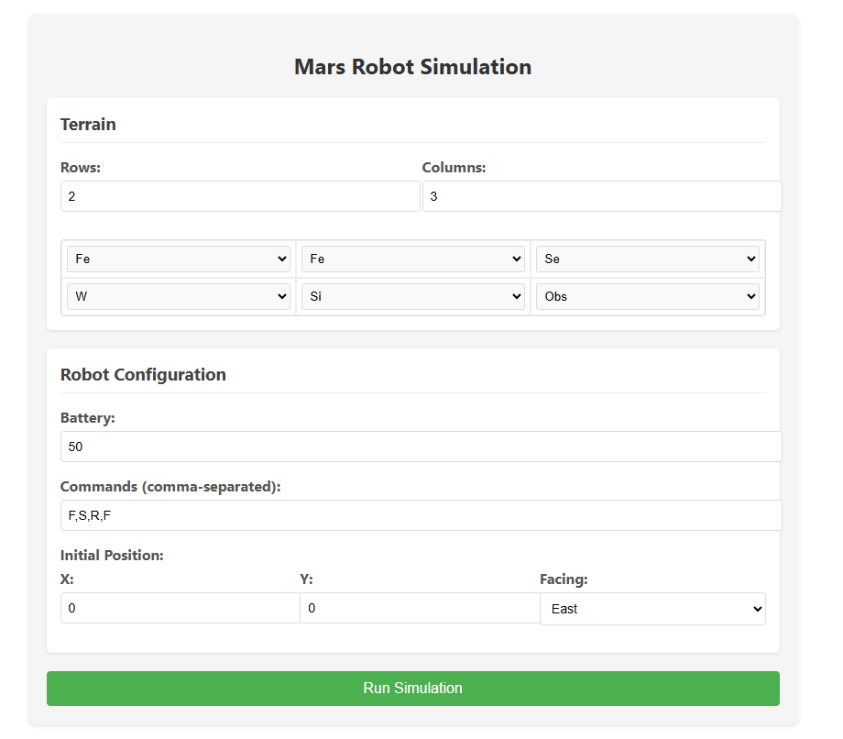
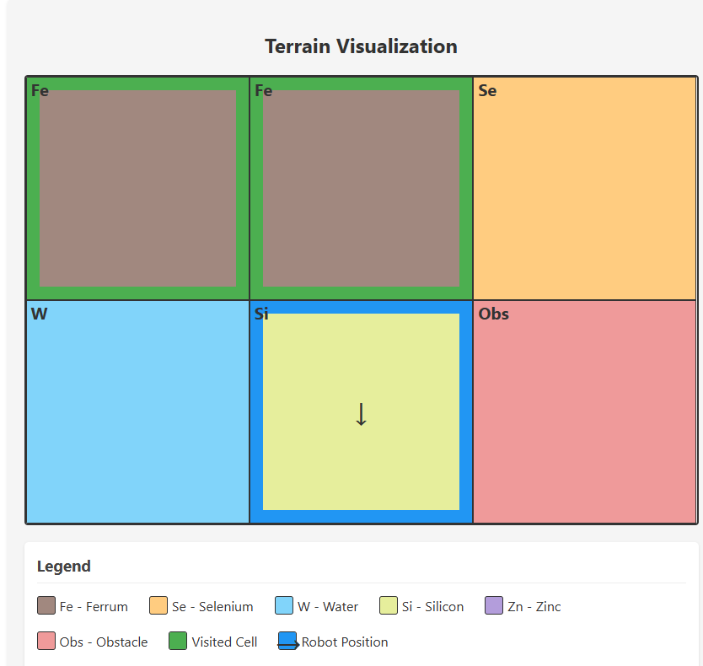
Bonus Features
Web Visualization:
React-based grid with robot movement
Interactive CLI:
Step-by-step robot control in terminal
Pathfinding (A*):
Optimal route generation

Slide 9
Future Enhancements
Multi-robot simulations
Real-time updates (WebSockets)
Procedural terrain generation
ML-based path optimization
Cloud-native deployment (Kubernetes)

