Slide 1

New Developments in Graph Editing Algorithms
Sam Moon [2001779]

Slide 2
Project Objectives
To research, implement, test and analyse the following recently proposed algorithms:
An algorithm for testing König-Egerváry graphs for Unique Minimum Vertex Covers [1]
An FPT algorithm for Local Search Vertex Cover problem on planar graphs [2]
An algorithm for König-Egerváry vertex deletion problem [3]
[1] V. Raman et al., A characterization of König-Egerváry graphs with extendable vertex covers, Inf Process. Lett. (2020)
[2] M. R. Fellows, F. V. Fomin, D. Lokshtanov, F. A. Rosamond, S. Saurabh, and Y. Villanger. Local search: Is brute-force avoidable? Journal of Computer and System Sciences, (2012)
[3] A. Chandra Babu, P.V. Ramakrishnan. New Proofs of Konig-Egervary Theorem and Maximal Flow - Minimal Cut Capacity Theorem using O.R Techniques, (1991)

Slide 3
Progress
An algorithm for testing König-Egerváry graphs for Unique Minimum Vertex Covers
Research – Complete Implementation – Complete Testing – Complete Analysis – Complete
An FPT algorithm for Local Search Vertex Cover problem on planar graphs
Research – Partial Implementation – Partial
An algorithm for König-Egerváry vertex deletion problem
Research – Partial

Slide 4
Unique Minimum Vertex Cover in König-Egerváry Graphs
König-Egerváry graphs
Defined as graphs such that the size of a maximum matching is exactly equal to the size of a minimum vertex cover. For example, all bipartite graphs by König-Egerváry Theorem [4] are König-Egerváry.
We can fully characterise this class of graphs as any graph admitting a vertex partition (A, B) such that A is a minimum vertex cover (or equivalently, B is an independent set) and a maximum matching M which fully saturates A.
M
B
A
[4] D. König, "Graphs and matrices" Mat. Lapok, (1931)

Slide 5
Unique Minimum Vertex Cover in König-Egerváry Graphs
Basics of the Implementation
Graph class
Maintains an adjacency list as a list<int>[n] array.
Methods include insertion and removal of edges and a copy constructor.
Limitations include fixed vertex set after instantiation and some methods will fail if the graph is directed.

Slide 6
Unique Minimum Vertex Cover in König-Egerváry Graphs
Basics of the Implementation
Edge class
Simple two-element int[2] array storing endpoints.
Methods include operator=(), operator==(Edge e) and meet(Edge e). These allow for easier edge manipulation and testing for equality and adjacency.
Limitations include only considering endpoints meaning multi-edge graphs aren’t supported.

Slide 7
Unique Minimum Vertex Cover in König-Egerváry Graphs
Basics of the Implementation
EdgeSet class
Maintains list<Edge> to represent matchings and paths.
Methods include adding and removing edges and path augmentation (symmetric difference), for use in the maximum matching algorithm.
Limitations include failing to maintain the uniqueness of elements automatically, this must be considered when the class is used.

Slide 8
Unique Minimum Vertex Cover in König-Egerváry Graphs
Basics of the Implementation
Other Methods
Basic set functions: Intersection/Union/Set Minus of list<int> objects representing sets of vertices.
File handling methods to read in graphs from text files and to combine general and bipartite graphs to create König-Egerváry Graphs and write these to new text files.

Slide 9
Unique Minimum Vertex Cover in König-Egerváry Graphs
Maximum Matching
Edmond’s Blossom Algorithm [5][6]: O(mn²)
Even and Kariv [7]: O(n^{2.5})
Micali and Vazirani [8]: O(mn^{0.5})
[5] C. Berge, Two theorems in graph theory, Proc. Natl. Acad. Sci. 43 (1957) 842–844.
[6] J. Edmonds, Paths, trees, and flowers, Can. J. Math. 17 (1965) 449–467.
[7] Even S, Kariv O.: An O(n ~5) Algorithm for Maximum Matching in General Graphs, FOCS, 16 (1975)
[8] Micali, Silvio; Vazirani, Vijay (1980). An O(V^{1/2}E) algorithm for finding maximum matching in general graphs. 21st Annual Symposium on Foundations of Computer Science. IEEE Computer Society Press, New York. pp. 17–27.

Slide 10
Unique Minimum Vertex Cover in König-Egerváry Graphs
Minimum Vertex Cover
Fǎnicǎ Gavril Semipartite Testing Algorithm [9]: O(n+m)
Semipartite is another name for König-Egerváry graphs
Alternating Tree algorithm to assign “even” or “odd” labels to every vertex
“Even” vertices form the minimum vertex cover saturated by the matching, A
“Odd” vertices form the corresponding independent set, B
[9] Fǎnicǎ Gavril, Testing for equality between maximum matching and minimum node covering, Information Processing Letters, Volume 6, Issue 6, 1977

Slide 11
Unique Minimum Vertex Cover in König-Egerváry Graphs
Determining Uniqueness
We test uniqueness by testing whether there exists a minimum vertex cover containing vertex v ∈ B such that (u, v) ∈ M. O(mn) We do this for every edge in M. |M| ≤ n/2 = O(n)
If such a vertex cover exists, then clearly A is not unique.
We need only test the matched vertices in B as we know that as a König-Egerváry graph, any vertex cover must be saturated by M.
M
B
A
v
u

Slide 12
Unique Minimum Vertex Cover in König-Egerváry Graphs
Finding a Minimum Vertex Cover containing Z ⊆ V(G)
We construct a directed bipartite graph G_{bip} as follows:
G_{bip} contains all vertices from G
For every (u, v) ∈ M with u ∈ A, v ∈ B, add directed edge (u, v) to G_{bip}
For every (u, v) ∈ E\M with u ∈ A, v ∈ B, add directed edge (v, u) to G_{bip}
G
G_{bip}
M
B
M
B
A
A

Slide 13
Unique Minimum Vertex Cover in König-Egerváry Graphs
Finding a Minimum Vertex Cover containing Z ⊆ V(G)
We find the set U of unsaturated vertices in G, that is all vertices not matched by M
We find the set of vertices R(U) of vertices reachable from U in G_{bip}
G_{bip}
G_{bip}
M
B
A
R(U)
U

Slide 14
Unique Minimum Vertex Cover in König-Egerváry Graphs
Finding a Minimum Vertex Cover containing Z ⊆ V(G)
We now compute a set of vertices S = S₁ ∪ S₂ from G/U
S₁ is the set of vertices to which there is an even length M-alternating path from Z ∩ B/U
S₂ is the set of vertices u ∈ A such that for (u, v) ∈ M, both u,v ∉ S₁
G/U
M
B
G
A
v
M
B
u
A

Slide 15
Unique Minimum Vertex Cover in König-Egerváry Graphs
Finding a Minimum Vertex Cover containing Z ⊆ V(G)
Finally, we take the set S and perform some simple checks:
S is in fact a vertex cover
|S| = |A|. That is, S is a minimum vertex cover
Z ⊆ S
If these checks are passed, then we return S.
Otherwise, we conclude no such Minimum Vertex Cover exists.

Slide 16
Unique Minimum Vertex Cover in König-Egerváry Graphs
Determining whether G has a unique Minimum Vertex Cover Summary
Find a Maximum Matching M.
O(mn²) – Note: if we used better algorithms, this would still be dominated later on.
Find a Minimum Vertex Cover A saturated by M, with corresponding independent set B.
O(n+m)
Test, for each v ∈ B with (u, v) ∈ M, whether there is a Minimum Vertex Cover containing v.
O(mn²)
If one exists, conclude G does not have a unique Minimum Vertex Cover.
Otherwise, A is the unique Minimum Vertex Cover of G.
Total Runtime: O(mn²)

Slide 17
Unique Minimum Vertex Cover in König-Egerváry Graphs
Testing
We require a set of guaranteed König-Egerváry Graphs
These can be constructed using their characterisation:
A minimum vertex cover A with independent set B and maximum matching M saturating A
Intuitively, this just means we have two sets of vertices A and B, and we allow any edges between A and B and any edges within A, but no edges within B. We must also ensure that there is a matching saturating A.
M
B
A

Slide 18
Unique Minimum Vertex Cover in König-Egerváry Graphs
Testing
To simplify things a little, the dataset used only contained graphs with |A| = |B| so we are looking for perfect matchings
The graph dataset [10] contained the following:
18 bipartite graphs on n vertices for n = 100, 200, 300, 400, 500, 600, 700
That is, with exactly half of the vertices in each part
18 general graphs on n vertices for n = 50, 100, 150, 200, 250, 300, 350
These can be combined into 2268 König-Egerváry graphs using the following process.
[10] Kartelj, Aleksandar (2019): General graph datasets. 4TU.ResearchData. Dataset. https://doi.org/10.4121/uuid:ae55266d-777d-463a-a823-4af3c241d784

Slide 19
Unique Minimum Vertex Cover in König-Egerváry Graphs
Testing
General Graph on n/2 vertices
Bipartite Graph on n vertices
Perfect Matching on n vertices
König-Egerváry Graph on n vertices

Slide 20
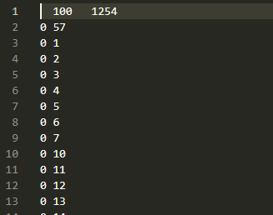
Unique Minimum Vertex Cover in König-Egerváry Graphs
Testing
These graphs were constructed and stored as individual text files to be loaded when testing
Text file format was simply:
| n m
| u₁ v₁
| u₂ v₂
| u₃ v₃
| …
| u_{m} v_{m}

Slide 21
Unique Minimum Vertex Cover in König-Egerváry Graphs
Testing
To test the runtime of the algorithm on each example graph, the time taken to load in each graph was not included, only once this was completed did the timer start.
Next, the results.

Slide 22
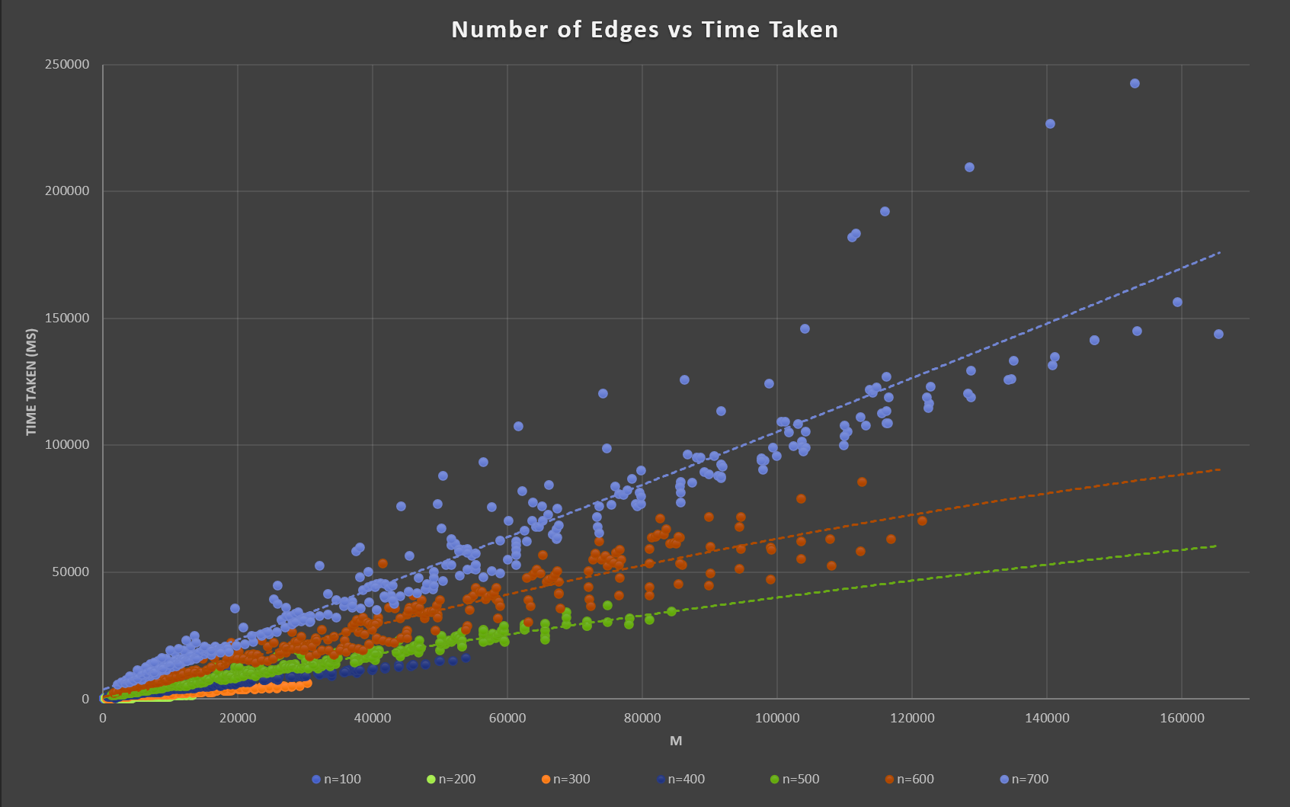

Slide 23
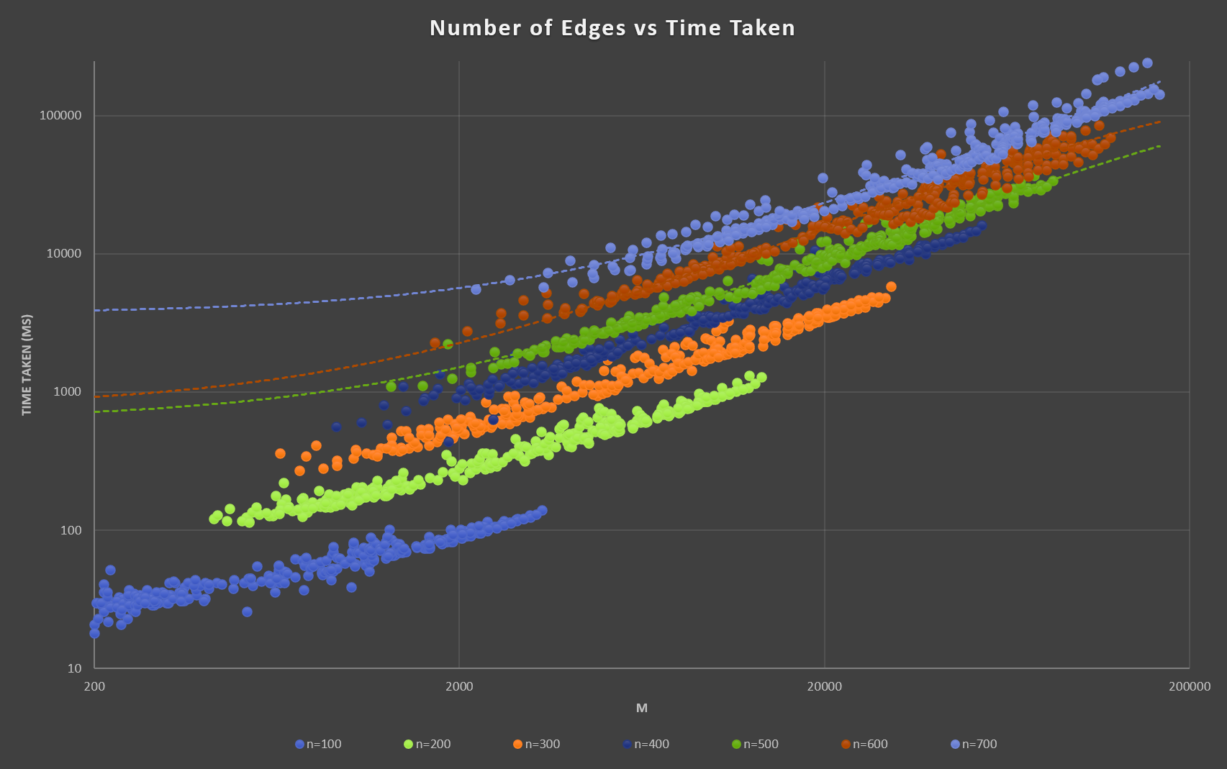

Slide 24
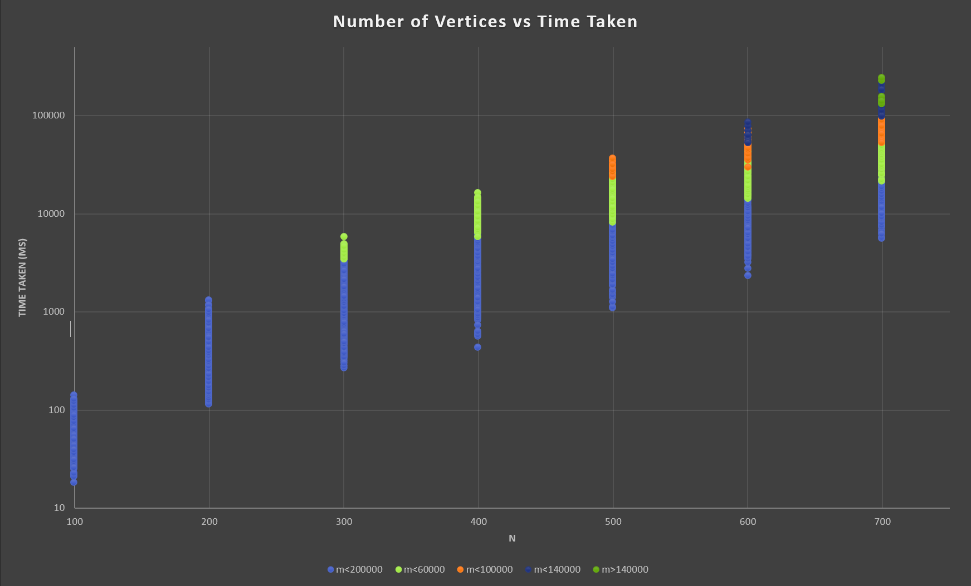

Slide 25
Unique Minimum Vertex Cover in König-Egerváry Graphs
Statistics
56% of the dataset took less than 5 seconds
80% of the dataset took less than 20 seconds
The graph with the largest number of vertices run in under 20 seconds had 18,000 edges on 700 vertices
The graph with the largest number of edges run in under 20 seconds had 54,000 edges on 400 vertices
The most extreme cases tested had over 150,000 edges and took a maximum of 4 minutes

