Slide 1
ROS Wall Following

Slide 2
참고 사이트 주소
주소 :
https://github.com/Octanas/Reactive-Wall-Following-Robot
설치방법
$ git clone https://github.com/Octanas/Reactive-Wall-Following-Robot
$ cd ..
$ catkin_make
$ source devel/setup.bash
파이썬 파일을 실행하도록 만들어줌
$ chmod u+x follow_wall.py

Slide 3
follow_wall.py 코드리뷰
update_command_vel 함수
scan_callback 함수
Load_arguments 함수
Main 함수

Slide 4
scan_callback 함수
Turn to the wall
Turn in random direction
“Wandering”
“Drive
towards wall”
“Follow Wall”
1. Check the front
2. If the wall, to avoid it, Rotate to 42°~85°
3. Calculate angular velocity to keep wall distance
3 steps

Slide 5
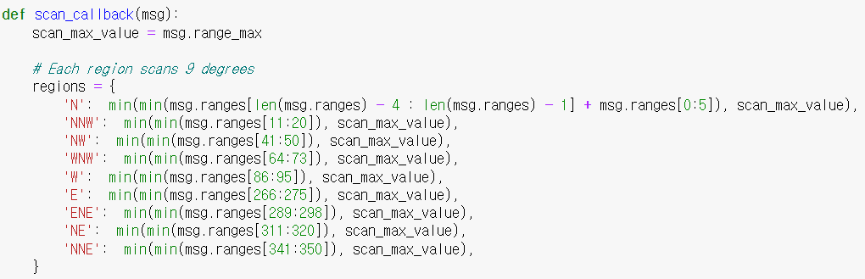
scan_callback 함수

Slide 6
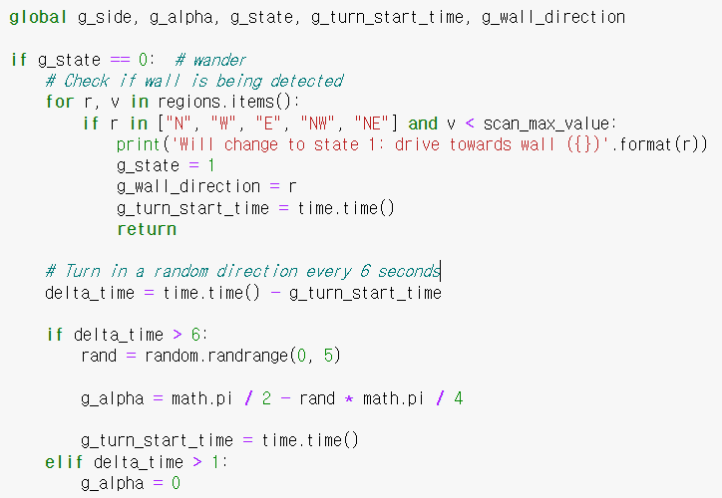
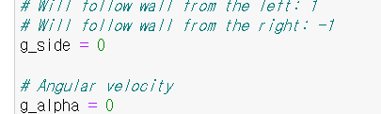
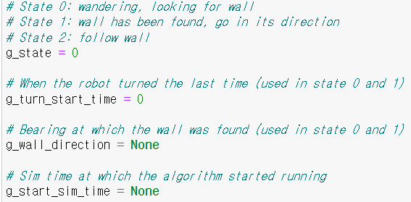
scan_callback 함수
“Wandering” State

Slide 7

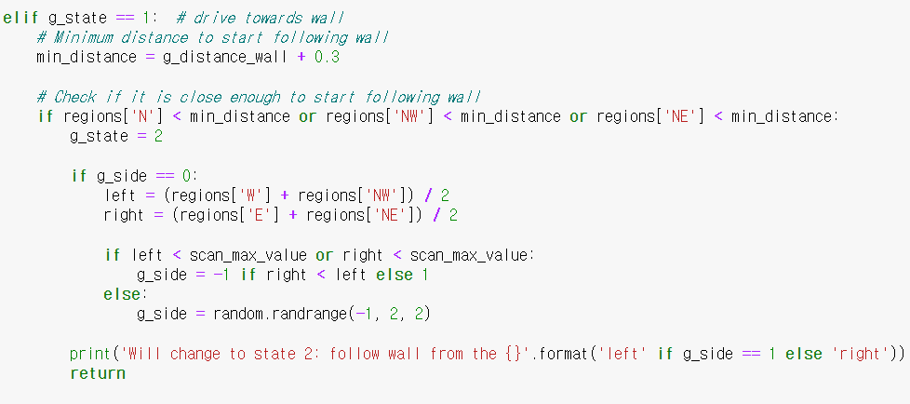
scan_callback 함수
“Drive towards wall” State

Slide 8
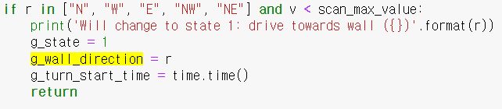
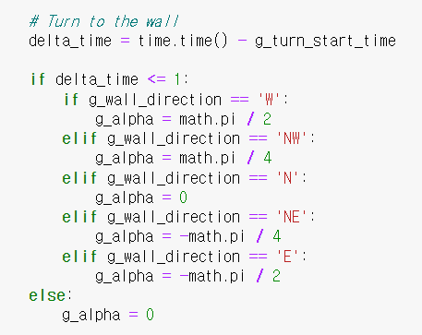
scan_callback 함수
“Drive towards wall” State

Slide 9
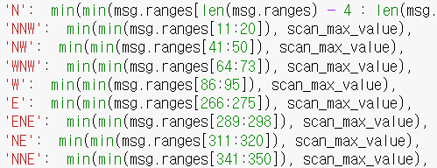
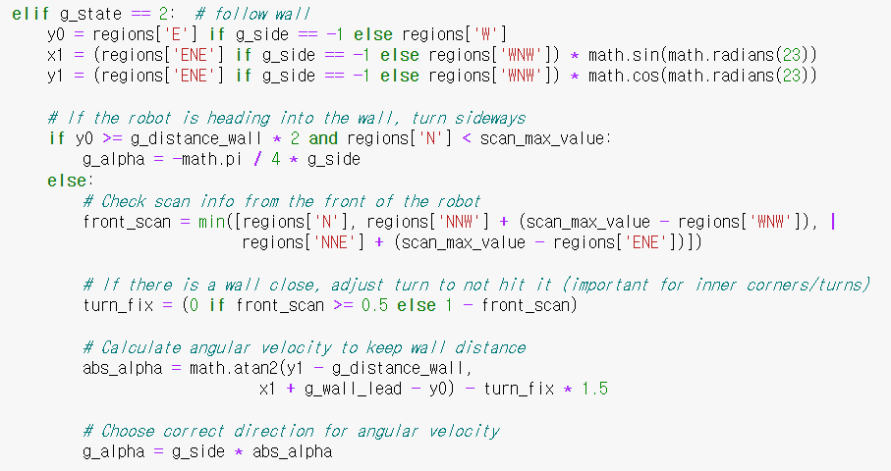
scan_callback 함수
“Follow wall” state

Slide 10
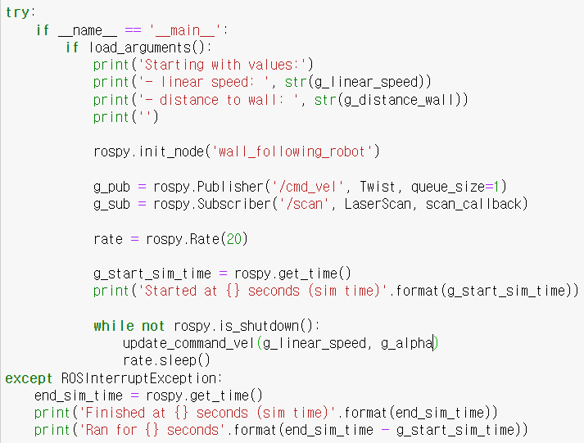
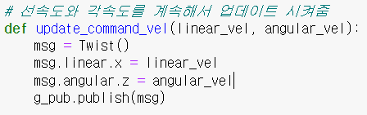
Main 함수

Slide 11
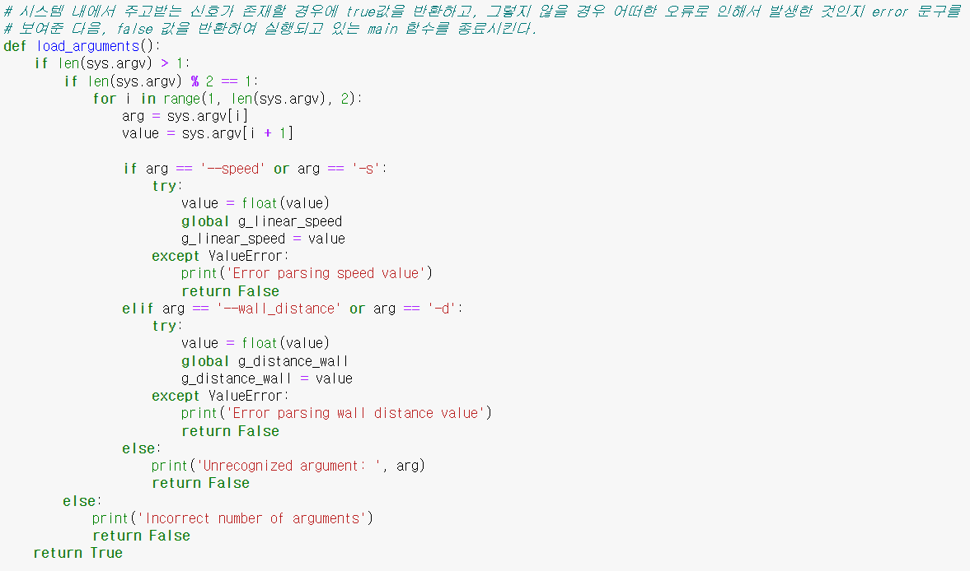
참고

