Slide 1
transportation
JED validation
Morita Yudai

Slide 2
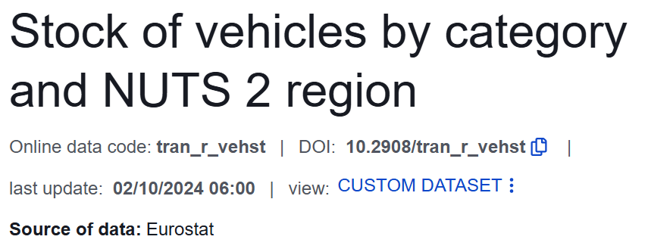
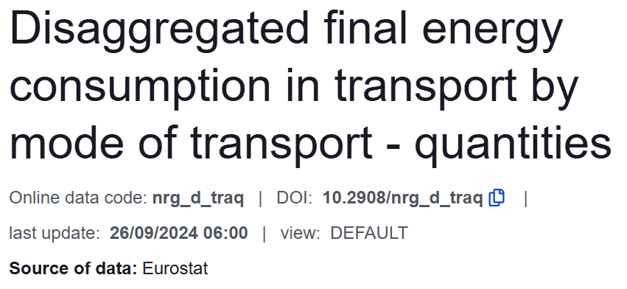
Data source: Eurostat data @ 2022
[1]
[2]
[1] https://ec.europa.eu/eurostat/databrowser/view/tran_r_vehst__custom_16234518/default/table?lang=en
[2] https://ec.europa.eu/eurostat/databrowser/view/nrg_d_traq/default/table?lang=en&category=nrg.nrg_quant.nrg_quanta.nrg_d

Slide 3

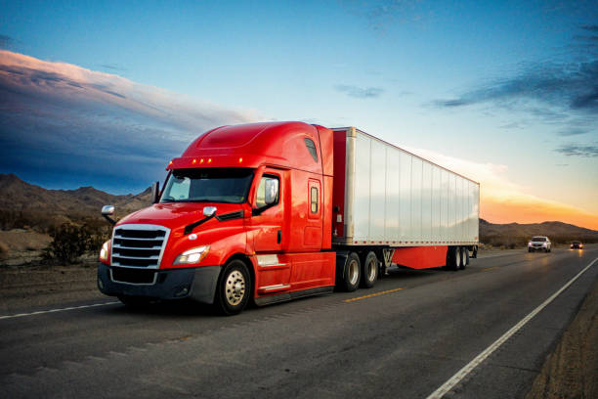
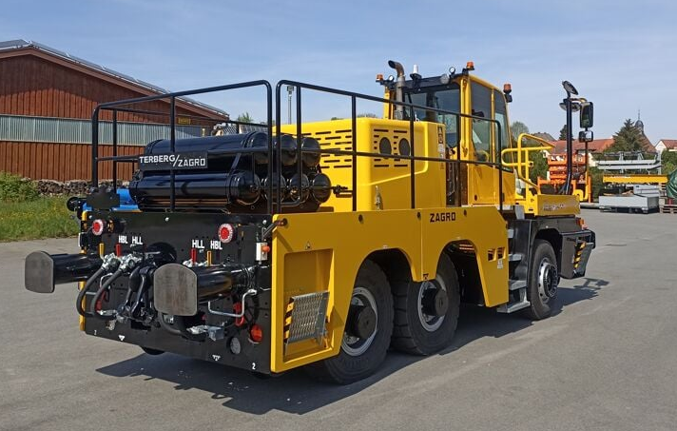
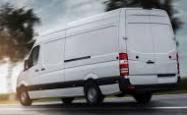
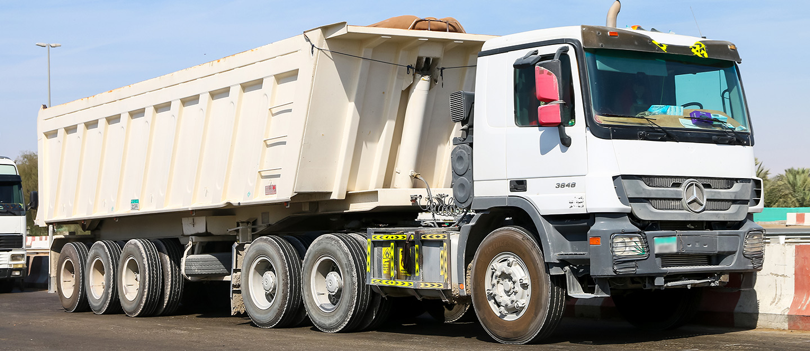
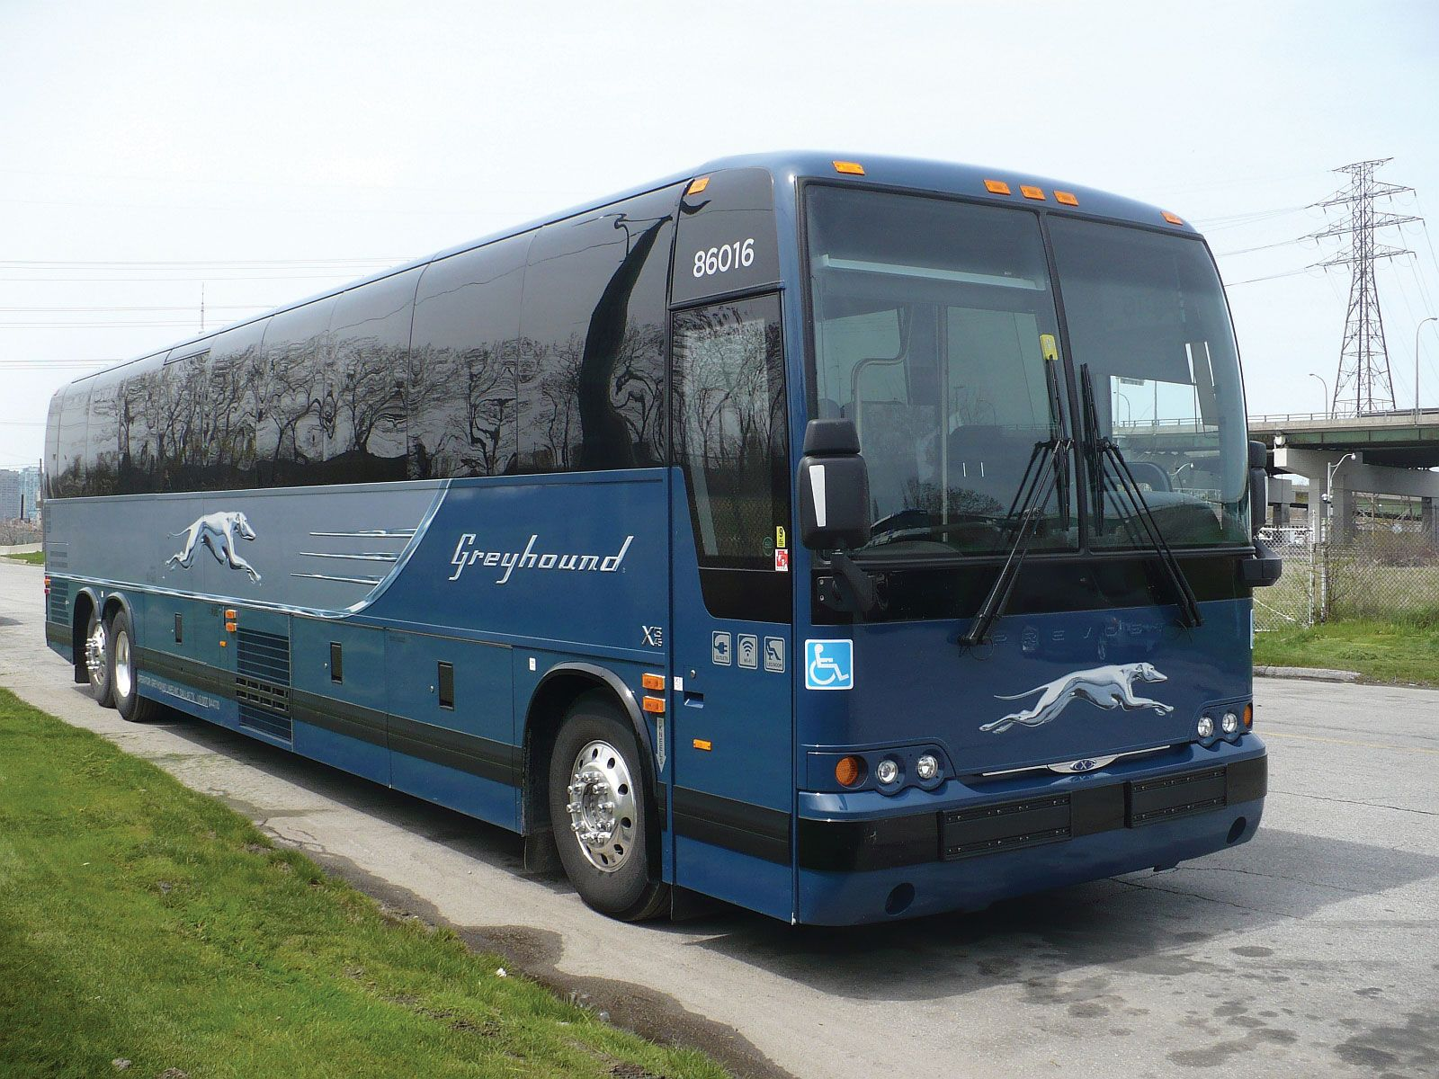
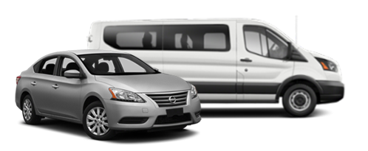

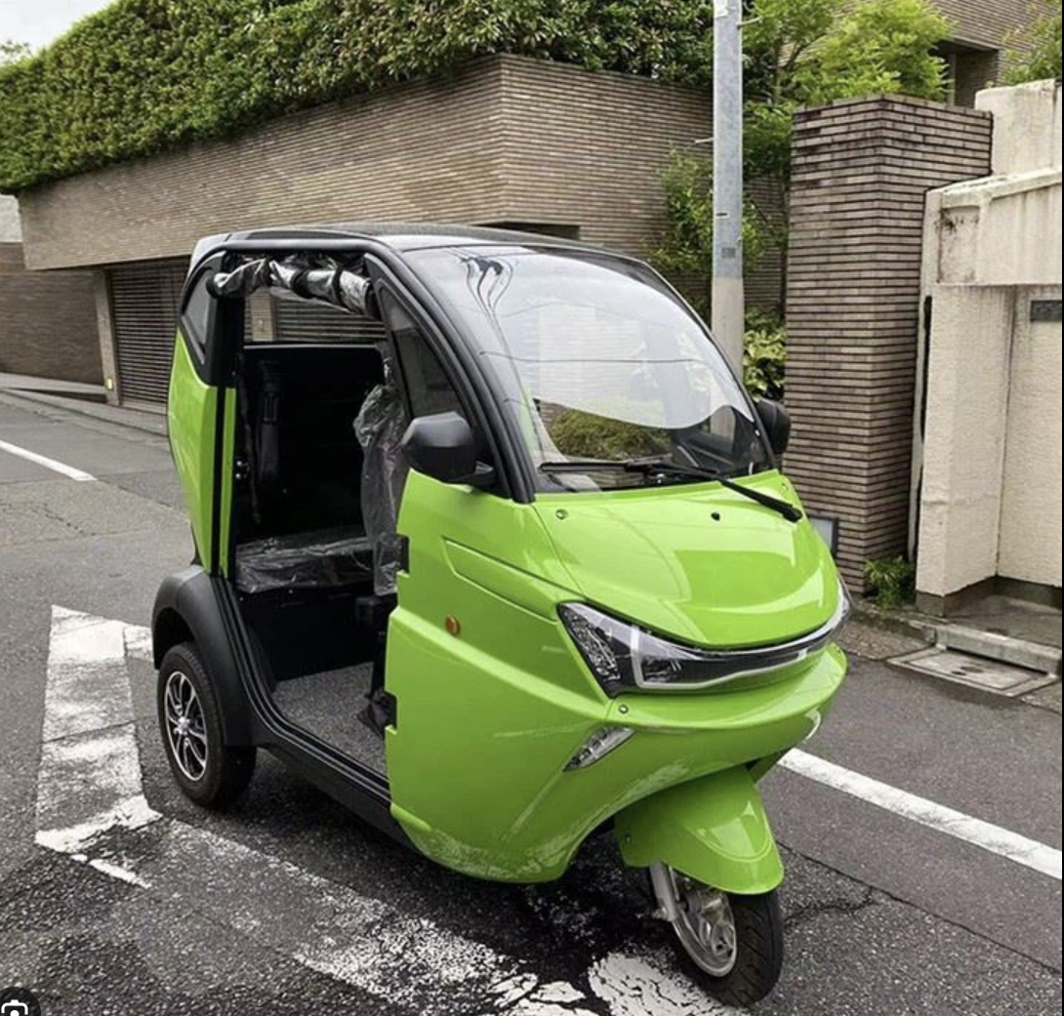
EU Segmentation of vehicles in energy consumption data and the number of registered vehicle data
Items in energy data
 | All | Heavy duty vehicles | Public vehicles | Cars & vans | Others | Two-wheeled vehicles
All (except trailers and motorcycle) | ✓
Total utility vehicles |  |  |  |  | ✓
Lorries |  | ✓
Road tractors |  | ✓
Trailers and semi-trailers | ✓ | ✓
Goods road motor vehicles <= 3.5t |  |  |  | ✓
Motorcycles | ✓ |  |  |  |  | ✓
Passenger cars |  |  |  | ✓
Buses and trolley buses |  | ✓ | ✓
Special vehicles |  |  |  |  | ✓
Items in vehicle registration data

Slide 4
EU Segmentation of vehicles in energy consumption data and the number of registered vehicle data
Items in energy consumption data
 | All | Heavy duty vehicles | Public vehicles | Cars & vans | Others | Two-wheeled vehicles
All (except trailers and motorcycle) | ✓
Total utility vehicles |  |  |  |  | ✓
Lorries |  | ✓
Road tractors |  | ✓
Trailers and semi-trailers | ✓ | ✓
Goods road motor vehicles <= 3.5t |  |  |  | ✓
Motorcycles | ✓ |  |  |  |  | ✓
Passenger cars |  |  |  | ✓
Buses and trolley buses |  | ✓ | ✓
Special vehicles |  |  |  |  | ✓
貨物自動車
旅客バス
旅客乗用車
ラストワン
マイル輸送
Items in vehicle registration data
3.5トン以下の小型の貨物車はcars&vansに含まれてしまい，
エネルギー消費量において一般乗用車と区別できない．

Slide 5
Result All vehicles
※Y-intercept is fixed to 0.
Ireland
Luxembourg
Slovenia
Malta
Biggest error: +34.2% at Malta, -72.5% at Luxembourg.
17 / 27 countries have error percentage within ±20% from the regression line.

Slide 6
Result Heavy duty vehicles
※Y-intercept is fixed to 0.
Luxembourg
Albania
Cyprus
Malta
Biggest error: +284% at Malta, -85.0% at Luxembourg.
15 / 27 countries have error percentage within ±50% from the regression line.

Slide 7
Result Heavy duty vehicles

Slide 8
Result Public vehicles
※Y-intercept is fixed to 0.
Czechia
Malta
Albania
Biggest error: +1006% at Albania, -70.3% at Czechia.
19 / 27 countries have error percentage within ±50% from the regression line.

Slide 9
Result Cars & Vans
※Y-intercept is fixed to 0.
Denmark
Romania
Slovenia
Luxembourg
Biggest error: +65.6% at Romania, -66.1% at Luxembourg.
17 / 27 countries have error percentage within ±20% from the regression line.

Slide 10
Conclusion
The relationship between the road transportation energy consumption and the number of vehicle is studied for each segment of the vehicles in EU.
・ Cars and vans segment shows the strongest proportional relationship by 0.97 of correlation.
・ Heavy duty vehicles and Public vehicles show relatively vague proportional relationship by 0.75 and 0.82 of correlation respectively.
・ The sum of the number of vehicles and the energy consumption also have the strong proportional relationship partly because the majority number of vehicles are categorized as cars and vans.
・ However, cars and vans include both regular passenger cars and goods road motor vehicles that have 3.5t or less. It indicates that we cannot divide the energy consumption for passenger transportation and cargo transportation.

