Slide 1
マルチエージェント強化学習を用いた自律分散型マイクログリッドのデザイン Design of Autonomous Decentralized Microgrids Using Multi-Agent Reinforcement Learning
Weekly seminar @Nakata Lab.
M2 Morita Yudai

Slide 2
CONTENT
1. Introduction and background
2. Objective
3. Methodology
3.1 Step 1: Data collection
3.1.1 Data (demand, PV supply, wholesale price, EV charging, CAPEX, OPEX)
3.1.2 Technology parameter (battery charge/discharge speed limit, efficiency)
3.2 Step 2: Model construction
3.2.1 Generate agent
3.2.2 Design P2P energy trading model
3.2.3 Design non-P2P energy model
3.3 Step 3: Train agents
3.3.1 Q table
3.3.2 Reward
4. Results and analysis
5. Summary and future work

Slide 3
CONTENT
1. Introduction and background
2. Objective
3. Methodology
3.1 Step 1: Data collection
3.1.1 Data (demand, PV supply, wholesale price, EV charging, CAPEX, OPEX)
3.1.2 Technology parameter (battery charge/discharge speed limit, efficiency)
3.2 Step 2: Model construction
3.2.1 Generate agent
3.2.2 Design P2P energy trading model
3.2.3 Design non-P2P energy model
3.3 Step 3: Train agents
3.3.1 Q table
3.3.2 Reward
4. Results and analysis
5. Summary and future work

Slide 4
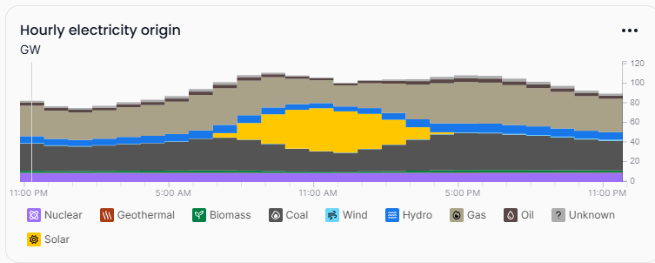
1. Introduction and background
9.2 %
14~16 %
Trends in renewable energy adoption in Japan [1]
JEPX spot price (30 min resolution) [2]
・ Rooftop is considered as a location for installing further solar panels. [1]
・ Volatility in electricity wholesale prices within a day increased.
・ Up to approx.50% of electricity comes from solar panels on sunny days.
In this context, a decentralized energy system has worth being studied for further usage of Distributed Energy Resources (DERs).
Solar
日本のエネルギーミックス (2024/12/2) [3]
[1] https://www.enecho.meti.go.jp
[2] https://www.jepx.jp/electricpower/market-data/spot/
[3] https://app.electricitymaps.com

Slide 5
1. Introduction and background
Conventional structure
Current structure (2016～)
Electric companies in each region
Electric companies
Generation
Transmission
Distribution
Retail
TSO
DSO
FIT
Generation
Generation
Generation
Generation
Legal Separation
←
FIP
Wholesale Market(JEPX)
FIP
Retailer
Retailer
Retailer
Retail
Supply obligations, regional monopolies Price regulation based on the full-cost method
FIT
Prosumer
Consumer
Consumer
Consumer
Consumers
Each consumers/prosumers can choose appropriate Energy Retailer
一般財団法人 新エネルギー財団 電力市場の概要(その1)

Slide 6
1. Introduction and background
Conventional structure
Future structure (20XX～)
Electric companies in each region
Electric companies
Generation
Transmission
Distribution
Retail
TSO
DSO
Generation
Generation
Generation
Generation
Legal Separation
←
Wholesale Market
Participate as a Virtual Power Plant (VPP)
Supply obligations, regional monopolies Price regulation based on the full-cost method
Prosumer
Prosumer
Prosumer
Prosumer
Consumers
Peer to Peer energy trading
一般財団法人 新エネルギー財団 電力市場の概要(その1)

Slide 7
1. Introduction and background
Author | Objective function | Variable | method | DR | BES | EV | bid | year | ref.
Lu et al. | Maximize the prifit of aggregator. Minimize the cost of prosumers, including prosumer’s dissatisfaction values. | アグリゲーターの電力卸売価格． | Q学習 | ✓ | - | - | - | 2018 | [6]
He et al. | アグリゲーターの利益最大化． | アグリゲーターの電力売買価格． | Q学習 | ✓ | ✓ | - | - | 2021 | [7]
Watari et al. | アグリゲーターの利益最大化，プロシューマーの不快度数を含めたコスト最小化，ダックカーブの緩和． | 各プロシューマーへの卸売価格． | PPO | ✓ | ✓ | - | - | 2024 | [8]
Zhou et al. | DR (EV含む) の取引量最大化，各DR期間に対して供給する電力の変動の最小化． | バッテリー (BES) の放電量． | MILP | ✓ | ✓ | ✓ | ✓ | 2020 | [9]
Ilic et al. | - | - | - | - | - | - | ✓ | 2012 | [10]
Shojaeighadikolaei et al. | アグリゲーターの利益最大化，プロシューマーの利益最大化． | アグリゲーターの電力売買価格，各プロシューマーのバッテリー充放電量． | MADRL-DQN | - | ✓ | - | - | 2021 | [11]
Li et al. | MGCごとの電力コスト，BESの劣化，室温に対する不快度数の最小化． | MGCごとの電力希望取引価格と量． | MADRL-transformer | - | ✓ | - | ✓ | 2024 | [12]
May et al. | プロシューマーの利益最大化，MGC内の社会的厚生関数の最大化． | MGC内での取引価格，各プロシューマーの「売買，BES蓄電，何もしない」から行動選択 | MARL-PPO | - | ✓ | - | - | 2023 | [13]

Slide 8
CONTENT
1. Introduction and background
2. Objective
3. Methodology
3.1 Step 1: Data collection
3.1.1 Data (demand, PV supply, wholesale price, EV charging, CAPEX, OPEX)
3.1.2 Technology parameter (battery charge/discharge speed limit, efficiency)
3.2 Step 2: Model construction
3.2.1 Generate agent
3.2.2 Design P2P energy trading model
3.2.3 Design non-P2P energy model
3.3 Step 3: Train agents
3.3.1 Q table
3.3.2 Reward
4. Results and analysis
5. Summary and future work

Slide 9
CONTENT
1. Introduction and background
2. Objective
3. Methodology
3.1 Step 1: Data collection
3.1.1 Data (demand, PV supply, wholesale price)
3.1.2 Car usage survey → Car usage data
3.1.3 Technology parameter (battery charge/discharge speed limit, efficiency)
3.2 Step 2: Model construction
3.2.1 Generate agent
3.2.2 Design P2P energy trading model
3.2.3 Design non-P2P energy model
3.3 Step 3: Train agents
3.3.1 Q table
3.3.2 Reward
4. Results and analysis
5. Summary and future work

Slide 10
2. Objective
The main objective is to propose an autonomous decentralized P2P energy trading system, and investigate its impact to both prosumers and energy grid.
Considering 2 scenarios:
1. Prosumers without P2P energy trading. (future coming consequence)
2. Prosumers community with P2P energy trading. (proposed)

Slide 11
2. Objective
The main objective is to propose an autonomous decentralized P2P energy trading system, and investigate its impact to both prosumers and energy grid.
Considering 2 scenarios:
1. Prosumers without P2P energy trading. (future coming consequence)
➤Constructing the model… Done.
2. Prosumers community with P2P energy trading. (proposed)
➤On training Done.

Slide 12
CONTENT
1. Introduction and background
2. Objective
3. Methodology
3.1 Step 1: Data collection
3.1.1 Data (demand, PV supply, wholesale price)
3.1.2 Car usage survey → Car usage data
3.1.3 Technology parameter (battery charge/discharge speed limit, efficiency)
3.2 Step 2: Model construction
3.2.1 Generate agent
3.2.2 Design P2P energy trading model
3.2.3 Design non-P2P energy model
3.3 Step 3: Train agents
3.3.1 Q table
3.3.2 Reward
4. Results and analysis
5. Summary and future work

Slide 13
3. Method description
Step 1: Data collection
Step 2: Model construction
Step 3: Train agents
Data (demand, PV supply, wholesale price)
Generate agent
Agent
Reward
…
…
…
Car usage survey
→car usage data
State
Design P2P energy trading model
Design non-P2P energy model
Technology parameter (charge/discharge speed limit, efficiency)
Action
…

Slide 14
CONTENT
1. Introduction and background
2. Objective
3. Methodology
3.1 Step 1: Data collection
3.1.1 Data (demand, PV supply, wholesale price)
3.1.2 Car usage survey → Car usage data
3.1.3 Technology parameter (battery charge/discharge speed limit, efficiency)
3.2 Step 2: Model construction
3.2.1 Generate agent
3.2.2 Design P2P energy trading model
3.2.3 Design non-P2P energy model
3.3 Step 3: Train agents
3.3.1 Q table
3.3.2 Reward
4. Results and analysis
5. Summary and future work

Slide 15
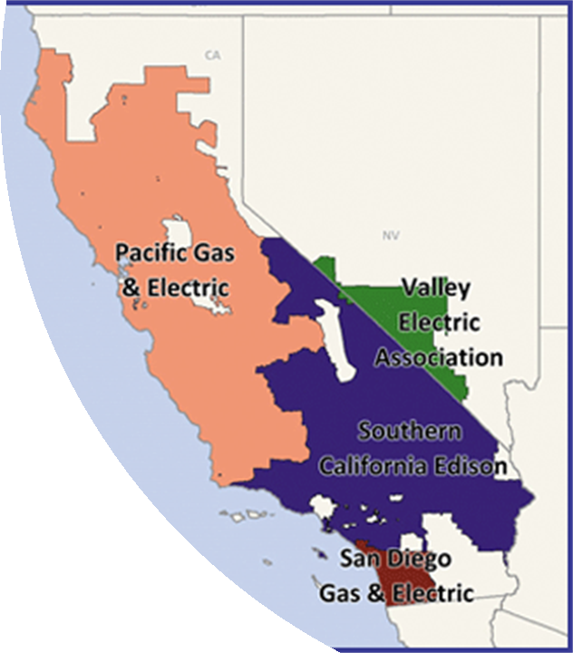
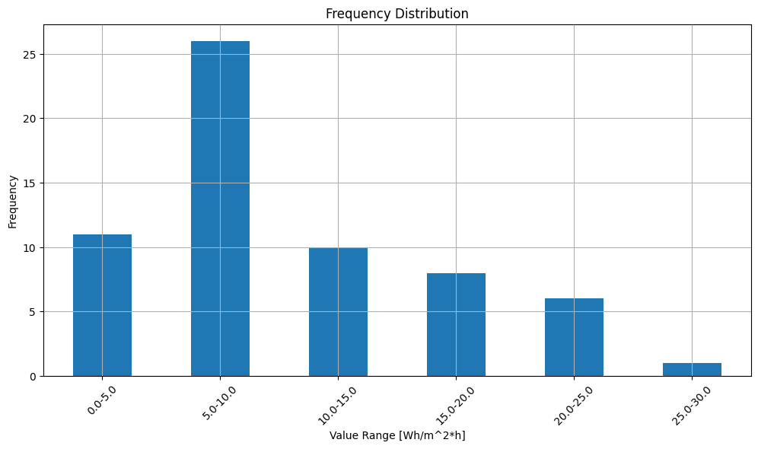
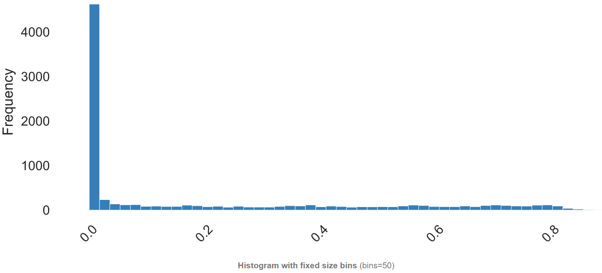
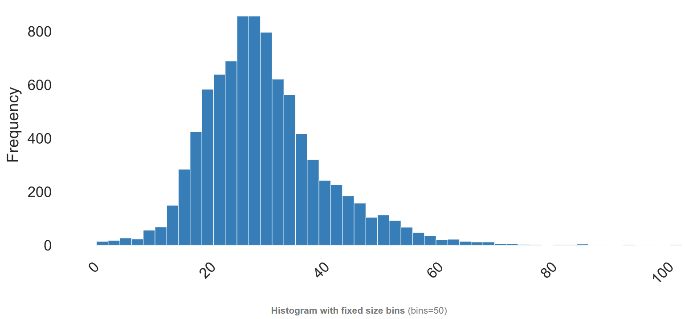
3.1.1 Data
 | Consumption | PV production | Wholesale electricity price
Location | UC Barkley (California) | California (For each zipcode) | California (For each zone)
Number of columns | 62 (93) Columns with more than 10% missing values are discarded, and the remaining columns are linearly interpolated. Data columns with average value of more than 30 [Wh/m^2*h] and less than 1 [Wh/m^2*h] are discarded. | 267 | 1 (4) Price data from Pacific Gas & Electric is selected.
Year | 2016/1/1~2017/12/31 | 2011/1/1~2016/12/31 | 2016/1/1~
Source | [1] | [2] | [3]
Histogram (average)
Consumption [Wh/m^2 per hour]
Production [kWh/kW per hour]
Price [cents/kWh]
[1] https://www.kaggle.com/code/claytonmiller/building-data-genome-project-2-overview/data
[2] https://www.californiadgstats.ca.gov/downloads/
[3] https://www.caiso.com/Pages/default.aspx

Slide 16
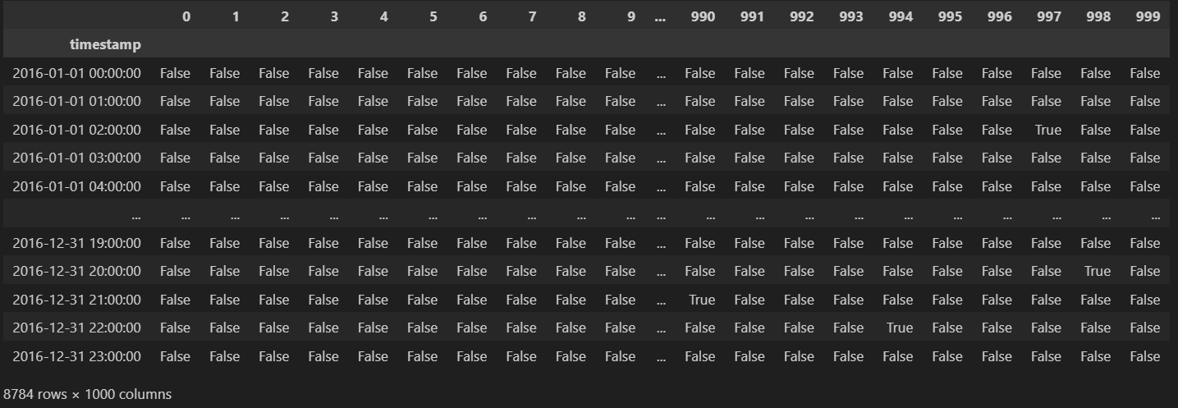
3.1.2 Car usage survey → car usage data
Car usage survey [1]
Annual mileage [km/year] | Usage frequency | Ratio [%]
~ 3000 | Do not ride often | 12.9
3000 ~ 5000 | Mostly for nearby shopping | 25.8
5000 ~ 7000 | Mostly for commuting to work or school (approx. 30 min/one way) | 22.5
7000 ~ 9000 | Mostly used on weekends, sometimes trips | 14.8
9000 ~ 11000 | Mostly for commuting to work or school (approx. 60 min/one way) | 13.8
11000 ~ 16000 | Long drive every day | 6.0
16000 ~ | Super long drive | 4.2
1000 car usage profile are made according to the distribution of the car usage frequency
[1] https://from.sonysonpo.co.jp/topics/pr/2023/07/20230727_01.html

Slide 17
3.1.3 Technology parameter
Parameter | Value
Battery charge efficiency [-] | 0.9
Battery discharge efficiency [-] | 0.9
EV battery charge efficiency [-] | 0.9
EV battery discharge efficiency [-] | 0.9
EV efficiency [km/kWh] | 7
Max battery charge speed [kW] | 3.0
Max battery discharge speed [kW] | 3.0
Max EV charge speed [kW] | 6.0
Max EV discharge speed [kW] | 3.0

Slide 18
CONTENT
1. Introduction and background
2. Objective
3. Methodology
3.1 Step 1: Data collection
3.1.1 Data (demand, PV supply, wholesale price)
3.1.2 Car usage survey → Car usage data
3.1.3 Technology parameter (battery charge/discharge speed limit, efficiency)
3.2 Step 2: Model construction
3.2.1 Generate agent
3.2.2 Design P2P energy trading model
3.2.3 Design non-P2P energy model
3.3 Step 3: Train agents
3.3.1 Q table
3.3.2 Reward
4. Results and analysis
5. Summary and future work

Slide 19
3.2.1 Generate prosumer (agent)
Parameter | Value
Demand Response (DR) | True, False
DR shift limit [h] | 6.0, 12.0, 18.0, or 24.0
Elastic ratio [-] | off-peak: 0.5, mid-peak: 0.3, on-peak: 0.1※
Battery capacity [kWh] | 0 or 13.5
EV battery capacity [kWh] | 0 or 40
PV install capacity [kW] | 0 or 5
Car speed [km/h] | 30
Alpha | 1, 1.5, 2, 2.5, 3, 3.5, or 4
Beta | 1, 1.5, or 2
Gamma | 1, 1.5, 2, 2.5, 3, 3.5, or 4
Epsilon | 1, 1.5, or 2
Psi | 1, 1.5, 2, 2.5, 3, 3.5, or 4
Omega | 1, 1.5, or 2
Demand, PV Supply, Car usage data are randomly chosen for each agent.
Other parameters for each agent are showed in the table
Described in 3.3.2 reward
※22PM-6AM: off-peak, 7AM-16PM: mid-peak, 17PM-21PM: on-peak

Slide 20







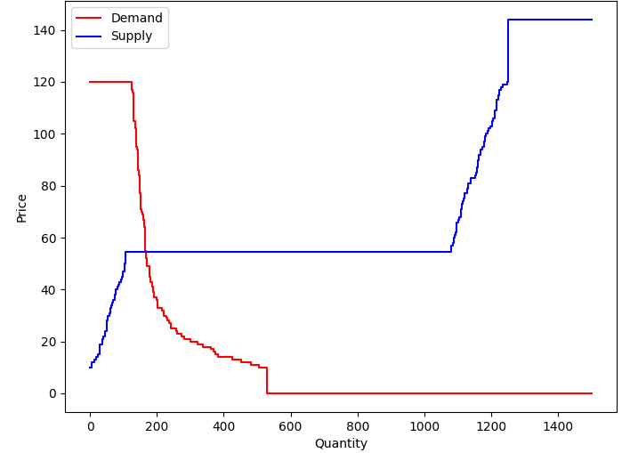
3.2.2 Design P2P energy trading model
…
…
Prosumer #1
Prosumer #2
PV
PV
Inelastic load
Inelastic load
Grid import
Elastic load
Elastic load
Battery
EV
EV
Wholesale electricity market
&
independent system operator
Bid
Bid
Price, Amount₁
Price, Amount₂
Price of grid import
Price, Amount₃
Price, Amount₄
Bid
Bid
Grid export
Prosumer #3
Prosumer #4
PV
Inelastic load
Inelastic load
Elastic load
Battery
…
EV
…

Slide 21
3.2.2 Design P2P energy trading model
Parameter | Value
Bid price max [cents/kWh] | 120
Bid price min [cents/kWh] | 10
Wheeling charge [cents/kWh] | 10
Sell price to grid [cents/kWh] | 0
Trade frequency [h] | 1
Number of agent [-] | 100

Slide 22
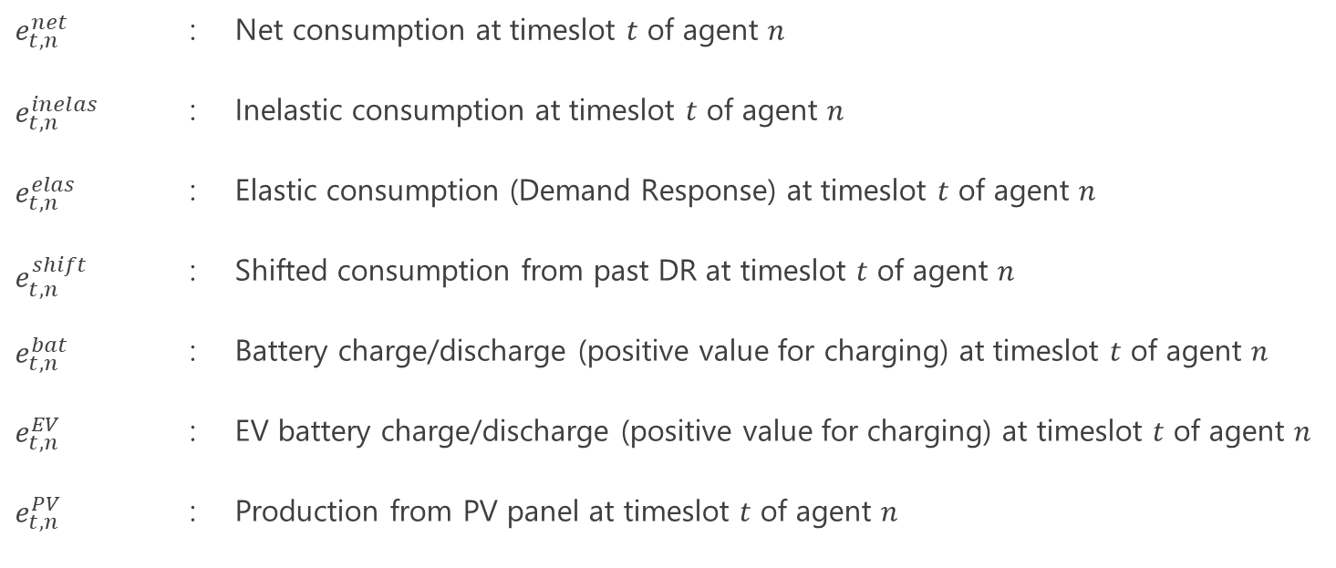
3.2.2 Design P2P energy trading model
Net demands of each agent are defined as following equation:
$$\begin{aligned}e_{t,n}^{net}=e_{t,n}^{inelas}+e_{t,n}^{elas}+e_{t,n}^{shift}+e_{t,n}^{bat}+e_{t,n}^{EV}−e_{t,n}^{PV} (1)\end{aligned}$$
$$e_{t,n}^{net}$$ | : | Net consumption at timeslot $t$ of agent $n$
$$e_{t,n}^{inelas}$$ | : | Inelastic consumption at timeslot $t$ of agent $n$
$$e_{t,n}^{elas}$$ | : | Elastic consumption (Demand Response) at timeslot $t$ of agent $n$
$$e_{t,n}^{shift}$$ | : | Shifted consumption from past DR at timeslot $t$ of agent $n$
$$e_{t,n}^{bat}$$ | : | Battery charge/discharge (positive value for charging) at timeslot $t$ of agent $n$
$$e_{t,n}^{EV}$$ | : | EV battery charge/discharge (positive value for charging) at timeslot $t$ of agent $n$
$$e_{t,n}^{PV}$$ | : | Production from PV panel at timeslot $t$ of agent $n$

Slide 23
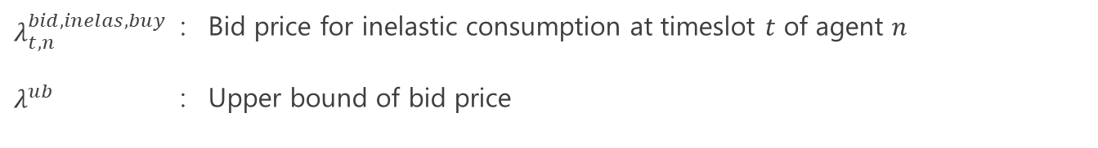
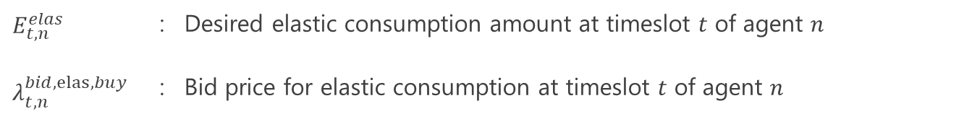

3.2.2 Design P2P energy trading model
$$\begin{aligned}λ_{t,n}^{bid,inelas,buy}=λ^{ub} (2)\end{aligned}$$
$$λ_{t,n}^{bid,inelas,buy}$$ | : | Bid price for inelastic consumption at timeslot $t$ of agent $n$
$$λ^{ub}$$ | : | Upper bound of bid price
$$E_{t,n}^{elas}$$
$$λ_{t,n}^{bid,elas, buy}$$
One of the targets of RL
$$E_{t,n}^{elas}$$ | : | Desired elastic consumption amount at timeslot $t$ of agent $n$
$$λ_{t,n}^{bid,elas, buy}$$ | : | Bid price for elastic consumption at timeslot $t$ of agent $n$

Slide 24
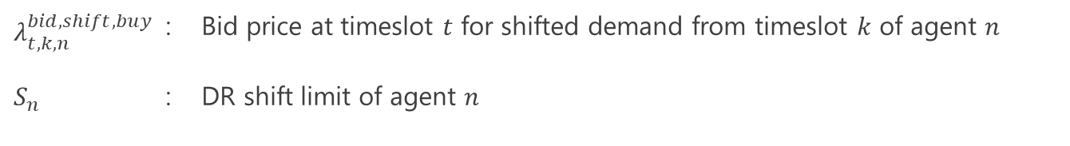

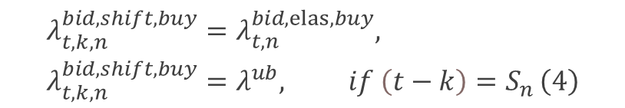
3.2.2 Design P2P energy trading model
$$e_{t,n}^{shift}=\sum_{k=1}^{t−1}{{(E}_{k,n}^{elas}−e_{k,n}^{elas}) (3)}$$
$$\begin{aligned}&λ_{t,k,n}^{bid,shift,buy}=λ_{t,n}^{bid,elas, buy},\# \\ &{λ_{t,k,n}^{bid,shift,buy}=λ}^{ub}, if \left(t−k\right)=S_{n }\#\left(4\right)\end{aligned}$$
$$λ_{t,k,n}^{bid,shift,buy}$$ | : | Bid price at timeslot $t$ for shifted demand from timeslot $k$ of agent $n$
$$S_{n}$$ | : | DR shift limit of agent $n$

Slide 25
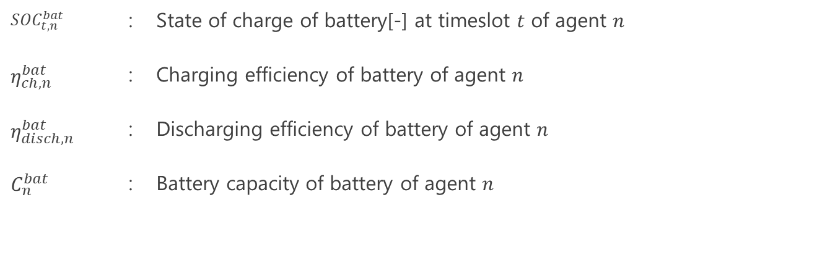
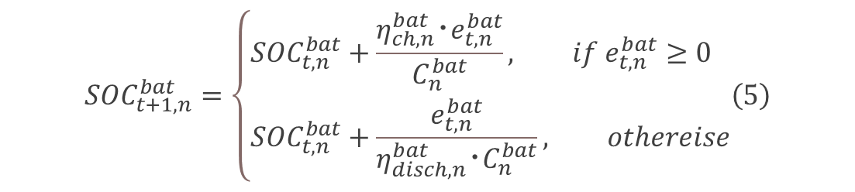


3.2.2 Design P2P energy trading model
$${SOC}_{t+1,n}^{bat}=\left\{\begin{aligned}&\begin{aligned}&{SOC}_{t,n}^{bat}+\frac{η_{ch,n}^{bat}･e_{t,n}^{bat}}{C_{n}^{bat}}, if e_{t,n}^{bat}≥0 \\ &{SOC}_{t,n}^{bat}+\frac{e_{t,n}^{bat}}{{η_{disch,n}^{bat}･C}_{n}^{bat}}, othereise\end{aligned}\#\left(5\right)\end{aligned}\right.$$
$${SOC}_{t,n}^{bat}$$ | : | State of charge of battery[-] at timeslot $t$ of agent $n$
$$η_{ch,n}^{bat}$$ | : | Charging efficiency of battery of agent $n$
$$η_{disch,n}^{bat}$$ | : | Discharging efficiency of battery of agent $n$
$$C_{n}^{bat}$$ | : | Battery capacity of battery of agent $n$
$$λ_{t,n}^{bid,bat,buy}$$
One of the targets of RL
$$λ_{t,n}^{bid,bat,sell}$$
One of the targets of RL

Slide 26
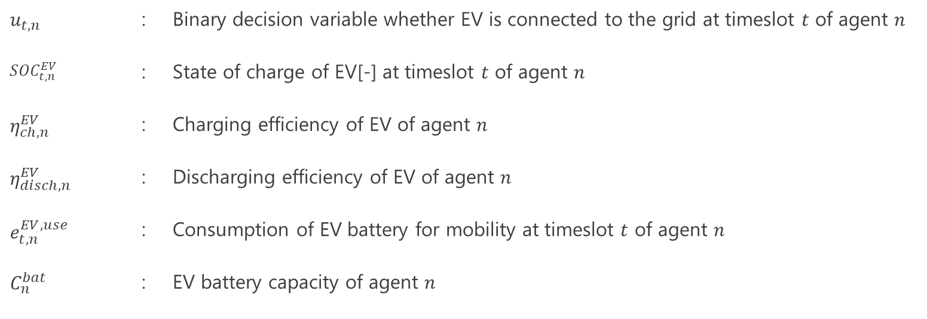
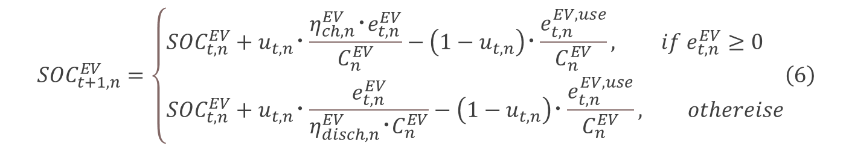


3.2.2 Design P2P energy trading model
$${SOC}_{t+1,n}^{EV}=\left\{\begin{aligned}&\begin{aligned}&{SOC}_{t,n}^{EV}+u_{t,n}･\frac{η_{ch,n}^{EV}･e_{t,n}^{EV}}{C_{n}^{EV}}−\left(1−u_{t,n}\right)･\frac{e_{t,n}^{EV,use}}{C_{n}^{EV}}, if e_{t,n}^{EV}≥0 \\ &{SOC}_{t,n}^{EV}+u_{t,n}･\frac{e_{t,n}^{EV}}{{η_{disch,n}^{EV}･C}_{n}^{EV}}−\left(1−u_{t,n}\right)･\frac{e_{t,n}^{EV,use}}{C_{n}^{EV}}, othereise\end{aligned}\#\left(6\right)\end{aligned}\right.$$
$$u_{t,n}$$ | : | Binary decision variable whether EV is connected to the grid at timeslot $t$ of agent $n$
$${SOC}_{t,n}^{EV}$$ | : | State of charge of EV[-] at timeslot $t$ of agent $n$
$$η_{ch,n}^{EV}$$ | : | Charging efficiency of EV of agent $n$
$$η_{disch,n}^{EV}$$ | : | Discharging efficiency of EV of agent $n$
$$e_{t,n}^{EV,use}$$ | : | Consumption of EV battery for mobility at timeslot $t$ of agent $n$
$$C_{n}^{bat}$$ | : | EV battery capacity of agent $n$
$$λ_{t,n}^{bid,EV,buy}$$
One of the targets of RL
$$λ_{t,n}^{bid,EV,sell}$$
One of the targets of RL

Slide 27
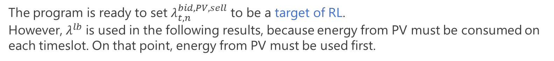

3.2.2 Design P2P energy trading model
$$λ_{t,n}^{bid,PV,sell}=λ^{lb} (7)$$
$$λ^{lb}$$ | : | Lower bound of bid price
The program is ready to set $λ_{t,n}^{bid,PV,sell}$ to be a target of RL.
However, $λ^{lb}$ is used in the following results, because energy from PV must be consumed on each timeslot. On that point, energy from PV must be used first.

Slide 28
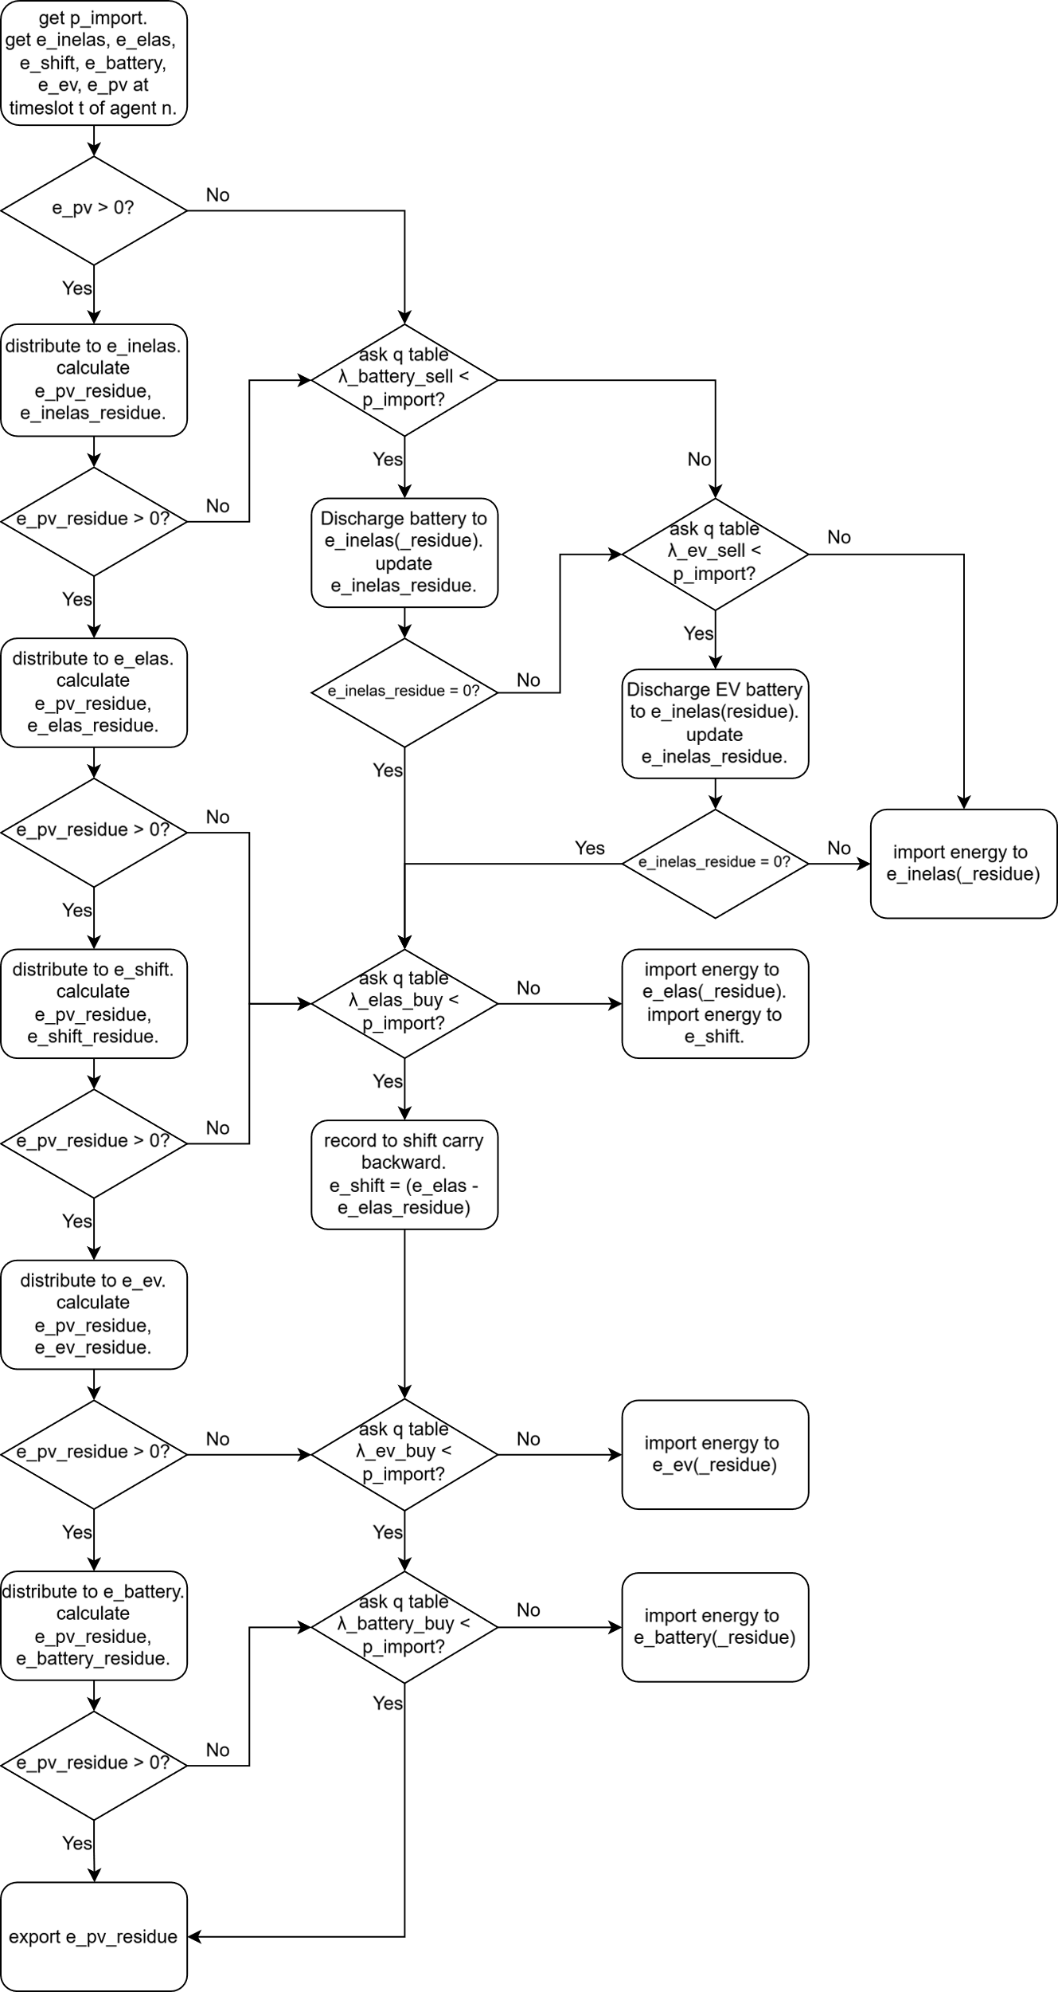
3.2.3 Design non-P2P energy model
Prosumer #1
Prosumer #2
PV
PV
Inelastic load
Inelastic load
Elastic load
Elastic load
…
Battery
EV
EV
Grid import Grid price
Grid export
Grid export
Grid import Grid price
Wholesale electricity market
&
independent system operator
Grid import Grid price
Grid import Grid price
Grid export
Grid export
Prosumer #3
Prosumer #4
PV
Inelastic load
Inelastic load
Elastic load
…
Battery
EV

Slide 29
CONTENT
1. Introduction and background
2. Objective
3. Methodology
3.1 Step 1: Data collection
3.1.1 Data (demand, PV supply, wholesale price)
3.1.2 Car usage survey → Car usage data
3.1.3 Technology parameter (battery charge/discharge speed limit, efficiency)
3.2 Step 2: Model construction
3.2.1 Generate agent
3.2.2 Design P2P energy trading model
3.2.3 Design non-P2P energy model
3.3 Step 3: Train agents
3.3.1 Q table
3.3.2 Reward
4. Results and analysis
5. Summary and future work

Slide 30
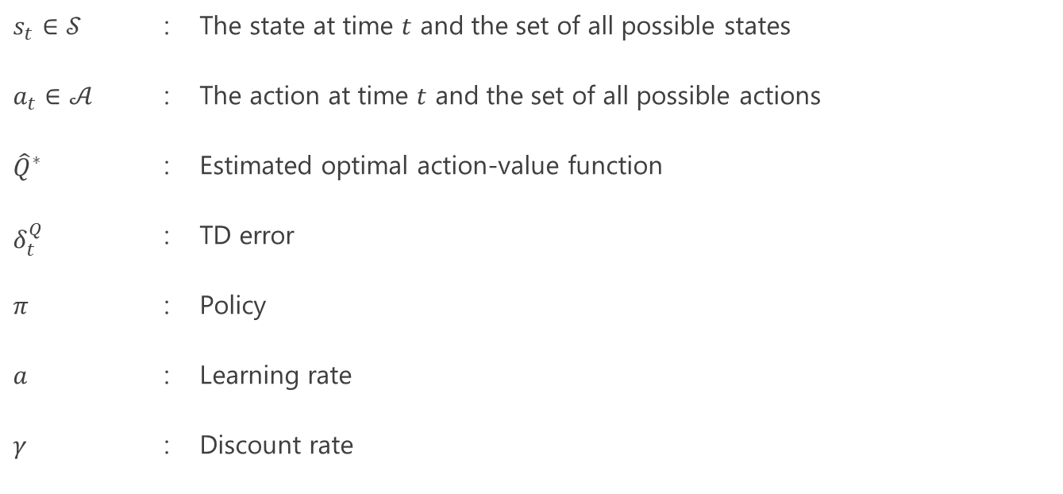

3.3 Train agents Learning method: Multi Agent Q Reinforcement Learning (Q-MARL)
target：bid price for DR bid price $λ_{t,n}^{bid,elas, buy}$ buy/sell of battery/EV battery$λ_{t,n}^{bid,bat,buy}, λ_{t,n}^{bid,bat,sell},λ_{t,n}^{bid,EV,buy}$, $λ_{t,n}^{bid,EV,sell}$
$${\hat{Q}}^{∗, new}\left(s_{t},a_{t}\right)={\hat{Q}}^{∗}\left(s_{t},a_{t}\right)+α･δ_{t}^{Q} \left(16\right)$$
$$δ_{t}^{Q}=r_{t}+γ･\max_{a^{′}∈𝒜}{{\hat{Q}}^{∗}\left(s_{t+1},a^{′}\right)−}{\hat{Q}}^{∗}\left(s_{t},a_{t}\right) \left(17\right)$$
$$π^{new}=ε‐greedy{\hat{Q}}^{∗}$$
$$s_{t}∈𝒮$$ | : | The state at time $t$ and the set of all possible states
$$a_{t}∈𝒜$$ | : | The action at time $t$ and the set of all possible actions
$${\hat{Q}}^{∗}$$ | : | Estimated optimal action-value function
$$δ_{t}^{Q}$$ | : | TD error
$$π$$ | : | Policy
$$a$$ | : | Learning rate
$$γ$$ | : | Discount rate
Learning parameter | Value
Discount rate | 0.99
Learning rate | 0.1
Episode | 100
Number of environment | 16

Slide 31
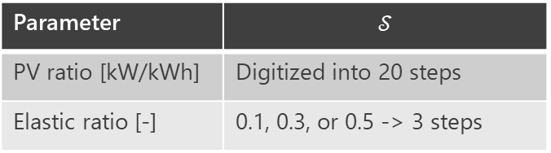
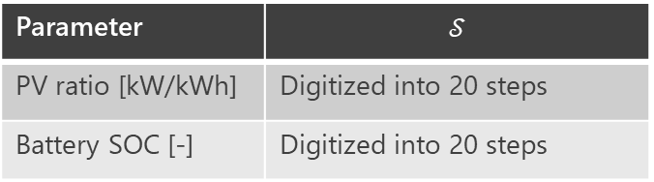
3.3.1 Q table
DR
Battery buy
Parameter | $$𝒮$$
PV ratio [kW/kWh] | Digitized into 20 steps
Elastic ratio [-] | 0.1, 0.3, or 0.5 -> 3 steps
Parameter | $$𝒮$$
PV ratio [kW/kWh] | Digitized into 20 steps
Battery SOC [-] | Digitized into 20 steps
Number of column is possible bid prices (price_max – price_min) +1 = (120 - 10) +1 = 111
Number of column is possible bid prices (price_max – price_min) +1 = (120 - 10) +1 = 111
DR q table size = 20*3 × 111
= 60 × 111
Battery buy q table size = 20*20 × 111
= 400 × 11
Battery sell
EV Battery buy
EV Battery sell
Q tables are made for each agent individually.

Slide 32
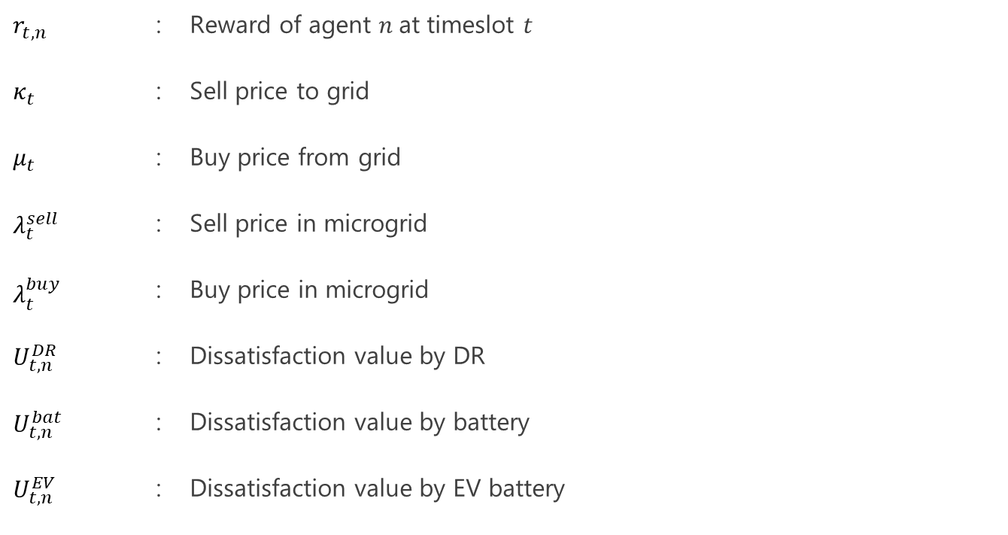
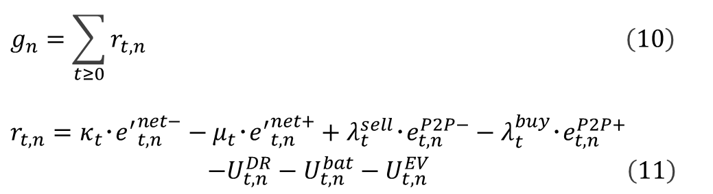
3.3.2 Reward
$$\begin{aligned}g_{n}=\sum_{t≥0}{r_{t,n} }\#\left(10\right)\end{aligned}$$
$$\begin{aligned}r_{t,n}=κ_{t}･{e^{′}}_{t,n}^{net−}−μ_{t}･{e^{′}}_{t,n}^{net+}+λ_{t}^{sell}･e_{t,n}^{P2P−}−λ_{t}^{buy}･e_{t,n}^{P2P+} \\ −U_{t,n}^{DR}−U_{t,n}^{bat}−U_{t,n}^{EV}\#\left(11\right)\end{aligned}$$
$$r_{t,n}$$ | : | Reward of agent $n$at timeslot $t$
$$κ_{t}$$ | : | Sell price to grid
$$μ_{t}$$ | : | Buy price from grid
$$λ_{t}^{sell}$$ | : | Sell price in microgrid
$$λ_{t}^{buy}$$ | : | Buy price in microgrid
$$U_{t,n}^{DR}$$ | : | Dissatisfaction value by DR
$$U_{t,n}^{bat}$$ | : | Dissatisfaction value by battery
$$U_{t,n}^{EV}$$ | : | Dissatisfaction value by EV battery

Slide 33
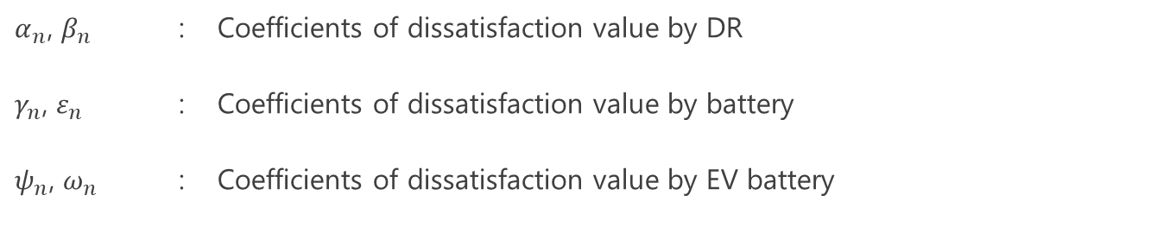
3.3.2 Reward
$$U_{t,n}^{DR}=\frac{α_{n}}{2}･{\left(E_{t,n}^{elas}−e_{t,n}^{elas}\right)}^{2}+β_{n}･\left(E_{t,n}^{elas}−e_{t,n}^{elas}\right) (13)$$
$$\begin{aligned}& \\ U_{t,n}^{bat}=\end{aligned}\frac{γ_{n}}{2}{\left({SOC}_{n}^{ub,bat}−{SOC}_{t+1,n}^{bat}\right)}^{2}+ε_{n}\left({SOC}_{n}^{ub,bat}−{SOC}_{t+1,n}^{bat}\right) (14)$$
$$\begin{aligned}&U_{t,n}^{EV}=\frac{ψ_{n}}{2}{\left({SOC}_{n}^{ub,EV}−{SOC}_{t+1,n}^{EV}\right)}^{2}+ω_{n}\left({SOC}_{n}^{ub,EV}−{SOC}_{t+1,n}^{EV}\right) (15) \\ &\end{aligned}$$
$α_{n}$, $β_{n}$ | : | Coefficients of dissatisfaction value by DR
$γ_{n}$, $ε_{n}$ | : | Coefficients of dissatisfaction value by battery
$ψ_{n}$, $ω_{n}$ | : | Coefficients of dissatisfaction value by EV battery
Action to battery at timeslot $t$ affects the SOC at timeslot $t+1$. Hence, SOC at $t+1$ is used to calculate reward.

Slide 34
Test simulation (Only exploitation, not update Q) is conducted every 10 episodes.
The same Q tables can be used in non-P2P simulation. They are used as the threshold of behaviors of each agent.

Slide 35
CONTENT
1. Introduction and background
2. Objective
3. Methodology
3.1 Step 1: Data collection
3.1.1 Data (demand, PV supply, wholesale price)
3.1.2 Car usage survey → Car usage data
3.1.3 Technology parameter (battery charge/discharge speed limit, efficiency)
3.2 Step 2: Model construction
3.2.1 Generate agent
3.2.2 Design P2P energy trading model
3.3 Step 3: Train agents
3.3.1 Q table
3.3.2 Reward
4. Results and analysis
5. Summary and future work

Slide 36
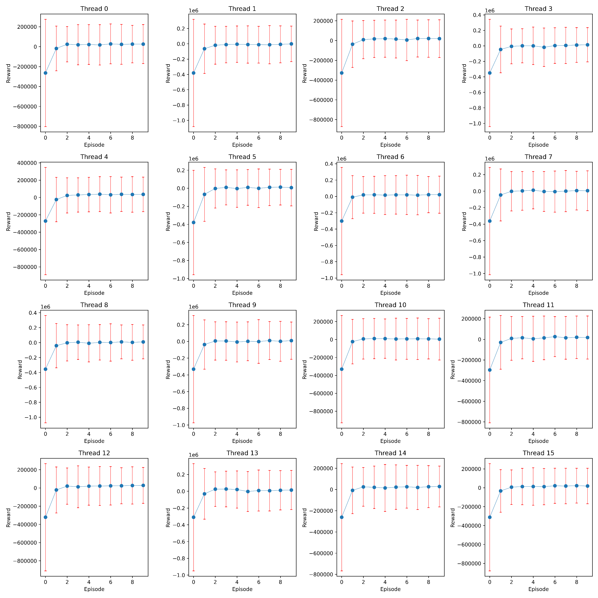
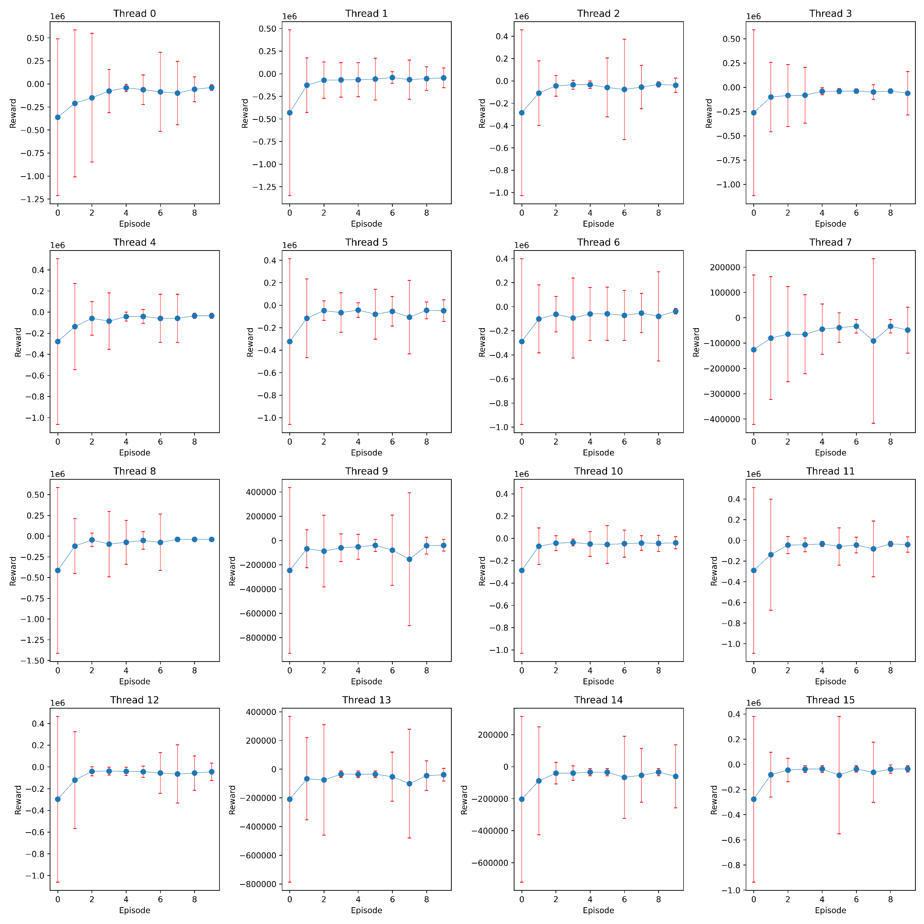
4. Result and analysis Reward history by leaning process
P2P
non-P2P

Slide 37
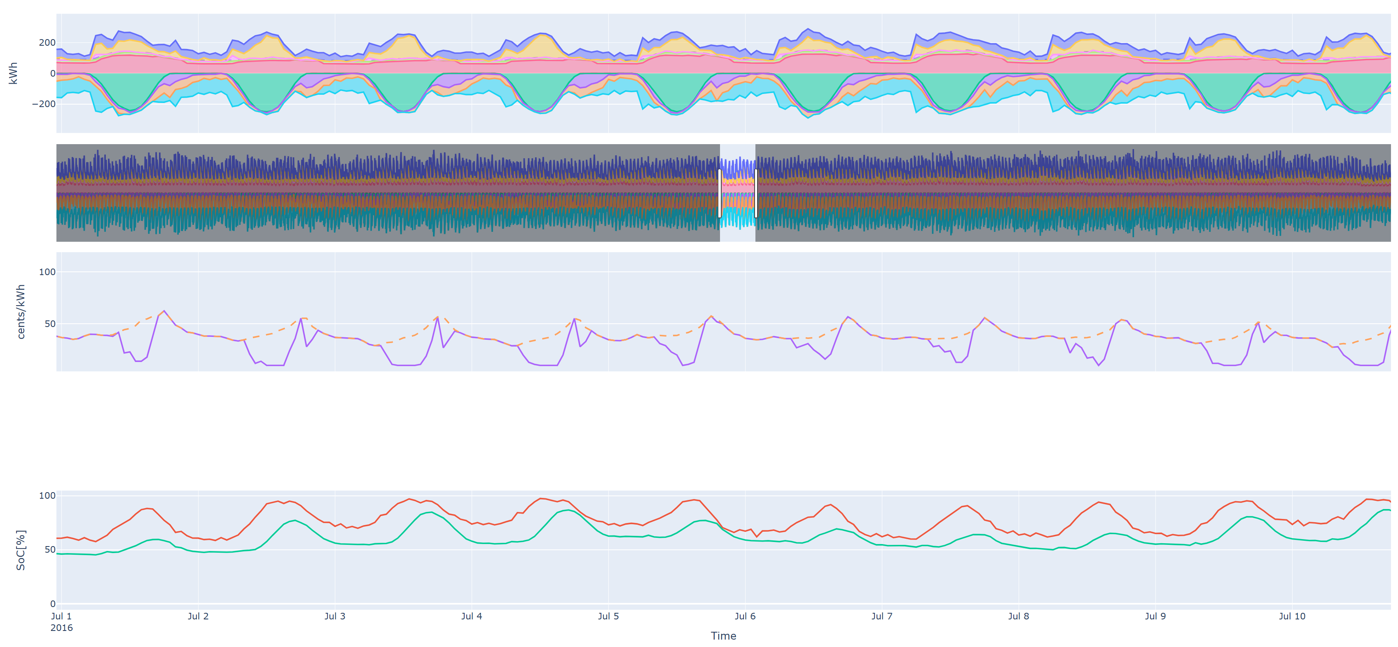
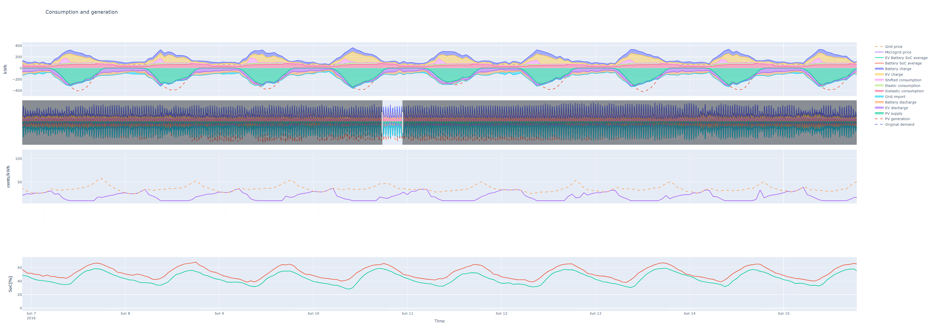
4. Result and analysis Energy mix in microgrid P2P
Energy mix in microgrid (sum) @thread 0 @episode 100 (test) w/ P2P
kWh
Cents/kWh
SoC [%]

Slide 38
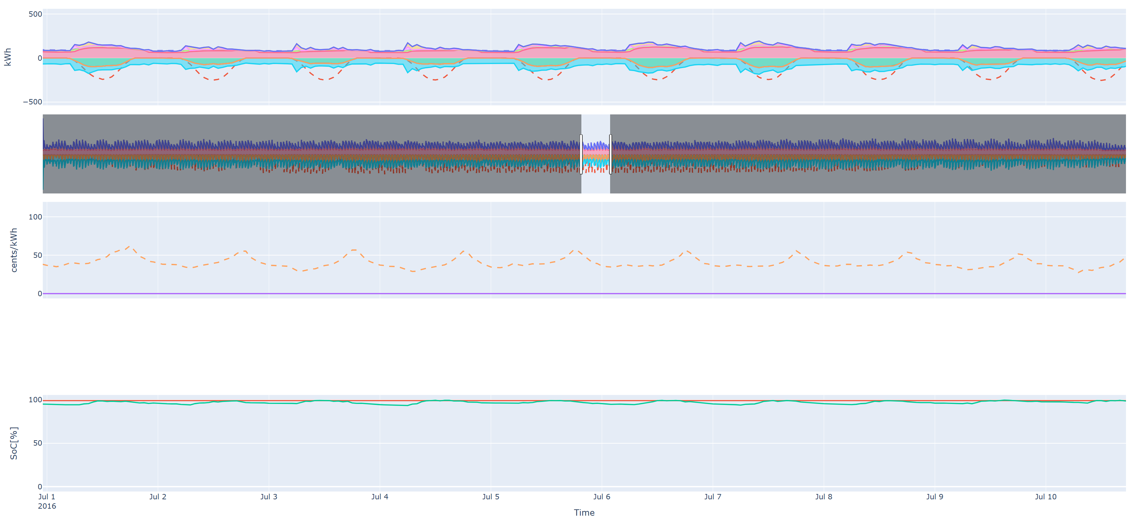
4. Result and analysis Energy mix in microgrid non-P2P
Energy mix in microgrid (sum) @thread 0 @episode 100 (test) w/o P2P
200
kWh
-200
Cents/kWh
SoC [%]

Slide 39
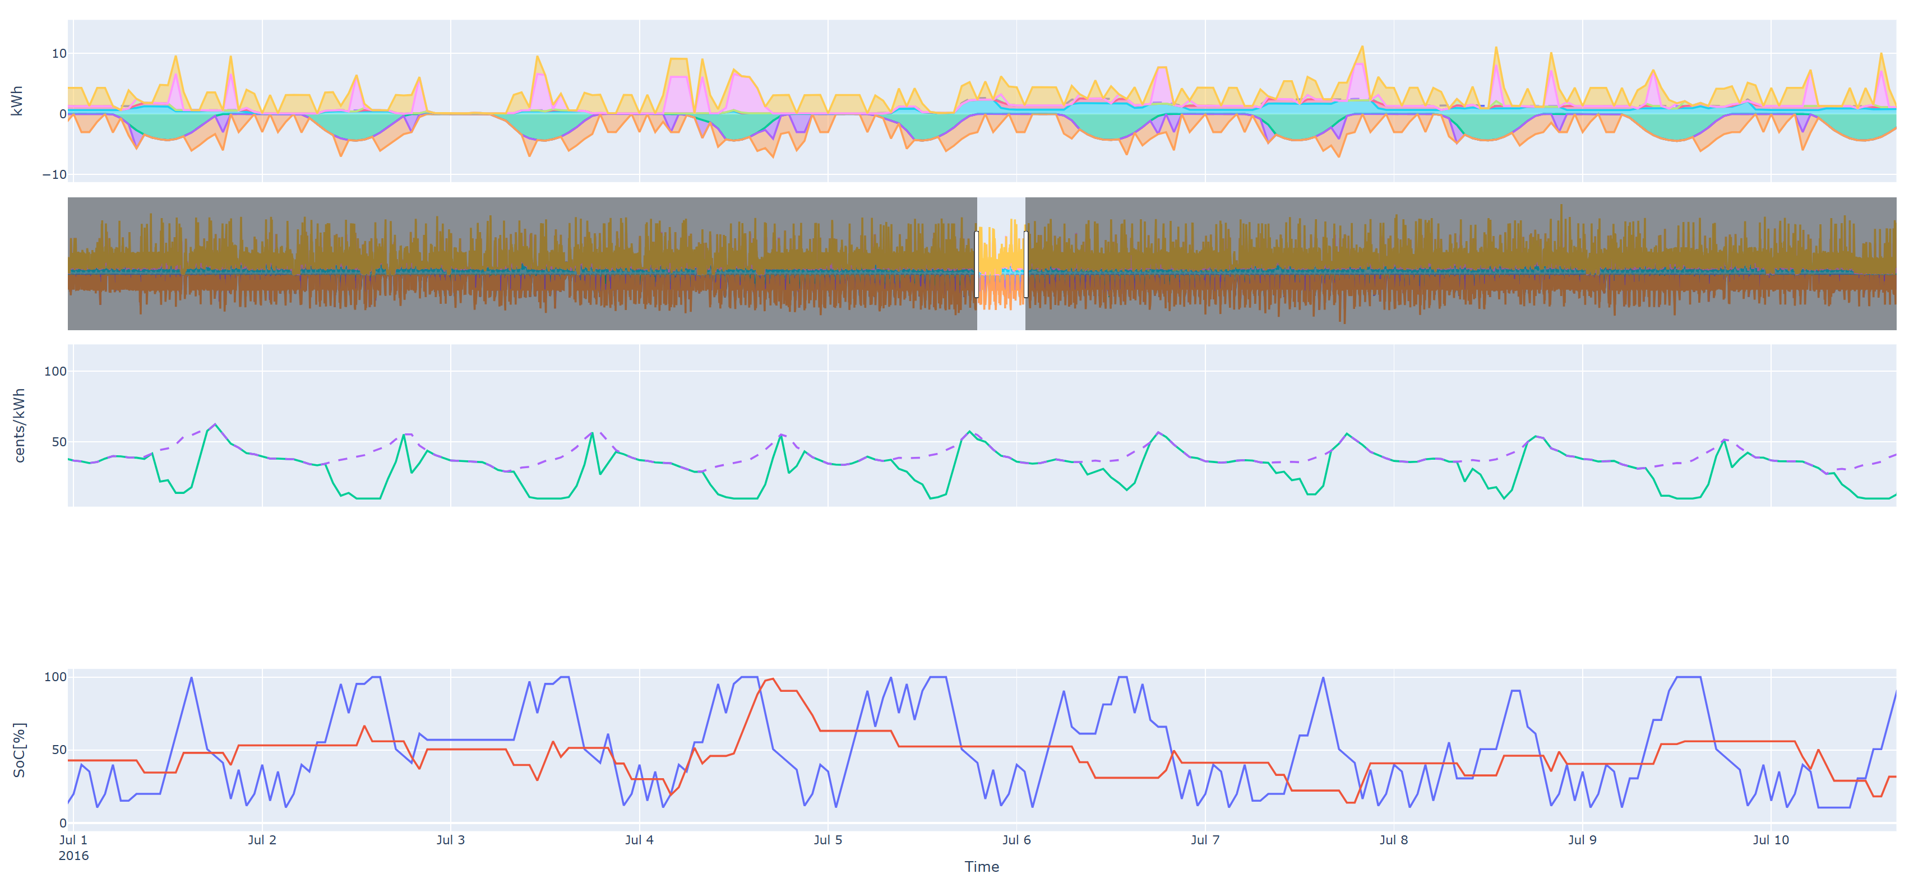
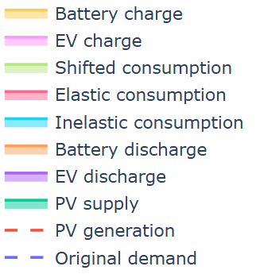


4. Result and analysis Energy mix of an agent P2P
Energy mix in microgrid @agent28 @thread 0 @episode 100 (test) w/ P2P
Charge & Discharge of battery is happening frequently.

Slide 40
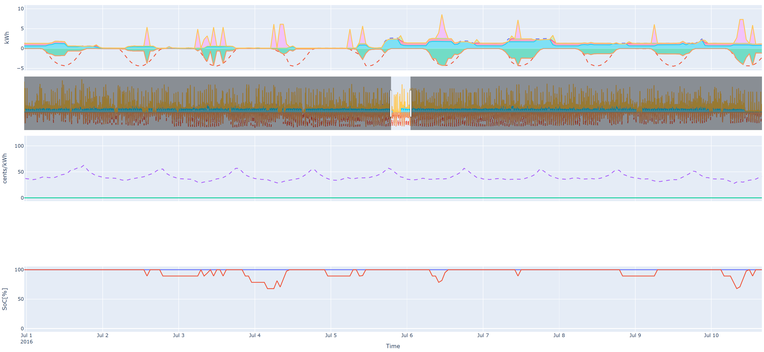
4. Result and analysis Energy mix of an agent non-P2P
Energy mix in microgrid @agent28 @thread 0 @episode 100 (test) w/o P2P

Slide 41
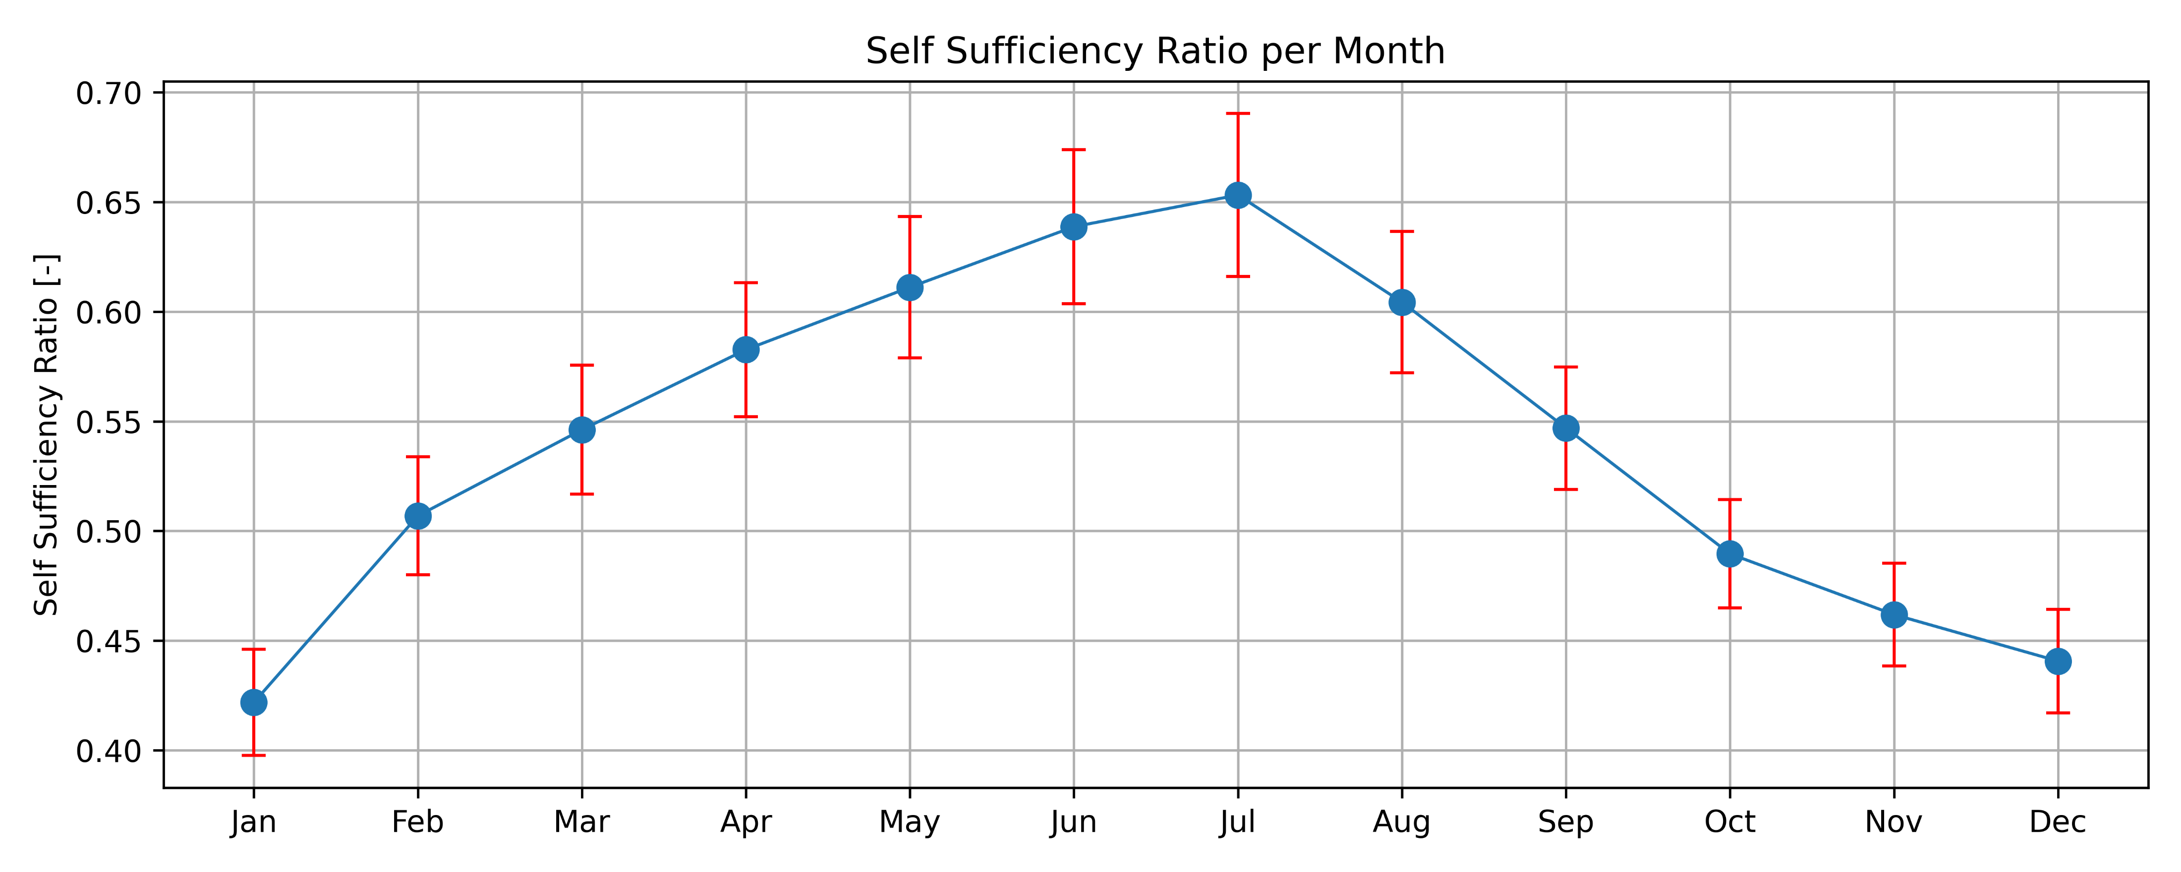
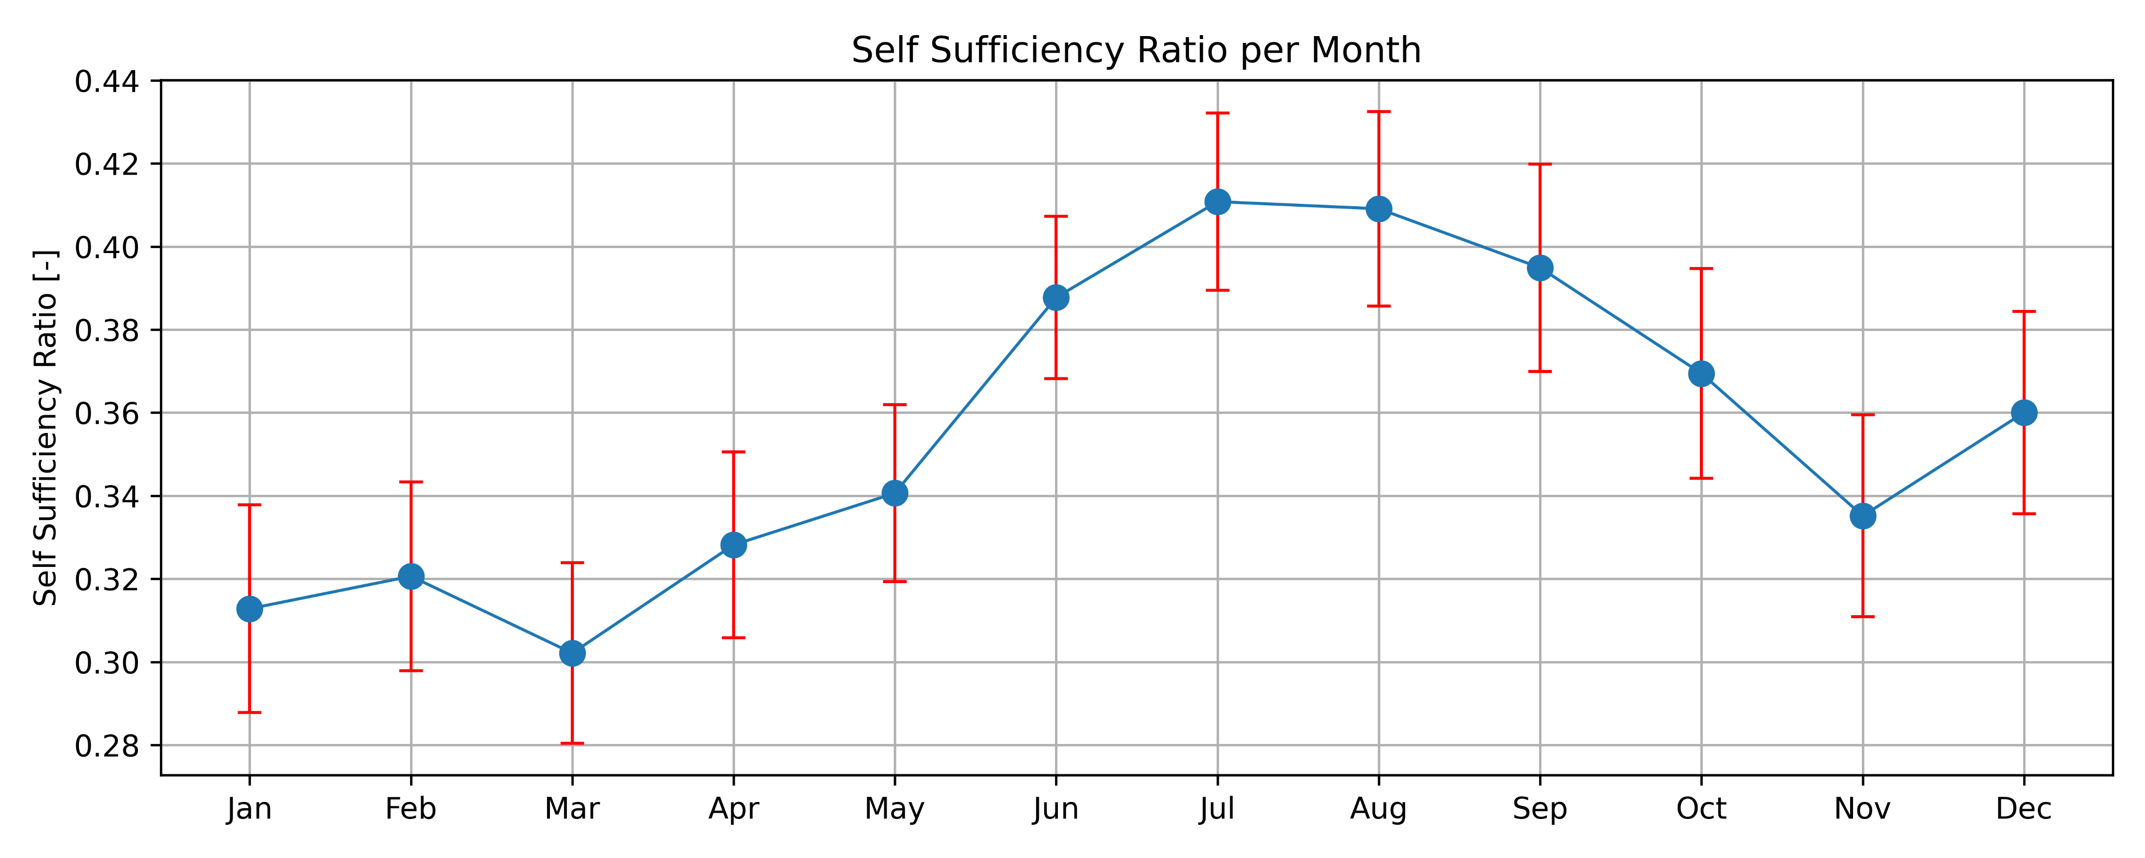
4. Result and analysis Self Sufficiency Ratio (SSR)
P2P
non-P2P

Slide 42
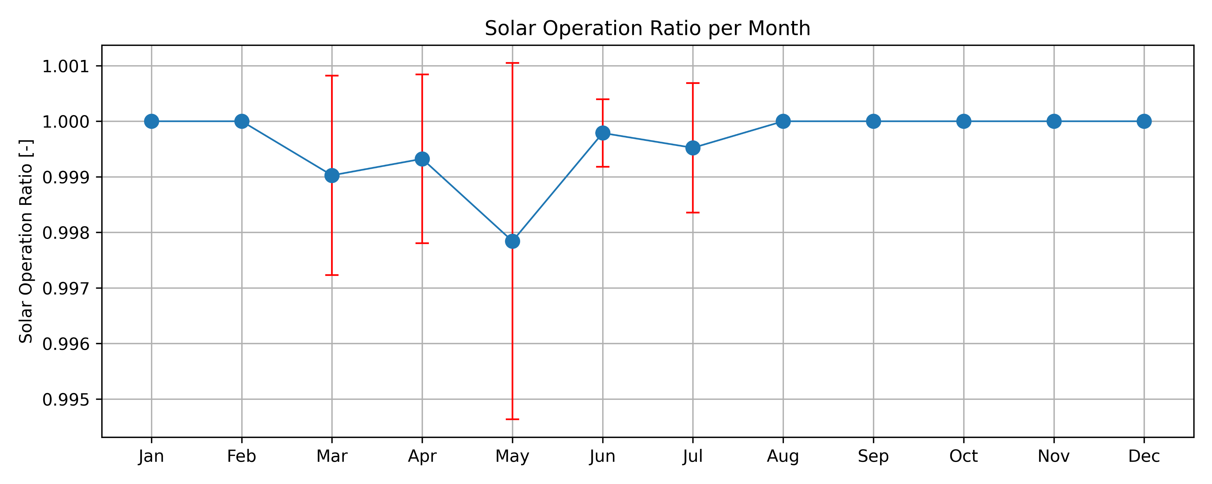
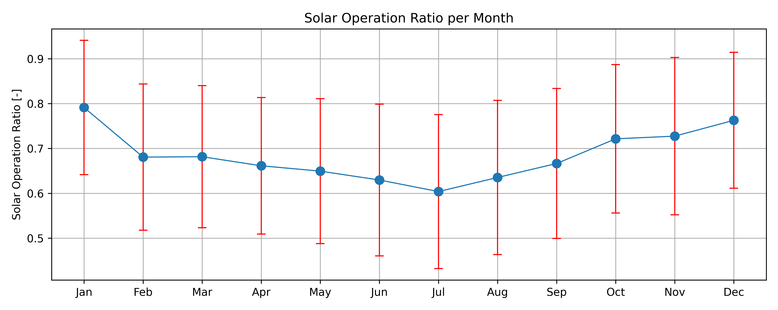
4. Result and analysis Solar Operating Ratio (SOR)
P2P
non-P2P

Slide 43
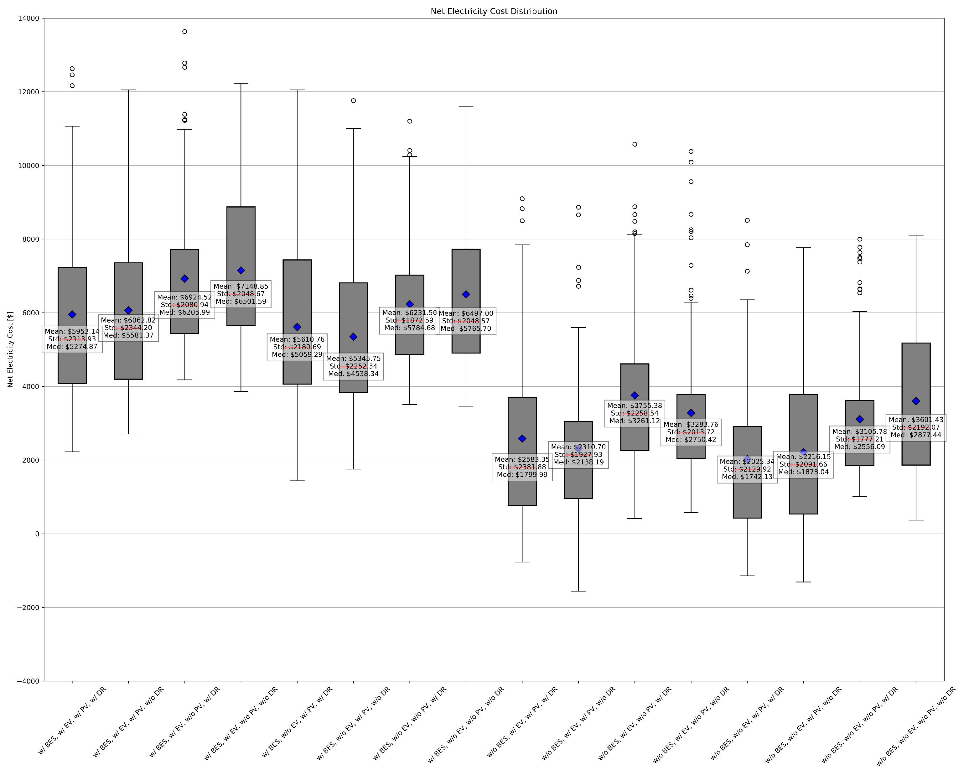
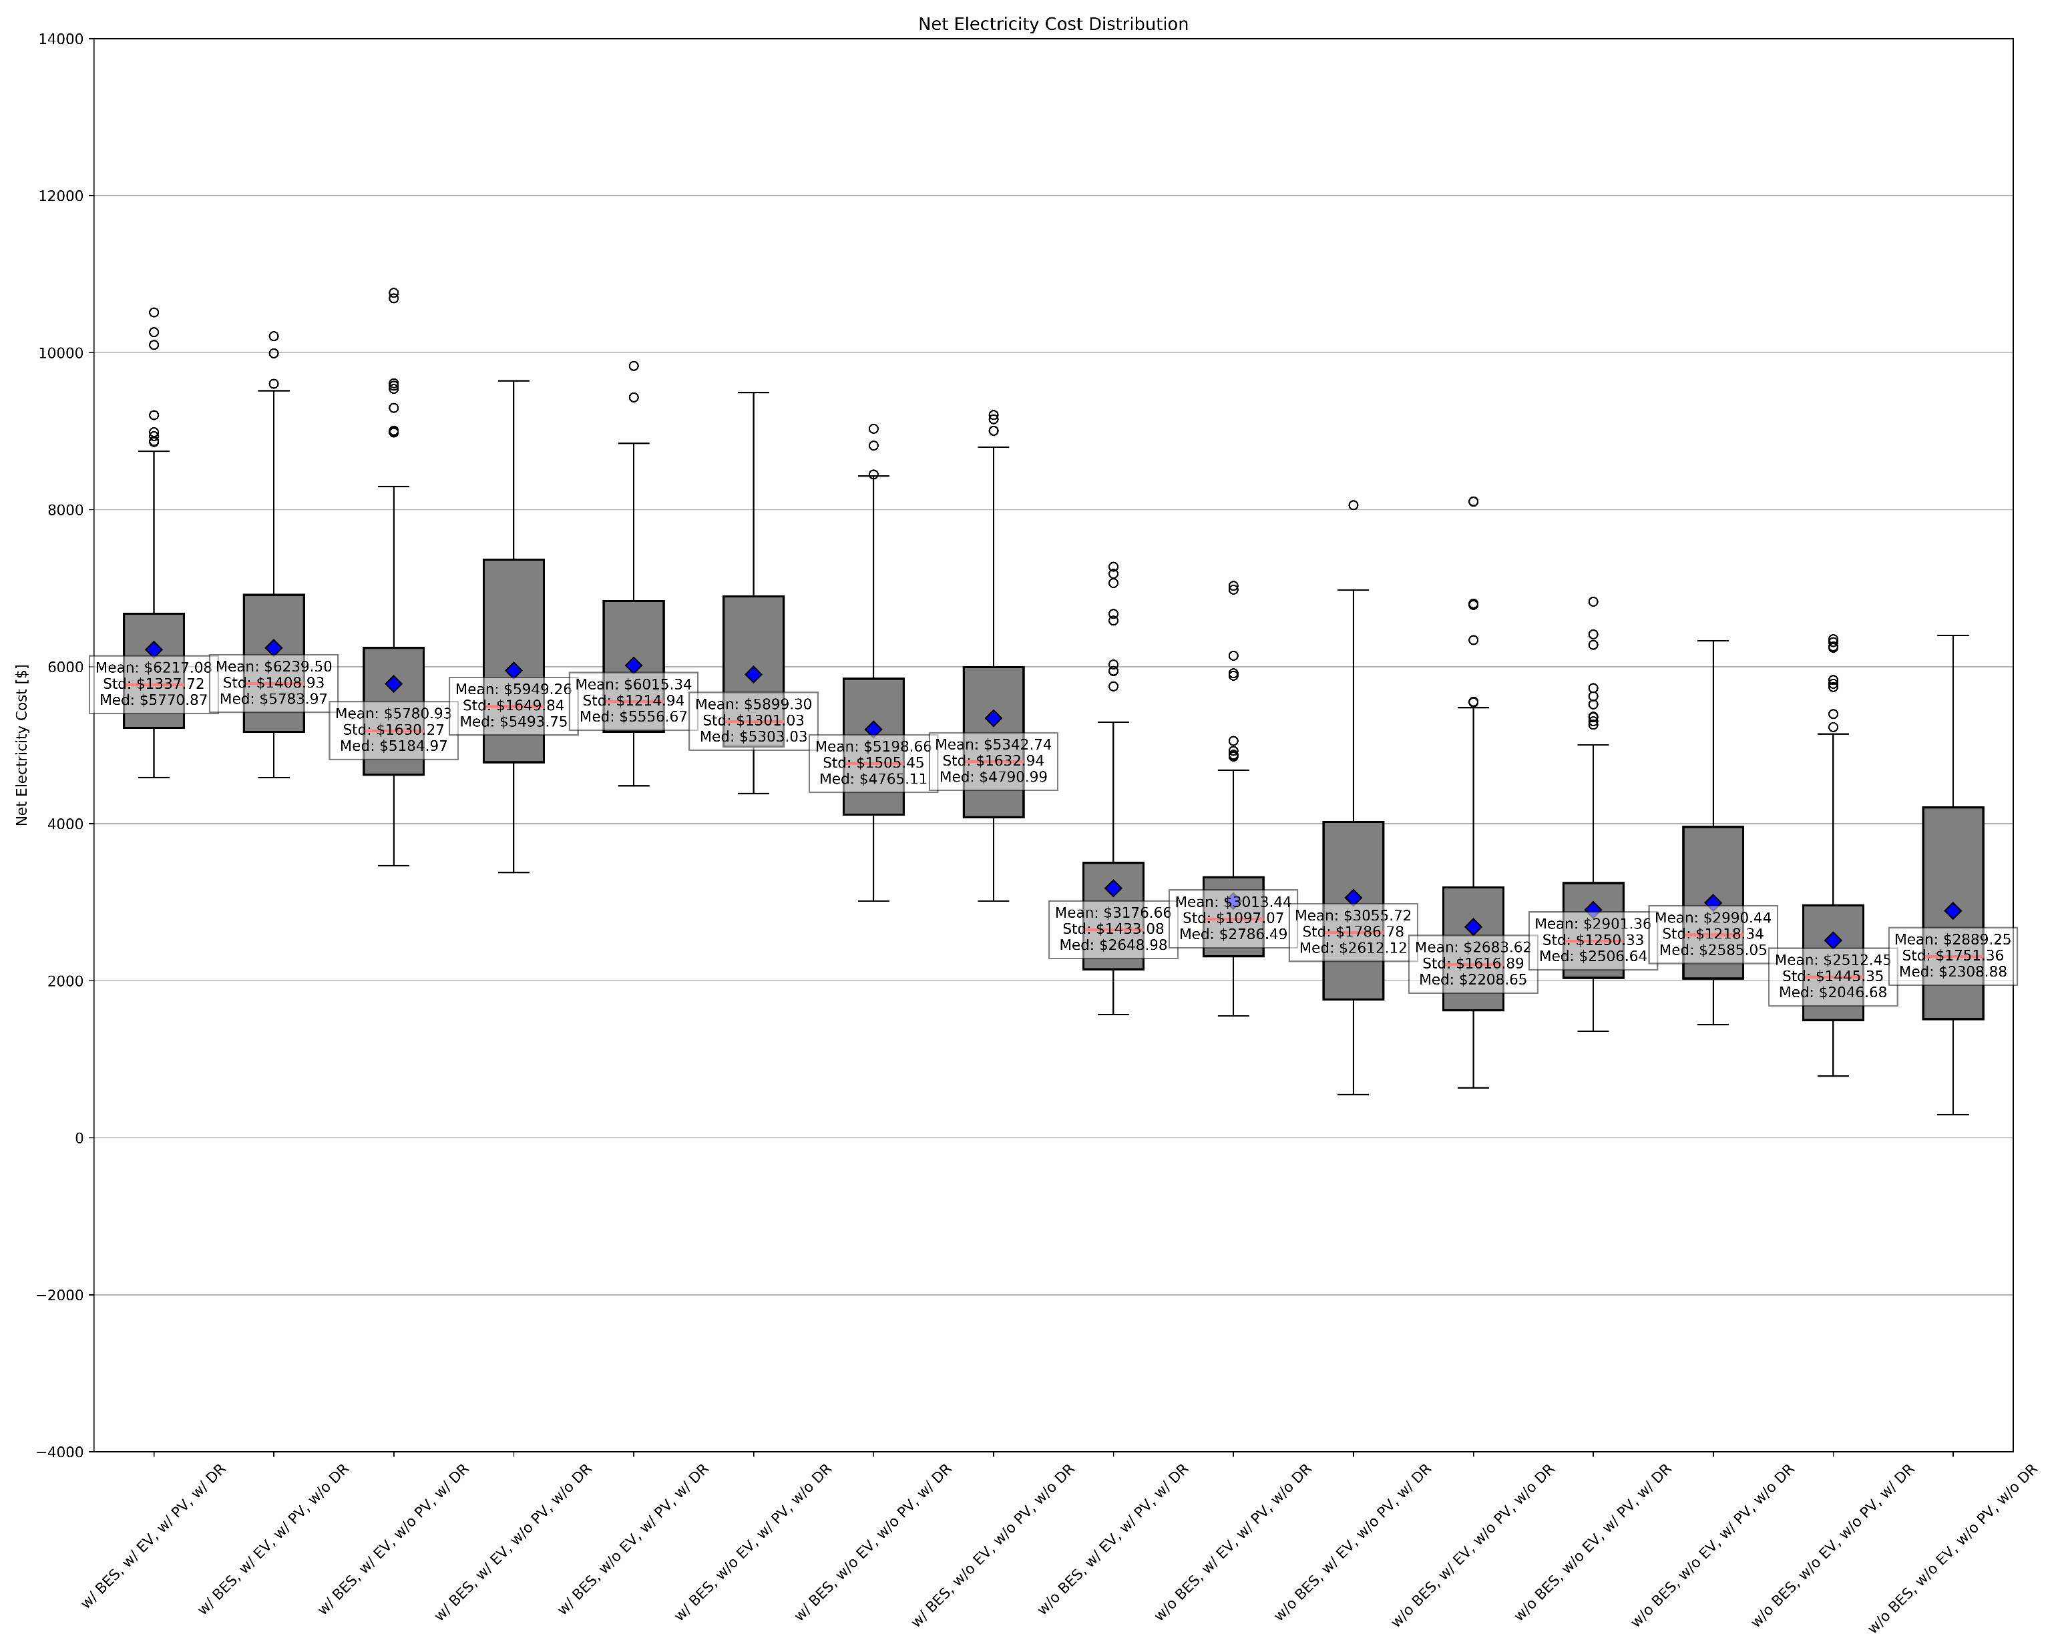
4. Result and analysis Net cost by agent group (CAPEX and OPEX are included)
P2P
non-P2P
Agents with EV reduced total electricity cost in both case. DR mostly works to reduce total electricity cost, except for agents with either battery or EV.

Slide 44
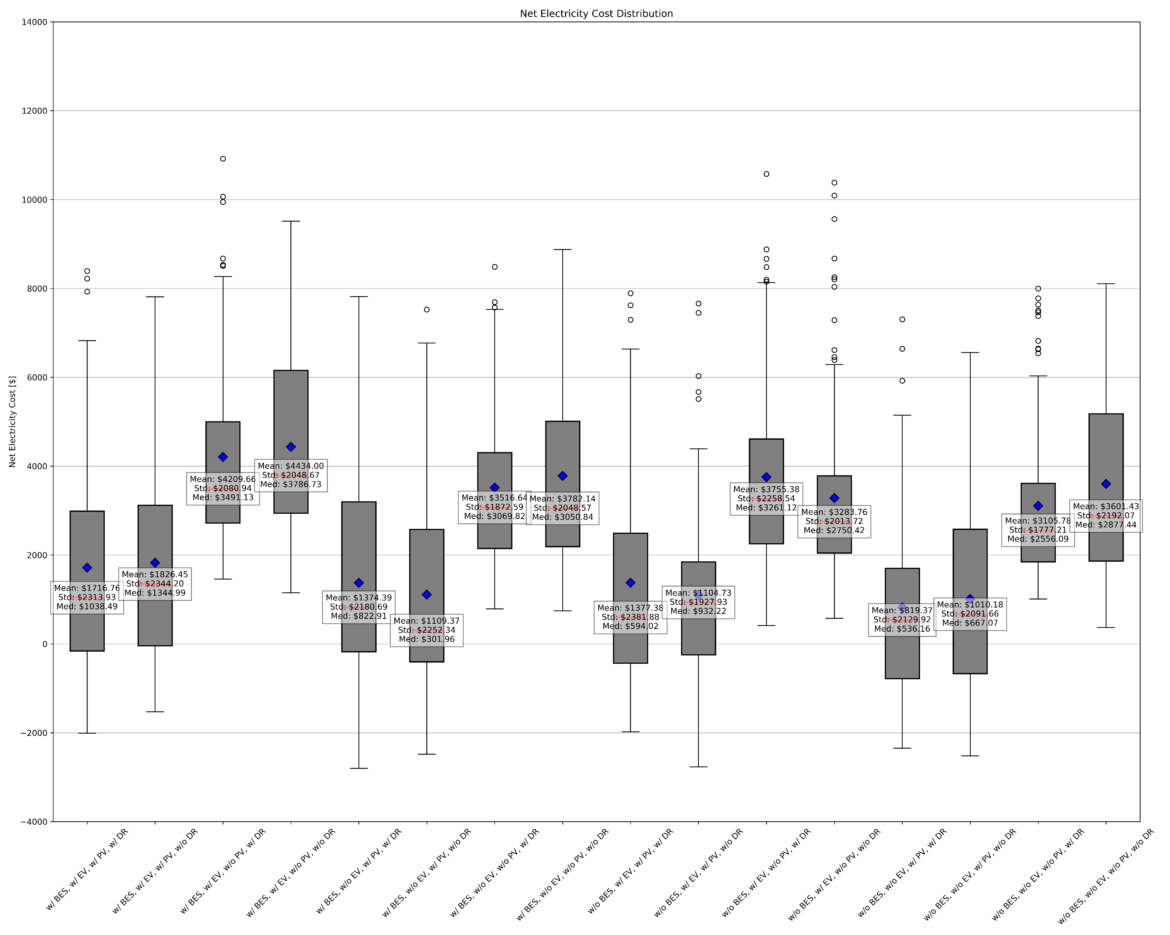
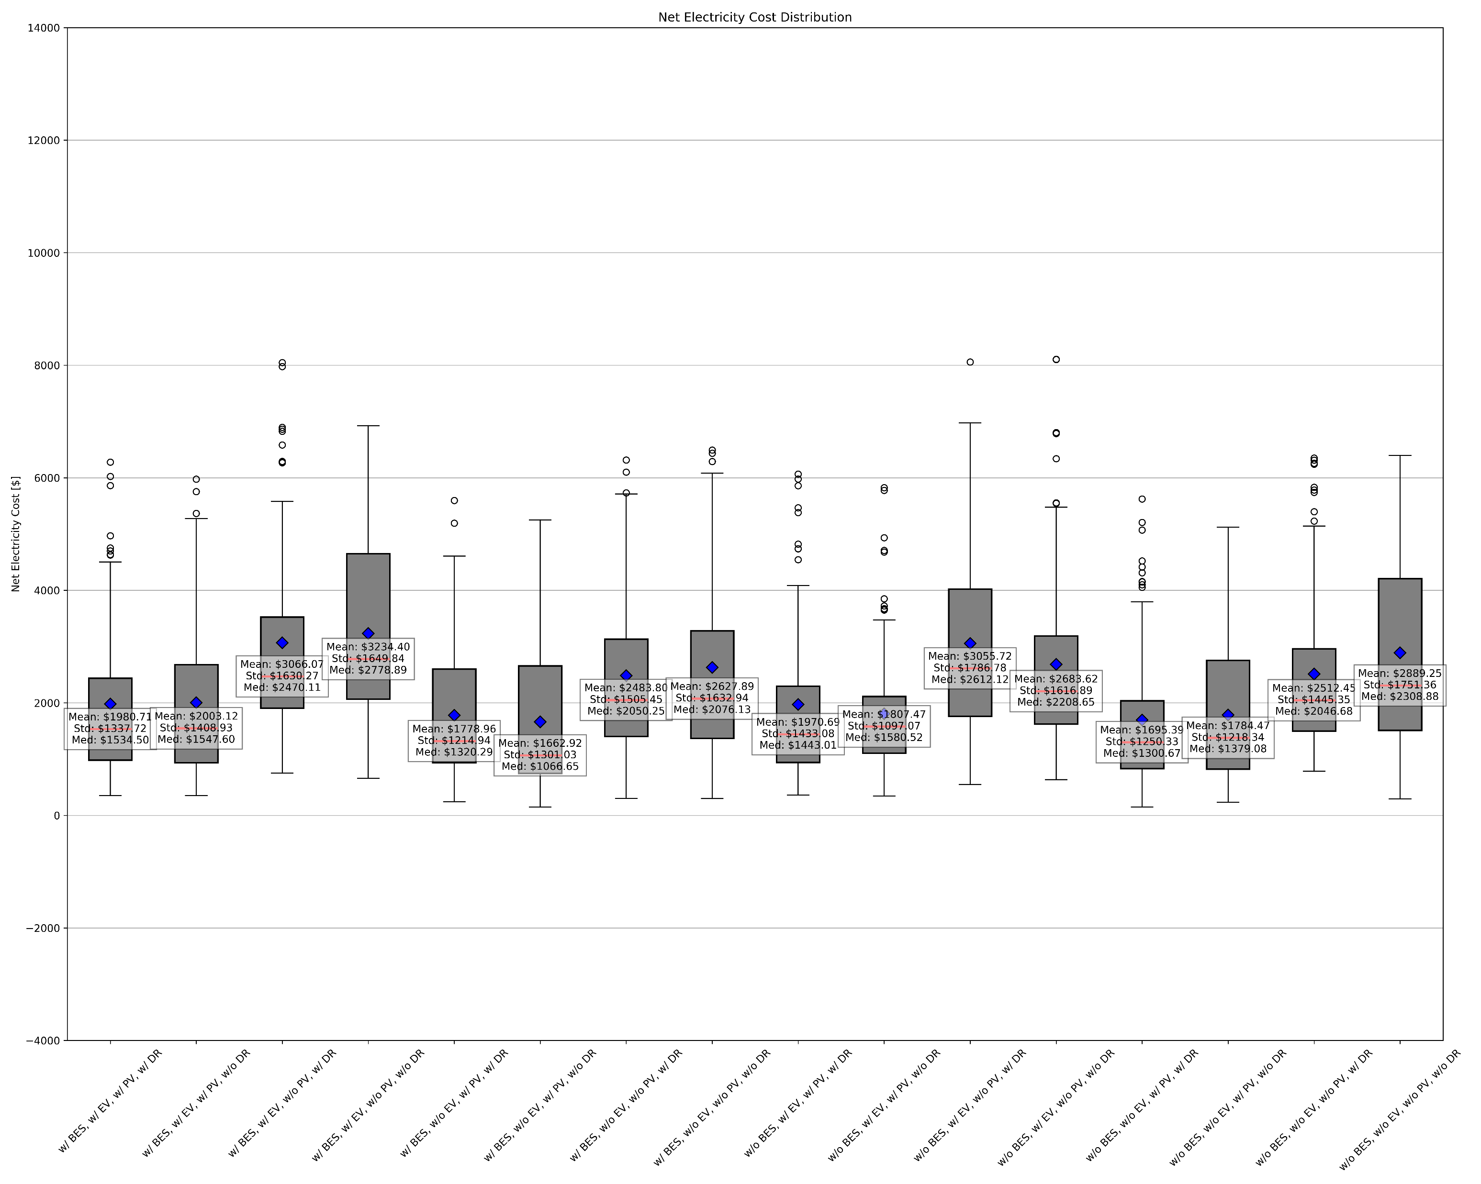
4. Result and analysis Net cost by agent group (CAPEX and OPEX are NOT included)
P2P
non-P2P
Agents with PV reduced total electricity cost by joining P2P community, while agents without PV increased total electricity cost. (← strange…)

Slide 45
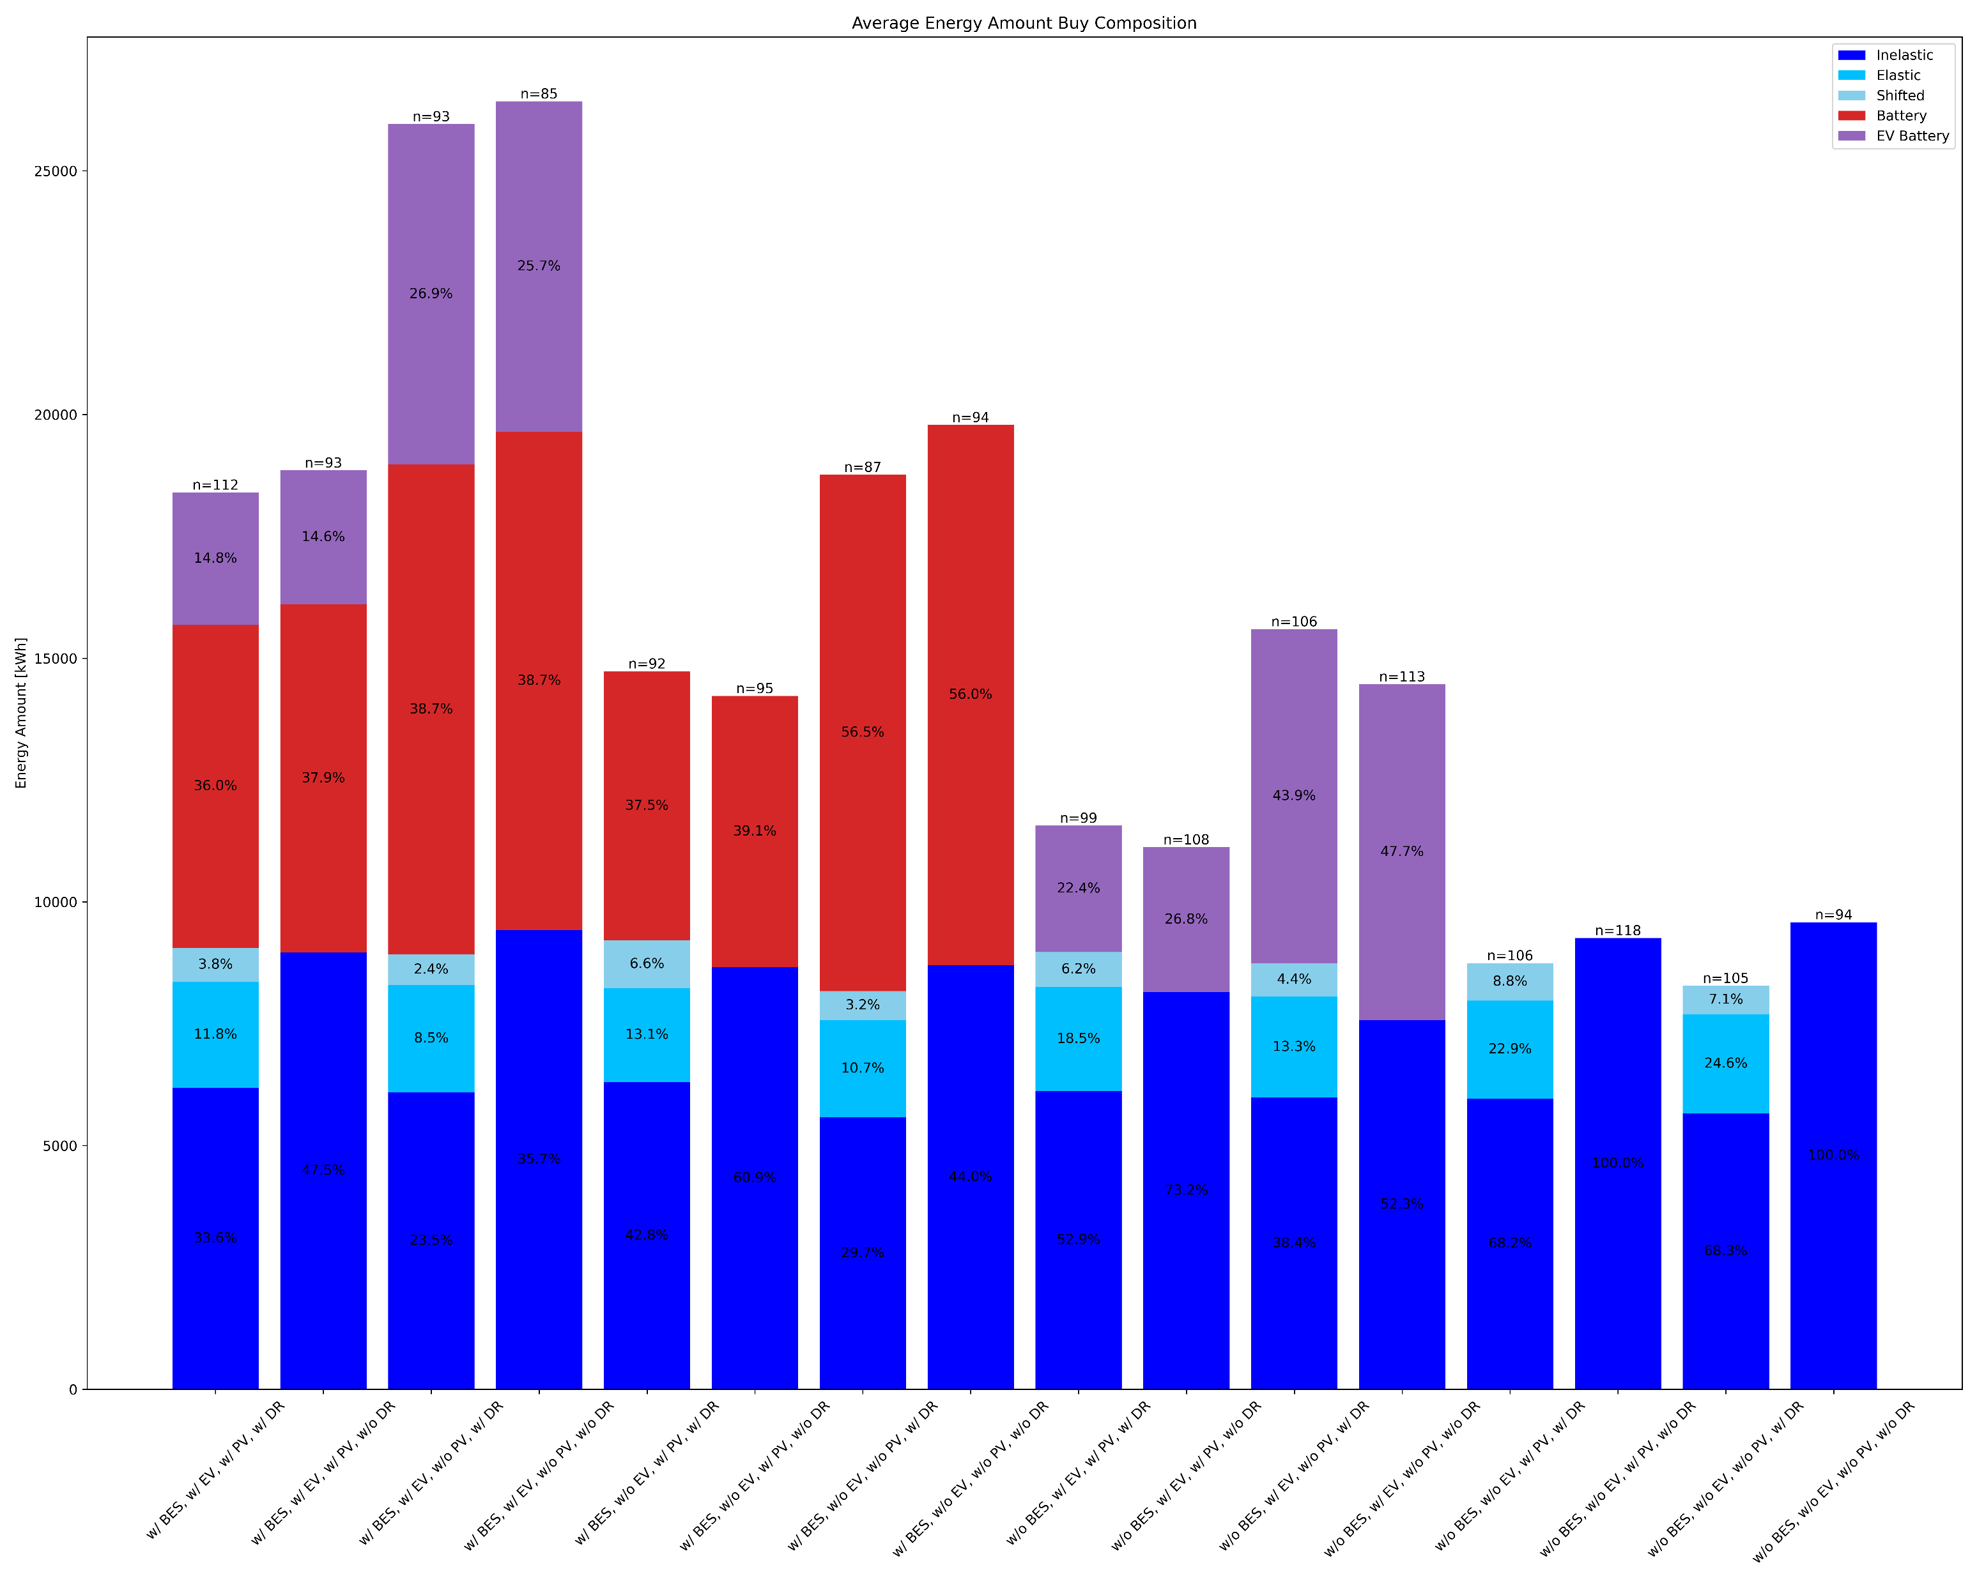
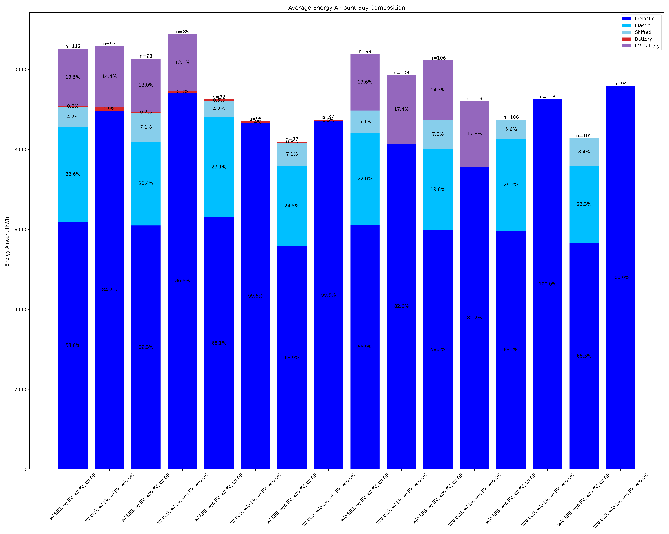
4. Result and analysis Energy amount buy by agent group
P2P
non-P2P
The amount of energy bought seems correct. →Cost calculation maybe wrong…???

Slide 46
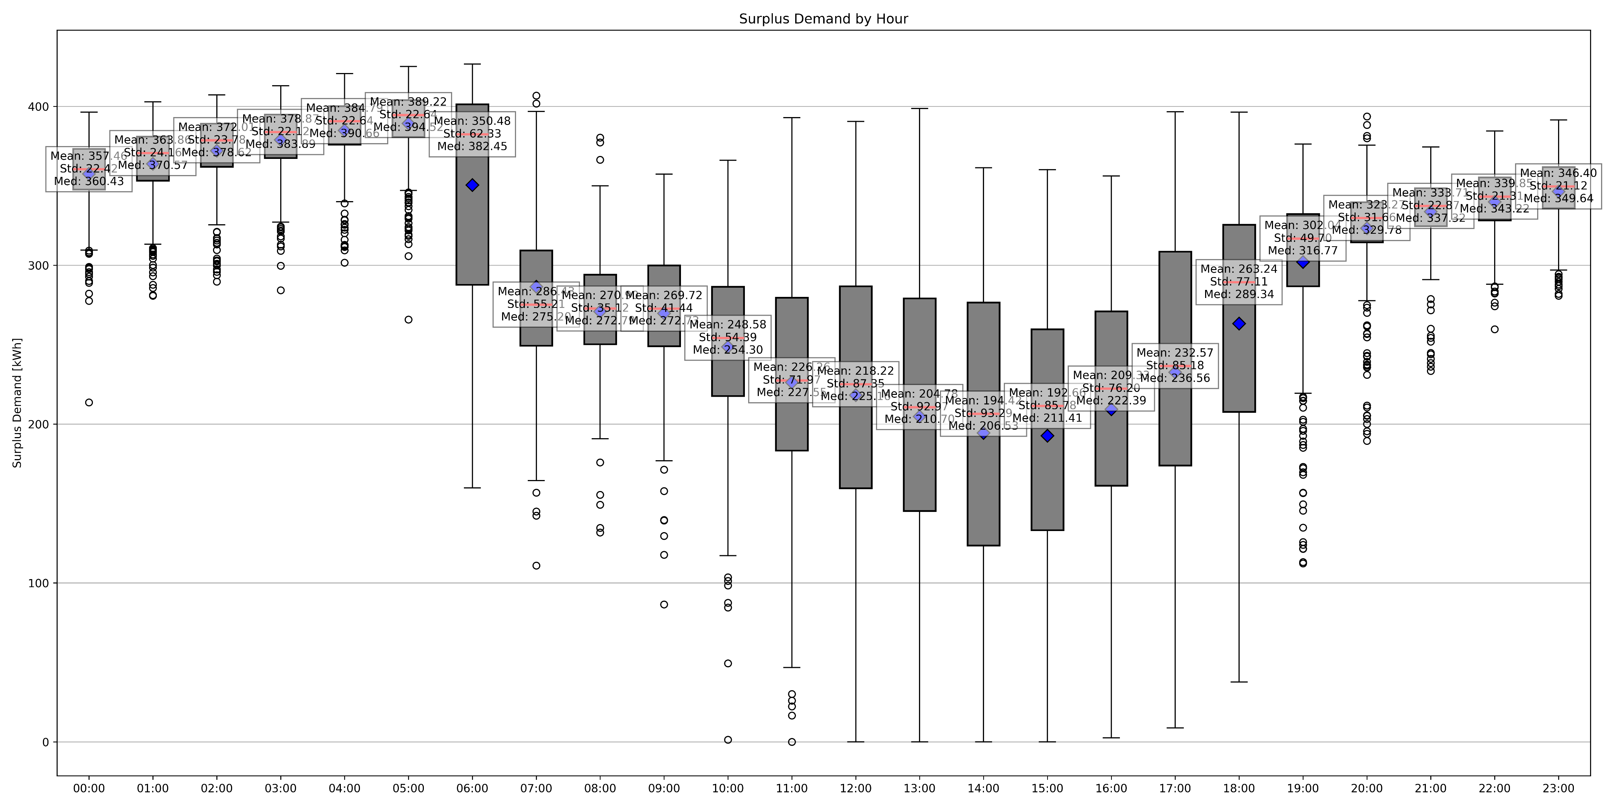
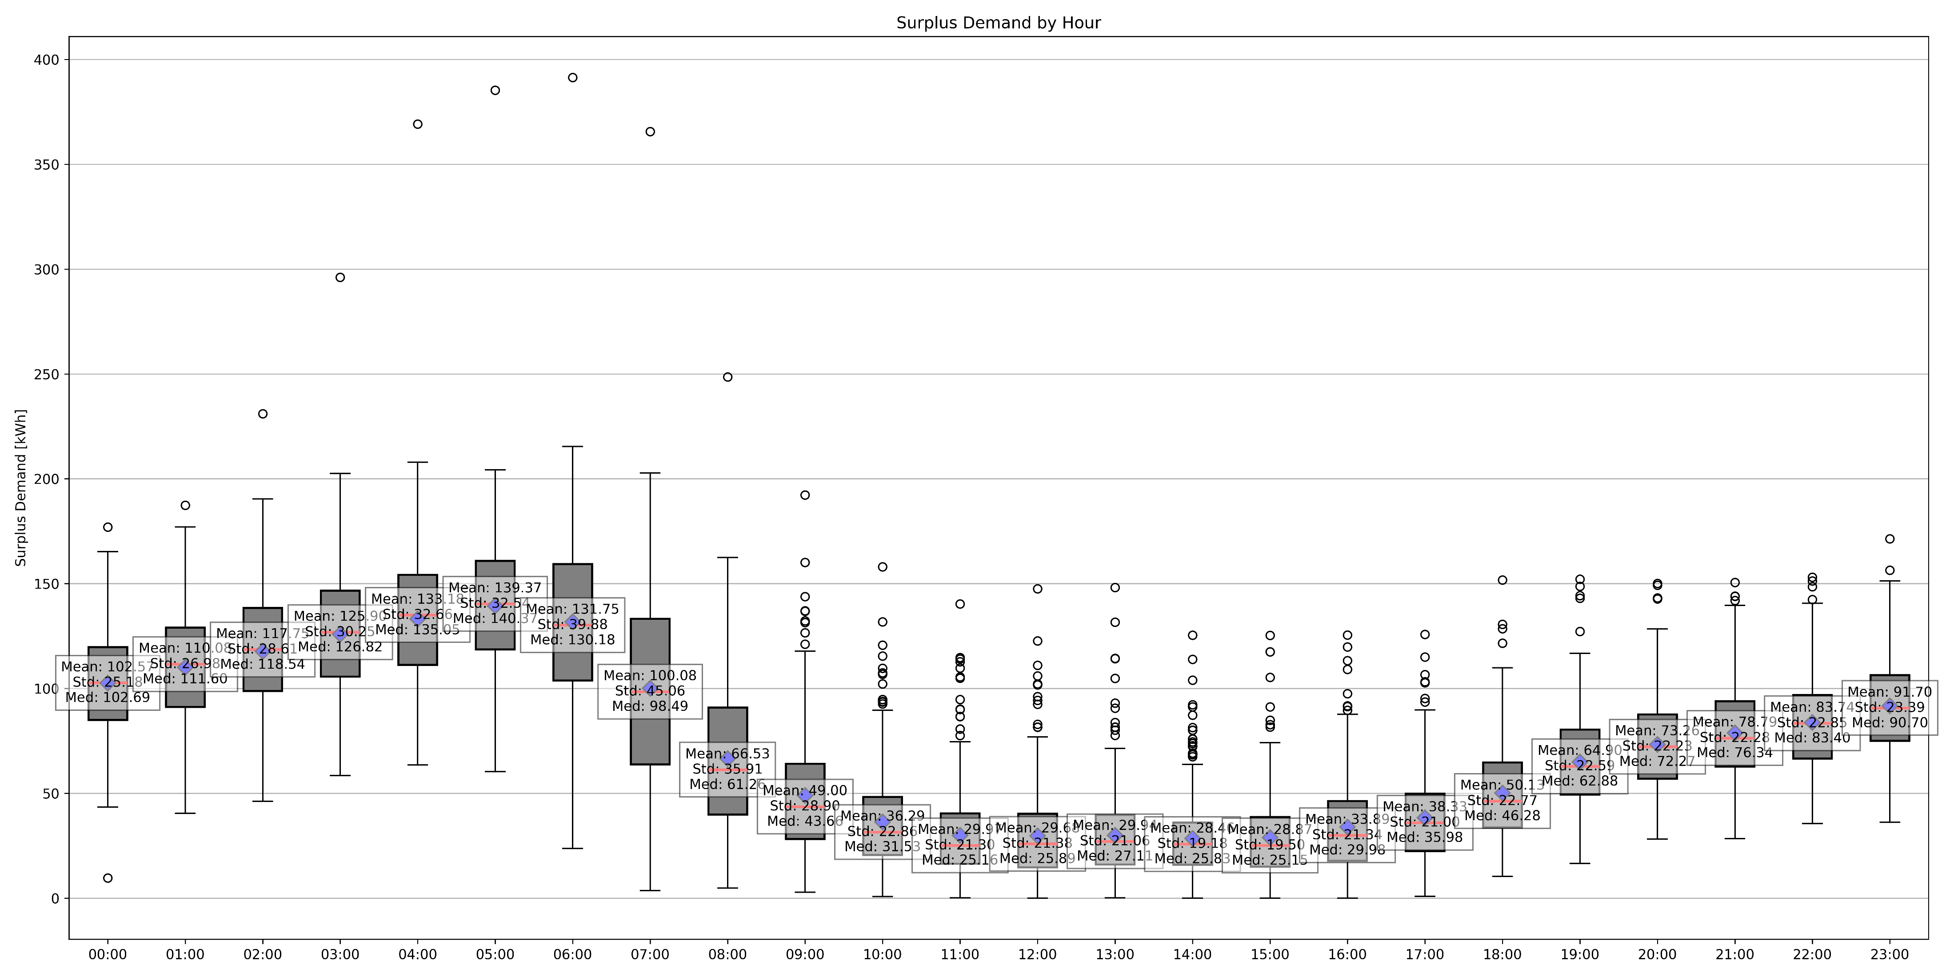
4. Result and analysis Surplus demand (VPP availability)
P2P
non-P2P
P2P increased the availability to consume more energy.

Slide 47
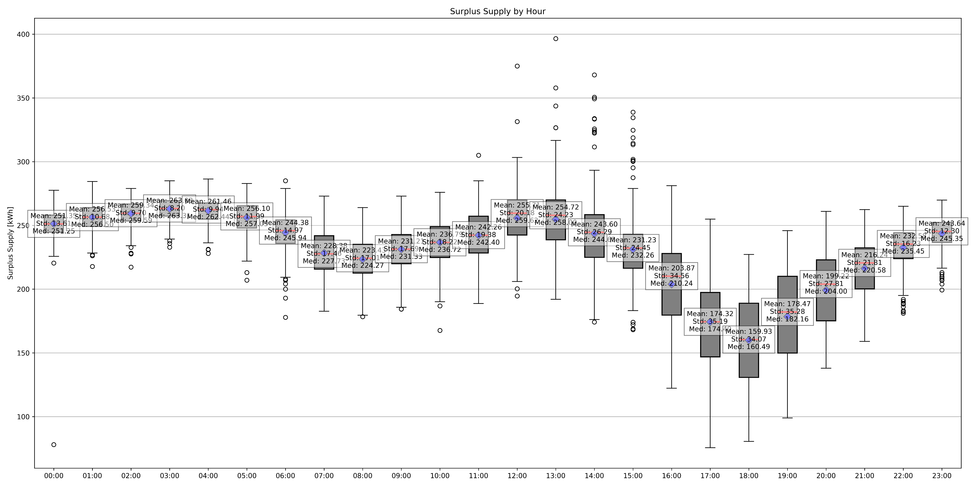
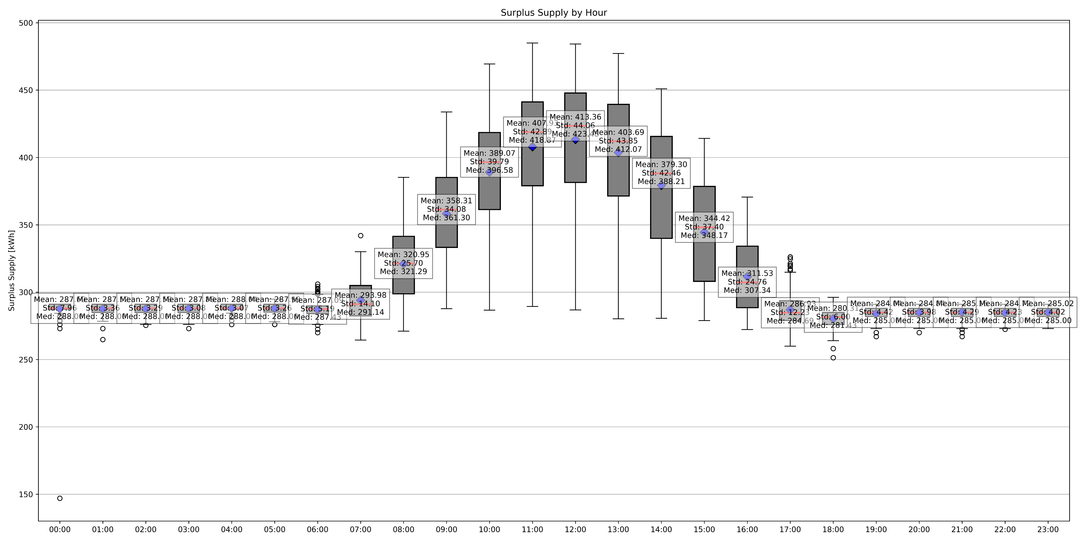
4. Result and analysis Surplus supply (VPP availability)
P2P
non-P2P
P2P has a negative impact on availability to supply more energy especially in evening.

Slide 48
CONTENT
1. Introduction and background
2. Objective
3. Methodology
3.1 Step 1: Data collection
3.1.1 Data (demand, PV supply, wholesale price)
3.1.2 Car usage survey → Car usage data
3.1.3 Technology parameter (battery charge/discharge speed limit, efficiency)
3.2 Step 2: Model construction
3.2.1 Generate agent
3.2.2 Design P2P energy trading model
3.3 Step 3: Train agents
3.3.1 Q table
3.3.2 Reward
4. Results and analysis
5. Summary and future work

Slide 49
Summary and future work
An autonomous decentralized energy system by using bidding is proposed.
P2P energy trade community boosts the utilization of PV panels and increase the energy self sufficiency rate.
EV connection to energy system decrease the total cost of each agent.
Installation of PV decrease the total cost of energy with P2P energy trade.
The best facility combination is to install only PV and do DR.
There is a trade-off in terms of surplus supply availability. P2P increase the energy usage in community⇔decrease surplus supply availability
Future tasks to do:
Update the model: Agents choose facility to maximize their reward.

Slide 50
Summary and future work
Today
2024
Oct.
Nov.
Dec.
Jan.
Feb.
Mar.
Construct a model without P2P trade
Analyze & Compare scenarios
Improve (Buffer)
Write thesis
Write paper
秋合宿
健康診断
予備審査 エネコン前刷
本審査

Slide 51
Appendix

Slide 52
CONTENT
1. Introduction and background
2. Objective
3. Methodology
3.1 Step 1: Data collection
3.1.1 Data (demand, PV supply, wholesale price)
3.1.2 Car usage survey → Car usage data
3.1.3 Technology parameter (battery charge/discharge speed limit, efficiency)
3.2 Step 2: Model construction
3.2.1 Generate agent
3.2.2 Design P2P energy trading model
3.2.3 Design non-P2P energy model
3.3 Step 3: Train agents
3.3.1 Q table
3.3.2 Reward
4. Results and analysis
5. Summary and future work

Slide 53
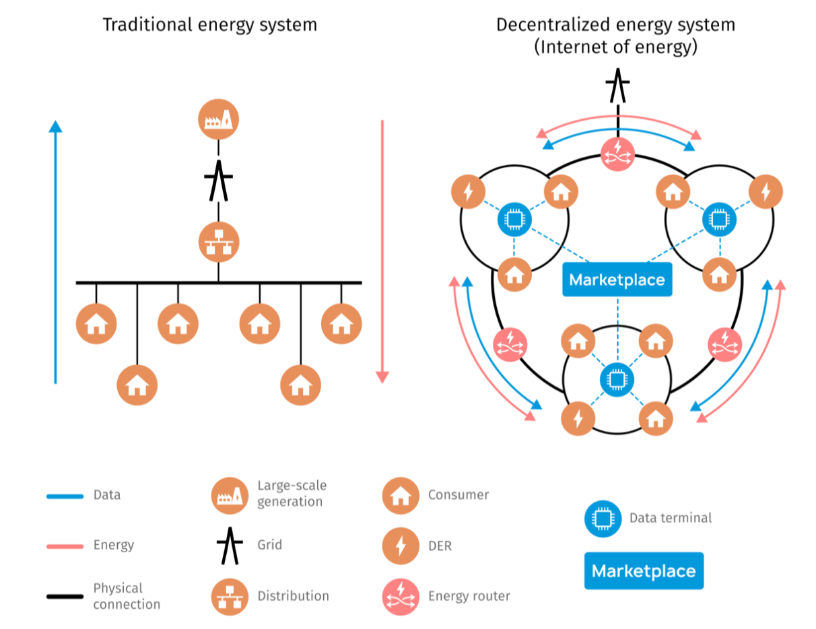
1. Introduction and background
・Increasing need for electricity in consumer’s everyday life, such as electrification of mobility
・Increasing decentralized and intermittent renewable electricity generation
The current system is struggling to deal with these developments, and this leads to higher energy bills, increased investment costs, and more challenges for the DSOs and TSO.[1]
Comparison of the principles of arrangement of centralized and decentralized energy systems [2]
[1] https://www.deloitte.com/nl/en/Industries/energy/blogs/peer-to-peer-energy-trading.html
[2] Chausov, Igor & Burdin, Ilya & Rybushkina, Alena & Ermolaev, Kirill & Kholkin, Dmitry. (2021). Internet of distributed energy architecture. Version 2.0.

Slide 54
背景 電力市場の自由化とP2P電力取引
従来の事業体制
電力システム改革後(2016年～)
各地域の一般電気事業者
(旧)一般電気事業者
発電
送電
配電
小売
発電
送配電
事業者
小売
FIT
発電
事業者
発電
事業者
発電
事業者
法的
分離
←
FIP
卸売電力取引市場 (JEPX)
FIP
小売電気
事業者
小売電気
事業者
小売電気
事業者
供給義務、地域独占
総括原価方式による料金規制
小売電力市場
消費者
FIT
生産
消費者
生産
消費者
生産
消費者
消費者
一般財団法人 新エネルギー財団 電力市場の概要(その1)

Slide 55
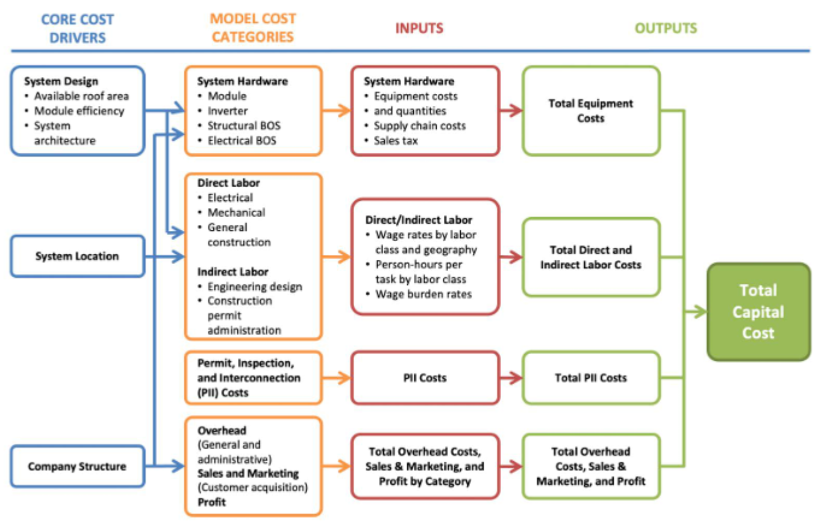
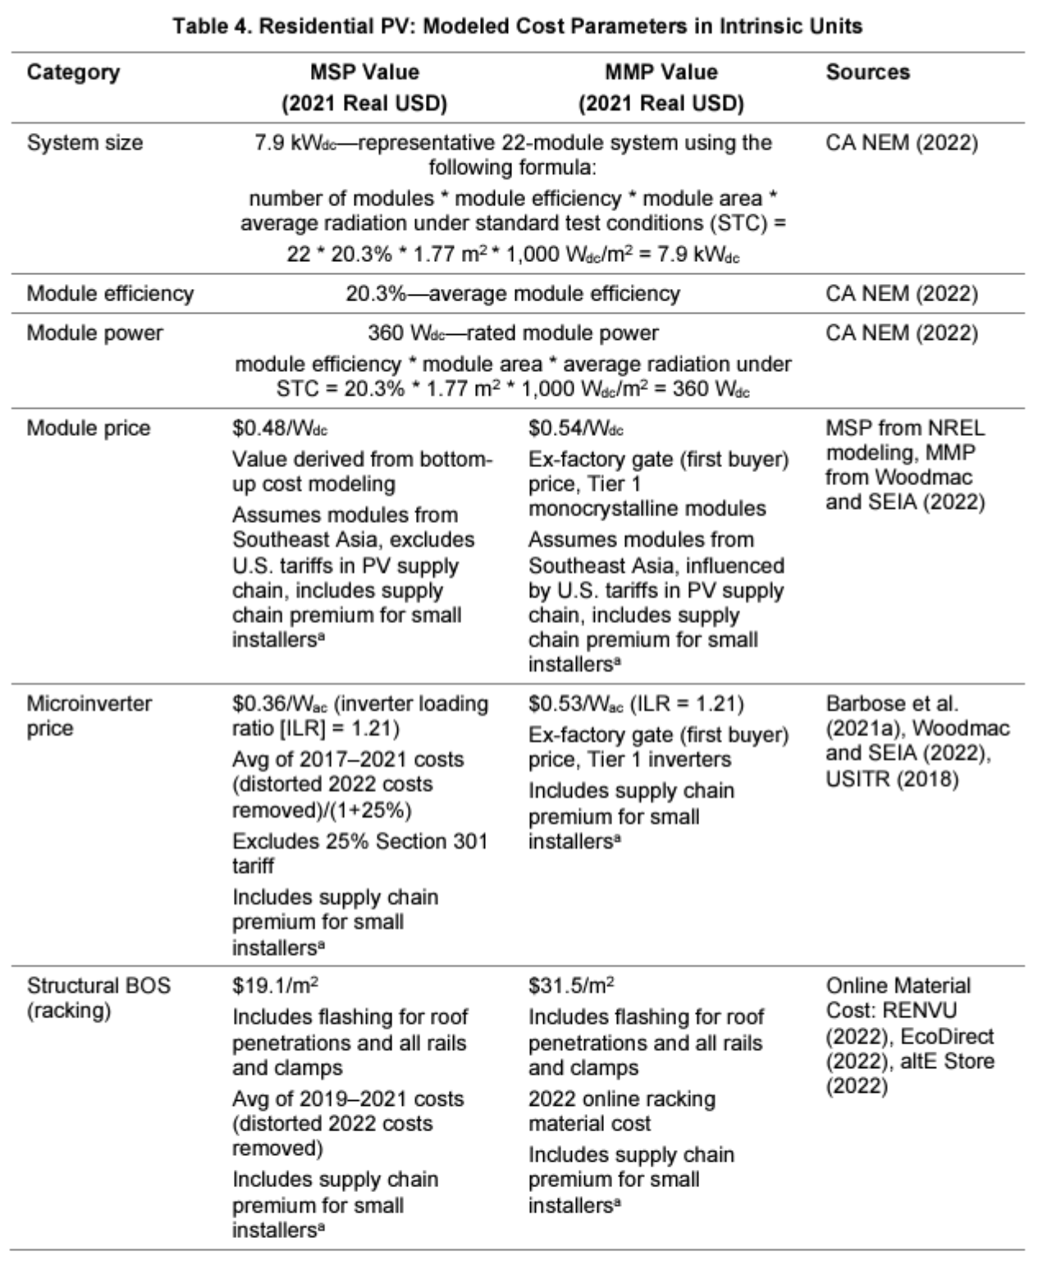


CAPEX of PV
MSP: Minimum Sustainable Price
MMP: Modeled Market Price
MMP model is used in the cost calculation.
CAPEX per year is calculated by Straight Line Method. The statutory useful life of the depreciable assets for PV is 17 years.
[1] https://www.nrel.gov/docs/fy22osti/83586.pdf

Slide 56


OPEX of PV
MMP residential model is used in the cost calculation.
[1] https://www.nrel.gov/docs/fy22osti/83586.pdf

Slide 57



CAPEX of Battery
MSP: Minimum Sustainable Price
MMP: Modeled Market Price
MMP model is used in the cost calculation.
CAPEX per year is calculated by Straight Line Method. The statutory useful life of the depreciable assets for Battery is 6 years.
※OPEX of Battery is not provided in the NREL report.
[1] https://www.nrel.gov/docs/fy22osti/83586.pdf

Slide 58
Previous research
Target variable | Method | Demand response | Battery | EV battery | bids | Year | Ref.
Energy retail price | Reinforcement Learning (Q-learning) | ✓ | - | - | - | 2018 | 1
Energy retail price | Deep Reinforcement Learning (Proximal Policy Optimization) | ✓ | ✓ | - | - | 2024 | 2
Energy retail price | Reinforcement Learning (Q-learning) | ✓ | ✓(Cen-tralized) | - | - | 2021 | 3
Total cost | Mixed-Lnteger Linear Problem | ✓ | ✓ | - | ✓ | 2020 | 4
Cost of each agent | Reinforcement Learning (DA-MADDPG) | - | ✓ | - | ✓ | 2021 | 5
Cost of each agent | Deep Reinforcement Learning (TD3) | - | ✓ | - | ✓ | 2023 | 6
[1] Renzhi Lu, Seung Ho Hong, Xiongfeng Zhang, "A Dynamic pricing demand response algorithm for smart grid: Reinforcement learning approach, " in Applied Energy, Vol. 220, pp. 220-230, 2018, doi: 10.1016/j.apenergy.2018.03.072.
[2] D. Watari, I. Taniguchi and T. Onoye, "Duck Curve Aware Dynamic Pricing and Battery Scheduling Strategy Using Reinforcement Learning," in IEEE Transactions on Smart Grid, Vol. 15(1), pp. 457-471, 2024, doi: 10.1109/TSG.2023.3288355.
[3] Li He, Yuanzhi Liu, Jie Zhang, “Peer-to-peer energy sharing with battery storage: Energy pawn in the smart grid,” in Applied Energy, Vol. 297, 117129, 2021, doi.org/10.1016/j.apenergy.2021.117129.
[4] Suyang Zhou, Fenghua Zou, Zhi Wu, Wei Gu, Qiteng Hong, Campbell Booth, “A smart community energy management scheme considering user dominated demand side response and P2P trading,” in International Journal of Electrical Power & Energy Systems, Vol. 114, 105378, 2020, doi.org/10.1016/j.ijepes.2019.105378.
[5] Qiu D., Wang J., Wang J., Strbac G,“Multi-Agent Reinforcement Learning for Automated Peer-to-Peer Energy Trading in Double-Side Auction Market,” in IJCAI International Joint Conference on Artificial Intelligence, pp. 2913 - 2920, 2021, doi.org/10.24963/ijcai.2021/401
[6] H. Zhang, K. Kok and N. G. Paterakis, "Deep Reinforcement Learning-Based Prosumer Aggregation Bidding Strategy in a Hierarchical Local Electricity Market," 2023 Asia Meeting on Environment and Electrical Engineering (EEE-AM), Hanoi, Vietnam, 2023, pp. 01-06, doi: 10.1109/EEE-AM58328.2023.10395533.

Slide 59

Match frequency in present society (Japan)​
[1] OCCTO電力広域的運営推進機関, (参考資料)需給調整市場について (2019)

Slide 60


Slide 61


