Slide 1

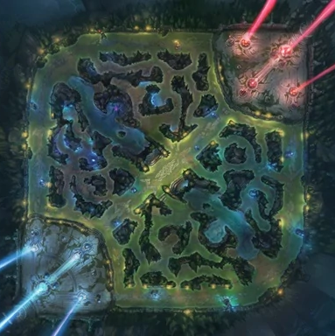
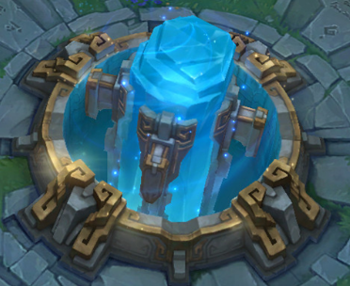
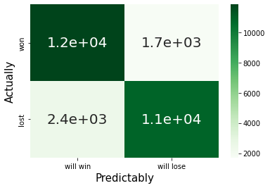
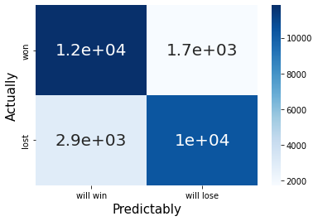
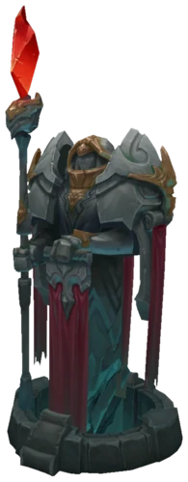
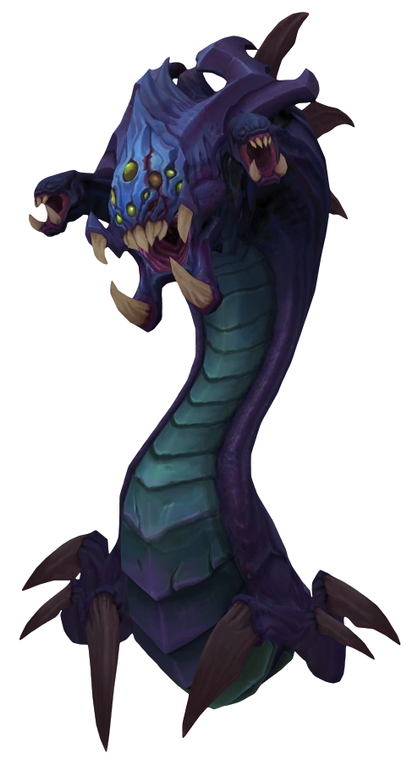
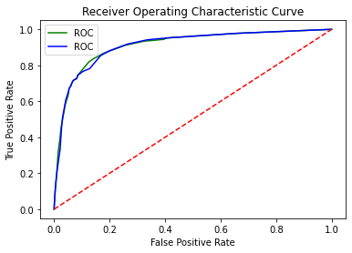
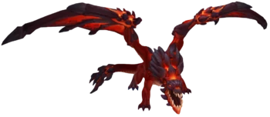

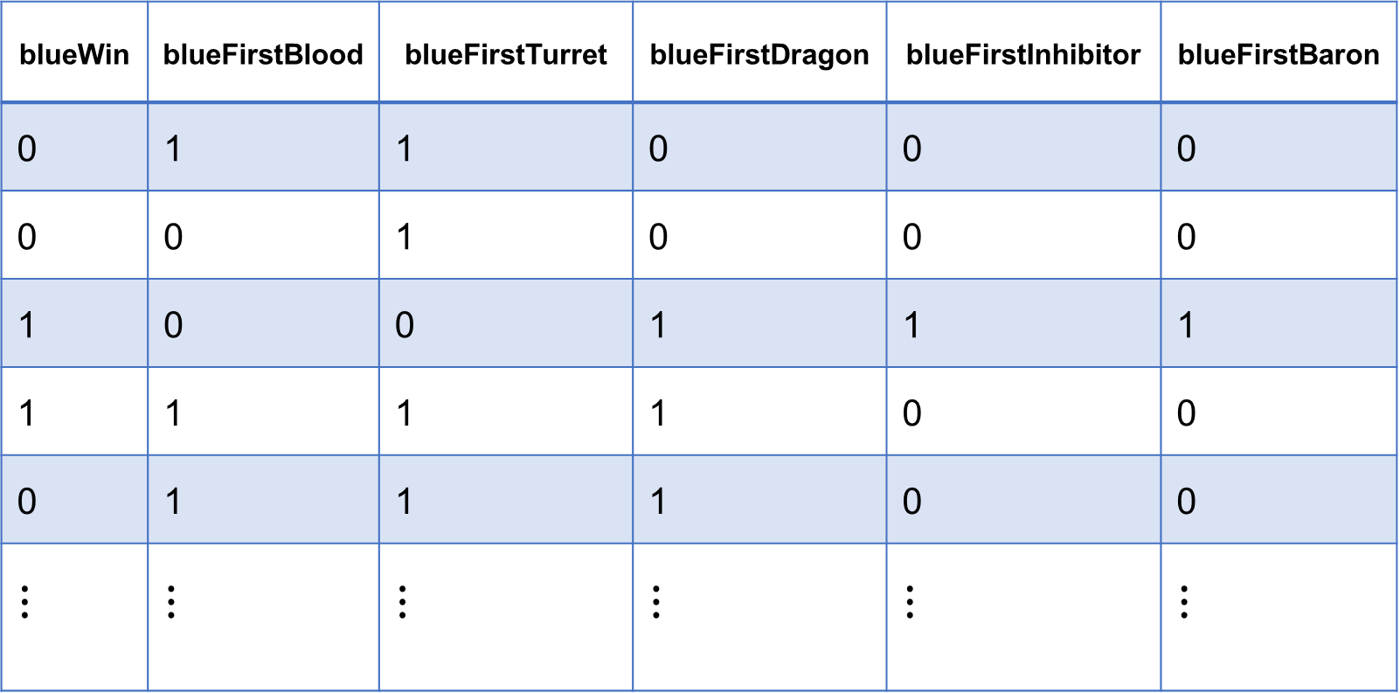
The Impact of First Objects Obtaining on the Win Rate
of League of Legends
Daeil Han
- Dept. of Applied A.I. - dalehan0606@seoultech.ac.kr
▶ ABSTRACT
▶ THE GAME RULES
Accuracy | Precision | Sensitivity | Specificity | F1 Score
0.847 | 0.864 | 0.820 | 0.874 | 0.841
▪ What is the Purpose?
Predicting outcomes of League of Legends games.
▪ What Dataset is Used?
League Of Legends High Elo Ranked Games (2020) from Kaggle.
▪ What are the Methods?
Logistic classification and Naïve Bayse.
▪ What are the Differences?
Analyzed the effects of getting the game objects first.
Tryed to reveal the dependence between features by using two kinds of models.
▪ What are the Conclusions?
The model has fatal flaws.
▪ The Basics
Two teams exist, Blue and Red.
If you destroy your enemy’s Nexus, you win.
The Naïve Bayse:
Accuracy | Precision | Sensitivity | Specificity | F1 Score
0.827 | 0.856 | 0.782 | 0.872 | 0.817
Nexus
▪ The Confusion Matrices
Logistic Classification
Naïve Bayse
▪ What are the Objects in LOL?
There are some objects providing rewards: Turret, dragon, Nashor, etc.
▪ The ROC Curves
Turret
Dragon
Nashor Baron
▶ INTRODUCTION
▶ DATASET
▪ Motivations
The primitive desire of humans to predict the future.
The limited knowledge of the author. (It started from linear regression)
▪ Snowball Effect, the Key to Win
In this game, it is important to get an object first before the opponent team because of the snowball effect.
Therefore, This work concentrated on the effects of getting the game objects first.
Use the dataset of master tier players because of a small variance.
The original dataset has so many features, but this work uses only the following five features.
Use only the blue team's features.
AUC of the L.C. : 0.911
AUC of the N.B. : 0.910
▶ CONCLUTIONS
Fatal flaws have been detected.
Distorted dynamic research into static research.
The winning rate can be predicted only at the end of the game.
Misjudged the features as indepen-dence cases.
Gave up various elements of the game.
blueWin | blueFirstBlood | blueFirstTurret | blueFirstDragon | blueFirstInhibitor | blueFirstBaron
0 | 1 | 1 | 0 | 0 | 0
0 | 0 | 1 | 0 | 0 | 0
1 | 0 | 0 | 1 | 1 | 1
1 | 1 | 1 | 1 | 0 | 0
0 | 1 | 1 | 1 | 0 | 0
$$⋮$$ | $$⋮$$ | $$⋮$$ | $$⋮$$ | $$⋮$$ | $$⋮$$
Win first
Get a reward
▶ METHODS & RESULTS
Win again by
the reward
▪ The Results of the Models
The logistic classification:
▶ REFERENCES
See the final report.
SEOUL NATIONAL UNIVERSITY OF SCIENCE & TECHNOLOGY

