Slide 1
Sudoku Solver
1

Slide 2

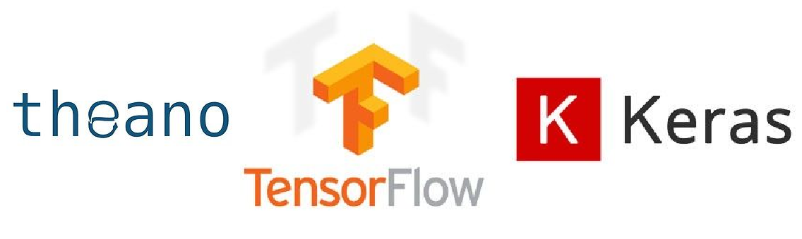
Overview
Fact: Solving Sudoku is fun.
Sudoku has been used as a benchmark for Artificial Intelligent algorithms.
Currently, some can even be solved using Consistency algorithms only without doing any search.
Artificial Neural Network has recently become very powerful.
Neural Network with Python is simpler with powerful packages.
Image from https://makeameme.org
2

Slide 3
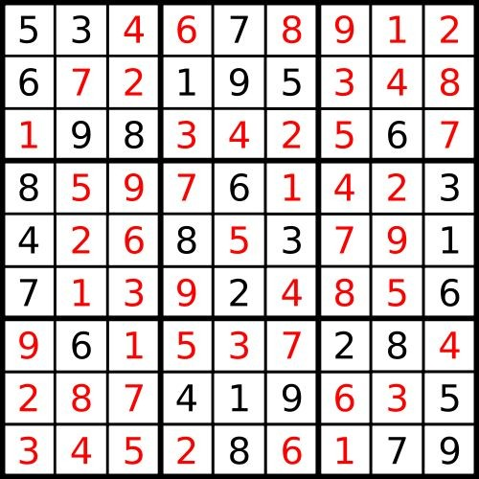
Dataset
1 million Sudoku puzzles from Kaggle https://www.kaggle.com/bryanpark/sudoku
Generated using Sudoku Generation Code from https://www.ocf.berkeley.edu/~arel/sudoku/main.html.
Preprocess:
Read file as string
Split into integer
Reshape
One-hot encoding
“5346789126721953
48198342567869761
42342685379171392
48569615372842874
19635345286179”
5, 3, 4, 6, 7, 8, 9, 1,
2, 6, 7, 2, 1, 9, 5, 3,
4, 8, 1, 9, 8, 3, 4, 2,
5, 6, 7, 8, 6, 9, 7, 6,
1, 4, 2, 3, 4, 2, 6, ...
0
0
1
0
0
0
0 0 0 0 0 0 1 0
0 0 1 0 0 0 0 0
0 0 0 0 0 0 0 0
0 0 0 0 1 0 0 0
0 0 0 0 0 0 0 1
1 0 0 0 0 0 0 0

Slide 4
Process
p₁, p₂, p₃,..., p₉
Dense (9, 9, 64)
Dense (9, 9, 64)
p₁, p₂, p₃,..., p₉
Dropout
Dropout
Flatten
p₁, p₂, p₃,..., p₉
0
0
1
0
0
0
0 0 0 0 0 0 1 0
0 0 1 0 0 0 0 0
Conv. (9, 9, 64)
Conv. (9, 9, 64)
p₁, p₂, p₃,..., p₉
0 0 0 0 0 0 0 0
0 0 0 0 1 0 0 0
0 0 0 0 0 0 0 1
o o o
1 0 0 0 0 0 0 0
Input (9, 9, 10)
p₁, p₂, p₃,..., p₉
ReLU activation function after each Dense/Convolutional layer.
Softmax activation function after the last layers.
Loss function: categorical cross-entropy
Output (81, 1, 9)

Slide 5
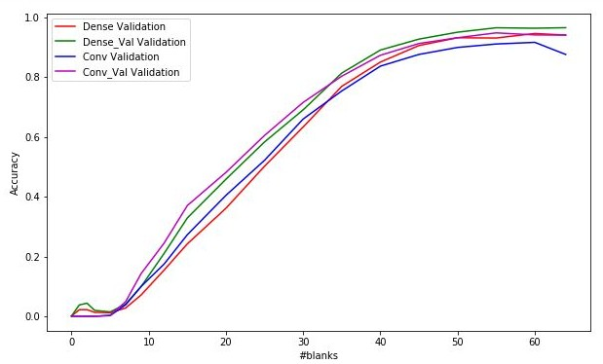
Training/Testing
Training:
50,000 puzzles: 32,000 for training, 8,000 for validating, and 10,000 for temporarily testing
Inspired from https://www.kaggle.com/dithyrambe/neural-nets-as-sudoku-solvers:
Gradually increase #blanks and #epochs in training set
Using the same validation set vs. gradually increase #blanks in validation set
Results
Iterative predict: feed the puzzle through the models, predict the highest probability cell, and repeat
Dense model with increasing #blanks has the best accuracy on validation set.
Accuracy on 10,000 temporary test set and 950,000 hold-out set is ~96.5%.

Slide 6

Conclusion
Additional testing data:
50,000 puzzles with 17 clues^{[1]} from UNL ConsystLab
Highest accuracy among all models is 0.05%.
472 puzzles from UNL Sudoku http://sudoku.unl.edu/SudokuSet/SudokuSetV5/
Highest accuracy among all models is 4.66%.
Solvable puzzles are among the easiest ones.
Problems:
Sudoku solver in C by Bill Dupree at https://github.com/attractivechaos/plb/blob/master/sudoku/incoming/sudoku_solver.c
Puzzle difficulties ranging from Trivial to Easy
More blanks != more difficult
Random deleting does not guarantee unique solution.
[1] McGuire, G., Tugemann, B., & Civario, G. (2014). There is no 16-Clue Sudoku https://arxiv.org/pdf/1201.0749.pdf
Image from https://memegenerator.net
6

