Slide 1
Java Identifiers
Start with a letter, $, or _
Continue with letter, $, _, digit
No limit on length
No Java keywords (language semantics) or reserved words (for use with the language)
Case sensitive
Reference: http://www.jwrider.com/riderist/java/javaidrs.htm
Notes:
Java keywords are language dependent words: int, char, for, while, if, else, private
Java reserved words include keywords plus other off limit identifiers such as goto
Java predefined identifiers: println, String,

Slide 2
Identifier Conventions
Letter as first character
CamelCase
First character is cap
Classes, Abstract Classes
Interfaces
First character is lower case
Class attributes (instance variables)
Method parameters and local variables
Package names

Slide 3
Identifier Conventions
Avoid case sensitive differences in namespace
Avoid abbreviations in naming
i, j, k are typical loop variable names

Slide 4
Strongly Typed
Identifiers declared before used
The value assigned must be the same type or a compatible type
Compiler tests suitability of values in assignments, parameters (type constraints)
Java and C# are strongly typed languages
Python and C are weakly typed languages
Challenging to compile, easy to run

Slide 5
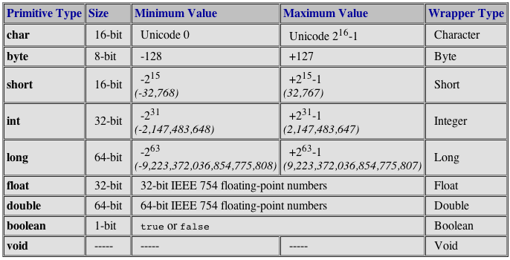
Primitive Types
Notes:
Java is not a purely object oriented language

Slide 6
Primitive Typed Identifiers
Store exactly one value of its declared type at a time
count = 5;
count = 10;
Instance variables all get a default value. 0 for byte, short, int, long, float, double. false for boolean. Null for non-primitive variables
Local variables (primitive and reference) in methods are not initialized by default

Slide 7
Reference Types
If type is not primitive, it is a reference type
Reference types refer to an object
Store location of an object in memory
The location is a memory address
The address is the first byte of an object in the heap
Person peter;
String name;
To get a message to an object use reference variable and method name:
peter.sayHello();
Notes:
Arguments passed to method parameters

Slide 8
Protecting Access to Class Members
Modifier | Class | Package | Subclass | World
public | Y | Y | Y | Y
protected | Y | Y | Y | N
No modifier | Y | Y | N | N
private | Y | N | N | N

Slide 9
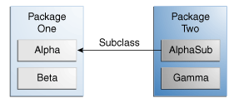
Modifier | Alpha | Beta | AlphaSub | Gamma
public | Y | Y | Y | Y
protected | Y | Y | Y | N
No modifier | Y | Y | N | N
private | Y | N | N | N

Slide 10
Design convention
Use the most restrictive access level that makes sense for a particular member. Use private unless you have a good reason not to.
Avoid public fields except for constants.

Slide 11
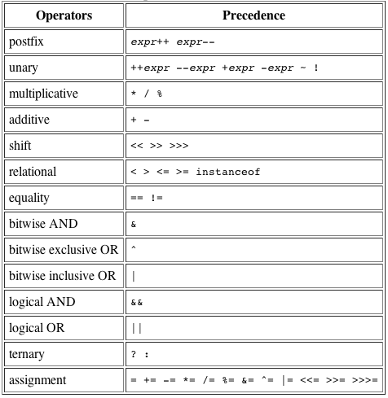
Operators

Slide 12
Argument Promotion and Casting
Changing a value from one type to a compatible type
Promotion – automatic conversion
Casting – programmatic conversion

Slide 13
Argument Promotion
Compiler change the type of a value
Math.sqrt(4);
Math.sqrt expects a float or double
The 4 is promoted from int to double BEFORE the value is passed to the method
A 2.0 is returned
Only applies to primitive types
Follows promotion rules that are compiler enforced

Slide 14
Argument Promotion Rules
boolean – none. Booleans are not promoted
byte – short, int, long, float, double (not char)
short – int, long, float, double (not char)
int - long, float, double
long - float, double
float – double
double – none
char – int, long, float, double (using ASCII code)
Notes:
“A” = 65

Slide 15
Argument Casting
Programmer induced type changes
Required for type changes that may reduce precision
1.82 ➔ 1 (truncation, not rounding)

Slide 16
Argument Casting
float f = 1.89;
// compiler error. 1.89 is a double. f is a float. double to float is an invalid promotion.
Solution 1:
float f = 1.89f; //short cut for primitive float
float f = (float) 1.89; //a cast

Slide 17
Argument Casting
Let A be the superclass of B
A myA; //A is not a B, so only casting is possible
B myB; //B isa A so promotion is possible
Promotion goes up. A a = myB; //a promotion
Casting can do down (B) myA; //a casting

