Slide 1
IoT-Enabled Real-Time Patient Monitoring and Alert System for Intraoperative and Postoperative Care
A Midterm Research and Software Project Proposal
Team Alisher
Babadjanov Alisher (ID 230271)
Scientific Research and Communication · 4-SRC-10-804
Supervisor: Dr. Eugene Castro · October 2026
Notes:
Introduce yourself and the project: a real-time IoT monitoring and alert system for patients during and after surgery. The talk follows the proposal: problem, questions, literature, design, MVP and roadmap.

Slide 2
Introduction and Context
Clinical context
Technology context
The gap
Heart rate, SpO₂ and temperature are monitored continuously during surgery and recovery. Staff cover several patients and are not always at the bedside, so abnormal values must be noticed quickly.
Internet of Medical Things (IoMT): low-cost ESP32 boards, wireless links, MQTT messaging and time-series databases make a working prototype feasible in one semester.
Existing books and reviews describe concepts and architectures. Measured evidence is missing on latency, behaviour under network faults and alert reliability for this scenario.
Our approach: a layered IoT pipeline (ESP32 → MQTT → backend → TimescaleDB → dashboard) built and measured as an MVP this semester.
Notes:
Vital signs are monitored continuously during and after surgery. IoT makes low-cost remote monitoring possible, but most literature is conceptual. The gap is a concrete, measured implementation of the sensor-to-alert pipeline.

Slide 3
The Core Problem and Motivation
RP1
Fragmented data access
RP2
Fragile transmission
RP3
Information overload
Continuous vital-sign data may not be available to medical staff in one remote interface.
Network delays or interruptions can reduce the timeliness of patient monitoring data.
Large data streams are hard to interpret quickly without automated alerts.
Missing capability: an open, measurable IoT pipeline from sensor to alert, evaluated against explicit latency, reliability and detection targets.
Notes:
Three research problems submitted earlier are retained. RP1 data not in one interface, RP2 network delays and interruptions, RP3 data overload without automated alerts. Together they show that the monitoring pipeline is not yet unified, fault-tolerant and self-explanatory.

Slide 4
Research Questions and SMART Objectives
Research question | SMART objective | Target / deadline
RQ1: How can an IoT system collect and display patient vital signs in near real time? | Design and implement the architecture ESP32 → MQTT → backend → database → dashboard for 10+ patients at 1 Hz. | Latency ≤ 2 s (p95) by Week 8
RQ2: To what extent can reliable data handling maintain timely monitoring during interruptions? | Develop QoS 1 delivery, edge buffering and a heartbeat watchdog; verify with 20+ fault-injection trials. | Detection ≤ 5 s; no loss for outages ≤ 60 s (Week 10)
RQ3: How can visualization and threshold alerts improve identification of abnormal readings? | Implement live charts, 24 h history and configurable per-patient thresholds; evaluate on injected events. | Alert ≤ 1 s; ≥ 95% detected (Weeks 10–13)
General objective: design, develop, implement and evaluate an IoT system for real-time remote patient monitoring during intraoperative and postoperative care, including data transmission and alerts.
Notes:
Each research question maps to one measurable objective. Targets: latency under 2 seconds at the 95th percentile, missing data detected within 5 seconds with no loss in outages up to 60 seconds, and alerts within 1 second with at least 95 percent detection of injected events.

Slide 5
Key Insights from the Literature Review
IoMT books and reviews [1]–[7] give architectures and use cases, but are surveys with no measured pipeline.
Source | Limitation / gap | How our project differs
IoMT books [1]–[5] | Overview level; no measured end-to-end pipeline | One concrete, measured pipeline
Reviews [6], [7] | Surveys, no implementation | Applies architecture to a prototype
Naeem et al. [12] | Gateway and SMS alerts; no outage targets reported | Latency, outage and alert targets verified
Krishnapriya & Prema [13] | HR and SpO₂ only; Wi-Fi reliability noted as limit | + temperature, buffering, watchdog, fault tests
AI books [10], [11] | AI-oriented, no IoT messaging design | Rule-based alerts; AI as future work
Kurose & Ross [8]; MQTT [9] | General-purpose theory | Applied to medical monitoring
Prototype studies [12], [13] confirm ESP32 + MQTT/cloud with threshold alerts and about 1–2 s latency.
Outage behaviour and recovery are discussed but not quantified: the gap addressed by RQ2.
Notes:
Seven groups of sources: five Springer books on IoMT, two review articles, two books on AI in healthcare, a networking textbook with the MQTT standard, and two ESP32 prototype studies. Prototype studies show that 1 to 2 second latency is realistic, but outage behaviour is not quantified. That is the gap RQ2 addresses.

Slide 6
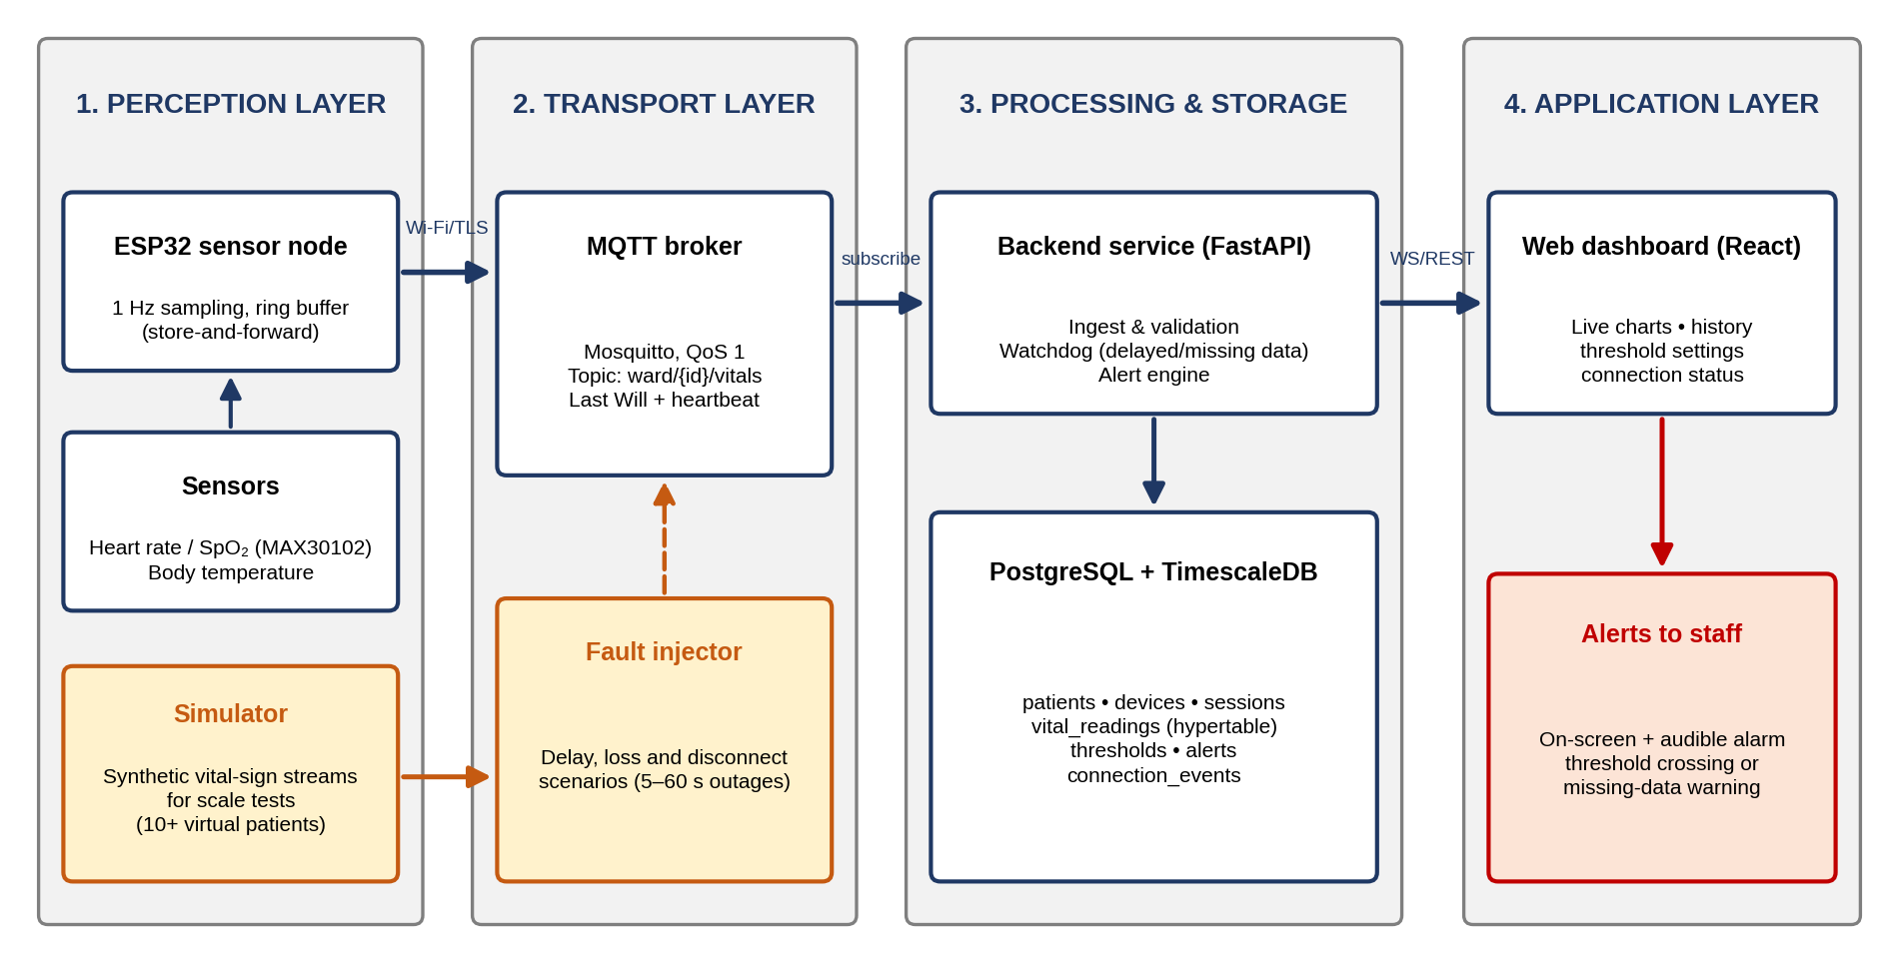
High-Level System Architecture and Component Diagram
Perception: ESP32 + MAX30102 and temperature sensor; simulator for 10+ virtual patients
Transport: Mosquitto MQTT, QoS 1, TLS, heartbeat and Last Will
Processing & storage: FastAPI: validation, watchdog, alert engine; PostgreSQL + TimescaleDB
Application: React dashboard: live charts, history, thresholds, alerts
Style: multi-tier client–server with publish/subscribe messaging; modularity and separation of concerns.
Notes:
Four-layer IoT architecture: perception, transport, processing and storage, application. Sensors or the simulator publish over MQTT with QoS 1 to the broker. The FastAPI backend validates, stores, runs the watchdog and alert engine. The React dashboard shows live data and alerts. A fault injector emulates network problems for evaluation.

Slide 7
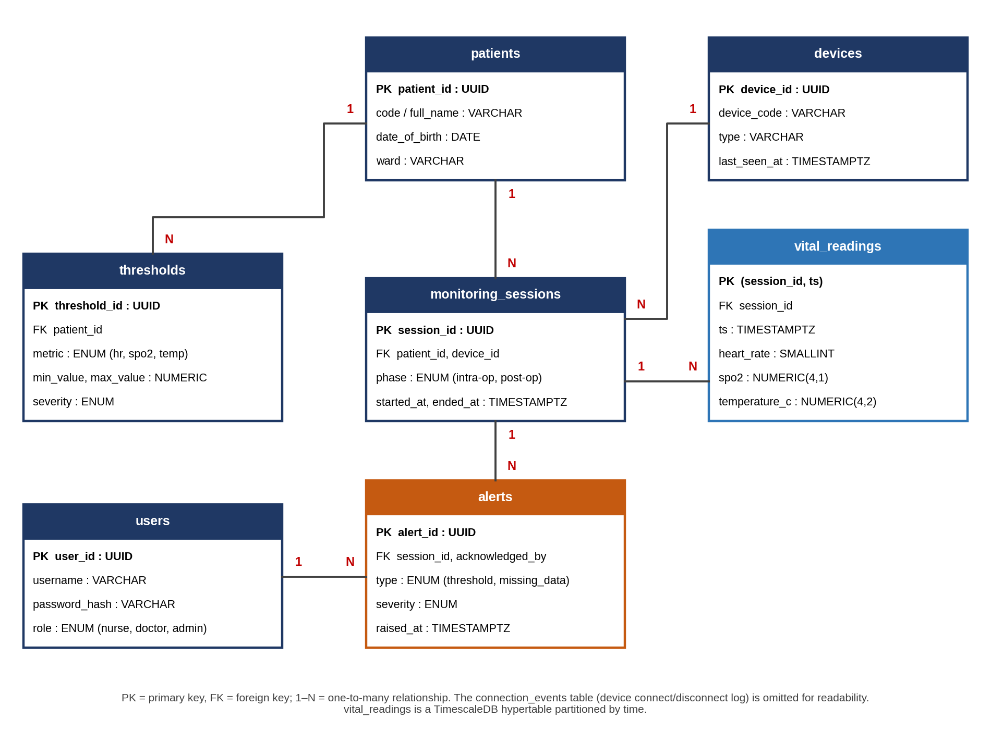
Core Technical Implementation: Database Schema (ERD)
Why PostgreSQL + TimescaleDB
ACID guarantees and constraints for configuration data
Time-partitioned hypertable for 1 Hz readings
One database instead of two engines
Entities
patients, devices, monitoring_sessions, vital_readings, thresholds, alerts, users
Notes:
PostgreSQL with TimescaleDB was chosen: ACID guarantees and joins for patients, devices, thresholds and alerts, plus time partitioning for the vital readings hypertable. Seven entities are linked by foreign keys. The full data dictionary is in the proposal.

Slide 8
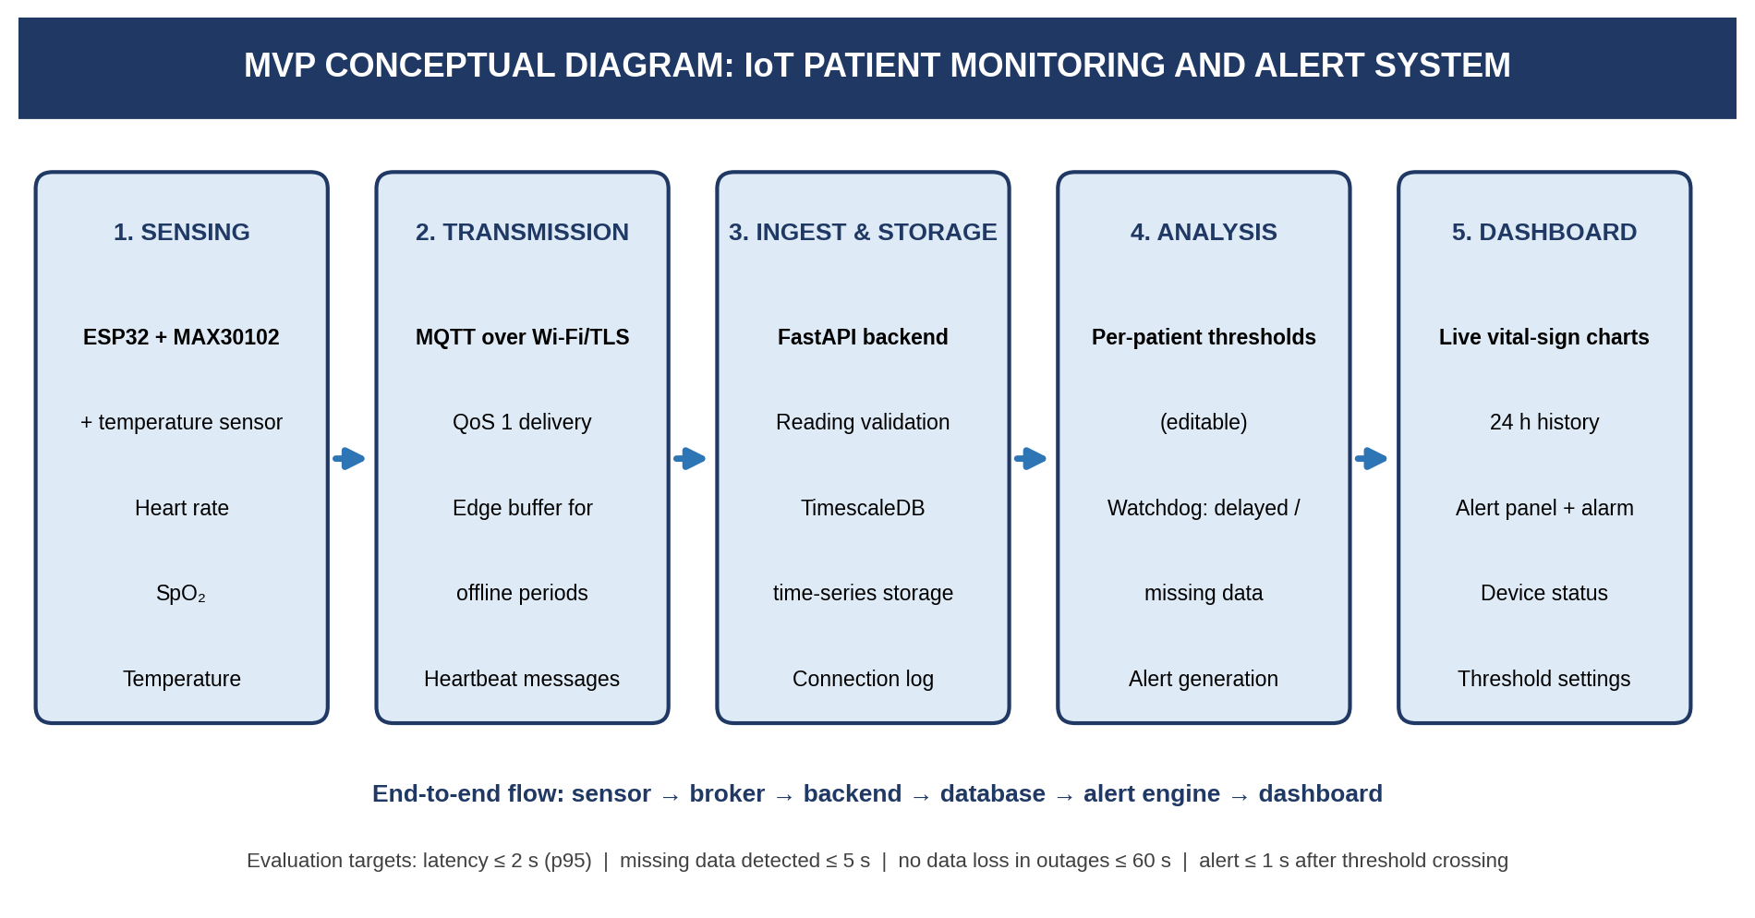
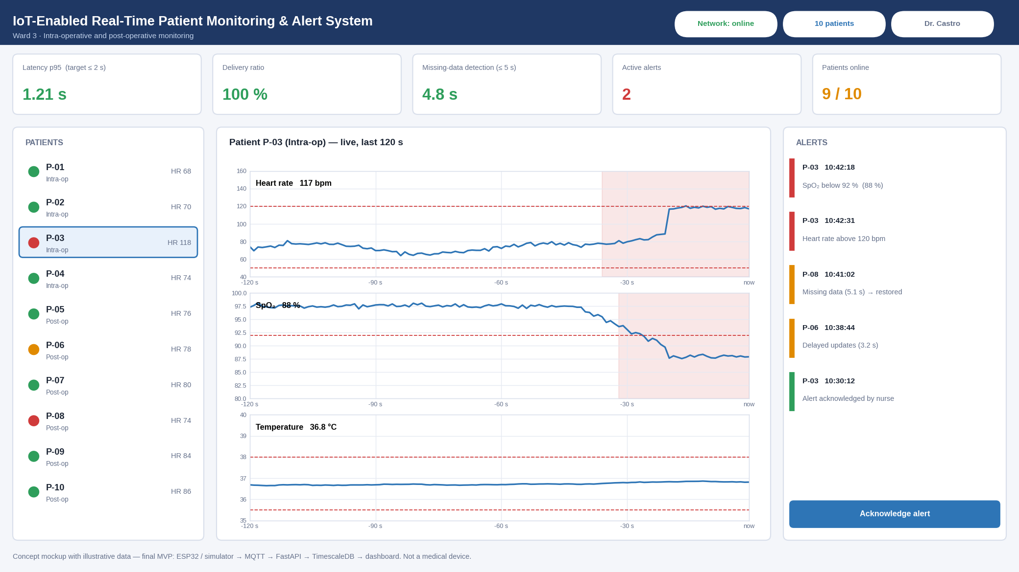
MVP Conceptual Diagram and Dashboard Mockup
Concept mockup, illustrative data
In scope: sensor data acquisition, processing pipeline, live dashboard, edge buffering and watchdog, per-patient thresholds and alerts, 24 h history, evaluation scripts.
Out of scope: ML prediction, hospital-system (EHR) integration, SMS/push notifications, native mobile apps, clinical validation.
Notes:
The MVP is a working end-to-end prototype: sensing, MQTT transmission, ingest and storage, analysis with watchdog and thresholds, and the dashboard. On the right is a concept mockup of the user interface with illustrative data. Out of scope: ML prediction, hospital system integration, SMS or push notifications and native mobile apps.

Slide 9
Semester Implementation Roadmap and MVP Milestones
Weeks | Target deliverable / milestone | Responsible
1–3 | Requirements, architecture, environment (Git, Docker Compose), sensor bring-up, literature review | Babadjanov Alisher
4–6 | Backend API, database schema, firmware and simulator, first end-to-end data flow | Babadjanov Alisher
7–8 | Edge buffering, watchdog, threshold engine → Objective 1 (latency ≤ 2 s) | Babadjanov Alisher
9–10 | Full dashboard, integration, functional testing → Objectives 2 and 3 implemented | Babadjanov Alisher
11–12 | Fault-injection campaign, load test (10+ patients), bug fixing, security checks | Babadjanov Alisher
13 | Research evaluation: metrics, analysis, answers to RQ1–RQ3 | Babadjanov Alisher
14 | Final documentation, report, demonstration and presentation | Babadjanov Alisher
Notes:
Agile Scrum with seven two-week sprints over 14 weeks. Objective 1 is reached in Week 8, Objectives 2 and 3 are implemented by Week 10, fault-injection testing happens in Weeks 11 and 12, evaluation of the research questions in Week 13 and final documentation and presentation in Week 14.

Slide 10
Conclusion, Expected Contribution and Q&A
MVP outcome
Expected contribution
Next steps
Working end-to-end prototype: sensor or simulator → MQTT → backend → TimescaleDB → dashboard with alerts.
Open, reproducible pipeline with measured latency, outage recovery and alert performance.
Build the stack in Weeks 1–8, evaluate with fault injection in Weeks 11–13, report in Week 14.
Thank you – Questions?
Notes:
To conclude: the project turns three clearly defined problems into measurable objectives and a feasible MVP. Expected contribution is an open, reproducible monitoring pipeline with measured latency and reliability. Thank the audience and invite questions.

