Slide 1
Anaconda 2022-2023 DEE
Beta V0.1.0, visual diff test
Bart Gerritsen, EWI, Jul 25, 2022

Slide 2
Configuration details
Anaconda 2022.05 (Python 3.9.12)
Full device name TUD209295.tudelft.net
Processor Intel(R) Core(TM) i5-6500 CPU @ 3.20GHz 3.19 GHz
Installed RAM 8.00 GB (7.89 GB usable)
Device ID 38835649-E06E-435E-9B78-B43FC08ACB20
Product ID 00329-00000-00003-AA330
System type 64-bit operating system, x64-based processor
Edition Windows 10 Enterprise
Version 21H2
Installed on ‎5/‎20/‎2022
OS build 19044.1826
Experience Windows Feature Experience Pack 120.2212.4180.0

Slide 3
Diff images
Diff;
Objective specifications (left)
As-is version V0.1.0 July 2022 (right)
on next images.
Check out comments and annotations of next pages, for details;
In the PowerPoint Review tab, select ShowMarkup
Check out all comments (17 comments)

Slide 4
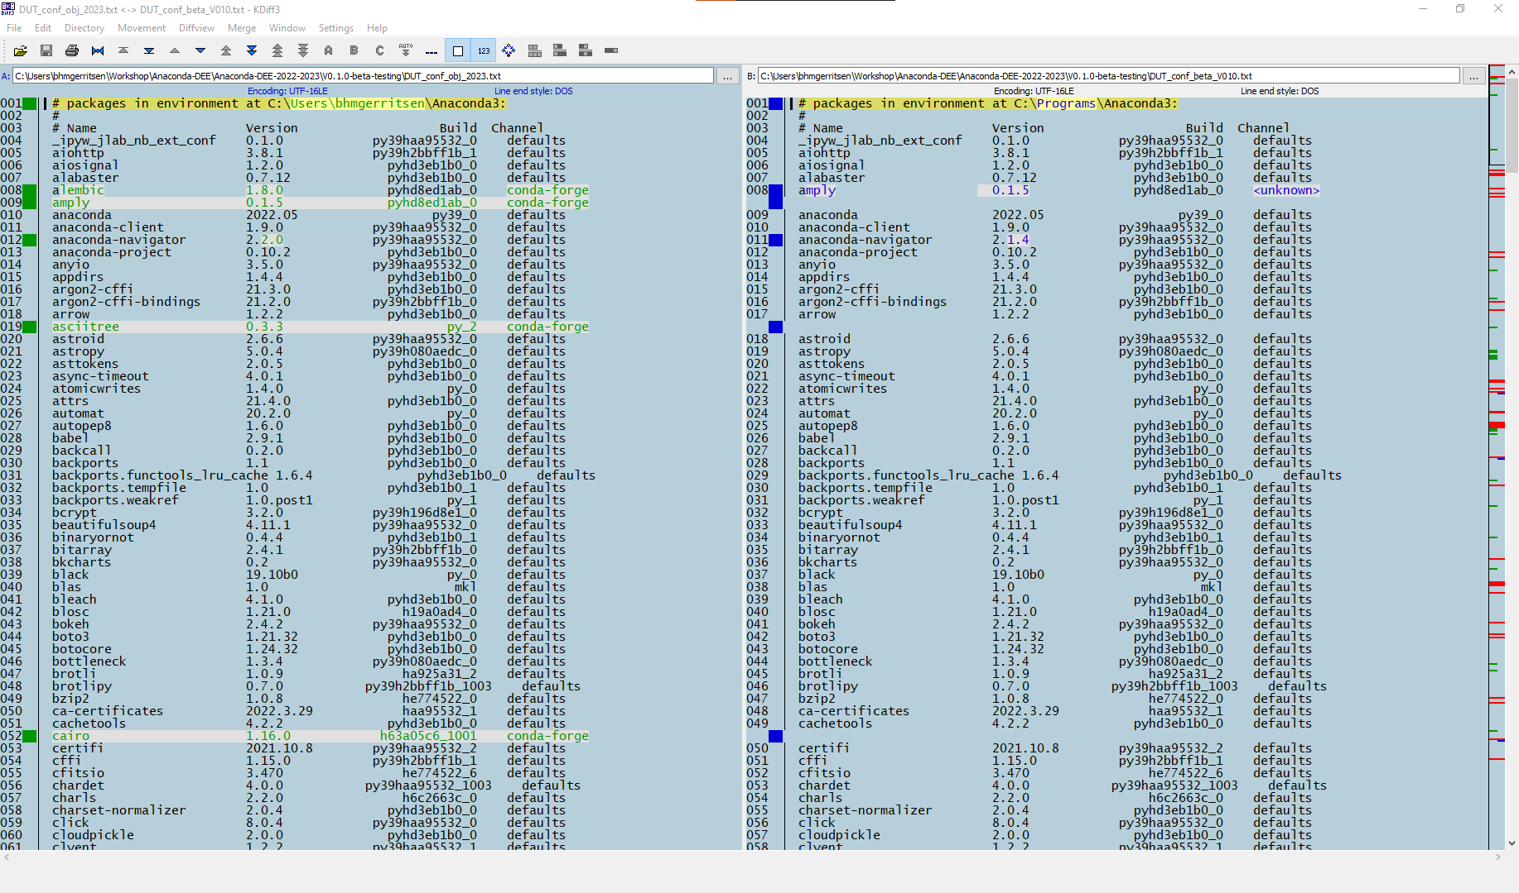
Dit zou het moeten zijn …
Dit is er NU geinstalleer op de TUD209295
Difference in channels used for installation irrelevant.

Slide 5
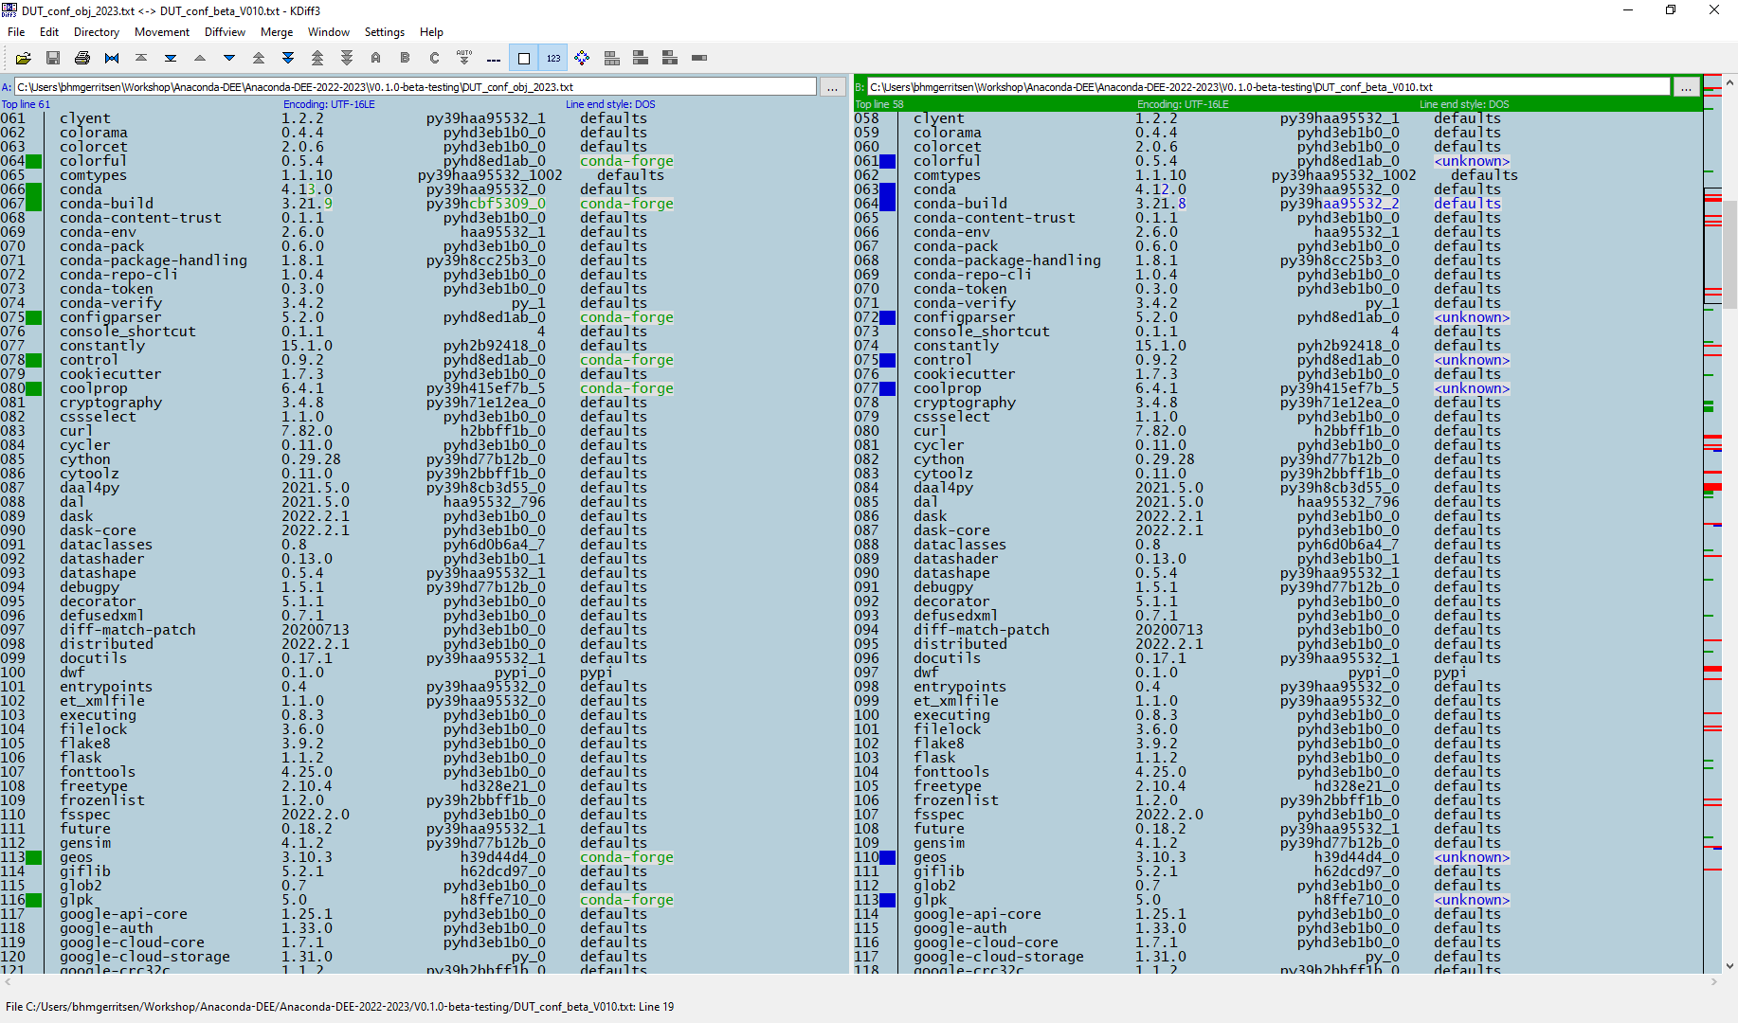

Slide 6
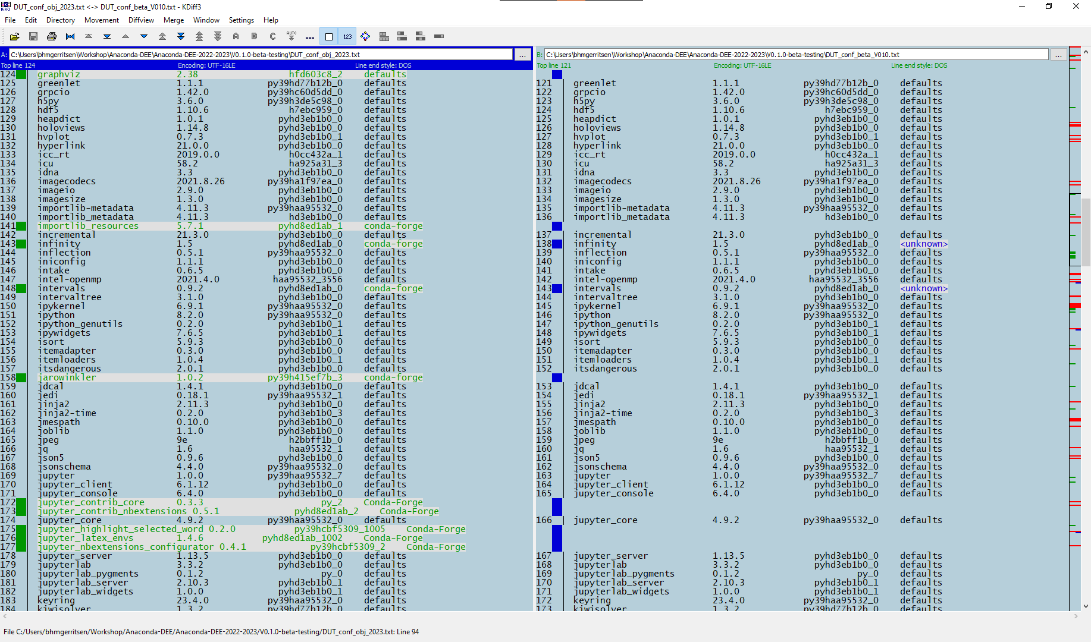

Slide 7
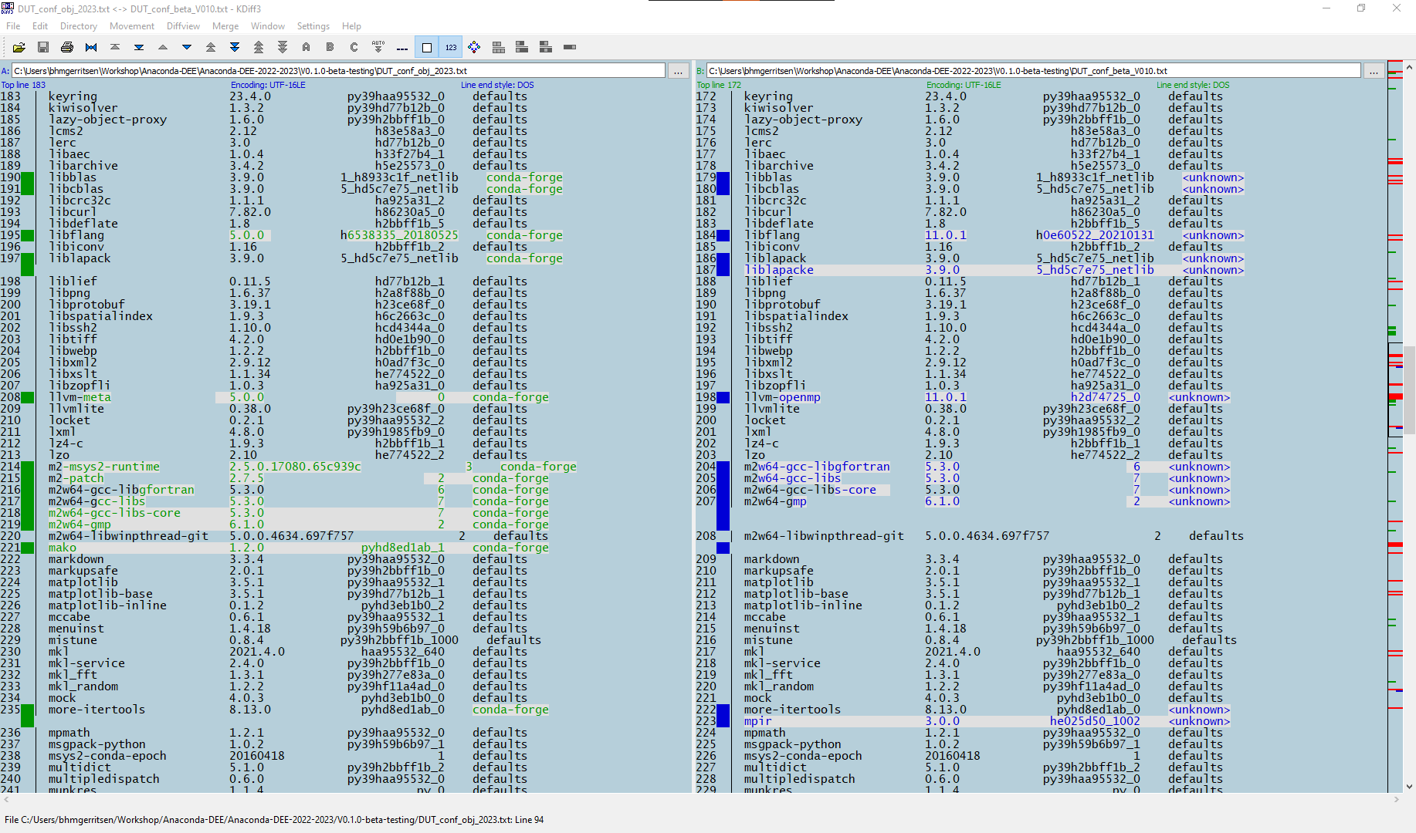
Binary differences platform dependent

Slide 8
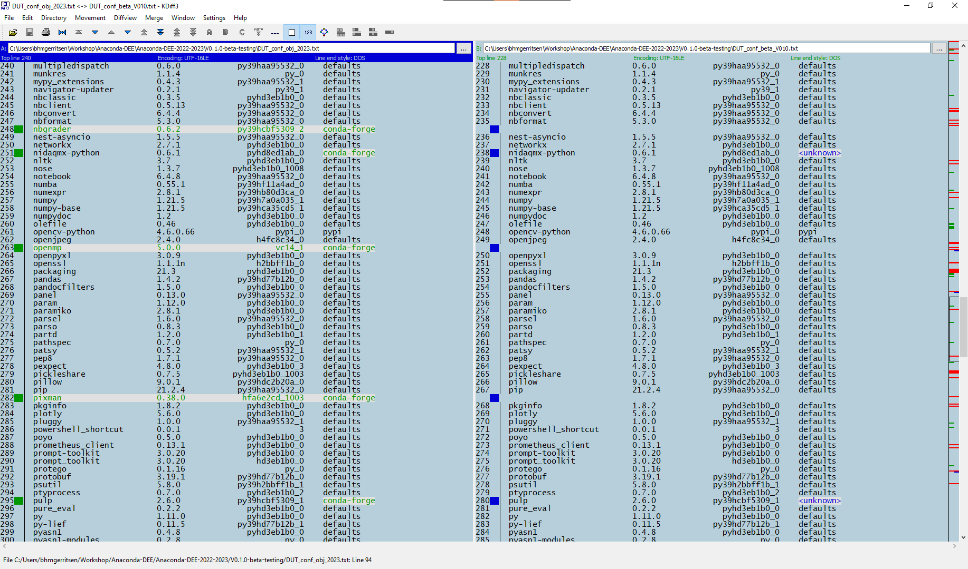

Slide 9
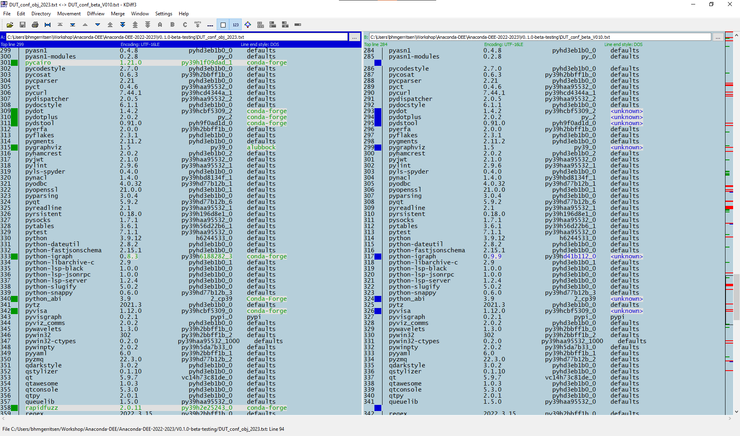

Slide 10
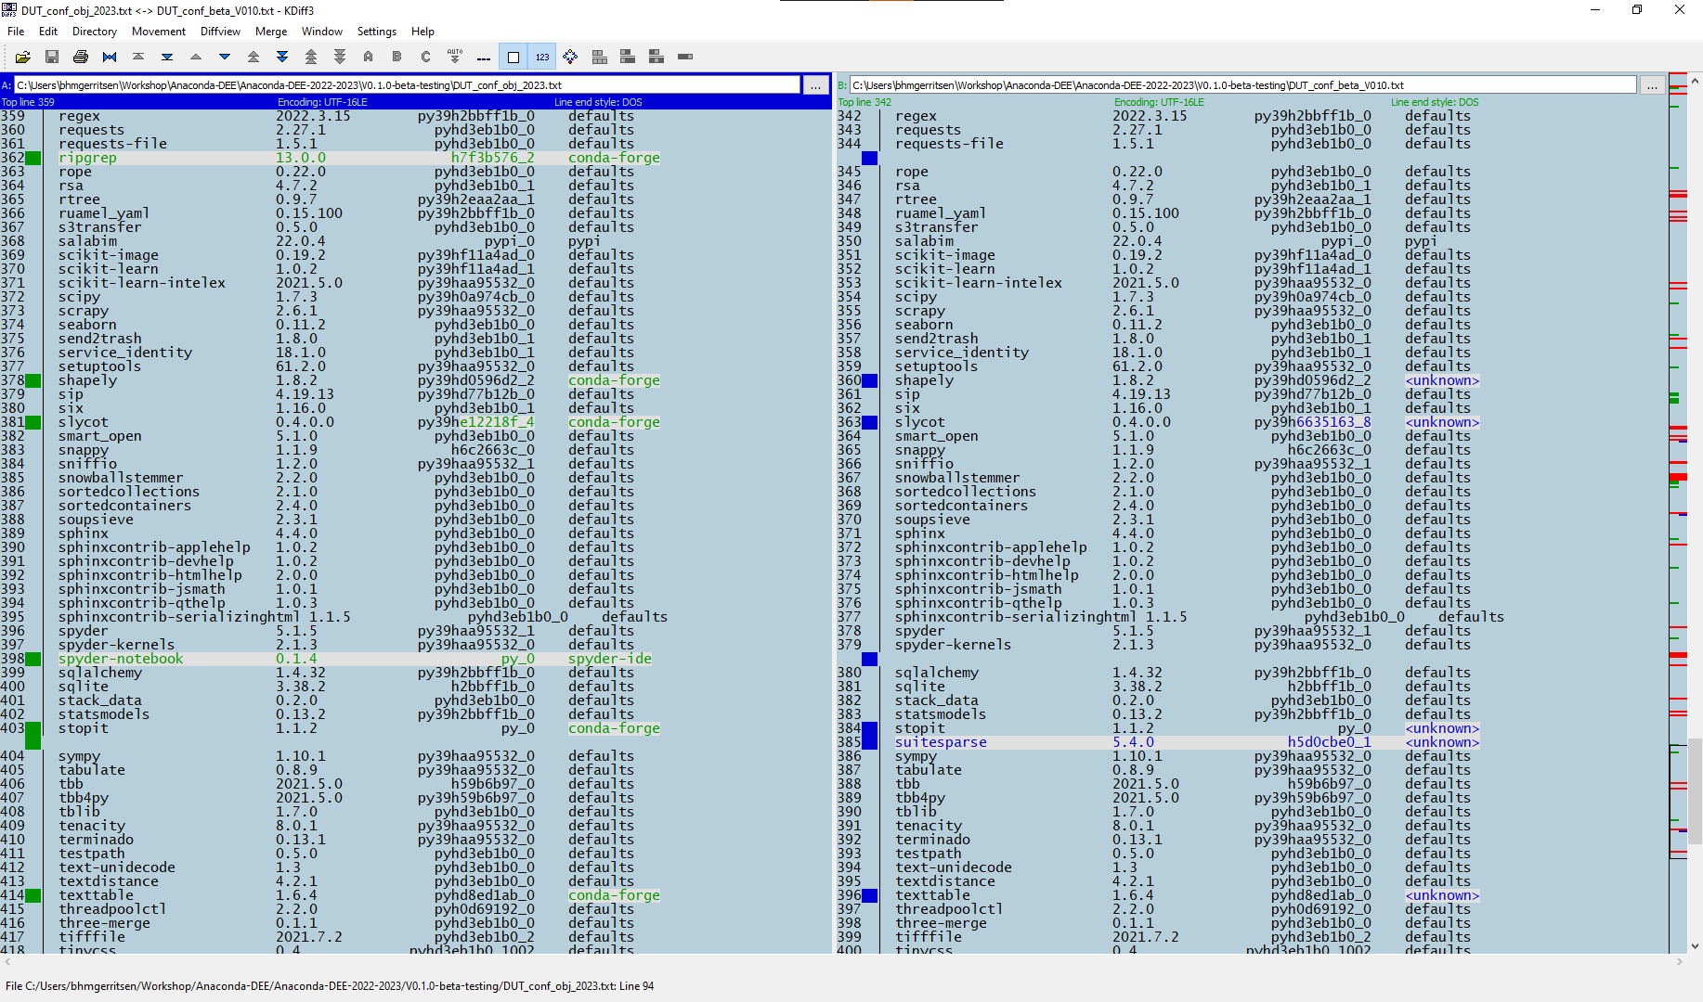

Slide 11
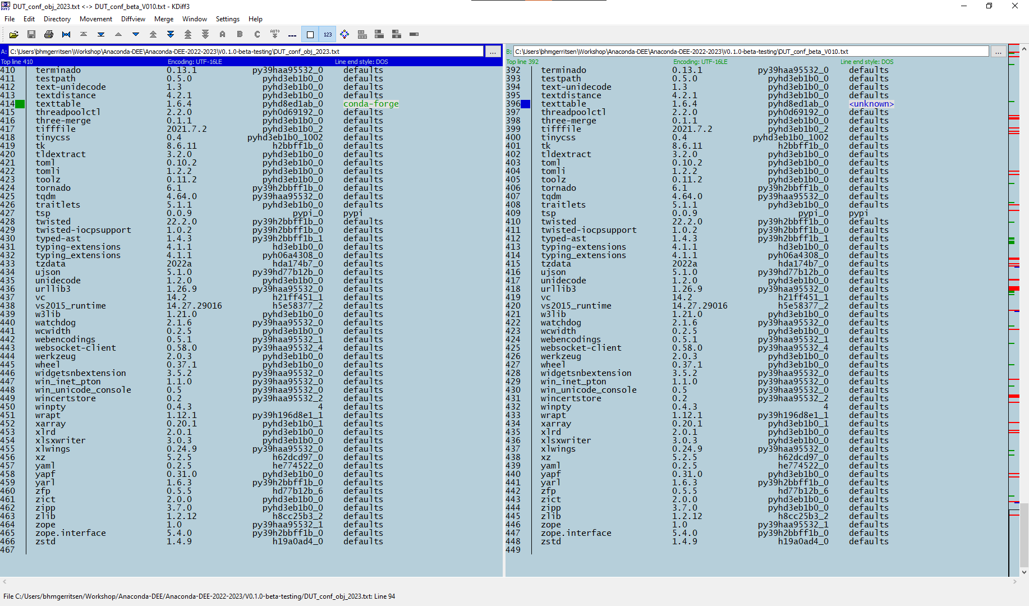

Slide 12
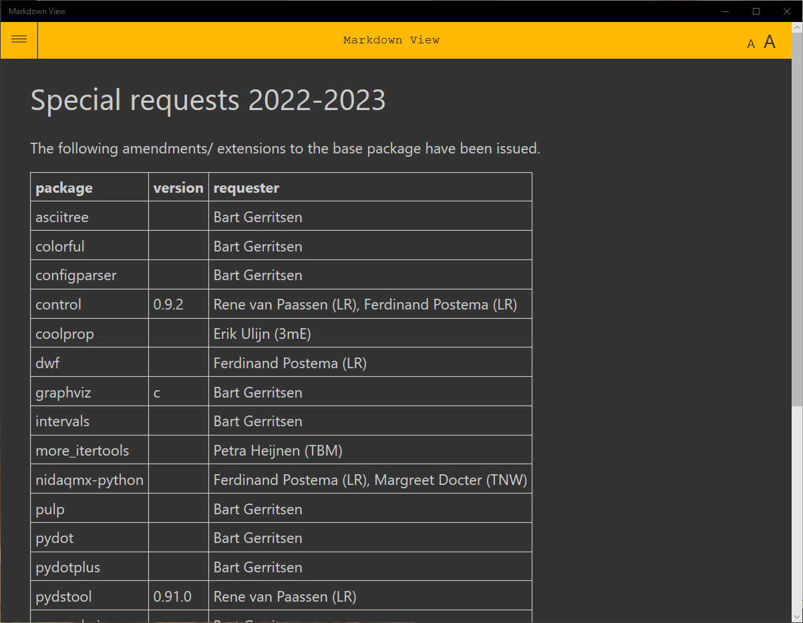

Slide 13
