Slide 2
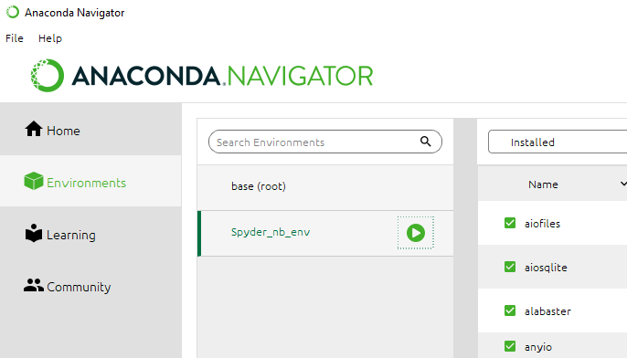
Launch a Notebook from Navigator
Notes:
Open a shell or a notebook presentation from within this environment

Slide 3
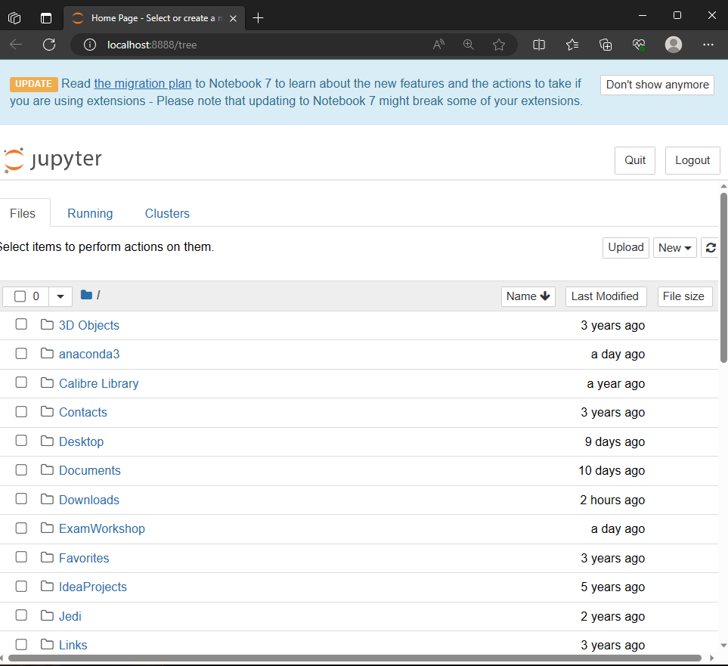
Notes:
Resulting notebook server when started from

Slide 4
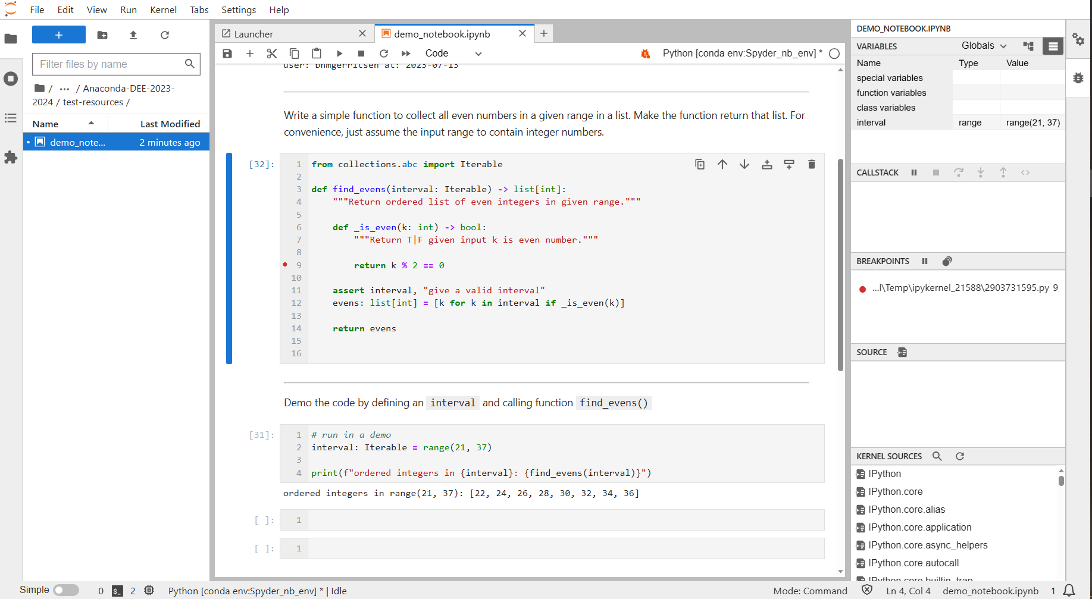
Spyder Notebook debug mode

Slide 5
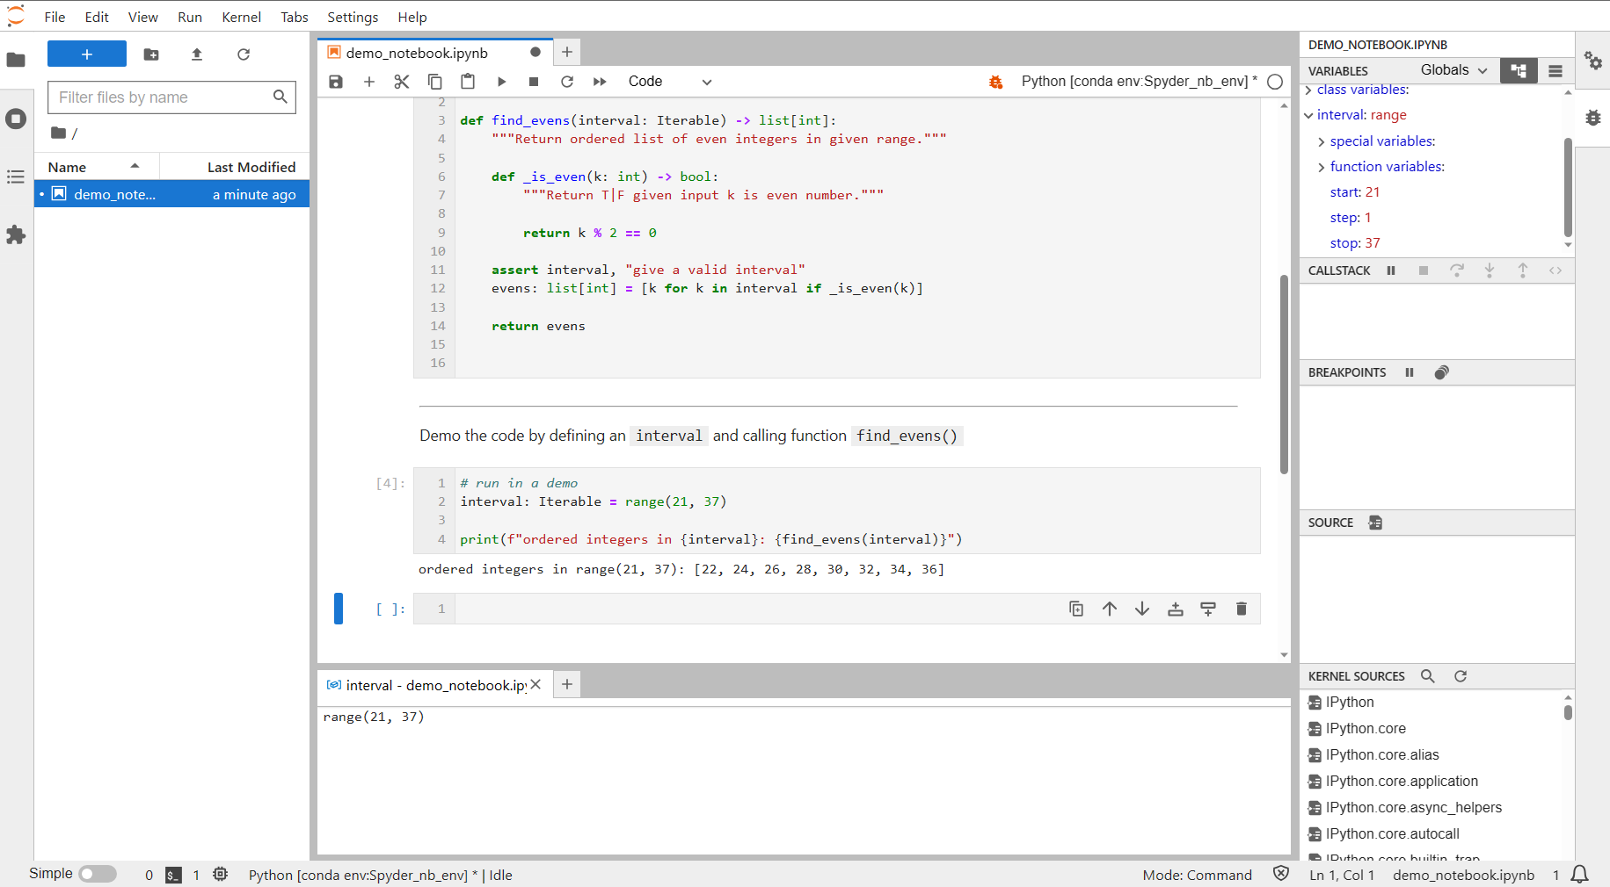
Jupyter Lab debug mode

Slide 6
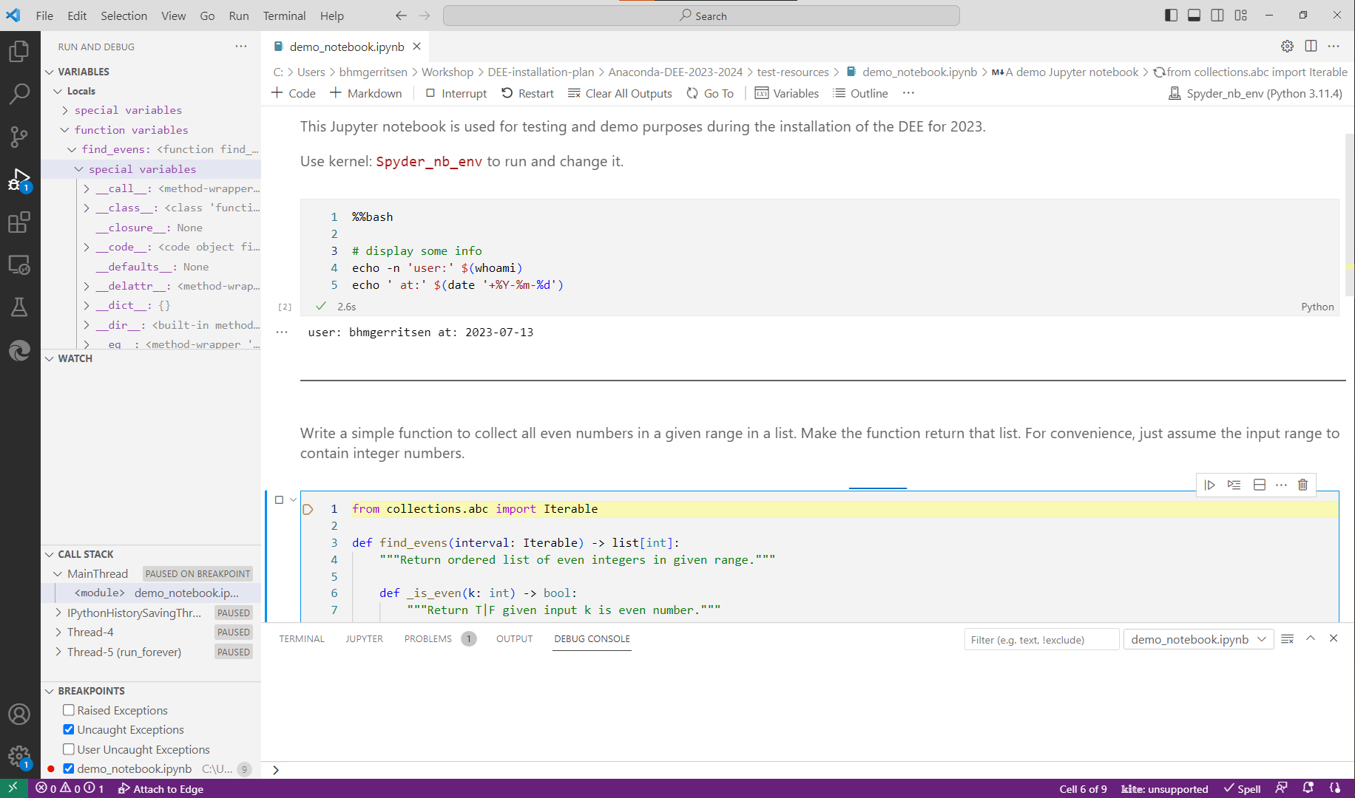
Visual Studio Code Notebook debug mode

Slide 7
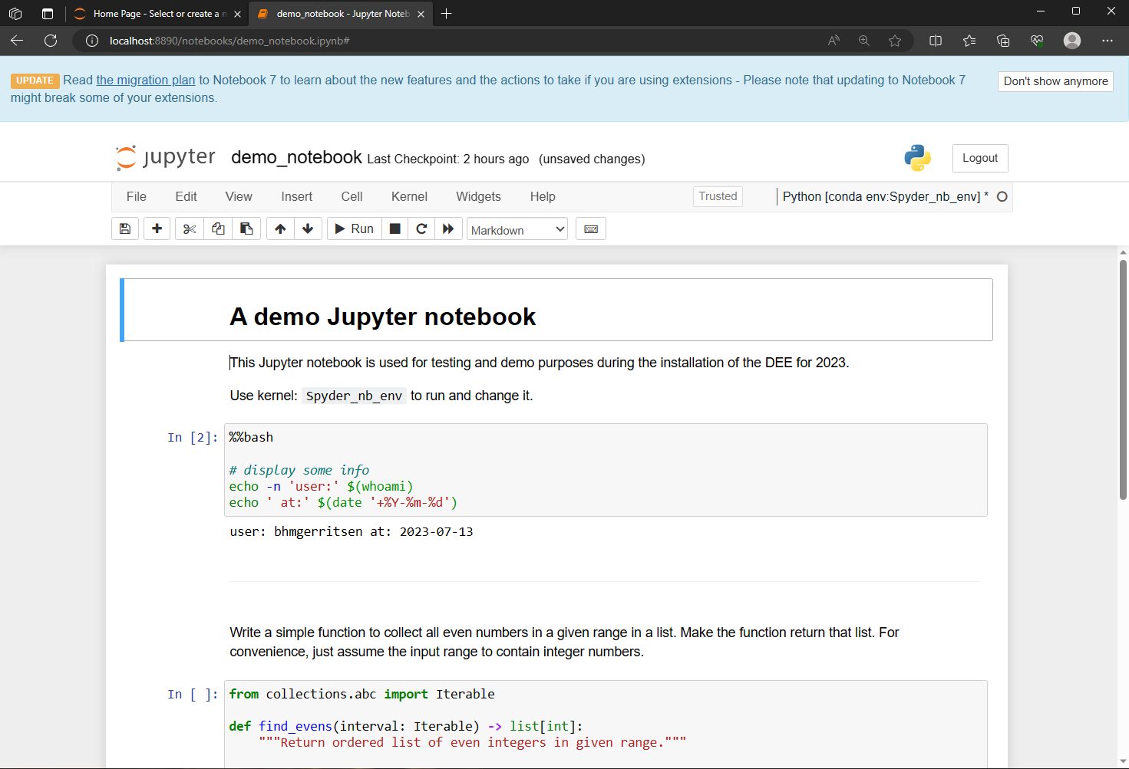
Classic Jupyter Notebook

Slide 8
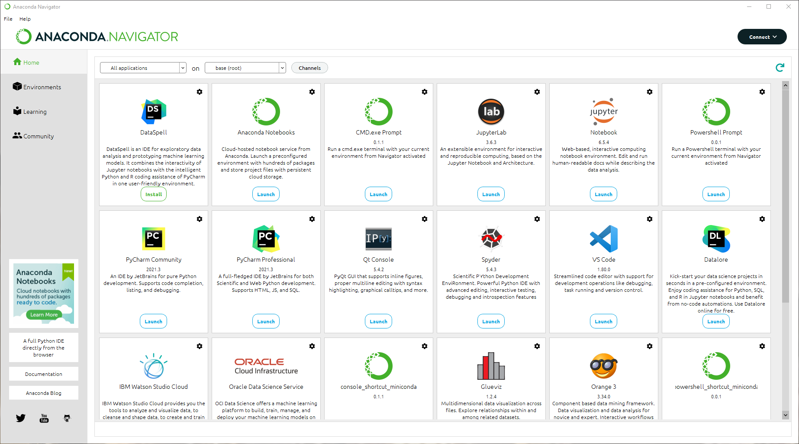
2023.07-0 Navigator window

Slide 9
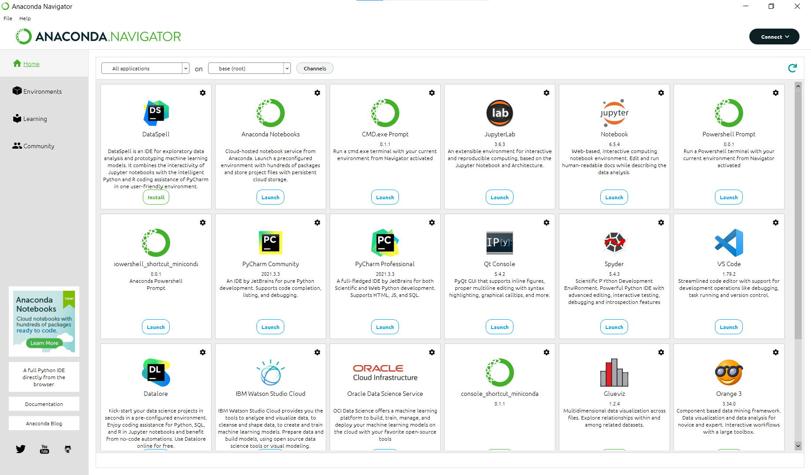
2023.07-1 Navigator window

Slide 10
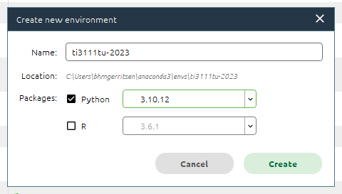

Slide 11
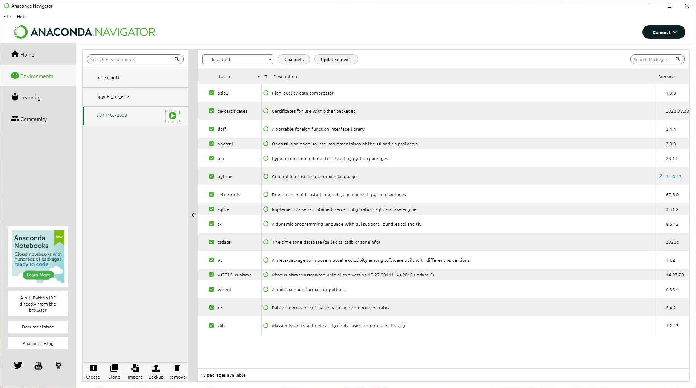
press

