Slide 1

Community Abundance Declassified
AAA 555555555555555555 1111111
A:::A 5::::::::::::::::5 1::::::1
A:::::A 5::::::::::::::::5 1:::::::1
A:::::::A 5:::::555555555555 111:::::1
A:::::::::A rrrrr rrrrrrrrr eeeeeeeeeeee aaaaaaaaaaaaa 5:::::5 1::::1
A:::::A:::::A r::::rrr:::::::::r ee::::::::::::ee a::::::::::::a 5:::::5 1::::1
A:::::A A:::::A r:::::::::::::::::r e::::::eeeee:::::eeaaaaaaaaa:::::a 5:::::5555555555 1::::1
A:::::A A:::::A rr::::::rrrrr::::::re::::::e e:::::e a::::a 5:::::::::::::::5 1::::l
A:::::A A:::::A r:::::r r:::::re:::::::eeeee::::::e aaaaaaa:::::a 555555555555:::::5 1::::l
A:::::AAAAAAAAA:::::A r:::::r rrrrrrre:::::::::::::::::e aa::::::::::::a 5:::::5 1::::l
A:::::::::::::::::::::A r:::::r e::::::eeeeeeeeeee a::::aaaa::::::a 5:::::5 1::::l
A:::::AAAAAAAAAAAAA:::::A r:::::r e:::::::e a::::a a:::::a 5555555 5:::::5 1::::l
A:::::A A:::::A r:::::r e::::::::e a::::a a:::::a 5::::::55555::::::5111::::::111
A:::::A A:::::A r:::::r e::::::::eeeeeeeea:::::aaaa::::::a 55:::::::::::::55 1::::::::::1
A:::::A A:::::A r:::::r ee:::::::::::::e a::::::::::aa:::a 55:::::::::55 1::::::::::1
AAAAAAA AAAAAAArrrrrrr eeeeeeeeeeeeee aaaaaaaaaa aaaa 555555555 111111111111
An investigation by
Steve Smith & Ryan Moore

Slide 2


Slide 3
Mock community
Grab viral taxonomy hits from SERC Illumina assembly
Count number of hits per species to get relative abundance
Select 10 genomes across the rank abundance curve
Pick so that GC histogram matches original
Pick logical organisms

Slide 6
Simulate reads
Illumina paired-end 250
“Realistic” error model
Insert size 600 bp
For uniform Grinder
Uniform 0.6% error rate (Dohm et al, 2008)
Good residues 38 G(ood),
Residues from insertion or sub get 12 (-)
For SimSeq
Miseq 250 error model

Slide 7
Error models
Notes:
32,000 reads for each except SimSeq (1.6 million)
Jacques -> 4 libraries 8000 reads per library, 4000 L 4000 R
Subsampling -> first N sequences
From Steve’s slide:
The read simulators make an attempt to provide data as close to illumina’s output as possible
The error profile created from our reads shows a curved error model.
EXPLAIN HOW THEY GOT ERRROR MODELS

Slide 8
rank | hits | grinder read # | orig abundance | this abundance | gc | name
1 | 3937 | 1019350 | 0.06796 | 0.62098 | 0.431 | Puniceispirillum phage HMO-2011
6 | 1066 | 276004 | 0.01840 | 0.16814 | 0.355 | Prochlorococcus phage P-SSM2
21 | 436 | 112887 | 0.00753 | 0.06877 | 0.320 | Pelagibacter phage HTVC011P
39 | 280 | 72496 | 0.00483 | 0.04416 | 0.405 | Cyanophage S-TIM5
53 | 208 | 53854 | 0.00359 | 0.03281 | 0.296 | Cellulophaga phage phi14:2
72 | 142 | 36766 | 0.00245 | 0.02240 | 0.474 | Cyanophage KBS-P-1A
91 | 116 | 30034 | 0.00200 | 0.01830 | 0.590 | Sulfitobacter phage pCB2047-C
116 | 73 | 18901 | 0.00126 | 0.01151 | 0.399 | Cyanophage NATL2A-133
132 | 55 | 14240 | 0.00095 | 0.00868 | 0.532 | Pseudomonas phage tf
157 | 27 | 6991 | 0.00047 | 0.00426 | 0.485 | Klebsiella phage JD001
Notes:
15,000,000 (tenth of lane)

Slide 9
Why assemble?
Illumina generates large numbers of short reads
Need to assemble!
Short reads preferentially find highly similar sequences with the BLAST database
Short read libraries find fewer homologs in general
Long contigs can help connect taxonomy and physiology
Gene neighborhoods
Wommack et al., 2009

Slide 10
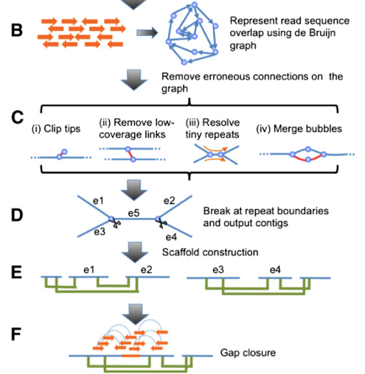
SOAPdenovo
Li et al., 2010
De Bruijn graph represents overlaps
Remove erroneous connections
Break connections at repeat boundaries
Join contigs into scaffolds w/PE info
Close gaps w/PE info
Notes:
Schematic overview of the assembly algorithm. (A) Genomic DNA was fragmented randomly and sequenced using paired-end tech- nology. Short clones with sizes between 150 and 500 bp were amplified and sequenced directly; while long range (2–10 kb) paired-end libraries were constructed by circularizing DNA, fragmentation, and then purifying fragments with sizes in the range of 400–600 bp for cluster formation. (B) The raw or precorrected reads were then loaded into computer memory and de Bruijn graph data structure was used to represent the overlap among the reads. (C ) The graph was simplified by removing er- roneous connections (in red color on the graph) and solving tiny repeats by read path: (i ) Clipping the short tips, (ii ) removing low-coverage links, (iii) solving tiny repeats by read path, and (iv) merging the bubbles that were caused by repeats or heterozygotes of diploid chromosomes. (D) On the simplified graph, we broke the connections at repeat boundaries and output the unambiguous sequence fragments as contigs. (E ) We realigned the reads onto the contigs and used the paired-end information to join the unique contigs into scaffolds. (F ) Finally, we filled in the intrascaffold gaps, which were most likely comprised by repeats, using the paired-end ex- tracted reads.

Slide 11
Assembly
SOAPdenovo
Kmer: 127
Reads used for both contigs & scaffolds
>= 3 PE reads for connecting contigs & pre-scaffolds
Min. aligned len. to contigs for read location = 64
Filter out contigs < 600bp
Num: 247, mean: 3248, median: 1108, max: 161,400
Notes:
Regarding map_len
There is an official answer came from a technician in Beijing Genomics Institute (BGI).
I want to share it with everyone here.
"Just leave the option "map_len" alone when you are doing initial assembly.
After the success of initial assembly, try increase "map_len" to gain a better scaffold result (or, sometime, worse) provided that, 1. The "map_len" option will not effect on libraries that reads are long than 100, 2. It's not wise to set over 50.
3. Increase 1 by 1, optimal results usually gain when increase by 2 or 3, don't increase to much, especially for genomes with higher heterozygosity.
"

Slide 14
Notes:
Another issue may be that the 2 read simulators created different length contigs from after the assembly.
This may mean that more of the genomes are spread over shorter contigs for the SimSeq read simulator.

Slide 15
Extracting community abundance
Contig counts
Contigs with hits to a genome are added to abundance of that genome. Irvine-Fynn, T., et al. (2013)
Contig spectra
CatchAll –uses the number of times a contig was made after an assembly to predict abundance of that contig. Allen(2013)
Recruitment based
GAAS, GRAAMy, GASiC, etc. Renard (2012)
Kmer coverage? (from assembly)

Slide 16
Recruitment based abundance
Notes:
We recruit reads back to contigs or ref genomes. Count the hits. → unadjusted/uncorrected abundance

Slide 17
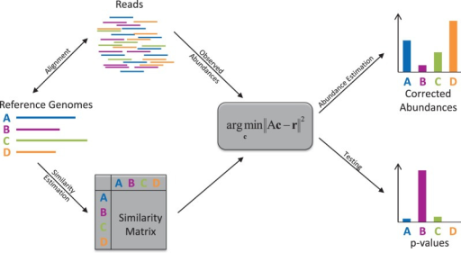
GASiC
Reads are input into a read mapper to compare to reference genomes.
Reference genomes and mapped reads are used to create a 1-1 matrix with logical likelihoods
Mapped reads are compared to likelihood of read mapping there .
Abundances are determined from reads.

Slide 18
Abundance from kmer coverage

Slide 19
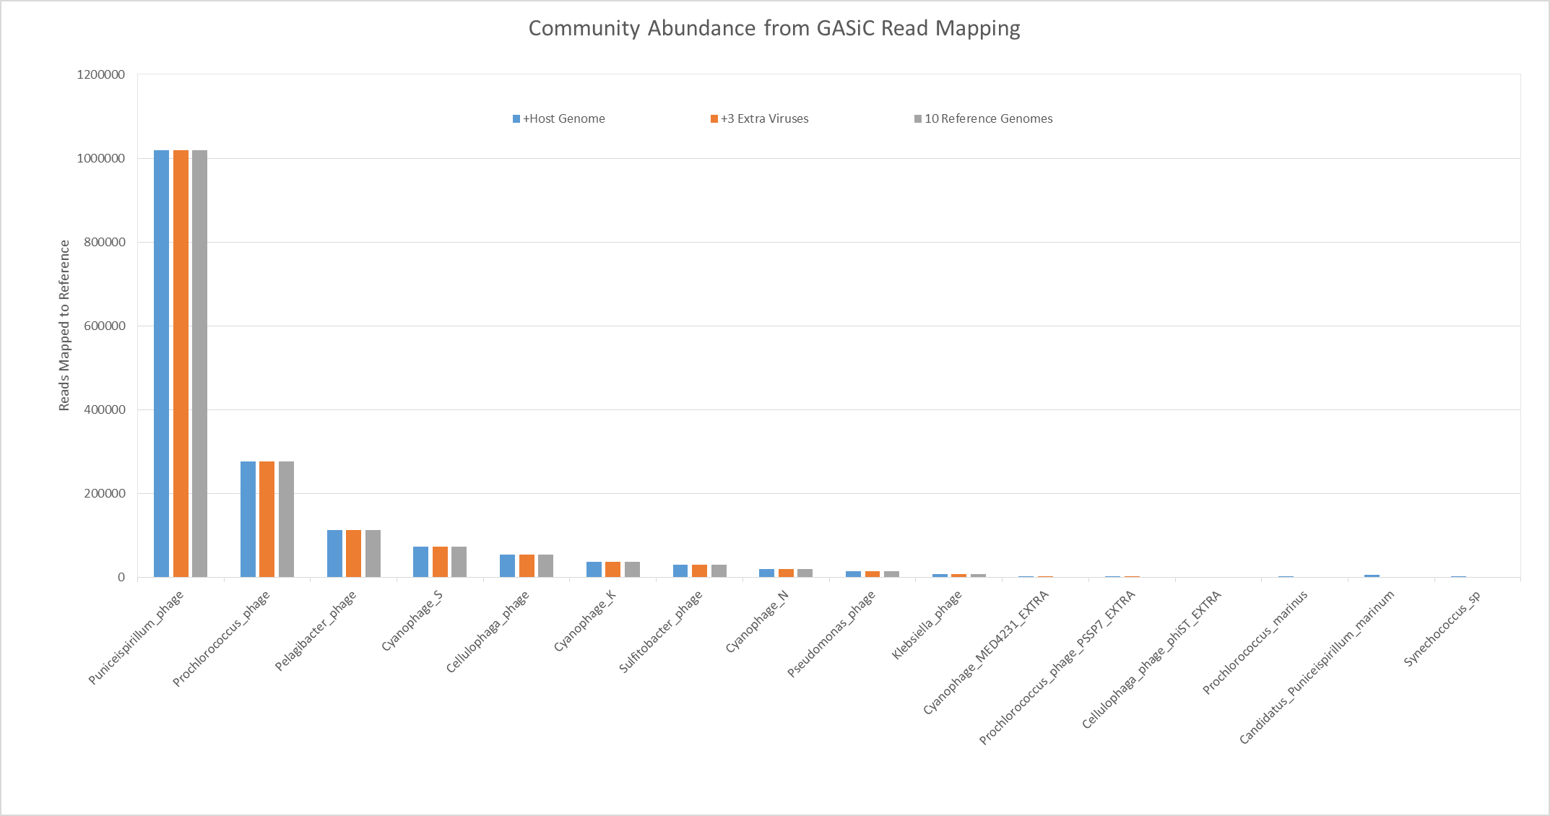
GASiC Results
GASiC | 10 Reference Viuses | 10 RefVir + 3 Close Relatives | 10 RefVir + 3 Relatives + 3 Host Bacterial Genomes
Total mapped reads | 1643253 | 1646927 | 1653313
Estimated reads | 1641520 | 1641520 | 1641520
Difference | 1733 | 5406 | 11793
Percent error | 0.1056% | 0.3294% | 0.7184%

Slide 20
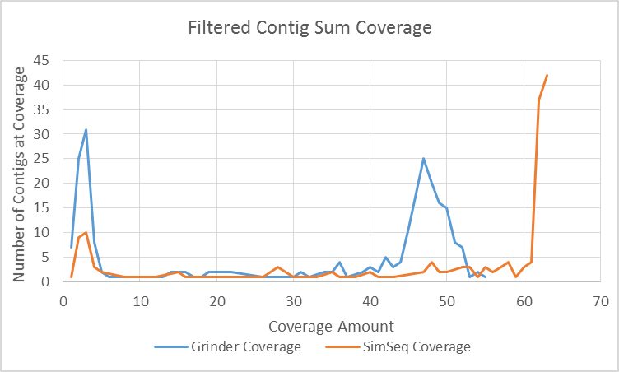
Community abundance from kmer coverage
Contigs with coverages are output from the SOAPdenovo assembler.
Coverages are compared within an assembly of the same in-silico reads.
A large number of Contigs with low and high coverage exist than with medium coverage.
Contigs with less than 600 bp in length have been filtered out to maintain high quality of data.

Slide 21
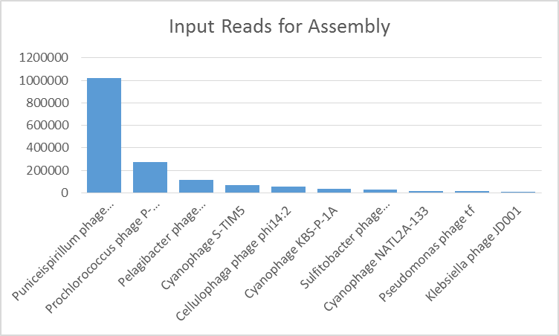
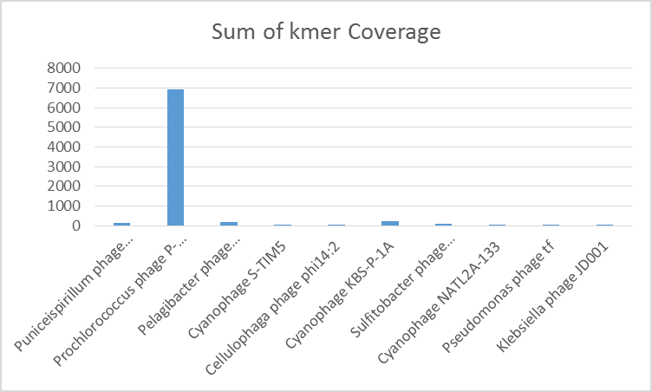
Kmer Coverage?
The output of the Grinder dataset has shown that contig coverage count does not correlate to the input of the dataset.
The SimSeq dataset has not been tested for correlation to the contig coverage yet.
Unfiltered reads have also not been tested to fit this curve.

Slide 22
Citations
Li, R., Zhu, H., Ruan, J., Qian, W., Fang, X., Shi, Z., et al. (2010). De novo assembly of human genomes with massively parallel short read sequencing. Genome Research, 20(2), 265–272. doi:10.1101/gr.097261.109
Curtis A. Suttle. Nature Reviews Microbiology 5, 801-812 (October 2007) | doi:10.1038/nrmicro1750
H. K. Allen, J. Bunge, J. A. Foster,D. O. Bayles,T. B. Stanton. (2013) Estimation of viral richness from shotgun metagenomes using a frequency count approach Allen et al. Microbiome2013,1:5 http://microbiomejournal.com/content/1/1/5
Martin S.Lindner, Bernhard Y.Renard (2012) Metagenomic abundance estimation and diagnostic testing on species level. Nucleic Acids Research, 2012, 1–8 doi:10.1093/nar/gks803
Edwards, A., Pachebat, J.A., Swain, M., Hegarty, M., Hodson, A.J., Irvine-Fynn, T., et al. (2013) A metagenomic snapshot of taxonomic and functional diversity in an alpine glacier cryoconite ecosystem. Environ Res Lett 8: 035003.

