Slide 1

Muhammad Moosa : 1MS23IS071
Kartikey Mani Tripathi : 1MS23IS052 Parth Jakar : 1MS23IS087

Slide 2


Slide 3
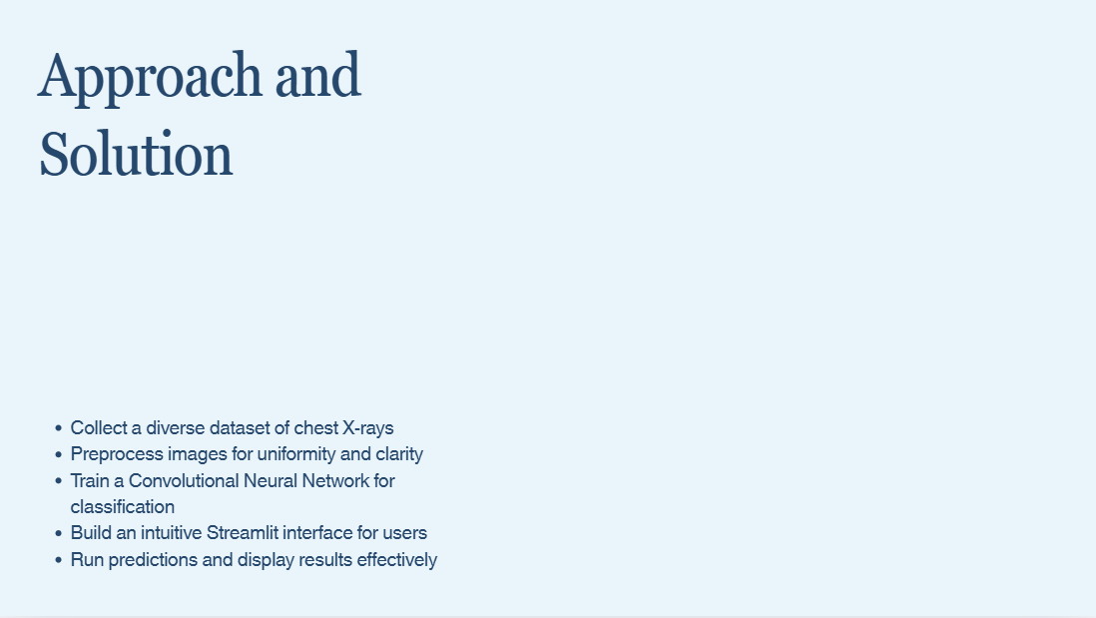
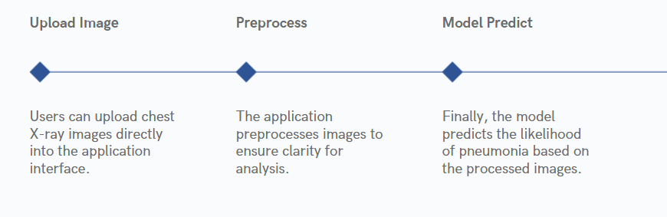

Slide 4


Slide 5

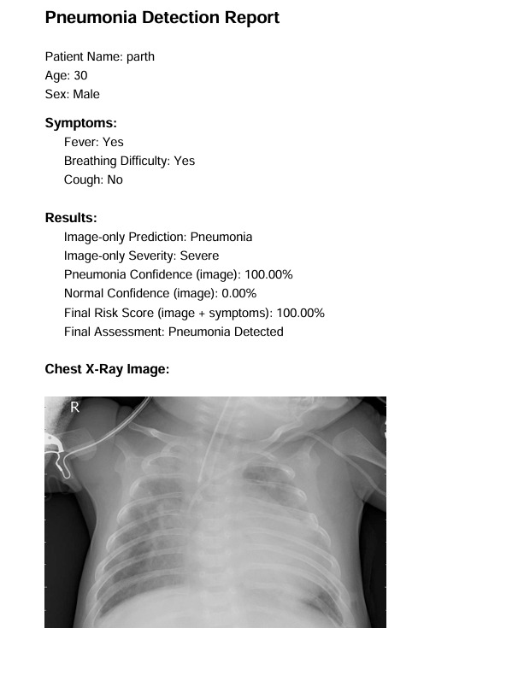
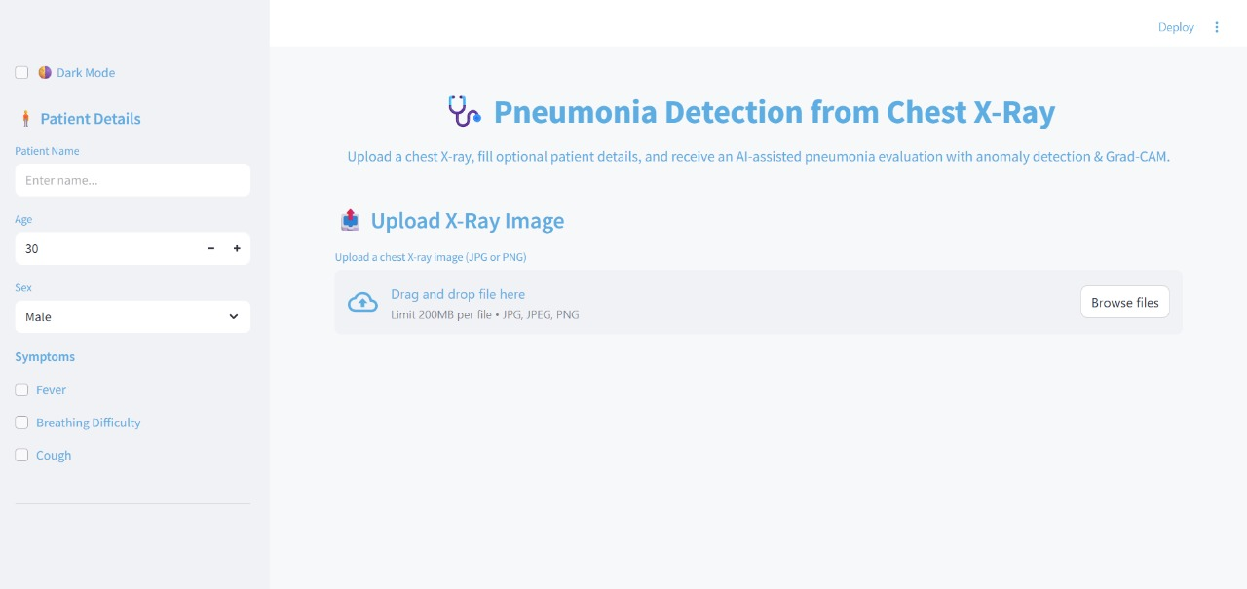
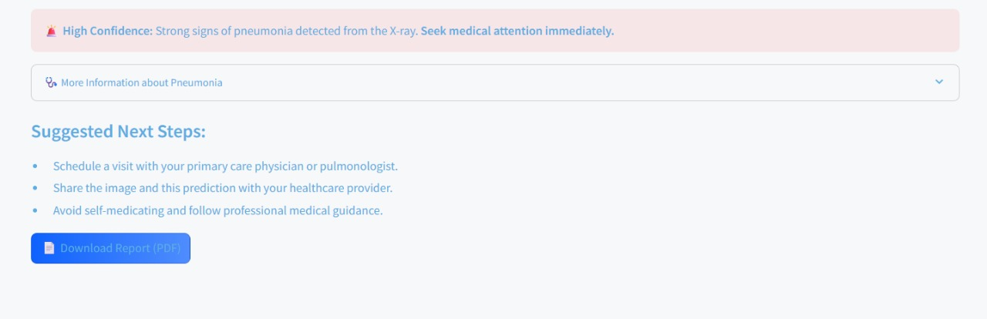

Slide 6


Slide 7

